Slide 1
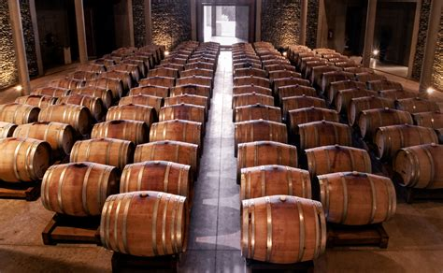
Wine Regions of the World
Exploring Morocco’s Wines
Presented by
Marc Silver

Slide 2
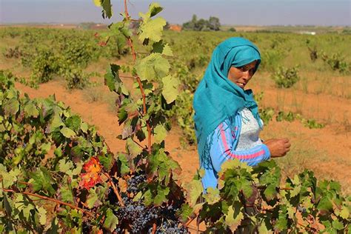
Exploring Morocco’s Wines
Introduction
Morocco is not the first country that comes to mind when you think of wine, but it should be.
This North African nation has a wine history that spans centuries and has been quietly producing some remarkable wines.
If you're ready to expand your wine knowledge and explore a new region, Morocco offers something distinct: wines with unique flavor profiles, a vibrant history, and a surprising variety of grape varietals.
In this presentation, we'll take a deep dive into Morocco’s wine landscape, focusing on its key wine regions, terroir, and the factors that make its wines special. Let's start with a quick look back at how Moroccan wine came to be.

Slide 3
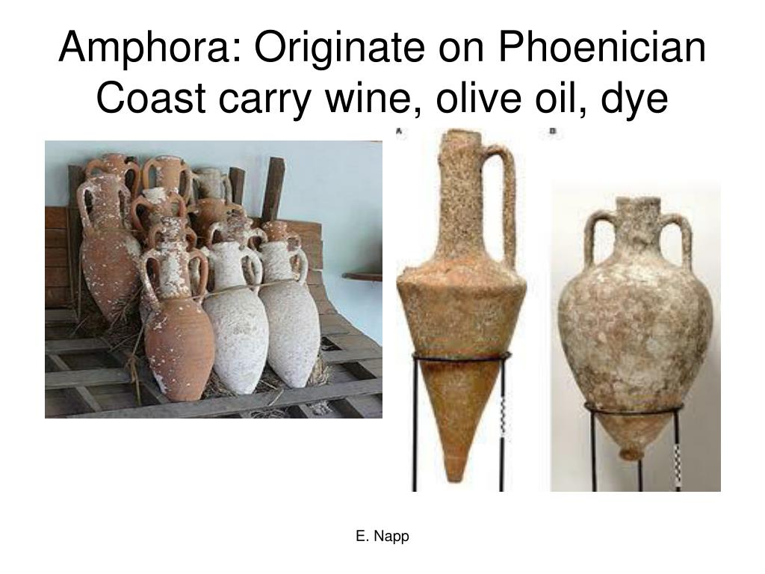
History of Morocco’s Wine
Wine has been made in Morocco for over 2,500 years, starting with the Phoenicians who brought vines to the region.
The wine tradition didn’t truly take hold until the Roman Empire set its sights on North Africa. The Romans, known for expanding vineyards wherever they settled, laid the groundwork for viticulture in Morocco. But after the fall of Rome, wine production stagnated for centuries, mainly due to the spread of Islam, which prohibits alcohol consumption.
The modern Moroccan wine industry we see today was
largely shaped by the French colonization period in the
early 20th century.
During French rule, vineyards flourished. The French, who
brought their wine expertise to Morocco, planted new
vineyards and applied winemaking techniques familiar to
their homeland.

Slide 4
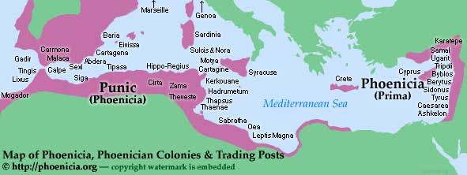
History of Morocco’s Wine
Phoenicians and Romans: Introducing Vine Growing to Morocco
You know what’s amazing about wine? Beyond its rich flavors and aromas, it’s deeply connected to history.
Morocco, a country known for its rich cultural tapestry, has a fascinating wine story that dates back to ancient times. But how did vines even make their way to this sun-soaked land?
Enter the Phoenicians and Romans—the original wine influencers of Morocco.
Let’s dive into how these ancient powerhouses played a pivotal role in shaping the country's winemaking traditions.

Slide 5
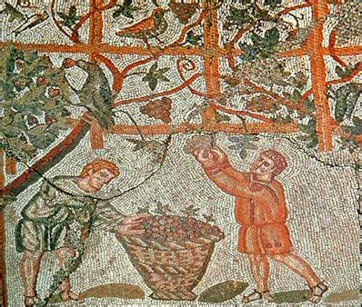
The Phoenicians: The First Movers
So, who were these Phoenicians? Think of them as ancient maritime traders who were all about exploration and spreading culture (and wine, of course) across the Mediterranean. They were sailing around from what’s now modern-day Lebanon, hitting up coastal towns, and—guess what?—they brought vines with them wherever they went.
But why vines? Well, grapes weren’t just a tasty treat; they
were an important economic resource. Vine growing was one of the key trades in Phoenician colonies, and Morocco, with its sun-drenched climate and fertile soil, was perfect for it. It’s like they saw the potential and said, “This place needs some wine!” And with that, they introduced vine growing to the region. Pretty visionary, right?
The Phoenicians set up colonies in places like Mogador (modern-day Essaouira), where they didn’t just trade goods but also laid the groundwork for agriculture, including viticulture. While they didn’t stick around forever, their love for vines left a lasting legacy.

Slide 6
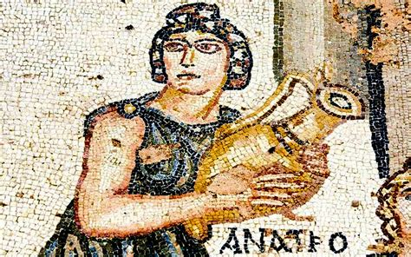
History of Morocco’s Wine
Romans: Taking It to the Next Level
And then came the Romans. If the Phoenicians were the vine-growing pioneers, the Romans were the ones who took things to the next level. The Romans weren’t just about military conquest; they were masters of agriculture and loved a good glass of wine as much as anyone. When they arrived in Morocco (or Mauretania, as they called it back then), they saw the fertile lands and realized they could expand their empire’s love for wine here.
Romans were known for their organized approach to farming, so they brought advanced techniques for vine cultivation.
They understood soil types, irrigation, and pruning in a way that made the vineyards thrive. And if you think about it, their influence on Moroccan wine is kind of like upgrading from a basic phone to a smartphone—same concept, but so much more sophisticated.

Slide 7
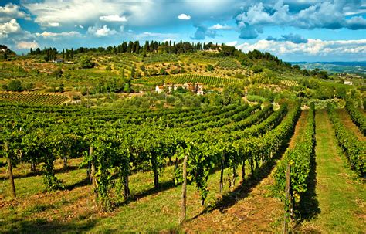
History of Morocco’s Wine
Why Morocco Was Perfect for Vineyards
But why were these ancient civilizations so keen on growing vines in Morocco? What makes this country so special for viticulture?
  For starters, Morocco's Mediterranean climate—with its long, hot summers and cool, breezy winters—was (and still is) ideal for grape growing. Plus, Morocco’s diverse geography offers everything from coastal plains to inland valleys, creating the perfect variety of microclimates that grapevines love.
The ancient winemakers weren’t concerned about things like appellations or grape varieties as we know them today, but they knew a good thing when they saw it.
The land was fertile, the conditions were right, and with that, Morocco’s love affair with wine began.

Slide 8
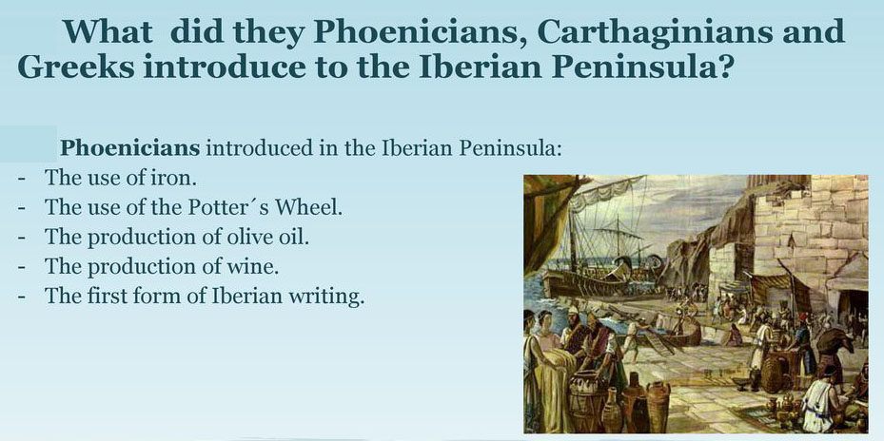
History of Morocco’s Wine
So, What Did This Mean for Wine in Morocco?
Here’s where it gets interesting. The introduction of vine growing by the Phoenicians and Romans wasn’t just about making a local wine scene; it was about integrating wine into the cultural and social fabric of Morocco.
Wine became a part of rituals, feasts, and everyday life. Over time, as new settlers and civilizations came and went, the winemaking traditions persisted, evolving today.
In a way, the Phoenicians and Romans were the catalysts, but Moroccan wine is now its own character with a unique identity, shaped by centuries of tradition, innovation, and—most importantly—a deep respect for the vine.

Slide 9
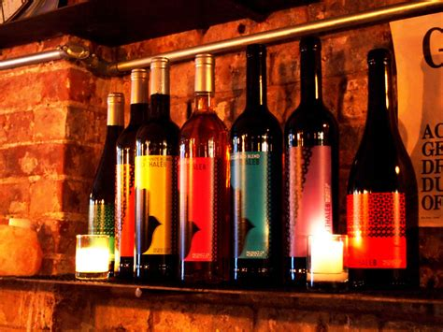
Morrocco's Wine Today
Post-Independence (1956-present):
Struggles during the independence period, followed by resurgence in the late 20th century due to government investment and renewed interest in winemaking.
Today, Morocco produces about 40 million bottles of wine annually, making it one of the largest wine producers in the Arab world.
Although a Muslim-majority country, Morocco has embraced winemaking as a cultural and economic asset, attracting wine lovers from around the globe.

Slide 10
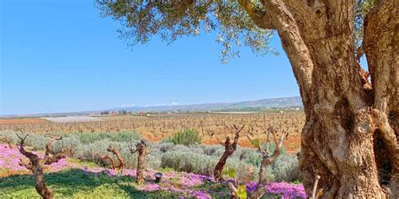
History of Morocco’s Wine
Fast Forward to Today
Now, if you’re curious about Moroccan wine today, you’ll find that it’s gone through some ups and downs—thanks to things like French colonization and modern agricultural advancements—but it’s still rooted in those early foundations laid by the Phoenicians and Romans.
The country's vineyards, especially in regions like Meknes, are producing some excellent reds, whites, and rosés. Want to explore Moroccan wine? There’s never been a better time to experiment and see what appeals to your palate!

Slide 11
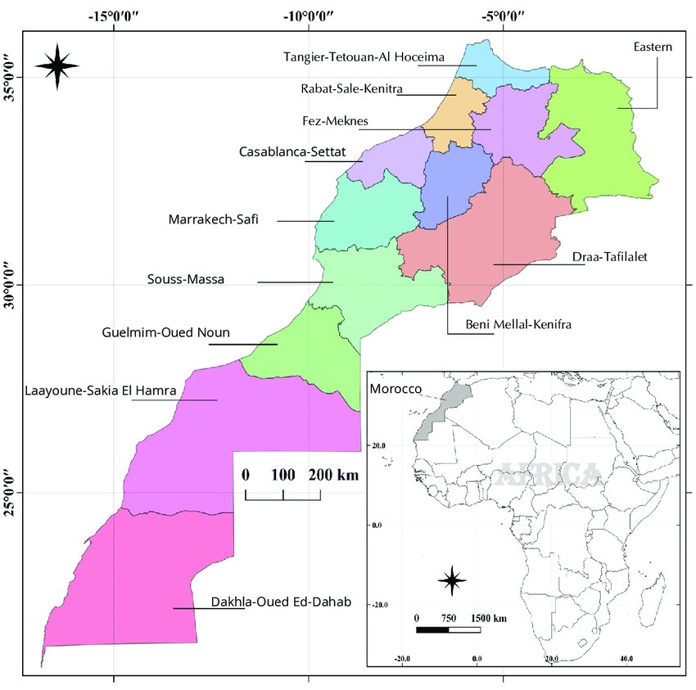
Wine Regions of Morrocco
There are seven wine regions containing a total of 14 AOGs (guaranteed appellation of origin) and 2 AOCs (controlled appellation of origin). The five main wine regions are predominantly located in the northern part of the country, where the Mediterranean climate creates ideal conditions for growing grapes.
Six of the seven regions are clustered on or near the Atlantic coast, to the southwest of Spain and Gibraltar, near Meknes, Rabat and Casablanca. The remaining region is farther east, bordering Algeria and the Mediterranean Sea.
About 75 percent of wines made here are red, predominantly Rhône varieties like Syrah, Grenache and Carignan, as well as Cabernet Sauvignon and Merlot. Rosé and Vin Gris—a style of greyish-pink blush wine—are produced, as are austere whites made from Chenin Blanc, Sauvignon Blanc, Sémillon and more full-bodied Chardonnay.

Slide 12
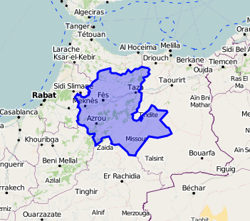
Wine Regions of Morrocco
Meknès-Fès Region
Location: North-central Morocco, just south of the Rif Mountains, surrounding the historic cities of Meknès and Fès.
Terroir: The region benefits from a unique combination of rich clay-limestone soils, which are ideal for growing grapes that produce wines with structure and complexity. The soils are similar to those found in some of the top French wine regions, allowing for a more “Old World” style of wine production.
Climate: Mediterranean climate with warm, sunny days and cooler nights due to the proximity to the Atlas Mountains. This diurnal temperature variation helps maintain acidity in the grapes, crucial for producing balanced wines.

Slide 13
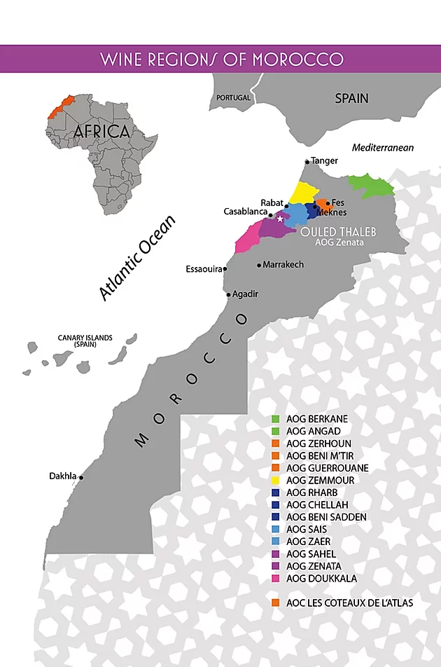
In-Depth Regional Breakdown
Meknès-Fès Region
Grape Varieties:
  Red: Cabernet Sauvignon, Syrah, Merlot, Tempranillo
  White: Chardonnay, Sauvignon Blanc, Muscat
Wine Profile:
  Reds: The wines from Meknès-Fès are typically bold, with rich tannins and ripe fruit flavors, such as blackberries, plums, and dark cherries. You’ll often notice peppery and spicy notes in the Syrah, with a solid structure in the Cabernet Sauvignon.
  Whites: Chardonnay is a standout here, producing full-bodied,
  floral wines with flavors of green apples and citrus. Muscat grapes are often used for sweet or semi-sweet wines.

Slide 14
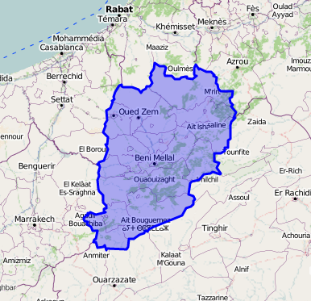
Wine Regions of Morrocco
Beni M’Tir
Location: North-central Morocco, slightly east of Meknès, extending
towards the Atlas Mountains.
Terroir: The region has higher elevations than other parts of Morocco,
with rocky, gravelly soils that provide excellent drainage. The harsh
environment means the vines have to dig deep into the soil, resulting
in wines with concentrated flavors.
Climate: Continental climate, with hot summers and cooler winters.
The nights tend to be cooler at higher altitudes, preserving acidity in
the grapes.
Grape Varieties:
  Red: Syrah, Grenache, Carignan - White: Clairette, Ugni Blanc
Wine Profile: Reds: Expect structured wines with earthy undertones and flavors of dark berries and spices. The Syrah is particularly noteworthy for its intensity and peppery finish.
  Whites: Clairette and Ugni Blanc produce lighter, refreshing wines, often with floral aromas and hints of citrus, great for casual drinking.

Slide 15
Wine Regions of Morocco
Zenata
Location: Coastal region just south of Casablanca,
bordering the Atlantic Ocean.
Terroir: Sandy soils and proximity to the ocean create a
more maritime climate, influencing the style of the wines
produced here. The sea breezes help cool the vineyards,
leading to slower ripening and more delicate flavors.
Climate: Mediterranean with strong Atlantic influences. Cooler temperatures and more consistent rainfall compared to inland regions make Zenata an ideal region for producing fresh, crisp wines.
Grape Varieties: Red: Syrah, Grenache, Cinsault, Mourvèdre - White: Sauvignon Blanc, Chardonnay
  Wine Profile: Reds: Known for producing light to medium-bodied reds, Zenata’s wines tend to have softer tannins and bright red fruit flavors, such as raspberries and strawberries. The maritime influence gives them a fresh, almost saline quality.
  Whites and Rosés: The whites are often vibrant and aromatic, with flavors of citrus and green apple. Rosé wines are a particular strength in Zenata, known for their crisp acidity and refreshing berry notes.
Zenata

Slide 16
Wine Regions of Morrocco
Guerrouane
Guerrouane
Location: South of Meknès, Guerrouane is located in a fertile plain
that benefits from a relatively mild climate.
Terroir: Sandy soils with occasional limestone outcroppings. The fertility of the soil combined with good drainage makes this an excellent region for growing grapes with bright, fruit-forward characteristics.
Climate: Warm, semi-arid climate with little rainfall, but enough temperature variation to allow the grapes to ripen fully while maintaining freshness.
Grape Varieties: Red: Carignan, Cinsault, Grenache - White: Clairette, Sauvignon Blanc.
Wine Profile: Reds: The wines from Guerrouane are known for their bright acidity and fresh, fruity character. These are wines meant to be enjoyed young, with flavors of red fruits like cherries and strawberries dominating the palate.
Whites: Light and refreshing, often with citrus and tropical fruit notes, making them ideal for casual summer drinking.

Slide 17
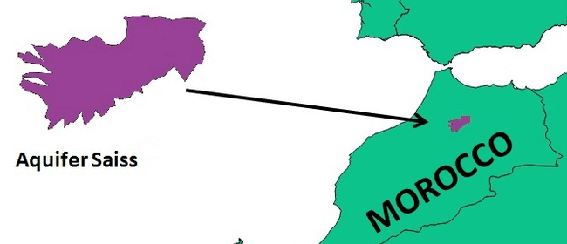
Wine Regions of Morrocco
Saïss
Location: Near the city of Fès, in the fertile Saïss plain.
Terroir: This region is known for its fertile soils, rich in minerals, with a mix of clay and loam. The soil fertility allows for a broad range of grape varietals to thrive.
Climate: Mediterranean climate, with significant rainfall in the winter and hot, dry summers. The cooler temperatures at higher altitudes contribute to the balanced acidity found in many of the wines.
Grape Varieties: Red: Cabernet Franc, Malbec, Syrah - White: Muscat, Sauvignon Blanc
Wine Profile:
  Reds: These wines tend to be well-structured, with good acidity and moderate alcohol levels. Flavors range from blackberries and plums to more savory, herbal notes, particularly in the Malbec.
  Whites: Muscat from Saïss is particularly aromatic, often with notes of orange blossom, honeysuckle, and stone fruits. These wines are perfect for pairing with Moroccan desserts or as a refreshing aperitif.
Notable Producers: Saïss is becoming known for its modern approach to winemaking, with producers experimenting with lesser-known varietals like Cabernet Franc and Malbec to create wines with distinctive profiles.

Slide 18
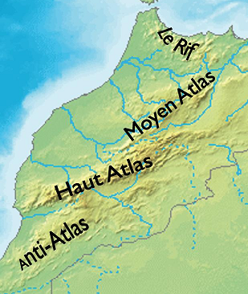
Honorable Mention
The Atlas and Rif Mountain Foothills
The foothills of the Atlas and Rif Mountains are gaining attention
for their boutique wineries. These higher elevation areas benefit
from cooler temperatures, allowing grapes to ripen slowly, which
preserves acidity and results in elegant, well-structured wines.
This contrasts with the warmer, lower-altitude regions of Morocco.
The diverse soils, including limestone and clay, create ideal conditions for experimenting with various grape varieties. Winemakers focus on small-batch, high-quality production that reflects the terroir, adding finesse and complexity to the wines.
Though not as prominent as Meknes, the foothills show strong potential. More boutique wineries are emerging, positioning these regions as future key players in Morocco's wine industry.

Slide 19
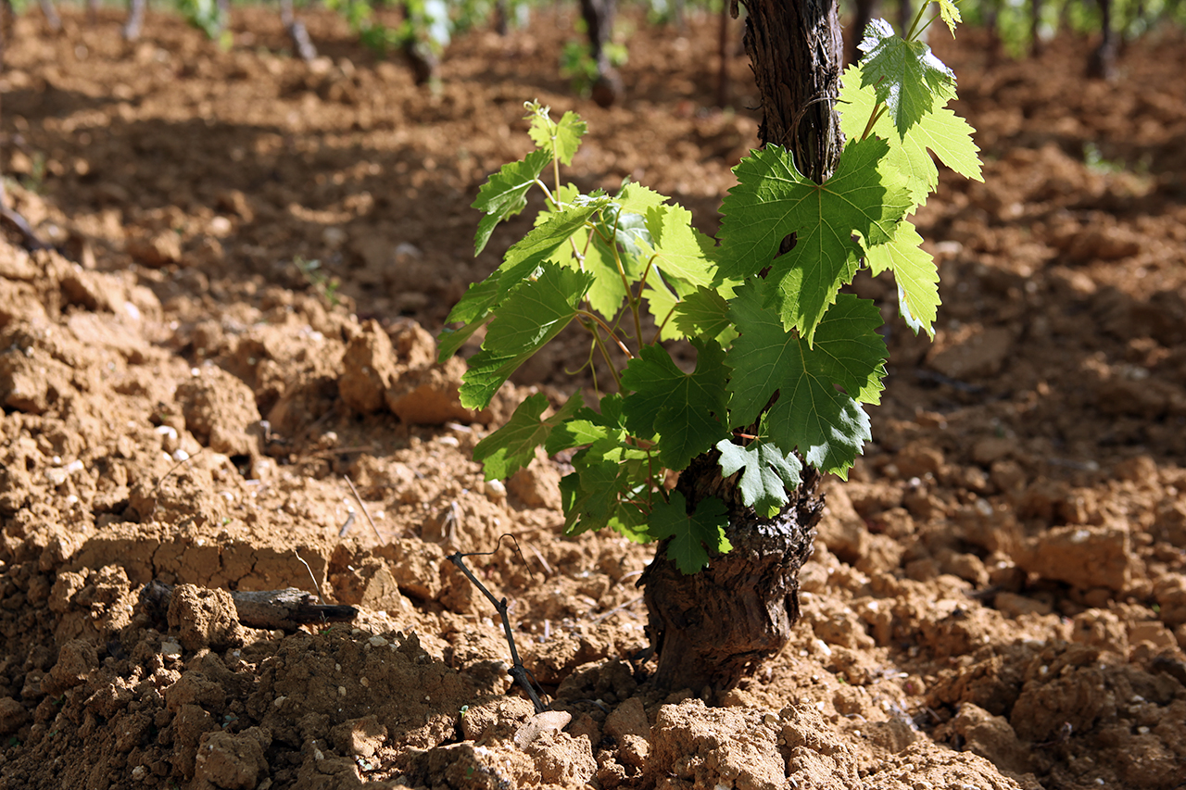
The Terroir of Morrocco
Morocco’s terroir is a blend of Mediterranean, Atlantic, and continental influences. The country's geography plays a huge role in shaping its wine styles, offering a mix of:
Climate: Warm, sunny days balanced by cool nights, especially in the mountainous and coastal regions. This temperature variation is key to preserving acidity and freshness in the wines.
Soil: The diversity of soils, ranging from sandy to limestone and clay, provides a foundation for wines with distinct character and depth.
Elevation: Many vineyards are planted at higher altitudes, especially near the Atlas Mountains, which helps balance the ripeness of the fruit with acidity, giving Moroccan wines their trademark balance and structure.

Slide 20
Wine Classification System
Morocco has adopted a French-style wine classification system, reflecting the strong influence of French viticulture. The system includes:
AOG (Appellation d'Origine Garantie): The equivalent of France’s AOC, it designates the top-tier wine regions, controlling grape varieties, yields, and production methods.
VDP (Vin de Pays): A lower tier, representing more relaxed rules, allowing for greater experimentation with grape varieties and winemaking techniques.
Vin de Table: Entry-level wines with no geographic designation but can offer great value.

Slide 21
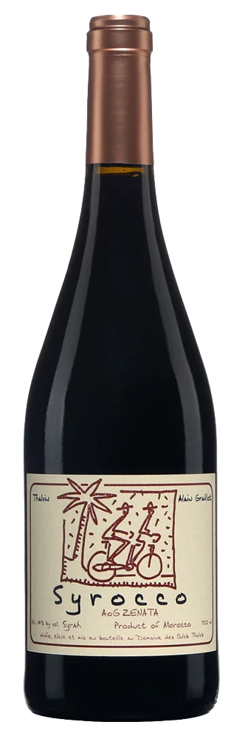
Major Varietals of Morrocco
Here are some of the key grape varieties you'll find in Morocco:
Syrah: Known for its rich, spicy, and full-bodied profile, Syrah flourishes in Morocco’s warm climate. The grapes develop deep flavors of blackberries, plums, and pepper, making the wine bold yet balanced.
The intensity of Syrah makes it perfect for pairing with grilled meats, particularly lamb, where the smoky, savory flavors of the meat complement the wine’s natural spice. It’s a go-to choice for robust dishes and is often enjoyed with Mediterranean-style cuisine.
This variety highlights the adaptability of Moroccan vineyards to produce internationally respected wines with distinct local character.

Slide 22
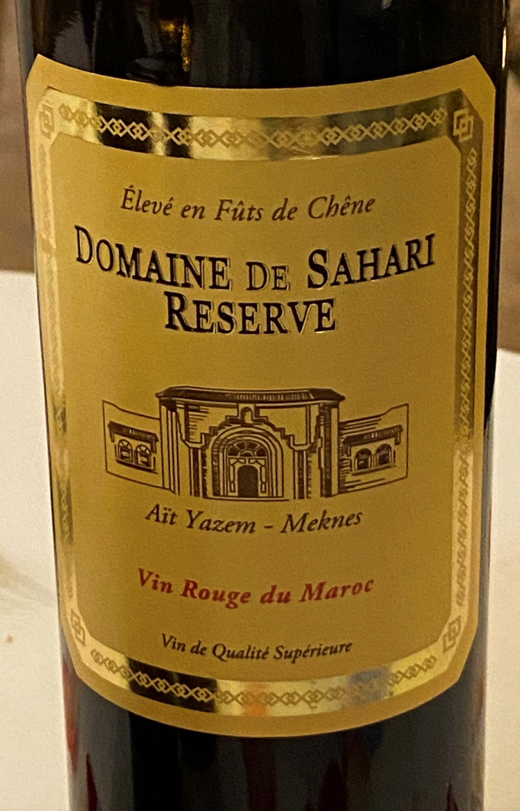
Major Varietals of Morrocco
Cabernet Sauvignon: Structured, robust, and globally recognized, Cabernet Sauvignon thrives in Morocco’s vineyards.
Known for its bold tannins and rich dark fruit flavors—like blackcurrant and plum—this wine delivers depth and intensity. Its structure makes it an ideal pairing for hearty dishes such as steaks, where the tannins balance the rich fat of the meat.
It also complements hard cheeses, enhancing the sharpness while rounding out the flavor. Cabernet Sauvignon from Morocco adds a unique regional touch to this classic varietal, blending international appeal with local terroir.

Slide 23
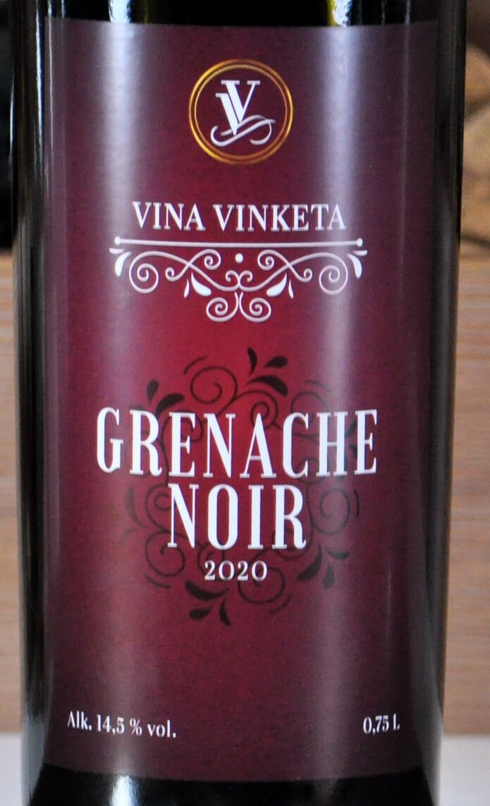
Major Varietals of Morrocco
Grenache: Light, fruit-forward, and versatile, Grenache is a red varietal that thrives in Morocco's diverse wine regions.
Known for its ripe berry flavors, including strawberry and raspberry, and soft tannins, it offers an approachable, easy-drinking style. Its lighter profile makes it an excellent pairing with Moroccan tagines, complementing the spices and slow-cooked richness of these traditional dishes.
Grenache adds a touch of brightness to the meal, balancing the deep flavors of the cuisine while still standing out on its own.

Slide 24
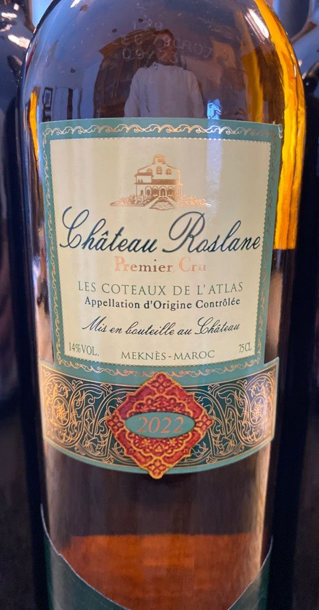
Major Varietals of Morrocco
Chardonnay: Crisp, floral, and refreshing, Moroccan Chardonnay is known for its bright acidity and fresh flavors.
Typically showcasing citrus and green apple notes, it brings a clean, vibrant profile to the table. Thanks to the cooler coastal influences in some Moroccan wine regions, this Chardonnay maintains a balanced, zesty finish.
It pairs beautifully with seafood dishes, enhancing the freshness of shellfish, grilled fish, and light Mediterranean salads. Its subtle floral undertones and lively fruit flavors make it an ideal choice for warm-weather dining, offering a refreshing contrast to the bold spices in Moroccan cuisine.

Slide 25
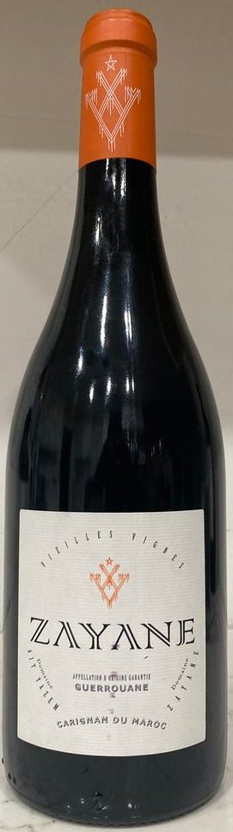
Major Varietals of Morrocco
Carignan: A versatile grape often used in blends, Carignan brings brightness and structure to Moroccan red wines.
With its vibrant acidity and fresh red fruit flavors—like cherry and cranberry—Carignan adds a lively edge to wines, helping to balance richer, fuller-bodied varieties.
Its firm tannins and moderate alcohol make it an excellent companion to Mediterranean dishes, especially those featuring olive oil, tomatoes, and roasted vegetables.
Whether paired with Moroccan lamb tagines or grilled vegetables, Carignan complements the earthy, savory elements of these dishes, enhancing both the food and the wine's natural freshness.
While it often plays a supporting role in blends, Moroccan winemakers are increasingly highlighting Carignan for its ability to add character and lift to their wines.

Slide 26
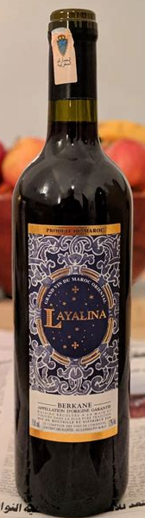
Major Varietals of Morrocco
Faranah: This indigenous Moroccan grape is named after the Arabic word for "joy," a nod to its lively and vibrant nature.
Faranah is one of the oldest known grape varieties in Morocco, deeply tied to the country’s winemaking traditions that date back centuries.
It’s primarily used in producing white wines, known for their refreshing acidity and bright fruit flavors, including notes of citrus, green apple, and subtle floral undertones.
Faranah’s crisp, light character makes it an ideal pairing for Moroccan seafood dishes, mezze platters, and light salads. This grape not only embodies Morocco's rich wine heritage but also stands out as a symbol of the country’s unique terroir and history in viticulture.

Slide 27
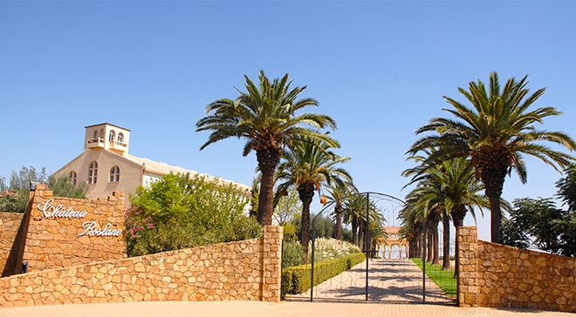
Notable Wineries
Les Celliers de Meknès: Morocco’s largest wine producer, known for its high-quality reds and whites.
Its flagship wine, "Château Roslane," is considered among the best in the country.
Located in the foothills of the Atlas mountains, the estate's vineyards cover 2000 hectares (4950 acres) at altitudes from 580 to 700m (1900-2300ft) above sea level. On these slopes, the altitude moderates the warm climate while offering plenty of sun, and a variety of soil types can be exploited.
The large winery, Château Roslane,
features 700,000 liters of tank space and
a cellar that can hold 3000 barrels and
three million bottles.
It is set in 700 hectares (1720 acres) of
land, including a boutique hotel, formal
gardens and event spaces, as well as its
own vineyards, which produce the flagship
wines of the portfolio.

Slide 28
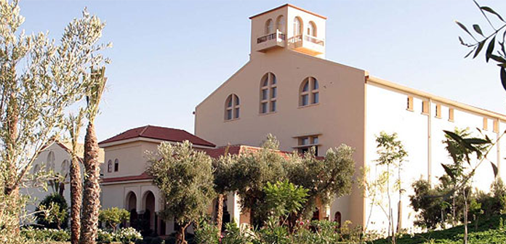
Notable Wineries
Domaine Ouled Thaleb is a renowned Moroccan winery located in the Zenata region, just northeast of Casablanca.
Founded in 1923, it has become a leader in Morocco’s wine production, particularly known for its organic farming practices. The winery embraces sustainable methods by hand-plowing and weeding without the use of herbicides or fungicides.
This commitment to organic farming is reflected in their wines, which showcase the unique terroir of the Zenata region.
In addition to their commitment to quality winemaking, Domaine Ouled Thaleb's proximity to the Atlantic Ocean allows for
cooling breezes that contribute to the balance
and elegance of their wines.
As Morocco’s wine industry continues to
grow, Ouled Thaleb remains at the forefront,
recognized for both innovation and adherence
to traditional winemaking techniques.

Slide 29
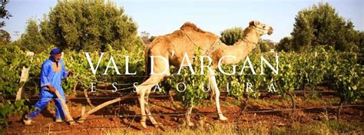
Notable Wineries
Val d'Argan: Founded by French winemaker Charles Mélia, Val d'Argan focuses on Rhône varietals, producing wines that are consistently highly rated.
At Le Domaine du Val d’Argan, they don’t use tractors in the vineyard. They use camels. The annual production at Le Domaine du Val d’Argan is roughly 1500 hectoliters or 200 000 bottles, stored in our cellar in Essaouira, Morocco.
Mélia left Châteauneuf-du-Pape to create the winery, inspired by the potential of the Moroccan terroir.
He planted the first vines on a 7-hectare plot of land near Essaouira.
This not only helps preserve the soil but also adds a touch of traditional Moroccan culture to the winemaking process.
Rhône varietals: The winery focuses on Rhône varietals, including Syrah, Grenache, Mourvèdre, Carignan, and Viognier. These grapes thrive in the warm, dry climate of Morocco, producing wines with bold flavors and complex aromas.

Slide 30
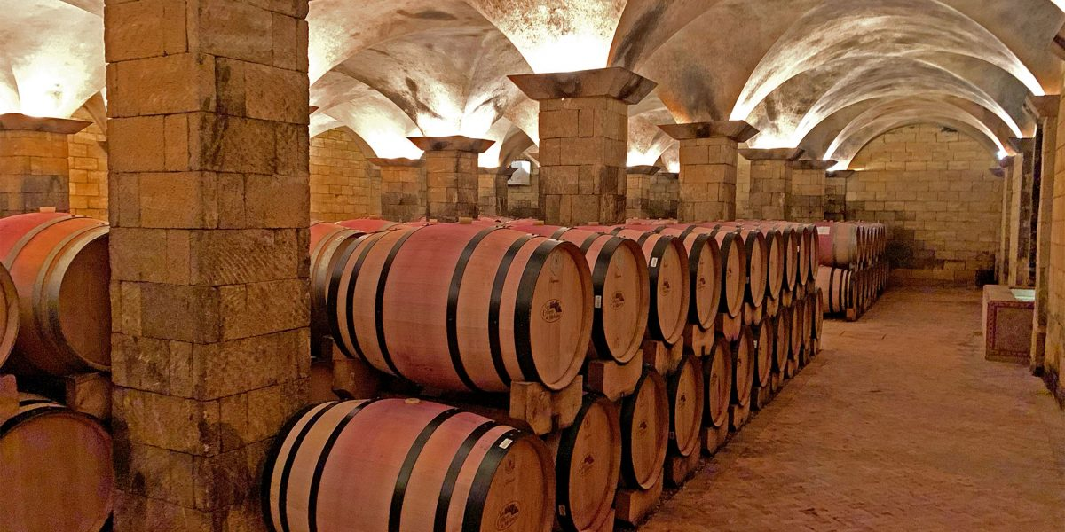
Notable Wineries
Baccari is a relatively new winery in Morocco that's making waves in the international wine scene. Located near Meknes, in the heart of Morocco's wine-growing region, Baccari is known for its commitment to quality and sustainability.
Modern Approach: Baccari embraces modern winemaking techniques while respecting traditional methods. This blend of old and new allows them to produce wines that are both innovative and rooted in the region's rich history.
Focus on Terroir: The winery is deeply committed to showcasing the unique terroir of Morocco. They carefully select grape varieties and vineyard sites to highlight the specific characteristics of each region.
Sustainable Practices: Baccari is dedicated to
sustainable winemaking. They employ organic
and biodynamic farming methods to minimize
their environmental impact and produce
healthier wines.

Slide 31
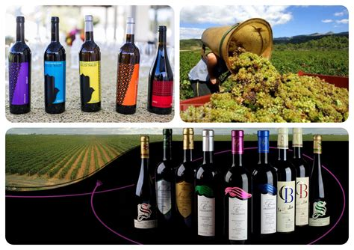
Conclusion
Morocco’s wine industry is a fascinating blend of history, culture, and terroir.
With a combination of ancient
viticultural traditions and
modern winemaking techniques,
Moroccan wines are gaining
recognition around the world.
Whether you're sipping on a
robust Syrah from Meknès or
enjoying a crisp Zenata rosé,
Morocco has a wine for every
palate.

Slide 32
Acknowledgement
My seminars are the result of many years of experience combined with many hours of research over the internet.
I would like to acknowledge the many source I have accessed.
These include Wine Spectator, Wine Enthusiast, BKWine Magazine, Wine & Spirits Magazine, American Vineyard Magazine, The Grapevine Magazine, Wikipedia.com, Britannica.com, and the
various Government websites.

Slide 33
Citations and References
Books: Look for books on global wine regions or North African viticulture. "Wine Grapes" by Jancis Robinson, for example, is an excellent resource.
Academic Journals: presentations from journals such as Journal of Wine Research or American Journal of Enology and Viticulture can provide scientific insights into Moroccan wine production.
Wine Websites: Trusted wine platforms like Wine Enthusiast, Wine Spectator, and Decanter often feature in-depth presentations about emerging wine regions, including Morocco.
Winery Websites: Websites of notable Moroccan wineries (e.g., Les Celliers de Meknès, Domaine Ouled Thaleb) provide direct information about their wines and production processes.
Tourism Websites: National tourism websites or Morocco-specific wine tours may offer useful insights into the history and current state of the wine industry in the country.

