Slide 1
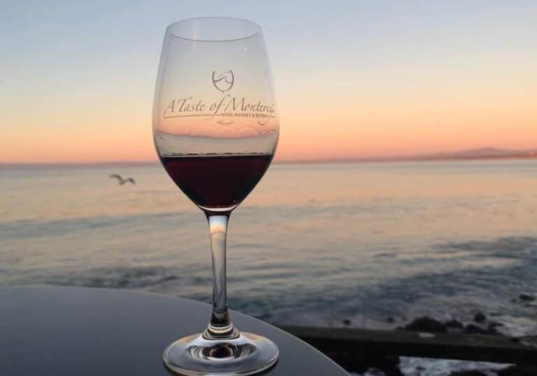
Wine Regions of California
Monterey
Presented by
Marc Silver

Slide 2
An Introduction to Wine in Monterey
Table of Contents
Wines of Monterey
Monterey’s Wine History
The AVA Revolution
Global Recognition and Beyond
Monterey’s Wine Sub-Regions
Major Varietals of Monterey, California
Notable Wineries in Monterey
Monterey’s Wine Culture and Traditions
Sustainable Winemaking Practices in Monterey
Final Thoughts
References

Slide 3
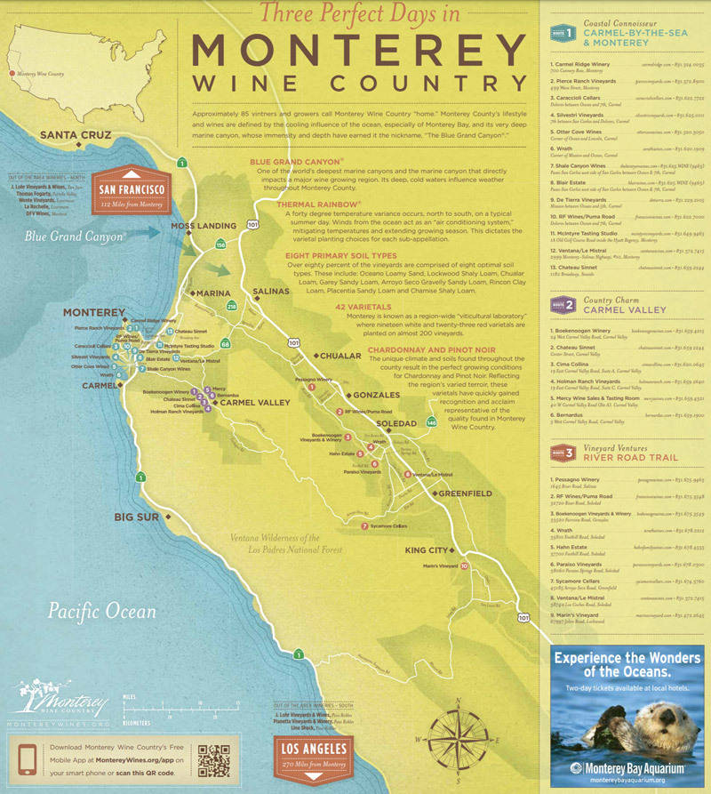
Wines of Monterey
Monterey, California, stands as a beacon in the American wine landscape, renowned for its diverse wine styles and exceptional terroir.
Positioned along the Central Coast, this region bridges tradition with innovation, producing wines that reflect its unique geography and climate.
With a winemaking history that has evolved over centuries, Monterey has carved a place for itself in the global market, offering varietals that rival the best from Europe and beyond.
Whether you’re a seasoned connoisseur or a curious enthusiast, Monterey’s wines promise a journey of discovery.

Slide 4
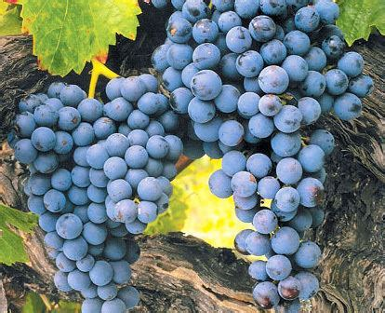
Ancient Beginnings
Monterey’s wine story starts with the early Spanish missionaries, who brought vines to California in the 18th century. These missionaries were practical folks, and wine was essential, not just for sacramental use but also for daily life.
Their Mission grapes, the backbone of early winemaking, laid the groundwork for California’s broader viticultural identity.
While the Mission varietal isn’t the star of the show today, it holds a special place in the hearts of local winemakers as the humble start of it all.

Slide 5

The Quiet Years and Rediscovery
For a long stretch, winemaking in Monterey
was modest at best. While the Gold Rush
brought attention to California as a whole,
Monterey’s wine industry was overshadowed
by flashier regions.
In the early 20th century, Prohibition delivered a near-fatal blow to wine production. Vineyards were abandoned, and much of the region’s winemaking heritage was almost lost.
Yet, a few resilient growers managed to keep the spirit alive, holding out until the wine renaissance that followed.

Slide 6
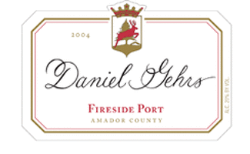
Modern Revitalization
Modern Revitalization
The 1960s and 70s were transformative years for Monterey. Winemakers, armed with new viticultural knowledge and a pioneering spirit, realized the region’s untapped potential. Dr. Daniel Gehrs, one of the early innovators, conducted groundbreaking research on Monterey’s unique climate and soils. He discovered that the region’s cool coastal breezes and long growing season were ideal for certain varietals, especially Pinot Noir and Chardonnay.
This scientific approach to winemaking put Monterey back on the map, helping it emerge as a serious contender in the global wine arena.

Slide 7
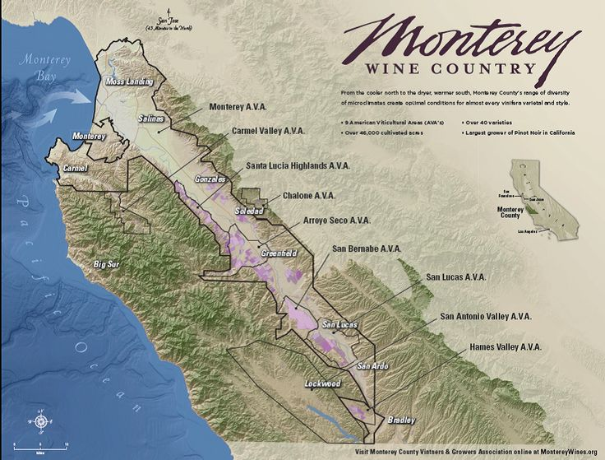
The AVA Revolution
The creation of the Monterey AVA in 1984 was a pivotal moment. This designation recognized the region’s unique terroir and gave winemakers a way to emphasize the distinctiveness of their wines.
With nine sub-AVAs, each highlighting specific microclimates and soils, Monterey became a hub of diversity. From the cool, foggy Santa Lucia Highlands to the warm, sun-soaked Carmel Valley, the region’s wines began to reflect the incredible variety of its landscape.

Slide 8

Global Recognition and Beyond
Today, Monterey’s wines are celebrated worldwide. The region is known not only for its classic varietals but also for its willingness to experiment. Winemakers here don’t just follow trends, they set them. Monterey is a place where tradition meets innovation, producing wines that are as exciting as they are timeless.
From its humble beginnings with Mission grapes to its current status as a wine powerhouse, Monterey’s history is a testament to resilience and creativity. Its journey hasn’t always been easy, but that’s what makes the wines so special, they’re a reflection of a region and its people who never gave up on their potential.
Wouldn’t you agree that every sip of Monterey wine carries a little piece of this history?

Slide 9
Wine Sub-Regions of Monterey, California
Monterey County is home to nine distinct AVAs, each offering a unique contribution to the region’s wine portfolio.
Stretching from the cool, foggy coast to the warmer inland valleys, these regions produce an impressive array of varietals.

Slide 10
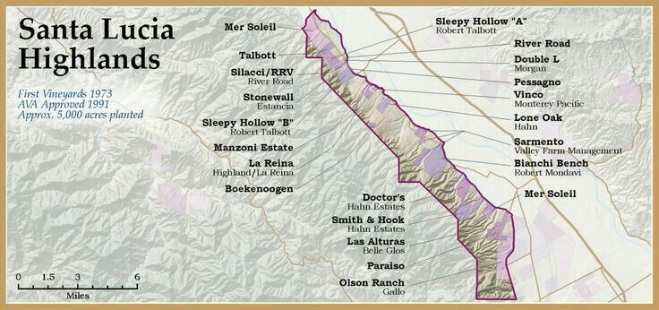
Wine Sub-Regions of Monterey, California
Santa Lucia Highlands
Perched on the eastern slopes of the Santa Lucia Mountains, this AVA is celebrated for its cool, fog-laden mornings and sunny afternoons. These conditions make it a haven for Pinot Noir and Chardonnay, producing wines with elegant structures and vibrant acidity.
The region's elevation and proximity to the Pacific create microclimates that allow subtle differences between vineyards, resulting in wines with nuanced layers of red fruit, floral notes, and a touch of minerality. It’s no wonder Santa Lucia Highlands has become synonymous with world-class Pinot.

Slide 11
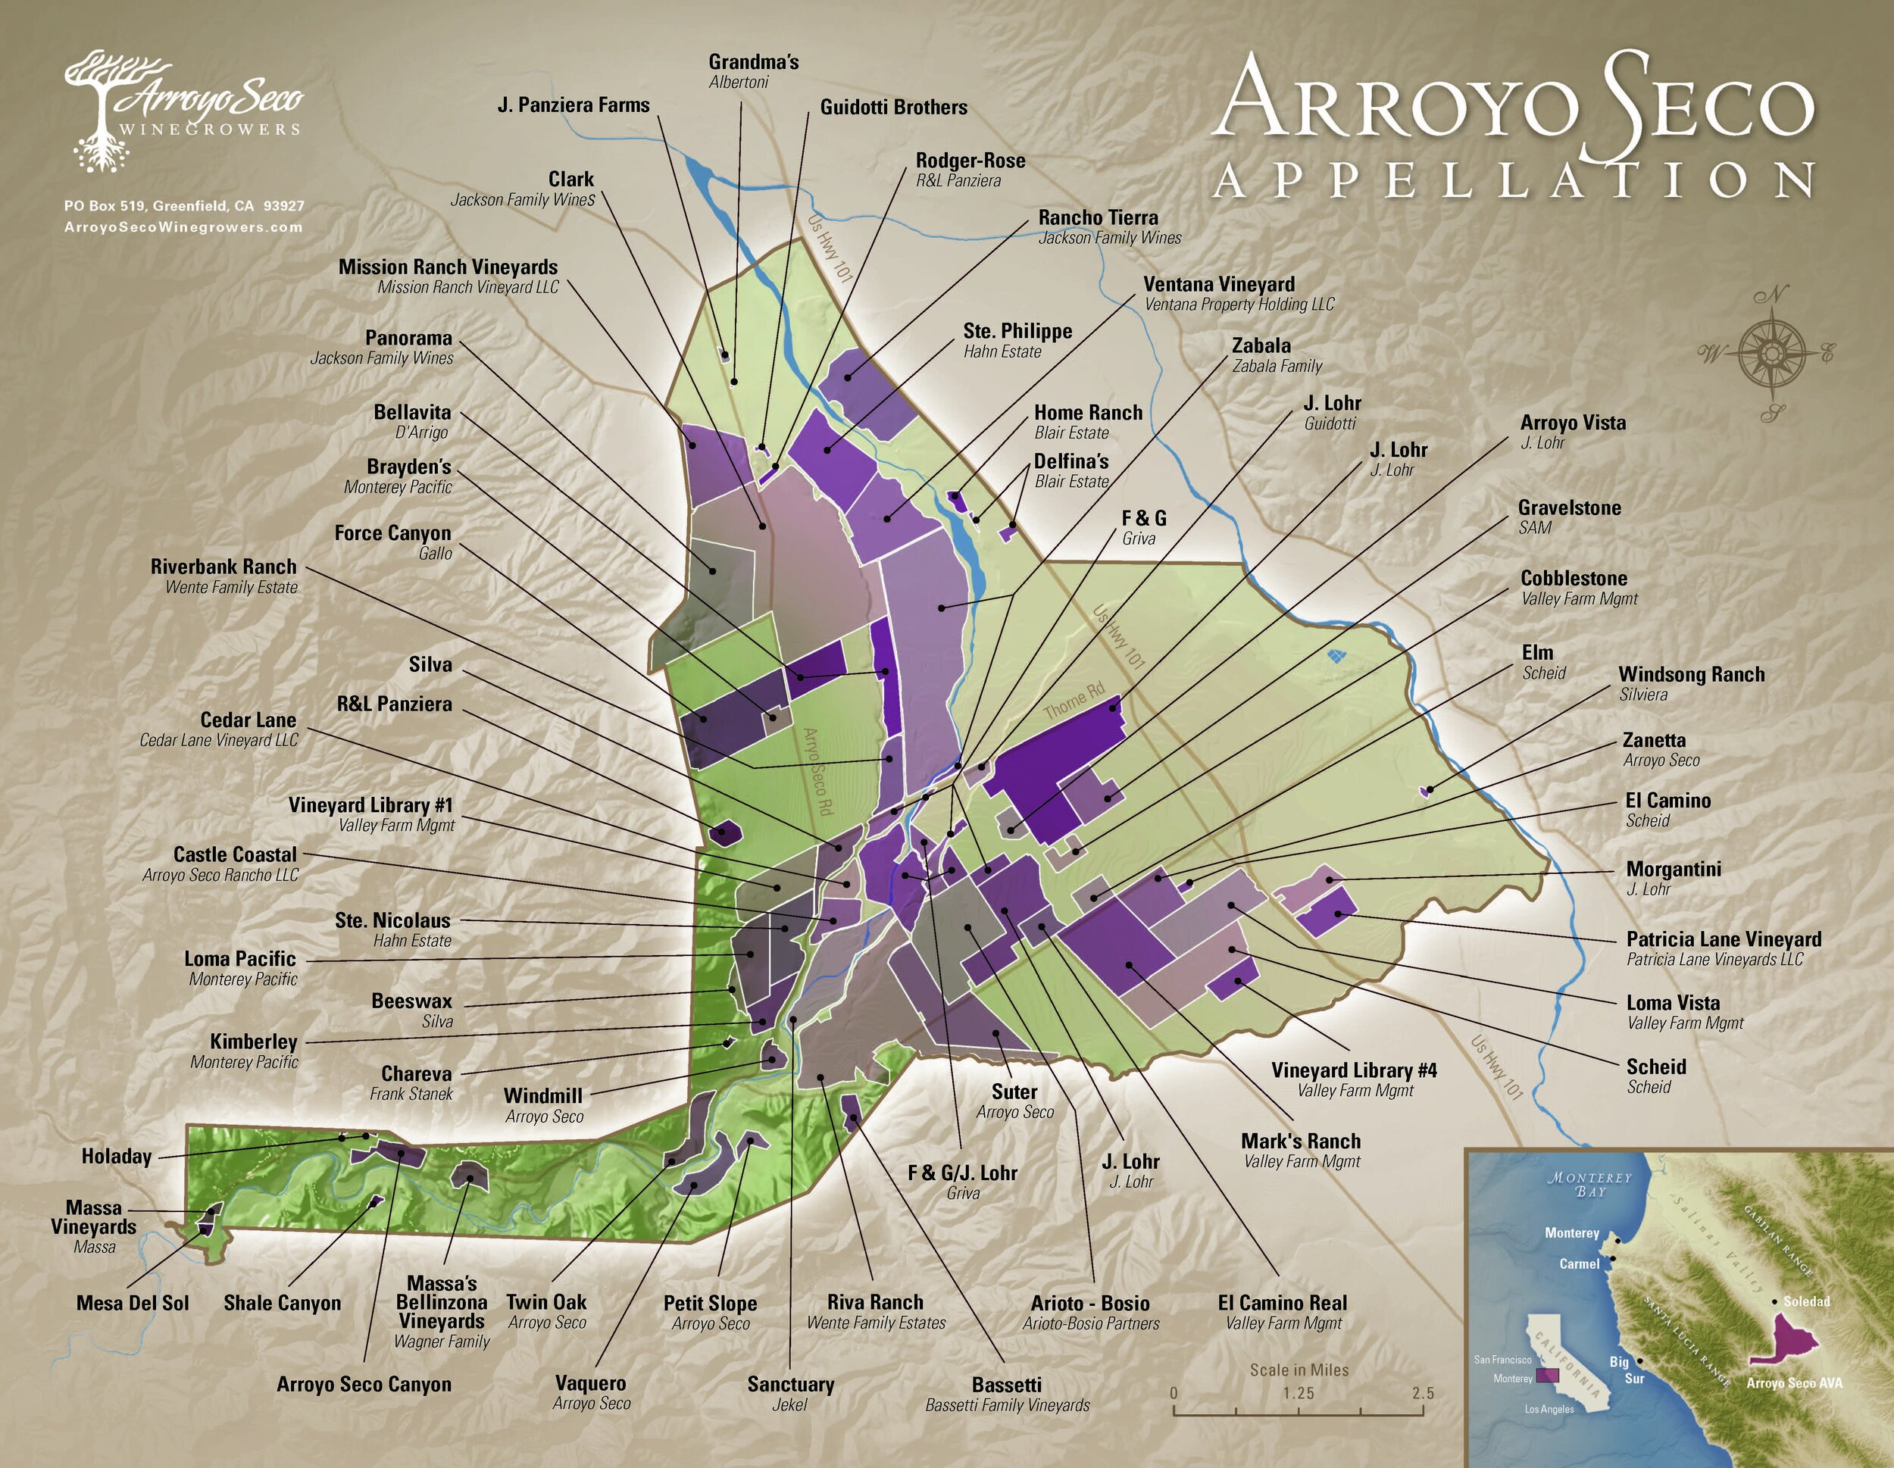
Wine Sub-Regions of Monterey, California
Arroyo Seco
Meaning "dry creek" in Spanish, Arroyo Seco features gravelly, well-draining soils and a sheltered location that protects vines from harsh winds.
This AVA produces balanced and approachable wines, particularly Sauvignon Blanc, Chardonnay, and Zinfandel. The combination of moderate daytime warmth and cool nights allows for slow, even ripening, giving wines a bright, fresh character.
Arroyo Seco’s standout feature is its rock-strewn vineyards, where vines have to dig deep for nutrients, resulting in wines with concentrated flavors and a distinctive earthiness.

Slide 12
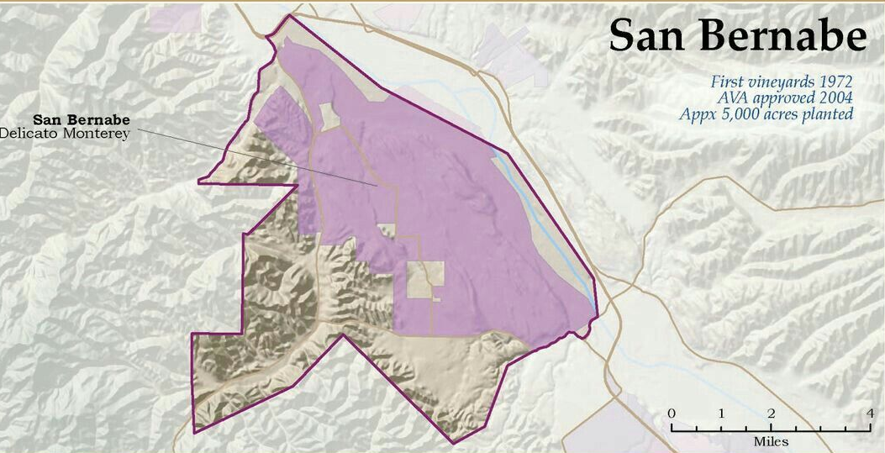
Wine Sub-Regions of Monterey, California
San Bernabe
Stretching across over 8,000 acres, San Bernabe is a viticultural marvel, with a patchwork of microclimates and soil types.
It’s often referred to as a winemaker’s playground because nearly every major varietal can thrive here.
From crisp Riesling to bold Cabernet Sauvignon, San Bernabe is a testament to Monterey’s diversity. The region’s unique blocks allow winemakers to create wines with precision and complexity. Despite its size and scale, San Bernabe is known for maintaining high-quality standards, with wines that consistently overdeliver for their price.
Monerey Wine Co.
Crushwerks

Slide 13
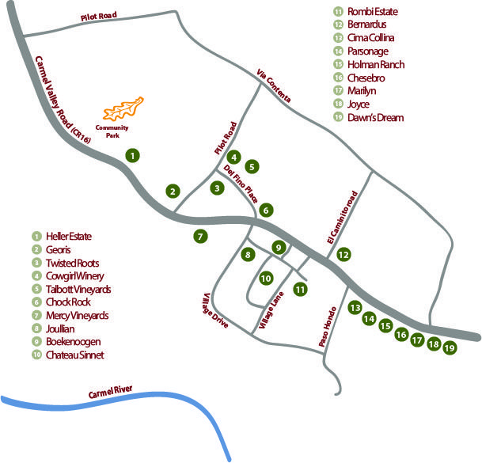
Wine Sub-Regions of Monterey, California
Carmel Valley
Tucked away in the rugged hills inland from the coast, Carmel Valley is one of Monterey’s warmest AVAs. This sunny region is perfect for Bordeaux-style wines, particularly Cabernet Sauvignon and Merlot.
Its steep slopes and small-scale vineyards lend an artisanal feel, with winemakers often working by hand to craft wines that embody the valley’s character. Expect bold, full-bodied reds with lush dark fruit, velvety tannins, and hints of herbs that reflect the valley’s wild landscape.

Slide 14
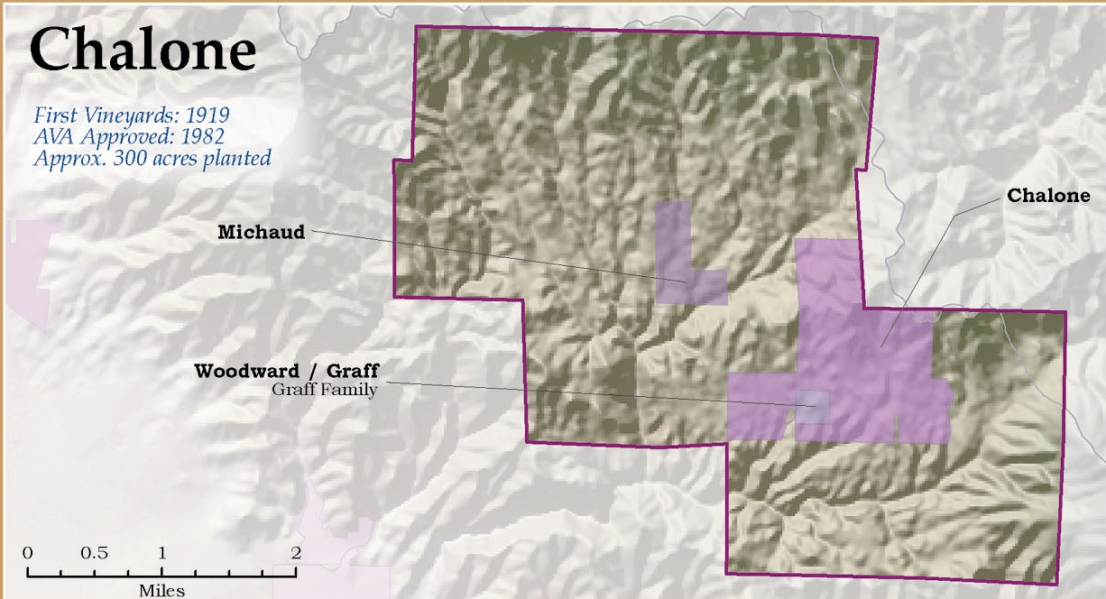
Wine Sub-Regions of Monterey, California
Chalone
Located at the base of the Pinnacles National Park, Chalone is one of Monterey’s most distinct AVAs. The limestone-rich soils here are rare in California and lend a signature minerality to the wines.
Chalone is particularly famous for its Chardonnay and Pinot Noir, which exhibit exceptional balance and finesse.
The dry, arid climate and high-altitude vineyards create conditions that yield small, concentrated grapes, resulting in wines with intense flavors and remarkable aging potential.
Chalone is a little off the beaten path but produces some of the region’s most iconic wines.

Slide 15
Wine Sub-Regions of Monterey, California
Each of these regions contributes something unique to Monterey’s wine story, offering a fascinating mix of flavors, styles, and experiences.
Whether you prefer the elegance of Santa Lucia Highlands or the rugged charm of Carmel Valley, there’s a glass of Monterey wine waiting to surprise and delight you.

Slide 16
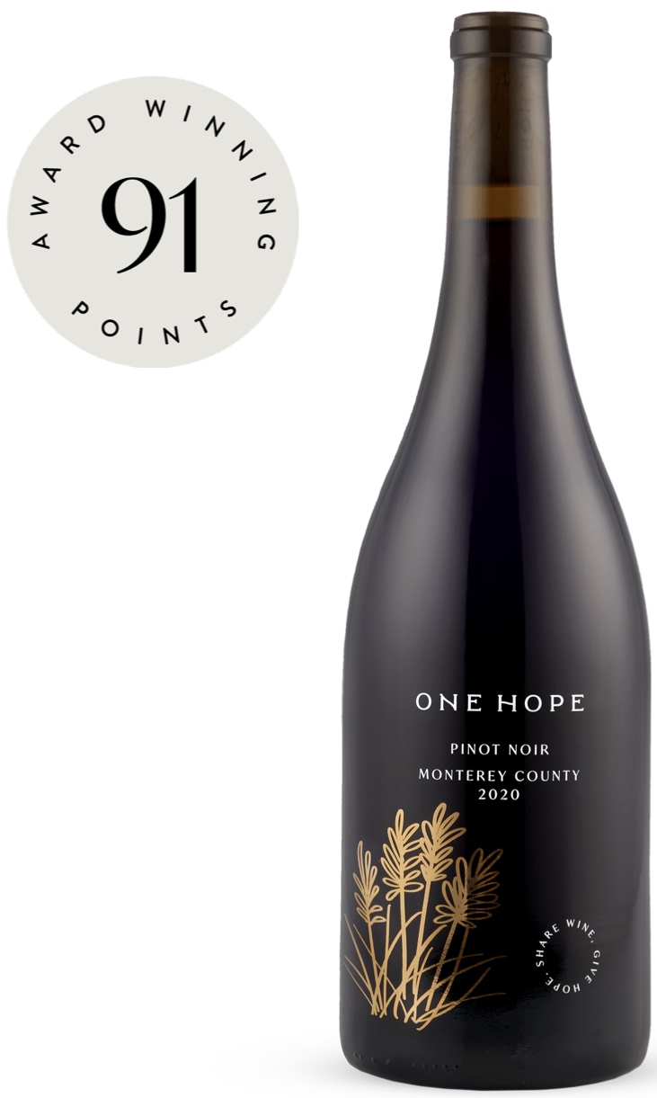
Major Varietals of Monterey, California
Pinot Noir
Often hailed as Monterey’s signature red, Pinot Noir thrives in the cooler AVAs like Santa Lucia Highlands and Chalone. Its bright red fruit notes, think cherry and raspberry, are complemented by earthy undertones of mushroom and forest floor.
These wines often exhibit silky tannins and a delicate structure, making them versatile and food-friendly.
Pair Monterey Pinot Noir with roasted duck, mushroom risotto, or a simple charcuterie board to experience its full charm.

Slide 17
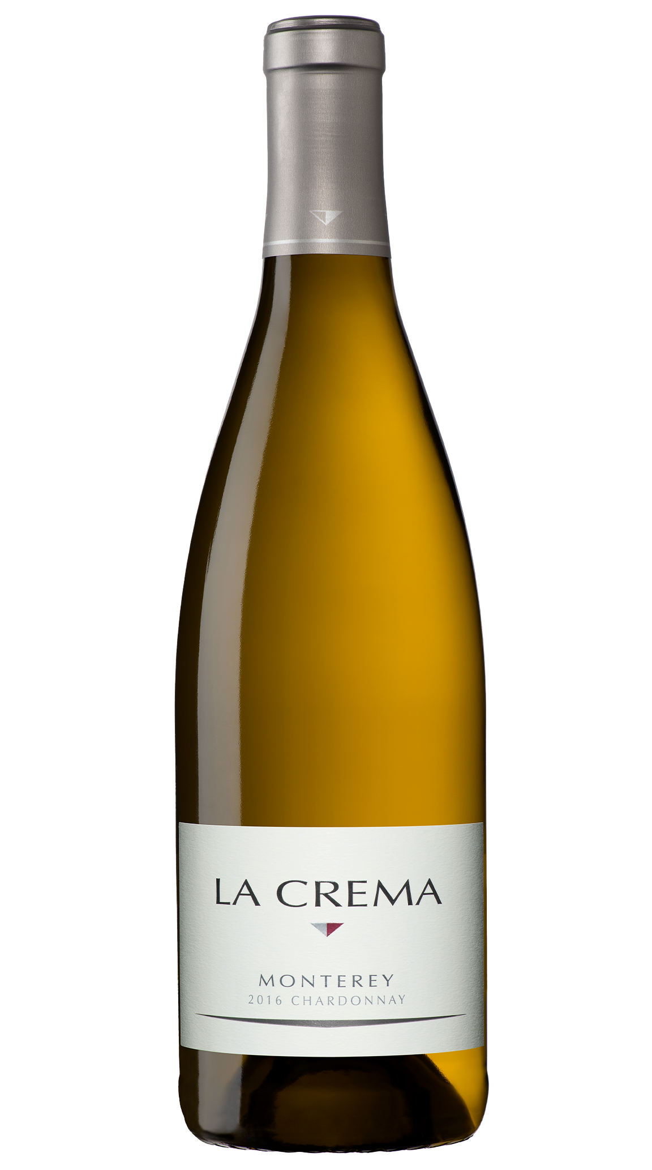
Major Varietals of Monterey, California
Chardonnay
Monterey’s Chardonnay is as diverse as its terroir. Coastal vineyards produce crisp, citrusy versions with hints of green apple and minerality, while warmer inland areas yield rich, buttery Chardonnays with tropical fruit notes and a creamy texture.
These wines often showcase subtle oak influences, with flavors of vanilla and baking spices.
Pair them with seafood dishes like crab cakes, creamy pastas, or roasted chicken for a classic match.

Slide 18
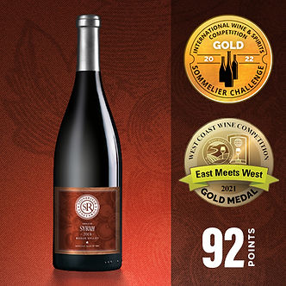
Major Varietals of Monterey, California
Syrah
Syrah is Monterey’s hidden gem. Known for its deep, smoky profile, this varietal flourishes in the warmer, sun-soaked regions like San Bernabe.
Expect bold flavors of blackberry, plum, and black pepper, often layered with notes of smoked meat and dried herbs.
With its rich, full-bodied character, Syrah pairs beautifully with barbecued ribs, lamb shanks, or even spicy sausage dishes.

Slide 19
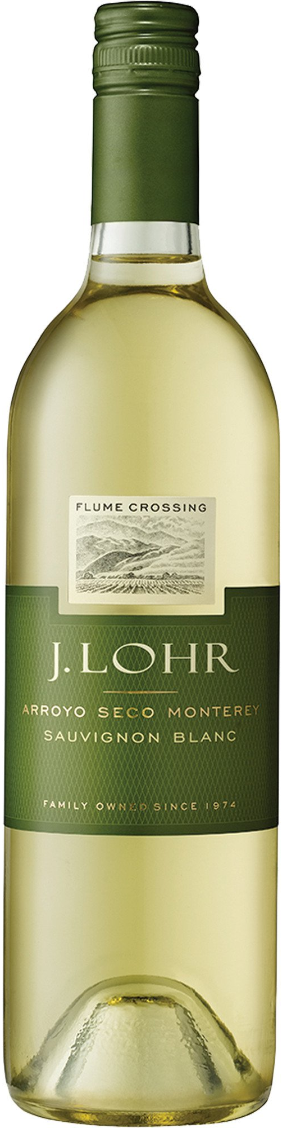
Major Varietals of Monterey, California
Sauvignon Blanc
Fresh, zesty, and full of life, Sauvignon Blanc is another standout from Monterey. The cooler climates of regions like Arroyo Seco produce wines with vibrant acidity and flavors of lime, green apple, and tropical fruit.
Some examples even show a subtle grassy or herbaceous quality, adding complexity.
Pair Sauvignon Blanc with fresh goat cheese, ceviche, or a bright citrus salad for a refreshing combination.

Slide 20
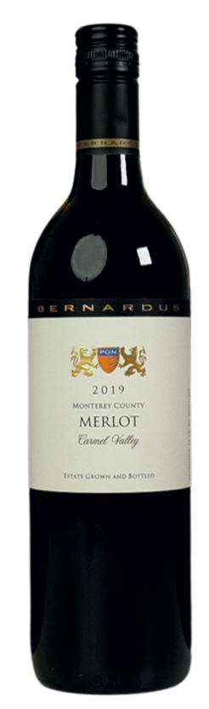
Major Varietals of Monterey, California
Merlot
Merlot finds a comfortable home in Monterey, particularly in the Carmel Valley AVA. The wines are plush and fruit-forward, with flavors of ripe plum, black cherry, and a hint of chocolate.
Softer tannins make Merlot an excellent choice for those who prefer a rounder, smoother red.
It’s a natural pairing for dishes like roast pork, grilled vegetables, or meatloaf.

Slide 21
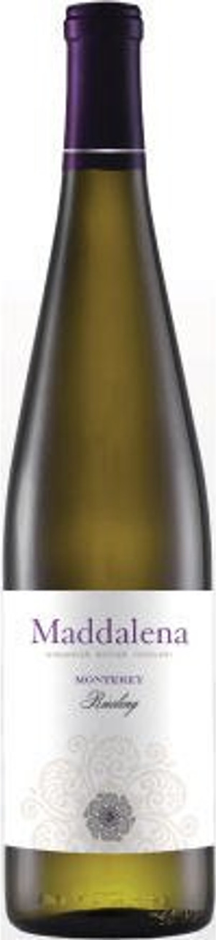
Major Varietals of Monterey, California
Riesling
Monterey is quietly making waves with Riesling, especially in cooler pockets like San Bernabe.
This aromatic white wine often showcases stone fruit flavors like peach and apricot, balanced by bright acidity and occasional floral or honeyed notes.
Dry and off-dry styles are both common, making Riesling a versatile option for pairing with spicy Asian cuisine, lightly spiced curries, or desserts featuring fruit.

Slide 22
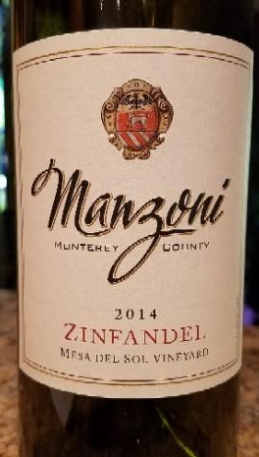
Major Varietals of Monterey, California
Zinfandel
Zinfandel from Monterey tends to lean toward a more balanced, elegant style than the jammy versions found in hotter regions.
It offers flavors of red and black berries, a touch of spice, and a smooth, medium-bodied structure.
Arroyo Seco produces some standout examples, perfect with barbecued chicken, pepperoni pizza, or hearty pasta dishes.

Slide 23
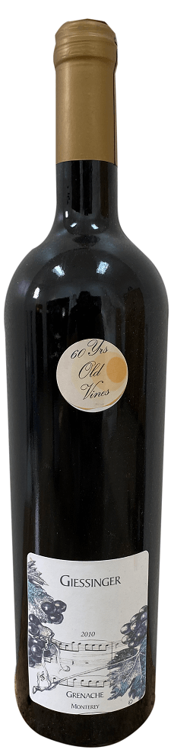
Major Varietals of Monterey, California
Grenache
Although less common, Grenache is gaining attention in Monterey for its bright red fruit profile and soft, approachable tannins.
These wines often exhibit strawberry, cherry, and subtle herbal notes.
Grenache is a great choice for lighter fare like grilled salmon, Mediterranean dishes, or even a Margherita pizza.

Slide 24
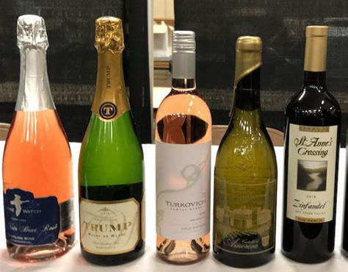
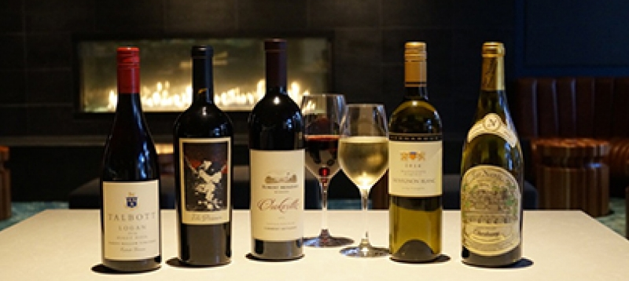
Major Varietals of Monterey, California
Monterey’s diverse climate and terroir allow for an incredible range of varietals, from cool-climate whites to robust reds.
Whether you’re a fan of the classics like Pinot Noir and Chardonnay or enjoy exploring less traditional options like Riesling and Grenache, Monterey has something to delight every palate.

Slide 25
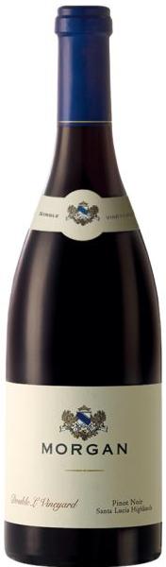
Notable Wineries
Morgan Winery (Santa Lucia Highlands)
Morgan Winery, founded by Dan and Donna Lee in 1982, is a pioneer in sustainable winemaking in the Santa Lucia Highlands AVA.
Their focus on Pinot Noir and Chardonnay has earned them a stellar reputation. Morgan’s estate vineyard, Double L Vineyard, is certified organic and serves as the foundation for their signature wines.
The Double L Pinot Noir consistently garners high scores from wine critics, with its bright cherry and spice notes balanced by a silky texture. Their Chardonnay is equally celebrated, offering crisp minerality and hints of tropical fruit. Awards like the Wine Spectator “Top 100” solidify Morgan’s standing as a must-visit winery.

Slide 26
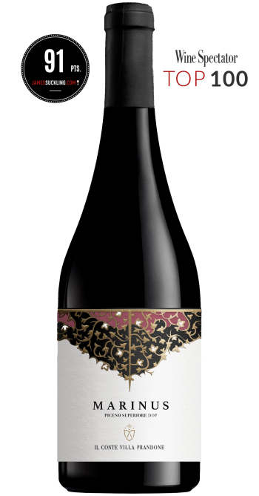
Notable Wineries
Bernardus Winery (Carmel Valley)
Bernardus Winery is synonymous with Bordeaux-style elegance in Monterey. Established by Bernardus Marinus Pon, the winery aimed to craft wines rivaling those of Bordeaux’s finest estates.
Their Marinus Bordeaux Blend, a rich and structured red, has received numerous accolades, including gold medals at international wine competitions. Bernardus is also known for its single-vineyard Pinot Noirs and Chardonnays, which showcase the diversity of Carmel Valley’s terroir.
Visitors to the Bernardus tasting room are treated to not only exceptional wines but also warm hospitality and a deeper understanding of the art of blending.

Slide 27
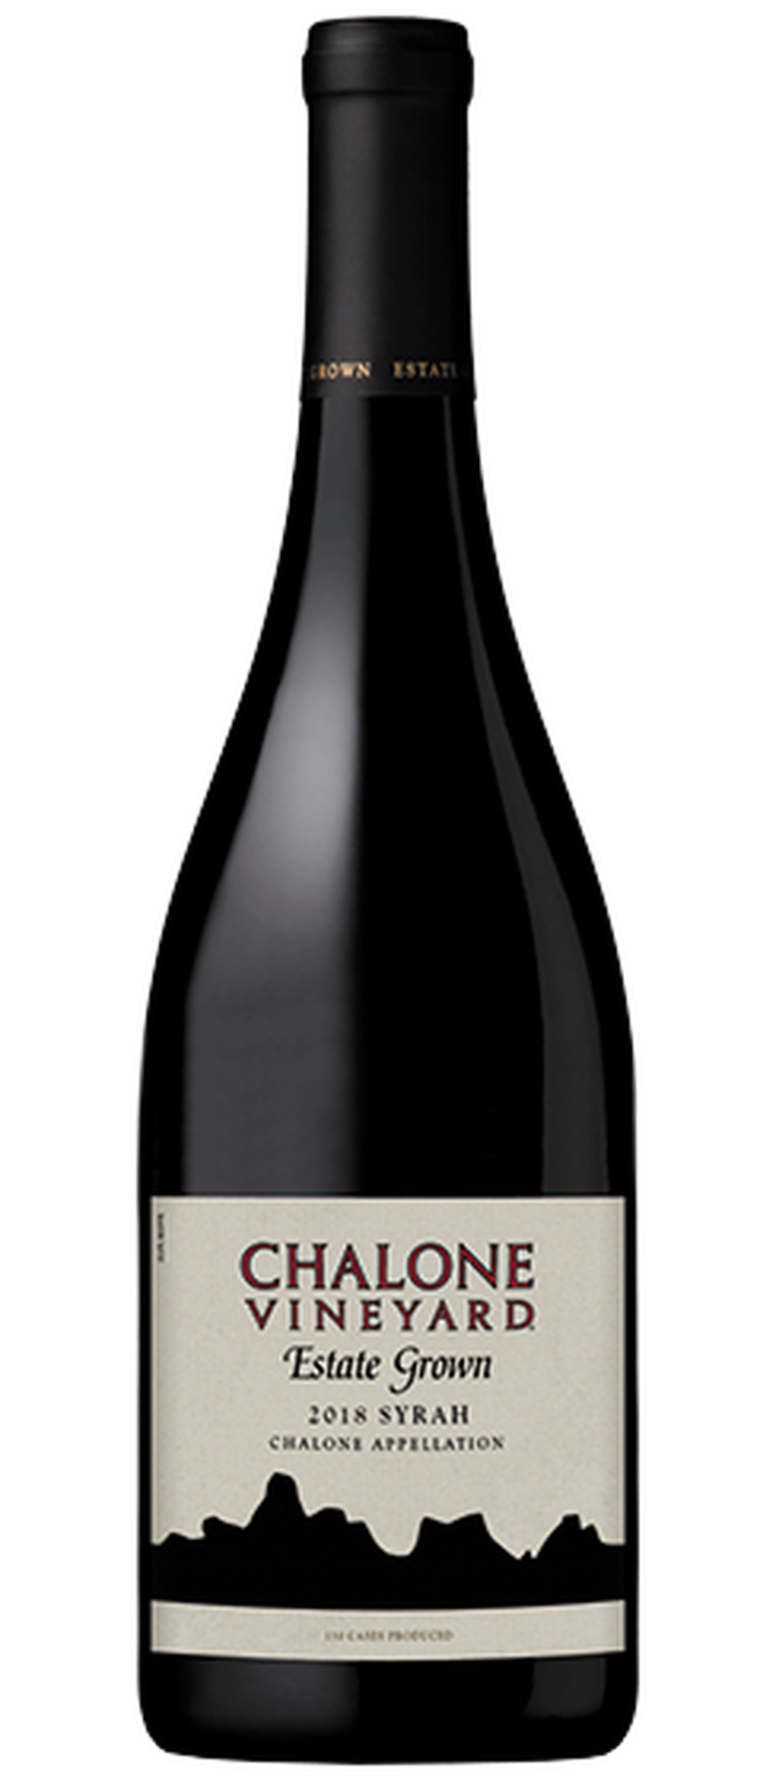
Notable Wineries
Chalone Vineyard (Chalone AVA)
As one of Monterey’s most historic wineries, Chalone Vineyard holds a special place in the region’s history. Located at the foot of the Pinnacles National Park, this winery boasts some of the oldest producing vines in California.
Chalone’s limestone-rich soils are the secret to its renowned Chardonnay and Pinot Noir, wines that exhibit a rare combination of power and finesse.
The Chalone Chardonnay has consistently received top honors, including placement in the coveted "Judgment of Paris" competition, where it stood alongside France’s finest. Visitors can explore the winery’s breathtaking location and experience wines that truly reflect the rugged beauty of the AVA.

Slide 28
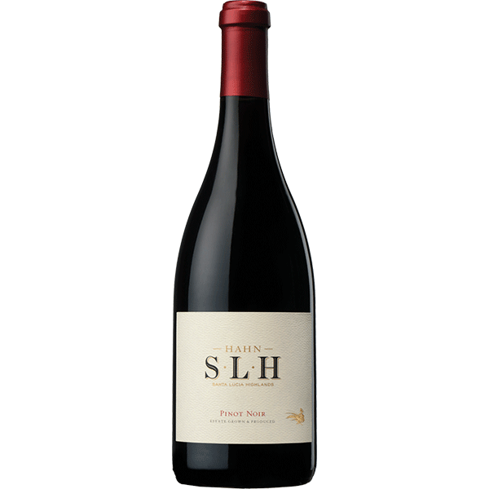
Notable Wineries
Hahn Family Wines (Santa Lucia Highlands)
Hahn Family Wines, a household name in Monterey County, is celebrated for its vibrant, approachable wines that highlight the region’s cool-climate characteristics.
Their SLH Pinot Noir, a flagship offering, is prized for its lush red fruit flavors and balanced acidity, earning high praise from Wine Enthusiast and other notable critics. Hahn also produces excellent value-driven wines under their “Hahn” and “Smith & Hook” labels, making it a favorite for both casual drinkers and collectors.
The winery itself is perched on a hilltop with sweeping views of the Santa Lucia Highlands, making it an ideal spot for wine tasting.

Slide 29
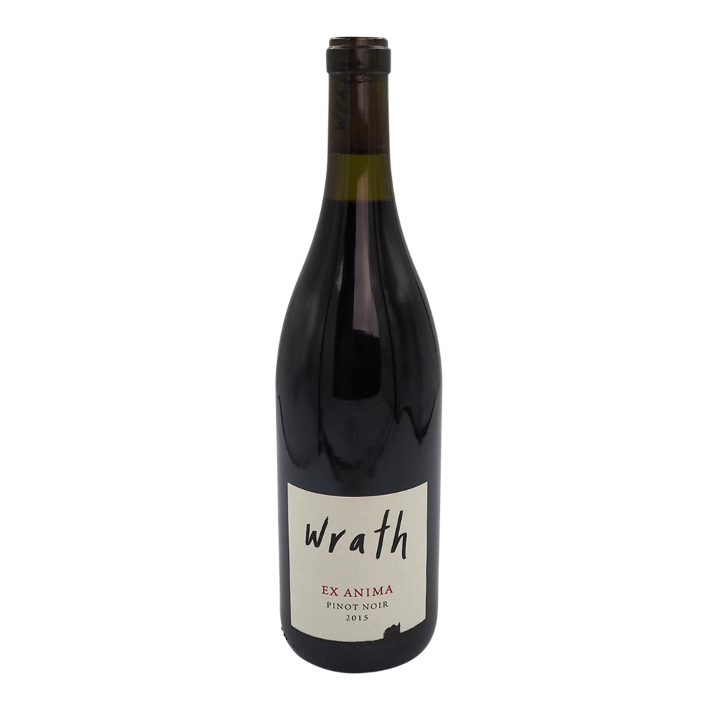
Notable Wineries
Wrath Wines (Santa Lucia Highlands)
Wrath Wines is known for pushing the boundaries of traditional winemaking. Focused on small-lot, high-quality production, Wrath produces distinctive Pinot Noir, Syrah, and Chardonnay.
Their Ex Anima series (“from the soul”) embraces minimalist winemaking techniques, resulting in wines that are bold, expressive, and terroir-driven. The Wrath San Saba Vineyard Pinot Noir has received multiple 90+ point scores from leading wine publications for its concentrated flavors of dark cherry and spice.
The tasting room in Carmel-by-the-Sea offers an intimate setting to explore their unique offerings.

Slide 30
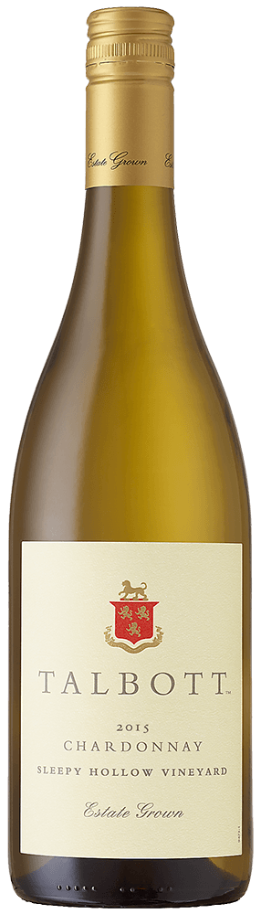
Notable Wineries
Talbott Vineyards (Santa Lucia Highlands)
Talbott Vineyards is a true Monterey legend. Established by Robert Talbott, this winery focuses on estate-grown Chardonnay and Pinot Noir from its Sleepy Hollow Vineyard.
The Sleepy Hollow Chardonnay is a standout, regularly earning awards and accolades for its lush texture and flavors of ripe apple, pear, and a hint of vanilla.
Talbott’s Pinot Noir also captures the essence of the Santa Lucia Highlands with its silky tannins and bright red fruit.
The winery’s reputation for excellence has made it a favorite among collectors and critics alike.

Slide 31
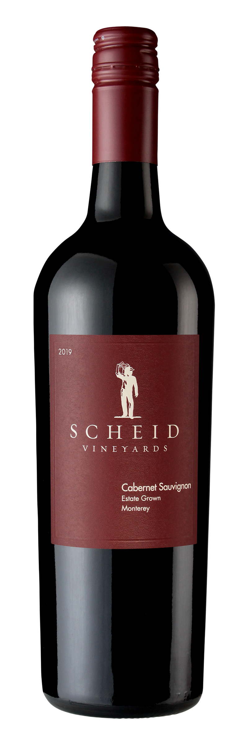
Notable Wineries
Scheid Vineyards (San Bernabe and Beyond)
Scheid Vineyards operates one of the most extensive vineyard estates in Monterey, encompassing over 4,000 acres across several AVAs.
Known for their innovative practices, Scheid is committed to sustainability, with much of their energy coming from their own wind turbine.
Their flagship wines, like the Reserve Cabernet Sauvignon and the Estate Pinot Noir, have won gold medals at competitions such as the San Francisco Chronicle Wine Competition.
Visitors to their tasting room in Carmel can explore a wide range of varietals and styles, all reflecting the diversity of Monterey’s terroir.

Slide 32
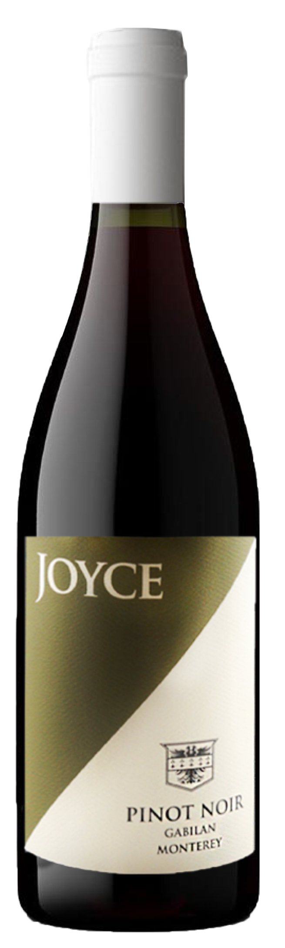
Notable Wineries
Joyce Wine Company (Carmel Valley)
The Joyce Wine Company has quickly risen as a standout in Monterey’s wine scene.
Focusing on site-driven wines with minimal intervention, Joyce has built a reputation for crafting Pinot Noir and Chardonnay with incredible purity and depth.
Their Tondré Grapefield Pinot Noir, sourced from the Santa Lucia Highlands, has earned multiple 90+ point scores for its layered red fruit, spice, and floral notes.
Their Sea Otter Chardonnay, named after the region’s beloved marine residents, is bright, refreshing, and elegantly balanced.
Joyce Wine Company’s modern approach and growing accolades make it a rising star worth watching.

Slide 33


Monterey, California’s Wine Culture
Wine is more than a product in Monterey; it’s a way of life.
Annual events like the Monterey Wine Festival and Harvest Celebration bring locals and visitors together to toast the region’s achievements.
Wine also plays a pivotal role in local cuisine, enhancing the region’s vibrant food culture.

Slide 34
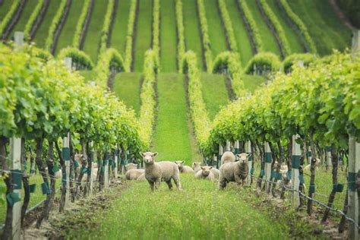

Sustainable Winemaking Practices
Organic and Biodynamic Viticulture
Many Monterey vineyards are adopting organic and biodynamic practices to preserve the environment and enhance wine quality.
Environmental Initiatives
From water conservation to renewable energy, Monterey’s wineries are leading the way in sustainable winemaking.

Slide 35
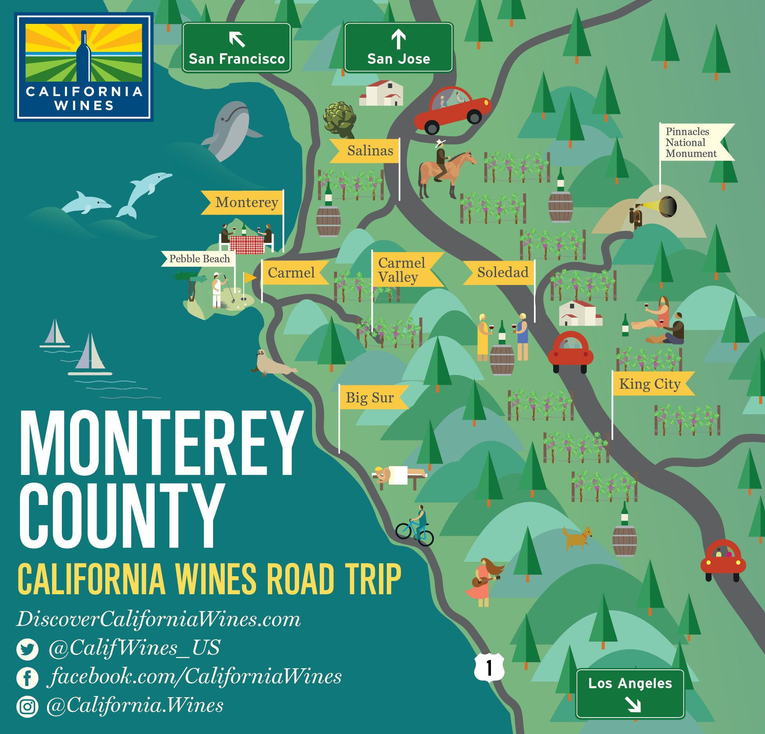
Final Thoughts
Monterey, California, is a testament to the creativity and resilience of American winemaking.
With its rich history, diverse terroir, and commitment to sustainability, it offers wines that are both world-class and uniquely Californian.
Whether you’re exploring its AVAs or savoring a glass at home, Monterey’s wines invite you to experience the magic of the Central Coast.

Slide 36
Acknowledgement
My seminars are the result of many years of experience combined with many hours of research over the internet.
I would like to acknowledge the many source I have accessed.
These include Wine Spectator, Wine Enthusiast, BKWine Magazine, Wine & Spirits Magazine, American Vineyard Magazine, The Grapevine Magazine, Wikipedia.com, Britannica.com, and the
various Government websites.

Slide 37
Citations and References
Monterey County Vintners & Growers Association
Wine Enthusiast Magazine
California Wine Institute
Scholarly articles on Monterey AVAs

