Slide 1
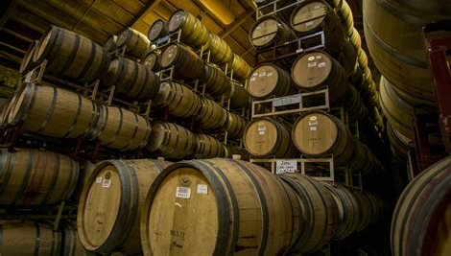
Montenegro’s Wine
Presented by:
Marc Silver

Slide 2

Montenegro’s Wine History
From Ancient Roots to Modern Revival
Montenegro, a small yet richly diverse country along the Adriatic, boasts a long history of winemaking, dating back to the Illyrians and Romans.
These ancient cultures first recognized the land’s potential for viticulture due to its favorable climate and fertile soils. During the Roman Empire, viticulture flourished, spreading across the regions of modern-day Montenegro.
By the Middle Ages, local monasteries continued to nurture this tradition, using wine for religious and medicinal purposes.

Slide 3
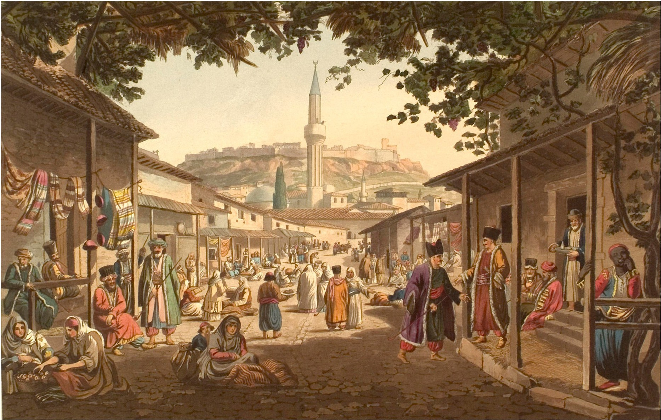
Montenegro’s Wine History
From Ancient Roots to Modern Revival
However, Montenegro's winemaking took a significant hit during the Ottoman occupation, when the production and consumption of alcohol were discouraged. Despite this, many Montenegrin families continued to produce wine in secret, ensuring that ancient techniques and grape varieties were preserved for future generations.
The revival of winemaking in Montenegro began in the late 19th and early 20th centuries, but it wasn’t until the country gained independence in 2006 that Montenegro began investing in its wine industry in earnest.
Today, the country is recognized for its unique blend of indigenous and international grape varieties, with wine tourism on the rise, drawing enthusiasts from around the world.

Slide 4
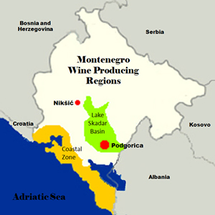
Montenegro’s Wine Regions
Montenegro’s wine regions are concentrated mainly in two key areas: the Lake Skadar region and the Coastal region, each offering distinct terroirs and microclimates that shape the wine production.
Lake Skadar Wine Region
Located in southern Montenegro, the Lake Skadar region is the heart of the country’s wine production. This area boasts a Mediterranean climate with hot summers, mild winters, and abundant sunshine, making it ideal for grape cultivation.
The proximity to Lake Skadar creates a unique microclimate, with cool breezes from the lake helping to balance the summer heat.

Slide 5
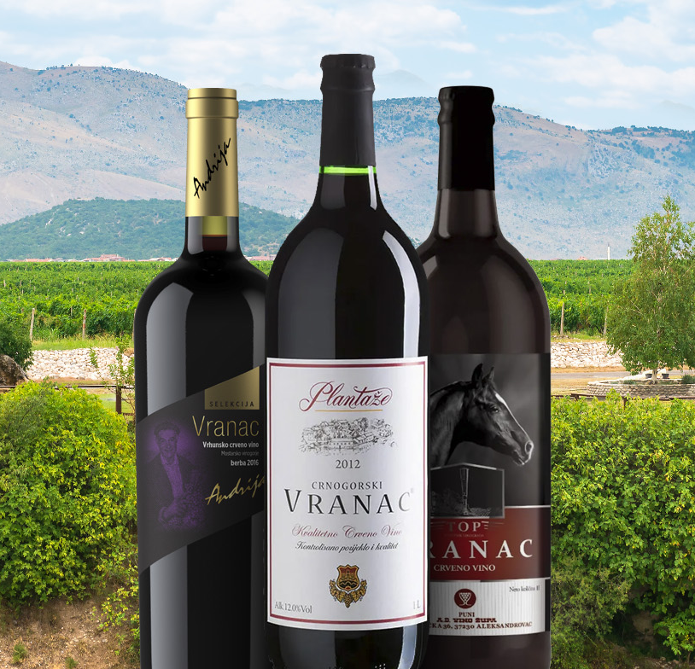
Montenegro’s Wine Regions
Lake Skadar Wine Region
The soil in this region is diverse, ranging from limestone to clay, contributing to the complexity of the wines produced here.
The most notable grape from this region is Vranac, Montenegro’s flagship red grape variety. Vranac produces deep, full-bodied wines with bold tannins and flavors of dark cherry, blackberry, and plum, often complemented by earthy undertones and a hint of spice.
This wine pairs wonderfully with hearty dishes such as lamb, beef stew, and aged cheeses.

Slide 6
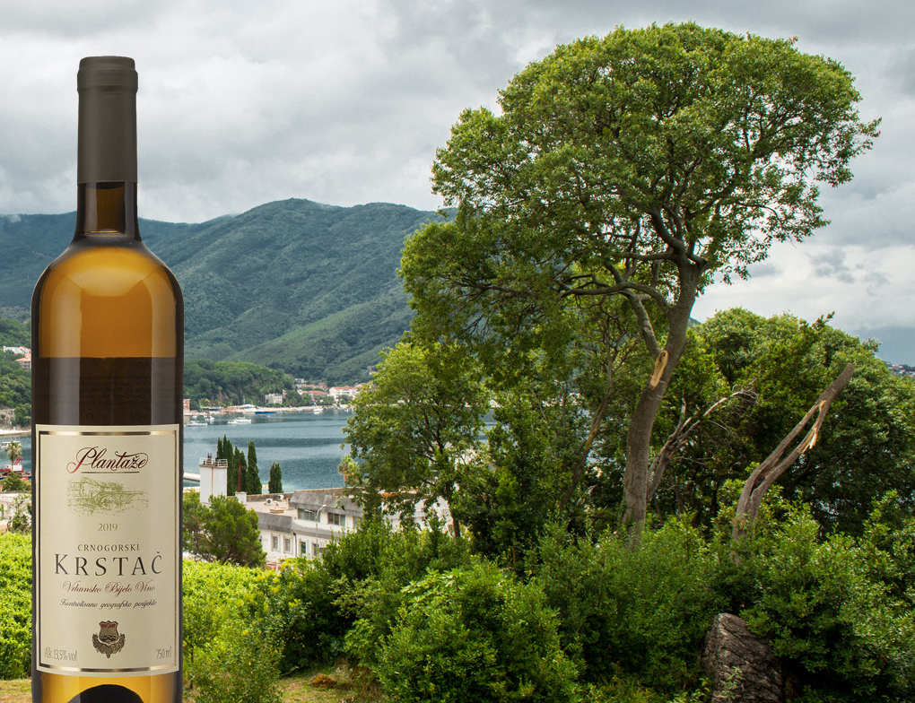
Lake Skadar Prominent Varietals
Varietals
Another significant varietal from this region is Krstač, a white grape that produces crisp, aromatic wines with delicate floral notes and refreshing acidity.
These wines are excellent companions to seafood dishes, grilled chicken, and Mediterranean salads.

Slide 7
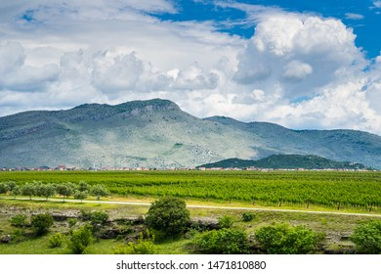
Montenegro’s Unique Terroir
What Sets It Apart?
Montenegro’s terroir is distinct due to its geographic diversity. The country's landscape is characterized by high mountain ranges, deep valleys, and coastal plains, all within a relatively small area.
The Adriatic Sea and Lake Skadar play crucial roles in moderating the climate, ensuring that the vines receive ample sunlight while being protected from extreme heat.
The soils in Montenegro are equally diverse, with regions rich in limestone, which imparts minerality and complexity to the wines.
The combination of warm Mediterranean climate, cooling influences from the water, and varied soil types allows for a wide range of grape varieties to thrive.

Slide 8
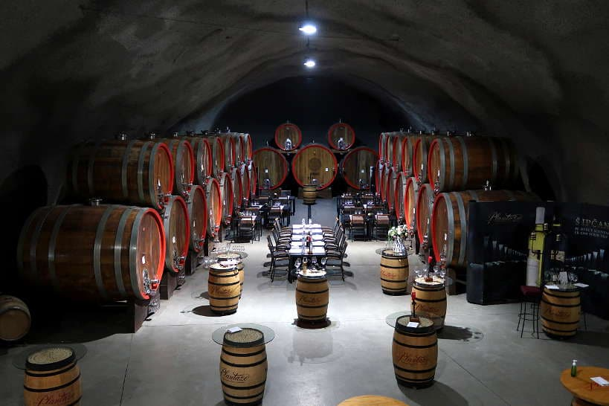
Notable Wineries in Montenegro
Plantaze
The most significant and well-known winery in
Montenegro is Plantaze. Located in the
Podgorica area, near Lake Skadar, Plantaze
operates one of the largest vineyards in Europe,
covering over 2,300 hectares.
Known for its production of Vranac, Plantaze
also produces a range of international varieties
like Chardonnay, Merlot, and Cabernet Sauvignon. The winery is celebrated for its sustainable practices and commitment to quality, with wines like Vranac Pro Corde gaining international acclaim for their rich, full-bodied character and aging potential.

Slide 9

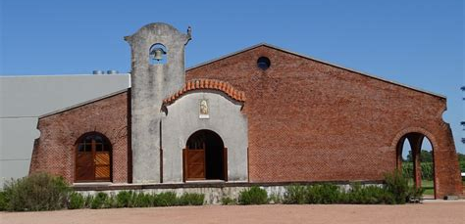
Notable Wineries in Montenegro
Notable Wineries
Bodega Garzón: One of Uruguay’s most prestigious wineries, known for its modern approach to Tannat and its stunning vineyard landscapes.
Bouza Bodega Boutique: A family-owned winery producing high-quality Tannat alongside other varietals like Albariño.

Slide 10
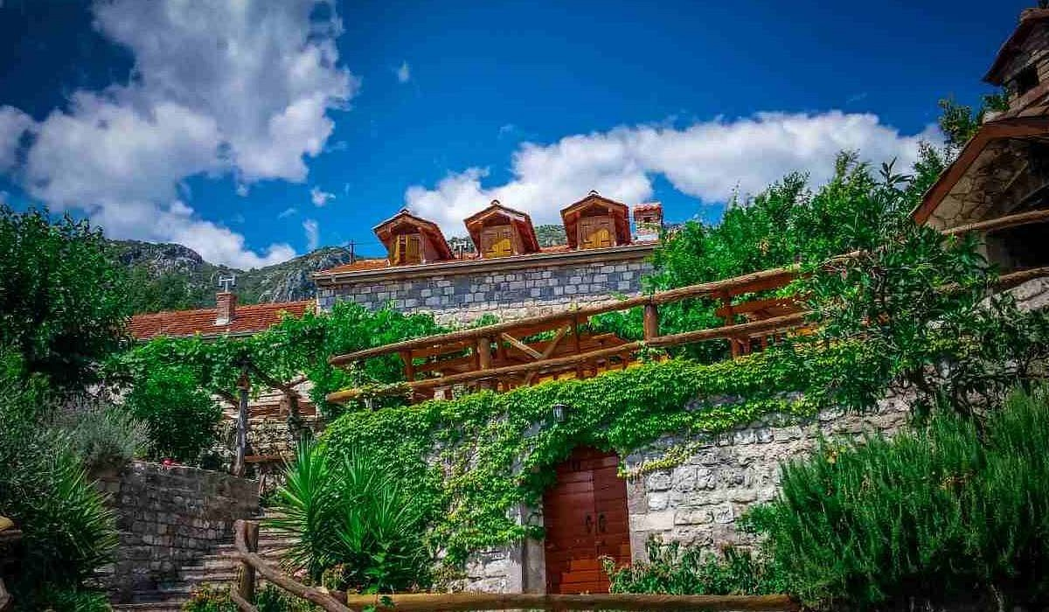
Notable Wineries in Montenegro
Lipovac Winery
Situated near Lake Skadar, Lipovac Winery is known for its boutique approach, producing small batches of handcrafted wines.
The winery focuses primarily on Vranac but also experiments with lesser-known local varieties, offering a unique experience for wine
enthusiasts interested in discovering rare
Montenegrin grapes.
Lipovac’s wines are known for their depth,
complexity, and strong connection to the terroir,
making them ideal for pairing with local cuisine
such as grilled meats and smoked fish.

Slide 11
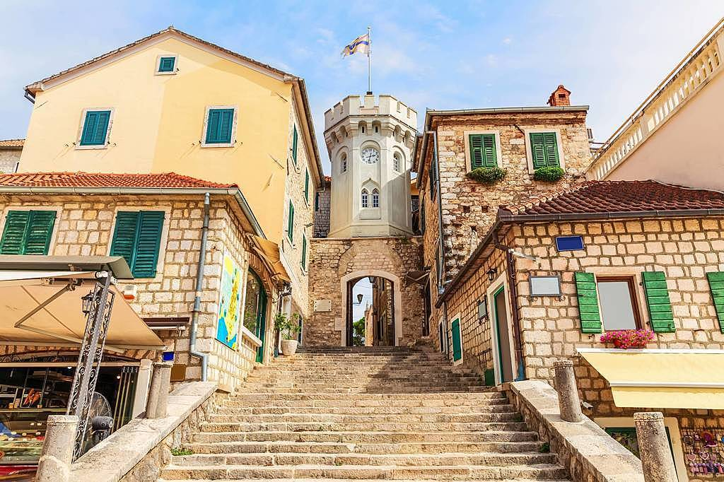
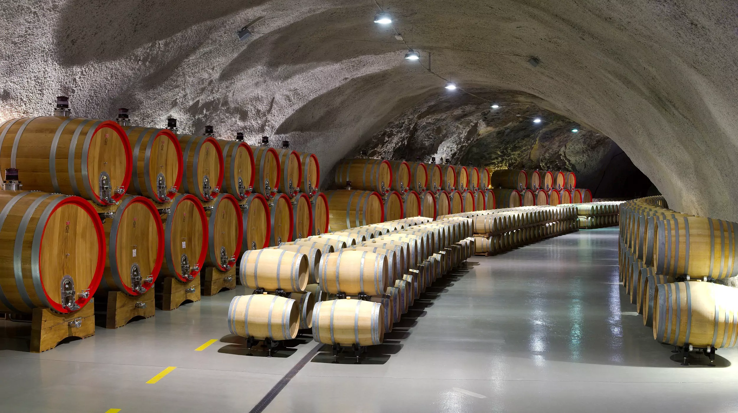
Notable Wineries in Montenegro
Castel Savina
Located on the Luštica Peninsula, overlooking the Bay of Kotor, Castel Savina is a family-run estate that combines winemaking with breathtaking views of the Adriatic.
The winery specializes in producing high-quality Cabernet Sauvignon and Rosé, with an emphasis on organic farming practices. Castel Savina’s wines are elegant, with bright acidity and flavors of red berries and herbs, making them perfect for
pairing with Mediterranean cuisine like seafood and
fresh salads.

Slide 12
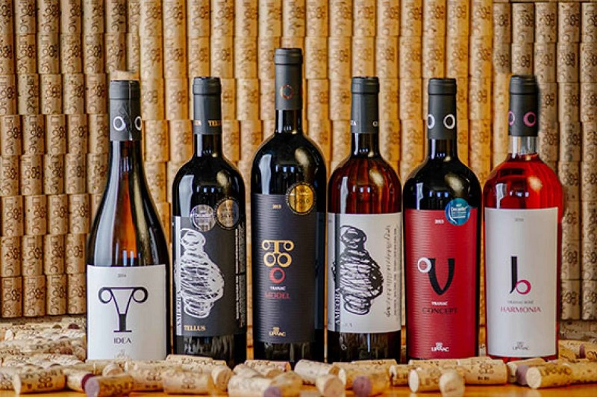
Exploring Montenegro’s Wine Culture
Montenegro’s wine industry is a reflection of the country’s rich history and diverse landscapes. From the robust, powerful Vranac wines of Lake Skadar to the elegant, mineral-driven wines of the Coastal region, Montenegro offers a wide range of experiences for wine lovers.
Whether visiting large producers like
Plantaze or exploring boutique wineries
like Lipovac and Castel Savina,
Montenegro provides a unique
opportunity to discover wines that are
deeply connected to their terroir.

Slide 13

Exploring Montenegro’s Wine Culture
For wine enthusiasts, a trip to Montenegro is not just about tasting excellent wines; it’s about experiencing the passion, history, and culture that make each glass special.
The country’s blend of indigenous and international grape varieties, combined with its stunning landscapes and welcoming wine producers, ensures that Montenegro will continue to grow as a prominent player in the world of wine.

Slide 14
Acknowledgement
My seminars are the result of many years of experience combined with many hours of research over the internet.
I would like to acknowledge the many source I have accessed.
These include Wine Spectator, Wine Enthusiast, BKWine Magazine, Wine & Spirits Magazine, American Vineyard Magazine, The Grapevine Magazine, Wikipedia.com, Britannica.com, and the
various Government websites.

Slide 15
References
"Exploring the Historical Wine Regions of Montenegro," All Wines of Europe.
"Top Wine Regions to Visit in Montenegro 2024," WineTourism.com.
"Wine Tasting in Montenegro: A Journey through Vineyards," EuropaAdventure.
Wines of Montenegro - This source provides an overview of the wine industry in Montenegro, highlighting key grape varieties, wine regions, and significant wineries. It discusses the historical context of wine production and the recent developments in the industry. You can explore more at Wines of Montenegro.
Montenegro’s Wine Regions: A Deep Dive - This article details the different wine regions of Montenegro, their unique terroirs, and the types of grapes that thrive in each area. It emphasizes the impact of the Adriatic climate on wine production. For more insights, check out Montenegro’s Wine Regions.
Vranac: The Pride of Montenegrin Wine - This piece focuses specifically on Vranac, the indigenous grape variety of Montenegro, discussing its characteristics, flavor profiles, and food pairings. It offers tasting notes and insights into why Vranac is so emblematic of Montenegrin winemaking. Find more at Montenegro Vranac Wine.
Wine Enthusiast: Montenegro’s Rising Star - An article from Wine Enthusiast that highlights Montenegro's emergence on the global wine stage, discussing various wineries and their approaches to wine production. It covers the importance of local grape varieties and innovative winemaking techniques. Read the full article at Wine Enthusiast.
Wine-Searcher: Understanding Montenegro’s Wine Landscape

Slide 16
Referances
"Exploring the Historical Wine Regions of Montenegro," All Wines of Europe.
"Top Wine Regions to Visit in Montenegro 2024," WineTourism.com.
"Wine Tasting in Montenegro: A Journey through Vineyards," EuropaAdventure.
• Wines of Montenegro - This source provides an overview of the wine industry in Montenegro, highlighting key grape varieties, wine regions, and significant wineries. It discusses the historical context of wine production and the recent developments in the industry. You can explore more at Wines of Montenegro.
• Montenegro’s Wine Regions: A Deep Dive - This article details the different wine regions of Montenegro, their unique terroirs, and the types of grapes that thrive in each area. It emphasizes the impact of the Adriatic climate on wine production. For more insights, check out Montenegro’s Wine Regions.
• Vranac: The Pride of Montenegrin Wine - This piece focuses specifically on Vranac, the indigenous grape variety of Montenegro, discussing its characteristics, flavor profiles, and food pairings. It offers tasting notes and insights into why Vranac is so emblematic of Montenegrin winemaking. Find more at Montenegro Vranac Wine.
• Wine Enthusiast: Montenegro’s Rising Star - An article from Wine Enthusiast that highlights Montenegro's emergence on the global wine stage, discussing various wineries and their approaches to wine production. It covers the importance of local grape varieties and innovative winemaking techniques. Read the full article at Wine Enthusiast.
• Wine-Searcher: Understanding Montenegro’s Wine Landscape - This resource offers a comprehensive overview of the country's wine scene, including historical context, current trends, and notable producers. It provides insights into wine tourism in Montenegro as well. For further information, visit Wine-Searcher Montenegro.

