Slide 1
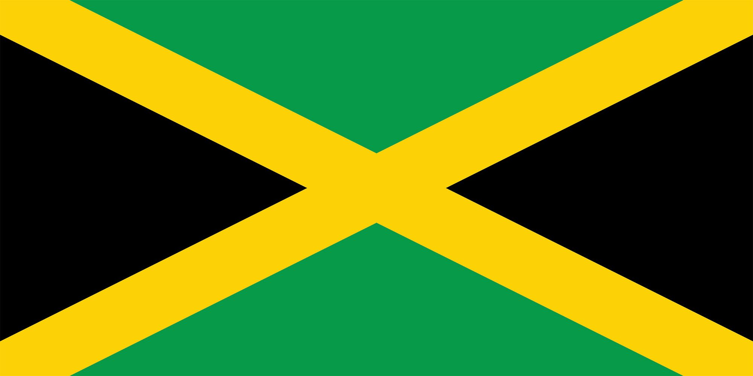
Montego Bay
Jamaica
Presented by
Marc Silver

Slide 2
What I Will Cover
My Port Philosophy
Don’t Miss the Ship
Money
About Montego Bay, Jamaica
Area Map of Jamaica
Map of Montego Bay
Montego Bay Transportation
Places to see or at least consider
A few restaurant recommendations
Conclusion

Slide 3
My Port Philosophy
I have been cruising for over 45 years and have taken over 100 cruises.
So, I consider myself an experienced cruiser.
The information I will present is based on those many years of
experience.
When I am on a cruise where the city, I want to visit is not the port city,
I always recommend taking a ship’s tour.
But when I am in a port with multiple attractions nearby and easy to see
on my own - I will do it on my own.
This presentation is for that type of port.

Slide 4

Don’t Miss the Ship
How to Avoid Missing Your Ship
Pay attention to the time. - Ship time and local time are often
different.
Put a return-to-ship reminder on your phone.
Choose excursions wisely.
If a ship-sponsored excursion is late returning to port, the ship will
wait for you. If you are on your own???
Be Prepared
Have your Passport, Credit Card, and phone numbers for your ship
port agent.
What to Do If You Miss the Ship
Most cruise lines have port agents stationed in the port area to assist if your ship has left without you. If your are lucky, when cruisers are late returning to the vessel, the ship’s crew will often remove the passengers’ essential items – passports, cell phones, and medication -- from the ship to leave with the port agents.
The Port Officials can help you with contacting your ship
and making necessary travel arrangements.

Slide 5
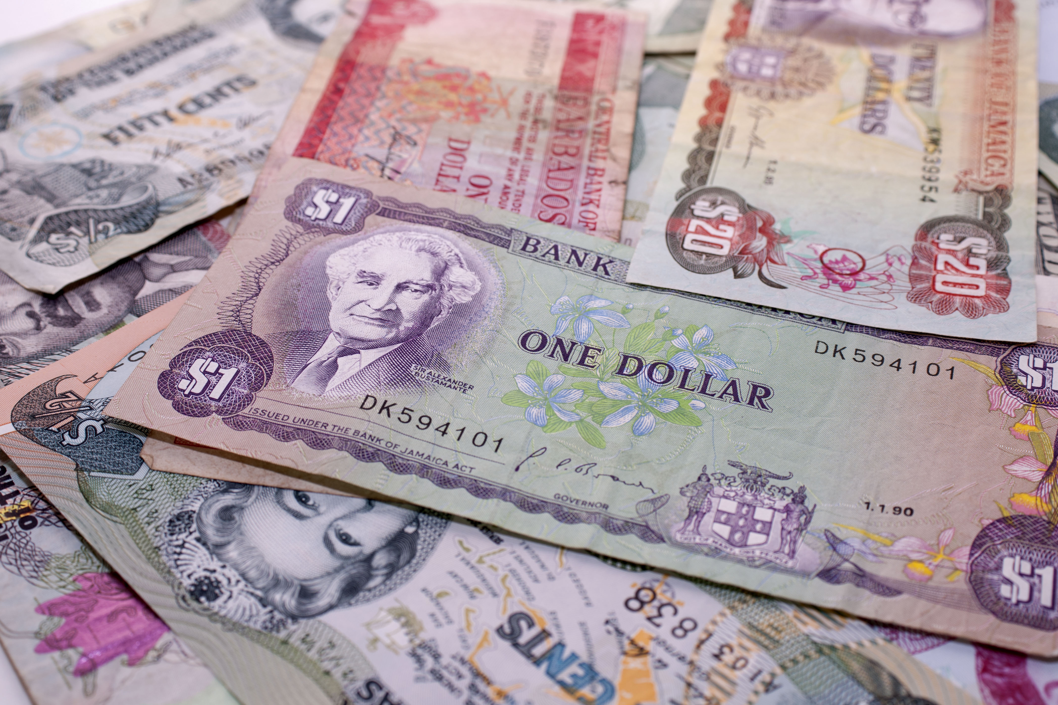
Money
The Jamaican Dollar is the official currency of Jamaica
The official Exchange is 155.06 Jamaican Dollars for $1 US Dollar.
The Jamaican Dollar symbol is JMD

Slide 6
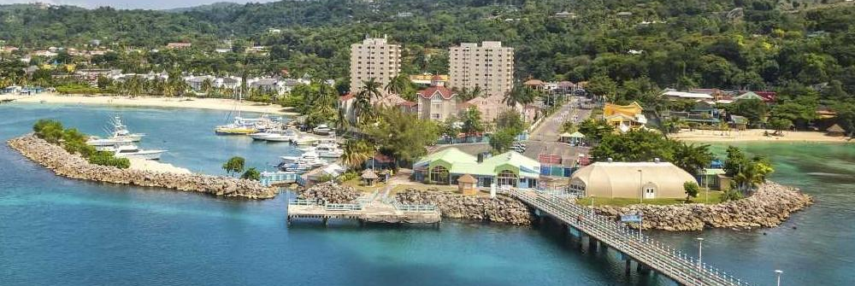
About Montego Bay
Montego Bay is the capital of the parish of St. James in Jamaica.
The city is the fourth-largest urban area in the country by population, after Kingston, Spanish Town, and Portmore, all of which form the Greater Kingston Metropolitan Area, home to over half a million people. As a result, Montego Bay is the second-largest anglophone city in the Caribbean, after Kingston.

Slide 7
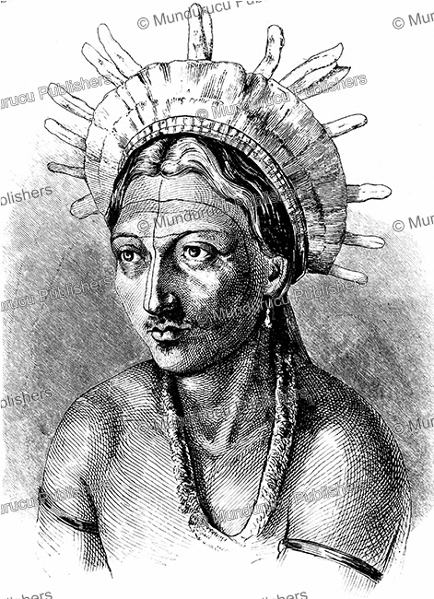
Jamaican Natives
The Caribbean Island of Jamaica was initially inhabited in approximately 600 AD or 650 AD by the Redware people, often associated with redware pottery, By roughly 800 AD, a second wave of inhabitance occurred by the Arawak tribes, including the Tainos, before the arrival of Columbus in 1494.
Early inhabitants of Jamaica named the land "Xaymaca", meaning "land of wood and water". The Spanish enslaved the Arawak, who were ravaged further by diseases that the Spanish brought with them. Early historians believe that by 1602, the Arawak-speaking Taino tribes were extinct.
However, some of the Taino escaped into the forested mountains of the interior, where they mixed with runaway African slaves, and survived free from first Spanish, and then English, rule.

Slide 8
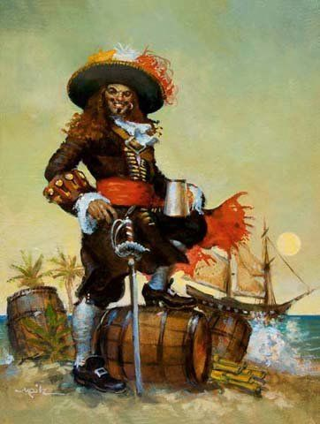
Jamaican Early Settlements
In 1655, the English invaded Jamaica and defeated the Spanish. Some African enslaved people took advantage of the political turmoil and escaped to the island's interior mountains, forming independent communities that became known as the Maroons.
Meanwhile, on the coast, the English built the settlement of Port Royal, a base of operations where piracy flourished as so many European rebels had been rejected from their countries to serve sentences on the seas.
Captain Henry Morgan, a Welsh plantation owner and privateer, raided settlements and shipping bases from Port Royal, earning him his reputation as one of the richest pirates in the Caribbean.

Slide 9
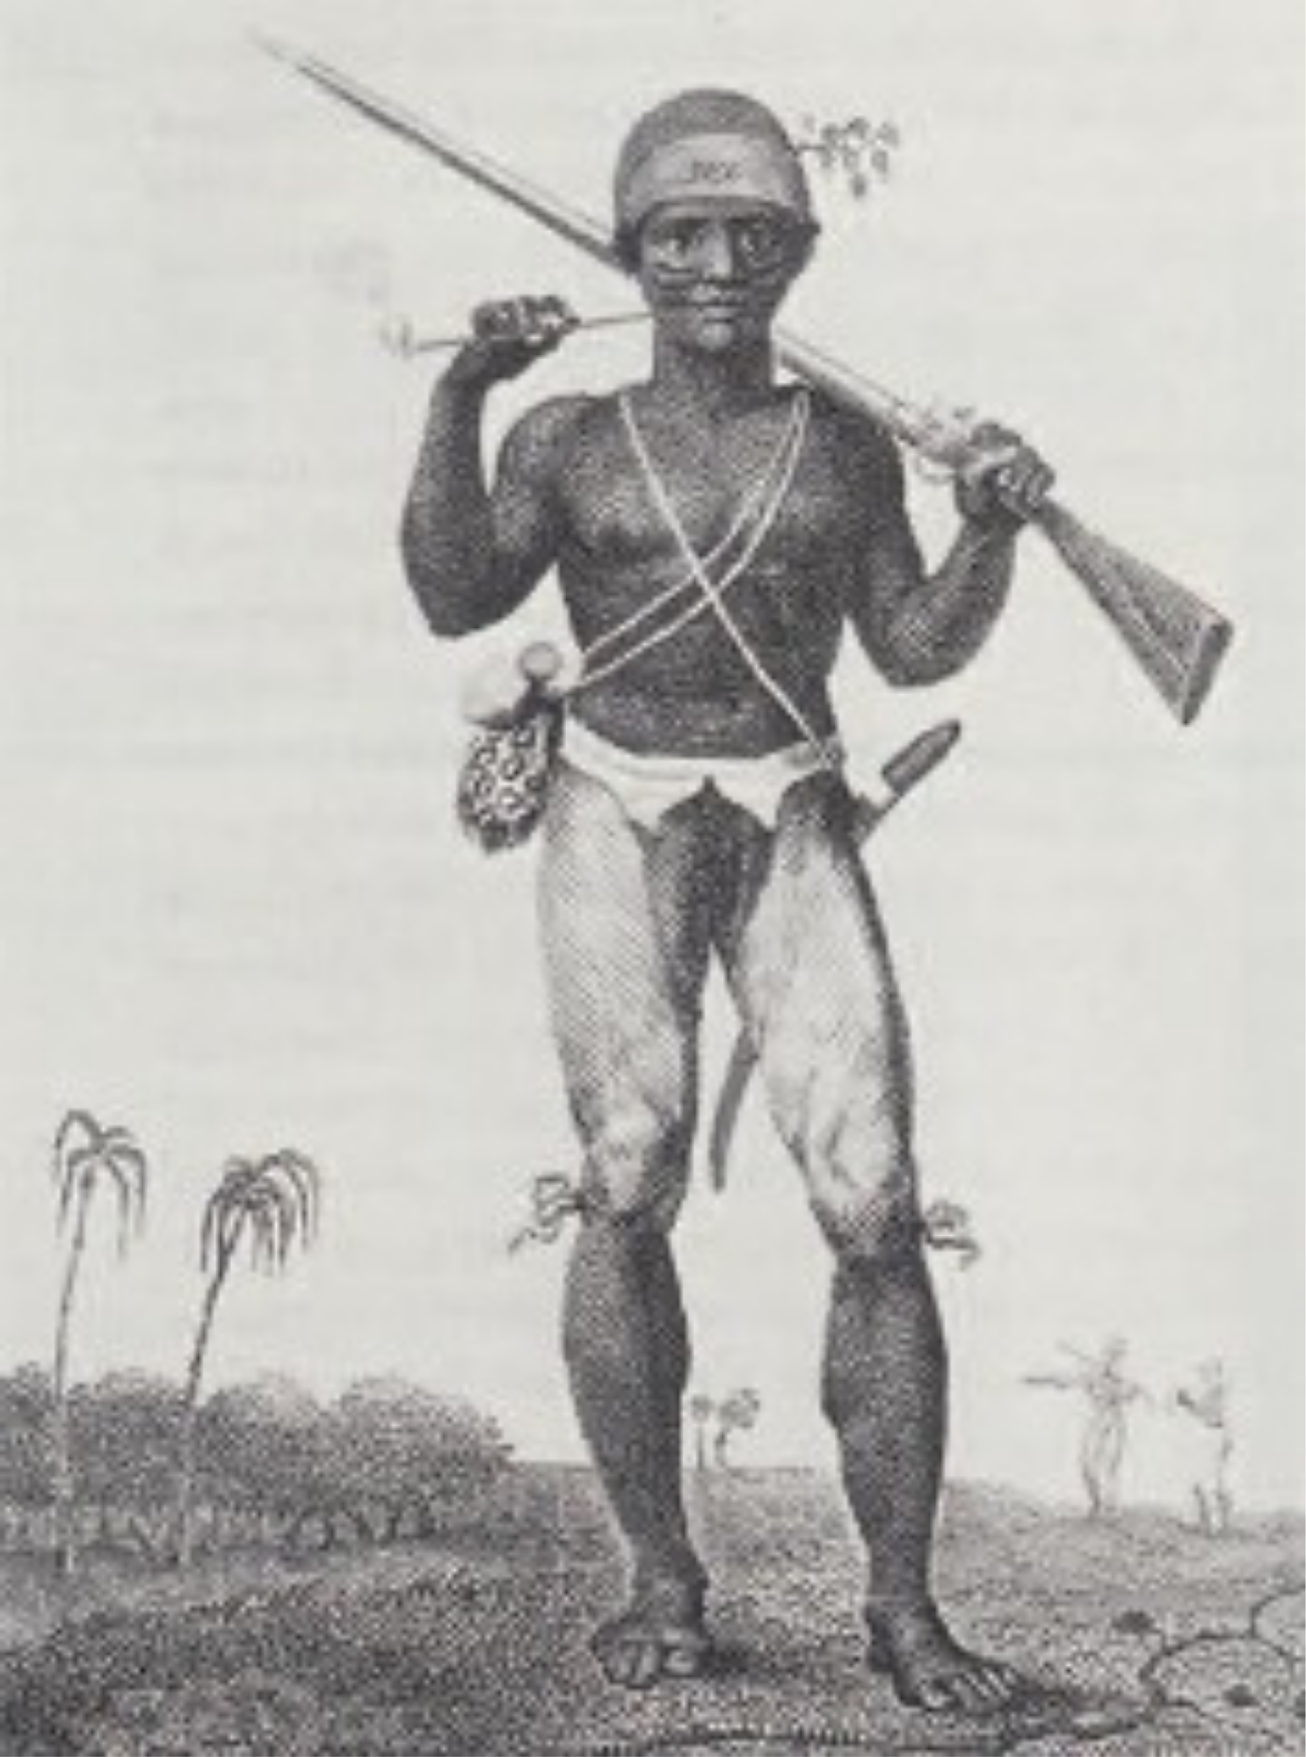
Jamaican Colonization
In the 18th century, sugar cane replaced piracy as British Jamaica's main source of income. The sugar industry was labor-intensive, and the British brought hundreds of thousands of enslaved black Africans to the island. By 1850, the black and mulatto Jamaican population outnumbered the white population by a ratio of twenty to one.
Enslaved Jamaicans mounted over a dozen major uprisings during the 18th century, including Tacky's Revolt in 1760. There were also periodic skirmishes between the British and the mountain communities of the Jamaican Maroons, culminating in the First Maroon War of the 1730s and the Second Maroon War of 1795–1796

Slide 10
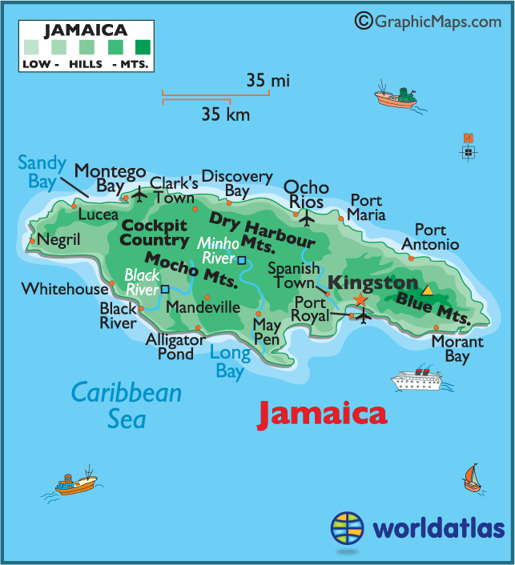
Map of Jamaica

Slide 11
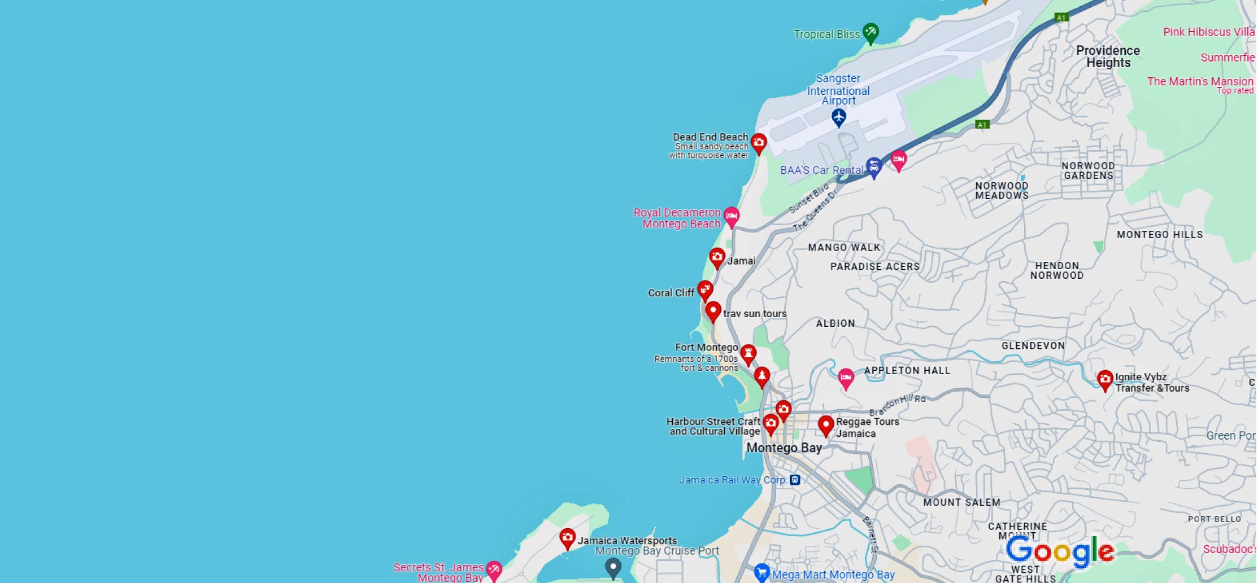
Map of Montego Bay

Slide 12
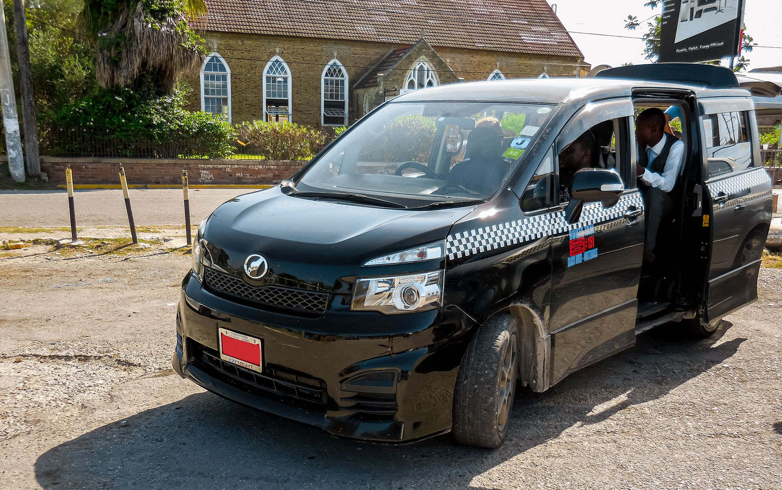
Montego Bay Taxis
Getting around Jamaica by taxi is very easy. Private taxis are provided for visitors to Jamaica, while Route Taxis are designed for locals and operate similarly to buses with specific routes they travel. These drivers are only licensed to drive in a specific area. These taxis can stop anywhere to pick up and drop off passengers and usually carry multiple people at any time.
You can tell a taxi by its Red license Plate. Also, their route will be shown on the side of the taxi.
The prices are set by the government. Typically, $1 or $2 US.
Because the Route Taxis make more money the more people they carry, often they will over pack the car. If the Taxi is packed just wait for another.
Chartered Route Taxi, means you will be the only
passengers but you need to agree to a price before getting
in the taxi. They will then post a Chartered Sign in the
window.
The Mini Route Buses run from city to city. Prices run
between $3 and $6 US depending upon the distance.

Slide 13
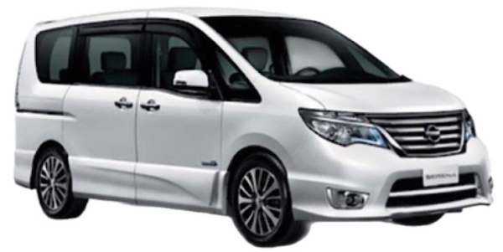
Montego Bay Tourist Taxis
You can Recognize a tourist taxi by its Red license plate, and they will have the name of their company on the front and back of the taxi. All tourist taxis must’ to be less than 5 years old and in good condition. They are also all air-conditioned and insured.
JUTA, are private taxis that primarily due tours for tourists. They are knowledgeable and drive much safer than the Route Taxis. A tour could run $200 US for an all-day tour but realize the taxi expenses could run as high as $150 for fuel, license fees, maintenance, and commission fees.
If you do take a taxi tour, and had a great time, remember to tip your driver.

Slide 14
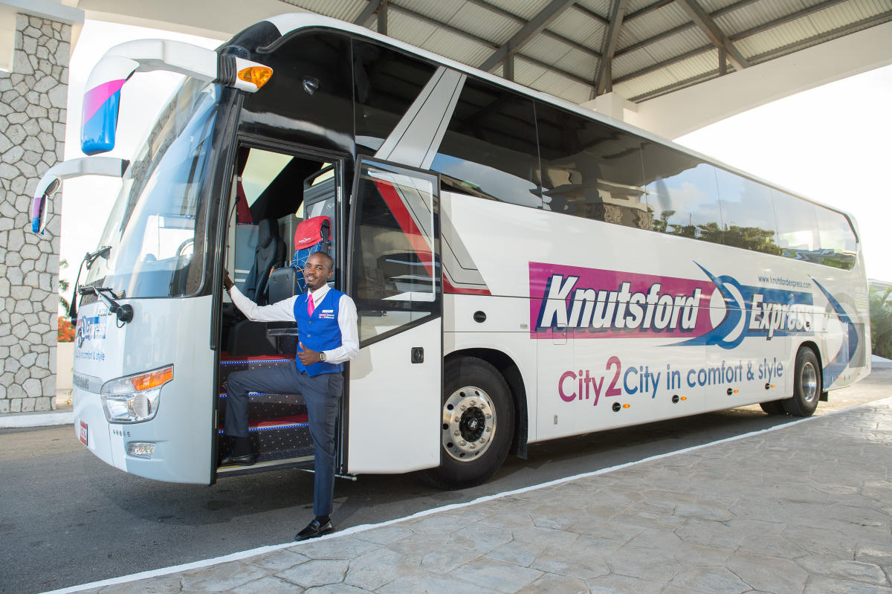
Knutford Express
Knutford Express is a luxury passenger and courier transportation company offering safe, reliable, comfortable, and cost-effective scheduled services.
They offer scheduled services from convenient locations on Jamaica's north and south coasts Passengers can traverse the island to points in Portland, St. Mary, Manchester, Negril, Trelawny and Kingston in spacious, air-conditioned coaches.
Most tickets run $10 to $30 US. Chances are you won’t use this service, but I hope it’s good information.
If you want to travel from Montego Bay to Negril this bus makes sense, otherwise, a Route Taxi is a better choice.

Slide 15
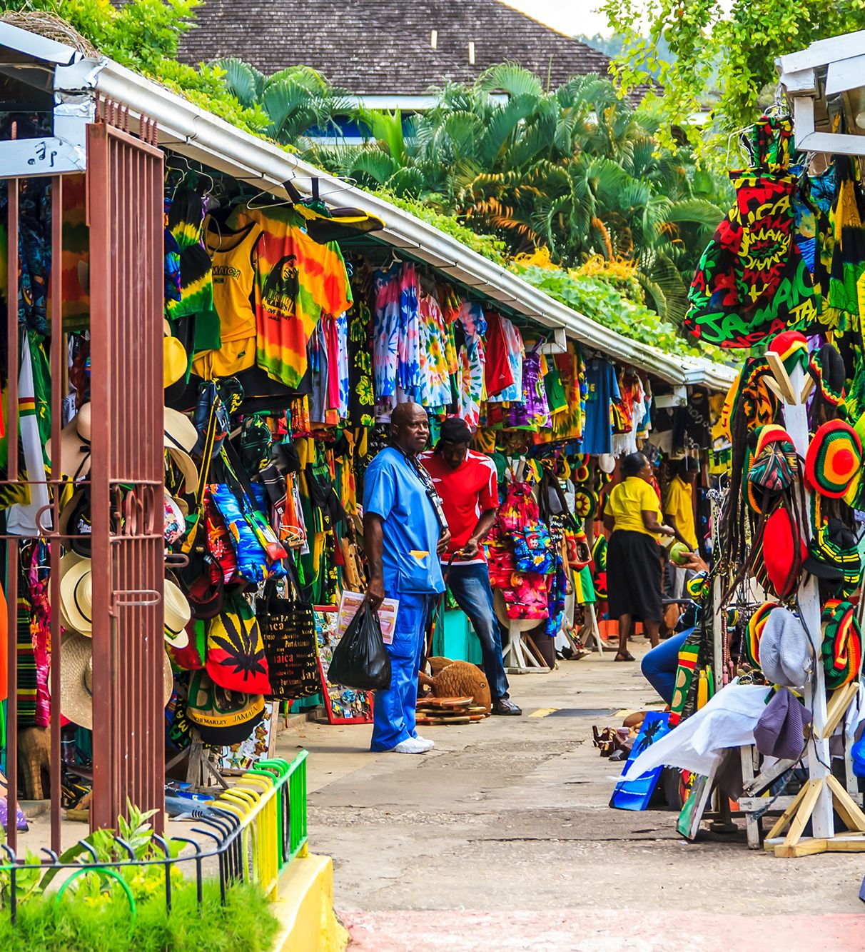
Harbour Street Craft and Cultural Village
Nestled in the heart of Montego Bay, Harbour Street Craft Market is within walking distance of the cruise port and all the city’s main restaurants and activities.
The Craft Village is a great place to find the very best of local creative craft pieces and ethnic jewelry.
Stroll through vibrant stalls and shops that showcase an array of handcrafted goods, from woodcarving to basket weaving, the village provides a platform for skilled craftspeople to showcase their talents and share their cultural heritage with visitors.

Slide 16
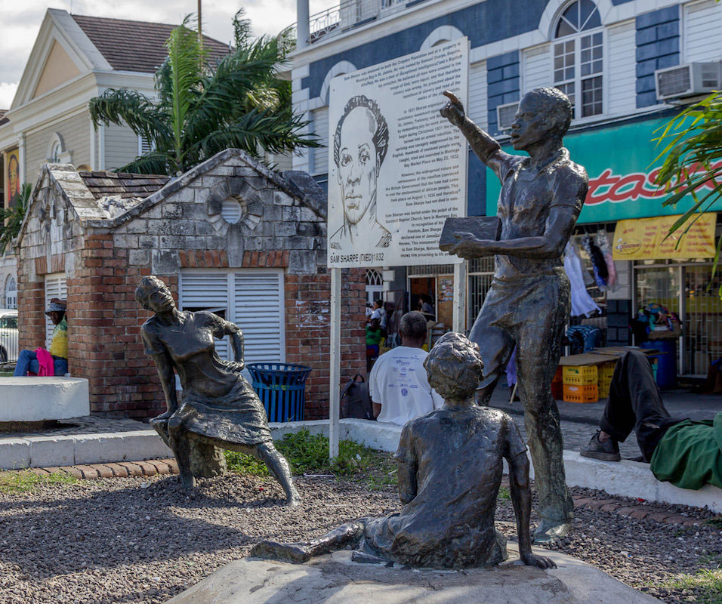
Sam Sharpe Square
The Sam Sharpe Square, located in the center of Downtown Montego Bay, gives visitors a historical snapshot of Jamaica during the 1800s.
It was originally named Charles Square but was later renamed in honor of Sam Sharpe, a Jamaican National hero, and anti-slavery activist.
The main attraction to the area is the monument, commemorating the struggles faced by Sam Sharpe.

Slide 17
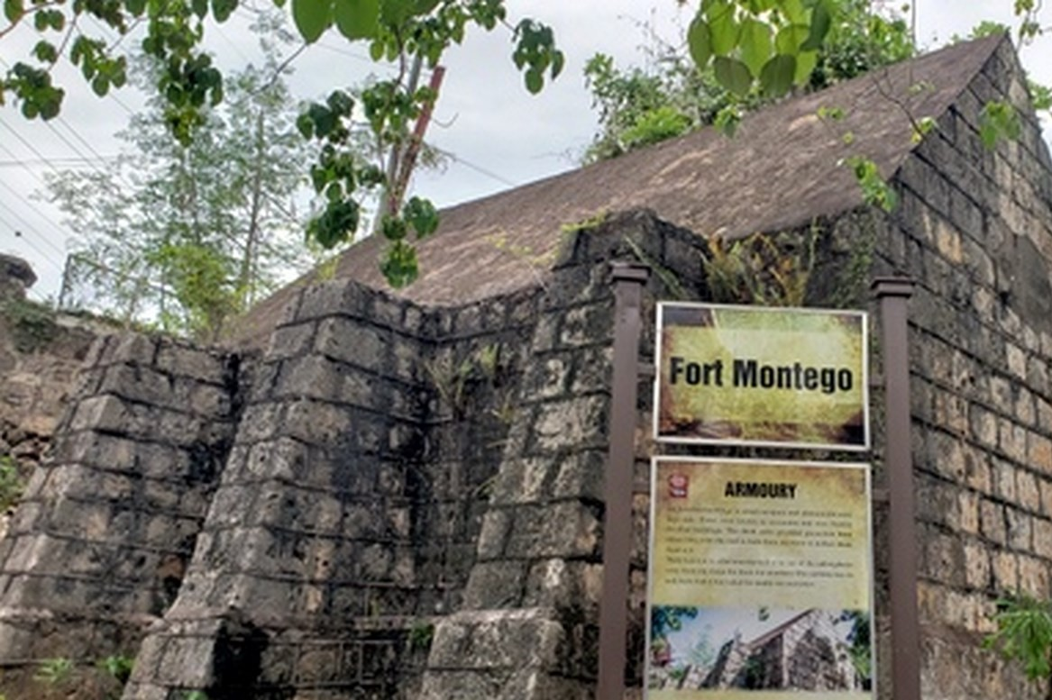
Fort Montego
Built in the early 1700s, Fort Montego is one of many forts built by the British to protect Jamaica’s coastline from Pirates, and the naval forces of the Spanish and French.
Located just a few minutes from the Donald Sangster International Airport, and walking distance from Montego Bay’s hip-strip, the Fort is central and easy to get to.
The fort houses four 12-pound cannons and a few lower caliber guns. It never saw military action but claimed the life of a gunner when
it exploded during the celebration of the fall
of Havana to the British. The cannons and
guns were fired mostly to celebrate the
birthday of British Monarchs, or the visit of
important persons like the governor.
Getting to Fort Montego requires a bit of an
uphill hike, but is not too challenging.
shoes.
There is also a crafts market near by.

Slide 18
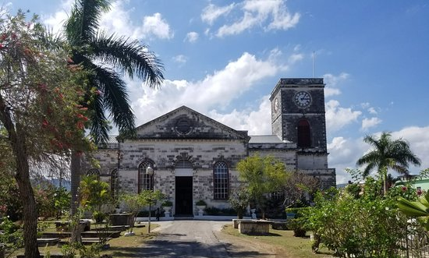
St James Parish Church
The St James Parish Church is located about 3 blocks East of Harbour Street Craft Market.
It was established in 1774 when the town was increasing in importance as a center for trade.
Regarded as the finest church on the island, it was originally built between 1775 and 1782, but was so damaged by the earthquake of March 1, 1957, that it had to be rebuilt.
Note the wonderful stained glass depicting the Crucifixion, and the marble monuments, including works by renowned 18th-century English sculptor John Bacon.

Slide 19
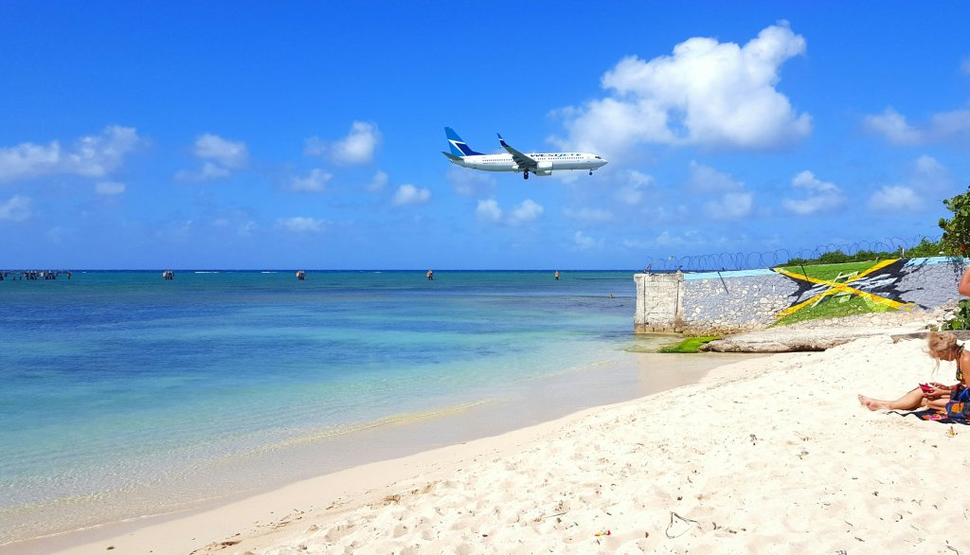
Dead End Beach
Dead-end Beach (sometimes called Buccaneer Beach) is a public beach at the northern end of central Montego Bay.
The beach is located at the end of the airport runway. It is free to access but mostly attracts local visitors.
Tourists tend to use Doctor's Cave, Cornwall Beach or Aquasol which have more facilities. There is a bar opposite the beach with a pool table which is popular with Montego Bay residents.

Slide 20
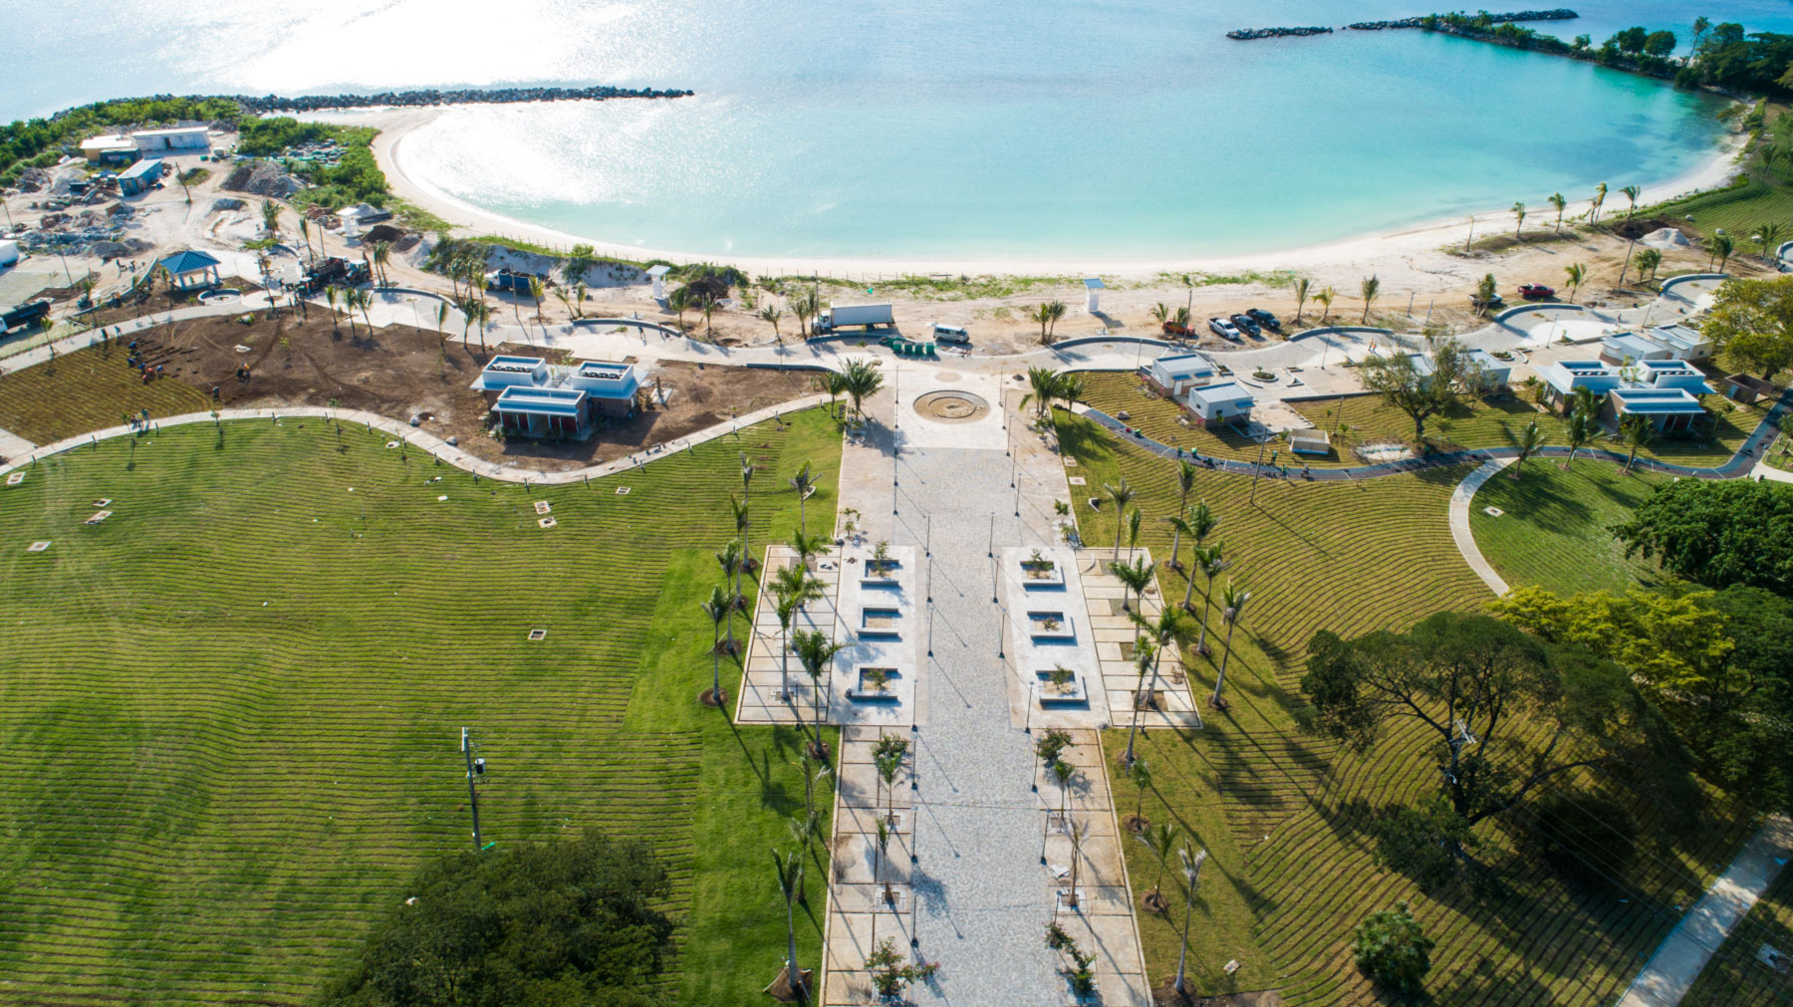
Harmony Beach Park
Harmony Beach Park is located along Howard Cooke Boulevard and approximately seven minutes from the Sangster International Airport. This free, public access Beach Park which spans 16 acres is the recreational focal point for the city of Montego Bay.
The Park is also home to several species of plants that are endemic to Jamaica.
Food services are available as there are restaurants, snack shops, and a picnic area. The facility also has a multipurpose court, and a 600-meter jogging trail, with beautiful trees.
Bathrooms, showers and changing rooms are also available.

Slide 21
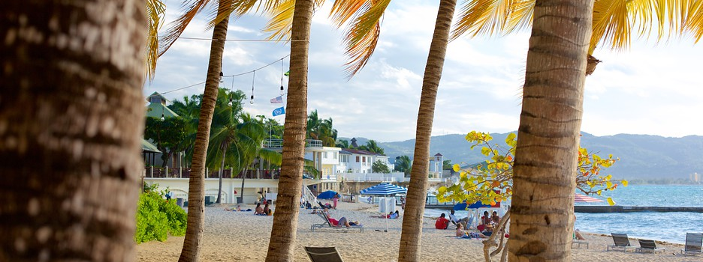
This is Montego Bay’s most famous beach and the one with the most facilities. A pretty arc of sugary sand fronts a deep-blue gem studded with floating dive platforms.
There are lots of facilities on hand, including a restaurant, a grill bar, an internet cafe and water sports, and lots of things to rent (beach chairs, towels, snorkeling gear).
Doctor’s Beach

Slide 22
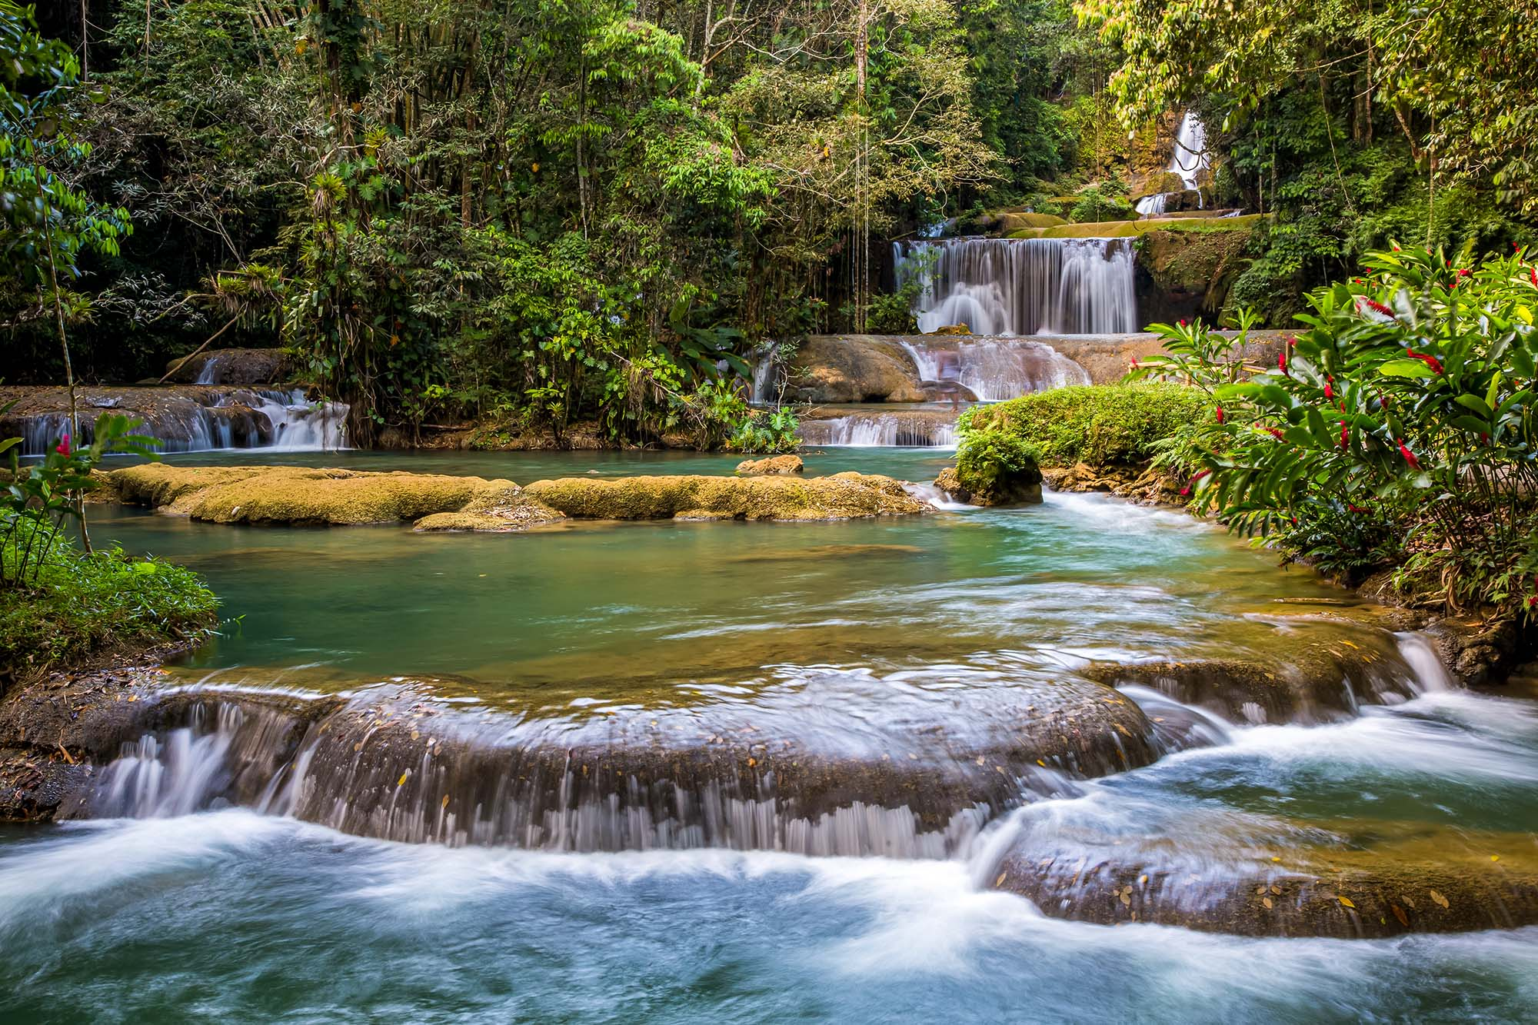
Mayfield Falls & Mineral Springs
Located about 22 miles south-west of Montego Bay, you can spend the whole day in the mountains, see the waterfalls, hike up the river and explore over twenty natural swimming pools, and a Jacuzzi to pamper you.
Come experience Jamaica's #1 eco-tourism attraction - see nature at its best; 52 varieties of ferns, an abundance of exotic flowers and plant species, several types of birds, butterflies, and indigenous wildlife.
Mayfield Falls also has a petting zoo with beautiful peacocks, rabbits, turkeys, ducks, silk birds, doves, sensei fowl, ring-necked pheasants, parrots, sheep, and "Pet" the friendly donkey. There are several private walking trails, bamboo huts on the bank of the river, the wedding gazebo, and lots of wide open spaces - complete with lawn chairs. Ring-

Slide 23
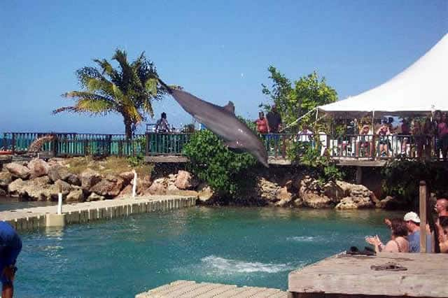
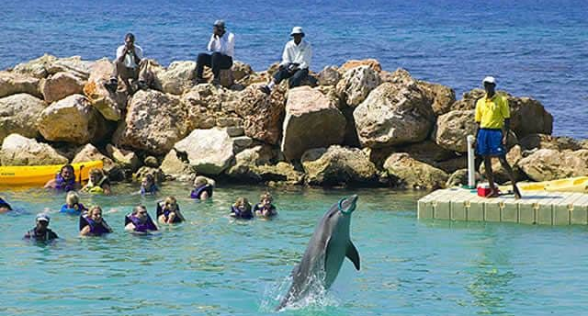
Dolphin Cove Montego Bay
Immerse yourself in the unique experience of swimming with Dolphins in Jamaica.
Dolphin Cove Montego Bay offers the most friendly marine mammal species in Jamaica.
Discover what it feels like to hug and swim with a dolphin and fulfill your dream of swimming with dolphins in their natural habitat!
There are lots to do including Dolphin Encounters, Swim Adventures, and Royal Swim or meeting Sharks. Observe beautiful birds, feed them, and add other activities at Dolphin Cove.

Slide 24
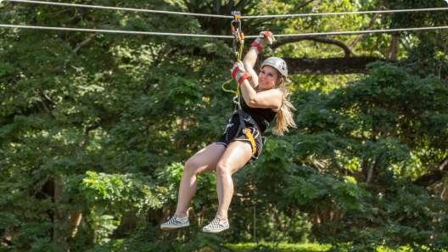
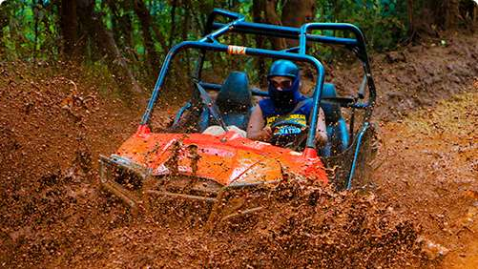
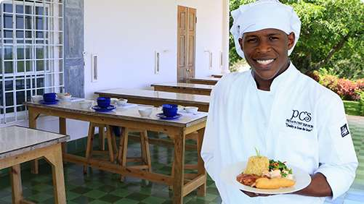
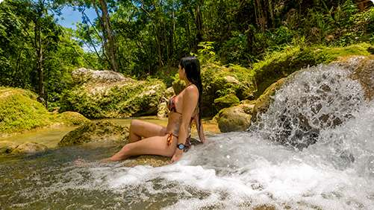
Yaaman Adventure Park
Yaaman promotes themselves as “Friendly Jamaica Cruise Excursions”
Their activities include adrenaline sports, like buggy and ATVS riding, swimming in a Secret Blue Hole, Jamaican Gastronomy on a Cooking tour, and zip lines with impressive views!
Zip lines $59
ATVS riding Jamaican Cooking tour Secret Blue Hole
$109 $69 $49

Slide 25
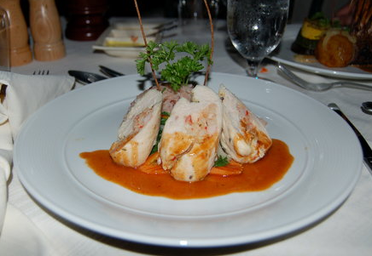
Restaurants
There are a lot of excellent restaurants in Montego Bay. Especially for seafood and Caribbean dishes.
Here are some recommendations:
Restaurants in Montego Bay.:
Sugar Mill $$$$ Caribbean, Jamaican, Vegetarian
Half Moon Resort, Montego Bay
The Houseboat Grill $$ - $$$ Caribbean, Seafood, Jamaican
Southern Cross Blvd, Montego Bay
The Pelican Grill $$ - $$$ Caribbean, Jamaican, Vegetarian
Gloucester Ave Miranda Hill, Across the Street From the Old Hospital Park, Montego Bay
Scotchies $ Caribbean, Barbecue, Jamaican
Falmouth Road, Montego Bay
For those of you who just like good food, you can’t go wrong just about anywhere you go in Montego Bay.
Good Eating

Slide 26
Conclusion
Montego Bay is a beautiful Area with a rich history and seemingly endless attractions.
Regardless of what you're looking for, Montego Bay has something for everyone.
I hope this presentation will help when we visit Montego Bay

Slide 27
Thanks For Coming
If you have any more questions, please ask.
I will do my best to answer them for you.
Have a great visit in Montego Bay !

