Slide 1
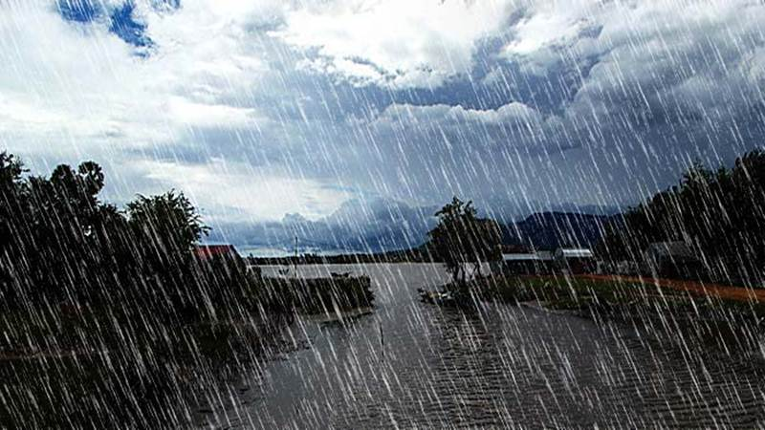
Monsoons in India An In-depth Overview Presented by: Marc Silver

Slide 2
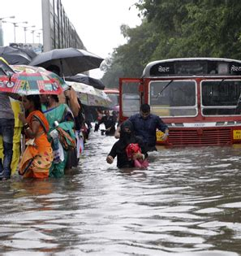
Monsoons in India
The term "monsoon" is derived from the Arabic word “mausim,” which means "season" or "changing winds."
This aptly describes the characteristic of monsoon winds—periodic winds that reverse direction with the changing seasons.
Every six months, there is a complete shift in the wind’s direction, dramatically affecting the climate and agricultural patterns across South Asia.
During summer, winds blow from the sea toward the land, bringing moisture-laden air, whereas in winter, the winds shift from land to sea, carrying dry air away from the subcontinent.

Slide 3

The Two Monsoons: Northeast and Southwest
India experiences two primary monsoon patterns: the southwest monsoon in summer and the northeast monsoon in winter.
The southwest monsoon is the more prominent of the two, arriving in June and lasting until September. It is caused by high-pressure systems over the Tibetan and Siberian plateaus and brings heavy rainfall to most of the country.
In contrast, the northeast monsoon, which occurs between October and December, primarily affects the southeastern coast, including Tamil Nadu and parts of Andhra Pradesh.
Countries such as India, Bangladesh, and Myanmar receive the bulk of their annual rainfall during the southwest monsoon, while parts of Southeast China and Japan are more influenced by the northeast monsoon.

Slide 4
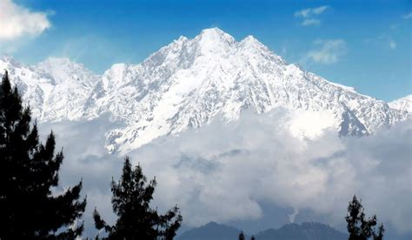
Altitude and the Himalayas
One of the most critical influences on India’s climate is the Himalayan range, which acts as a massive barrier to cold winds from Central Asia.
The towering peaks of the Himalayas, averaging about 6,000 meters in height, prevent these cold air masses from entering the subcontinent, keeping much of India warmer than it would otherwise be during winter months.

Slide 5
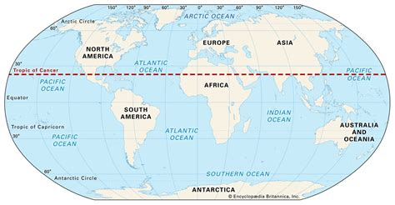
Why Does India Have a Monsoon Climate?
Several geographical and atmospheric factors converge to give India its distinct monsoon-driven climate.
Latitude and Location
The Tropic of Cancer cuts across the middle of India, dividing the nation into two climatic zones: tropical in the south and subtropical in the north.
Regions below the Tropic of Cancer, such as southern India, are warmer and more prone to tropical conditions, while the northern part experiences more temperate weather.

Slide 6
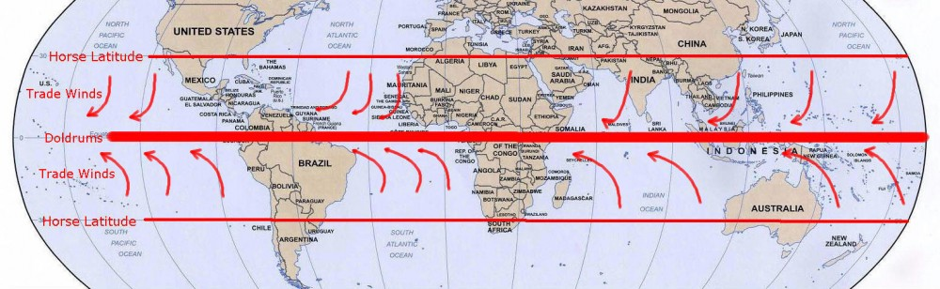
Pressure Systems and Winds
India's climate is heavily influenced by pressure systems and wind patterns.
The north-east trade winds, which blow from land to sea during the winter, carry little moisture and thus provide only minimal rainfall.
In contrast, during summer, the southwest monsoon winds bring abundant moisture from the Indian Ocean, resulting in significant rainfall across most of the country.

Slide 7
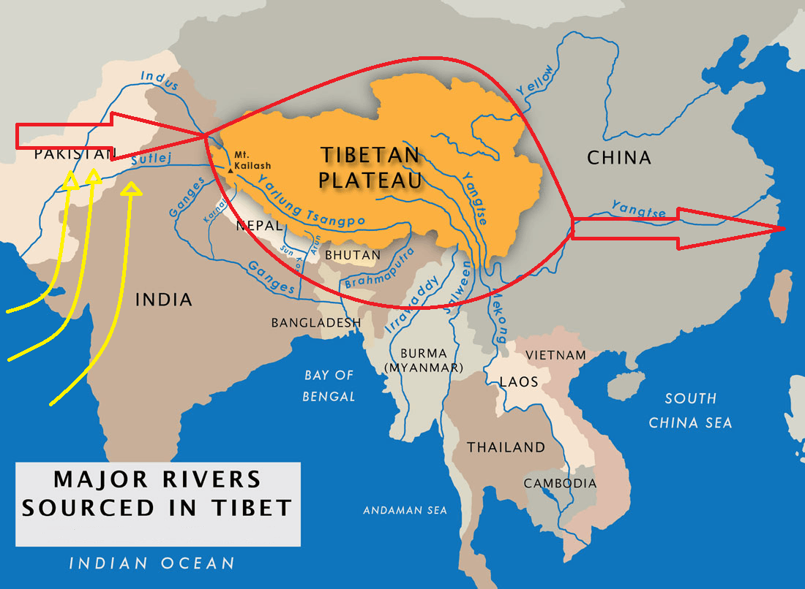
The Role of Jet Streams and Western Cyclonic Disturbances
Upper air circulation also plays a vital role in shaping India's climate. The Subtropical Westerly Jet Stream, which flows at high altitudes, impacts the southwest monsoon by directing winds and atmospheric pressure patterns.
During winter, western cyclonic disturbances originating from the Mediterranean region bring sporadic rain to northern and northwestern India, influencing the winter crop cycle.

Slide 8
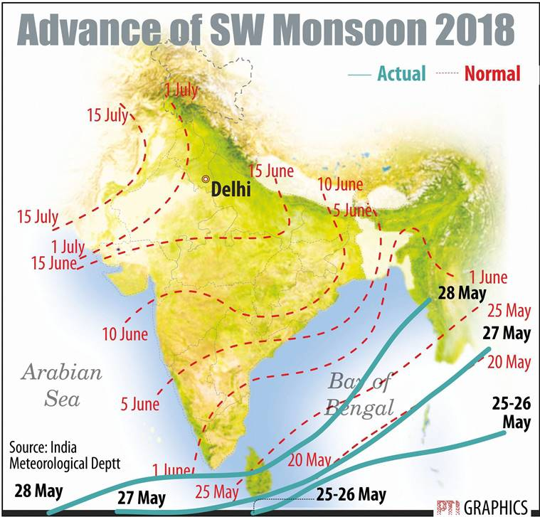
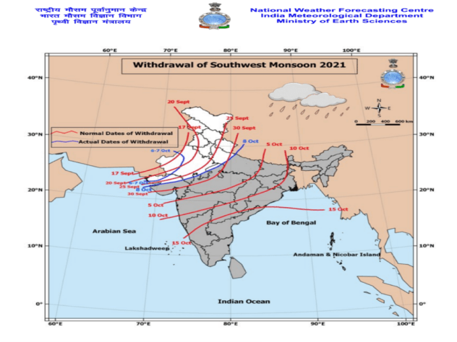
Features of the Indian Monsoon
India’s monsoon season is known for its unpredictability, with some regions experiencing floods while others face drought.
Rainfall can vary dramatically from one location to another, even within relatively short distances.
The Southwest Monsoon (June to September): Most of India’s annual rainfall occurs during this period, with the heaviest precipitation in the windward side of the Western Ghats, parts of the Eastern Himalayas, and northeastern hill ranges. Some areas receive more than 400 cm of rain, while western Rajasthan gets as little as 20 cm.
The Northeast Monsoon (October to December): While this monsoon brings less rain than its counterpart, it is crucial for southeastern India, particularly Tamil Nadu, which receives most of its annual rainfall during this period.

Slide 9
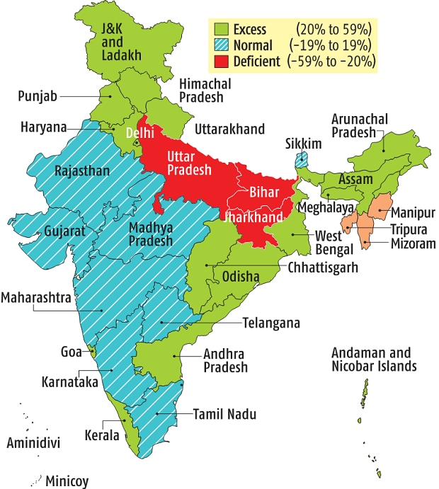
Rainfall Distribution and Its Impact
Rainfall distribution across India is highly uneven. For example, the Western Ghats and northeastern regions can receive over 250 cm of rainfall, while places like Delhi and Rajasthan receive less than 50 cm.
This variability in rainfall influences agriculture, water availability, and overall economic activity in different regions.
The timing and duration of the monsoon are critical. If the rains arrive late or withdraw early, it can negatively affect crop yields, particularly of rice, which relies heavily on monsoon rains.
Similarly, erratic rainfall patterns can lead to floods in some regions and droughts in others, complicating efforts to manage water resources effectively.

Slide 10
Seasons of the Indian Monsoon
India’s climate can be divided both by season and region:
Seasonal Classification:
Northeast Monsoon (Winter): Mid-December to mid-March
Temperature: Cold, with significant regional variations. Northern India, especially the Himalayas, experiences freezing temperatures and snowfall, while southern India remains relatively mild.
Weather: Clear skies, low humidity, and cold winds. Snowfall in northern hill stations.
Cultural Significance: Celebrations include Christmas, New Year, Lohri, Makar Sankranti, and Pongal. Winter sports like skiing are popular in the north
Hot Weather Season: March to May
Temperature: Extremely hot, particularly in northern and central India, with temperatures often exceeding 40°C (104°F).
Weather: Hot and dry conditions with occasional dust storms.
Cultural Significance: Festivals such as Holi, Rath Yatra, and Guru Purnima. Families often travel to cooler hill stations to escape the heat.

Slide 11
Seasons of the Indian Monsoon
India’s climate can be divided both by season and region:
Seasonal Classification:
Rainy Season (Southwest Monsoon): June to September
Temperature: Cooler than summer, averaging around 34°C (93°F).
Weather: Heavy rainfall, particularly in western coastal regions and the northeast. Vital for agriculture.
Cultural Significance: Festivals like Onam, Janmashtami, Raksha Bandhan, and Teej. The monsoon is crucial for replenishing water sources and sustaining agriculture.... Read more at: https://www.studyiq.com/articles/seasons-of-india/
Season of Retreating Monsoon: October to mid-December
Temperature: Mild and pleasant, with average temperatures around 33°C (91°F).
Weather: Clear skies, low humidity, and cool breezes.
Cultural Significance: Celebrations include Navratri, Durga Puja, Diwali, and Vijayadashami. It is also the harvest season for kharif crops.

Slide 12
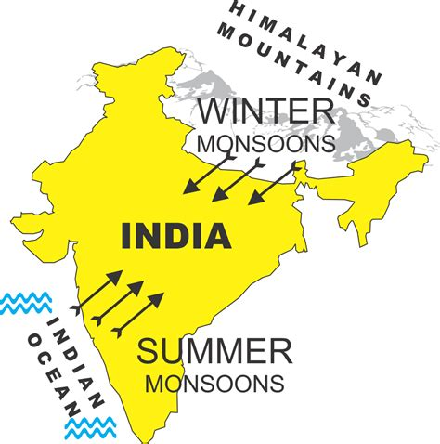
Climatic Regions
Summer, Winter, Monsoon, Autumn, and Spring
India's diverse geography—from coastal regions to mountainous terrain—creates a wide range of microclimates.
Coastal regions receive heavy monsoon rains, while interior regions, particularly in the northwest, experience more arid conditions.
Moving inland from coastal areas, rainfall diminishes sharply, with notable drops as seen from Kolkata (119 cm) to Allahabad (76 cm) and Delhi (56 cm).

Slide 13
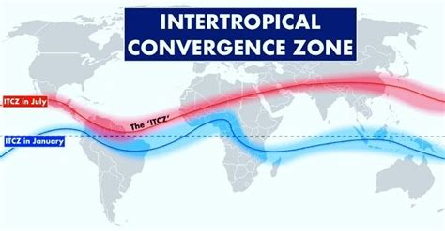
Mechanism of the Monsoon in India
Onset of the Southwest Monsoon
The onset of the southwest monsoon in India is closely tied to the movement of the Inter-Tropical Convergence Zone (ITCZ), a low-pressure belt where the trade winds from the northern and southern hemispheres converge.
As the Sun moves northward toward the Tropic of Cancer in June, the ITCZ also shifts northward. This movement plays a key role in t riggering the Indian monsoon.

Slide 14
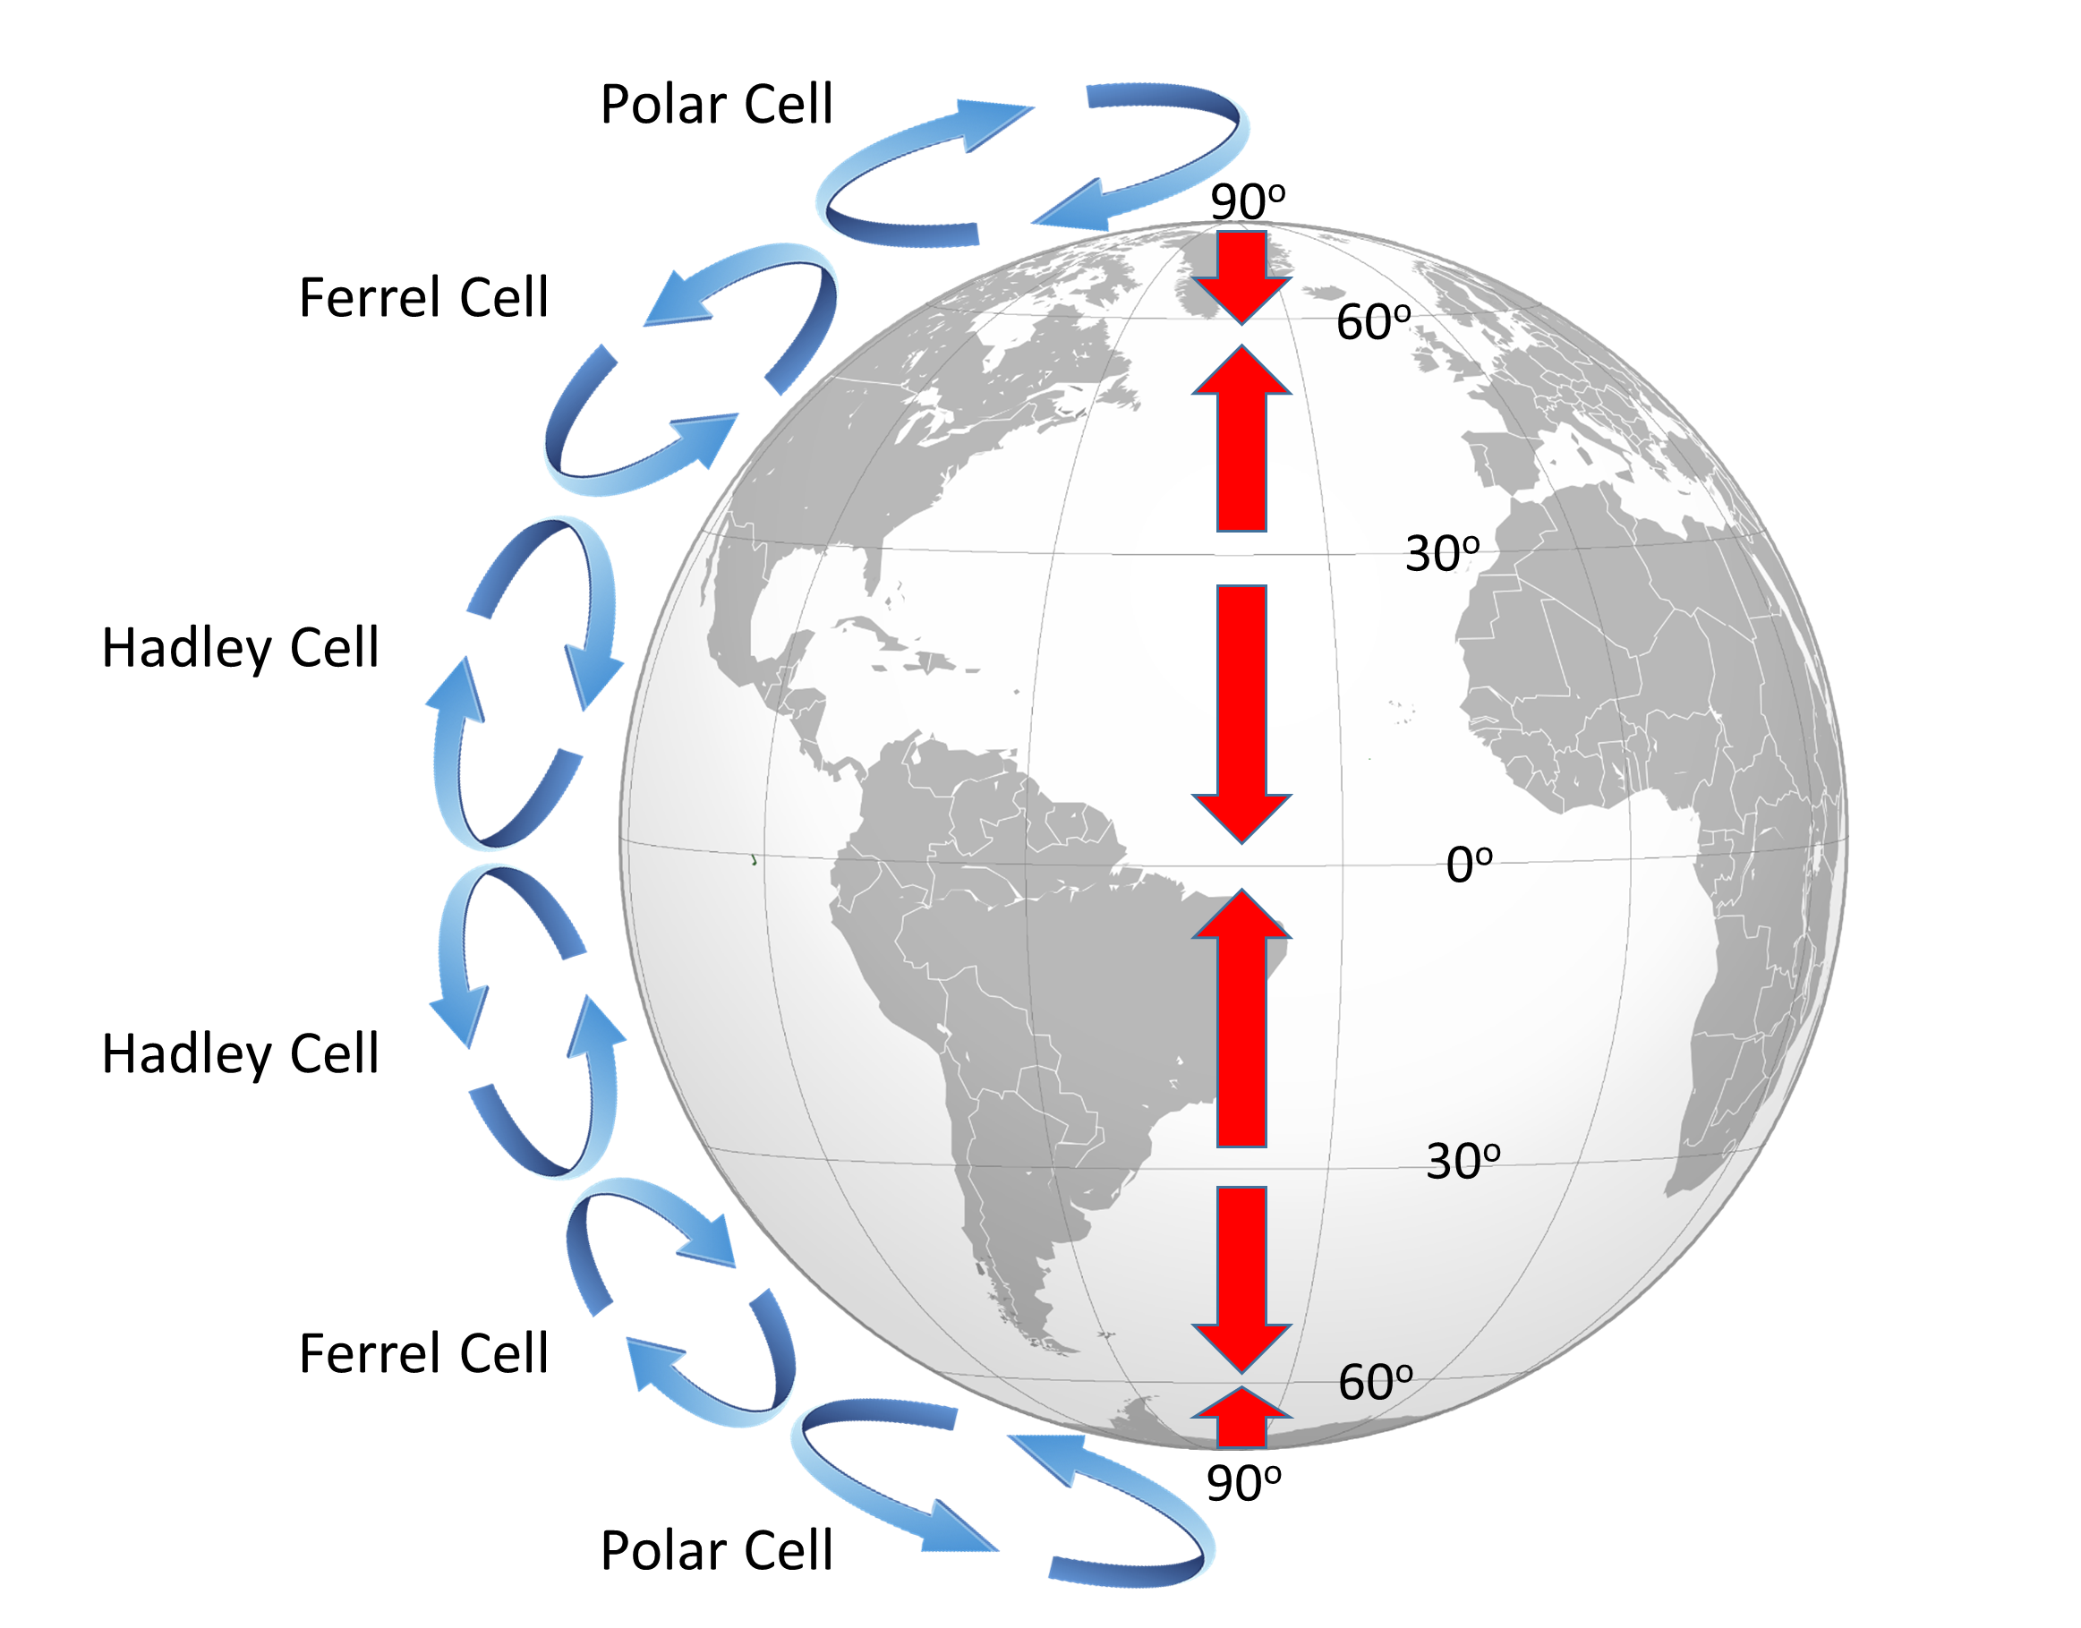
Mechanism of the Monsoon in India
Onset of the Southwest Monsoon
Due to the Coriolis effect, the southeast trade winds of the southern hemisphere, which usually blow toward the equator, are deflected to the northeast after crossing the equator.
As they pass over the warm waters of the Indian Ocean, these winds absorb significant moisture. By July, the ITCZ shifts over the Indo-Gangetic Plain, and the moisture-laden winds from the Arabian Sea and the Bay of Bengal hit the Indian subcontinent. This creates what is known as the Monsoon Trough, where intense rainfall occurs as part of the southwest monsoon.

Slide 15
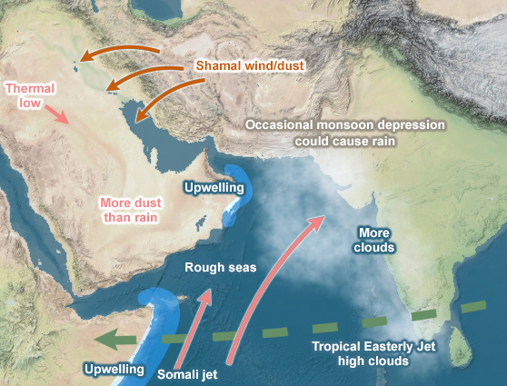
Mechanism of the Monsoon in India
Onset of the Southwest Monsoon
A critical atmospheric phenomenon accompanying this is the westerly jet stream, which retreats northward, allowing the easterly jet stream (often referred to as the Somali Jet) to form at around 15°N latitude. This shift initiates the full burst of the Indian monsoon, which hits the subcontinent in two branches:
Arabian Sea Branch: Originating over the Arabian Sea, these winds bring heavy rainfall to the western coast of India, particularly the Western Ghats.

Slide 16
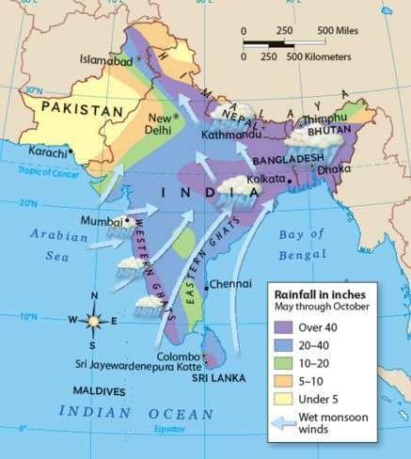
Mechanism of the Monsoon in India
Onset of the Southwest Monsoon
Bay of Bengal Branch: Redirected by the Arakan Hills along Myanmar’s coast, this branch moves toward northeastern India, entering West Bengal and Bangladesh, delivering substantial rainfall to these regions.
A key feature of the monsoon is its "break" periods—short intervals of dry weather that occur between periods of heavy rainfall. These breaks are due to the north-south oscillation of the monsoon trough. The movement of this trough can lead to periods of no rain, even during the peak monsoon season.

Slide 17
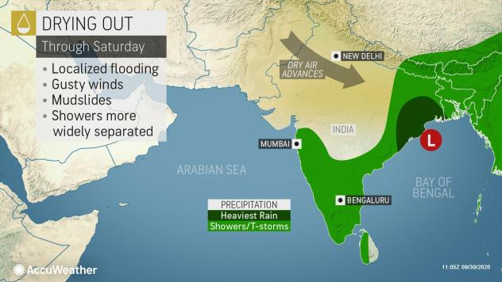
Retreating Monsoon in India
As the southwest monsoon begins to withdraw in September, the weather transitions, leading to what is commonly referred to as October heat.
The sun returns, temperatures rise, and although the soil is still moist, the air becomes uncomfortably humid. By mid-October, temperatures start to drop, especially in northern India, marking the onset of cooler weather.
During this phase, while northern India dries out, the eastern parts of the peninsula and the southeastern coast receive rainfall.
This rainfall is brought on by cyclonic depressions originating in the Andaman Sea, which sweep across the eastern coast of the southern peninsula, particularly affecting the Coromandel Coast.

Slide 18
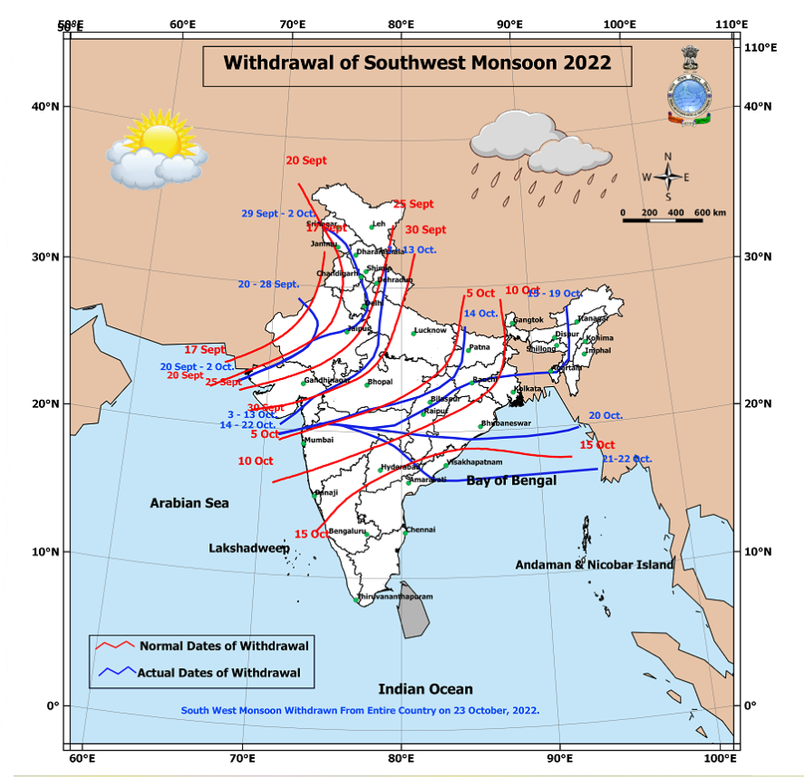
Retreating Monsoon in India
Cyclones are responsible for the bulk of the rain during the retreating monsoon and often cause significant damage due to their intensity.
The northeast monsoon that follows is vital for southern India, especially for states like Tamil Nadu and Andhra Pradesh, which rely on it for water supply and agriculture.
Unlike most of India, which receives rain from the southwest monsoon, these regions depend on the northeast monsoon between October and November.

Slide 19
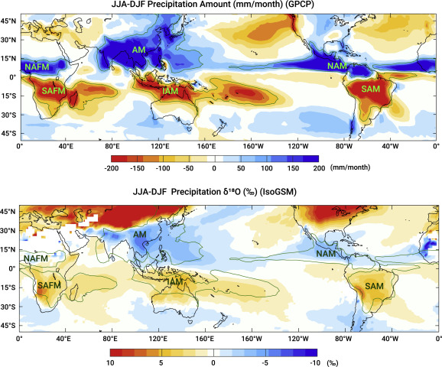
Classical and Modern Theories of the Monsoon
Historically, the Indian monsoon has been a subject of fascination and study for centuries. The Rig Veda, one of the oldest texts in Indian culture, mentions the monsoon, but the scientific understanding of this phenomenon began with Arab traders.
These traders, who sailed the seas for commerce, first documented the reversal of the monsoon winds in the north Indian Ocean. In the 11th century, the Arab explorer Al Masudi described how monsoon winds and ocean currents reverse with the changing seasons.
Later, in the 17th century, Sir Edmund Halley offered a more scientific explanation, attributing the monsoon to the differential heating of land and sea.

Slide 20
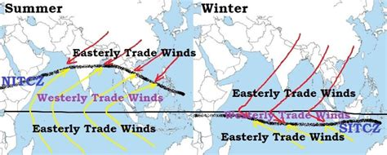
Theories of the Monsoon
The Dynamic Concept of the Monsoon, proposed by Hermann Flohn in 1951, introduced a more modern understanding of the monsoon. According to Flohn, the monsoon is driven by the seasonal changes in the planetary wind system, specifically the movement of the ITCZ.
Seasonal ITCZ Movement: During the summer, the ITCZ shifts northward to approximately 20°N-25°N, over the Indo-Gangetic plain, creating a low-pressure zone that draws in moisture-laden winds. These winds, now deflected by the Coriolis effect, turn from southeast to southwest, resulting in the onset of the southwest monsoon.
Winter Monsoon: In the winter, the ITCZ moves southward, reversing the wind direction. The winds now blow from the northeast to the southwest, bringing the northeast monsoon rains to southeastern India.

Slide 21
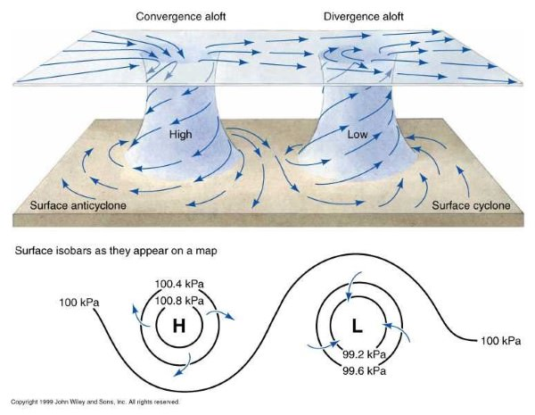
Air Mass Theory of the Monsoon
Another explanation for the monsoon is the Air Mass Theory, which centers on the behavior of planetary winds in the tropical region. According to this theory:
Planetary Winds: The trade winds in the tropics blow consistently from east to west. However, as the ITCZ shifts northward in summer, these winds cross the equator, where they are deflected to the northeast due to the Coriolis force. This results in the southwest monsoon.

Slide 22
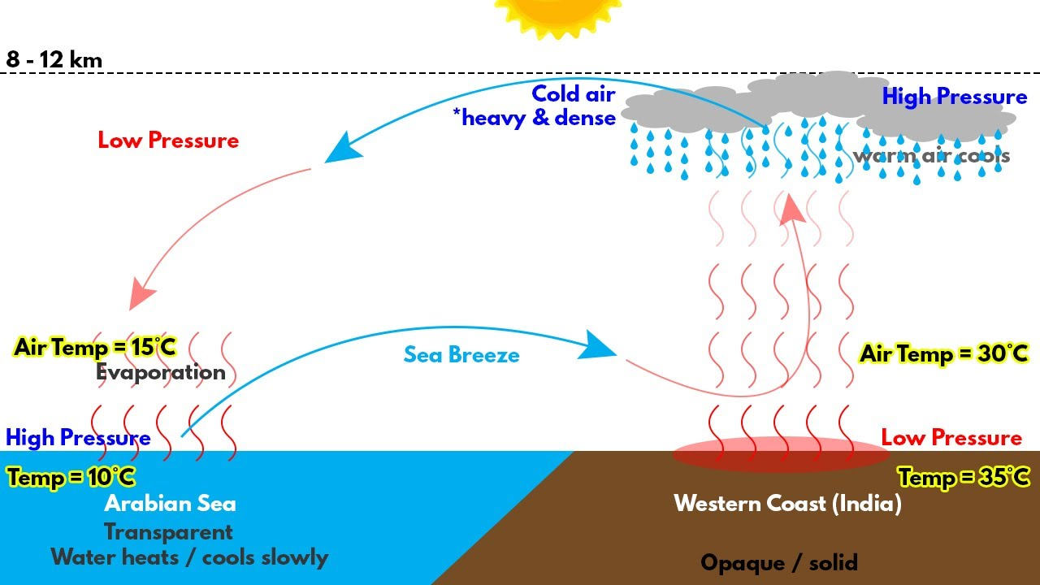
Air Mass Theory of the Monsoon
Moisture Absorption: As these winds traverse the warm waters of the Indian Ocean, they gather moisture and bring torrential rains to India.
Winter Reversal: In the winter, when the ITCZ moves south, the winds reverse direction, becoming the dry northeast monsoon that brings rain only to southeastern India.
The Indian monsoon, therefore, is a complex system influenced by a variety of atmospheric, geographical, and oceanic factors. Its onset, distribution, and retreat are critical to India’s agriculture, economy, and overall weather patterns, making it one of the most studied climatic phenomena in the world.

Slide 23
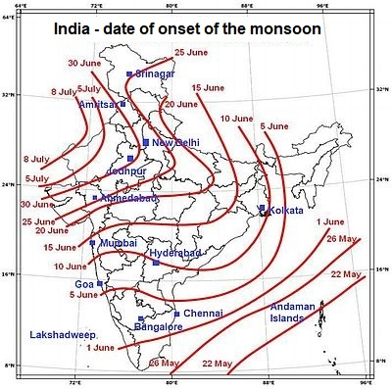
Jet Stream Theory of Monsoon in India
The Jet Stream Theory provides significant insight into the seasonal changes in wind circulation that drive the Indian monsoon. In winter, the Tibetan Plateau plays a crucial role in influencing the subtropical westerly jet stream. This high-altitude plateau splits the westerly jet stream into two distinct branches:
Northern Branch: This branch moves to latitudes between 20°N and 35°N, often influencing the climate patterns of northern India and the surrounding regions.

Slide 24
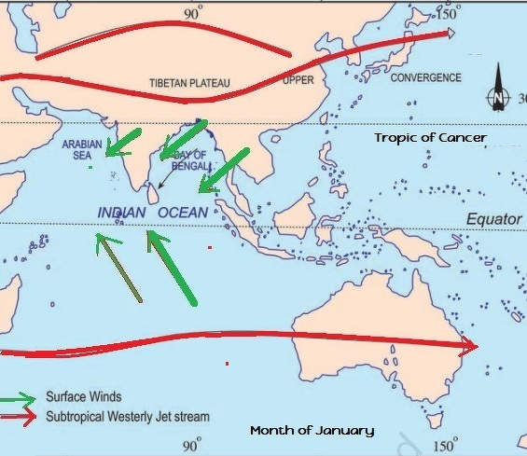
Jet Stream Theory of Monsoon in India
Tropical Easterly Jet Stream (TEJ): Under certain conditions, especially during the summer months, the TEJ emerges from the Tibetan anticyclone. This high-altitude easterly wind sometimes reaches the southern tip of India, affecting the overall wind flow in the region.
The interaction between these jet streams and surface winds plays a critical role in the onset and intensity of the Indian monsoon. A notable feature of the summer monsoon is the formation of the Mascarene High, a large high-pressure system over the Indian Ocean.
As this high strengthens, it pushes winds toward the low-pressure areas over northern India. These winds, after crossing the equator, are deflected by the Coriolis force, turning into the southwesterly summer monsoon winds, which carry moisture and rainfall into the subcontinent.

Slide 25
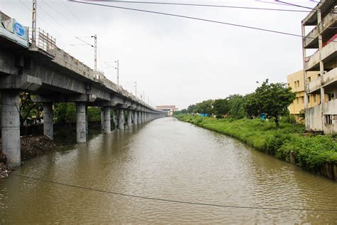
Importance of Monsoon in India
The monsoon is central to India's economy, environment, and social life. The monsoon rains are the lifeblood of India's vast network of dams, reservoirs, rivers, and canals, which provide essential water for irrigation, drinking, and electricity generation.
The annual rainfall directly influences agriculture, forestry, and fisheries, making it crucial for the country's food security.
For India’s farmers, the monsoon is eagerly awaited, as it dictates the agricultural calendar and the success of the crops. Good monsoon rains can lead to a bountiful harvest, while a failed monsoon can result in drought, food shortages, and economic hardship.

Slide 26
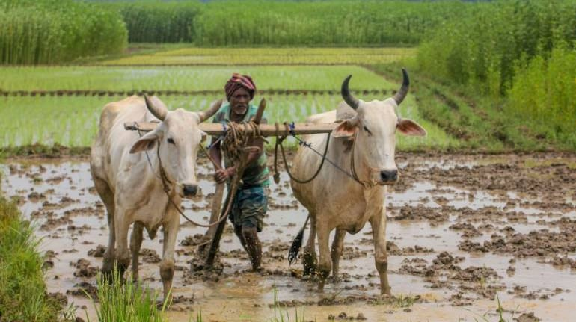
Importance of Monsoon in India
The importance of the monsoon is reflected in the many harvest festivals celebrated across India, such as Bihu in Assam, Pongal in Tamil Nadu, Onam in Kerala, and Lohri in Punjab. These festivals not only celebrate a successful harvest but also serve as important social gatherings that bring communities together.
In addition to its economic impact, the monsoon has a profound cultural significance in India, | creating a rhythmic cycle of seasons that shapes the lives and traditions of millions.
A good monsoon brings relief from the scorching summer heat and refreshes the land, promoting growth and prosperity throughout the country.
However, when the rains are inadequate, it can lead to severe droughts, crop failures, and hardship for many communities.

Slide 27
Acknowledgement
My seminars are the result of many years of experience combined with many hours of research over the internet.
I would like to acknowledge the many source I have accessed.
Including: India Meteorological Department (IMD), National Geographic, and the Resources following.

Slide 28
Referances
Geography of India by Majid Husain
World Geography by Majid Husain
Certificate Physical and Human Geography
Geography Through Maps by K.Siddhartha
Terms and Concepts of Geography – Majid Husain
Indian and World Geography: Objective Questions with Explanatory Notes for Civil Services Preliminary Examination.
Objective Indian and World Geography by Majid Husain
Geography of India by Surender Singh (alternative to Majid Husain).
India: A Comprehensive Geography by D.R Khuller (alternative to Majid Husain)
Physical Geography by Savindra Singh. (alternative to Goh Ching Leong)

