Slide 1
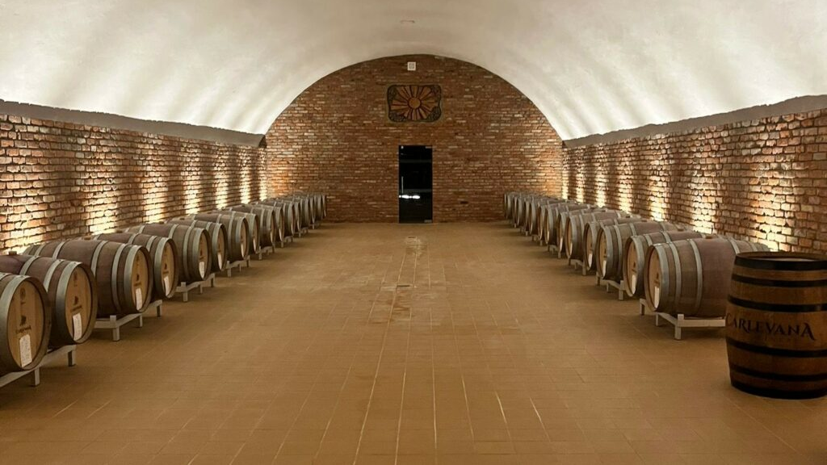
Moldova's Wine Industry
A Journey Through Time and Taste
Presented by
Marc Silver

Slide 2

History of Moldova's Wine
Ancient Beginnings (3000 BC - 1359 AD)
Moldova’s winemaking tradition stretches back over 7,000
years, placing it among the world’s oldest wine-producing
countries.
Archeological evidence shows that viticulture began
around 3000 BC, when indigenous populations cultivated
wild vines, producing rudimentary wines.
These early Moldovan wines were tied to pagan rituals and
the agrarian lifestyle of early Moldovan tribes.
The region’s fertile land, located between the Dniester and Prut rivers, provided ideal conditions for grape cultivation.
Over centuries, winemaking techniques improved, influenced by Greek and Roman settlers. By the time of the Roman Empire, Moldovan wine was being traded along the Dniester River and integrated into Roman feasts.

Slide 3
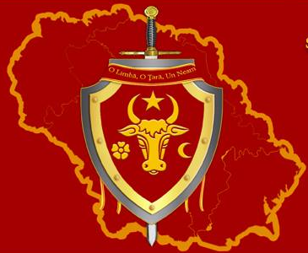
History of Moldova's Wine
Medieval Era (1359 - 1812)
The foundation of the Principality of Moldavia in 1359 marked a key turning point. Wine became a central part of Moldova’s economy and culture.
Monasteries played a crucial role during this period, as monks were often the keepers of viticulture knowledge. They refined winemaking techniques and expanded vineyards, particularly around religious sites.
In the late 14th century, the Moldovan ruler Stephen the Great encouraged winemaking, and wine was an integral part of celebrations, ceremonies, and diplomacy. Moldovan wine even reached the courts of Poland and Russia.
However, the Ottoman Empire’s rule over Moldova from the 16th century limited wine production. Islamic law imposed restrictions, but locals clandestinely maintained winemaking traditions.

Slide 4
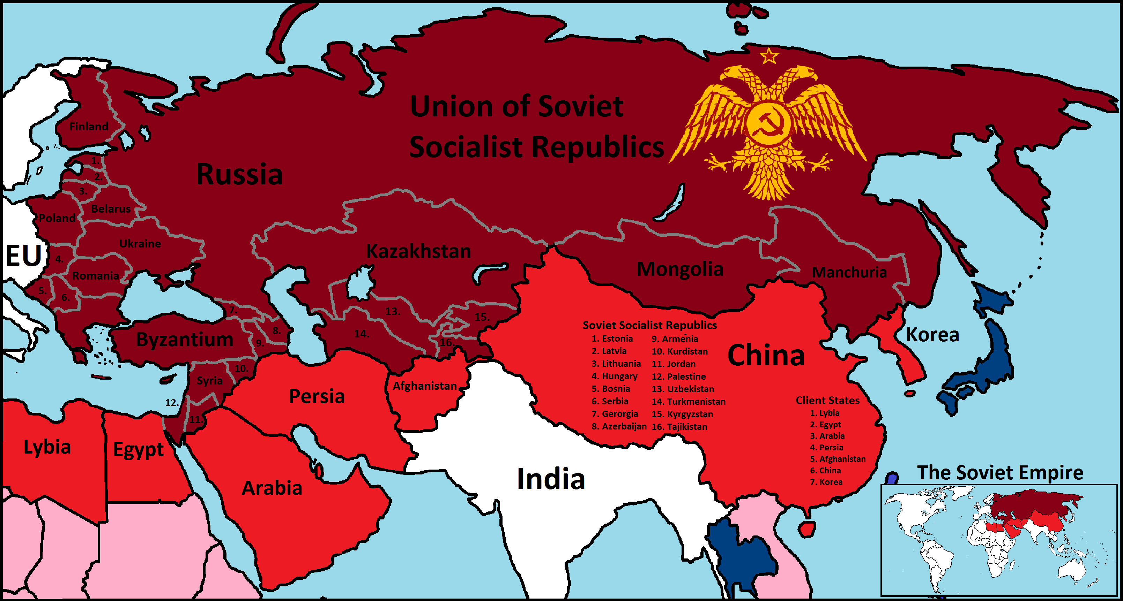
History of Moldova's Wine
Russian Empire and Soviet Era (1812 - 1991)
After the Russian Empire annexed Bessarabia (modern-day Moldova) in 1812, Moldovan winemaking entered a new era of growth.
Russian influence brought advanced viticulture techniques and increased wine exports. European grape varieties, such as Cabernet Sauvignon and Merlot, were introduced alongside local varieties, enriching the wine portfolio.
The Soviet period (1940-1991) transformed Moldova into one of the USSR’s largest wine producers. State-run collectives centralized winemaking, focusing on mass production over quality.
During the 1950s and 60s, Moldova supplied over
50% of the Soviet Union’s wine. However, the
quality was often sacrificed in favor of quantity,
leading to a decline in global reputation.
In 1985, Gorbachev’s anti-alcohol campaign dealt
a severe blow to Moldova’s wine industry, with
many vineyards uprooted and distilleries destroyed.

Slide 5
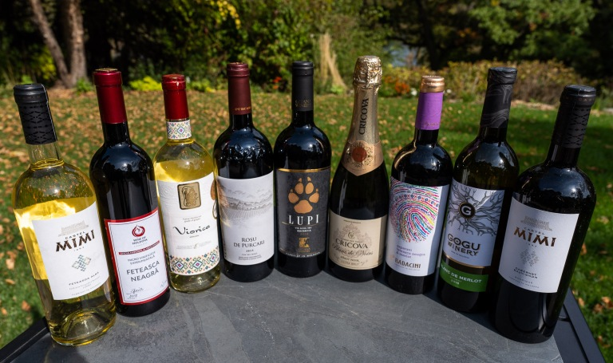
History of Moldova's Wine
Post-Soviet and Modern Era (1991 - Present)
Moldova’s independence in 1991 marked the beginning of a renaissance in its wine industry.
With a focus on quality over quantity, private wineries began reviving traditional methods while also embracing modern technology.
In 2006, Russia’s embargo on Moldovan wine forced producers to diversify export markets.
This led to a new focus on Western markets, including Europe, the United States, and China.
Today, Moldova is regaining its place on the global wine stage, earning accolades at international wine competitions.
The country’s wine culture is deeply rooted in tradition, but it now blends old-world heritage with new-world innovation.

Slide 6
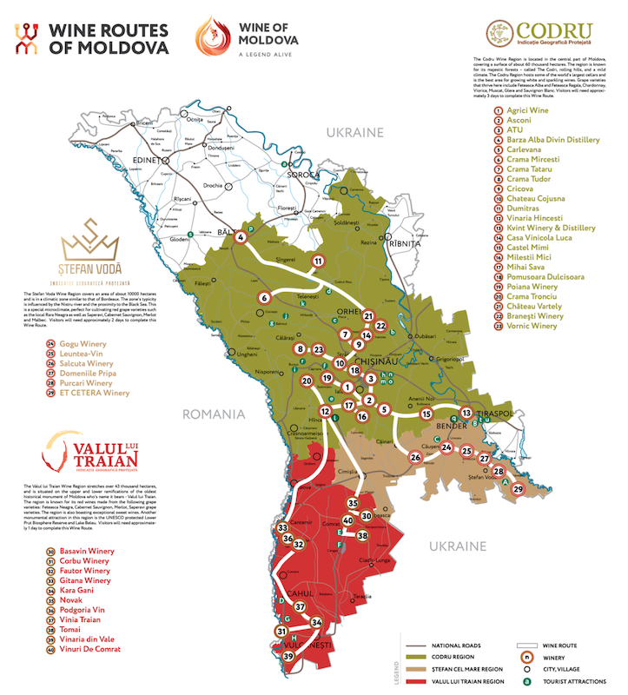
Moldova's Wine Roads
The Wine Routes of Moldova currently consist of three main routes that stretch into the country's historic wine regions: Codru, Valul lui Traian, and Ștefan Vodă.
Each route starts from the capital, Chișinău, and serves as a cultural and adventure pathway.
These routes offer travelers festivals, events, and key attractions such as bed-and-breakfasts, fortresses, monasteries, nature reserves, and archaeological sites.
You can find the untouched authenticity of Moldova's wine culture, which is deeply rooted in over 5,000 years of wine-making history.

Slide 7
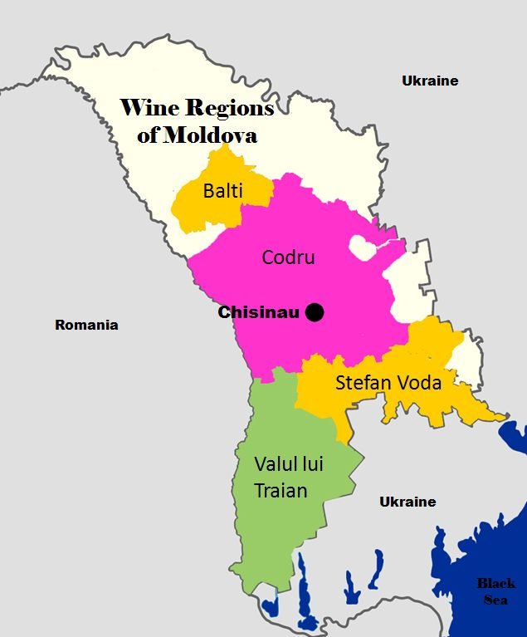
Wine Regions in Moldova
Codru Wine Region
Codru, located in central Moldova, is the country’s largest and most important wine region, responsible for about 60% of Moldova’s wine production.
The region is renowned for its cool climate and forested hills, creating an ideal environment for both white and red wines.
Tourism Highlights: Codru is home to the famous Cricova and Mileștii Mici wine cellars, the latter holding the Guinness World Record for the largest wine collection.
These cellars offer extensive underground tours that wind through miles of limestone tunnels lined with aging barrels.
Unique Features: Codru’s cool climate and limestone-rich soils produce wines with excellent acidity and complexity, particularly in white varieties like Fetească Albă and Chardonnay.

Slide 8
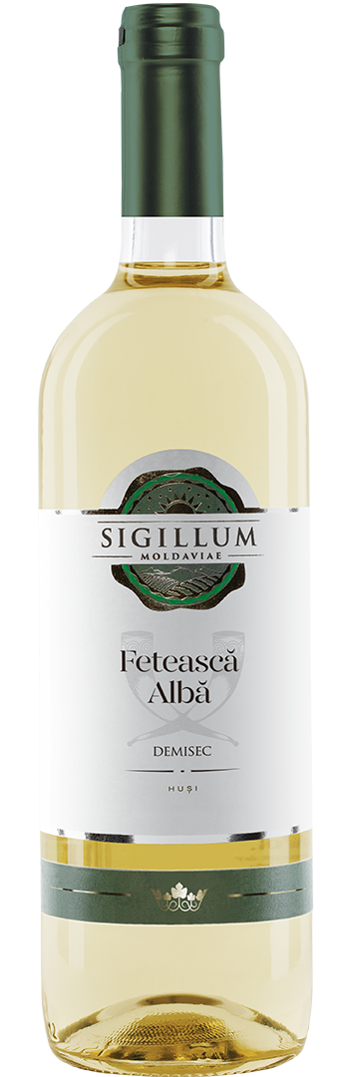
Regional Breakdown
Codru Region
Location: Central Moldova
Terroir: Limestone-rich soils and cool climate.
Climate: Mild summers and cold winters, with significant temperature variation between day and night.
Grape Varieties: Fetească Albă, Chardonnay, Pinot Noir, Cabernet Sauvignon.
Wine Characteristics: Codru’s wines, especially its whites, are known for their fresh acidity and minerality. Reds from this region are more elegant, with softer tannins due to the cooler climate.

Slide 9
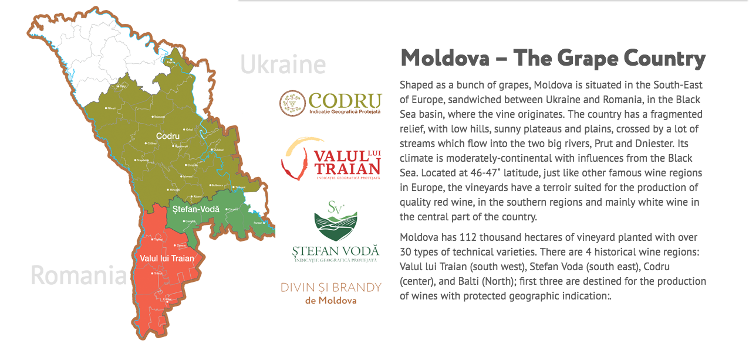
Wine Regions in Moldova
Ștefan Vodă Wine Region
Located in the southeast, Ștefan Vodă is gaining
international recognition for its premium red wines.
The region benefits from the Black Sea’s maritime
influence, offering warmer temperatures than
Codru, ideal for red varieties like Cabernet
Sauvignon and Merlot.
Tourism Highlights: Wine enthusiasts can explore boutique wineries like Purcari and Et Cetera, which have modern tasting rooms and scenic vineyards near the Nistru River.
Unique Features: The Ștefan Vodă region’s proximity to the Black Sea moderates its climate, resulting in full-bodied, rich red wines with soft tannins.
Notes:
Charles IV, King of Bohemia

Slide 10
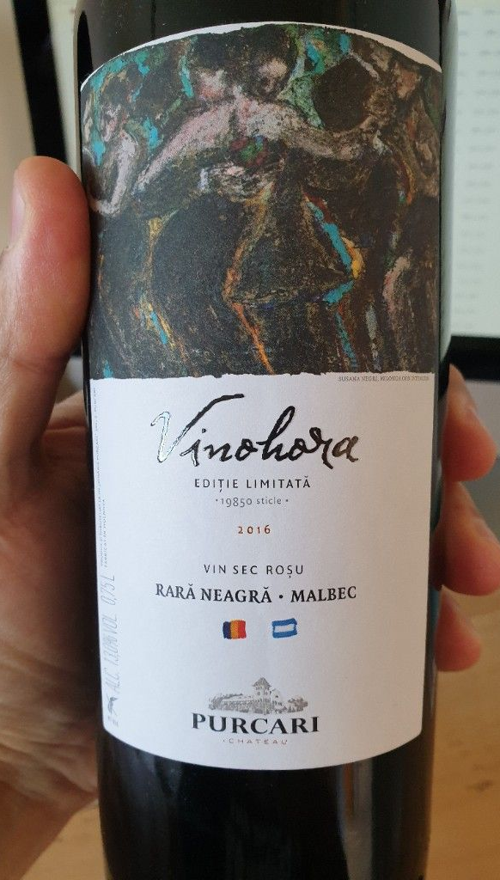
Regional Breakdown
Ștefan Vodă Region
Location: Southeast Moldova
Terroir: Sandy loam soils, maritime influence from the Black Sea.
Climate: Warmer temperatures and milder winters than Codru.
Grape Varieties: Rara Neagră, Cabernet Sauvignon, Merlot.
Wine Characteristics: The reds from Ștefan Vodă are rich, full-bodied, and aromatic, with notes of dark fruit, spices, and earthy undertones.

Slide 11
Wine Regions in Moldova
Valul lui Traian Wine Region
In the southwest, Valul lui Traian is known for its warm, sunny climate and fertile soils, producing robust red wines with deep concentration.
Tourism Highlights: Wineries like Château Vartely offer immersive experiences, including vineyard tours and stays at vineyard lodges, perfect for those looking to pair wine tasting with relaxation.
                Unique Features: The region’s warm climate allows for extended grape ripening, leading to bold, structured wines, particularly reds like Rara Neagră and Malbec.

Slide 12
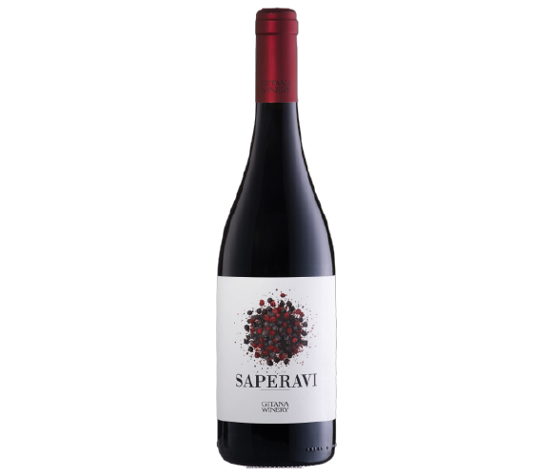
Regional Breakdown
Valul lui Traian Region
Location: Southwest Moldova
Terroir: Chalky, fertile soils, high in calcium.
Climate: Hot summers and dry, sunny conditions.
Grape Varieties: Malbec, Saperavi, Rara Neagră.
Wine Characteristics: Bold, tannic wines with deep color and concentrated flavors of blackberry, plum, and pepper.

Slide 13
Wine Regions in Moldova
Bălți Wine Region
Bălți, in the north, is less prominent in terms of production but holds historical significance as an ancient winemaking region. It focuses mainly on white wines due to its cooler climate.
Tourism Highlights: Bălți offers a more off-the-beaten-path experience, where smaller family-run vineyards give visitors a taste of traditional Moldovan hospitality.
Unique Features: Cooler temperatures here result in crisp, fresh white wines with floral and citrus notes.

Slide 14
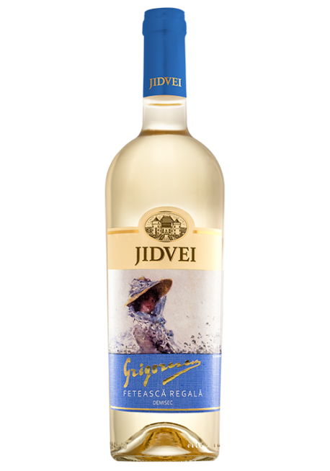
Regional Breakdown
Bălți Region
Location: Northern Moldova
Terroir: Clay and limestone soils, with higher elevation.
Climate: Cooler, with significant temperature variation.
Grape Varieties: Fetească Regală, Sauvignon Blanc.
Wine Characteristics: Crisp, aromatic white wines with bright acidity and notes of green apple and citrus.

Slide 15
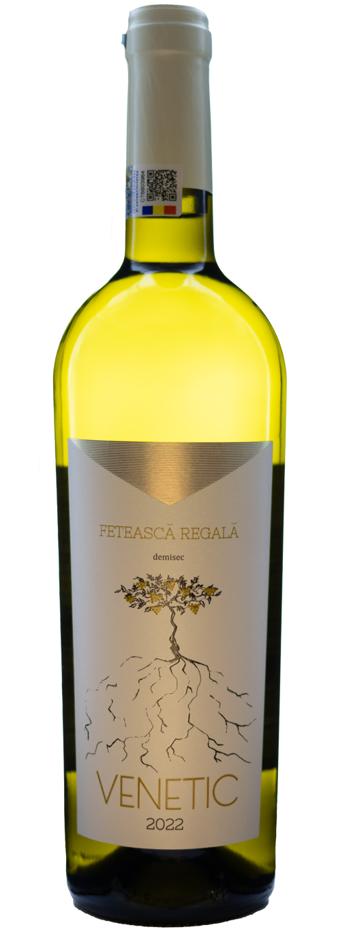
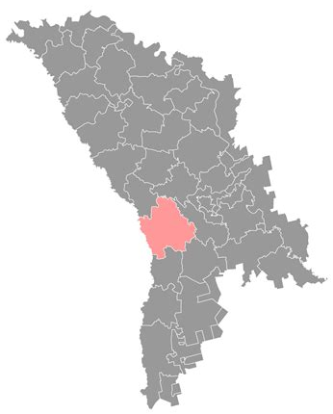
Other Regions
While these are Moldova’s key regions, smaller areas such as the Călărași and Hîncești districts contribute to the country’s diverse wine landscape.
In California we would refer to these areas as micro climates or micro regions, typically associated to a more dominant wine region. In this case Codru Region.
These regions although extremely small, with
very few wineries they are particularly
important for the cultivation of indigenous
grape varieties.
Călărași
Hîncești

Slide 16
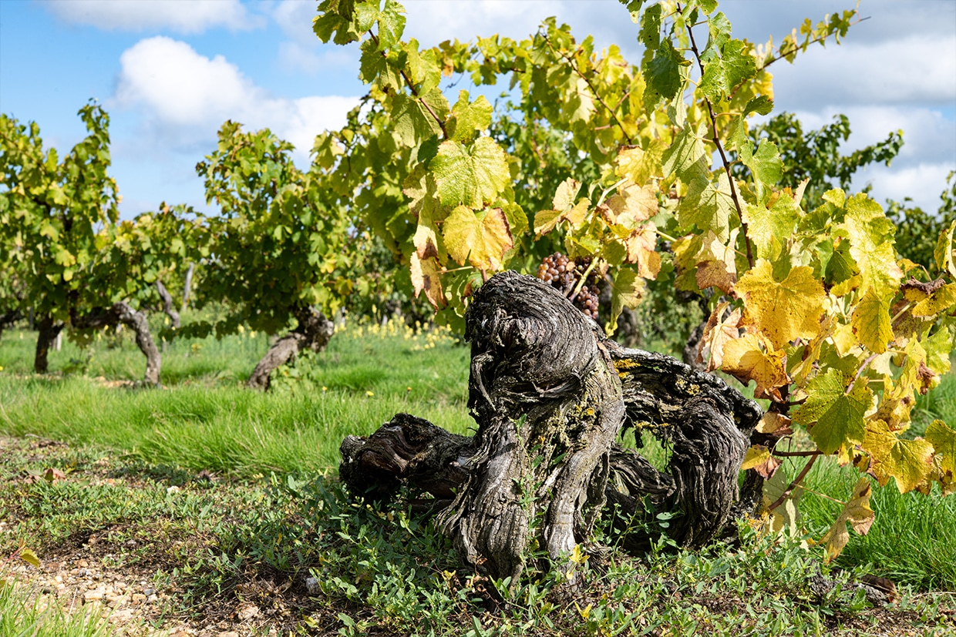
Moldova's Unique Terroir
Moldova’s terroir is shaped by its geographical position, climate,
and soil composition. Situated at the same latitude as some of
Europe’s finest wine regions, Moldova benefits from a continental
climate, with hot summers and cold winters.
Soil: The majority of Moldova’s vineyards are planted in fertile,
loamy soils with high limestone content. This soil is excellent
for drainage, forcing vines to dig deep into the earth for nutrients, resulting in concentrated flavors in the grapes.
Climate: The country enjoys a continental climate, with long, sunny growing seasons. The moderate rainfall ensures that grapes ripen fully, developing balanced sugars and acids.
Geography: Moldova’s hilly terrain allows for vineyards at various altitudes, which contributes to a diversity of microclimates. This is key for producing different wine styles, from crisp whites in the north to powerful reds in the south.

Slide 17
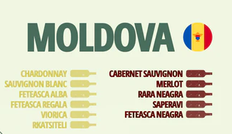
Varietals and Wine Characteristics

Slide 18
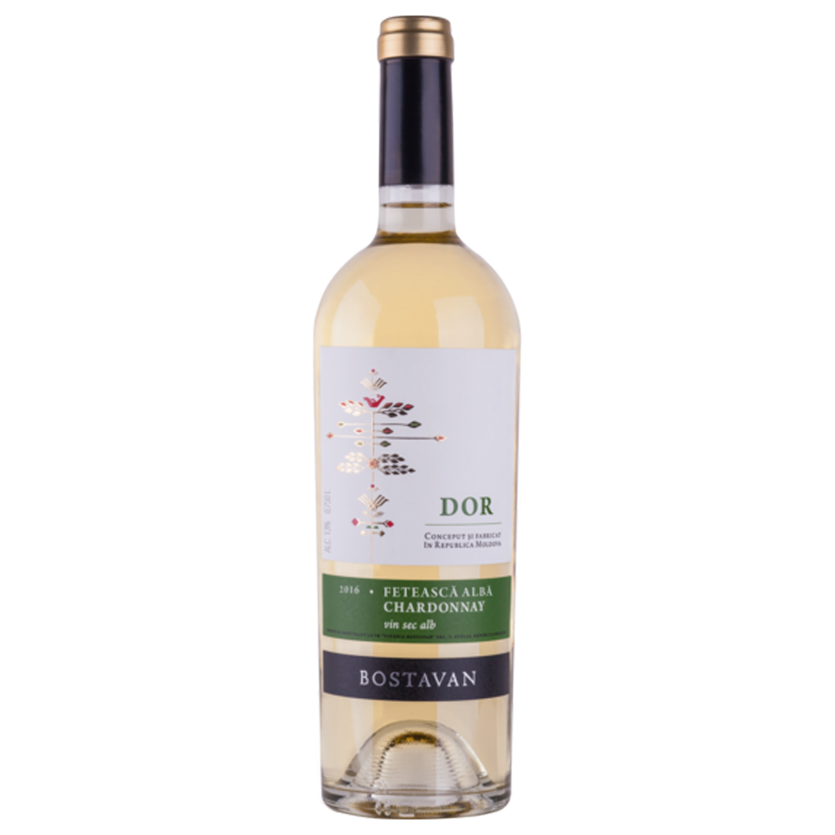
Varietals and Wine Characteristics
Fetească Albă
Characteristics: Crisp and floral, with notes of white flowers, apple, and pear. High acidity makes it refreshing and versatile.
Tasting Notes: Delicate flavors of green apple, peach, and elderflower.
Food Pairings: Ideal with seafood, salads, and soft cheeses.

Slide 19
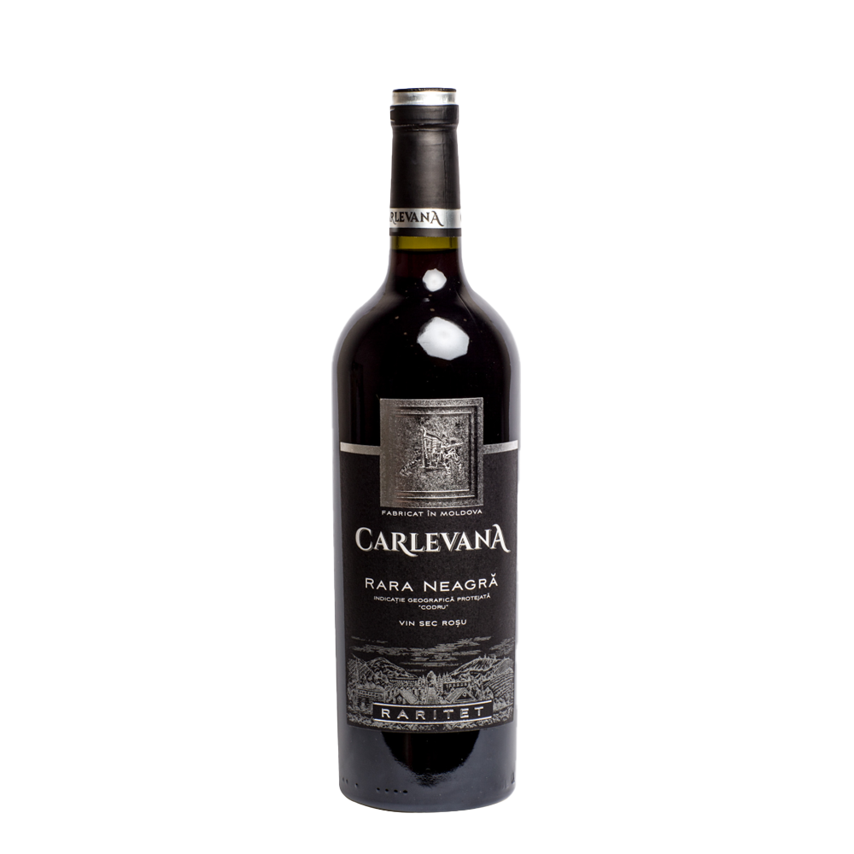
Varietals and Wine Characteristics
Rara Neagră
Characteristics: Native to Moldova, this red grape produces light to medium-bodied wines with soft tannins.
Tasting Notes: Red fruit, such as raspberry and strawberry, with a hint of spice.
Food Pairings: Pairs well with grilled meats, poultry, and Mediterranean dishes.

Slide 20
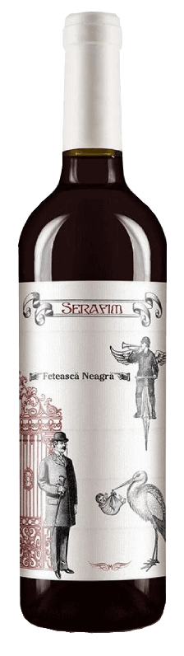
Varietals and Wine Characteristics
Fetească Neagră is Moldova's signature red wine variety, known for its full body, tannic structure, deep color, and aging potential. It thrives in the warmer southern regions, producing rich, high-alcohol wines with bold flavors.
The tasting profile includes ripe plum, blackberry, and black cherry, with earthy and smoky undertones. As the wine ages, notes of dried fruits, spices like clove and cinnamon, and hints of tobacco or leather may emerge.
Fetească Neagră pairs well with grilled or roasted meats, game dishes, hearty stews, barbecued ribs, and aged cheeses.
Vegetarian options include roasted eggplant, mushrooms, and tomato-based pasta dishes.

Slide 21
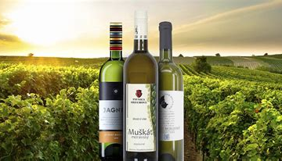
Conclusion
The Czech Republic's wine industry, though often overlooked, is a hidden gem for wine enthusiasts.
With its rich history, diverse wine regions, and unique terroir, the country offers a treasure trove of wines waiting to be discovered.
Whether you're exploring the
aromatic whites of Znojmo or the
rich reds of Velké Pavlovice, Czech
wines promise an unforgettable
journey of flavors and traditions.

Slide 22
Acknowledgement
My seminars are the result of many years of experience combined with many hours of research over the internet.
I would like to acknowledge the many source I have accessed.
These include Wine Spectator, Wine Enthusiast, BKWine Magazine, Wine & Spirits Magazine, American Vineyard Magazine, The Grapevine Magazine, Wikipedia.com, Britannica.com, and the
various Government websites.

Slide 23
Citations
Moldova Wine Guild - Provides a wealth of information on Moldova's wine regions, varietals, and terroir.
Website: https://wineofmoldova.com
International Organization of Vine and Wine (OIV) - Offers statistics and reports on global wine production, including Moldova's contribution. Website: https://www.oiv.int
Cricova Winery - One of the most famous wineries in Moldova with detailed insights into Moldova's wine history and its evolution during the Soviet era. Website: https://cricova.md
Purcari Winery - Offers detailed accounts of Moldova's grape varieties and wine regions, including a history of winemaking in Ștefan Vodă.
Website: https://purcari.wine
Moldova Wine Report (by USAID) - Provides comprehensive data and analysis of Moldova’s wine industry, export trends, and viticultural practices.
Link: Moldova Wine Report
Jancis Robinson - Renowned wine expert who has written about Moldova's wine regions and its growing international reputation.
Website: https://www.jancisrobinson.com
Decanter Magazine - Articles on Moldovan wines, wineries, and their emergence in global markets.
Website: https://www.decanter.com

