Slide 1
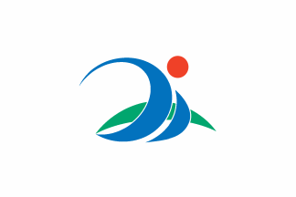
Miyakojima (Okinawa), Japan Presented by Marc Silver

Slide 2
What I Will Cover
My Port Philosophy
Don’t Miss the Ship
Money
About Miyakojima (Okinawa), Japan
Map
HIS Lea Lea Bus
Places to see or at least consider
A few restaurant recommendations
Conclusion

Slide 3
My Port Philosophy
I have been cruising for over 45 years and have taken over 100 cruises. So, I consider myself an experienced cruiser.
The information I will present is based on those many years of
experience.
When I am on a cruise where the city, I want to visit is not the port city,
I always recommend taking a ship’s tour.
But when I am in a port with multiple attractions nearby and easy to see
on my own - I will do it on my own.
This presentation is for that type of port.

Slide 4

Don’t Miss the Ship
How to Avoid Missing Your Ship
Pay attention to the time. - Ship time and local time are often different.
Put a return-to-ship reminder on your phone.
Choose excursions wisely.
If a ship-sponsored excursion is late returning to port, the ship will wait for you. If you are on your own???
Be Prepared
Have your Passport, Credit Card, and phone numbers for your ship port agent.
What to Do If You Miss the Ship Most cruise lines have port agents stationed in the port area to assist if your ship has left without you. If your are lucky, when cruisers are late returning to the vessel, the ship’s crew will often remove the passengers’ essential items – passports, cell phones, and medication -- from the ship to leave with the port agents.
The Port Officials can help you with contacting your ship and making necessary travel arrangements.

Slide 5
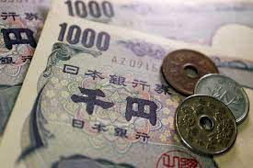
Money
The Yen is the official currency of Japan
Official Exchange is 100 Yen is 72 cents US
Or 142.15 Yen to the US Dollar

Slide 6
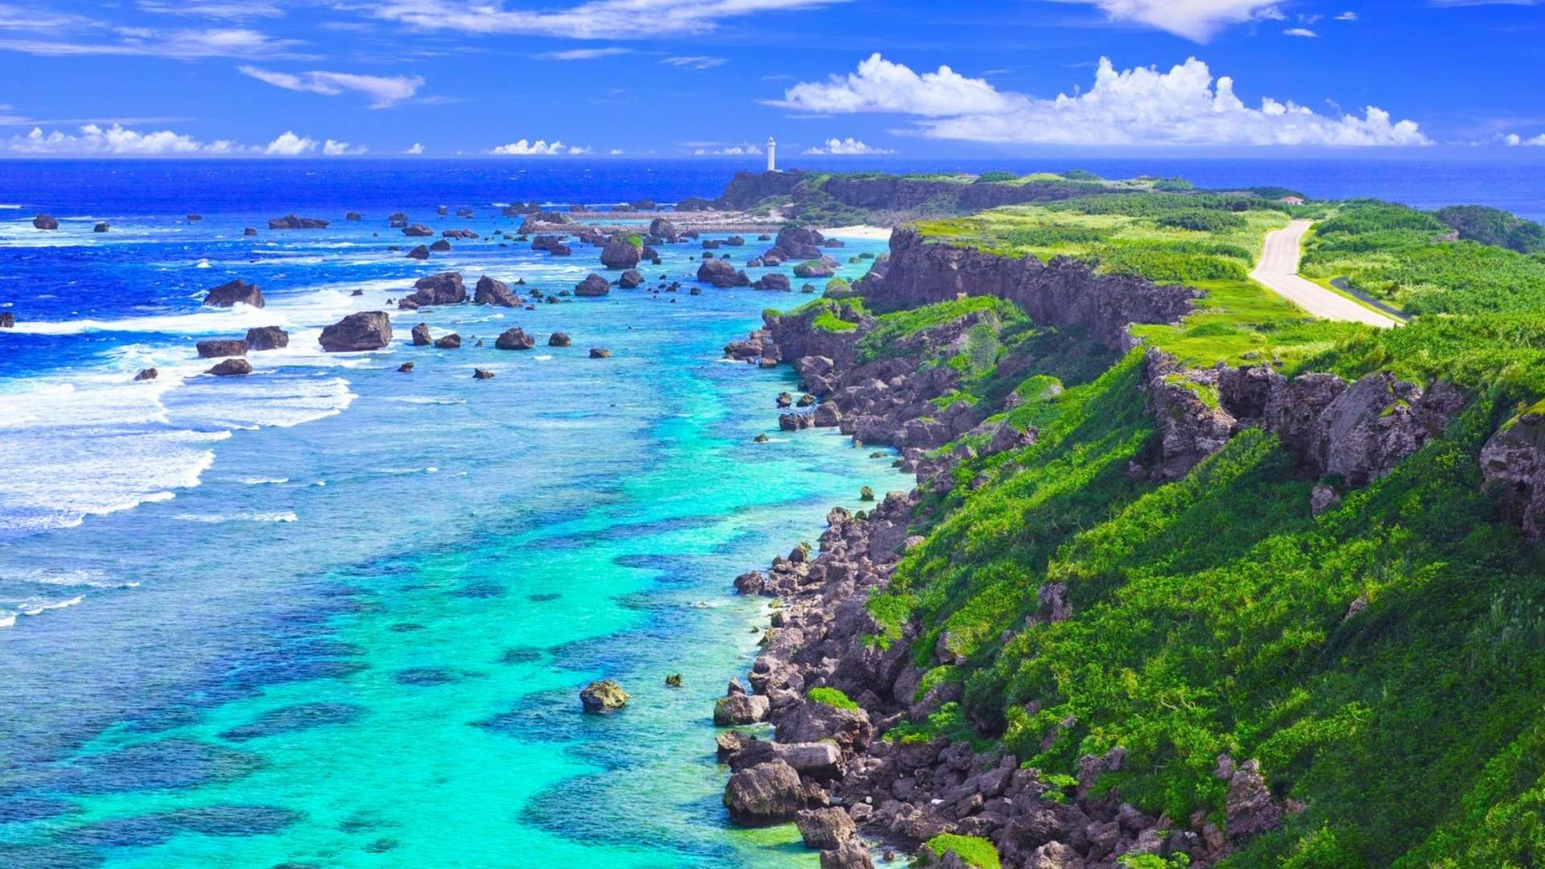
About Miyakojima
Miyakojima is a city in Okinawa Prefecture, Japan, located on the Miyako Islands. As of 2012, it had a population of 54,908. The modern city of Miyakojima was established on October 1, 2005, from the merger of the old city of Hirara, the towns of Gusukube, Irabu and Shimoji plus the village of Ueno (all from Miyako District). As a result of the merger, Miyako District only has one remaining village.

Slide 7
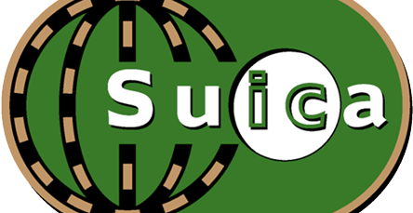
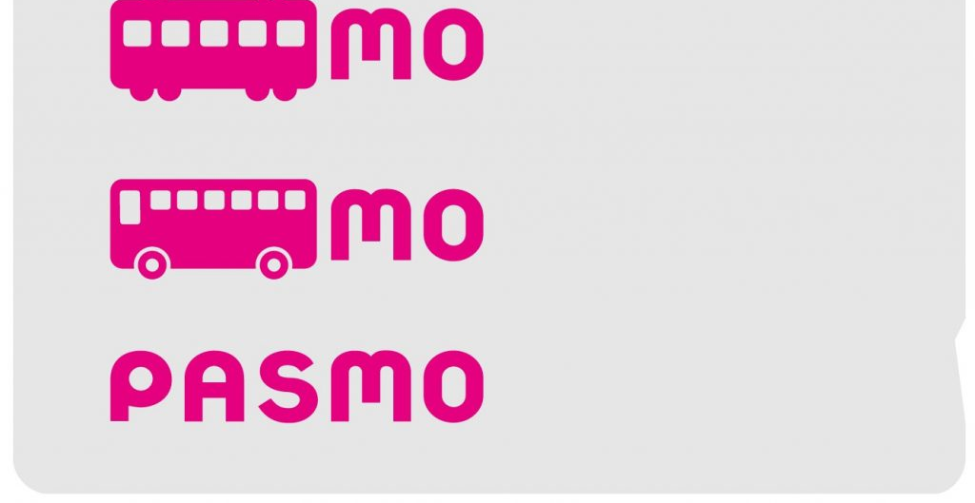
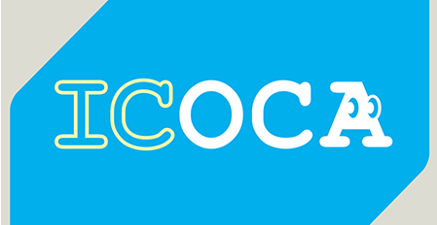
PASMO, Suica, & ICOCA Cards
The PASMO, Suica, and ICOCA Cards are e-money IC cards that can be used for travel and shopping across Japan.
Cashless fare payment
Use it for shopping
No waiting for change
Get special privileges
Apple phone users can also link with all three cards.
PASMO refunds - If you no longer need your PASMO, it can be refunded. Suica and ICOA cards do not offer refunds.

Slide 8
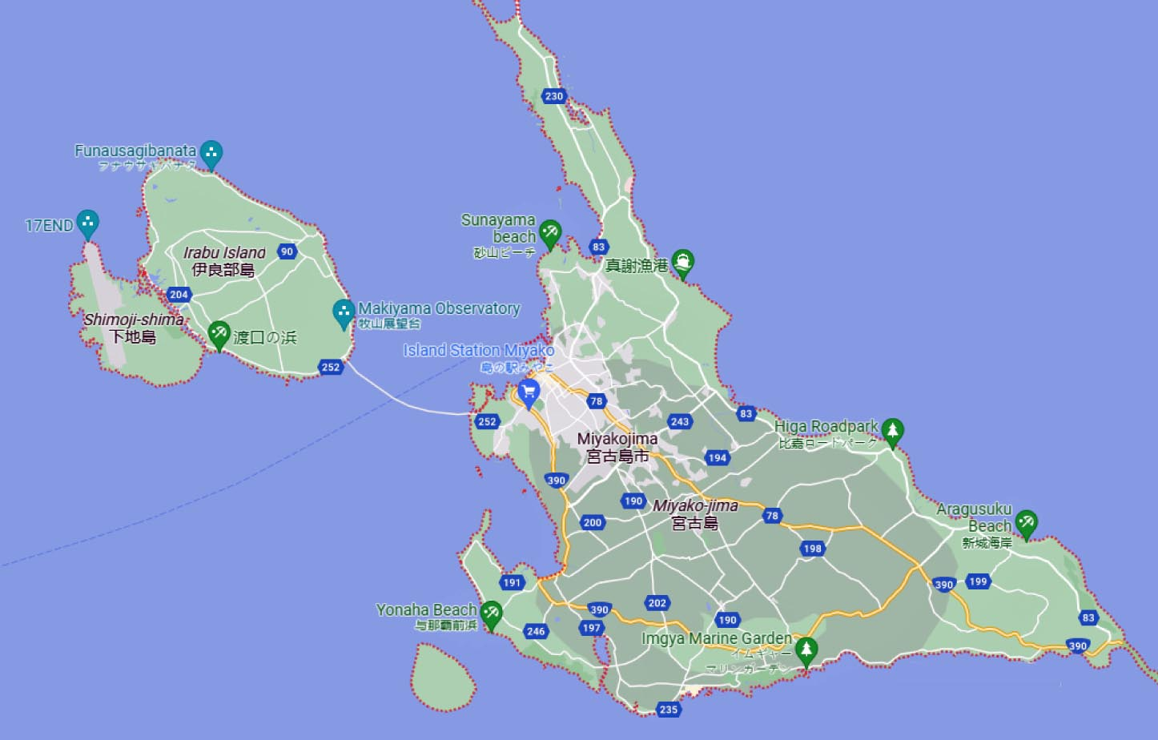
Map of Miyakojima

Slide 9
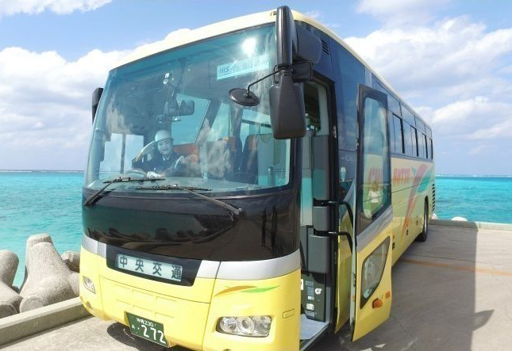
HIS Lea Lea Bus
HIS Lea Lea Bus is the only tour bus on the island. Book a cheap tour of Miyako 5 islands and 3 major bridges! What is included in the price:
Bus fare, insurance premium, consumption tax, Utopia Farm Miyakojima admission ticket, a little present, snow salt ice cream, snow salt sample
Start time - 8:30
Time required About 9 hours
HIS Lea Lea Bus Schedule]
Hotel departure: 8: 30 ~ 9: 25 ① Ikeja Ohashi: Arrival at 10:00 ② Snow salt – salt-making plant: arrival at 10:50 ③ Irabe Ohashi (car window) ④ Beach of Sawada (car window) ⑤ Shimojijima Airport: arrival at 11:45 arrival ⑥ Miyako each station on the island Lunch: arrival at 13:00 arrival ⑦ Komandjima (free walk): arrive at 13: 30 ⑧ Utopia Farm: 14: 50 arrival 15:20 departure 9 Higashi Heian Anagasaki: 16:00 Arrival 16:30 Hotel return: 17: 10 ~ 18: 05
Tour price: US$ 49.19

Slide 10
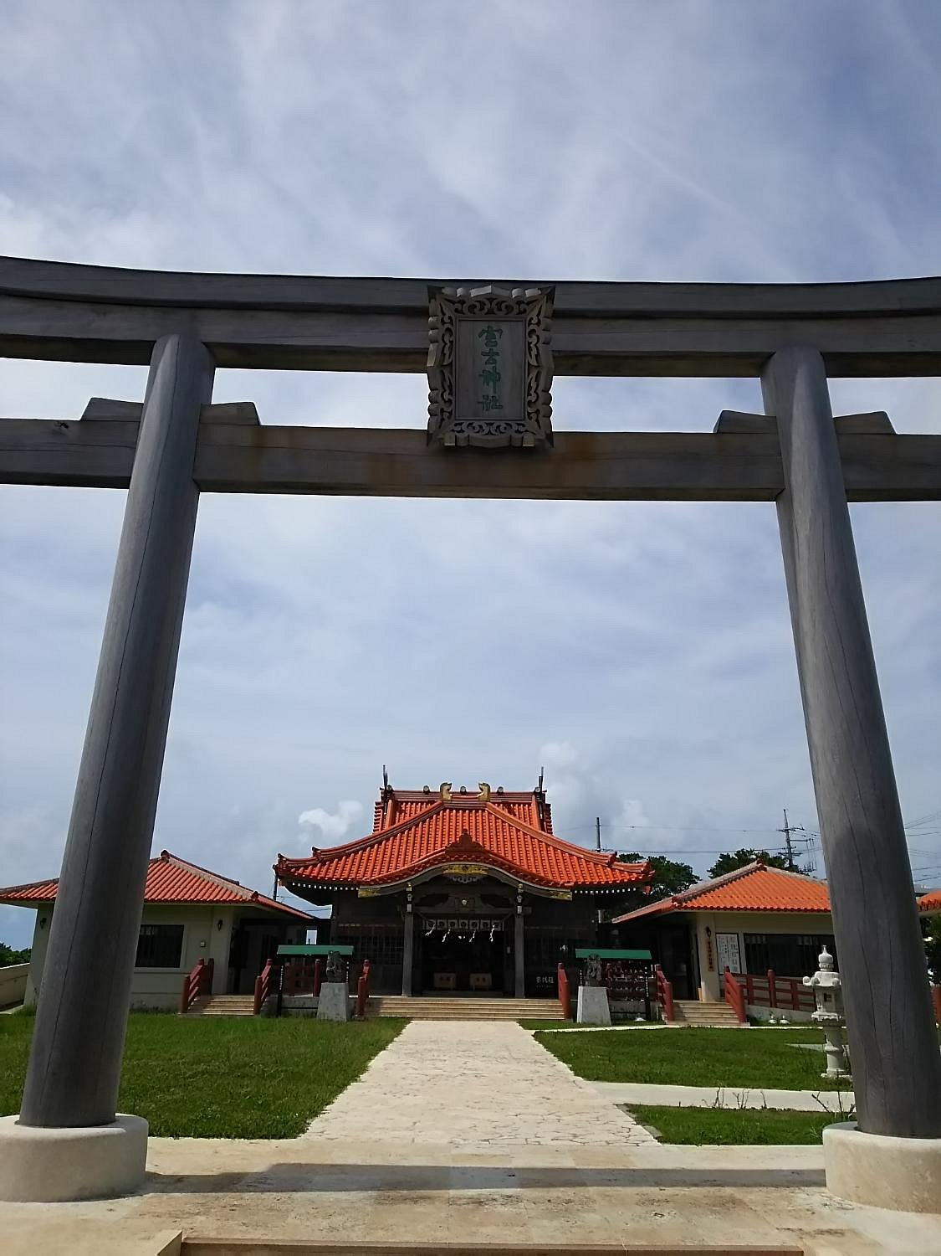
Miyako Shrine
Just a stone’s throw away from Miyako Daiichi Hotel, a peaceful and serene place to visit.
Miyako Shrine was erected in 1590 and is the shrine situated at the southernmost location in Japan (as a shrine that is under the comprehensive administration of the Jinja Honcho or Association of Shinto Shrines). Kumamo Mikami (three deities of Kumano) and Toimiya Mikami (local ancestral leaders) are worshiped here. The building was once a church. A cross can be seen on the roof.

Slide 11
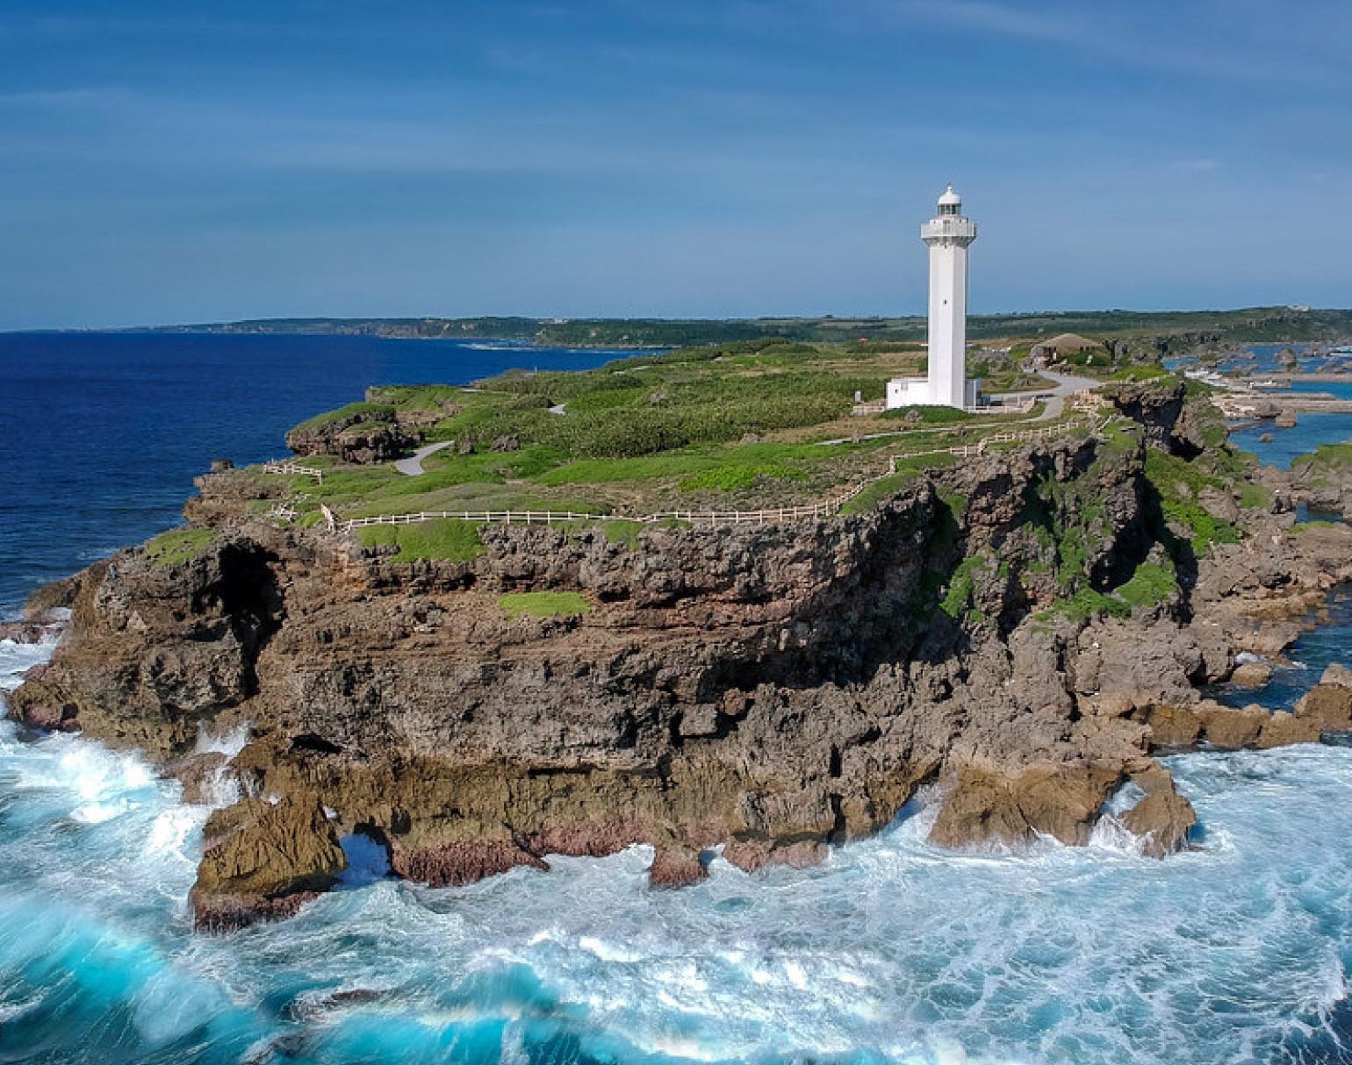
Higashi Hennazaki Lighthouse
The cape of Higashi-henna-zaki Miyako is a
nationally designated Place of Scenic Beauty
located at the southeasternmost point of Miyako
Island, Okinawa Prefecture, Japan. It is
connected by a road No. 83.
At the end of the cape is a white lighthouse
which gives 320° panorama view of the ocean,
a very popular spot for sunrise viewing.
The lighthouse was erected in 1967 with the
assistance from the Japanese government after a man called Mr. Sunakawa, who was head of the local fishing union, had become concerned by several severe boating incidents near the coast of Higashi Hennazaki

Slide 12
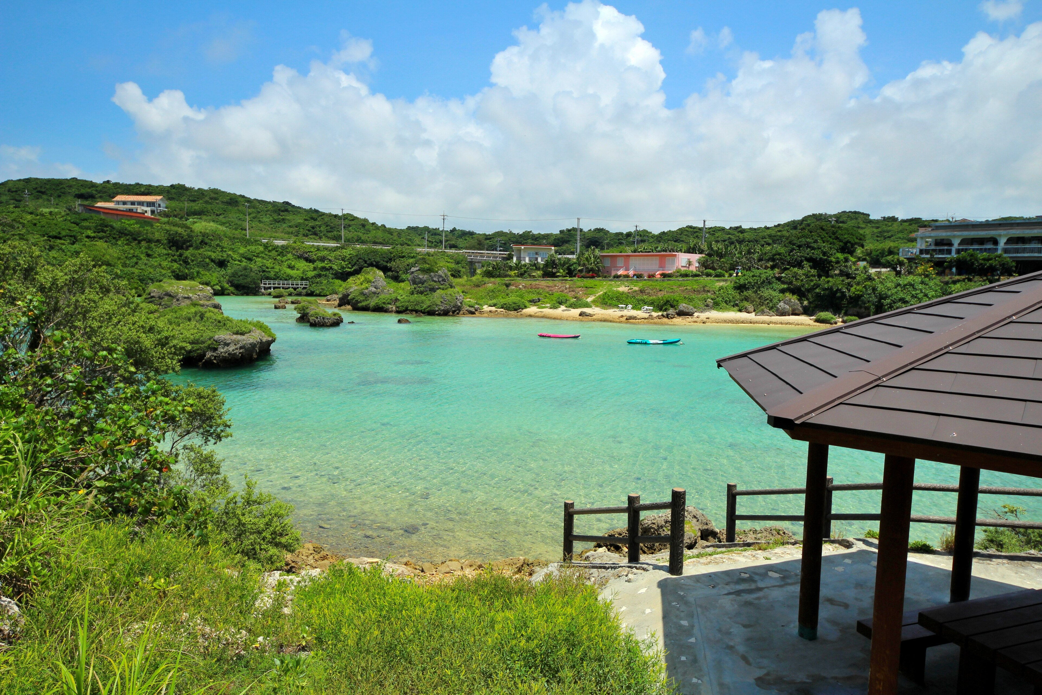
Imugya Marine Garden
Located on the southern shore is where you'll find Imgya Marine Garden. It's free, which means you'll have more money in your pocket to explore! Some other recommended attractions around the protected ocean area include Maebama Beach, Shigira Beach, and Hirara Tropical Botanical Garden. Discover a mesmerizing underwater world at Miyakojima Marine Park. Full of colorful and curious creatures, it's the perfect place to learn about marine life.

Slide 13
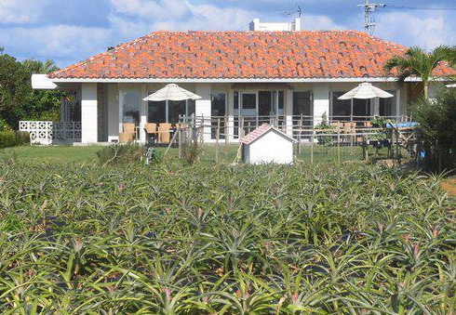
Maipari Miyakojima Island Tropical Fruit Park
The orchard features fields of tropical fruit trees and plants including bananas, pineapples, and coconuts, allowing visitors to experience a tropical atmosphere. It also offers horseback riding on Miyako horses. The orchard also offers tropical guided tours in which participants are driven around the grounds in a golf cart by a staff member. The trip takes about 25 minutes. Juice, ice cream, and other items made with fresh fruit are sold at the orchard's cafe. This is a good place to spend an hour.
Feed the goats and see many different tropical species many in bloom or with fruit. The shop also sells delicious fruit smoothies.

Slide 14
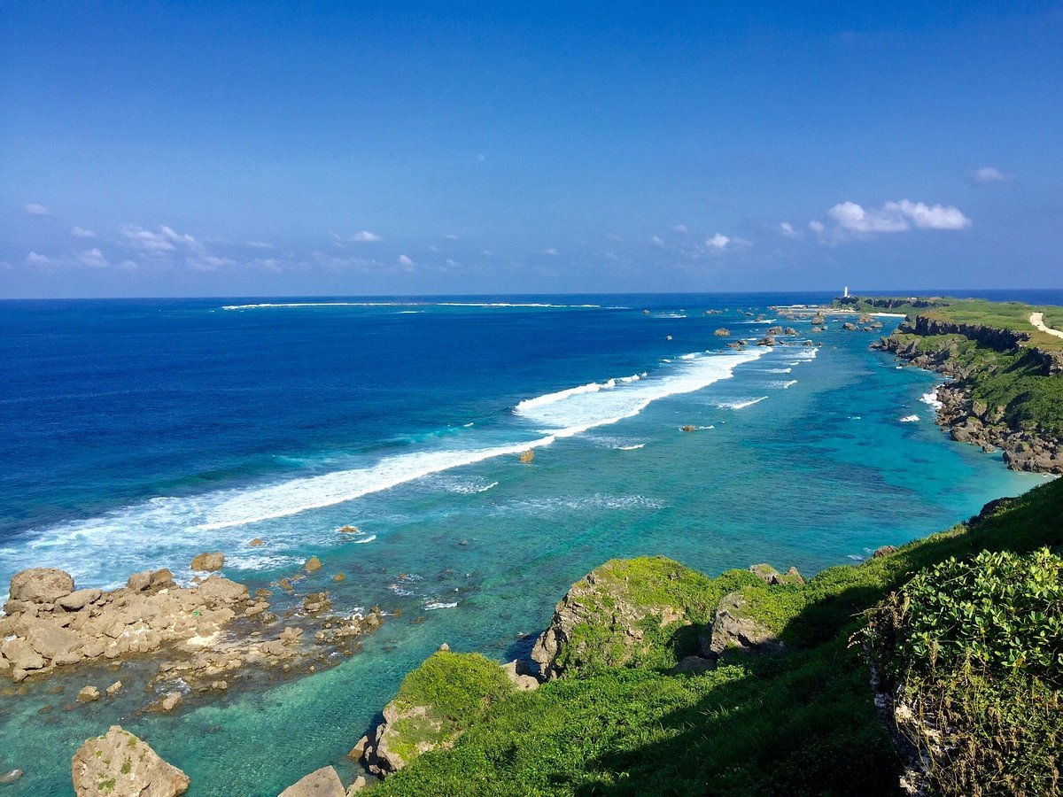
East Henna Cape
You can really enjoy the dynamic cobalt blue sea and beach; unlike anything you have ever seen.
Despite the powerful waves pounding against the cliffs, the calm serenity there can be a very unique experience.
The East Henna Cape is stunningly beautiful and well worth the visit.

Slide 15
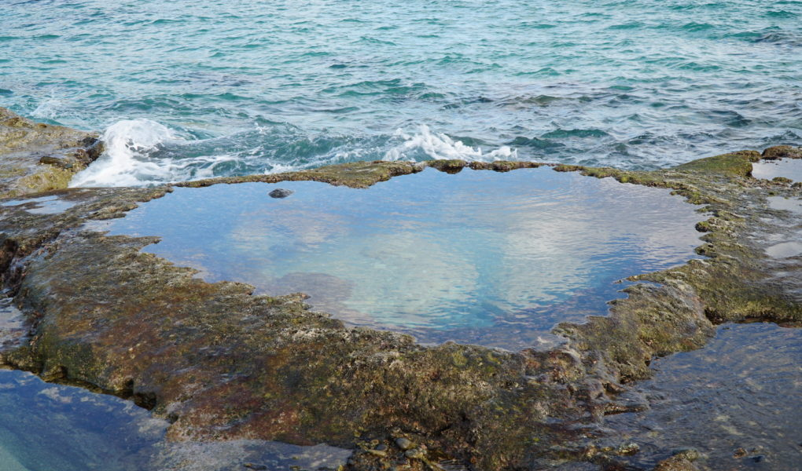
Heart Rock
The Heart Rock on Amami Oshima is a tidal pool, shaped like a heart. The spot has been popular for years and is known as a power spot. It is a highly popular location for couples and good friends to take photos together. Located near the narrowest point on Amami Oshima is Heart Rock. To get there it is necessary to walk a couple of minutes through the
wild and beautiful green forest which
borders the coast. After making your
way through the large leaves and lush
greenery, which seemingly attempts to
reclaim the path, you arrive on a
beautiful, sandy beach.

Slide 16
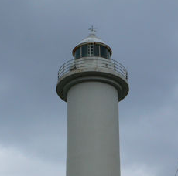
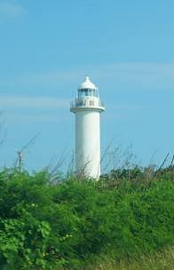
Ikemashima Lighthouse
Ikemajima Lighthouse is located at the northern end of Ikemajima, which is north of Miyakojima. The Ikemajima Lighthouse was built in 1940 but was temporarily destroyed in the war and then reconstructed.
Today, meteorological observation equipment is installed, and it is one of the meteorological observation bases. There is no observatory in particular, so you can only see the exterior.

Slide 17
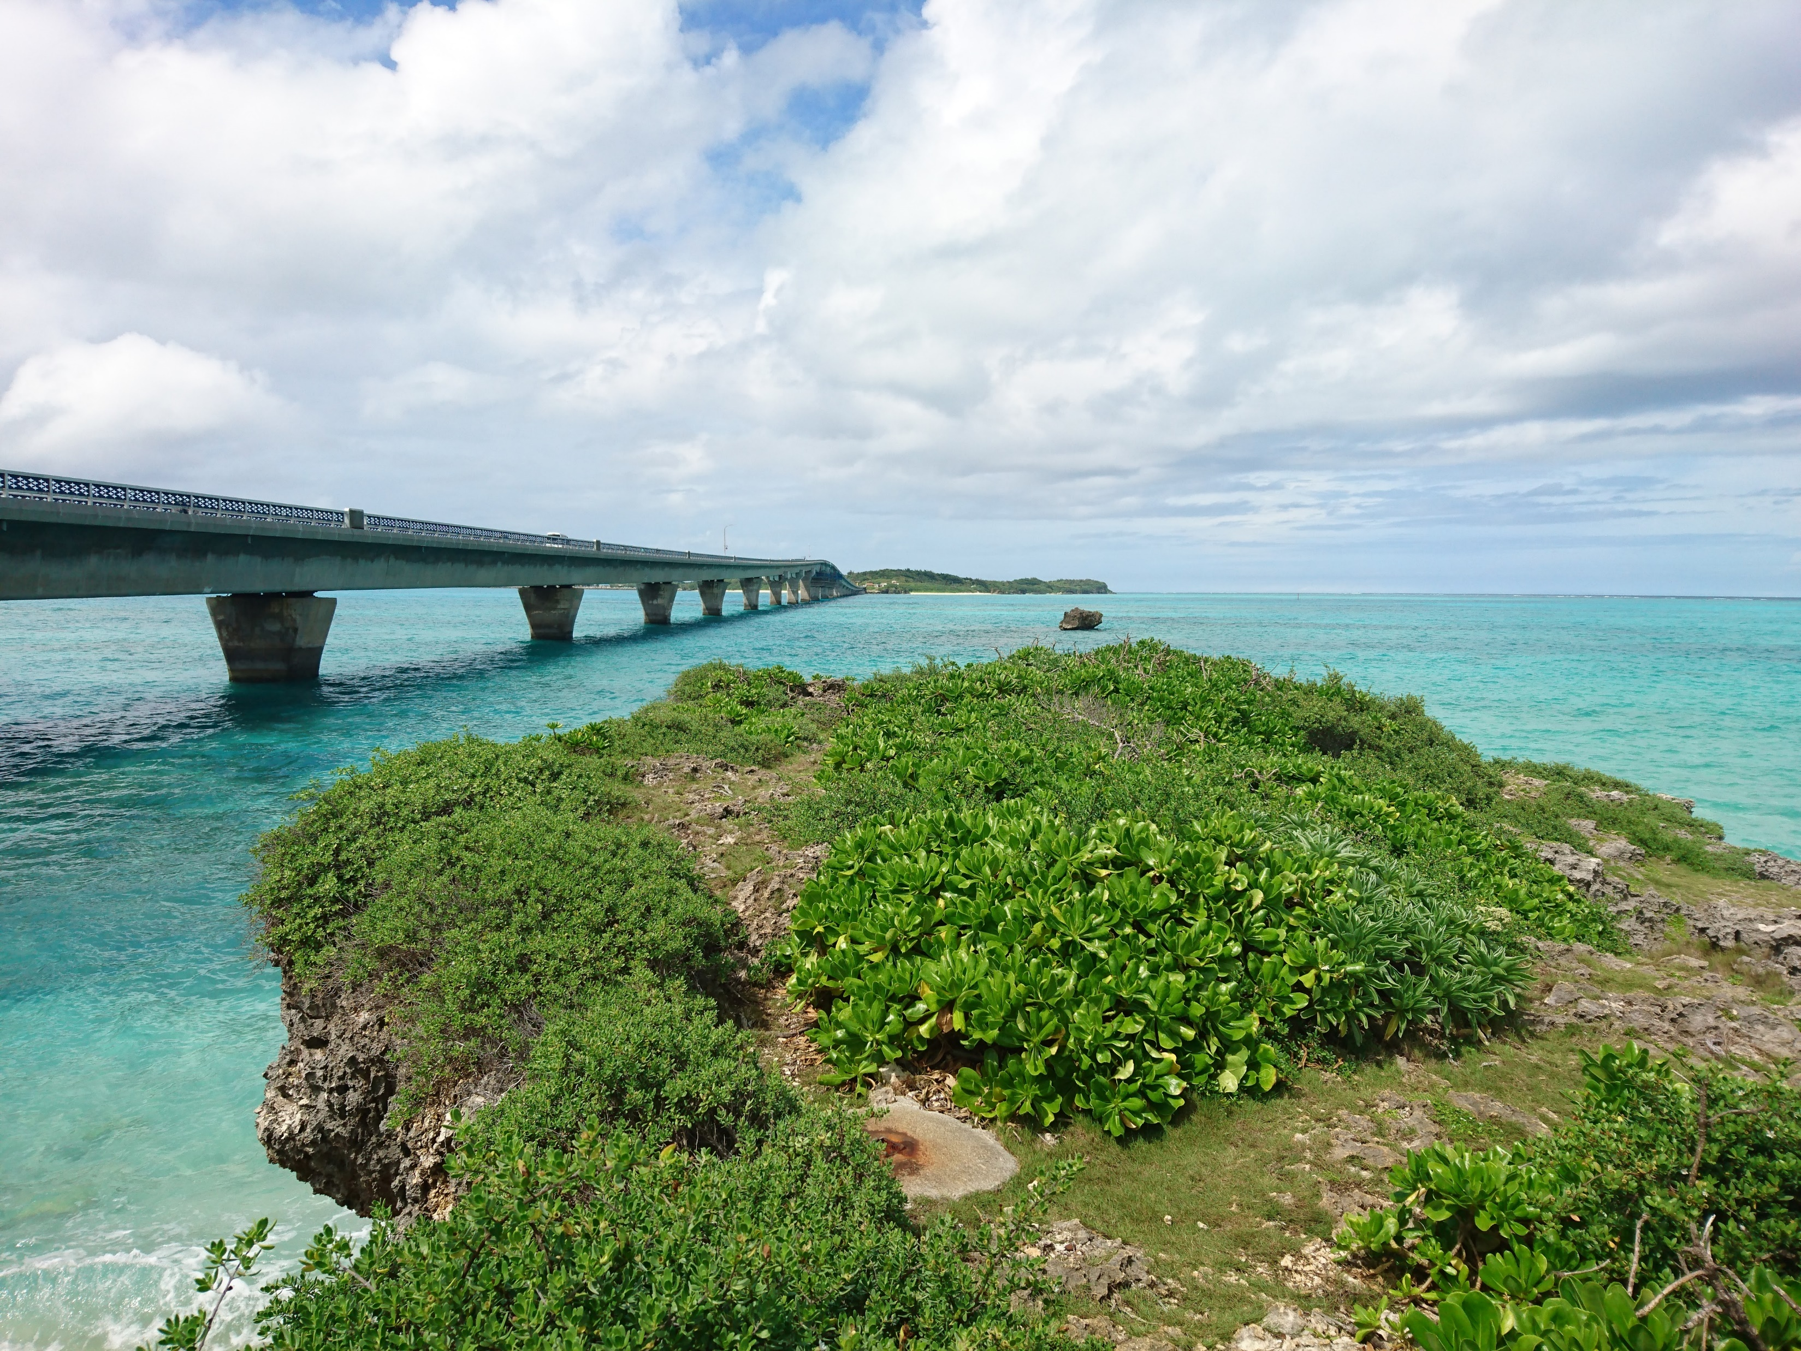
Ikema Ohashi Bridge
The Ikema Ohashi Bridge is a 1,425-meter-long bridge connecting Miyako Island and Ikema Island. It had a total construction cost of 9.9 billion yen and opened in February 1992. The bridge is popular as the perfect driving course due to it running over very clear emerald green seas. The bridge connects the Main island with Ikema island on the north side.

Slide 18
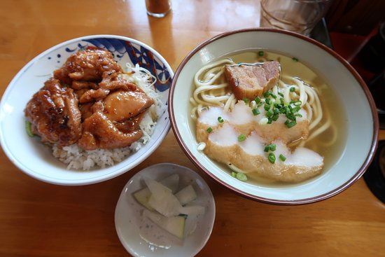
Miyakojima Restaurants
Many of us on the ship are foodies, so naturally, we’re always on the hunt to eat at the most exclusive spots anytime we travel.
Here are a few fine Restaurants to consider.
Hirochan Shokudo - $$ - $$$ Japanese International
746-9 Ueno Miyaguni, Miyakojima
Goya - $$ - $$$ Japanese
570-2 Hirara Nishizato, Miyakojima
Blue Turtle - $$$ Italian
1352-16 Irabu Irabu, Miyakojima
Blue Turtle $$ - $$$ Italian
1352-16 Irabu Irabu, Miyakojima
Blue Turtle $$ - $$$ Italian
1352-16 Irabu Irabu, Miyakojima
For those of you that just like good food, you can’t go wrong just about anywhere you go in _____.
GOOD EATING

Slide 19
Conclusion
Miyakojima is a beautiful City with a rich history and numerous attractions. Whether you're looking for stunning beaches, historic sites, or unique attractions, Miyakojima has something for everyone.
I hope this presentation will help when we visit Miyakojima!

Slide 20
Thanks For Coming
If you have any more questions, please ask.
I will do my best to answer them for you.
Have a great visit to Miyakojima!

