Slide 1
Miami
Sun, Style, and Cultural Fusion
Presented by
Marc Silver

Slide 2
What I Will Cover
My Port Philosophy
Don’t Miss the Ship
Where Are We
About Maimi
Getting Around Maimi
Some Top Attractions
Cuisine
Practical Tips
Conclusion

Slide 3
My Port Philosophy
I have been cruising for over 46 years and have taken over 100 cruises.
So, I consider myself an experienced cruiser.
The information I will present is based on those many years of experience.
When I am on a cruise where the city, I want to visit is not the port city,
I always recommend taking a ship’s tour.
But when I am in a port with multiple attractions nearby and easy to see on my own -
I will do it on my own.
This presentation is for that type of port.

Slide 4
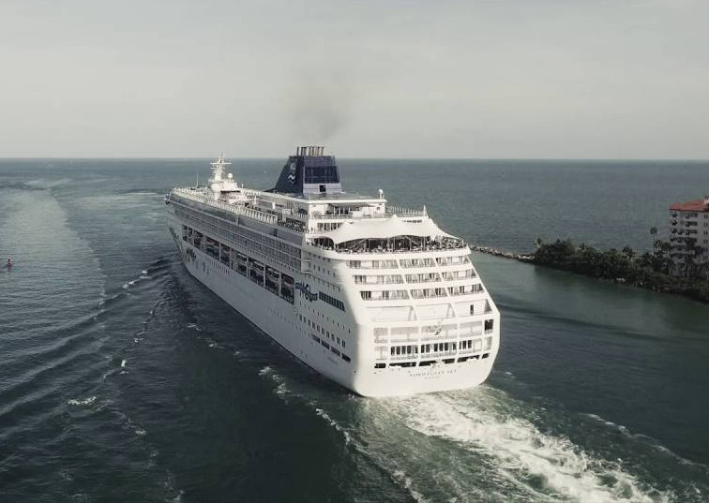
Don’t Miss the Ship
How to Avoid Missing Your Ship
Pay attention to the time. - Ship time and local time
are often different.
Put a return-to-ship reminder on your phone.
Choose excursions wisely.
If a ship-sponsored excursion is late returning to
port, the ship will wait for you.
If you are on your own they won’t.
Be Prepared
Have your Passport, Credit Card, and phone numbers for your ship port agent.
What to Do If You Miss the Ship
Most cruise lines have port agents stationed in the port area to assist if your ship has left without you. If your are lucky, when cruisers are late returning to the vessel, the ship’s crew will often remove the passengers’ essential items – passports, cell phones, and medication -- from the ship to leave with the port agents.
The Port Officials can help you with contacting your ship
and making necessary travel arrangements.

Slide 5
Where Are We
Miami sits on Florida’s southeastern coast, bordered by Biscayne Bay and the Atlantic Ocean.
It’s a global hub for travel, business, and beach life , where Latin America meets the U.S.

Slide 6
About Maimi
Miami dazzles as America's most vibrant tropical metropolis, where Latin American culture pulses through sun-drenched streets and Art Deco landmarks line pristine beaches.
This gateway city uniquely blends Caribbean warmth with cosmopolitan sophistication, Spanish flows as freely as English, while world-class art galleries and electrifying nightlife attract global visitors year-round.
Nestled between the Everglades' wild beauty and the Atlantic's turquoise waters, Miami offers an unmatched fusion of natural wonders and urban energy.
From authentic Cuban coffee in Little Havana to cutting-edge cuisine in the Design District, Miami captivates with its multicultural spirit, endless sunshine, and infectious joie de vivre that transforms every visitor into a temporary local.

Slide 7
A Brief History
Miami was officially founded in 1896 when Henry Flagler's railroad reached the tropical coastline, transforming a small settlement into a city.
The name honors the Mayaimi tribe who historically inhabited the Lake Okeechobee region.
During the roaring 1920s, Miami experienced explosive growth as America's premier winter resort destination, attracting wealthy northerners seeking sunshine and luxury.
The real estate boom of that era established Miami's reputation as a glamorous escape.
Today, the city has evolved far beyond its resort origins into a dynamic international hub, serving as the vital cultural, financial, and commercial gateway connecting North and South America.

Slide 8
The Landscape
Miami is known for its tropical climate, palm-lined boulevards, and white-sand beaches.
Biscayne Bay and the
Everglades frame the
city’s natural beauty.
Downtown and Brickell
define its modern skyline.

Slide 9
Getting Around Miami
Miami offers diverse transportation options including taxis, rideshares, and public transit. Taxis are metered and readily throughout the city.
Rideshare services like Uber and Lyft are extremely popular and convenient in Miami. Simply request a ride through the app to get upfront pricing, track your driver in real-time, and enjoy cashless payment.
The Metrorail and Metromover provide
affordable public transit options. The
Metromover is free and serves downtown
Miami, while the Metrorail connects other
key areas. Single trip: $2.25 / Daily unlimited pass: $5.65
Car rentals are popular for exploring beyond the city center, but be prepared for heavy traffic and limited parking in South Beach and downtown areas.

Slide 10
Some Top Attractions
South Beach – Iconic Art Deco architecture and nightlife.
Little Havana – Cuban culture, cigars, and cafecitos.
Wynwood Walls – Outdoor museum of street art.
Vizcaya Museum & Gardens – Italian-style villa by the bay.
Bayside Marketplace – Shopping, dining, and bay views.

Slide 11
Beaches and Outdoor Life
Miles of beaches: South Beach, Crandon Park, Key Biscayne.
Water sports include sailing, snorkeling, and jet-skiing.
Everglades National Park offers airboat rides and wildlife encounters.

Slide 12
Cuisine
Miami’s food scene is as vibrant as its people.
Try Cuban sandwiches, fresh seafood, Key lime pie, and tropical cocktails.
Trendy restaurants fuse Latin, Caribbean, and international flavors.

Slide 13
Practical Tips
Currency: U.S. Dollar (USD).
Language: English and Spanish widely spoken.
Weather: Tropical; warm year-round.
Transportation: Ride shares, trolleys, and MetroMover.
Best season: November to April for pleasant weather.

Slide 14
Day Trip Ideas
Everglades Airboat Adventure
This is Miami’s signature half-day excursion , close, wild, and memorable.
Most tours pick up near the
port, drive 40–45 minutes
west, and include a 30-minute
airboat ride through the
sawgrass marshes of Everglades National Park.
You’ll glide past alligators, herons, and egrets, with a short wildlife presentation before returning.
Total time: 3.5–4 hours round trip.
Tip: Choose tours that guarantee return by cruise departure time , several operators cater specifically to cruise passengers.

Slide 15
Day Trip Ideas
Miami City Highlights Tour
A compact, narrated drive that hits the major neighborhoods including: South Beach’s Art Deco District, Wynwood Walls, and Little Havana’s Calle Ocho.
You’ll sample Cuban coffee, see Wynwood’s outdoor murals, and still have time for a quick photo stop at Ocean Drive or Biscayne Bay.
Total time: 3.5 hours.
Best for: First-time visitors who want to see “the whole city” in one loop.

Slide 16
Day Trip Ideas
Vizcaya Museum & Coconut Grove
For a slower, elegant outing, head 15 minutes south to Vizcaya Museum & Gardens , a 1916 Italian-style villa surrounded by formal gardens and bay views.
After exploring Vizcaya, drive a few minutes to Coconut Grove, Miami’s oldest neighborhood, filled with shady banyan trees and outdoor cafés.
Total time: 3–3.5 hours.
Best for: History, architecture,
and scenic tranquility close to
the port.

Slide 17
Day Trip Ideas
South Beach & Ocean Drive Stroll
If you’d rather skip a tour, grab a cab or rideshare (about 15 minutes) to South Beach.
Walk along Ocean Drive, admire the pastel-colored Art Deco hotels, or relax at Lummus Park Beach. Add a quick bite at a beachfront café, then return to the ship.
Total time: 3 hours including transport.
Best for: Low-stress beach time and people-watching.

Slide 18
Day Trip Ideas
Coral Gables Drive and Venetian Pool
If you prefer something quieter and greener,
Coral Gables is only 25 minutes away.
Drive past the Biltmore Hotel, explore the
shaded boulevards, and stop by the
Venetian Pool, a historic spring-fed
swimming grotto built in 1923. Even if you
don’t swim, it’s worth seeing.
Total time: 3.5 hours.
Best for: Architecture lovers and return visitors who’ve already seen South Beach.
Timing Notes
Plan to be back at the port no later than 90 minutes before sail-away to allow for traffic.

Slide 19
Reflections
“Miami isn’t just a place , it’s a mood.”
From sunrise yoga on the beach to sunset cruises on the bay, the city celebrates life with color and rhythm.

Slide 20
Conclusion
Maimi is a beautiful City with a rich history and numerous attractions.
Whether you're looking for stunning views, historic sites, or unique attractions, Ketchikan has something for everyone.
I hope this presentation will help when we visit Maimi.

Slide 21
Thanks For Coming
If you have any more questions, please ask.
I will do my best to answer them for you.
Have a great visit in Maimi!

Slide 22
Q&A
Questions & Curiosities
Let’s explore this Magic City together!

