Slide 1
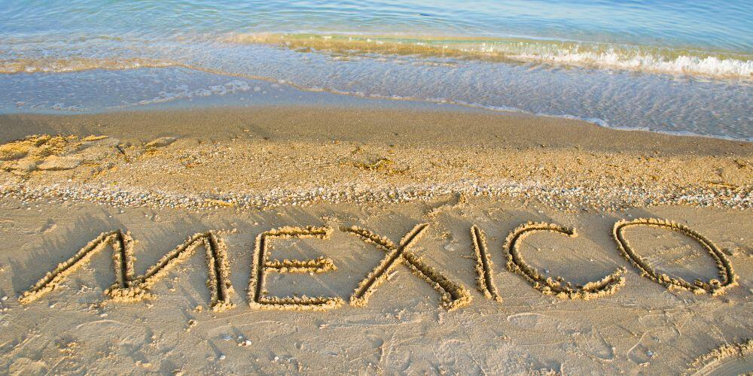
MEXICO IS FUN, INTERESTING, AND FULL OF SURPRISES Presented by: Marc Silver

Slide 2
MEXICO IS FUN, INTERESTING, AND FULL OF SURPRISES
Welcome fellow explorers. If you’ve ever thought of Mexico as simply beaches, burritos, and spring break spots, you’re missing out on one of the most complex, surprising, and downright fascinating countries in the Americas.
This seminar isn’t a travel brochure or a history lecture.
It’s an exploration into the strange, the significant, and the smile-inducing facts that make Mexico. One of the most interesting countries on the map.
Let’s take a stroll through some of the most unexpected, amusing, and intriguing truths about our southern neighbor.

Slide 3
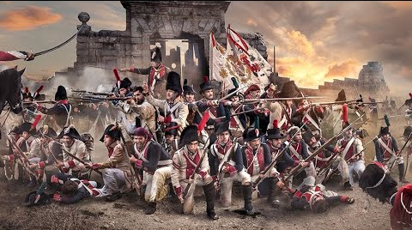
MEXICO: IT’S OLDER THAN YOU THINK
Mexico officially became a country in 1821 after a brutal war of independence against Spanish rule.
But long before it was Mexico, it was home to advanced civilizations like the Olmecs, Maya, and Aztecs.
We’re talking pyramids, cities, and writing systems while much of Europe was still fumbling through the Dark Ages.
Mexico’s War of Independence

Slide 4
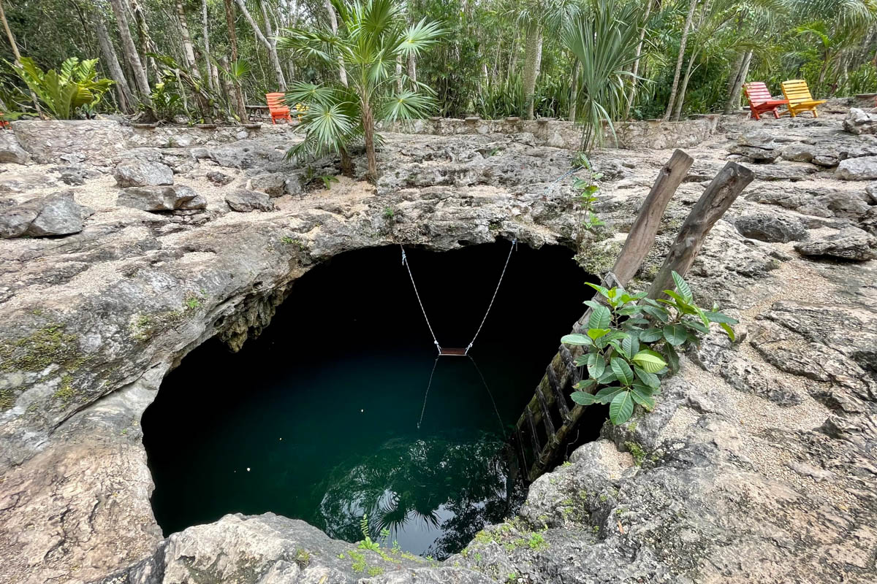
MEXICO: IT’S OLDER THAN YOU THINK
In fact, human civilization here dates back to over 8,000 BC.
That makes Mexico one of the six cradles of civilization, alongside Mesopotamia, Egypt, India, China, and Peru.
Prehistoric Human Skeleton Found Near Tulum
Dating Back over 8000 Years

Slide 5
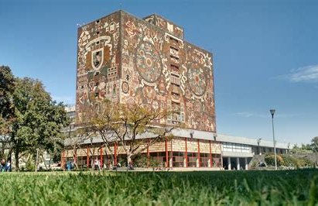
MORE OLD THINGS
And while we’re on the topic of old things...
Mexico is also home to the oldest university in North America. The National University of Mexico was founded in 1551, more than a century before Harvard or Yale.
That’s how far back the country’s academic roots stretch.
The University of Mexico

Slide 6
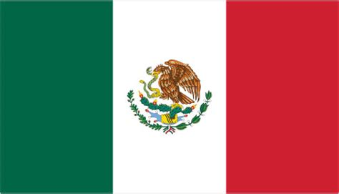
AZTECS, GODS, AND A CITY ON A LAKE
Mexico’s capital, Mexico City, was once Tenochtitlan, an Aztec metropolis floating on a lake. According to legend, the Aztecs were told to settle where they saw an eagle perched on a cactus eating a snake. They found it in the middle of Lake Texcoco, and that’s where they built their city.
That image? It’s now the center of the Mexican flag.
Mexico City still bears the bones of its past. But it’s also sinking, literally. Built on a lakebed, parts of the city have dropped over 30 feet in the past century as groundwater is pumped from beneath.
And yes, it’s congested. According to GPS data, it has some of the worst traffic in the world.
Figure 4 Flag of Mexico

Slide 7
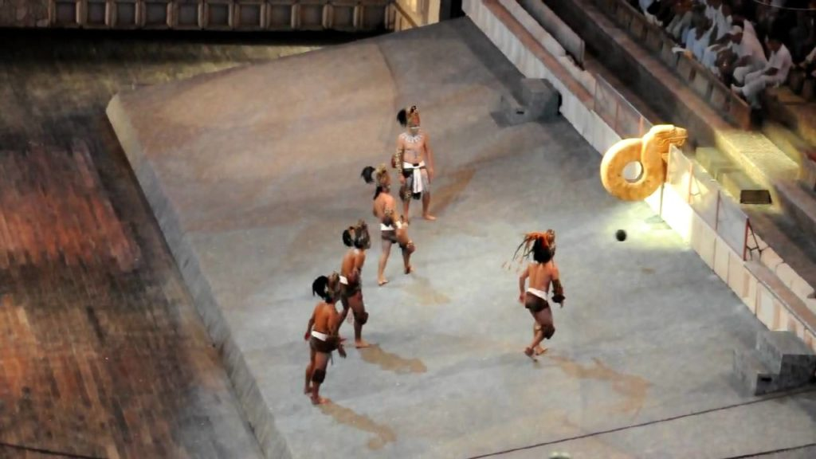
CIVILIZATIONS THAT INVENTED GAMES, POPCORN, AND... MASS SACRIFICE
Let’s talk human sacrifice. The Aztecs weren’t shy about it. They believed it pleased the gods. Around 250,000 people per year were sacrificed at their peak, often prisoners or slaves.
But they weren’t all blood and brutality. The Aztecs also played one of the world’s oldest sports. Called tlachtli, it used a solid rubber ball and a stone hoop.
You could only use your hips, forearms, or a stick to get the ball through the hoop.
Losers sometimes paid with their lives.
Welcome

Slide 8
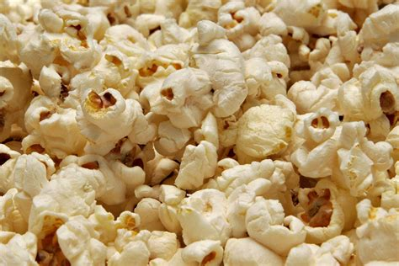
FULL OF SURPRISES
Another Mesoamerican invention?
Popcorn.
Domesticated in Mexico 9,000 years ago.

Slide 9
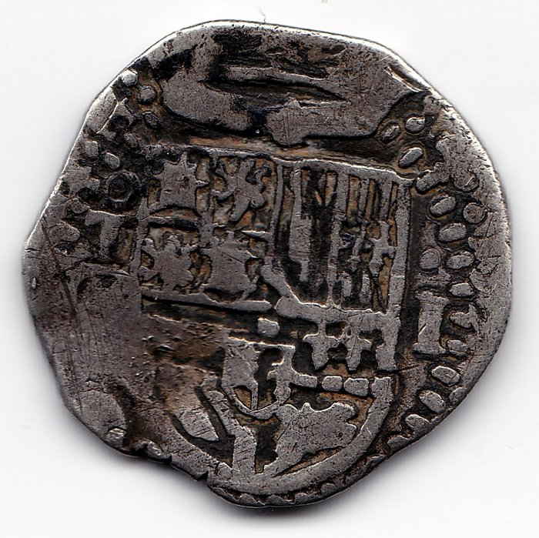
THE WORLD’S FIRST GLOBAL CURRENCY
Here’s one for the treasure hunters: Mexico minted the first global currency. The silver peso, or Spanish dollar, was used everywhere from Europe to Asia.
Pirates called them Pieces of Eight.
They were minted using silver from Mexico’s vast mines. Even today, Mexico is the world’s top silver producer.
Spanish Silver Peso

Slide 10

A LAND OF LAWS, LEGENDS, AND LINGUISTIC CURVEBALLS
Mexico has 68 official languages and over 300 dialects. Spanish may be dominant, but indigenous languages like Nahuatl and Yucatec Maya are still spoken.
And what does "Mexico" mean? No one agrees. Some say it refers to the god of war. Others say it means "navel of the moon.“
What is certain is that Mexico has given the world some truly odd laws. In the city of Torreon, you can be fined for grooming behind the wheel, specifically for shaving or putting on makeup while driving .
It's part of the local traffic laws aimed at reducing distracted driving, even if it sounds a little unusual.

Slide 11
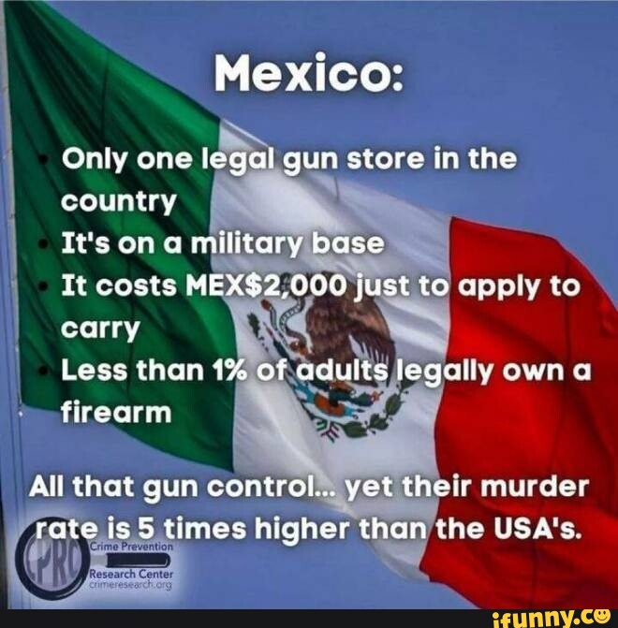
A LAND OF LAWS, LEGENDS, AND LINGUISTIC CURVEBALLS
Professional Artists can pay their taxes in artwork.
Mexico once held a funeral for a general’s amputated leg.
There’s also just one legal gun store in the entire country—and it’s on a military base in Mexico City.

Slide 12
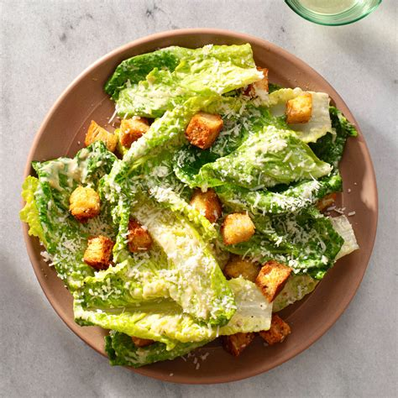
FOOD: THE FLAVOR THAT CONQUERED THE PLANET
Forget Tex-Mex. Real Mexican cuisine is UNESCO-recognized. It’s the home of chocolate, vanilla, avocados, tomatoes, and chilies.
And yes, the Caesar salad was invented in Mexico. In Tijuana, to be exact, by an Italian-American chef.
Caesar Salad

Slide 13
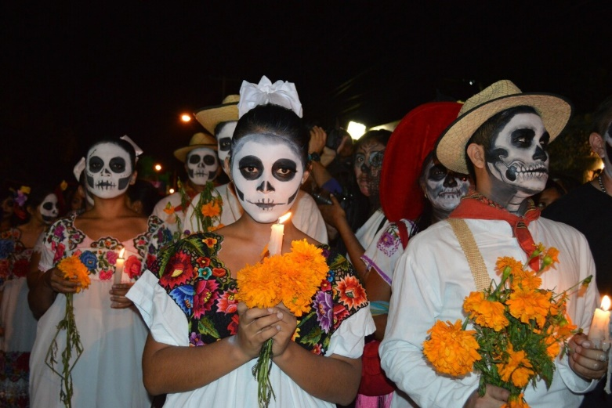
FAITH, FAMILY, AND FESTIVITIES
Mexico has the second-largest population of Roman Catholics in the world, after Brazil.
Religion is deeply woven into its festivals, especially the Day of the Dead, when families gather to remember lost loved ones with altars, food, and marigolds.
Family is central to Mexican life.
Elders are respected. Hospitality is sacred.
And while kids do get presents, it’s not always on December 25.
Many children receive gifts on January 6, Three Kings’ Day, instead.
Day of the Dead Festival

Slide 14
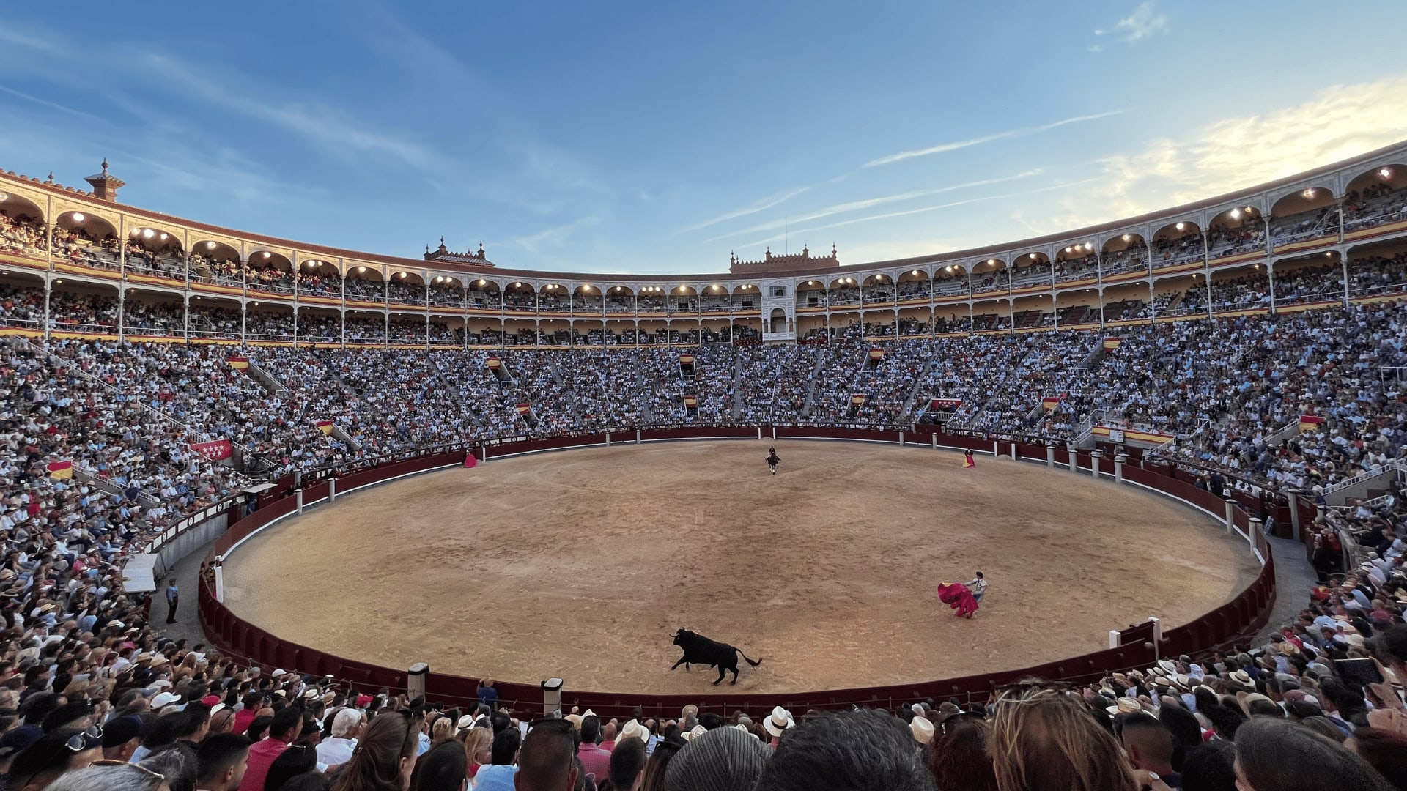
MUSEUMS, MONUMENTS, AND MEGA-CITIES
Mexico City isn’t just big. It’s enormous. And culturally rich.
It has more museums than any city in the world. More concert halls than most countries. And the world’s largest fleet of taxis, over 100,000.
It’s also home to the world’s largest bullring and Latin America’s busiest airport.
World’s largest bullring Mexico City

Slide 15
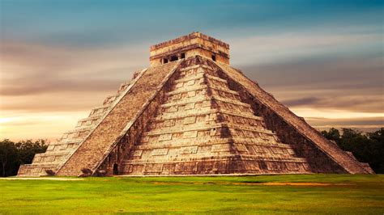
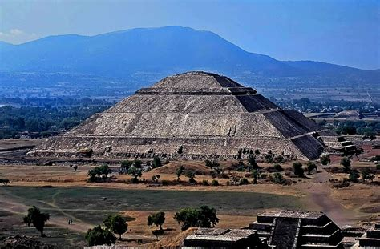
MUSEUMS, MONUMENTS, AND MEGA-CITIES
Then there’s Chichen Itza, a pyramid that draws over two million visitors a year and is considered one of the New Seven Wonders of the World.
Cholula
Chichen Itza
And don’t forget Cholula, the largest pyramid in the world by volume, hidden beneath a grassy hill.

Slide 16
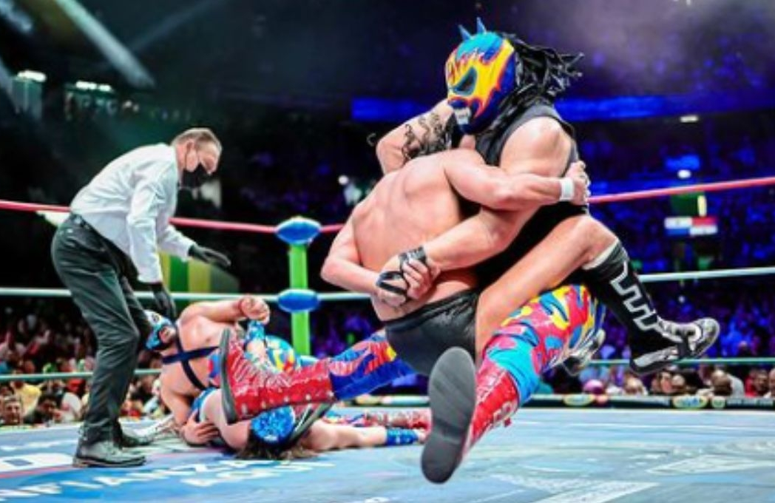
STRANGE SPORTS, RARE RABBITS, AND COLORFUL CHICKENS
Mexico’s national sport isn’t soccer, it’s charrería, a kind of rodeo.
But lucha libre, or Mexican wrestling, is a close runner-up with its masks, flips, and high drama.
Lucha Libre Mexico's Wrestling

Slide 17
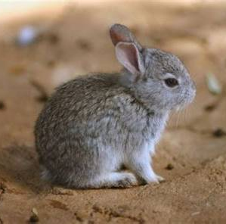
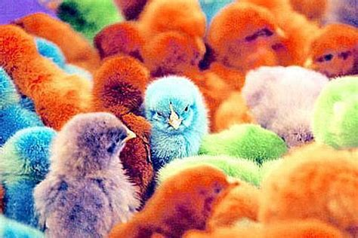
STRANGE SPORTS, RARE RABBITS, AND COLORFUL CHICKENS
You’ll also find unique critters here: like the Volcano Rabbit, tiny, endangered, and found only near Mexico’s volcanic peaks.
And yes, you can buy dyed chickens in bright colors in some rural markets.

Slide 18
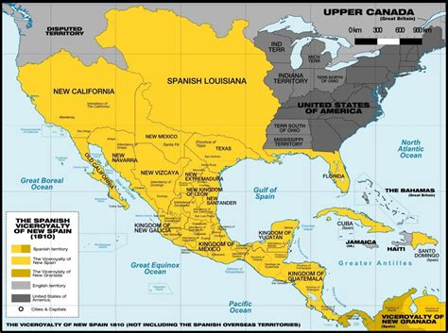
A LAND THAT SHAPED A CONTINENT
At one point, Mexico stretched from Guatemala all the way up through California, Arizona, New Mexico, Nevada, and Utah. Even Texas was Mexican territory until 1836.
After the Mexican-American War, Mexico lost about half its land. But its influence is still strong across the U.S., especially in language, food, and place names.
And today, Mexico is home to the world’s largest population of Spanish speakers, even more than Spain itself.

Slide 19
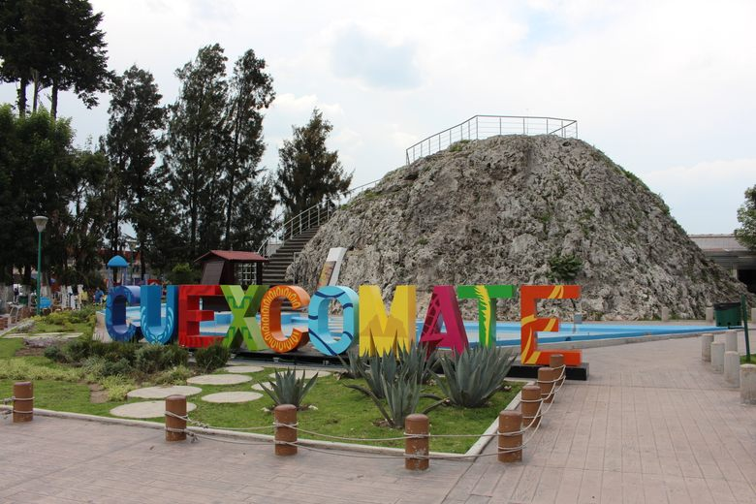
A Tiny Volcano
The Cuexcomate Volcano, just outside Puebla, is the smallest volcano in the world at just 43 feet tall.

Slide 20
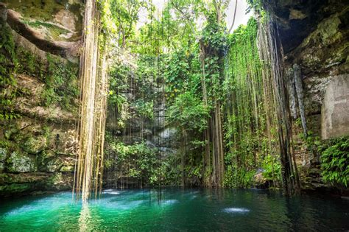
Country of Holes
Mexico is home to the most cenotes on the planet, with more than 6,000 of these magical sinkholes

Slide 21
FINAL THOUGHTS
THE VIBRANT MOSAIC CALLED MEXICO
Mexico is not one story, it’s thousands. It’s ancient temples and modern megacities.
It’s tacos and tlachtli, pyramids and popcorn, Catholic cathedrals and Aztec sacrifice.
It’s the sound of mariachi at a family party and the smell of grilled corn on a city street. It’s a place where contradictions live comfortably together.
What makes Mexico so fascinating isn’t just its history or culture, it’s the way it never stops being surprising.

Slide 22
Thank You for Coming
I hope I’ve educated and entertained you today.
I can be contacted by e-mail at marc@soundscapeav.com

Slide 23
REFERENCES
UNESCO World Heritage Centre: whc.unesco.org
National Institute of Statistics and Geography (INEGI), Mexico
OECD Report on Working Hours (2017)
CIA World Factbook
The World Pursuit: Fun Facts About Mexico (source document)
Mexico’s National Institute of Anthropology and History (INAH)
Smithsonian National Museum of the American Indian
Mexican Secretariat of Culture

