Slide 1
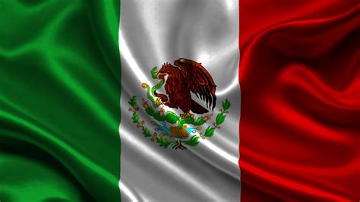
Mazatlán, Mexico
Presented by
Marc Silver

Slide 2
What I Will Cover
My Port Philosophy
Don’t Miss the Ship
Money
About Mazatlán, Mexico
History of Mazatlán, Mexico
Transportation
Points of Interest
Places to see or at least consider
A few restaurant recommendations
Conclusion

Slide 3
My Port Philosophy
I have been cruising for over 45 years and have taken over 100 cruises.
So, I consider myself an experienced cruiser.
The information I will present is based on those many years of
experience.
When I am on a cruise where the city, I want to visit is not the port city,
I always recommend taking a ship’s tour.
But when I am in a port with multiple attractions nearby and easy to see
on my own -
I will do it on my own.
This presentation is for that type of port.

Slide 4
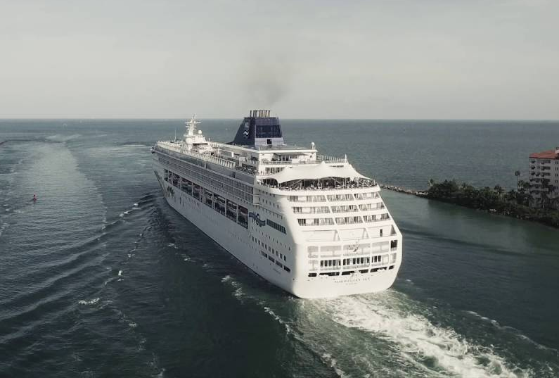
Don’t Miss the Ship
How to Avoid Missing Your Ship
Pay attention to the time. - Ship time and local time are often
different.
Put a return-to-ship reminder on your phone.
Choose excursions wisely.
If a ship-sponsored excursion is late returning to port for, the ship will
wait for you.
If you are on your own Be Prepared
Have your Passport, Credit Card and phone numbers for your ship port agent.
What to Do If You Miss the Ship
Most cruise lines have port agents stationed in the port area to assist if your ship has left without you. If you’re lucky, when cruisers are late returning to the vessel, the ship's crew will often remove the passengers' essential items -- passports, cell phones and medication -- from the ship to leave with the port agents.
The Port Officials can help you with contacting your ship
and making necessary travel arrangements.

Slide 5
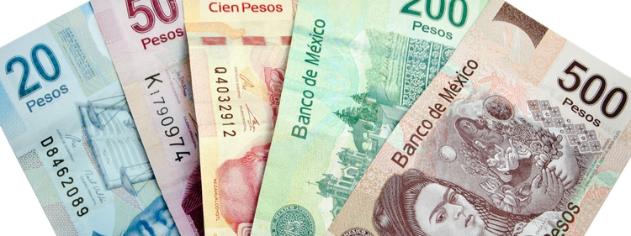
Money
The Peso is the official currency of Mexico
Official Exchange is 100 Pesos is $5.80 US
Or 17.35 Pesos to the US Dollar

Slide 6
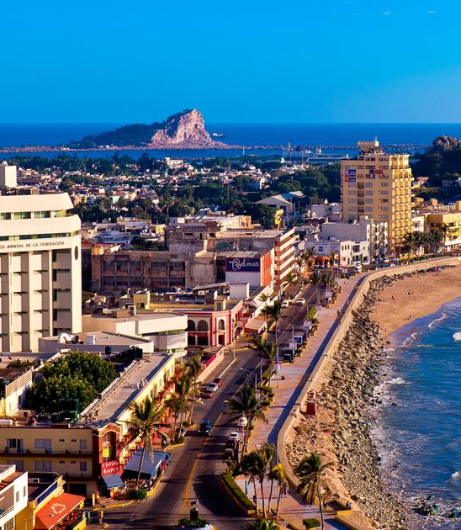
About Mazatlán
Mazatlán has a rich culture and art community. In addition to the Angela Peralta Theater, Mazatlán has many galleries and artist's studios, such as the Mazatlán's art museum, and the Museo del Arte, which both have exhibits from Mexican and international artists.
With a population of 438,434 as of the 2010 census, Mazatlán is the second-largest city in the state. It is also a tourist destination, with its beaches lined with resort hotels. A car ferry crosses the Gulf of California, from Mazatlán to La Paz, Baja California Sur. The municipality has a land area of 1,184.75 sq mi and includes smaller outlying communities.
Mazatlán is served by General Rafael Buelna International Airport.

Slide 7
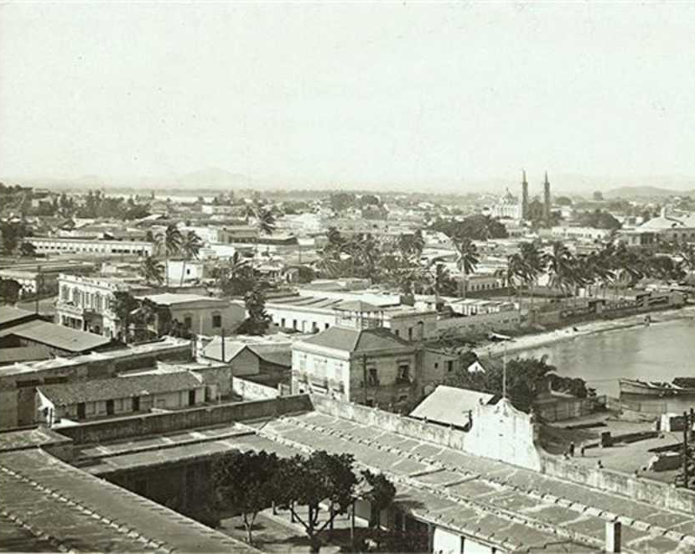
Historical Mazatlán
Indigenous groups were in the region of Mazatlán before the arrival of the Spanish. These groups included the Totorames, who lived from the south bank of the River Piaxtla to the Río de las Cañas, as well as the Xiximes, who lived in the mountains in the bordering state of Durango.
The city was colonized in 1531 by Spain. Mazatlán is a Nahuatl word for "place of deer". The Conquistador colonized the city in 1531, where many indigenous people lived.
Until the early 19th century, Mazatlán was a collection of huts inhabited by indigenous people whose major occupation was fishing.
In 1829, a Filipino banker named Juan Nepomuceno Machado arrived and established commercial relations with vessels coming to Mazatlán from far-off places such as Chile, Peru, the United States, Europe, and Asia Pacific. By 1836, the city had a population of between 4,000 and 5,000. It subsequently became the largest port on the Mexican Pacific coast.
By the mid-19th century, a large group of Germans developed the bay into a commercial seaport, importing equipment for the nearby gold and silver mines. It served as the capital of Sinaloa from 1859 to 1873.

Slide 8
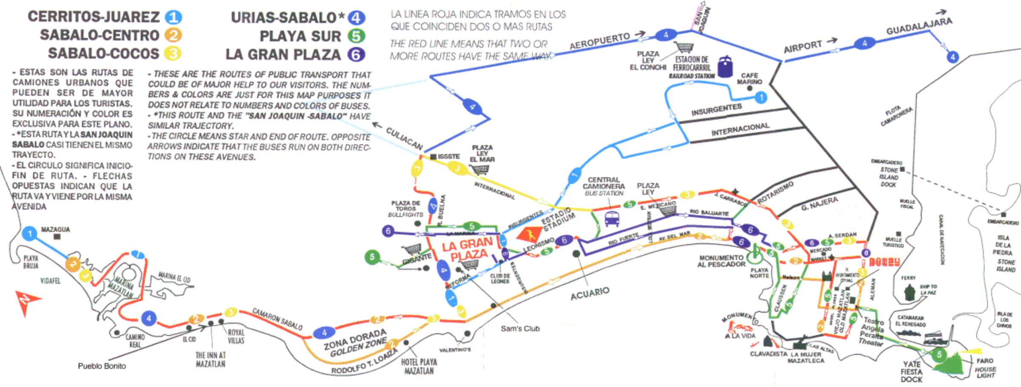
Mazatlán City Bus
Mazatlán has a very simple and inexpensive bus system with many bus routes. Traveling north and south along the Malecon makes it easy to reach not just the beaches but also the malls and shopping centers.
Traveling by bus is safe and is an interesting experience if you like to mingle with the locals.
Fares are 12.5 pesos per ride on an Air-conditioned Bus.

Slide 9
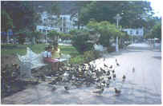

Mazatlán Taxis
Taxis in Mazatlán are plentiful. Taxis can be very reasonable, as long as you ask the price BEFORE you get in.
Fares are fixed by zones; rates for trips in town and to more distant points should be posted at local hotels.
Centro Historico to Golden Zone: MXN 200
Golden Zone/Hotel Area to Mazatlan Airport: MXN 500
Make sure you have small change. Taxis will not carry change so they can keep yours.
You do not tip taxi drivers. The tip is included in the price.

Slide 10
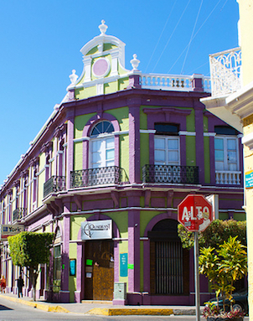
Old Mazatlán
Some of Mazatlán's most beloved sights (such as the Basilica of the Immaculate Conception) are centered in Old Mazatlán. You won't need to make a special effort to enjoy this part of town, but you can rest assured that you'll spend plenty of time there. And if you only have one day in the area, this is where travelers suggest you come.
You should come hungry. You'll have plenty of food options from restaurants to a market where you can buy produce and tamales to taco stands. Walk off your meal with a tour of the Teatro Angela Peralta opera house or a stroll along the Malecón.
Old Mazatlán is free to enjoy at any time of day but know that individual vendors will have their own operating hours and costs.

Slide 11
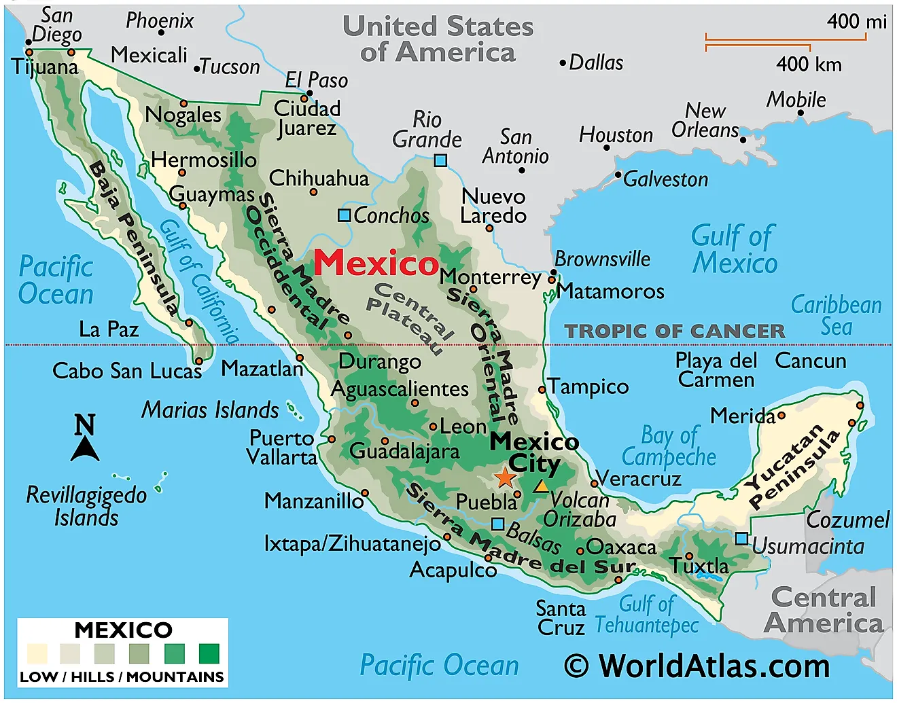

Slide 12
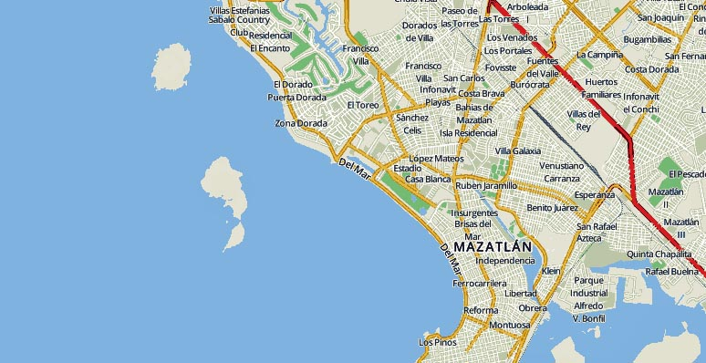

Slide 13


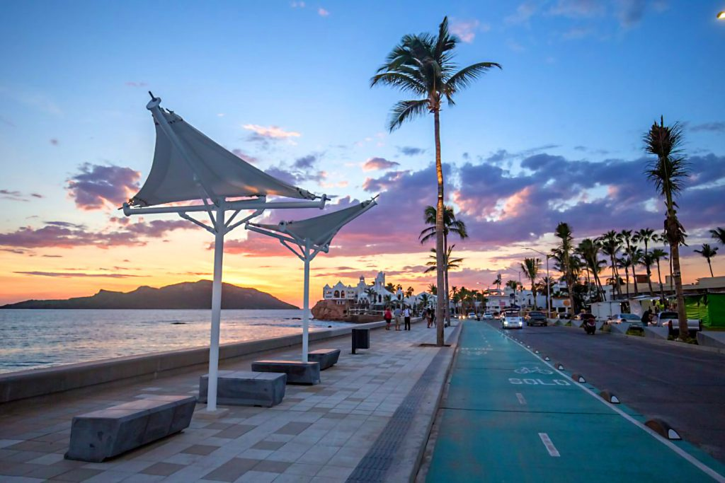
The Malecón
Mazatlán's gorgeous beachfront walkway spans 13 miles. You will see food vendors, bars, shops, and resorts on the Malecón.
Starting in the North around the
Zona Dorada (where most of the
high-end hotels can be found), it
continues along the Paseo Claussen
and through Old Mazatlán before
ending at Playa Olas Altas. Residents
and vacationers favor this stretch for
jogging, cycling or just strolling.
What you can't do on the southern
the section is sunbath because the beach
is too narrow. Head north to the Playa
las Gaviotas or south to Olas Altas if
you want to lay on the beach.

Slide 14
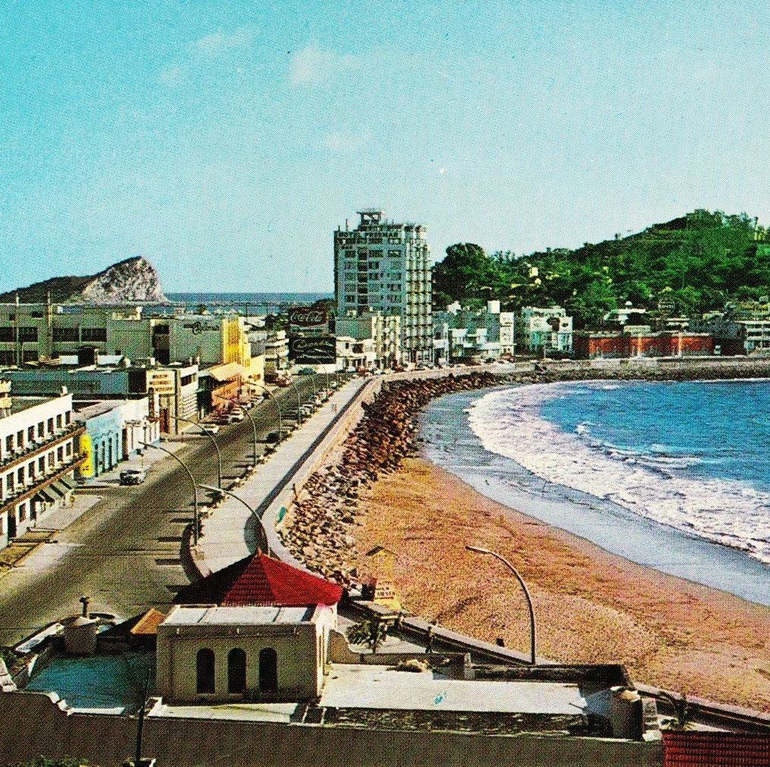
Playa Olas Altas
If you want to avoid Mazatlán’s tourist gridlock on Playa las Gaviotas visit Playa Olas Altas.
This lovely pocket of golden sand and aquamarine waves is decidedly more tranquil. The cafes in the area are also more reasonably priced.
You will see the occasional beach vendor, but if you're not interested, just say a polite but firm, "No gracias." And be warned: Playa Olas Altas means "High Waves Beach" so not for weak swimmers.
Be prepared for a 20-minute walk from the ship.

Slide 15
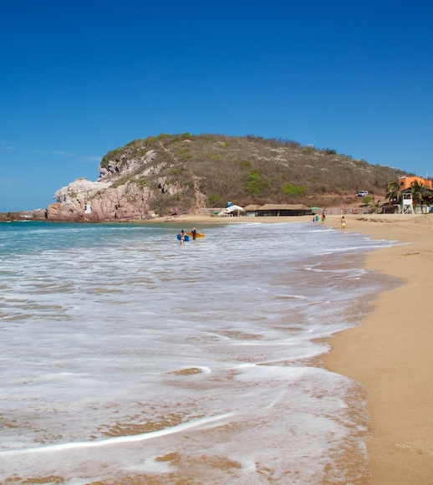
Playa Brujas
This beach is said to have been a favorite spot among witches to perform their rituals, hence its current name (brujas means "witches" in Spanish).
Today, the beach is popular with water sports fans, especially surfers who love big waves.
This is also a less crowded beach, so you’ll have more room to spread out. Swimming can be dangerous because of a sometimes-tricky undertow.
Playa Brujas is located at the northern end of Mazatlán, approximately 10 miles north of Old Mazatlán.

Slide 16
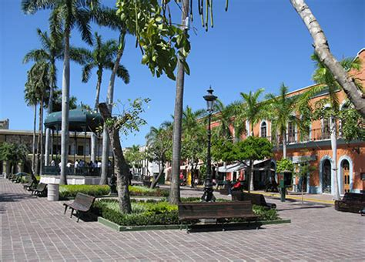
Plaza Machado
Located in the historic district, Plaza Machado is a central hub for everything from restaurants to galleries and has been since 1837.
Check out the French- and Spanish-influenced architecture, listen to local musicians perform, and simply take in this public square, which is popular not only with tourists but also with locals.
This lively spot is fun for people-watching and shopping.
The plaza is just around the corner from the Teatro Angela Peralta in Old Mazatlán.

Slide 17
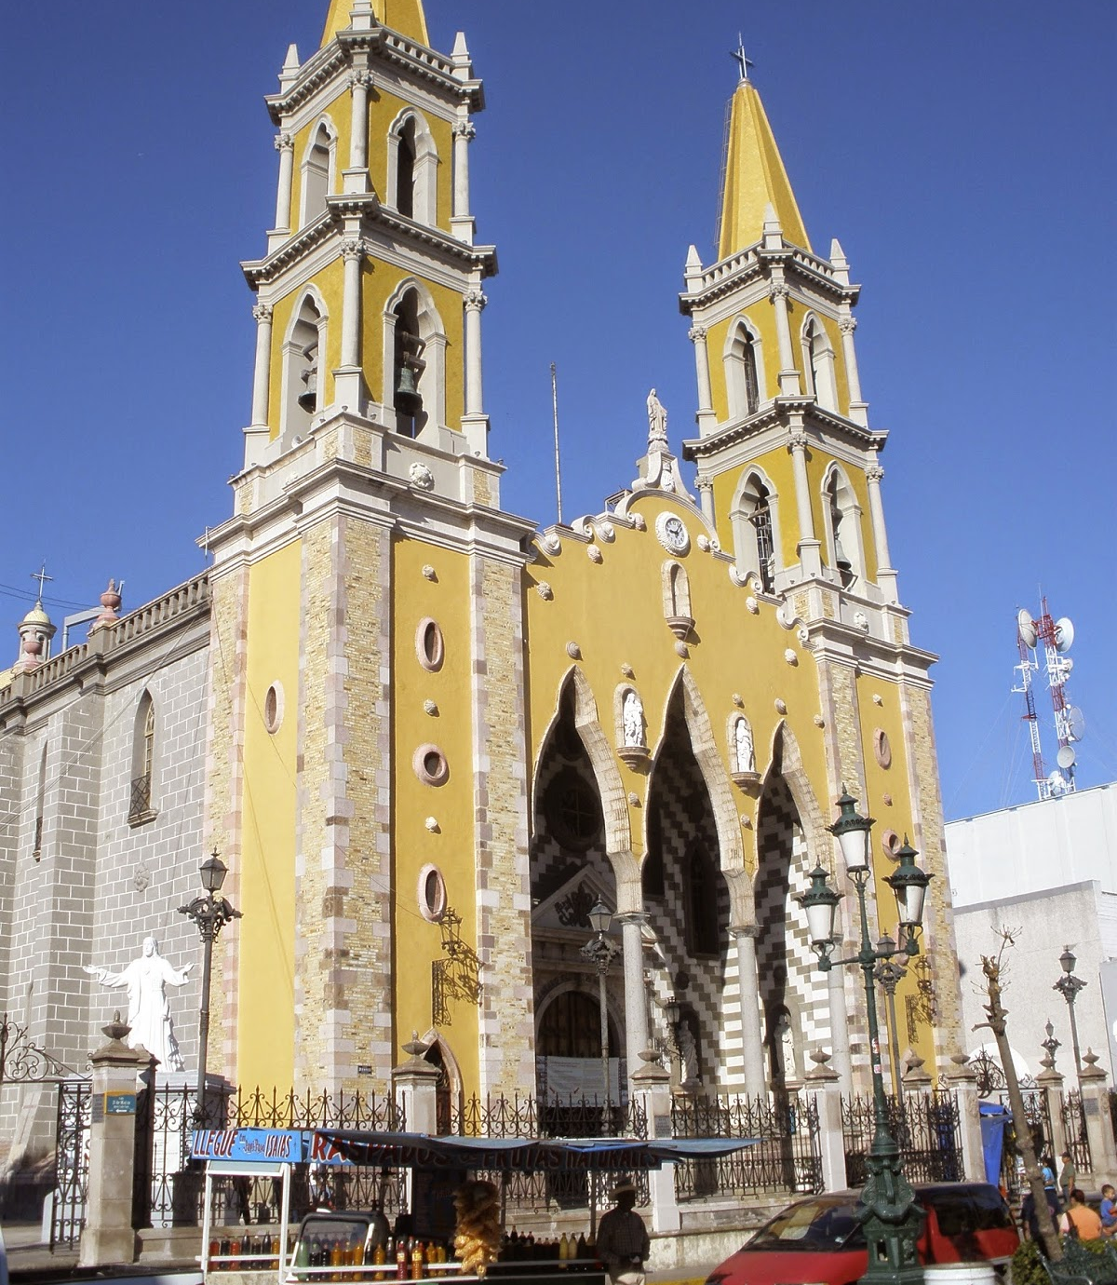
Basilica of the Immaculate Conception
Offset by canary-colored spires and Italian marble, the Basilica of the Immaculate Conception, built in the 19th century, is quite the sight to behold. This church in Old Mazatlán is a must-see if you have time.
Because this is an active church, be respectful if you do decide to go inside.
The basilica holds services several times each day. But since there's no official website for the church I could not find the Mass schedule.
The Basilica is less than a 20-minute walk from the port.

Slide 18
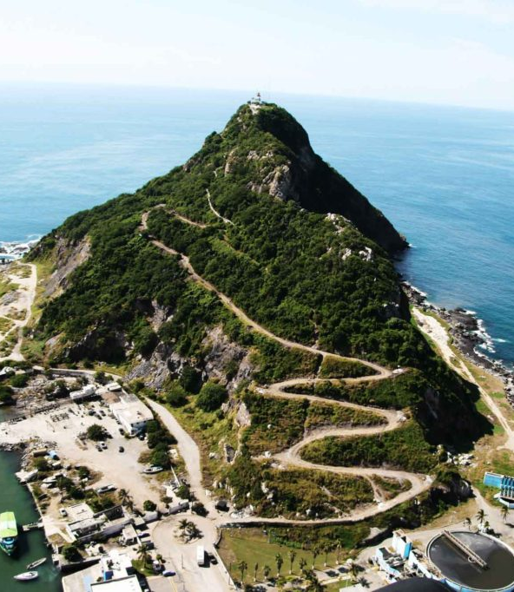
El Faro
El faro means "the lighthouse" in Spanish. This is one of the town's best-known attractions. A jaw-dropping view awaits the brave soul who embarks on the strenuous 30- to 45-minute hike up.
You'll need shoes with good treads and long pants (to ward off bug bites). Bringing a bottle of water is also a good idea. If you need a break, there are several spots along the trail to sit and relax.
El Faro, located along Mazatlán’s southern tip, is free to enjoy at any time of day. On some afternoons you might also catch local divers jumping from one of the high rocks near El Faro to the Pacific Ocean down below.

Slide 19
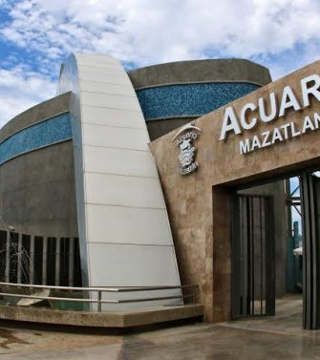
Acuario Mazatlán
The Mazatlán Aquarium is one of the best of its kind in Mexico. It boasts a variety of marine life spread across more than 50 tanks.
The aquarium should appeal to several age groups. Exhibits include an interactive stingray pool, a lovebird aviary, a turtle museum, and more.
Various shows are entertaining, covering everything from how divers interact with marine life to bird demonstrations to sea lion antics. Special packages, such as swimming with sharks or sea lions, are offered seasonally.
The Mazatlán Aquarium is open daily from 9:30 a.m. to 5 p.m. Tickets cost 380 pesos for adults,
270 for Seniors, and 250 pesos for children.

Slide 20
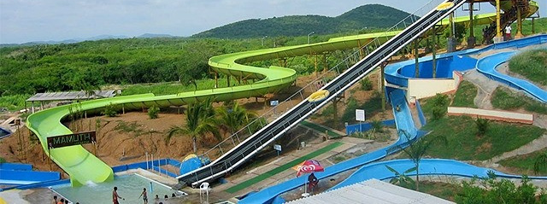
Aquatic Park Mazagua
This water park boasts enough slides, pools, and fun activities to keep the whole family busy for hours at a reasonable price.
There are slides and pools for tiny tots, as well as more exciting water attractions for those looking for more adventure.
Admission is 200 pesos (about $8.30).
Hours: 10 a.m. to 5 or 6 p.m.; it is closed in the winter.

Slide 21
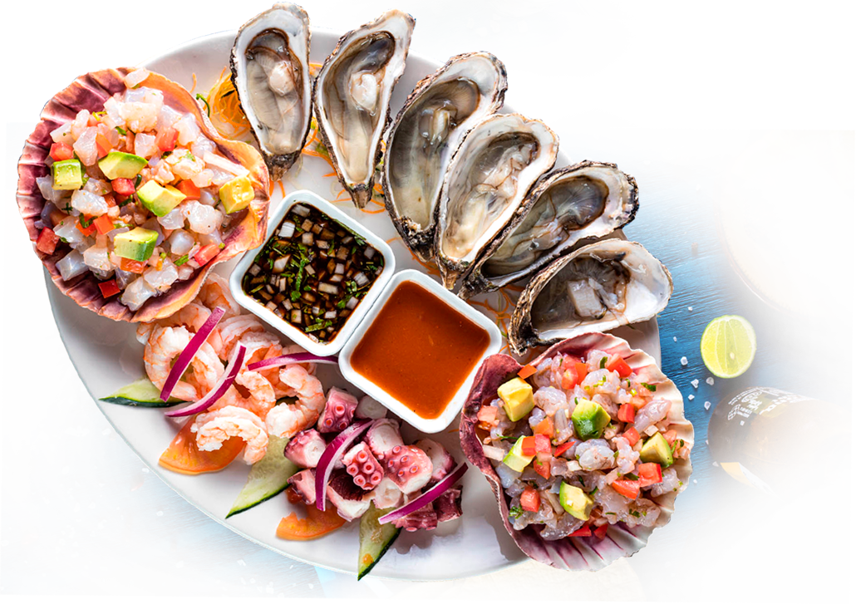
Mazatlán Restaurants
Mazatlán has many excellent restaurants. Many of us on the ship are
foodies, so naturally, we’re always on the hunt to eat at the most
exclusive spots anytime we travel.
Here are a few of the best restaurants to consider in Mazatlán.
Mahi Omakase $$$$ Japanese Seafood Sushi
Calle Belisario Domínguez 1410 Centro, Mazatlan
Los Arcos $$ - $$$Mexican Seafood International
Av. Camaron Sabalo # 1019 Between Hotel El Cid and The Palms Resort
Mariscos Bahia $$ - $$$ Mexican Bar Seafood
Calle Mariano Escobedo 203 Esquina con calle venus a una cuadra de olas altas
Pancho’s $$ - $$$ Mexican Seafood Vegetarian Friendly, B, Av Camaron Sabalo 1614, Sabalo Country
Atol $$$$ Mexican Latin Gluten Free, Calle 21 de Marzo 1412, Mazatlan
Fat Fish $ Mexican American Barbecue, Calz. Camaron Sabalo, Mazatlan
For those of you who just like good food, you can’t go wrong just about anywhere you go in Mazatlán.
GOOD EATING

Slide 22
Final Thoughts
Mazatlán is a beautiful City with a rich history and numerous attractions.
Whether you're looking for stunning beaches, historic sites, or unique attractions, Mazatlán has something for everyone.
I hope this presentation will help when we visit Mazatlán!

Slide 23
Thanks For Coming
If you have any more questions, please ask.
I will do my best to answer them for you.
Have a great visit in Mazatlán!

