Slide 1
Mastering Windows Shortcuts
Presented by Marc Silver
Work Smarter, Not Harder
A One-Hour Guide to Boosting Your Productivity

Slide 2
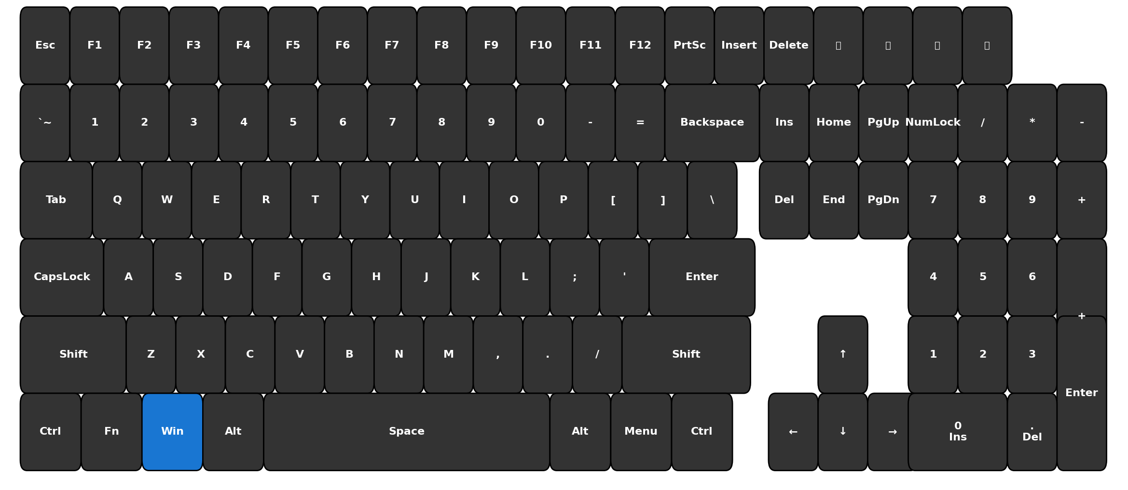
Mastering Windows Shortcuts
Keyboard Layout

Slide 3

Why Learn Shortcuts?
REASONS
  Save 8 work days per year (64 hours)*
  Reduce repetitive strain injuries
  Impress colleagues and look like a pro
  Stay focused on your work
“How many of you only use copy and paste?
You’re about to triple that toolkit today.”
Note: *Based on saving just 15 minutes per workday

Slide 4
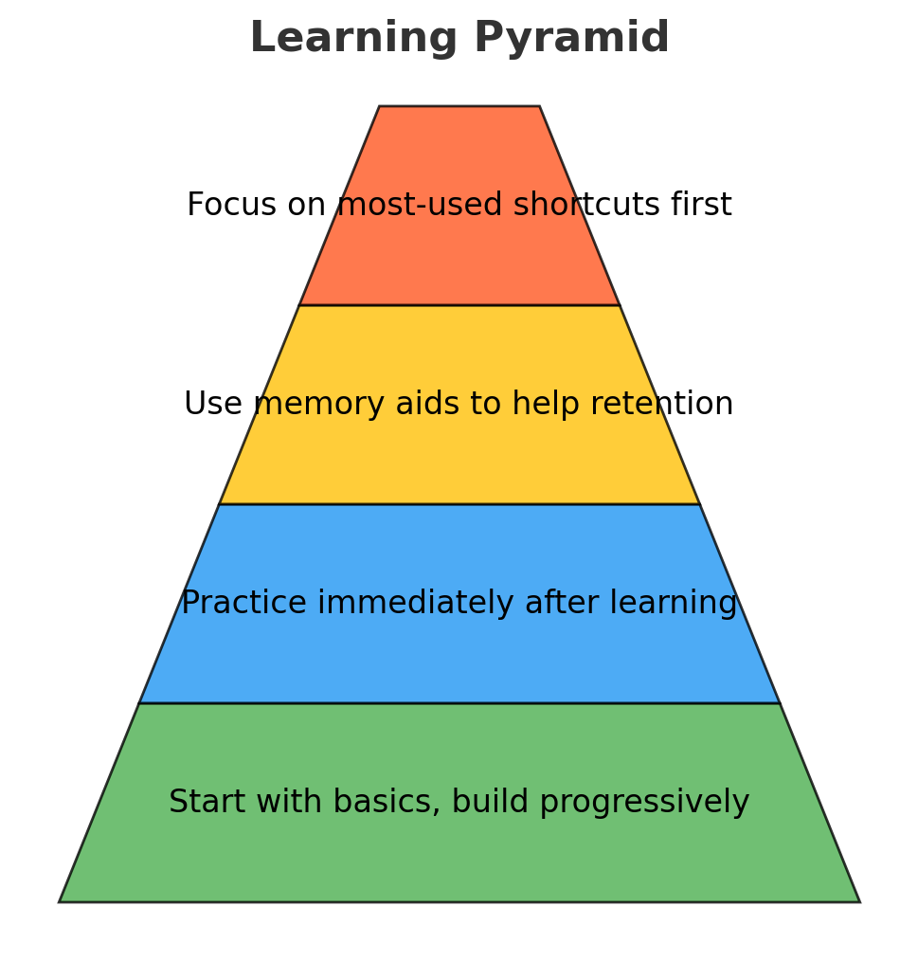
How We Learn
My Learning Approach
  Start with basics, build progressively
  Practice immediately after learning
  Use memory aids to help retention
  Focus on most-used shortcuts first
Note: Physical practice is critical for muscle memory

Slide 5

The Windows Key Universe
Module 1: Essential Navigation
Content: The Windows Key Universe
--------------→
Note: the Windows key opens up a universe of functionality

Slide 6
Windows Key Basics
Windows Key Navigation Basics
  Windows Key → Opens the Start Menu
  Windows Key + S → Search
  Windows Key + I → Settings
  Windows Key + Left/Right Arrow → Snap (left/right)
  Windows Key + Tab → Task View
  Practice Prompt: Open 2 windows, snap them side by side, maximize, restore, show desktop.
Transition: “Now that you can move windows, let’s move text just as quickly.”
"Let's try these together now"

Slide 7
Windows Key Basics
  Practice Prompt: Open 2 windows, snap them side by side, maximize, restore, show desktop.
Open 2 windows
  Use Windows + S to search and open apps (e.g., Word and Browser). Press and Hold TAB button down.
  Open one window, then press Alt + Tab to switch and open another.
Snap them side by side
  Select the first window, press Windows + Left Arrow.
  Select the second window, press Windows + Right Arrow.
"Let's try these together now"

Slide 8
Windows Key Basics
  Practice Prompt: Open 2 windows, snap them side by side, maximize, restore, show desktop.
Restore (un-maximize)
  Press Windows + Down Arrow once (if maximized, this restores; if restored, it minimizes).
Process
  Press Windows + D.
  Press again to bring windows back.
👉 This sequence is actually a great practice challenge in your seminar — learners will feel like they’re “driving Windows” efficiently.
"Let's try these together now"

Slide 9

Windows Key Basics
Windows Key Navigation Basics
Content:
  Windows Key → Start Menu
  Windows + E → File Explorer
  Windows + D → Show/Hide Desktop
  Windows Key Universe (Start, Search, Settings, Snap, Task View).
Practice Prompt: "Let's try these together now"

Slide 10
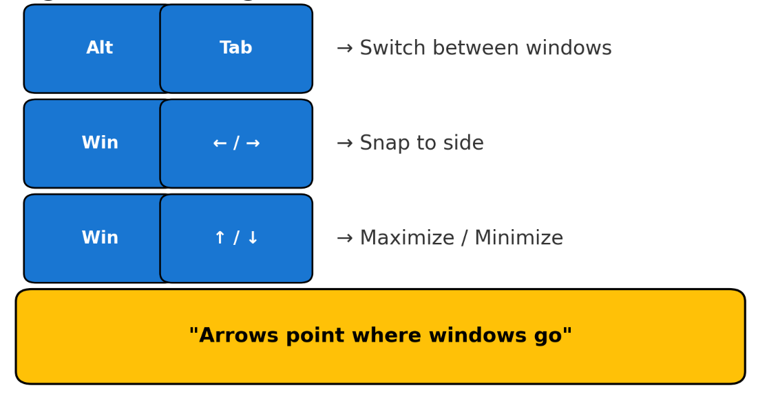
Window Management
Window Management Magic
Content:
  Alt + Tab → Switch between windows
  Windows + Left/Right → Snap to side
  Windows + Up/Down → Maximize/Minimize
Memory Aid: "Arrows point where windows go"

Slide 11
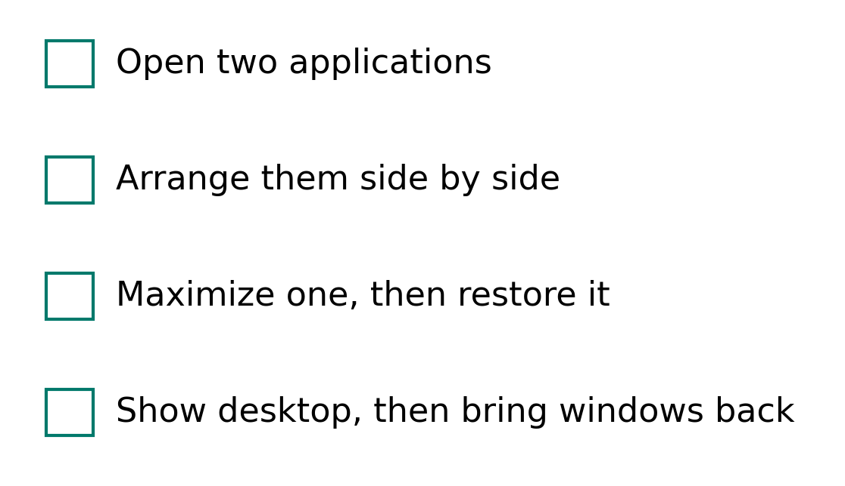
Let's Practice Navigation!
Hands-On Practice #1
Challenge:
  Open two applications
  Arrange them side by side
  Maximize one, then restore it
  Show desktop, then bring windows back
Visual: Checkboxes for each step
Challenge: Window Management

Slide 12
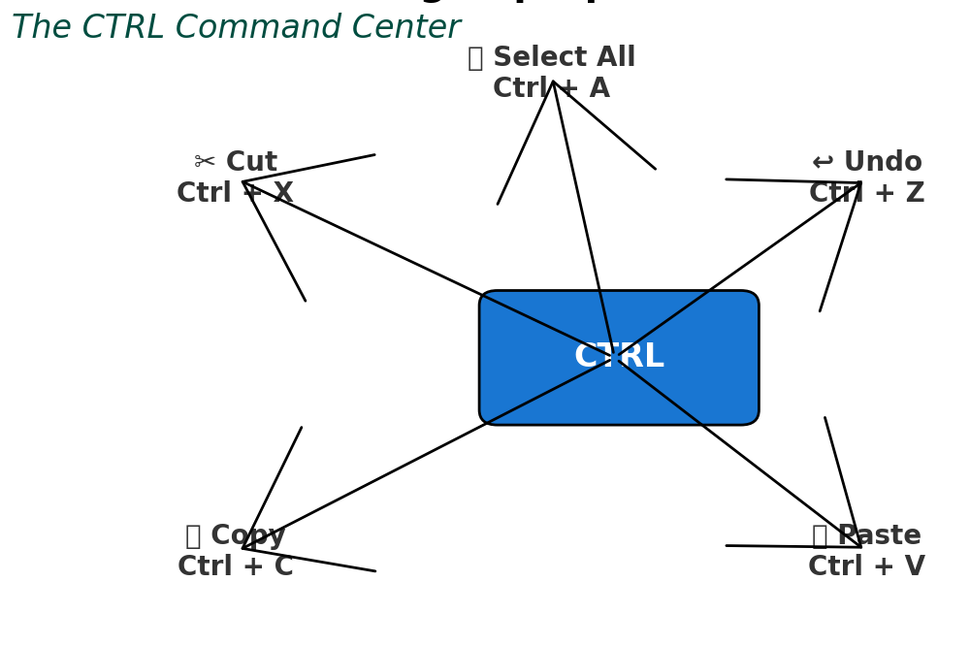
Let's Practice Navigation!
Hands-On Practice 2: Text Editing Superpowers
Content: The CTRL Command Center
Visual: Diagram of Ctrl key with
text editing functions
Note: Mastering these few shortcuts can cut document work time in half

Slide 13
Selection & Basic Editing
Selection & Basic Editing
Content:
  Ctrl + A → Select All
  Ctrl + C → Copy
  Ctrl + X → Cut
  Ctrl + V → Paste
Memory Aid: "X looks like scissors for Cut"

Slide 14

Undo & Smart Text Navigation
Undo & Word Navigation
Content:
  Ctrl + Z → Undo
  Ctrl + Y → Redo
  Ctrl + Backspace → Delete whole word
  Ctrl + Arrow keys → Move by word
Memory Aid: "Z for going back to Zzzz (sleep)"

Slide 15
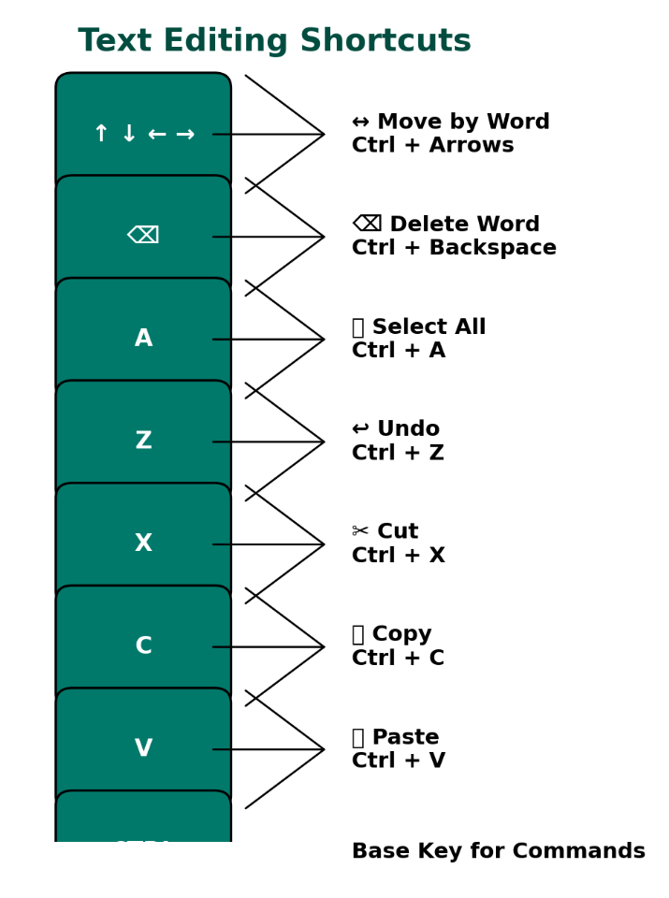
Let's Practice Text Editing!
Hands-On Practice #2
Challenge: Open a document and:
  Select all text
  Copy it
  Create new document & paste
  Make edits using word navigation
  Use undo when you make a mistake
Note: Have a practice document ready for participants

Slide 16
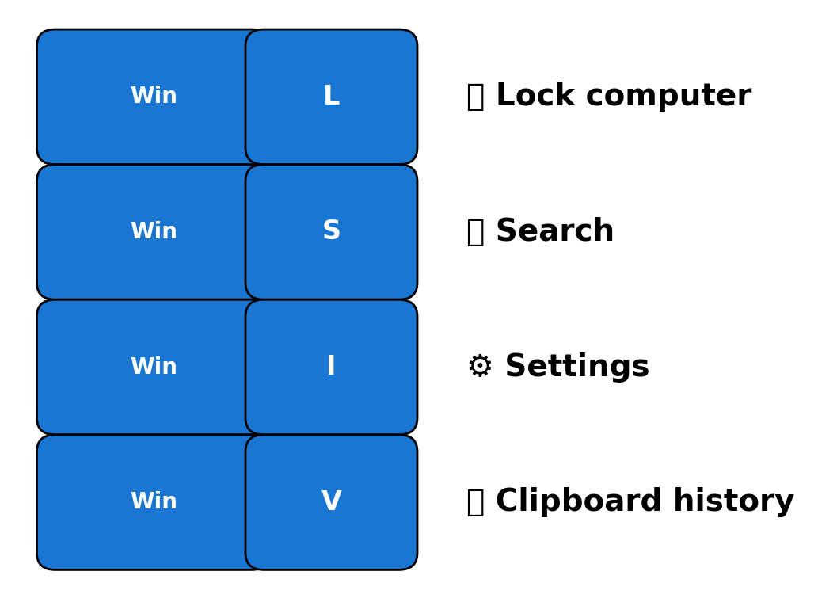
Quick Access Champions
Quick Access Shortcuts
Content:
  Windows + L → Lock computer
  Windows + S → Search
  Windows + I → Settings
  Windows + V → Clipboard history
Memory Aid: "L for Lock, S for Search, I for Information"

Slide 17
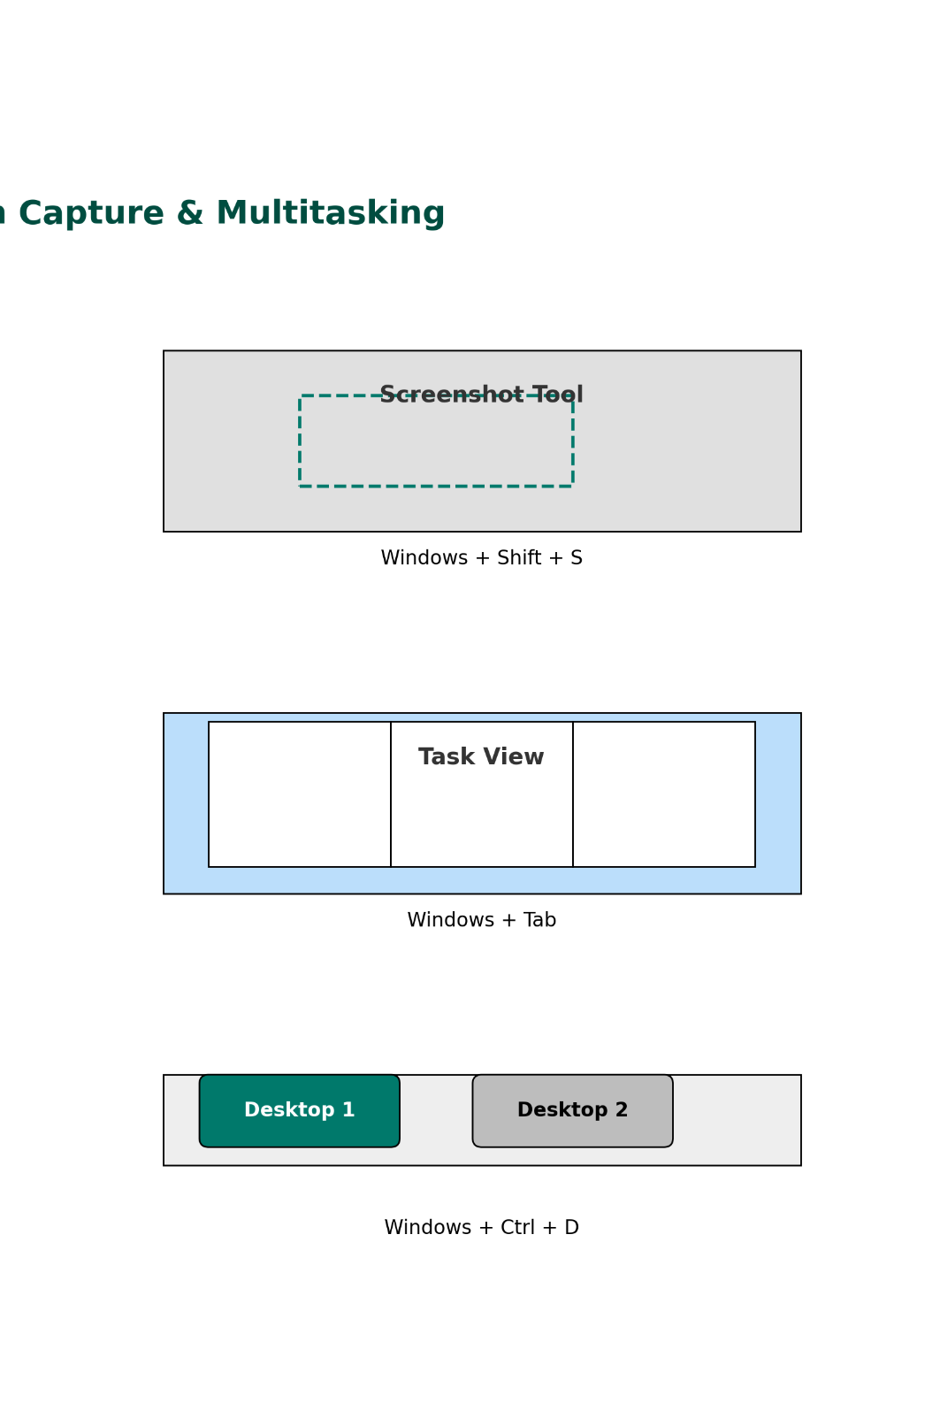
Screen Capture & Multitasking
Screen Capture & Multitasking
Content:
  Windows + Shift + S → Screenshot tool
  Windows + Tab → Task view
  Windows + Ctrl + D → New virtual desktop
Memory Aid: "S for Screenshot with
Shift for more options"

Slide 18
Let's Practice Productivity Boosters!
  Hands-On Practice #3
  Challenge:
    Take a screenshot of part of your screen
    Search for an application
    Open clipboard history
    Create a virtual desktop
  Note: Emphasize that these save multiple clicks each time

Slide 19
Module 4: Power User Fast Track
Module 4 - Power User Fast Track
Content: The Expert Toolkit
Visual: Toolbox with advanced shortcut tools
Note: Explain these separates casual from power users

Slide 20
System Control Shortcuts
System Control Shortcuts
Content:
  Windows + X → Power user menu
  Ctrl + Shift + Esc → Task Manager
  Windows + R → Run dialog
Visual: Screenshots of each menu/tool
Memory Aid: "X marks the expert spot"
Note: Demonstrate opening Run and launching an app

Slide 21
File Management Boosters
File Management Boosters
Content:
  F2 → Rename
  Alt + Enter → Properties
  Shift + Delete → Permanent delete
Visual: File explorer showing these actions
Memory Aid: "F2 gives a second chance to name"
Note: Caution about Shift+Delete being permanent

Slide 22
Final Challenge: Put It All Together!
Hands-On Practice #4
Challenge: Complete these tasks without using your mouse:
  Create a text file
  Rename it
  View its properties
  Open Task Manager
  Return to desktop
Visual: Progress tracker with shortcut reminders
Note: Time this challenge and recognize quick finishers

Slide 23
Your Shortcut Learning Path
Your Shortcut Learning Path
Content:
  Week 1: Master 5 shortcuts (choose your favorites)
  Week 2: Add 5 more shortcuts
  Week 3: Challenge yourself to go "mouse-free" for 30 minutes daily
Visual: Progress path showing improvement over time
Note: Emphasize consistency over quantity

Slide 24
Resources & Practice
Resources & Practice
Content:
  [QR code for downloadable cheat sheet]
  [Shortcut practice web game link]
  Reminder: Set sticky notes for "Shortcut of the day"
Visual: QR code and resource screenshots
Note: Explain you'll share digital copies of all resources

Slide 25
Resources & Practice
Q&A
Title: Questions?
Content: [Space for questions]
Visual: Keyboard with question mark keys highlighted
Note: Leave time for specific shortcut questions

Slide 26
Resources & Practice
Thank You!
Content:
  Remember: Small changes → Big results
  Your feedback is welcome
  Contact information
Visual: Keyboard with "Thank You" keys highlighted
Note: Distribute quick reference cards before people leave
Note: Leave time for specific shortcut questions

Slide 27
Resources & Practice
Visual Design Elements
Color Scheme:
  Primary: Blue (#0078D7) - Windows blue
  Secondary: Light gray (#F2F2F2)
  Accent: Orange (#FF8C00) for highlighting key points
Consistent Visual Elements:
  Keyboard icon in bottom corner of each slide
  Shortcut keys always bold and in accent color
  Memory aids in italics with lightbulb icon
Visual Design Elements
Diagrams:
  Keyboard layout diagrams highlighting relevant keys
  Before/after screenshots showing result of shortcuts
  Simple animations showing keyboard actions
Interactive Elements:
  Slide transitions that use keyboard triggers when possible
  Visual timers for practice sessions
  Progress checklist for hands-on sections
Note: Leave time for specific shortcut questions

Slide 28
Windows Shortcuts - Organized Reference Guide
Basic System Navigation
Windows key: Open Start menu
Windows + X: Open the secret/power user Start menu
Windows + S or Windows + Q: Open search bar
Windows + I: Open Settings menu
Windows + R: Open Run dialog
Windows + E: Open File Explorer
Windows + D: Show/hide desktop
Basic System Navigation
Windows + ,: Peek at desktop (temporary)
Windows + L: Lock your computer
Windows + Tab: Open Task view (virtual desktops)
Alt + Tab: Switch between open apps or windows
Alt + F4: Close current app or window
Windows + C: Open Microsoft Copilot

Slide 29
Windows Shortcuts - Organized Reference Guide
Window Management
Windows + M: Minimize all windows
Windows + Shift + M: Restore minimized windows
Windows + Home: Minimize all windows except active window
Windows + Up arrow: Maximize selected window
Windows + Down arrow: Minimize selected window
Windows + Left arrow: Snap window to left half of screen
Windows + Right arrow: Snap window to right half of screen
Windows + Alt + Up: Snap window to top half of screen
Windows + Alt + Down: Snap window to bottom half of screen
Windows + Shift + Left/Right arrow: Move window to left/right monitor
Windows + Shift + Up arrow: Maximize window vertically while maintaining width

Slide 30
Windows Shortcuts - Organized Reference Guide
Virtual Desktop Management
Windows + Ctrl + D: Add new virtual desktop
Windows + Ctrl + Left/Right arrow: Switch between virtual desktops
Windows + Ctrl + F4: Close current virtual desktop

Slide 31
Windows Shortcuts - Organized Reference Guide
System Tools & Maintenance
Windows + R then type:
  cleanmgr: Open Disk Cleanup utility
  msconfig: Open System Configuration
  services.msc: Open Services Manager
  appwiz.cpl: Open Programs and Features
  prefetch: Access prefetch folder (delete files to clear)
  temp: Access temporary files folder (delete files to clear)
  %TEMP%: Access temp files
  cmd: Open Command Prompt
  shell:appsfolder: View installed apps for uninstallation
  ncpa.cpl: Network adapter settings
  sysinfo: System information
  regedit: Registry Editor (use with caution)

Slide 32
Windows Shortcuts - Organized Reference Guide
Ctrl + Shift + Esc: Open Task Manager directly
Windows + G: Open Game bar/Windows Performance
System Maintenance Commands
In Command Prompt:
  sfc /scannow: System file check and repair
  chkdsk /f: Check disk for errors
  ipconfig /flushdns: Clear DNS cache
  ipconfig /all: View IP configuration
  MRT: Run Malware Removal Tool
  net user: View users on system
  DISM /online /cleanup-image /restorehealth: Repair Windows image
In PowerShell:
  winget update: Check for updates
  winget upgrade --all: Update all applications

Slide 33
Windows Shortcuts - Organized Reference Guide
Screenshot & Recording
PrtScn: Screenshot entire screen to clipboard
Windows + PrtScn: Screenshot entire screen saved to Pictures folder
Windows + Shift + S: Open Snipping Tool for partial screenshots
Windows + Alt + R: Record screen (when Game bar is enabled)
System Access & Utilities
Windows + A: Open Action Center
Windows + H: Open Voice Typing
Windows + K: Open Connect sidebar (Bluetooth/wireless display)
Windows + P: Open projection settings
Windows + U: Open Ease of Access center
Windows + Control + Shift + B: Reset graphics drivers

Slide 34
Windows Shortcuts - Organized Reference Guide
Text Editing Shortcuts
Ctrl + A: Select all
Ctrl + C or Ctrl + Insert: Copy
Ctrl + V or Shift + Insert: Paste
Ctrl + X: Cut
Ctrl + Z: Undo
Ctrl + Y: Redo
F2: Rename selected item

Slide 35
Windows Shortcuts - Organized Reference Guide
Special Utilities
MSRSC: Remote Desktop window
NETPLWIZ: User Account management
servicesmsc: Access running applications
Windows + F1: Open Windows help in default browser

Slide 36
Windows Shortcuts - Organized Reference Guide
File Operations
Shift + Delete: Permanently delete (bypass Recycle Bin)
F3: Search in File Explorer
F4: Focus address bar in File Explorer
F5: Refresh current window
F6: Cycle through elements in a window
Command Prompt Specific Shortcuts
Ctrl + C or Ctrl + Insert: Copy selected text
Ctrl + V or Shift + Insert: Paste text
Ctrl + A: Select all text on current line
Ctrl + F: Search in Command Prompt
Ctrl + M: Enter Mark mode for text selection

Slide 37
Windows Shortcuts - Organized Reference Guide
Magnifier & Display
Windows + (+) or (-): Zoom in/out with magnifier
Windows + Esc: Exit magnifier
Windows + O: Lock screen orientation
Taskbar Navigation
Windows + T: Cycle through taskbar apps
Windows + [Number]: Open app in that position on taskbar
Windows + Alt + [Number]: Open right-click menu for app in that position

