Slide 1

Martinique Presented by Fellow Cruiser Marc Silver

Slide 2
What I Will Cover
My Port Philosophy
Don’t Miss the Ship
Money
About Martinique
Area Map of Martinique
Map of Martinique
Martinique Transportation
Places to see or at least consider
A few restaurant recommendations
Conclusion

Slide 3
My Port Philosophy
I have been cruising for over 45 years and have taken over 100 cruises. So, I consider myself an experienced cruiser.
The information I will present is based on those many years of
experience.
When I am on a cruise where the city, I want to visit is not the port city,
I always recommend taking a ship’s tour.
But when I am in a port with multiple attractions nearby and easy to see
on my own - I will do it on my own.
This presentation is for that type of port.

Slide 4

Don’t Miss the Ship
How to Avoid Missing Your Ship
Pay attention to the time. - Ship time and local time are often different.
Put a return-to-ship reminder on your phone.
Choose excursions wisely.
If a ship-sponsored excursion is late returning to port, the ship will wait for you. If you are on your own???
Be Prepared
Have your Passport, Credit Card, and phone numbers for your ship port agent.
What to Do If You Miss the Ship Most cruise lines have port agents stationed in the port area to assist if your ship has left without you. If your are lucky, when cruisers are late returning to the vessel, the ship’s crew will often remove the passengers’ essential items – passports, cell phones, and medication -- from the ship to leave with the port agents.
The Port Officials can help you with contacting your ship and making necessary travel arrangements.

Slide 5
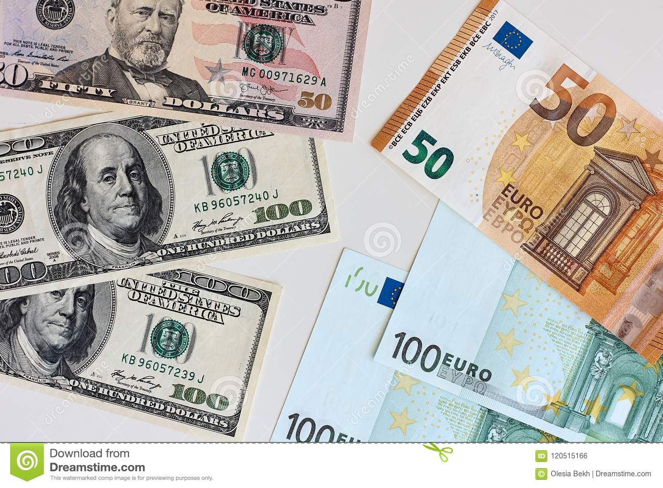
Money of Martinique
The euro is the official currency of 20 European Union countries which collectively make up the euro area, also known as the eurozone. Martinique is part of that union.
Official Exchange is $1.079 US to €1

Slide 6
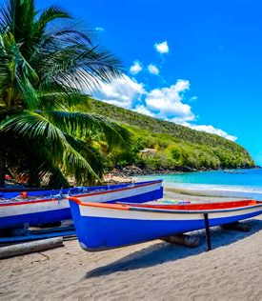
About Martinique
Martinique, is an island and overseas territorial of France, in the eastern Caribbean Sea. It is included in the Lesser Antilles island chain. Its nearest neighbors are the island republics of Dominica, 22 miles to the northwest, and Saint Lucia, 16 miles to the south. Guadeloupe, another part of overseas France, lies about 75 miles to the north.
The original Carib Indian population disappeared after Europeans arrived, partly as a result of disease, conflicts with the Europeans, and assimilation.
In 1658 French settlers on the island numbered about 5,000. Slaves brought from Africa added a further ethnic component.

Slide 7
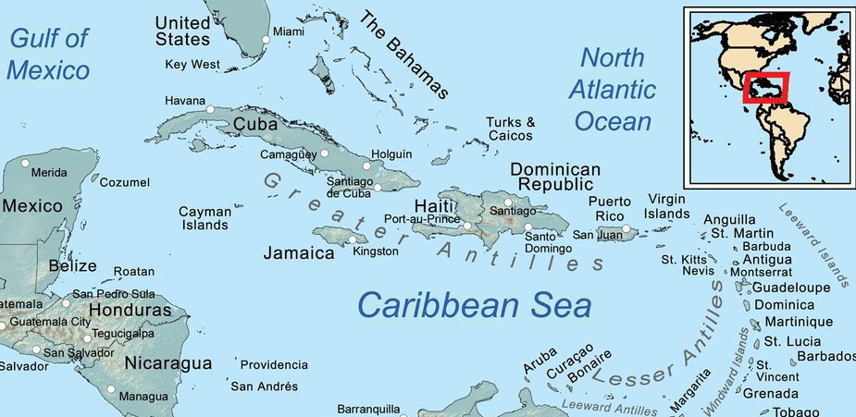
Area Map of Caribbean

Slide 8
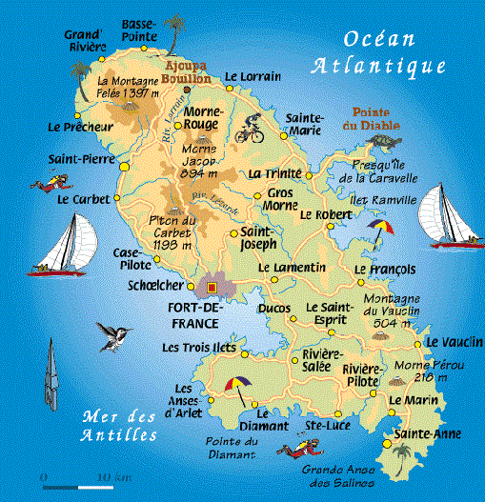
Map of Martinique

Slide 9
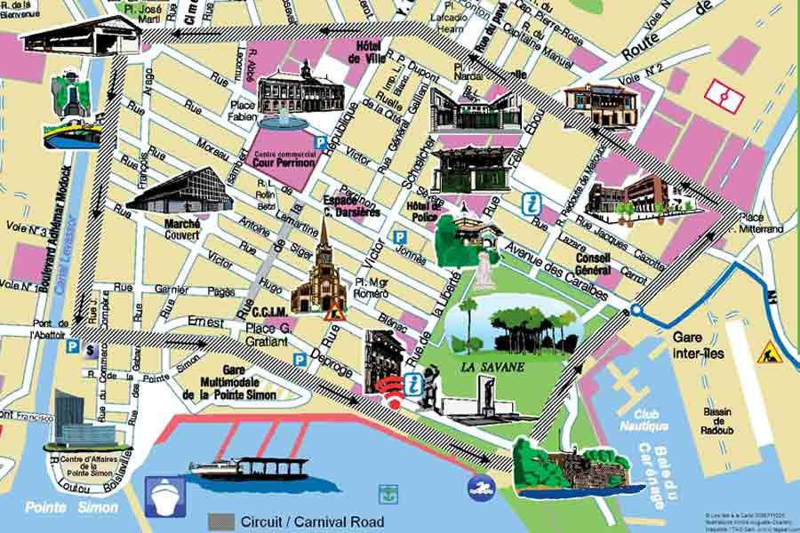
Map of Fort-de-France

Slide 10
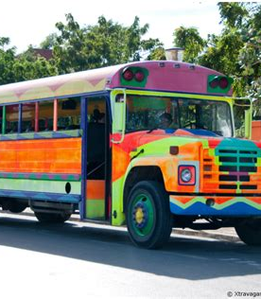
Martinique Buses
Walking is only a realistic option if you don't intend to leave Fort-de-France. Otherwise, you'll find activities and sites too spread out to reach on your own.
Minibusses marked with "TC" travel between Fort-de-France and popular tourist spots like St-Pierre, Trois Îlets, Le Diamant, and Ste-Anne. However, these vans are generally considered unreliable because the drivers are willing to change the route according to their passengers' needs. As such, the fare is also hard to determine. If you're up for the adventure.
Fares are 2€ to 2.50€ anywhere within the city limits of Fort-de-France

Slide 11
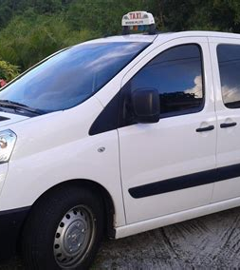
Martinique Taxis
Local laws demand that any licensed Martiniquais cab must contain a working meter. For specific itineraries wherein a passenger tells the driver where he or she wants to go the meter must be "on" and functioning.
If a taxi driver quotes a flat rate to a passenger instead of activating the meter, you're being robbed, and you should immediately get out and find another cab.
For a general tour of the island, prices are negotiable with the driver.
With that in mind, you may be better off on a tour.

Slide 12
Facts about Martinique
Martinique has a small version of the Parisien Sacré-Coeur. It is called the Balata church, and it is located in the Balata district, 7 kilometers away from Fort de France (the capital) on the Morne Savon.
There are only two seasons. Two seasons and one agreeable temperature all year long. The Martinican climate is tropical. The seasons are Rainy and Dry.
There is only one sugar refinery left. At the end of the 19th century, there was more than 500 sugar refinery. Today, there is only one left: the sugar refinery of Galion in Trinité, located in the northeast of the Island.
The mangrove of Martinique has a surface area of around 1800 hectares and represents six percent of the island’s forest area.
Most of Martinique is considered as a natural park. 32 of the 34 Martinican towns belong to the regional natural park of the island.
Martinican rum has an AOC label which is rare. Martinican rum is made up of cane juice. Agricultural rum is different from industrial rum which is made up of molasses. There is the infamous “Bush Rhum/Rum”, which is basically Moonshine, which is mostly infused with various harvested growing materials,
Martinique has many black sand beaches. These beaches have volcanic origins.

Slide 13
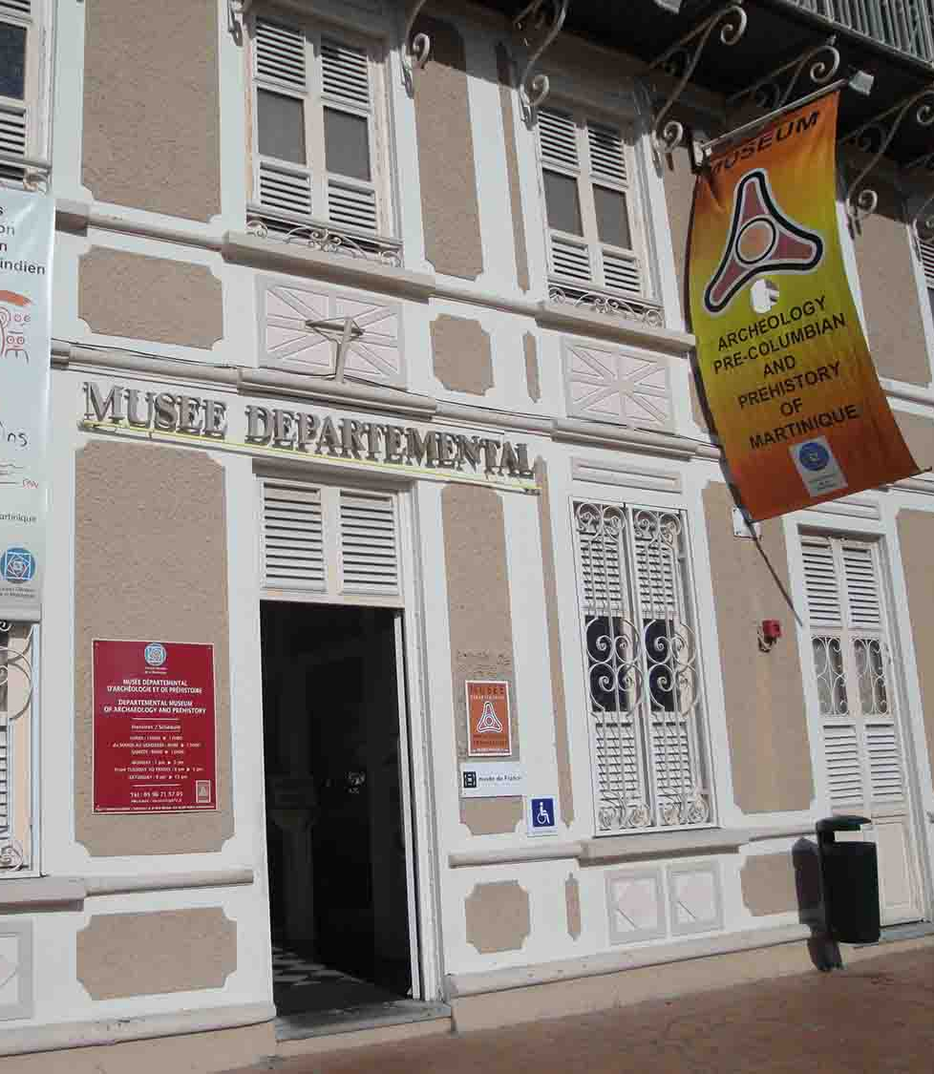
Musée Régional d'Histoire et d'Ethnographie
The Martinique Regional Council created the Regional Museum of History and Ethnography on June 11, 1985. The museum's collections raise Martinicans' awareness of historical and ethnographic heritage through exhibitions. After major restoration and interior design work on the villa, the History and Ethnography Museum was inaugurated in June 1999.
Admission: 3€ adults – Children 1€
Notes:
The museum The plenary assembly of the Martinique Regional Council created the Regional Museum of History and Ethnography on June 11, 1985. This first had, from 1986, a prefiguration phase through the Heritage Office which set about building the museum's collections and raising Martinicans' awareness of historical and ethnographic heritage through exhibitions. After major restoration and interior design work on the villa, the history and ethnography museum was inaugurated in June 1999.

Slide 14
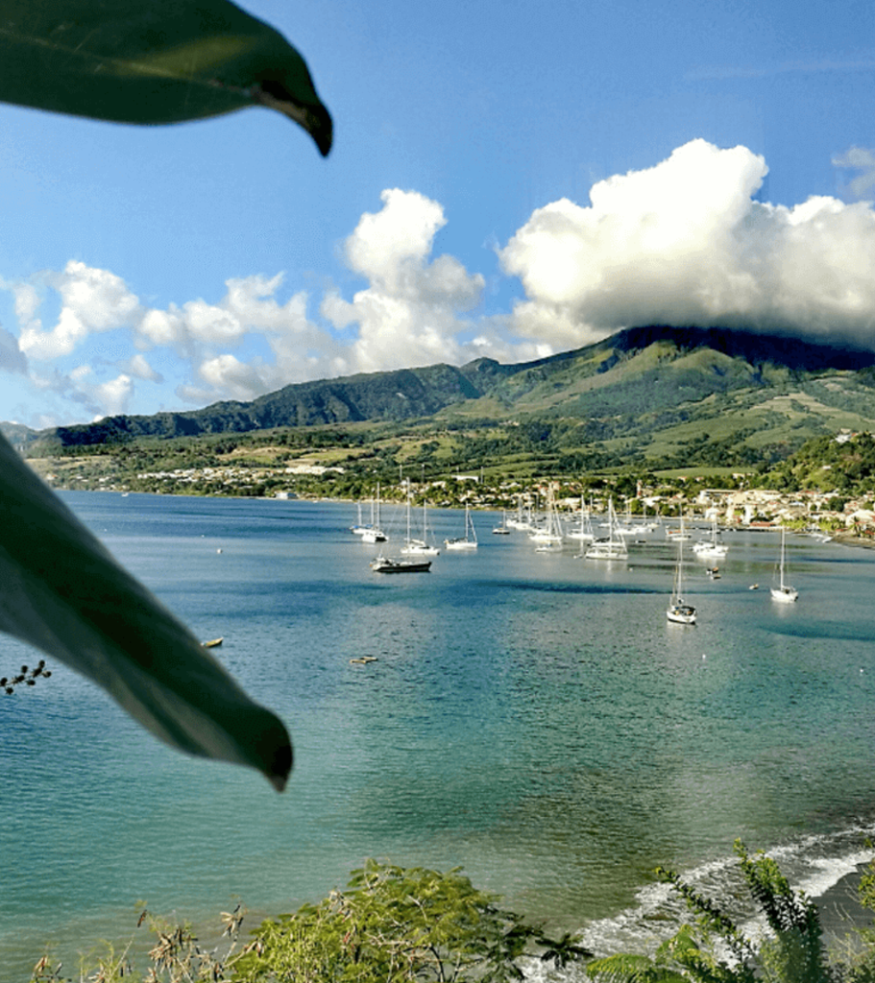
Les Trois-Ilets
On the opposite side of the bay, South of Fort-de-France, Les Trois-Ilets is a popular tourist area, with hotels, restaurants, and several attractions that illustrate the island's history and culture.
Two of these center around former industries: sugarcane and pottery. Village de la Poterie des Trois-Ilets is a large complex housed in a former pottery yard where roof tiles were made.
Today, the buildings house craft studios and shops, along with restaurants and a sports center where you can take kayak tours.

Slide 15
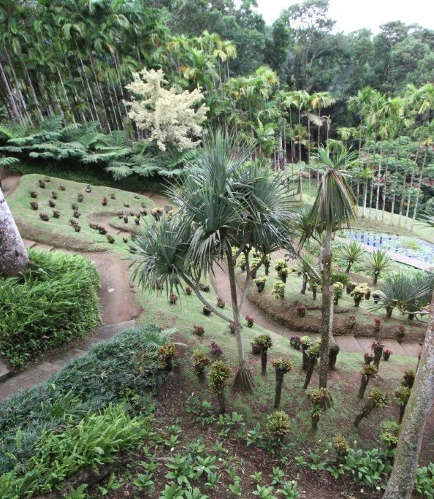
Balata Botanical Garden
Created by a passionate horticulturalist, the garden features more than 3,000 species of tropical plants and flowers that cascade down a hillside, past ponds punctuated with water lilies and lotus blossoms.
Raised wooden rope bridges suspended amid the treetops give an aerial view over the lush gardens while hummingbirds buzz in the fragrant air.
Plenty of benches are tucked amid the foliage to relax and admire the beautiful mountain views framed by the gardens.
Adult ticket : 16€ Kids ticket : 11€

Slide 16
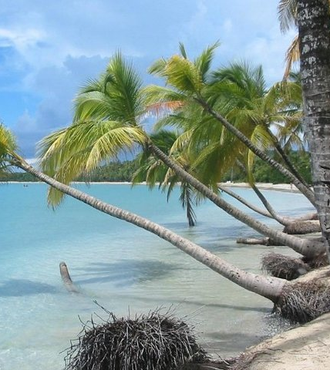
Sainte-Anne
Sprinkled with palm-fringed coves, Sainte-Anne has the distinction of being the island's southernmost village and one of its prettiest. Shops, restaurants, and a craft market are here, but the main attractions are the beaches.
South of Sainte-Anne, at the very tip of the peninsula, are the dramatic red-earth landscapes of Savane Des Petrifications, which you can explore on trails from Anse a Prunes.

Slide 17

Zoo de Martinique and Le Carbet
About 10 10-minute drive north of Le Carbet, Zoo de Martinique — Habitation Latouche is a family-friendly attraction nestled among botanical gardens and the ruins of an old sugar plantation. If you're visiting on a couple's holiday, don't worry — this fun attraction isn't just for children.
There are plenty of entertaining things to do for adults as well. In fact, a visit to this charming zoo may be just the thing to make you feel like a kid again.
The beautiful setting is as delightful as the small zoo. Paths and rope bridges meander through the lush tropical plants, and the large, well-designed animal enclosures are often built around the atmospheric ruins.
Adults €17.50 / Child entry from 3 to 12 years old. €12.00 - + Nature Pass

Slide 18
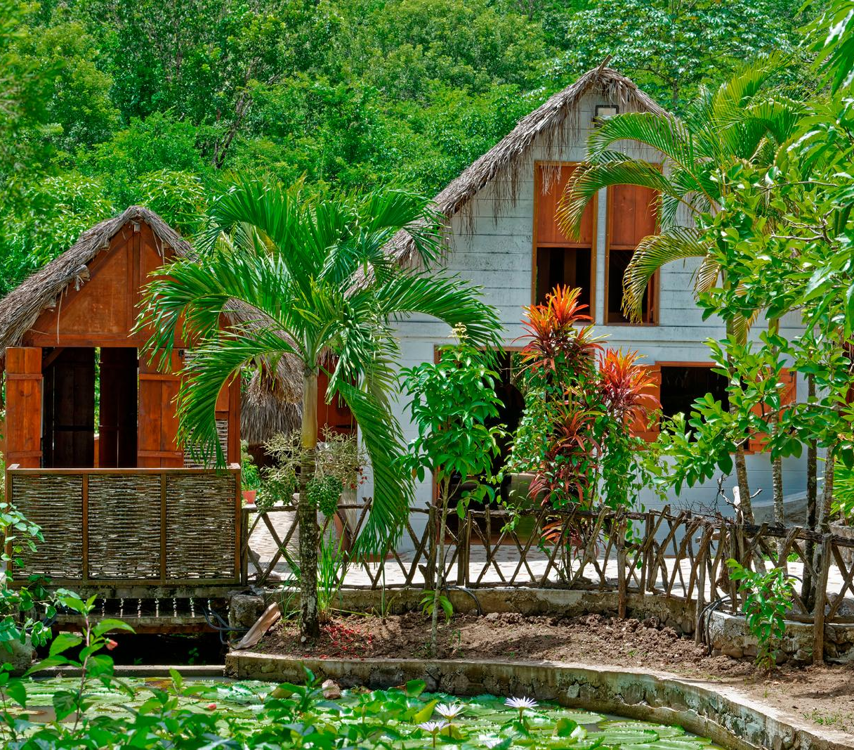
La Savane des Esclaves
Right near Musée de la Pagerie, La Savane des Esclaves complements the museum by providing a glimpse into the lives of slaves in Martinique.
Here, a reconstructed slave village of traditional huts with earth floors and sugarcane-leaf roofs tells about the history of slavery on the island.
Carved mahogany sculptures illustrate the life of slaves, escape attempts, and final liberation.
You can even see exhibits on traditional skills and foods, such as cacao, cassava, and sugarcane juice, as well as a garden of fruits, vegetables, and medicinal plants on which their lives depended.
Free Admission

Slide 19
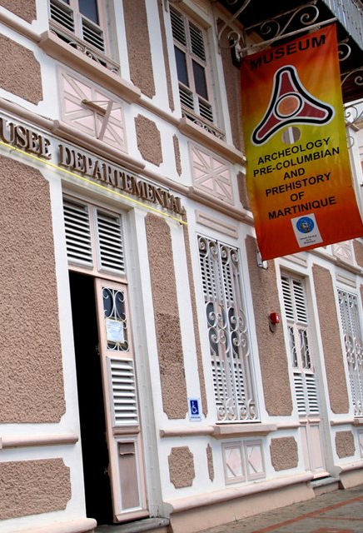
Musée Départemental d'Archéologie
The Museum of Archaeology and Prehistory of Martinique is dedicated to West Indian prehistory and the Amerindian civilizations that populated Martinique more than 4,000 years ago.
The building, which was then a military administration building, was acquired by the General Council of Martinique in 1968, which wanted to turn it into a museum to promote the heritage of Martinique.
Admission €3.50 per person

Slide 20
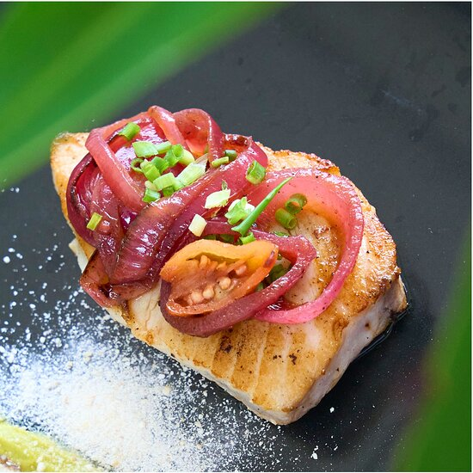
Restaurants in Forte de France
There are a lot of excellent restaurants in Forte de France. Especially for seafood.
Here are some recommendations: Kay Ali $$$$ French 145 Avenue Condorcet, Fort-de-France
The Yellow $$$$ French Caribbean European 51 Rue Victor Hugo 1er Etage, Fort-de-France
Galanga fish bar $$-$$$ Caribbean Peruvian Diner 31 Route de L Union Espace Wopso, Fort-de-France
Chez Carole $ Caribbean Healthy Marche Aux Epices, Fort-de-France
Garage Popular $ Italian Pizza Pub 121 Rue Lamartine, Fort-de-France
I wish you all Good Eating!

Slide 21
Conclusion
Martinique is a beautiful City with a rich history and numerous attractions. Regardless of what you're looking for, Martinique has something for everyone.
I hope this presentation will help when we visit Martinique!

Slide 22
Thanks For Coming
If you have any more questions, please ask.
I will do my best to answer them for you.
Have a great visit in Martinique !

