Slide 1

Manzanillo, Mexico
Presented by
Fellow Cruiser
Marc Silver

Slide 2
What I Will Cover
My Port Philosophy
Don’t Miss the Ship
Money
About Manzanillo, Mexico
History of Manzanillo, Mexico
Transportation
Points of Interest
Places to see or at least consider
A few restaurant recommendations
Conclusion

Slide 3
My Port Philosophy
I have been cruising for over 45 years and have taken over 100 cruises.
So, I consider myself an experienced cruiser.
The information I will present is based on those many years of
experience.
When I am on a cruise where the city, I want to visit is not the port city,
I always recommend taking a ship’s tour.
But when I am in a port with multiple attractions nearby and easy to see
on my own -
I will do it on my own.
This presentation is for that type of port.

Slide 4
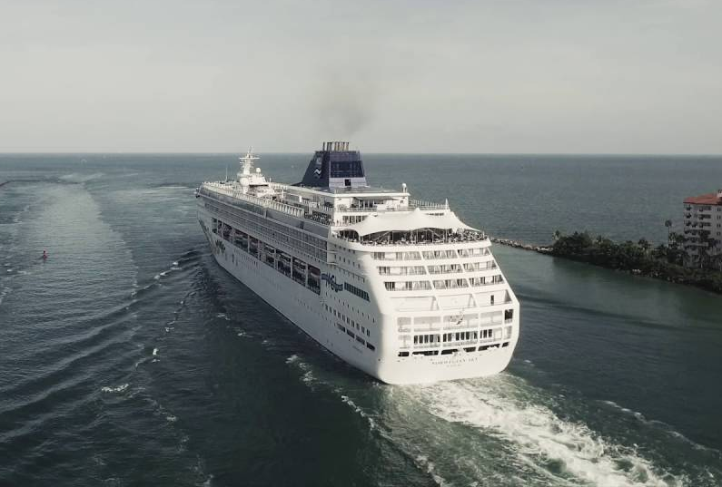
Don’t Miss the Ship
How to Avoid Missing Your Ship
Pay attention to the time. - Ship time and local time are often
different.
Put a return-to-ship reminder on your phone.
Choose excursions wisely.
If a ship-sponsored excursion is late returning to port for, the ship will
wait for you. If you are on your own???
Be Prepared
Have your Passport, Credit Card and phone numbers for your ship port agent.
What to Do If You Miss the Ship
Most cruise lines have port agents stationed in the port area to assist if your ship has left without you. If you’re lucky, when cruisers are late returning to the vessel, the ship's crew will often remove the passengers' essential items -- passports, cell phones and medication -- from the ship to leave with the port agents.
The Port Officials can help you with contacting your ship
and making necessary travel arrangements.

Slide 5

Money
The Peso is the official currency of Mexico
Official Exchange is 100 Pesos is $5.80 US
Or 17.35 Pesos to the US Dollar

Slide 6
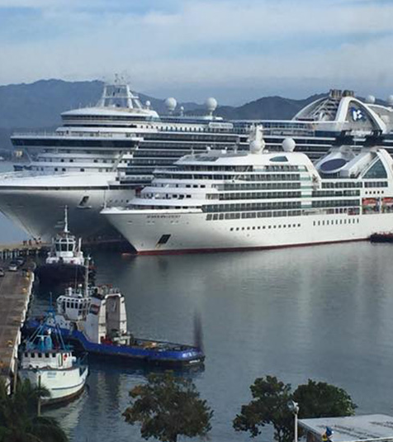
About Manzanillo
Manzanillo is one of the three most important ports in Mexico as international ships arrive here bringing products from different countries. Because of its important port and the growth in tourism, Manzanillo is one of the best destinations in the Costa Alegre which is comprised of the beaches in the states of Jalisco and Colima.

Slide 7
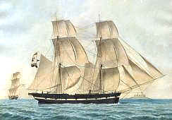
Historical Manzanillo, Mexico
HERNAN CORTES in search of Chinese treasure in the
Pacific, were among the first to visit the area now known
as Manzanillo. In 1522, Gonzalo de Sandoval, under
orders from Cortes, dropped anchor in the Bay of
Salagua (north of Manzanillo Bay).
MANZANILLO BAY was discovered in 1527 by navigator
Alvaro de Saavedra, naming it Santiago de la Buena
Esperanza, or Santiago's Bay of Good Hope. It became a
departure point for important expeditions. Cortes visited the bay twice to protect his galleons from Portuguese pirates. Over the next 300 years, the Pacific Coast’s history is filled with accounts of pirates from Portugal, England, France, and even Spain assaulting, looting, and burning ships for their rich cargo.

Slide 8

History of Manzanillo Cont.
In 1825 the port of Manzanillo opened, so named because of the abundant groves of manzanillo trees that were used extensively in the early days of shipbuilding. It was raised to the status of a city on June 15, 1873.
The railroad to Colima was completed in 1889 after budgeting for this necessity to expand the country, and other amenities, such as electricity and potable water soon followed. In 1908, President Porfirio Dias inaugurated the railway linkage with Guadalajara and designated Manzanillo as an official port of entry. It was the state capital from February 20 to March 1, 1915, while Pancho Villa’s troops were threatening to capture the city of Colima.

Slide 9
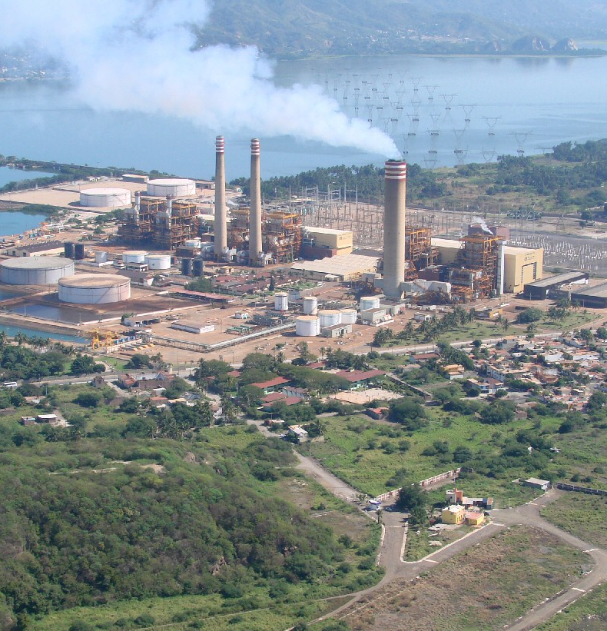
History of Manzanillo Cont.
IN 1825 the port of Manzanillo opened, so named because of the abundant groves of manzanillo trees that were used extensively in the early days of shipbuilding. It was raised to the status of a city on June 15, 1873. The railroad to Colima was completed in 1889 after budgeting for this necessity to expand the country, and other amenities, such as electricity and potable water soon followed. In 1908, President Porfirio Dias inaugurated the railway linkage with Guadalajara and designated Manzanillo as an official port of entry. It was the state capital from February 20 to March 1, 1915, while Pancho Villa’s troops were threatening to capture the city of Colima.
As the largest port in Mexico, it can admit ships of more than 30,000 tons. The federal government has built a coal-fueled power generating plant, which supplies electricity to a 5-state area (although the city of Manzanillo has its own separate power plant.)

Slide 10
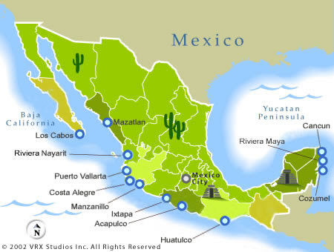
Map of Mexico

Slide 11
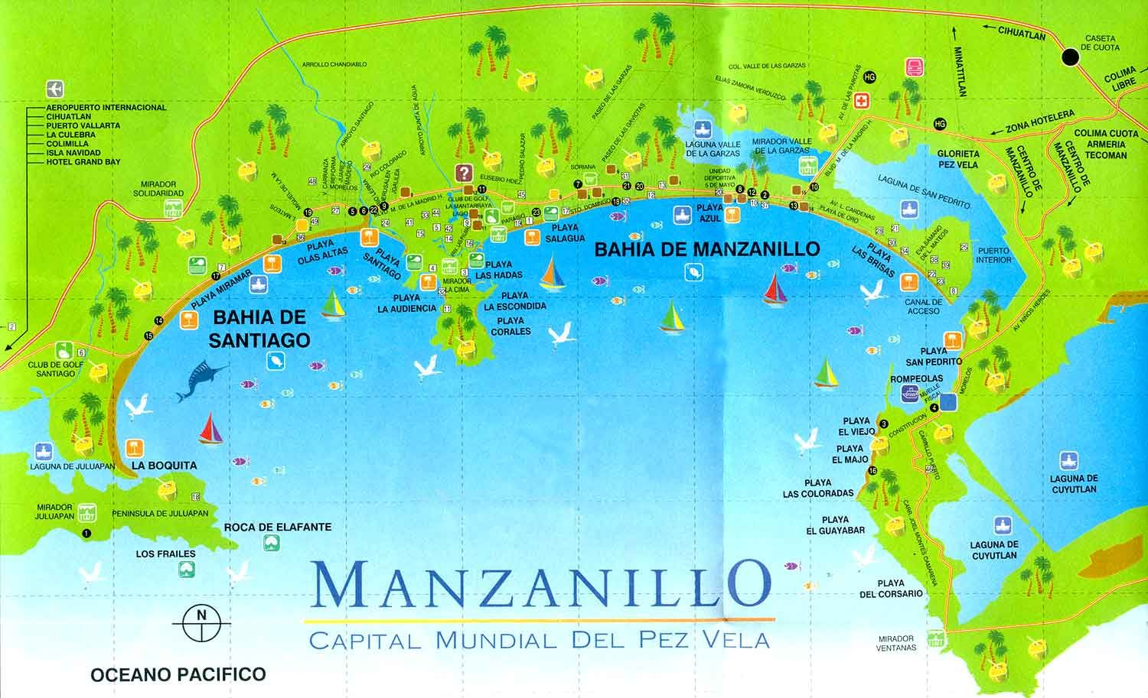

Slide 12
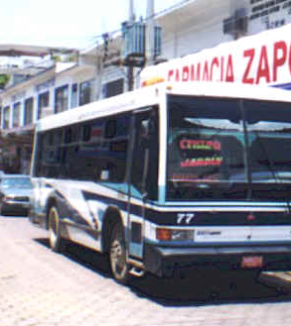
Manzanillo City Bus
Manzanillo has a very simple bus system. The camionetas (local buses) make a circuit from downtown in front of the train station, along the Bay of Manzanillo, to the Santiago Peninsula and the Bay of Santiago to the north; the fare is 4-6 pesos (About 23-35 cents) depending on the quality of the bus. Have the exact change for the trip. You won’t get change.
If you change buses, you pay again. It's best if you offer 4 pesos to the driver as you board, and act like you know what you're doing. If you ask a question in English, the driver won't understand you.
Traveling by bus is totally safe and is an interesting experience if you like to mingle with the locals.

Slide 13
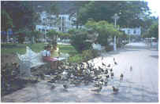
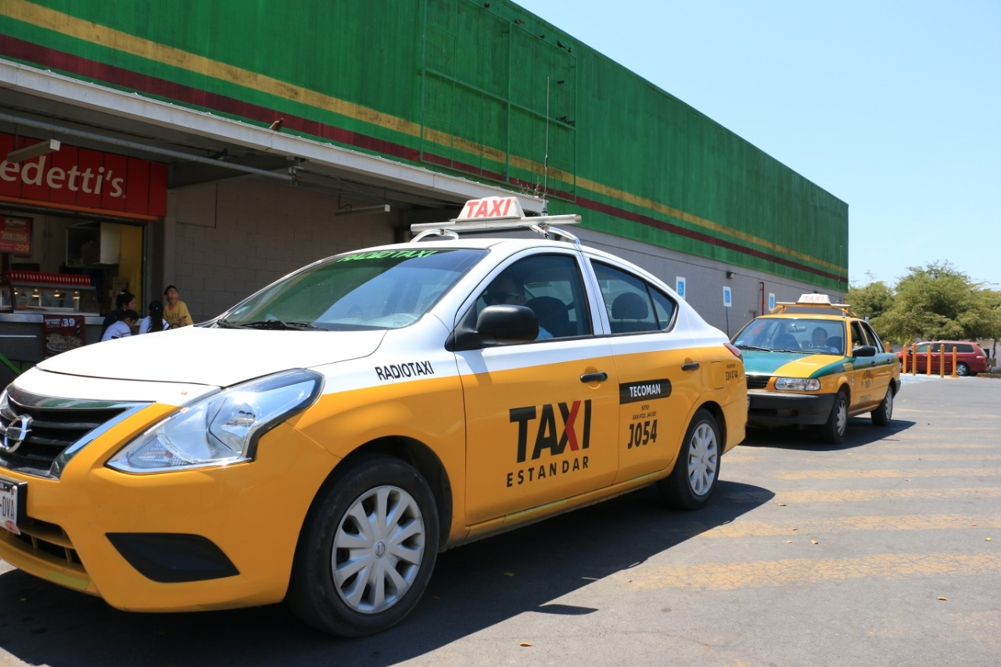
Manzanillo Taxis
Taxis in Manzanillo are plentiful. Taxis can be very
reasonable, as long as you ask the price BEFORE you
get in.
Fares are fixed by zones; rates for trips in town and
to more distant points should be posted at local hotels.
For example, a taxi ride from the port to Downtown
will cost $3.00. Daily rates can be negotiated for longer
drives outside the Manzanillo area. The going rate is
$50-80 U.S. dollars per day, depending on where you
want to go.
Be aware that Hotel taxis charge a premium rate because they've paid a higher union fee to sit in front of the hotel.
Make sure you have small change. Taxis will not carry change so they can keep yours.
You do not tip taxi drivers. The tip is included in the price.

Slide 14
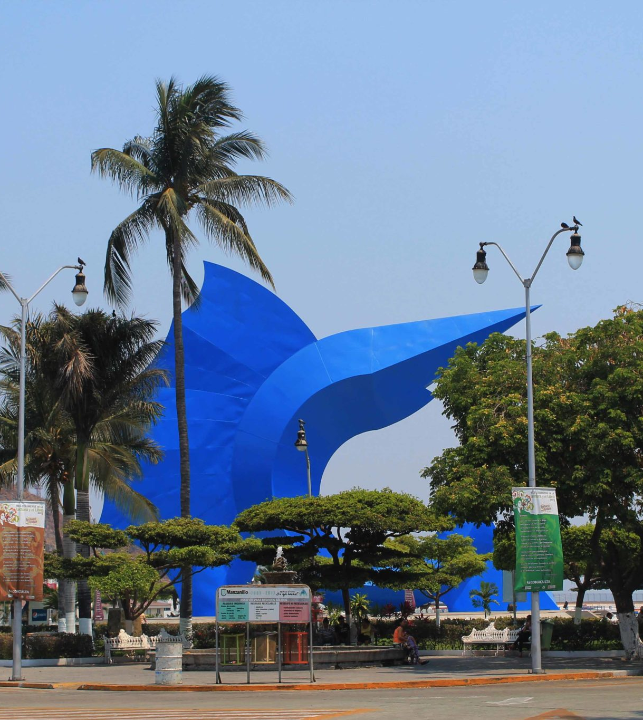
El Centro
The downtown area of Manzanillo consists of a Malecon, about a mile long. You can walk along the harbor, enjoying the view of anchored fishing boats, motor cruisers chartered for tourists, to small pangas, used by local fishermen. Along the way, there are numerous benches, shaded by palm trees, and sculptures done by local artists. An old ship's anchor (from a cargo ship sunk in the hurricane of 1959) is an interesting conversation piece and a good background for a photo.
As you get to the downtown area, you'll see the "Jardin," or garden, which is the town square. The Jardin is where everyone congregates to have lunch, or "people watch." Feeding pigeons is a favorite pastime, too.

Slide 15


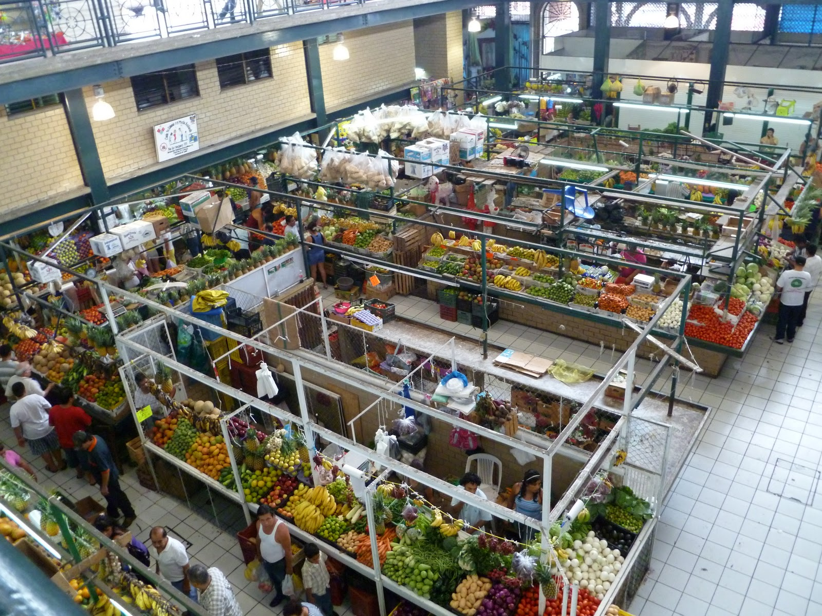
The "Mercado"
Manzanillo’s Mercado, or market, offers a variety of items for consumption. If you want the freshest seafood, fruits, or vegetables, go from 8-10 in the morning. This is mainly a “locals” market, but tourists love it for its authentic Mexican flavor. Of course, other items, such as piñatas, pottery, and leather goods are
available.
The Mercado area is located on Av. Francisco I.
Madero, behind the Club de Leones (Lions Club),
one block south of Av. Mexico. About a 1.5km
walk from the cruise port.
Although the emphasis is on food other types of
merchandise is available.
Visiting the Mercado offers a glimpse into life in
Mexico.

Slide 16
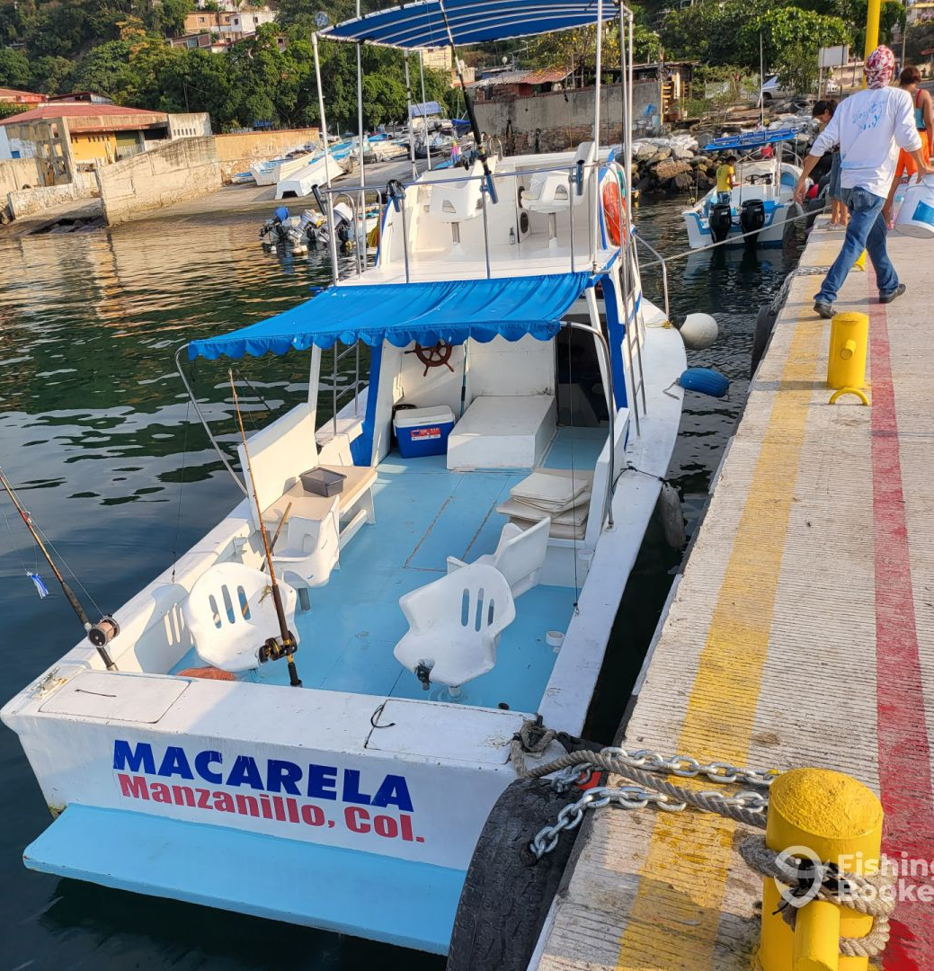
Sport Fishing
Dubbed the sailfish capital of the world, there’s no doubt Manzanillo has some great sport fishing. Whether you’re after sailfish, marlin, or swordfish, there are dozens (if not hundreds) of boats ready to take you out for the day.
Manzanillo is also home to some of the largest fishing tournaments in the world with prizes routinely in the millions. Sometimes the prizes even include houses and boats. The international tournaments draw people in from around the world and the town itself proudly boasts the largest Sailfish statue you’re ever going to see.
Fishing charters on a well-equipped 30’-40’ cabin cruiser run about $50/hour with a 6-hour minimum. Larger vessels can run significantly more.

Slide 17
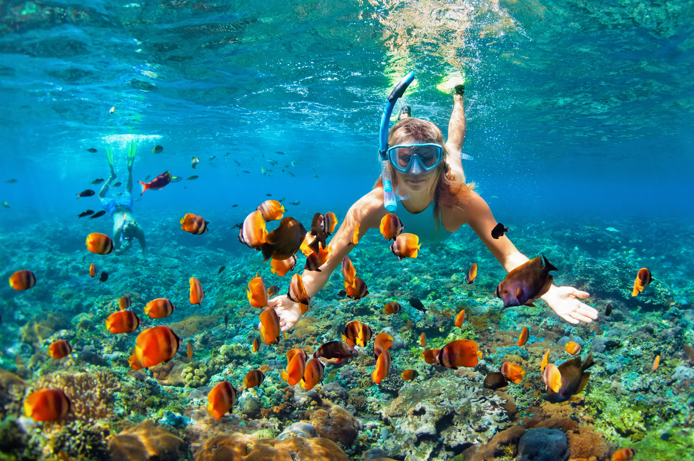
Snorkeling
The town’s beaches are renowned for their sparkling water and soft sand. Visitors can enjoy snorkeling in Manzanillo’s waters, where they will be able to see a variety of colorful fish and other marine life. There are tons of places to snorkel around Manzanillo.
The warm, calm waters make snorkeling a joy and most of the reefs can be reached directly from the shore. If you’re going it alone, Playa Audencia next to the Tesoro Hotel is a very popular snorkel site with decent visibility. Playa La Perla is another great place to snorkel and is actually part of Playa Audencia.

Slide 18
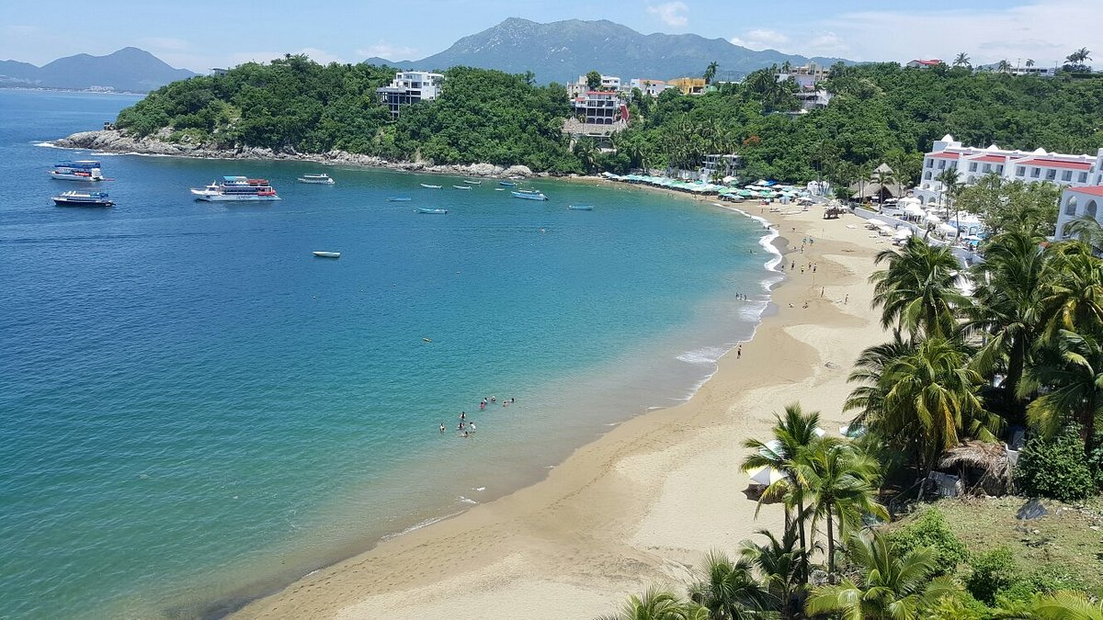
Manzanillo Beaches
Playa La Audiencia is popular for families and people
who prefer very calm waters for swimming. This is
also, a great place to go snorkeling. There are a few
places to grab food as well as plenty of vendors
offering water sports activities.
La Boquita is a favorite beach for tourists. Bring a
towel, snacks, and drinks, and spend the day
lounging. The waves are, for the most part, pretty
mellow. There is so much beach to lay on here and
only a few vendors come past throughout the day
selling food, coconuts, or souvenirs. During busier seasons like November-February, there are many people offering boat trips or parasailing rides.
Playa Las Brisas is the beach you find in the next bay over from La Boquita. This a good beach for surfing, skimboarding, and bodyboarding for those who want the bigger waves (but still not really enormous). This is also where lots of beachfront restaurants can be found.

Slide 19
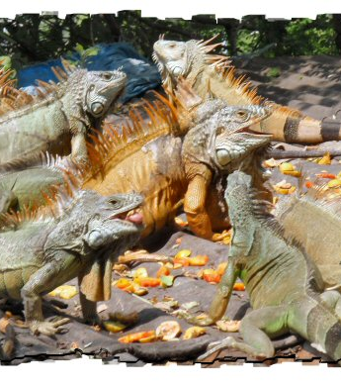
Visit the Iguana Sanctuary
The Iguana Sanctuary is one of the best things to do in Manzanillo if you want to see some beautiful, endangered iguanas as well as a few other animals that have been rescued over the years.
It’s called Iguanario Archundia. It’s easy to get to by taxi or by taking the bus, get off at the Malecon and it’s about a 15-minute flat walk to the sanctuary.
With some of the larger reptiles reaching lengths of more than 6 feet and 70 lbs., Juan Garcia (the caretaker) has the responsibility of securing almost 200 lbs. Of fruits and vegetables, a day.
Juan Garcia tries to get the vendors to donate the old fruits and vegetables, and he is somewhat successful, and sometimes they'll even donate fresh produce. Many times, however, he has to pay out of his own pocket. As his brood grows, the search for food is constant, and he receives no support from any group or organization, or even the government, even though both black and green iguanas are protected by the state of Colima.

Slide 20
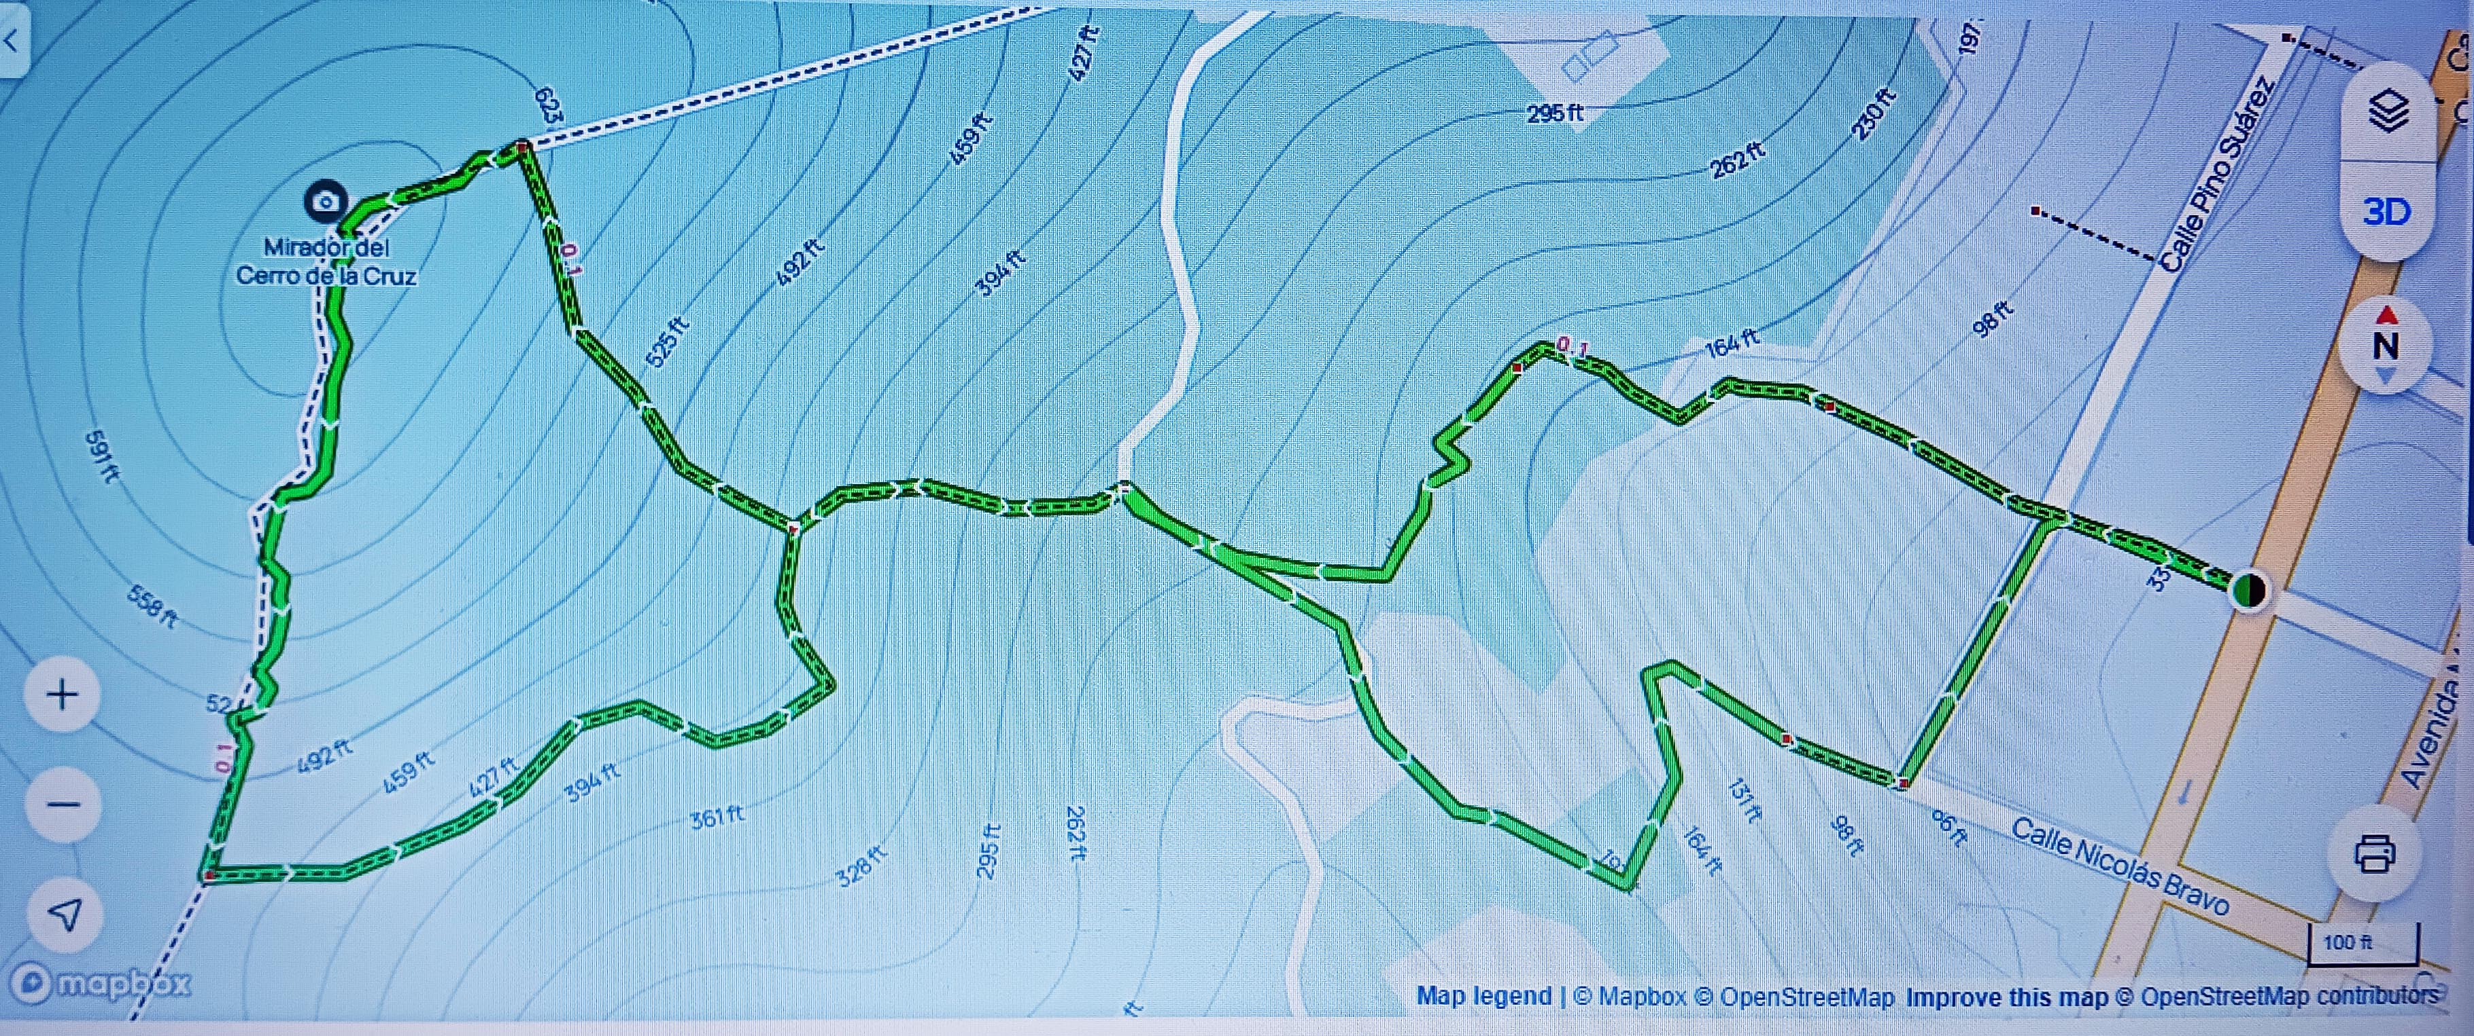
Explore this 1.0-mile loop trail near Manzanillo, Colima. Generally considered a moderately challenging route, it takes an average of 46 min to complete.
This is a popular trail for walking, but you can still enjoy some solitude during quieter times of the day.
Mirador del Cerro de La Cruz

Slide 21
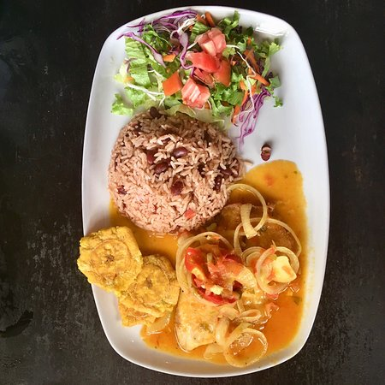
Manzanillo Restaurants
Manzanillo has many excellent restaurants. Many of us on the ship are
foodies, so naturally, we’re always on the hunt to eat at the most exclusive
spots anytime we travel.
Here are a few of the best restaurants to consider in Manzanillo.
El Terral by Brisas $$$$ Mexican Seafood International,
Av. Vista Hermosa S/N, Península de Santiago Hotel Las Hadas, Manzanillo
Oasis Ocean Club $$ - $$$ Mexican Bar Seafood, Delfin 15, Manzanillo
Punta Zuk $$ - $$$ Italian Seafood, Olas Altas, 28860 Manzanillo, Manzanillo
Mariscos El Toro Mambo $ Mexican Seafood, Calle Tabachin #21 Colonia Arboledas, Manzanillo
Legazpi Restaurant by Brisas $$$$ Seafood International Mediterranean, Av. Vista Hermosa, Manzanillo
Pata Salada Beach Bar $$ - $$$ Seafood, Avenida Playa de Oro 1509, Manzanillo
La Sal $$ - $$$ Mexican Seafood Grill, Calle Articulo 123 # 20 Puerto de Manzanillo, Manzanillo
Pacifica Del Mar $$ - $$$ Seafood International Vegetarian Friendly Vegan, Avenida Del Mar No. 1506 Col. Las Brisas, Manzanillo
For those of you who just like good food, you can’t go wrong just about anywhere you go in Manzanillo.
GOOD EATING

Slide 22
Final Thoughts
Manzanillo is a beautiful City with a rich history and numerous attractions. Whether you're looking for stunning beaches, historic sites, or unique attractions, Manzanillo has something for everyone.
I hope this presentation will help when we visit Manzanillo!

Slide 23
Thanks For Coming
If you have any more questions, please ask.
I will do my best to answer them for you.
Have a great visit in Manzanillo!

