Slide 1
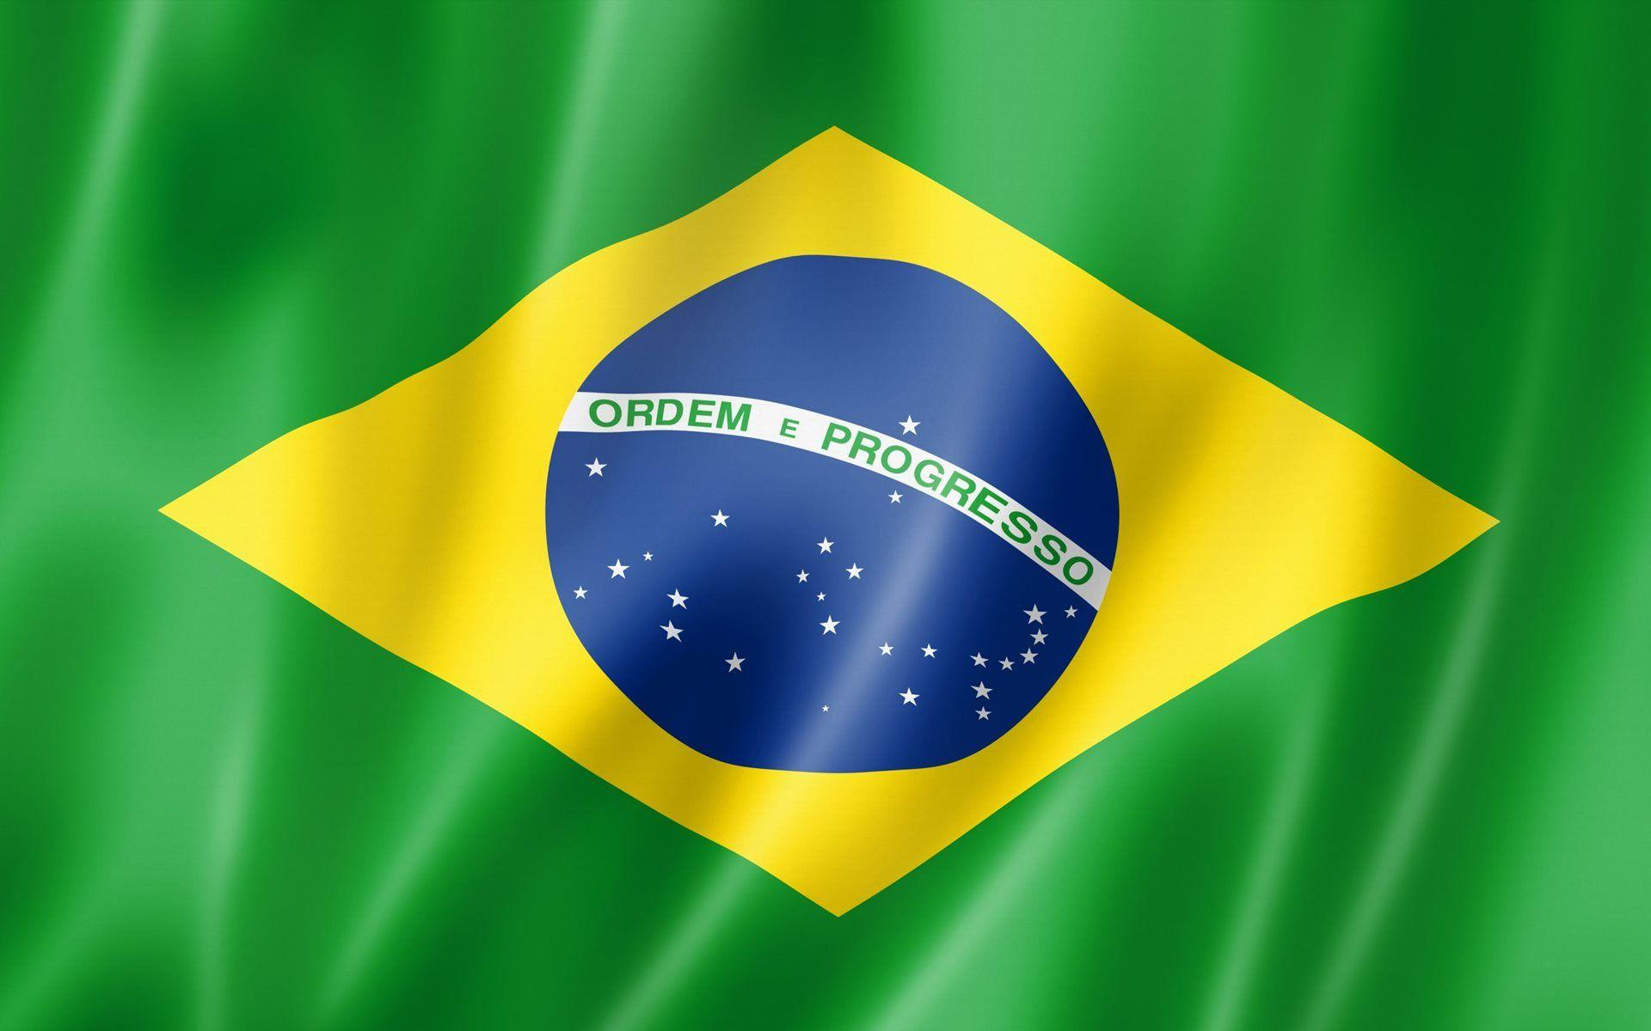
Manaus, Brazil Presented by Marc Silver

Slide 2
What I Will Cover
My Port Philosophy
Don’t Miss the Ship
Money
About Manaus
Manaus History
Area Map of Manaus
Map of Manaus
Manaus Transportation
Places to see or at least consider
A few restaurant recommendations
Conclusion

Slide 3
My Port Philosophy
I have been cruising for over 44 years and have taken over 200 cruises. So, I consider myself an experienced cruiser.
The information I will present is based on those many years of
experience.
When I am on a cruise where the city, I want to visit is not the port city,
I always recommend taking a ship’s tour.
But when I am in a port with multiple attractions nearby and easy to see
on my own - I will do it on my own.
This presentation is not like that.

Slide 4

Don’t Miss the Ship
How to Avoid Missing Your Ship
Pay attention to the time. - Ship time and local time are often different.
Put a return-to-ship reminder on your phone.
Choose excursions wisely.
If a ship-sponsored excursion is late returning to port, the ship will wait for you. If you are on your own.
Be Prepared
Have your Passport, Credit Card, and phone numbers for your ship port agent.
What to Do If You Miss the Ship Most cruise lines have port agents stationed in the port area to assist if your ship has left without you. If your are lucky, when cruisers are late returning to the vessel, the ship’s crew will often remove the passengers’ essential items – passports, cell phones, and medication -- from the ship to leave with the port agents.
The Port Officials can help you with contacting your ship and making necessary travel arrangements.

Slide 5
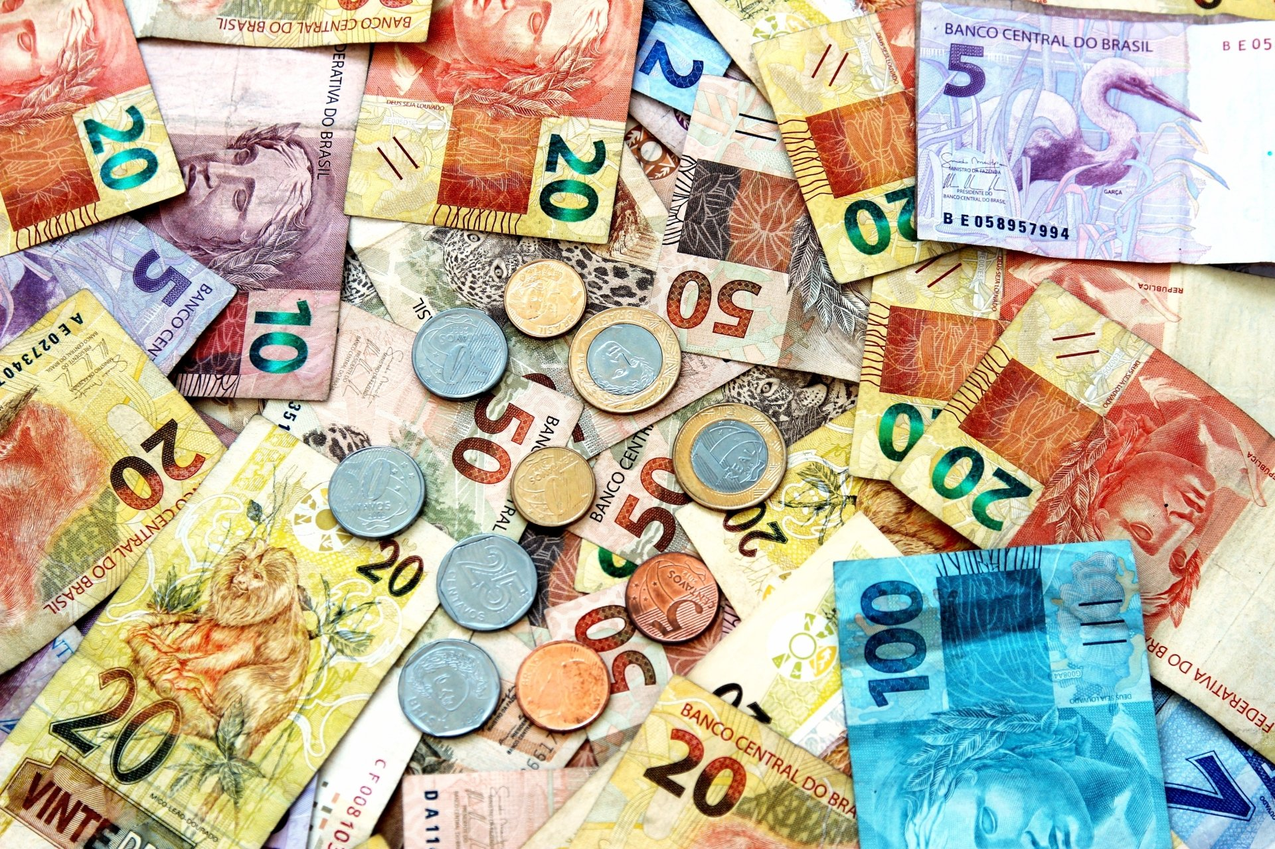
Money
The Brazilian Real
The official exchange rate is:
$1.00 US = 4.9310457 Real
1.00 Brazilian Real = 0.2028 US Dollars

Slide 6
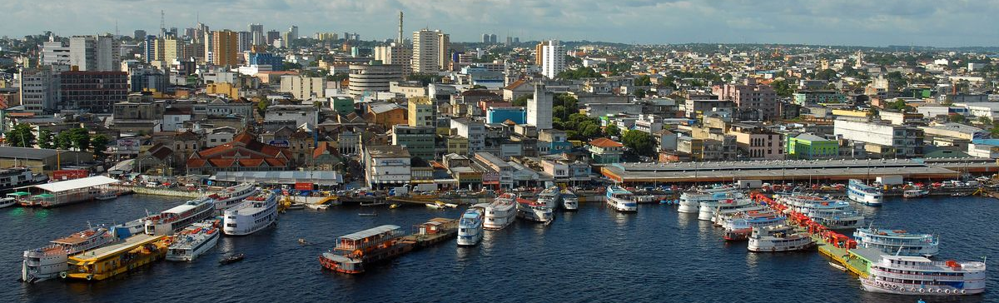
About Manaus, Brazil
Manaus is the capital and largest city of the Brazilian state of Amazonas. It is the seventh-largest city in Brazil, with an estimated 2020 population of 2,219,580 distributed over a land area of about 4,402 sq mi.
Manaus is the largest metropolitan area in the North Region of Brazil by urban landmass. Located at the Negro and Amazon rivers.
It is one of the two cities in the Amazon Rainforest with a population of over 1 million people, alongside Belém.

Slide 7
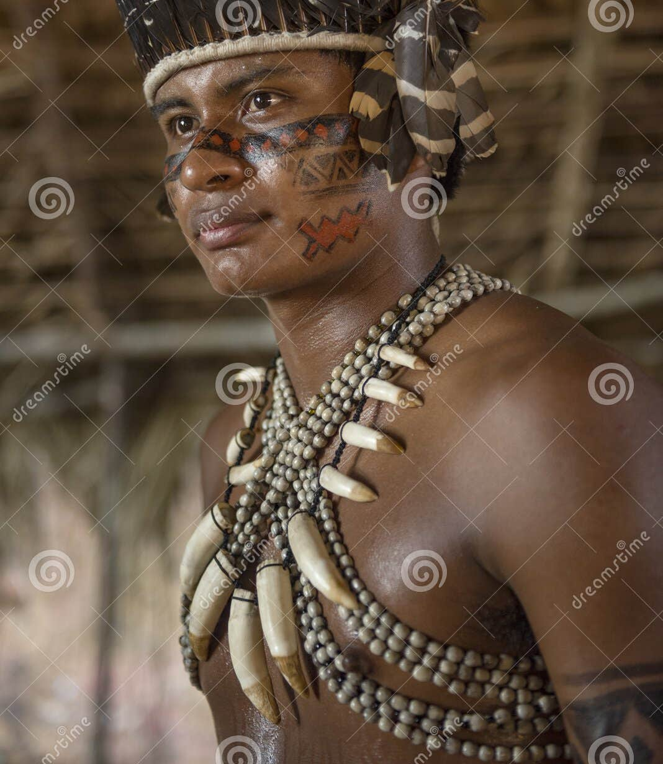
Manaus, Brazil History
The history of the European colonization of Manaus began in 1499 with the Spanish arrival at the mouth of the Amazon River.
The Spanish then continued to colonize the region north of Brazil. Development continued in 1668–1669 with the building of the Fort of São José da Barra do Rio Negro by the Portuguese against the Dutch, at that time.
The fort was constructed in rock and clay, with four cannons guarding the curtains. It continued to function for more than 100 years.
Next to the fort there were many indigenous mestizos, who helped in its construction and began to live in the vicinity.

Slide 8
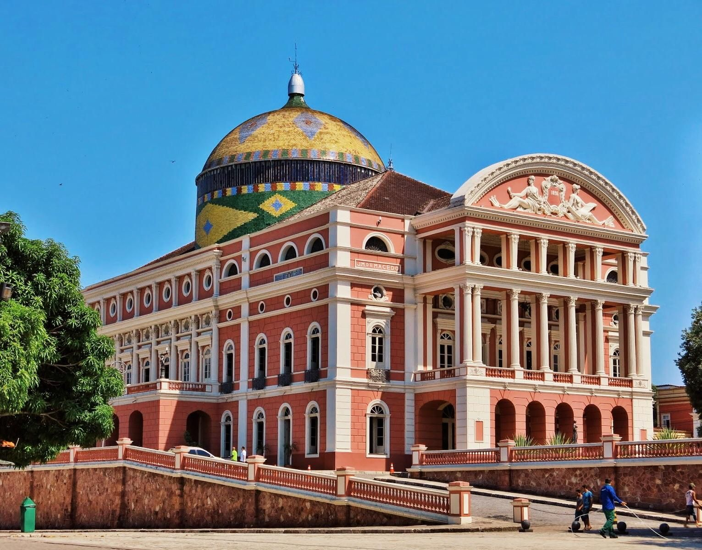
Manaus, Brazil History Cont.
On November 13, 1832, Lugar da Barra was elevated to town status, then on September 4, 1856, the governor, rename it "Manaus".
Due to the Amazon rubber boom during the late 19th century. Manaus was "one of the gaudiest cities of the world“
The city built a grand opera house, with vast domes and gilded balconies, with marble, glass, and crystal, from around Europe. Costing the equivalent of ten million dollars.

Slide 9
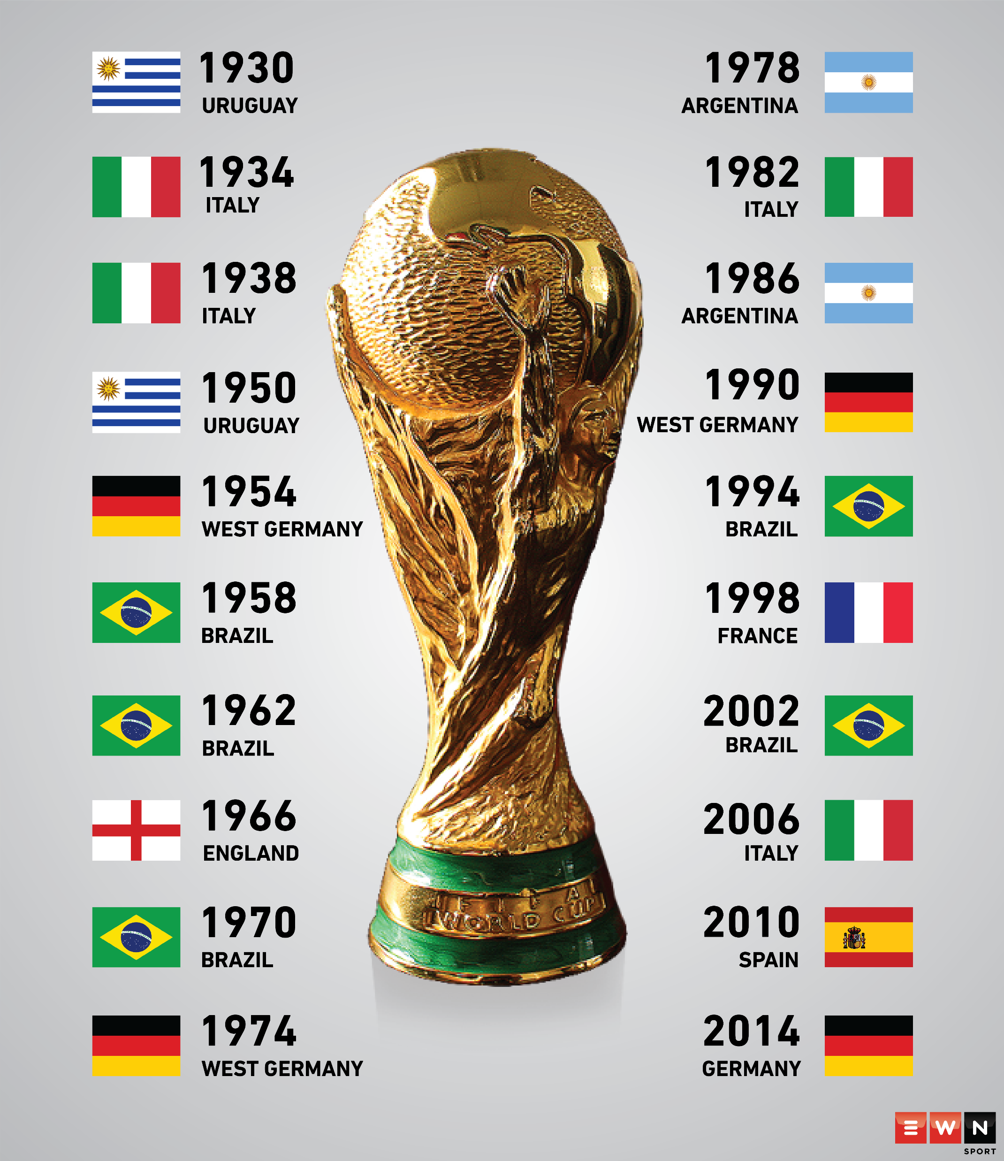
Manaus, Brazil History Cont.
In the 1960s during the establishment of the military dictatorship in Brazil, the newly installed government concerned about the "demographic gap in Brazil", began to introduce numerous projects in the interior of the country, especially in the Amazon region.
Manaus was designated a free trade zone in 1967, and with the opening of new roads within the region, the city benefited from investments by international companies, attracted by the tax incentives, in this period. Manaus had enormous demographic growth becoming one of the most populous cities in Brazil.
Manaus was one of the host cities of the 2014 FIFA World Cup and one of the seats of some Olympic football games. It was the only host city in the Amazon rainforest and the most geographically isolated host cities.

Slide 10
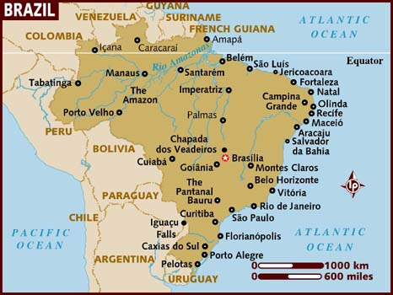
Map of Brazil

Slide 11
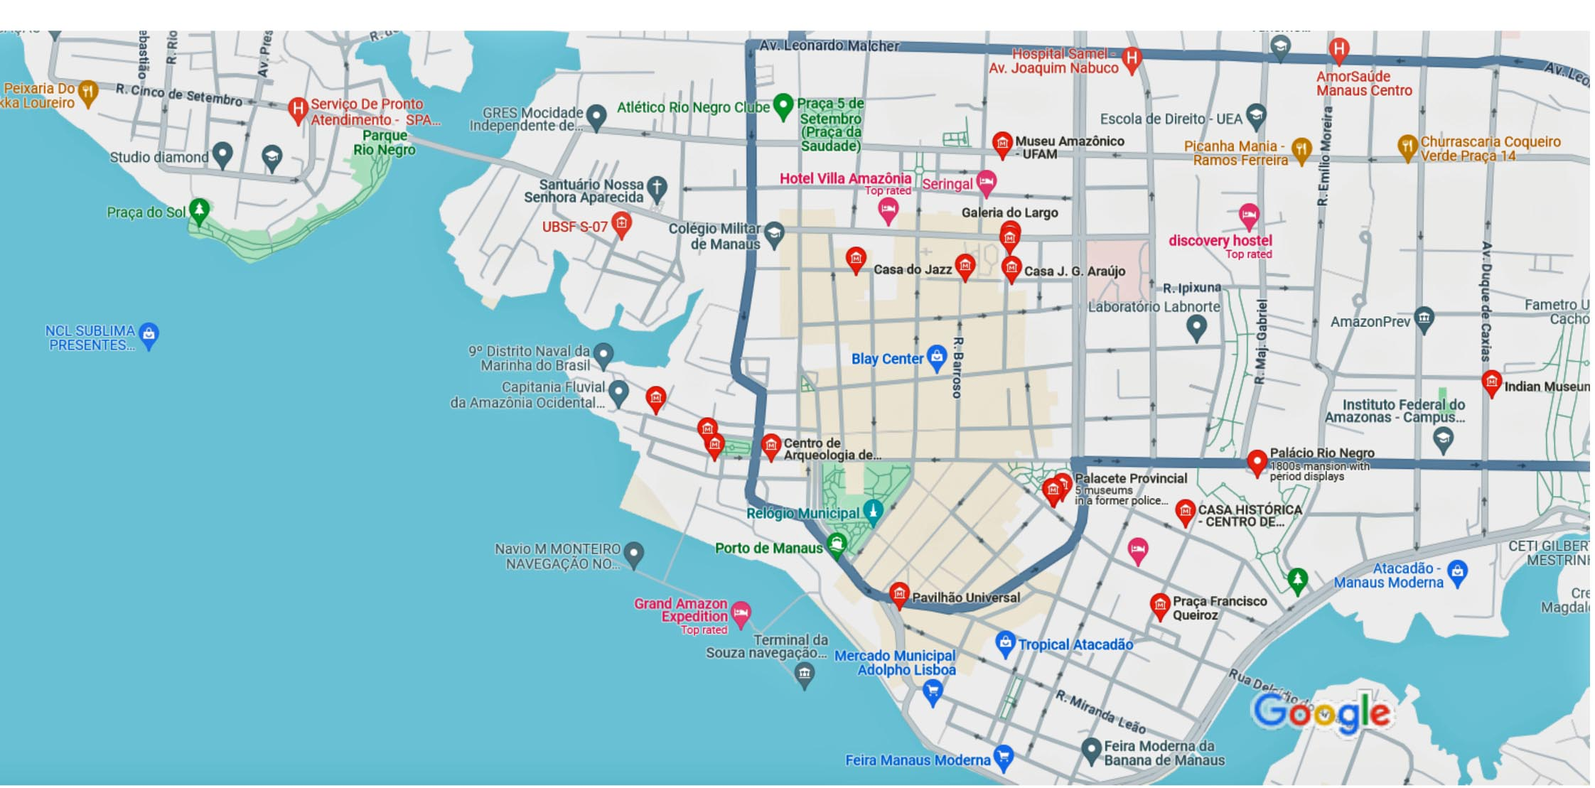
Map of Manaus

Slide 12
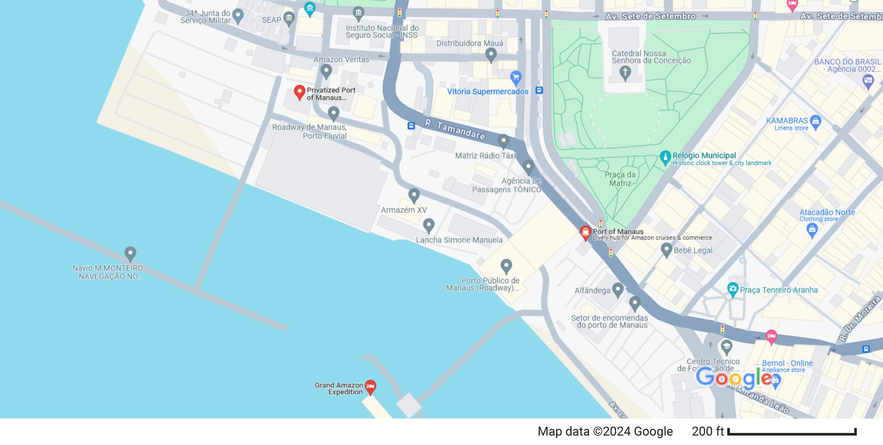
Port of Manaus

Slide 13
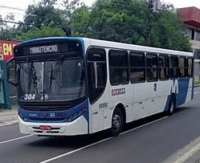
Manaus, Brazil Transportation
Like most large cities Manaus has an extensive rapid transit system making travel around Manaus very easy.
This year, the mayor signed an agreement for the acquisition of the first 12 electric buses, which will be introduced in the city’s fleet.
Public transportation in Manaus still needs a lot of improvement do to waiting time, and crowded vehicles as the main reasons for users’ complaints. Most lines of the system have a high frequency of users, with a drop in the frequency of users during non-peak hours.
Bus ticket in Manaus is R$3.80

Slide 14
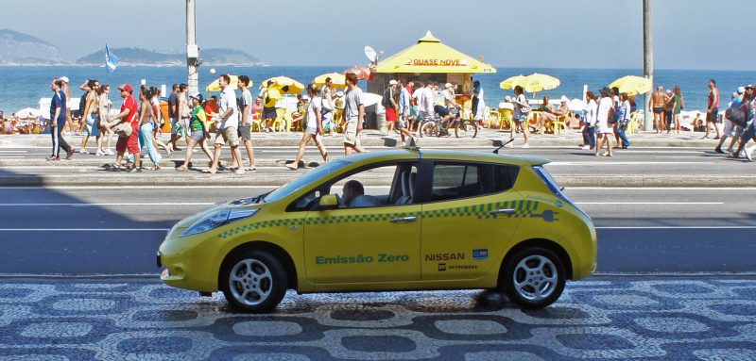
Manaus Taxis
Taxis and Ridesharing Companies are a comfortable way to get around Manaus.
There are several ride-share companies in Brazil including Uber, Easy Taxi, 99 Taxi, and Lyft, but you need the app on your phone to use them.
My warning to you is to watch out for taxi scams. So, if you can use a ride-share, I recommend doing so. If you have to take a Taxi, then be sure they are from a reliable taxi company.

Slide 15
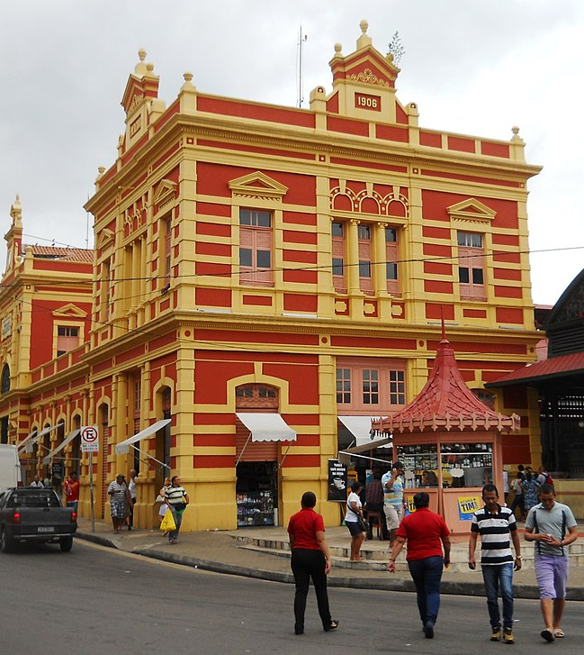
Mercadão Municipal Adolpho Lisboa
The Mercado Municipal or Mercadão (big market), is a marketplace located in Manaus, Brazil. It lies on the shore of the Rio Negro. The market was constructed between 1880 and 1883.
The building's metallic structures were built in Paris and sent to Manaus by ship.
The building has two completely different facades, one facing the Rio Negro and one facing the public road.
The market is one of the largest open markets in the city of Manaus, offering fresh fruits, spices, fish, souvenirs, traditional indigenous medications, and more.
Admission is Free

Slide 16
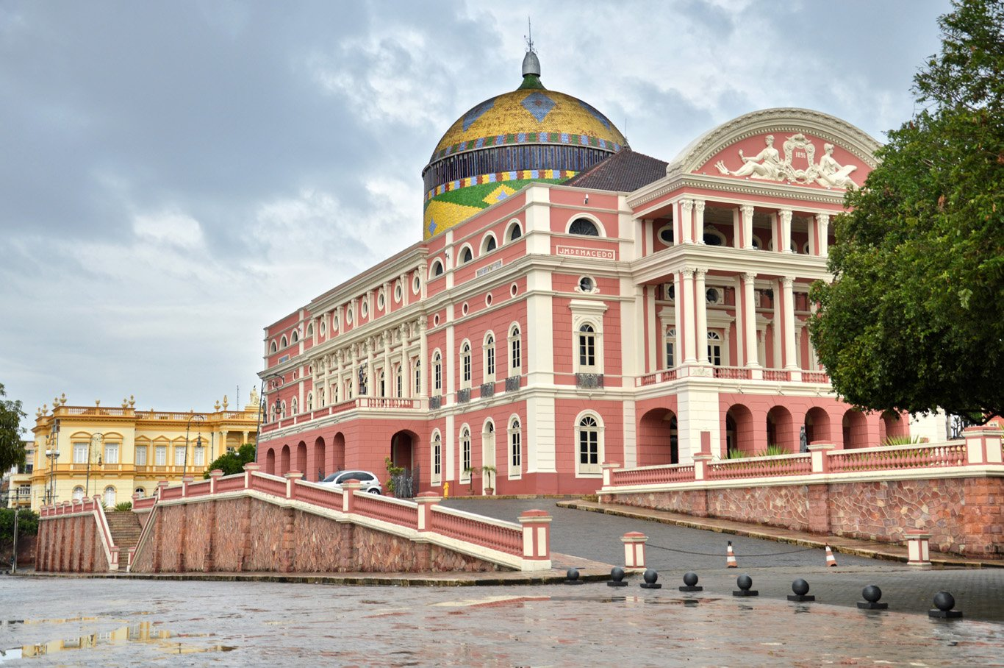
Teatro Amazonas - Amazonas Opera House
The city of Manaus is home to a remarkable cultural monument: a majestic 19th-century opera house that brought the grandeur of Europe to Brazil. The Opera House was built during the heyday of the rubber trade, using materials from all over the world, and was once visited by all the most famous opera divas and maestros of the time.
Regular guided tours in English, R$ 20.

Slide 17
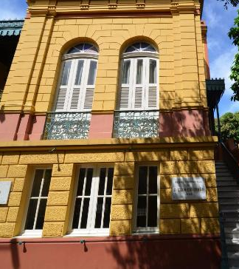
Museu da Casa Eduardo Ribeiro
The Eduardo Ribeiro House Museum, former residence of the former governor of Amazonas, Eduardo Gonçalves Ribeiro, presents a permanent exhibition of period residential furniture, objects of personal use and art that seek to recreate the way of life of the late 19th and early 20th centuries, the time in which he lived.
After the death of Eduardo Ribeiro, it became private property, being acquired by the Federal Government in 1961. In 2002, it was ceded to the State by way of lending, for the specific purpose of recovering the city's memory.

Slide 18
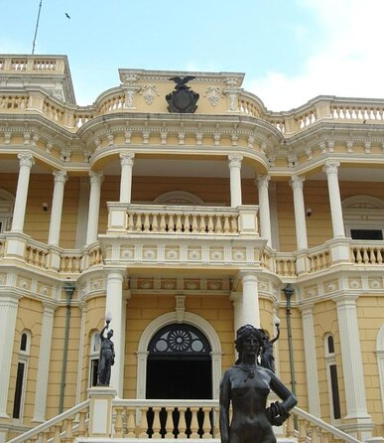
Palácio Rio Negro (Rio Negro Palace)
The Palácio Rio Negro in Manaus, Brazil, is a former seat of government and residence of the governor of the state of Amazonas.
The original name was Scholz Palace, built by the German entrepreneur Karl Waldemar Scholz, a well-known "Rubber Baron".
The name was changed to Palácio Rio Negro in 1918 when the government acquired the palace for 200,000,000 réis, and it was given the name Palácio Rio Negro. From 1918 until 1995 it served as the seat of government in Amazonas state.
Admission is Free

Slide 19
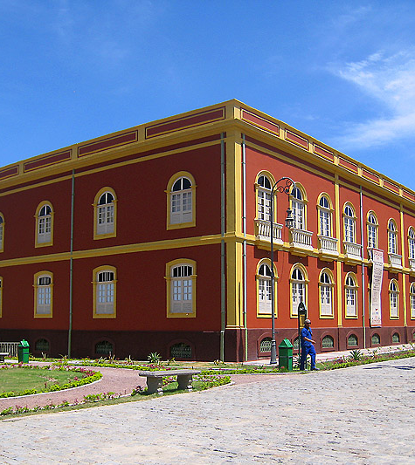
Palacete Provincial (Provincial Palace)
The building was founded in 1874 and, for more than 100 years, functioned as the Amazonas Military Police Barracks.
On March 24, 2005, it underwent a restoration, being reopened in 2009, with the space being opened for public visitation and free of charge, receiving visitors interested in getting to know the museums' collections and art collections, and who also participate in the cultural events.
The Heliodoro Balbi Square (former Police Square), in front of the building, is an extension to the site.
Free Admission

Slide 20
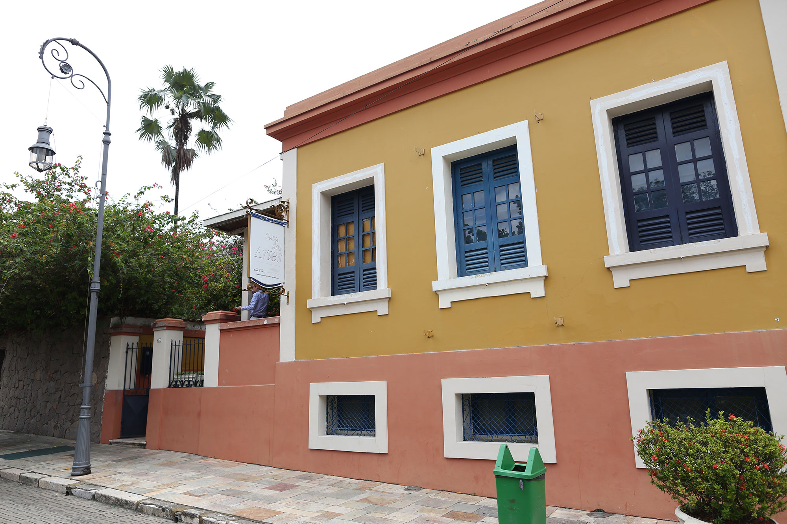
Casa das Artes (House of Arts)
The House of Arts is one of the oldest houses in Manaus.
Currently the administration of the Largo de São Sebastião Cultural Center is located in the Casa das Artes. The space also hosts temporary exhibitions.

Slide 21
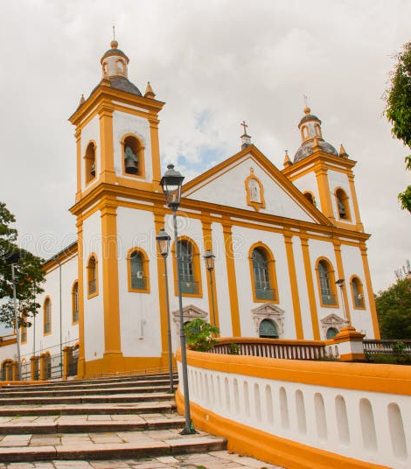
Cathedral of Our Lady of Conception
The Metropolitan Cathedral of Our Lady of the Conception also called Catedral Metropolitana de Manaus, is a Catholic cathedral located in the city of Manaus.
It is considered the mother church of the city, dating back to the Carmelite missionaries who, in 1695, created the early Church of Our Lady.
The current building is Greek style, with much of the material imported from Portugal
In 1892 the Diocese of Amazonas was created; the church was officially opened in 1878, and in 1946 the church was elevated to cathedral status.

Slide 22
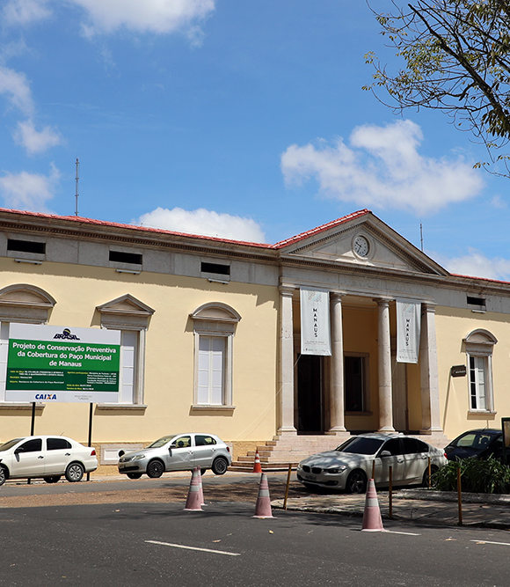
Palace of Liberty Museum Museu da Cidade de Manaus
A relatively new showcase of the city, its people, and local foods and culture.
The architectural exterior and interior of the building are quite opulent in themselves, as is the Rio Branco Palace, which is the state assembly building, just to the south
Admission is Free

Slide 23
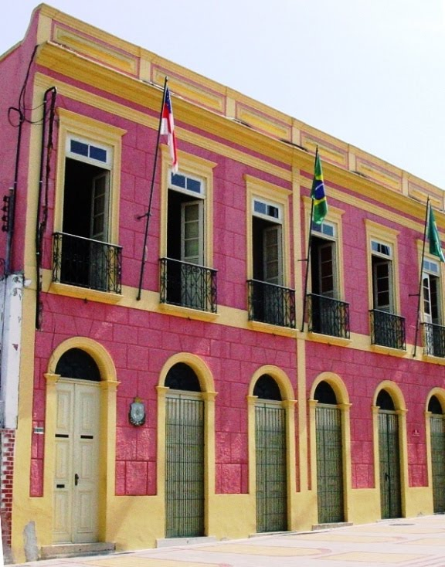
Geographical and Historical Institute of Amazonas
Instituto Geográfico e Histórico do Amazonas, is a small museum with an array of relics about this region of the Amazon. In a pretty pink historical mansion.
A find for those who like Social Sciences. Those interested in History and Anthropology still find this museum of great interest.
Its current heritage contains more than a thousand pieces, including ceramics, wooden instruments, bones, bows, arrows, objects of war adornments, headdresses, igaçabas, mollusk shells, etc.

Slide 24
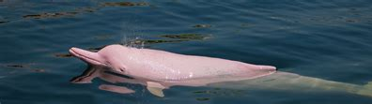
Swimming with Porpoises
The Amazon River can be a dangerous place if you venture out on your own. I recommend using a guide to safely cruise the water between the Amazon River and Tapajos in search of wildlife such as pink river dolphins or black piranhas.
It’s possible to charter a fishing boat to take you around to other islands in the area while you search for the playful river dolphins and other wildlife.
A half-day trip costs around 150 BRL (US$60) for up to four people.

Slide 25
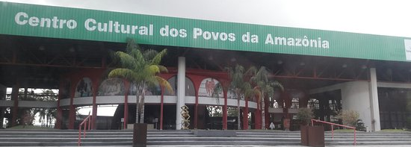
Cultural Center of the Peoples of the Amazon
Inaugurated on May 21, 2007, the Cultural Center of the Peoples of the Amazon is a space that aims to value, foster, and disseminate information about the countries of the Continental Amazon, formed by Bolivia, Brazil, Colombia, Ecuador, Guyana, Peru, Suriname, Venezuela and French Guiana.
In addition to its theme, it is a place to welcome artistic and scientific expressions.
FREE ADMISSION

Slide 26
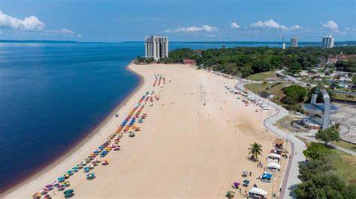
Praia da Ponta Negra (Ponta Negra Beach)
Praia da Ponta Negra (Ponta Negra Beach) (catch buses 120 or 126 from downtown). Copacabana's river counterpart, this fine sand beach has a very nice urbanized area on its back, with a large walkaway, a skateboard park, some beach volleyball fields and many food stalls. On Wednesdays and Sundays the car traffic is interrupted and locals occupy the extra space jogging, roller-skating and skateboarding. It hosts free dancing and calisthenics classes organized by the city, and some independent groups also meet there for activities, such as the slackline Mexa-se group. The adjoining neighborhood has the most expensive sq-meter in Manaus, so your açaí will cost more at Ponta Negra (around R$ 11 for 300 ml)

Slide 27
Thanks For Coming
If you have any more questions, please ask.
I will do my best to answer them for you.
Have a great visit to Manaus!

