Slide 1

Málaga, Spain
Port Presentation
Presented by
Marc Silver

Slide 2
Málaga, Spain
Málaga is a port city on southern Spain’s
Costa del Sol, known for its high-rise hotels
and resorts jutting up from yellow-sand beaches.
Looming over that modern skyline are the city’s 2
massive hilltop citadels, the Alcazaba and ruined
Gibralfaro, remnants of Moorish rule.
It is also the capital of Andalusia, and a town once
regarded as little more than a transit hub with bonus
points for being the birthplace of Pablo Picasso.

Slide 3
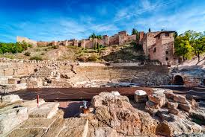
The Founding of Málaga
Málaga is one of the oldest cities
in the world with close to three
thousand years of history.
The Phoenicians originally
founded a commercial center
here in early 7C BC, which they
Named Málaga. The name is
most probably derived from the
word Malac – to salt. The Greeks and Carthaginians were briefly
present and further established Málaga as a trading post.

Slide 4
What I Will Cover
My Port Philosophy
Money
Don’t Miss the Ship.
Where is the Tourist Office?
A few interesting facts about Málaga
Places to see or at least consider
A few restaurant recommendations
Best way to get around Málaga.

Slide 5
My Port Philosophy
I have been cruising for over 43 years and have taken over 100 cruises.
So I consider myself an experienced cruiser.
The information I will present is based on those many years of experience.
When I am on a cruise where the city I want to visit is not the port city, I always recommend taking a ship’s tour.
But when I am in a port with multiple attractions nearby and easy to see on my own -
I will do it on my own.
This presentation is for that type of port.

Slide 6

Money
The euro is the official currency of 20 European Union countries which collectively make up the euro area, also known as the eurozone.
Official Exchange is $1.079 US to €1

Slide 7
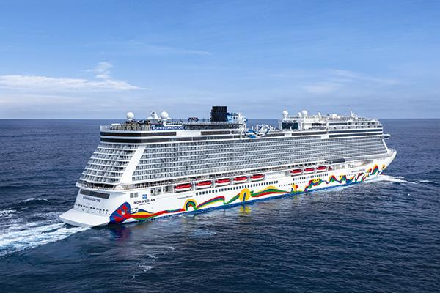
Don’t Miss the Ship
How to Avoid Missing Your Ship:
Pay attention to the time. - Ship time and local time are often
different. Put a return-to-ship reminder on your phone.
Choose excursions wisely:
If a ship-sponsored excursion is late returning to port, the ship
will wait, but not for excursions taken on your own.
Be Prepared:
Have your Passport, Credit Card, and phone numbers for the ship port agent.
What to Do If You Miss the Ship:
Most cruise lines have port agents stationed in the port area to assist if your ship has left without you. Sometimes, when cruisers are late returning to the vessel, the ship's crew may remove the passengers' essential items -- passports, cell phones, and medication -- from the ship to leave with the port agents.
The Port Officials can help you with contacting your ship
and making necessary travel arrangements.

Slide 8
We’re Not Here Alone
Ten wharves are currently in operation at the Port of Málaga: 4 of these are cruise terminals.
Expect to see cruise ships from several other lines in port with us.
You may want to plan accordingly!

Slide 9
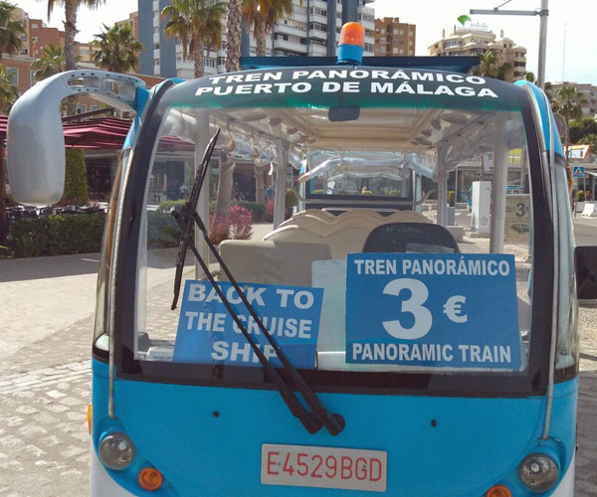
Cruise Terminal Bus
Cruise Bus Route
The Cruise Bus runs from all 7 of the cruise port terminals to the Christopher Columbus Monument and back.
The bus is wheelchair accessible.
Cruise Bus Tickets
The tickets for the Cruise Bus can only be purchased with cash on the bus itself. Alternatively you can book your tickets online in advance. Follow the link below to book in advance.
Lets off close to the Tourist Information Office.

Slide 10
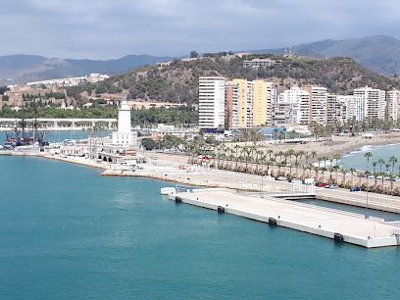
Cruise Terminal Info
Dock Location
The cruise ship dock in Malaga is located abut 2 km from Plaza de la Marina in the city center. A sandy beach is located just 200 meters from the dock.
Port Shuttle
The Port Authority in Malaga provides a shuttle service from the Malaga cruise terminal to Plaza de la Marina at a cost of 5 euro. Buses depart every 15 to 20 minutes.
.

Slide 11
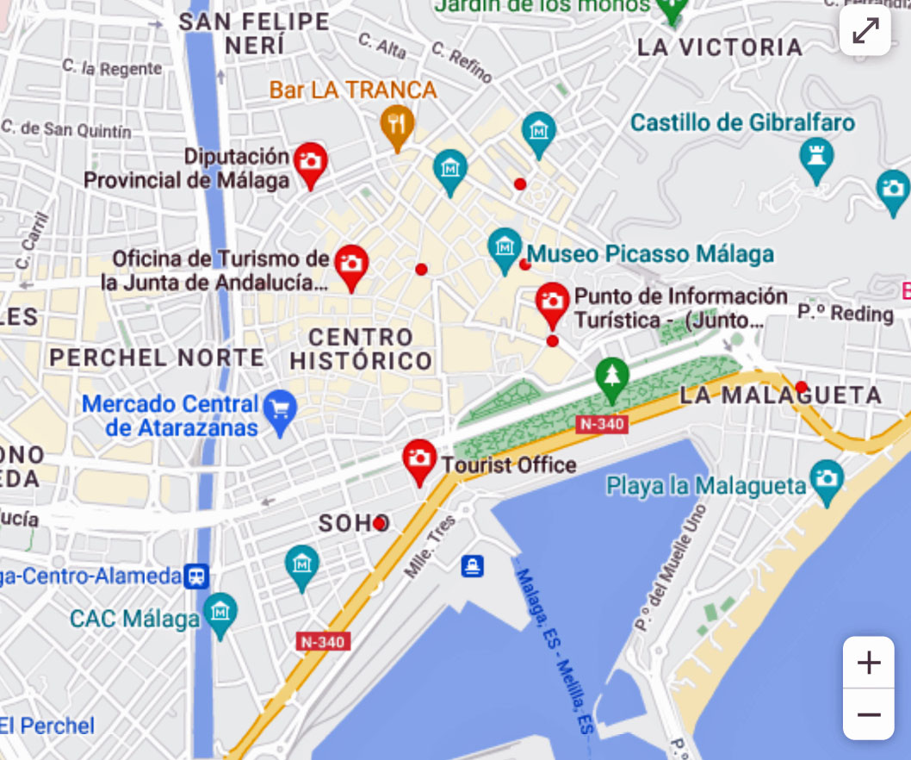
Official Málaga Tourist Offices
The Tourist information office is located across from Cruise Port Bus Stop.
There are six tourist offices in Malaga manned by the city council plus one at the port. They offer free information about the city, including opening times for monuments and museums. They can also tell you what’s on in Malaga link during your visit.
Staff are generally helpful and between them, speak several languages. You can get a free map of Malaga that marks the tourist offices and 37 things to see. The map isn’t great for finding your way round and you’ll need your glasses to read the names of the streets, but it gives you an idea.

Slide 12
Traffic in Málaga
Drivers in Spain are considered among the worst in the world, with accidents occurring in the city every thirty seconds! This can go up significantly on weekends, which makes it safer to walk than to drive.
However, PLEASE watch out for crazy drivers!

Slide 13
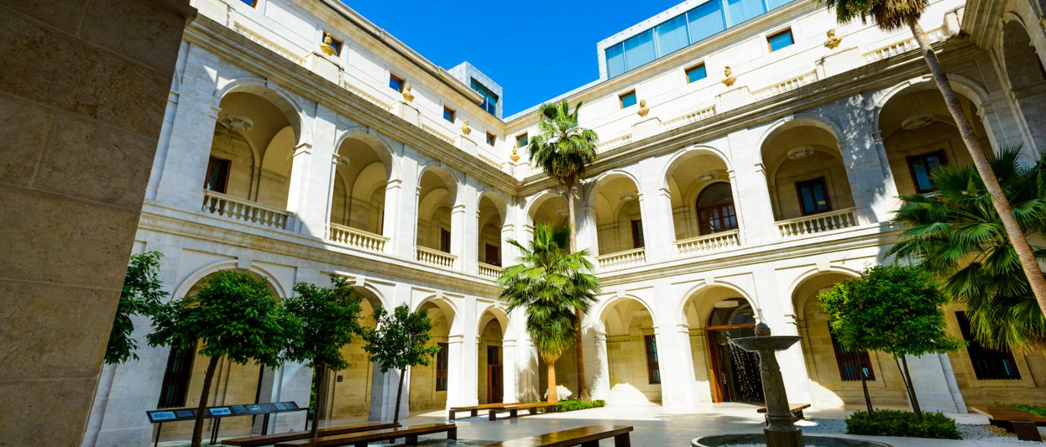
Archaeological Museum
(Museo Arqueologico)
The museum boasts prehistoric items from the most significant sites in Málaga, including the exceptionally well-preserved jawbone and femur of a Neanderthal individual that were found in the Cueva del Boquete cave in Zarraraya. The museum remains institutionally divided into two ‘sections’ corresponding to the older museums. There are slightly over 2,000 pieces in the Fine Arts collection and over 15,000 in the Archaeology collection.

Slide 14
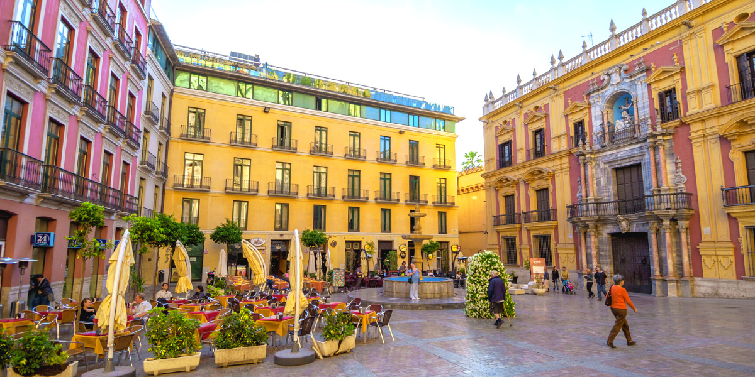
Historic Quarter
Malaga’s historic center, with its monuments and winding streets, is an inviting place for a leisurely stroll. Buy an espresso and a handful of Spanish churros from a street stall and set out exploring. You’ll see ancient Roman, Moorish and Andalusian Christian relics all within a few city blocks.
The promenade-turned-park is also the Old Town’s major transport hub and metro buses frequent the long promenade. Rising up from the east end of the park is the impressive Plaza de Toros, Malaga’s historic bullring, which is still in use today.

Slide 15
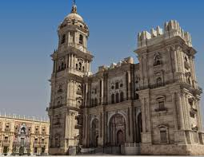
Malaga Cathedral
The cathedral of the Encarnación is one of the town's most important monuments. The south tower and the main façade are unfinished. It is situated in the historic centre of the town. The building sits where a mosque-Moorish quarter once existed. Work began in the first half of the 16th century, in the Gothic style, ordered by the Catholic Monarchs, and continued in the 17th and 18th centuries.

Slide 16
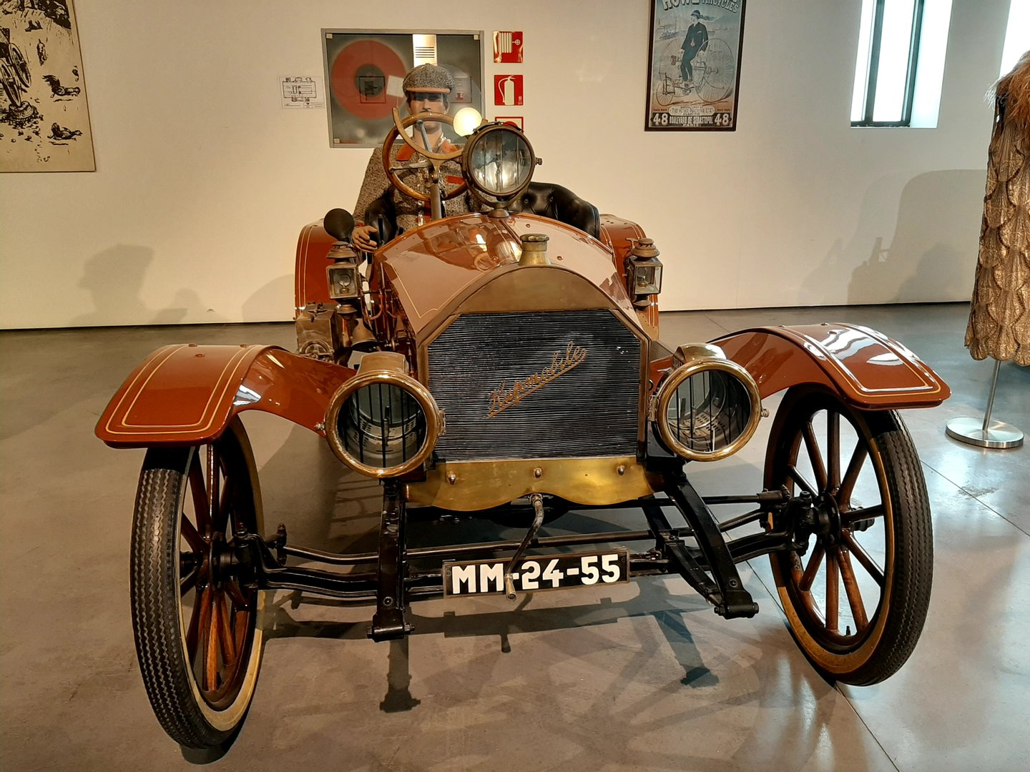
Museo Automovilístico de Málaga
The Malaga Automobile Museum is a fascinating place where you can explore a variety of classic cars, fashion and art. The museum features over 90 classic vehicles from different brands, as well as displays of couture clothing and hats. It's perfect for car enthusiasts of all genders, and is one of the most interesting museums in Malaga
Addmission €9.50

Slide 17
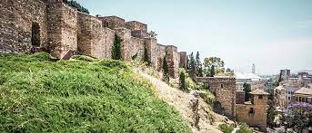
Moorish Fortress
Next to the historic center of Málaga, high up on the slopes of Mount Gibralfaro, stands an enormous fortification with double defensive walls that dates back to Moorish times. Built in the eleventh century by the Berber king of the Taifa of Granada, Badis ibn Habus, the Alcazaba—meaning citadel in Arabic—dominates the city’s skyline and bay at a strategic point where a Phoenician fortress once stood.
Admission: €3.50. Reduced admission: €0.60 (over 65) Free admission: Sundays from 2:00 PM.

Slide 18
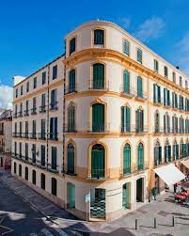
Picasso's Home
(Casa Natal de Picasso)
The "Casa Natal" or birthplace of the world famous artist Pablo Picasso has been an official heritage site since 1983. It is situated in Plaza de la Merced, in the heart of the historic center of Malaga..
Admission: 7€. Combined ticket 10€.

Slide 19
Picasso Museum
This world famous museum in Málaga, home to more than 200 pieces of art by famed artist Pablo Picasso, opened its doors to the public in 2003. The permanent collection features paintings, drawings, sculptures and prints from Picasso's early years through to his later works. Programs throughout the year offer visitors a range of interesting cultural activities such as seminars, conferences, visual arts exhibitions and classical music concerts. Admission €8.00 , 65+ €6.00

Slide 20
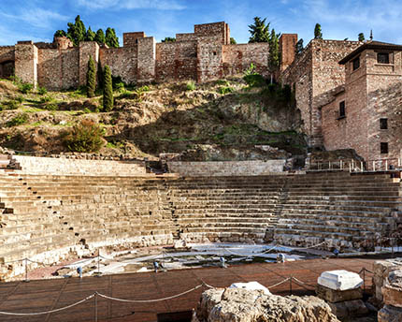
Roman Amphitheatre
(at the Alcazaba)
The Roman Theatre of Malaga is the greatest architectural exponent of the Roman Empire in Malaga and is located in the heart of the city, in Alcazabilla street. Addmission is Free.

Slide 21
Getting Around
Like most large European cities, getting mass transit system with both buses around is not difficult. has an excellent and Subway. You can choose from the different ticket types and travel cards.

Slide 22
Walking
Walking is possibly the best way to see the sites of Malaga, it is free, and it allows you to take whichever route you want with as many stops as you please, allowing you to view only the things you really want to see and spend as long as you wish doing so.
There are a number of guide books available that suggest walking tours of Malaga, or equally if you go into any of the tourist information centers you will find leaflets offering suggested routes. It is also possible to book guided tours around Malaga City which will offer you great views with insightful information, these however, are not free.

Slide 23
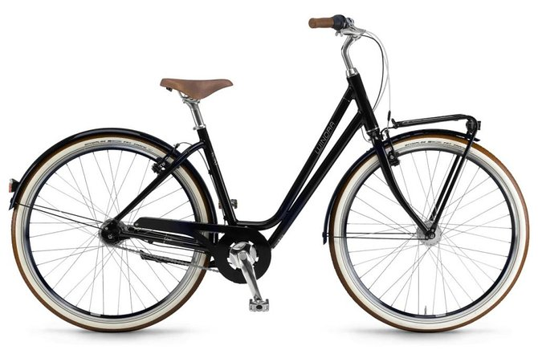
Malaga Bike Rental
Get acquainted with the historical and natural highlights of Malaga at your own pace by renting a mountain, road or electric bicycle from City Bikes. Ascend to the rocky summit of the Malaga Mountains on a mountain bike; explore the ancient monuments of the Old Town on a state-of-the-art electric bike; and marvel at the quaint White Villages on a road bike. Receive route recommendation and expert safety briefings from the informative staff and receive a protective helmet and bike pump free to use.
1 day rental $17.63
Location:
Southwest of the tourist information
office and ship’s Bus drop-off and
about a two minute walk.

Slide 24

City Bus
Metro is a cheap and convenient way to travel. Malaga has a very efficient local bus service network to connect you to areas around the city canter. The busses are operated by a municipal company called EMT.
Fares:
Single bus tickets cost € 1.30
MULTI-TRIP RECHARGE: €4.20 (10 trips)

Slide 25
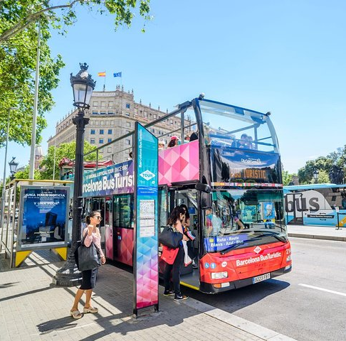
Hop-On Hop-Off Bus Tour
The Malaga's Hop-on Hop-off bus service stops at 13 places of interest in the city. One of its stops is near the cruise port.
Highlights
See some of ’s city highlights from a convenient open-topped bus
Determine your own itinerary with a hop-on hop-off sightseeing bus ticket
Enjoy unlimited travel for one or two days, depending on your schedule
Receive a complimentary coupon book with discounts to many top attractions
Ticket Price: €30,00
Children (4-12y) €16,00

Slide 26
Michelin Star Restaurants
Malaga is the home of twelve Michelin Star restaurants. Many of us
on the ship are foodies, so naturally, we’re always on the hunt to eat
at the most exclusive spots anytime we travel.
Kaleja - Marquesa de Moya 9, Malaga, €€€€ · Contemporary
José Carlos García - Plaza de la Capilla, Malaga, €€€€ · Creative, Andalusian
Beluga - Plaza de las Flores 3, Malaga, €€€ · Mediterránea
La Cosmopolita - José Denís Belgrano 3, Malaga, €€ · Market Cuisine
La Cosmo - Císter 11, Malaga, €€ · Andalusian
La Cosmopolita - José Denís Belgrano 3, Malaga €€ · Market Cuisine
For those of you that just like good food, you can’t go wrong just about anywhere you go in Malaga. After all this is Spain!
GOOD EATING

Slide 27
Thanks For Coming
If you have any more questions, Please ask.
I will do my best to answer them for you.
Have a great visit in Malaga !

