Slide 1
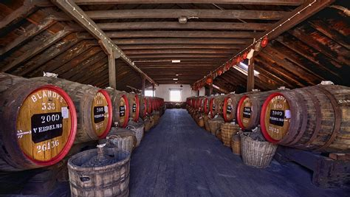
Madeira Wine
Presented by
Marc Silver

Slide 2
What I will cover
About Madeira
Winemaking Process
Wine History
Early American History
Modern Era
Wine Making
Aging Process
Uses
Conclusion
Acknowledgement

Slide 3
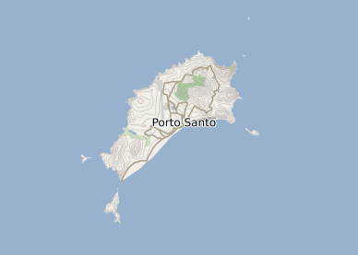
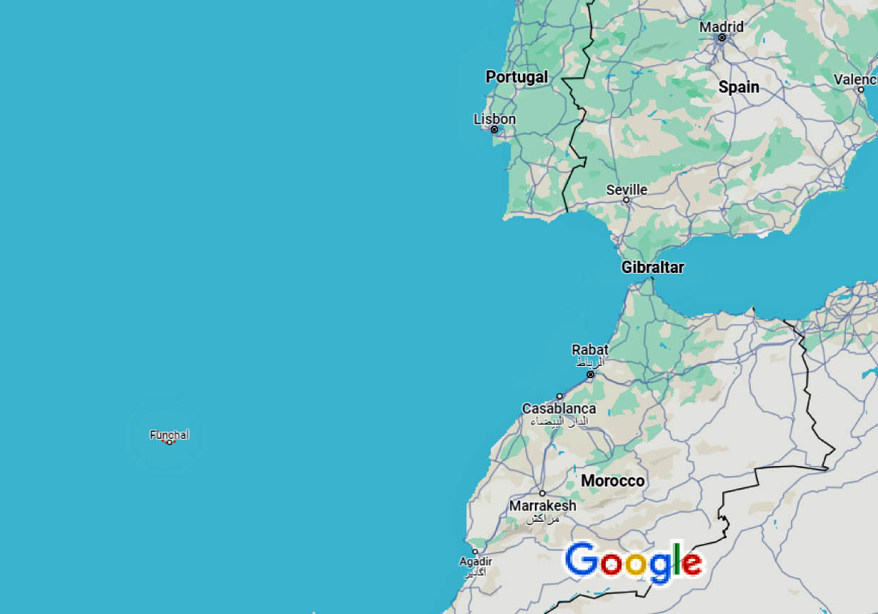
About Madeira
Madeira is a fortified wine made on the Portuguese Madeira Islands, off the coast of Africa. Madeira is produced in a variety of styles ranging from dry wines which can be consumed on their own, as an apéritif, to sweet wines usually consumed with dessert. Cheaper cooking versions are often flavored with salt and pepper for use in cooking, but these are meant to be used for consumption as a beverage.
The islands of Madeira have a long winemaking history, dating back to the end of the 15th century when Madeira was a standard port of call for ships heading to the New World or East Indies. To prevent the wine from spoiling, neutral grape spirits were added. On the long sea voyages, the wines would be exposed to excessive heat and movement which transformed the flavor of the wine. This was discovered by the wine producers of Madeira when an unsold shipment of wine returned to the islands after a round trip

Slide 4
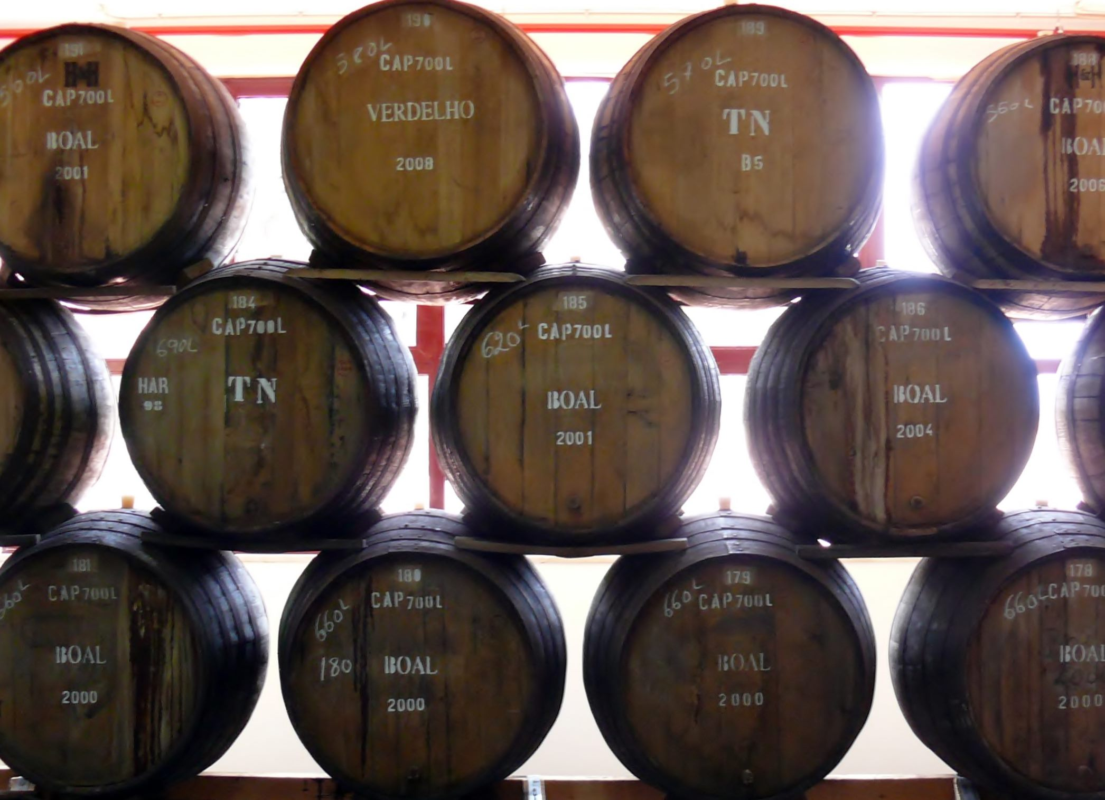
Winemaking Process
Today, Madeira is noted for its unique winemaking process which involves oxidizing the wine through heat and ageing. The younger blends (three and five years old) are produced with the aid of artificial application of heat to accelerate the aging process; the older blends, colheitas and frasqueiras, are produced by the canteiro method. The Canteiro method of aging Madeira wine is used for producing more expensive wine. The wine barrels are arranged in stacks that allow the gentle warming of the wine in contact with the wood of the barrel to produce a wonderful caramel note.
Because of the way these wines are aged, they are very long-lived in the bottle, and those produced by the canteiro method will survive for decades and even centuries, even after being opened. Wines that have been in barrels for many decades are often removed and stored in demijohns where they may remain unharmed indefinitely.

Slide 5
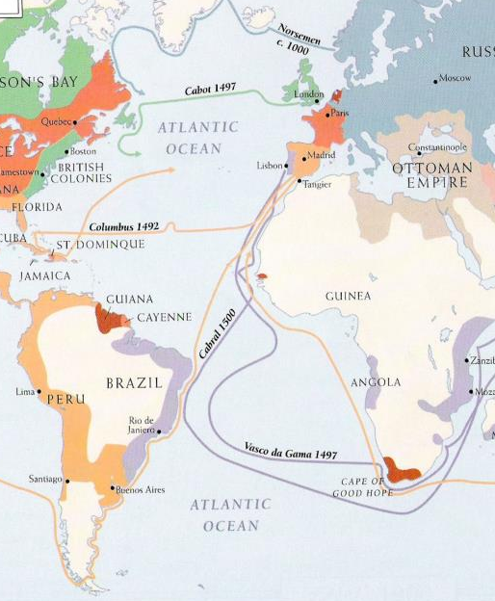
Wine History (15th–18th centuries)
The roots of Madeira's wine industry date back to the Age of Exploration, when Madeira was a regular port of call for ships travelling to the East Indies.
By the 16th century, records indicate that a well-established wine industry on the island supplied these ships with wine for the long voyages across the sea. The earliest examples of Madeira were unfortified and tended to spoil before reaching their destination.
Following the example of port, a small amount of distilled alcohol made from cane sugar was added to stabilize the wine by boosting the alcohol content (the modern process of fortification using brandy did not become widespread until the 18th century).
The Dutch East India Company became a regular customer, picking up large, 423-litre (112 US gal) casks of wine known as "pipes" for their voyages to India.

Slide 6
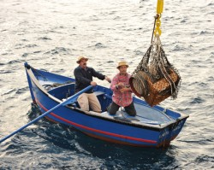
Wine History Cont.
The intense heat in the holds of the ships had a transforming effect on the wine, as discovered by Madeira producers when one shipment was returned to the island after a long trip. The customer was found to prefer the taste of this style of wine, and Madeira labeled as vinho da roda (wines that have made a round trip) became very popular.
Madeira producers found that aging the wine on long sea voyages was very costly, so they began to develop methods on the island to produce the same aged and heated style.
They began storing the wines on trestles at the winery or in special rooms known as estufas, where the heat of the island sun would age the wine.

Slide 7
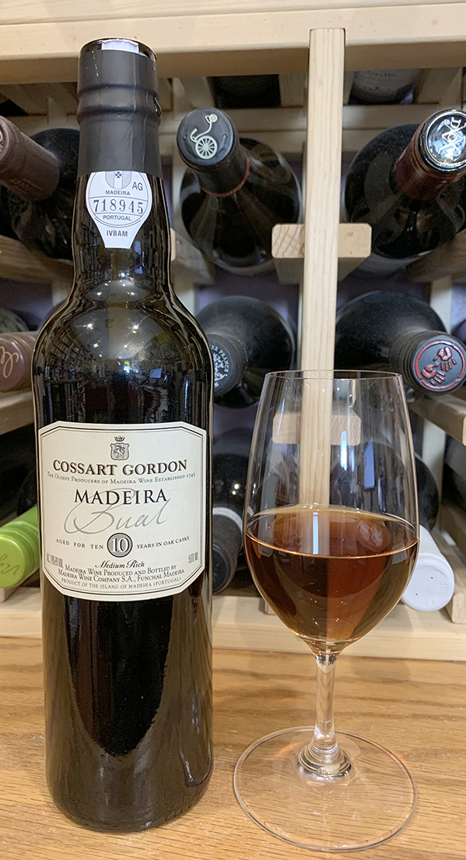
Wine History Cont.
With the increase of commercial treaties with England such as the Marriage Treaty in 1662, important English merchants settled on the island and, ultimately, controlled the increasingly important island wine trade.
The English traders settled in the Funchal as of the seventeenth century, consolidating the markets from North America, the West Indies and England itself. Notable brands include Cossart and Gordon founded in 1745 and Blandy's in 1811.
The eighteenth century was the "golden age" for Madeira. The wine's popularity extended from the American colonies and Brazil in the New World to Great Britain, Russia, and Northern Africa. The American colonies, in particular, were enthusiastic customers, consuming as much as 95% of all wine produced on the island each year.

Slide 8
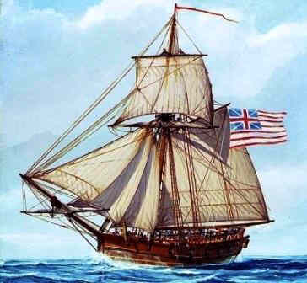
Early American History (17th–18th centuries)
Madeira was a very important wine in the history of the United States of America. No wine-quality grapes were grown among the thirteen colonies, so imports were needed, with a great focus on Madeira.
One of the major events on the road to the American Revolution in which Madeira played a key role was the British seizure of John Hancock's sloop Liberty on 9 May 1768.
Hancock's boat was seized after he had unloaded a cargo of 25 pipes (3,150 US gallons (11,900 L)) of Madeira, and a dispute arose over import duties. The seizure of Liberty caused riots to erupt among the people of Boston.

Slide 9
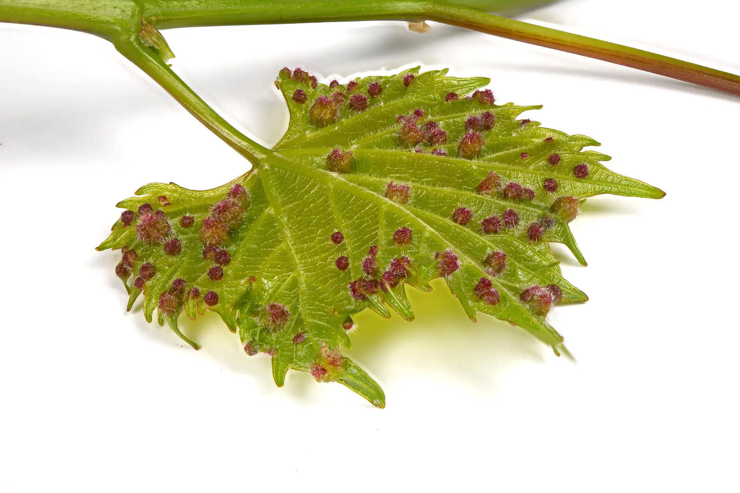
Modern Era (19th century – present)
The mid-19th century ushered an end to the industry's prosperity. First came the 1851 discovery of powdery mildew, which severely reduced production over the next three years. Just as the industry was recovering through the use of the copper-based Bordeaux mixture fungicide, the phylloxera epidemic that had plagued France and other European wine regions reached the island.
phylloxera
By the end of the 19th century, most of the island's vineyards had been uprooted, and many were converted to sugar cane production. Many of the vineyards that did replant chose to use American vine varieties, or hybrid grape varieties rather than replant with the Vitis vinifera varieties that were previously grown.

Slide 10
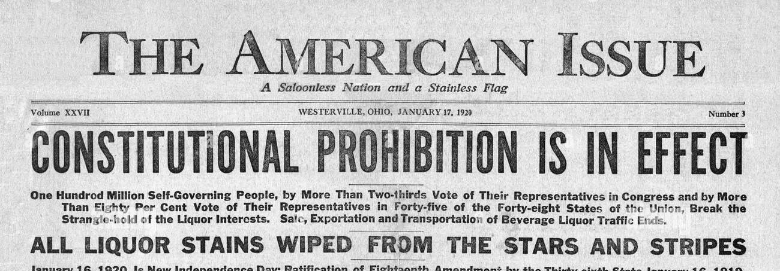
Modern Era Cont.
By the turn of the 20th century, sales started to slowly return to normal, until the industry was rocked again by the Russian Civil War and American Prohibition, which closed off two of Madeira's biggest markets.

Slide 11
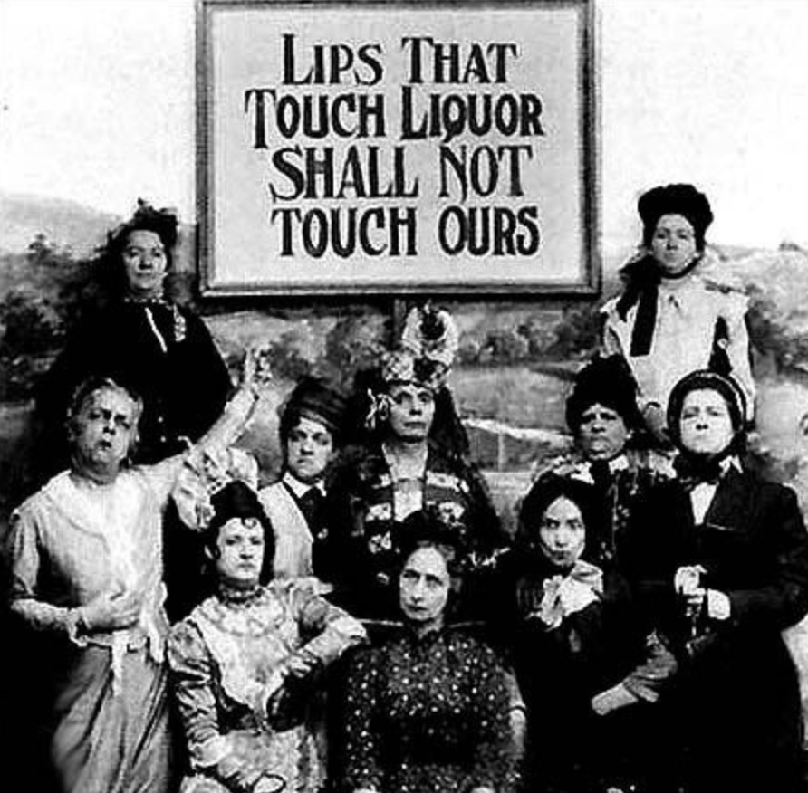
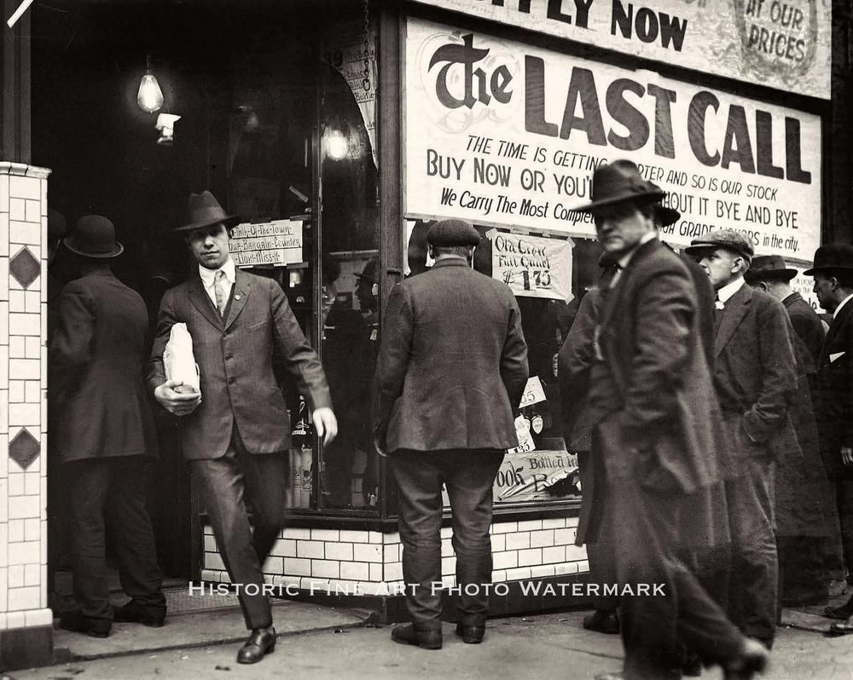
Modern Era Cont.

Slide 12
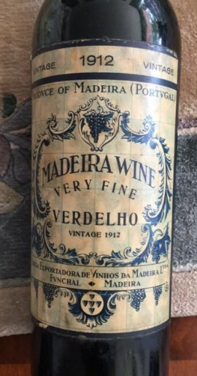
Modern Era Cont
In 1988, the Symington family of Portugal invested in the Madeira Wine Company which owned many of the Madeira brand names. They re-launched Madeira and create a market for it again in America, in 1989, establishing a firm rebirth of Madeira.
Towards the end of the 20th century, some producers started a renewed focus on quality—ripping out the hybrid and American vines and replanting with the "noble grape" varieties of Sercial, Verdelho, Bual and Malvasia. The "workhorse" varieties of Tinta Negra Mole now known officially as just Tinta Negra, and Complexa are still present and in high use, but hybrid grapes were officially banned from wine production in 1979.
Today, Madeira's primary markets are in the Benelux countries, France (where it is only used for cooking, salt and pepper having been added prior to bottling), and Germany; emerging markets are growing in Japan, the United Kingdom, and the United States.

Slide 13
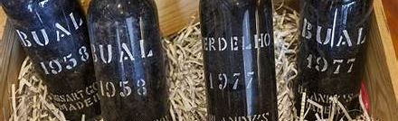
Winemaking
The initial winemaking steps of Madeira start out like most other wines: grapes are harvested, crushed, pressed, and then fermented in either stainless steel or oak casks.
The grape varieties destined for sweeter wines – Bual and Malvasia – are often fermented on their skins to leach more phenols from the grapes to balance the sweetness of the wine. Drier wines – made from Sercial, Verdelho, and Negra Mole – are separated from their skins prior to fermentation. Depending on the level of sweetness desired, fermentation of the wine is halted at some point by the addition of neutral grape spirits.

Slide 14
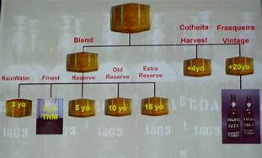
Winemaking Cont.
Younger wines (typically 3 and 5 years old) undergo the estufagem aging process to produce Madeira's distinctive flavor by artificial heating, whereas the wines destined for long aging are barrel-aged using only the naturally high temperatures of the barrel storage rooms.
Age really does matter. When wine is aged more than 10 years (Canteiro Method) it develops a smoother and more complex character than a Madeira aged 5 years or less.
From 10 to 15 years the maturation effect is quite noticeable and at 20 years Madeira wines achieve a level of perfection that is both unique and delightful.

Slide 15
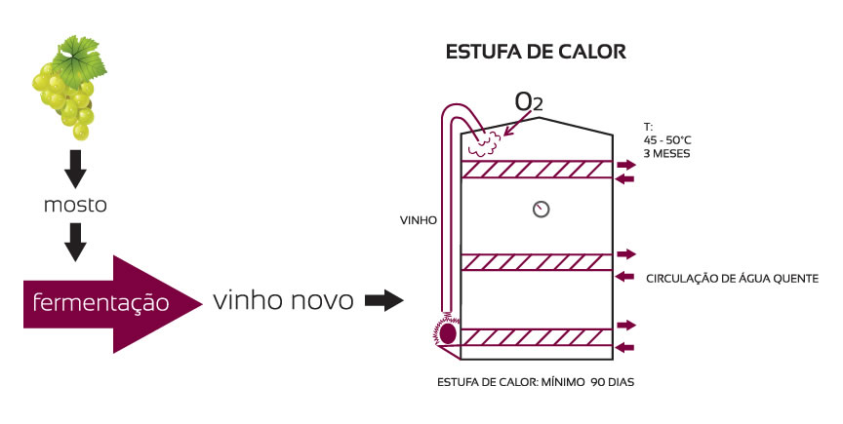
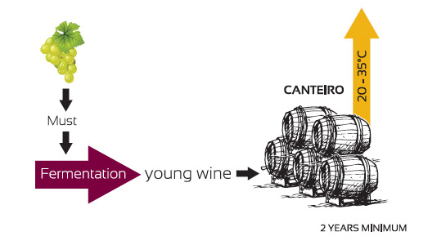
The Aging Process
What makes Madeira wine production unique is how the wines are aged in relatively high temperatures, meant to duplicate the effect of a long sea voyage on the aging barrels through tropical climates.
Three main methods are used to heat the wine during aging. The two processes belong to the estufagem process (estufa means hothouse or stove in Portuguese), in which artificial heat is used to accelerate the aging process of the wines, whereas the canteiro process is used for the older and more expensive wines and employs only the natural heat of the barrel warehouses

Slide 16

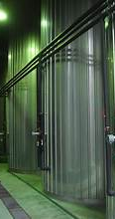
The Aging Process Cont.
Estufagem processes
Armazém de Calor: Only used by the Madeira Wine Company, this method involves storing the wine in large wooden casks in a specially designed room outfitted with steam-producing tanks or pipes that heat the room, creating a type of sauna. This process more gently exposes the wine to heat.
Cuba de Calor: The most common, used for low-cost Madeira, is bulk aging in stainless steel or concrete tanks surrounded by either heat coils or piping that allow hot water to circulate around the container.

Slide 17
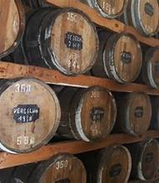
The Aging Process Cont.
Barrel-aging process
Canteiro: Used for the highest quality Madeiras, these wines are aged without the use of any artificial heat, being stored by the winery in warm rooms that are heated only by the warm climate of the Madeira island. In cases such as Frasqueira (vintage) Madeira, this heating process can last from 20 years to even more than 100 years.
The term Canteiro comes from canteiros – the wooden staves that keep the barrels in their places. Canteiro process is used by all of the top Madeira brands, including Blandy's, Borges, Broadbent, d'Oliveiras and Justino's.

Slide 18
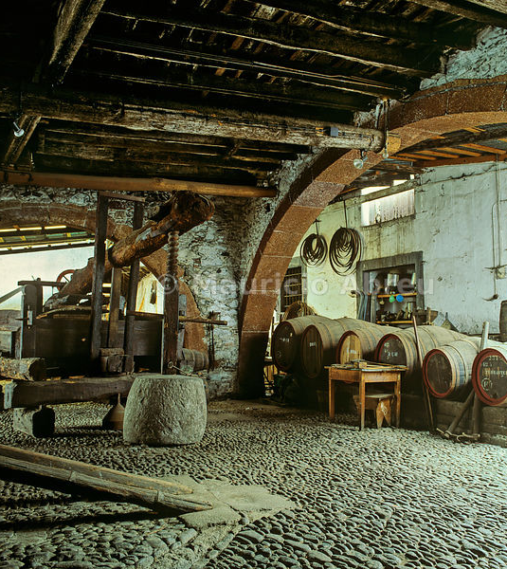
The Aging Process Cont.
Much of the characteristic flavor of Madeira is due to this practice, which hastens the mellowing of the wine and also tends to check secondary fermentation in as much as it is, in effect, a mild kind of pasteurization.
Furthermore, the wine is deliberately exposed to air, causing it to oxidize. The resulting wine has a color similar to a tawny port wine. Wine tasters sometimes describe a wine that has been exposed to excessive heat during its storage as being cooked or maderized.

Slide 19
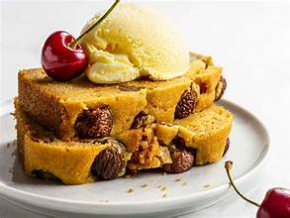
Uses
Popular uses include apéritifs (pre-meal) and digestifs (post-meal). In Britain it has traditionally been associated with Madeira cake.
Madeira is also used as a flavoring agent in cooking. Lower-quality Madeira wines may be flavored with salt and pepper to prevent their sale as Madeira wine, and then exported for cooking purposes. Madeira wine is commonly used in tournedos Rossini and sauce madère (Madeira sauce).] Unflavored Madeira may also be used in cooking, such as the dessert dish "Plum in madeira".

Slide 20
Conclusion
Madeira wine holds significant historical and cultural importance due to its unique production process and storied past. Produced on the Portuguese island of Madeira, this fortified wine gained fame in the 17th and 18th centuries for its durability on long sea voyages, making it popular among European explorers and traders.
Its distinct flavors, ranging from dry to sweet, are achieved through heating and oxidation during aging, a process that gives Madeira its characteristic complexity and long shelf life.
Today, Madeira wine continues to be cherished for its versatility in cooking and pairing with various dishes, from desserts to savory courses. Its rich, caramelized flavors and robust character make it a favorite among wine enthusiasts and collectors worldwide.
Beyond its culinary appeal, Madeira wine serves as a symbol of Madeiran culture and craftsmanship, embodying centuries of tradition and innovation in winemaking.

Slide 21
Madeira Wine
I hope you found these facts about Madeira Wine interesting and informative.
Hopefully, you all get the opportunity to visit the beautiful Island of Madeira and wine region for yourselves.
Thank you for coming!

Slide 22
Acknowledgement
My seminars are the result of many years of experience combined with many hours of research over the internet.
I would like to acknowledge the many source I have accessed.
These include Wine Spectator, Wine Enthusiast, BKWine Magazine, Wine & Spirits Magazine, American Vineyard Magazine, The Grapevine Magazine, Wikipedia.com, Britannica.com, and the various Government websites.

Slide 23
Early American History Cont.
Madeira was a favorite of Thomas Jefferson, and it was used to toast the Declaration of Independence. George Washington, Alexander Hamilton, Benjamin Franklin and John Adams are also said to have appreciated the qualities of Madeira.
The wine was mentioned in Benjamin Franklin's autobiography. On one occasion, Adams wrote to his wife, Abigail, of the great quantities of Madeira he consumed while a Massachusetts delegate to the Continental Congress.
A bottle of Madeira was used by visiting Captain James Sever to christen USS Constitution in 1797. Chief Justice John Marshall was also known to appreciate Madeira, as were his cohorts on the early U.S. Supreme Court. Madeira and walnuts were often served together as a last course at dinner parties in Washington in the early decades of the 1800s.

