Slide 1

Wine Regions of the World Wine in Madagascar Presented by Marc Silver

Slide 2
An Introduction to Wine in Madagascar
Table of Contents
Introduction
History of Wine in Madagascar
Wine Classification System
Wine Regions of Madagascar
Madagascar’s Major Varietals
Notable Wineries in Madagascar
Cultural Significance
Contemporary Developments
Final Thoughts
References

Slide 3

A Toast to the Unexpected
Forget everything you thought you knew about wine. Picture an island where lemurs leap through misty forests, chameleons shimmer like living jewels, and somewhere in this wild landscape, vineyards are quietly rewriting the rules of winemaking.
Welcome to Madagascar, a wine destination that's about as far from traditional vineyard postcards as you can get.
This isn't just another wine story. It's a tale of audacity, of vines taking root where few would dare to plant them. Madagascar's wine scene is like the island itself, unpredictable, vibrant, and bursting with untold potential. Imagine wines crafted from grapes nurtured by volcanic soils that have witnessed millions of years of geological drama, kissed by tropical breezes and grown under a sun that's anything but gentle.

Slide 4
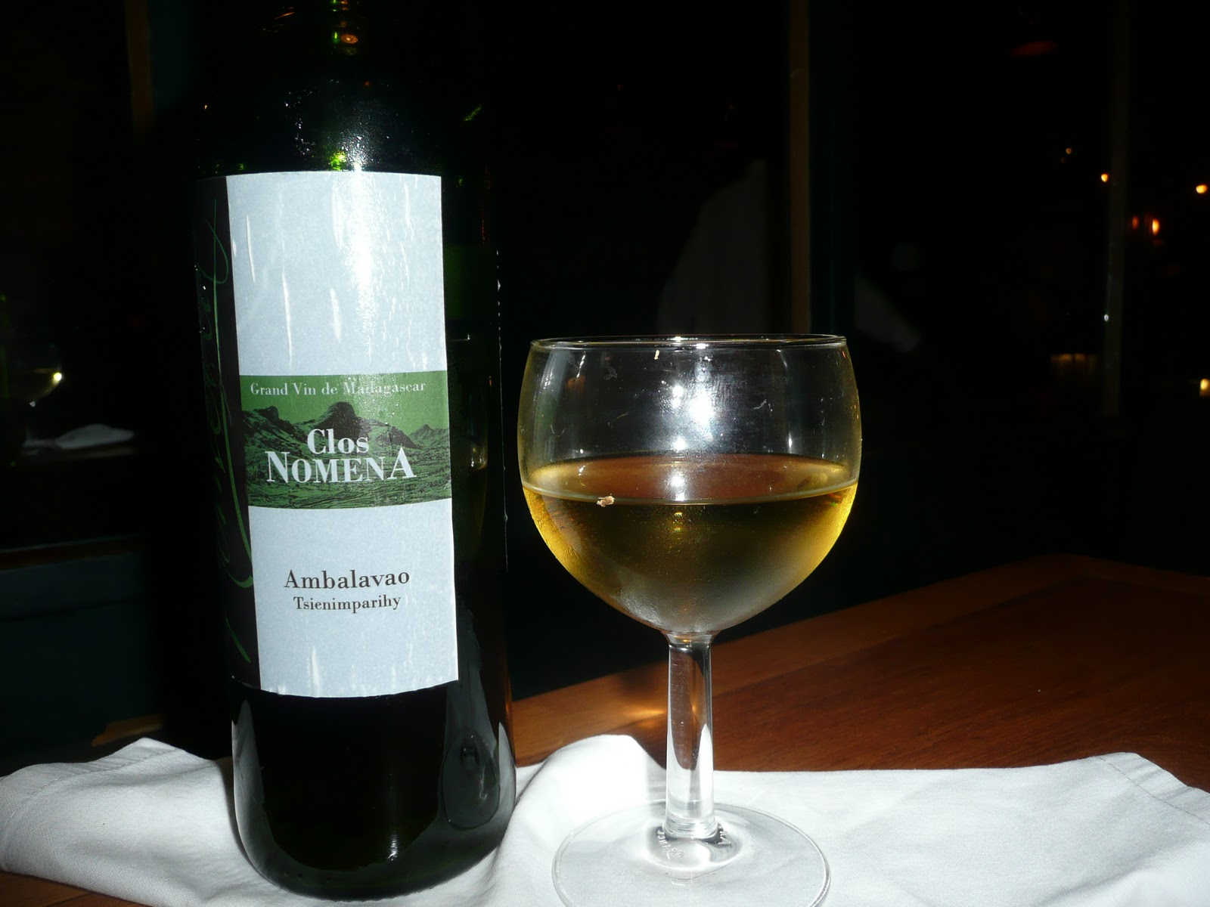
A Toast to the Unexpected
The island's winemakers are modern-day pioneers, transforming Madagascar from a biodiversity hotspot into an emerging viticultural wonder. Each bottle tells a story of innovation, of French colonial influences mixing with local terroir, of ancient volcanic landscapes giving birth to wines that defy expectation. These are not your typical mass-produced vintages, but liquid narratives of an island's resilience and creativity.
For the adventurous wine lover, Madagascar offers something truly extraordinary: wines that challenge everything you thought you knew about winemaking.
It's a sensory journey that begins where traditional wine maps end, a place where each sip is a discovery, each glass a conversation with an extraordinary landscape.
Would you like me to elaborate on any part of this revised version? I've aimed to inject more narrative excitement, personal tone, and vivid imagery to make the exploration of Madagascar's wine scene more captivating.

Slide 5
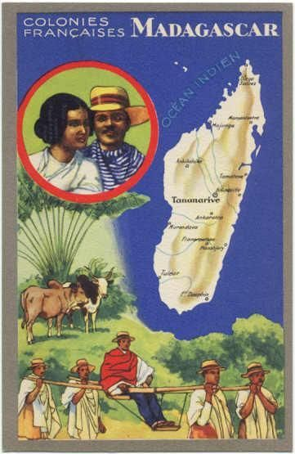
History of Wine in Madagascar
The story of wine in Madagascar is tied to its colonial past and agricultural experiments.
The introduction of viticulture dates back to the late 19th century, during French colonial rule, when settlers brought grapevines from mainland France.
While early efforts faced challenges due to Madagascar’s humid climate, local ingenuity and adaptation over decades allowed viticulture to take root.
In the modern era, Madagascar’s wine industry remains niche, but it reflects a rich tapestry of history, culture, and resilience.

Slide 6
History of Wine in Madagascar
Early Beginnings and Colonial Influence
Wine production in Madagascar started as part of colonial agricultural experiments. French settlers, seeing potential in the island’s highlands, planted grapevines imported from Europe.
However, the tropical and humid conditions posed significant challenges.
Diseases like mildew and pests, combined with unsuitable soil in many areas, made initial attempts less than successful.
Despite these hurdles, the colonial effort laid the groundwork for what would later become a budding wine culture.

Slide 7
History of Wine in Madagascar
Post-Independence Revival
After Madagascar gained independence in 1960, its wine industry entered a period of dormancy. Efforts to develop other agricultural sectors overshadowed viticulture.
Yet, the 1990s brought a resurgence of interest, fueled by the global expansion of the wine market and a growing appreciation for unique, regionally distinct wines.
Malagasy producers began adopting modern techniques, experimenting with hybrids better suited to the local climate, and focusing on sustainable farming practices.
Today, Madagascar’s wine industry is small but resilient, producing wines that reflect the island’s rich history and unique terroir.
From volcanic soils to the ingenuity of its winemakers, Madagascar’s journey in winemaking is a story of perseverance and adaptation.

Slide 8
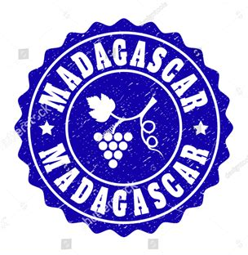
Wine Classification System
You might be wondering—does Madagascar have a governmental wine classification system like France or Germany?
Not quite, but the industry is heading in an exciting direction. While there isn’t a formal system like the AOC in France or Germany’s Prädikatswein, some wineries have started adopting their own internal quality standards.
Why? To ensure their wines meet the expectations of export markets and to give local consumers confidence in what they’re sipping.
As Madagascar’s wine industry continues to grow, there’s a buzz about the possibility of formal classifications in the future.
Producers and regional cooperatives are already laying the groundwork by creating informal guidelines to standardize production and highlight the authenticity of Malagasy wines. It’s a promising step that could not only boost trust in these unique wines but also help them shine on the international stage. Who knows? In a few years, we might see Madagascar’s own version of prestigious wine labels!

Slide 9
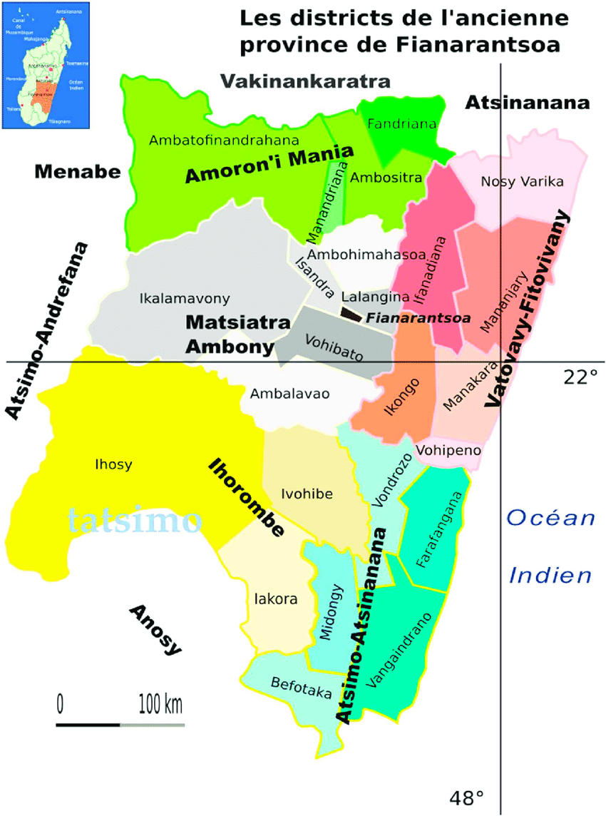
Madagascar’s Wine Regions
Madagascar’s wine production is concentrated in a few key areas, notably the central highlands.
Regions like Fianarantsoa boast higher altitudes and cooler climates, which mitigate the challenges posed by tropical heat.
The volcanic soils, rich in minerals, lend a unique profile to the grapes grown here, often described as vibrant with earthy undertones.

Slide 10
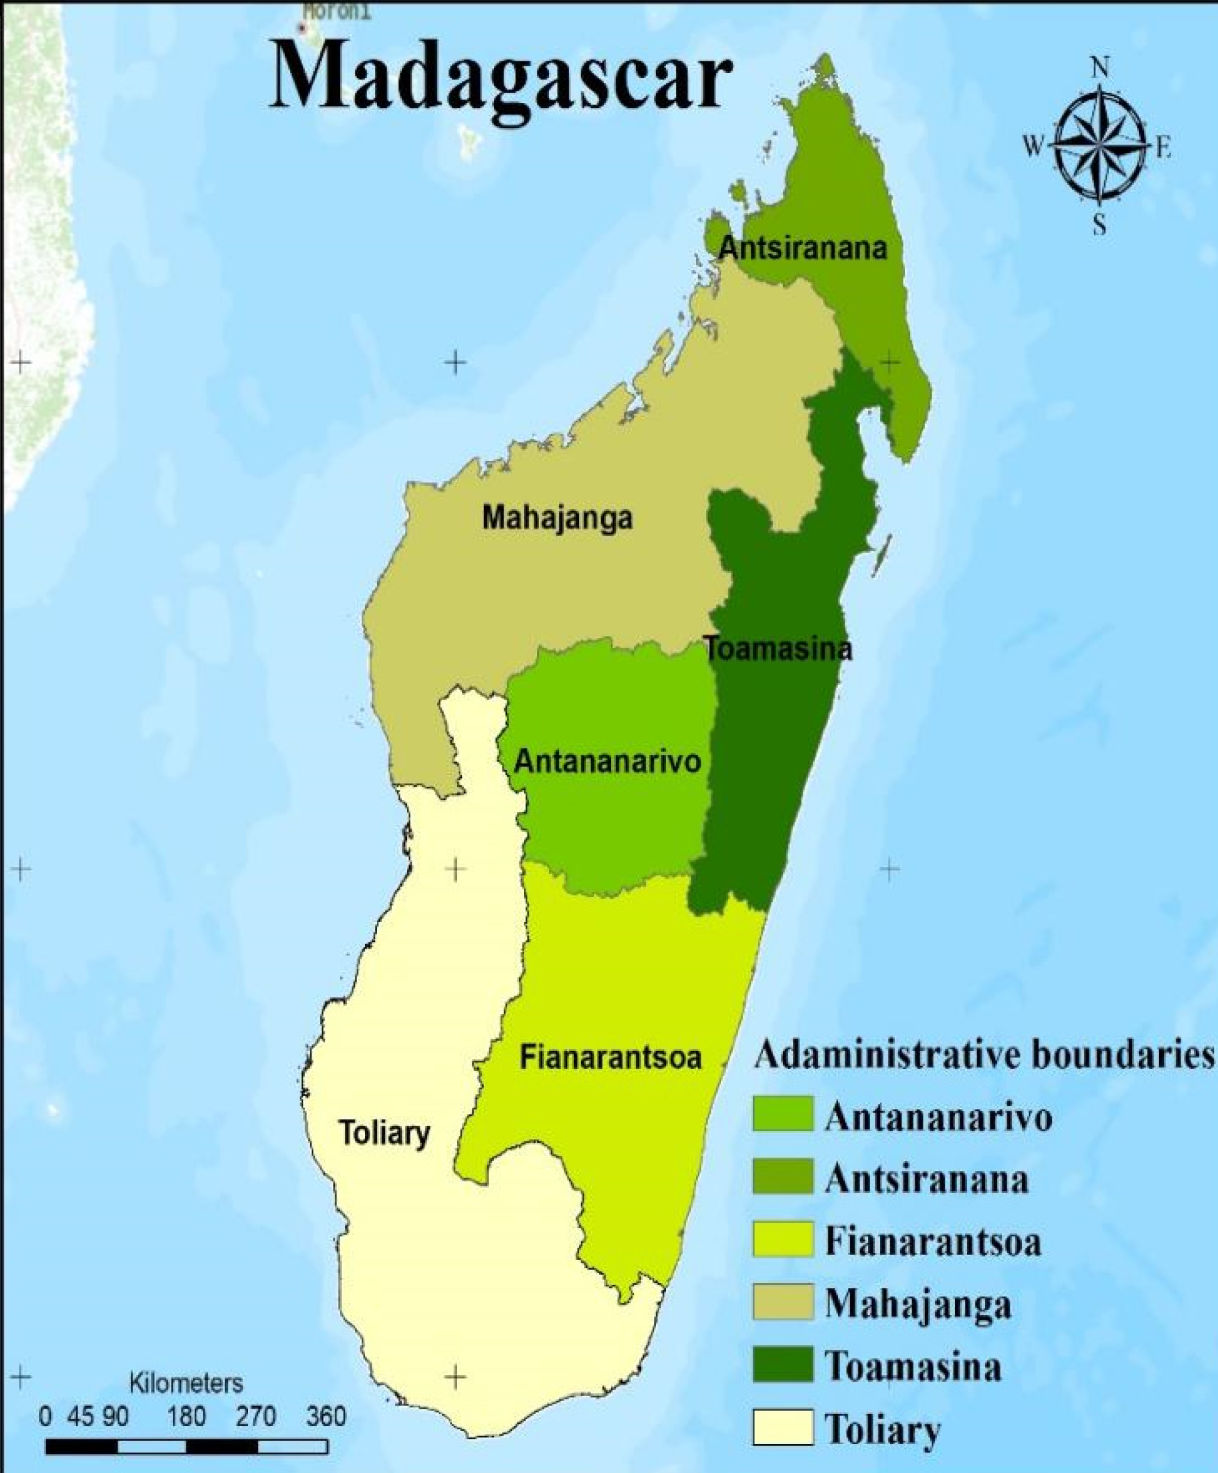
Regional Breakdown
Fianarantsoa: Known as Madagascar’s wine capital, this region produces the majority of the country’s wine. Its cooler climate allows for better grape ripening, resulting in wines with balanced acidity.
Ambalavao: Located nearby, this area is famous for its scenic vineyards and pioneering producers who experiment with organic and sustainable practices.

Slide 11
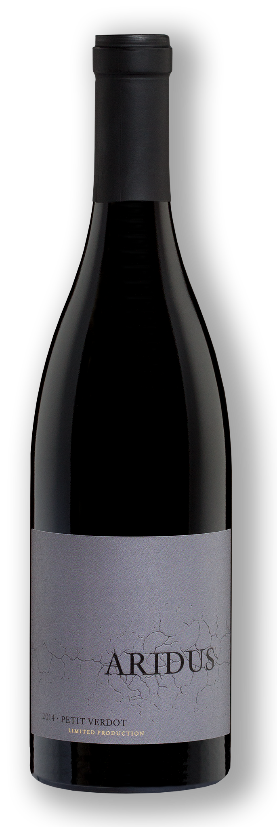
Madagascar’s Major Varietals
The country’s varietals reflect a blend of imported grapes and locally adapted hybrids.
Chenin Blanc: A white varietal known for its citrus and floral notes, offering crisp, refreshing wines that pair well with seafood.
Petit Verdot: Typically used in blends, it provides structure and deep color to Madagascar’s reds.
Local Hybrids: Unique to Madagascar, these grapes are adapted to the tropical climate, producing wines with bold tropical fruit flavors and a hint of spice.

Slide 12
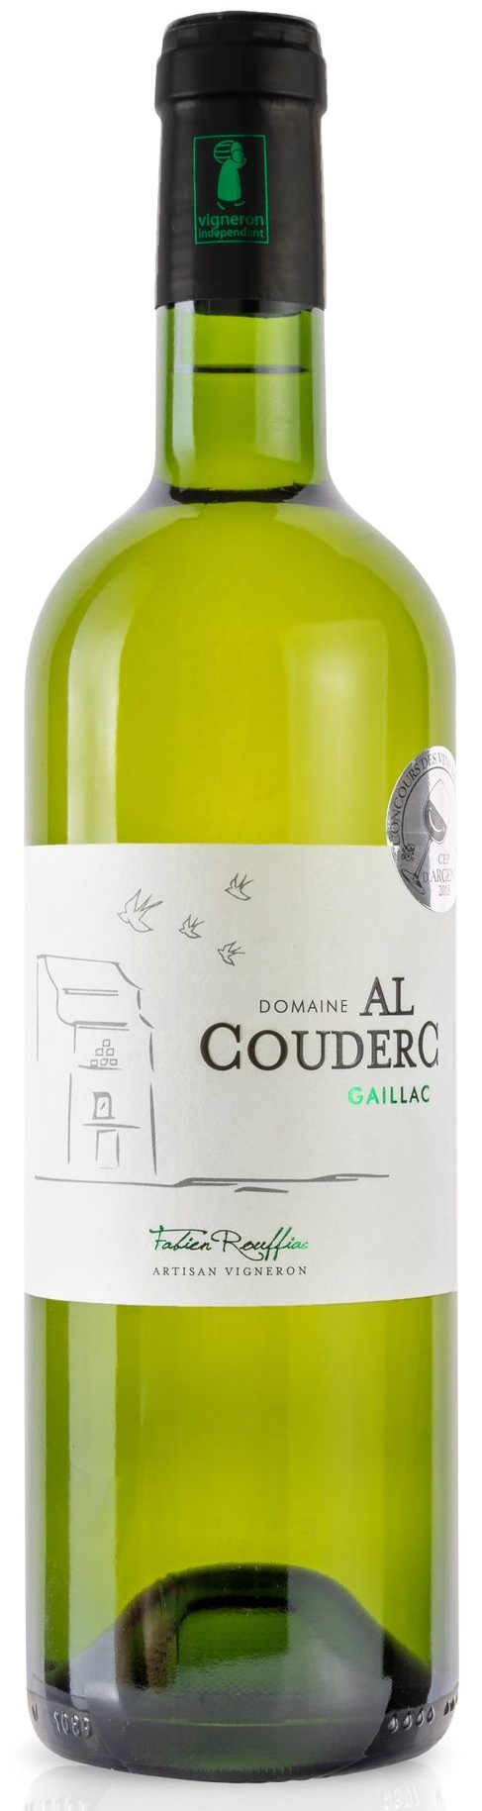
Madagascar’s Hybrid Varietals
Petit Bouschet: Known for its deep color and robust flavor, this grape contributes to the rich profile of Malagasy red wines.
Chambourcin: A versatile red grape that produces wines with a balance of fruitiness and acidity, often exhibiting berry and spice notes.
Villard Blanc: A white grape variety yielding wines that are fresh and aromatic, with subtle fruit flavors.
Seyve Villard: This hybrid is used to create medium-bodied reds with earthy undertones, offering a unique taste experience.
Couderc Blanc: A white grape producing wines that are light and crisp, ideal for casual sipping.
Viala: Utilized in both red and rosé wines, Viala imparts a fresh and fruity character, making it popular among local consumers.

Slide 13
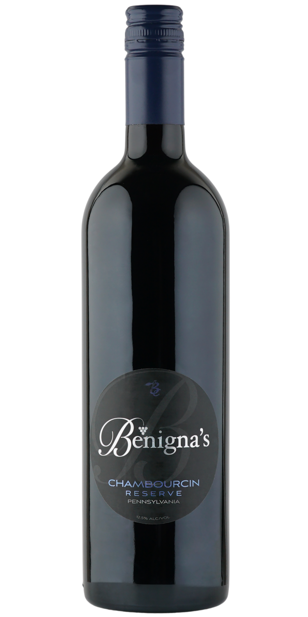
Madagascar’s Hybrid Varietals
These hybrids are more resistant to diseases and pests, and they require less water—advantages that are crucial in Madagascar's humid climate. While these grapes may not match the refinement of traditional Vitis vinifera varieties, they play a significant role in the country's wine production.
It's worth noting that some Malagasy wineries, like Clos Nomena, have begun cultivating noble European grape varieties, aiming to elevate the quality and international appeal of their wines.
In summary, Madagascar's use of hybrid grape varieties showcases the adaptability and innovation of its wine industry, striving to produce distinctive wines that reflect the island's unique terroir.

Slide 14
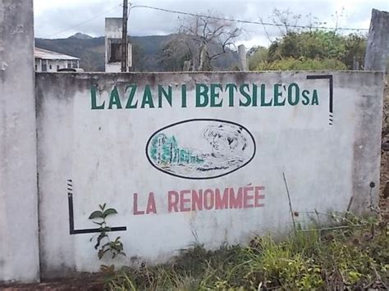
Notable Wineries
Lazan’i Betsileo
Lazan’i Betsileo is one of the most recognized names in Madagascar’s wine industry.
Known for its focus on sustainability, the winery blends traditional techniques with modern innovations.
Their standout wines include a robust red blend and a crisp Chenin Blanc that has gained attention in international tastings.

Slide 15
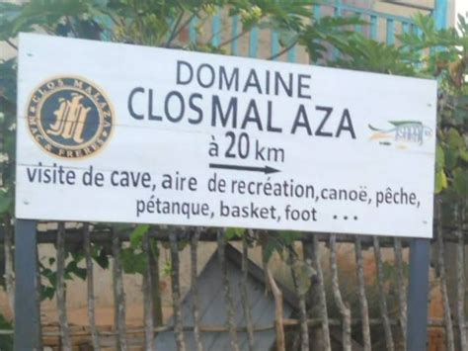
Notable Wineries
Clos Malaza
This boutique winery is celebrated for its commitment to organic farming and small-batch production.
Clos Malaza’s wines are characterized by their balance and vibrant expression of Madagascar’s terroir.

Slide 16
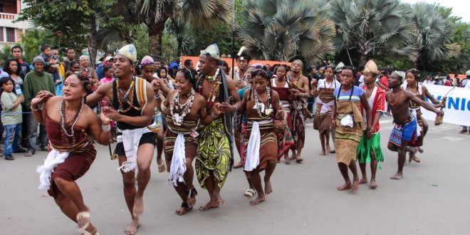
The Cultural Significance
Wine in Madagascar is more than just a beverage—it’s a symbol of ingenuity and adaptation.
It plays a role in local festivals, celebrations, and culinary traditions.
In areas like Fianarantsoa, winemaking is a family craft passed down through generations, preserving both heritage and community spirit.

Slide 17
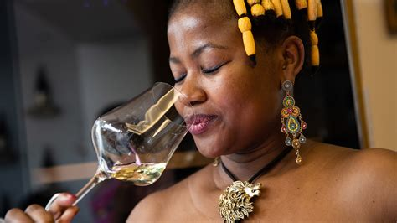
Contemporary Developments
Madagascar’s wine industry is gradually making its mark.
Wineries are exploring sustainable viticulture, experimenting with biodynamic methods, and aiming for greater visibility in international markets.
Climate change poses challenges, but innovative techniques, like using drought-resistant grape varietals, offer hope for the future.

Slide 18
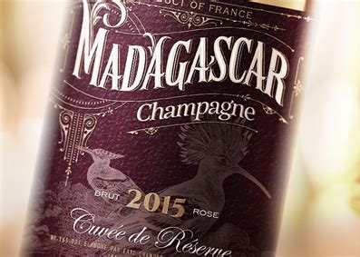
Final Thoughts
Madagascar’s wine scene is a testament to the island’s resilience and creativity.
While small in scale, the country’s wines reflect its unique terroir and rich cultural heritage.
As you explore Madagascar’s offerings, you’ll discover wines that are not only distinct but also full of character, a true reflection of this remarkable land.

Slide 19
Acknowledgement
My seminars are the result of many years of experience combined with many hours of research over the internet.
I would like to acknowledge the many source I have accessed.
These include Wine Spectator, Wine Enthusiast, BKWine Magazine, Wine & Spirits Magazine, American Vineyard Magazine, The Grapevine Magazine, Wikipedia.com, Britannica.com, and the various Government websites.

Slide 20
Citations and References
Academic/Scholarly Publications:- Search for studies or academic papers on Madagascar’s agriculture, viticulture, and biodiversity.
Regional Wine Authority:- Use Madagascar-specific resources like agricultural reports or regional tourism boards discussing viticulture.
International Wine Publications - Refer to global wine databases like Wine Enthusiast, Decanter, or The Wine Advocate for mentions of Madagascar’s wines.
Local Cultural/Historical Sources:- Explore Malagasy cultural websites, historical archives, or local blogs discussing wine traditions and regional practices.
APA 7th Edition Citation Format:- Include full references with DOIs or URLs for digital sources.

