Slide 1
Maceió, Brazil The Watercolor City
Beaches, Lagoons, and the Laid-Back Spirit of Northeastern Brazil

Slide 2
What I Will Cover
My Port Philosophy
Don’t Miss the Ship
Money and Currency Tips
About Maceió
Maps
Getting Around
Top Attractions & Points of Interest
Cuisine
Nature and Adventure
Important Tips & Practical Advice
Conclusion

Slide 3
My Port Philosophy
I have been cruising for over 46 years and have taken over 100 cruises. So, I consider myself an experienced cruiser.
The information I will present is based on those many years of experience.
When I am on a cruise where the city, I want to visit is not the port city, I always recommend taking a ship’s tour.
Lima is a fascinating port call, full of history, art, and incredible food. But the port of Callao, where ships dock, is industrial and distant from the city center.
For that reason, I strongly recommend organized ship tours or private, reputable excursions into Lima itself.

Slide 4

Don’t Miss the Ship
How to Avoid Missing Your Ship
Pay attention to the time. - Ship time and local time are often different.
Put a return-to-ship reminder on your phone.
Choose excursions wisely.
If a ship-sponsored excursion is late returning to port, the ship will wait for you. If you are on your own.
Be Prepared
Have your Passport, Credit Card, and phone numbers for your ship port agent.
What to Do If You Miss the Ship Most cruise lines have port agents stationed in the port area to assist if your ship has left without you. If you are lucky, when cruisers are late returning to the vessel, the ship’s crew will often remove the passengers’ essential items – passports, cell phones, and medication -- from the ship to leave with the port agents.
The Port Officials can help you with contacting your ship and making necessary travel arrangements.

Slide 5
Money
Brazil's currency is the Brazilian Real (BRL).
U.S. dollars are accepted at some tourist venues, but you'll get better value using Reals.
Credit cards are widely accepted, and ATMs are available throughout Maceió.
Always carry a few small bills for taxis or small purchases.
The official exchange rate is:
1 BRL = 0.1835 USD
1 USD = 5.4468 BRL
Be aware exchange rate fluctuate daily.

Slide 6
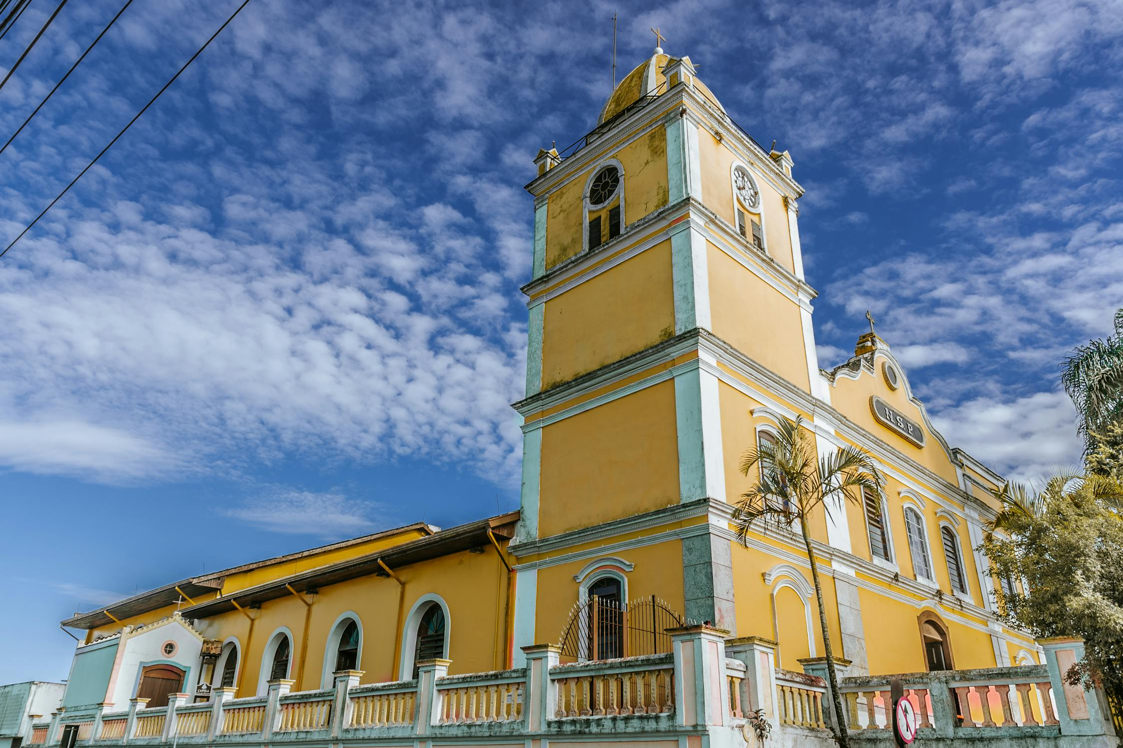
About Maceió, Brazil
Founded in the early 19th century as a sugar port.
Its name comes from the Indigenous term for 'spring of water’.
Grew rapidly through trade in sugar and coconut.
Today, it's a thriving resort city known for its clear seas and relaxed pace.
The coastline alternates between urban beaches and pristine natural stretches.
The nearby coral reefs protect the shore and create natural swimming pools.
Key Historic Sites: Cathedral of Nossa Senhora dos Prazeres (1840), Church of Bom Jesus dos Martires (1870)

Slide 7
Where We Are
Maceió is the capital of the state of Alagoas on Brazil’s northeastern coast.
It lies between the Atlantic Ocean and a series of tranquil lagoons, known for turquoise waters and coral reefs.

Slide 8
The Landscape
Maceió is surrounded by lagoons, palm-fringed beaches, and shallow reef pools.
The coastline alternates between urban beaches and pristine natural stretches.
The nearby coral reefs protect the shore and create natural swimming pools.
White sand beaches lined with coconut plantations create Brazil's "Caribbean coast"
Waters are remarkably clear with visibility up to 40-50 meters in some areas

Slide 9
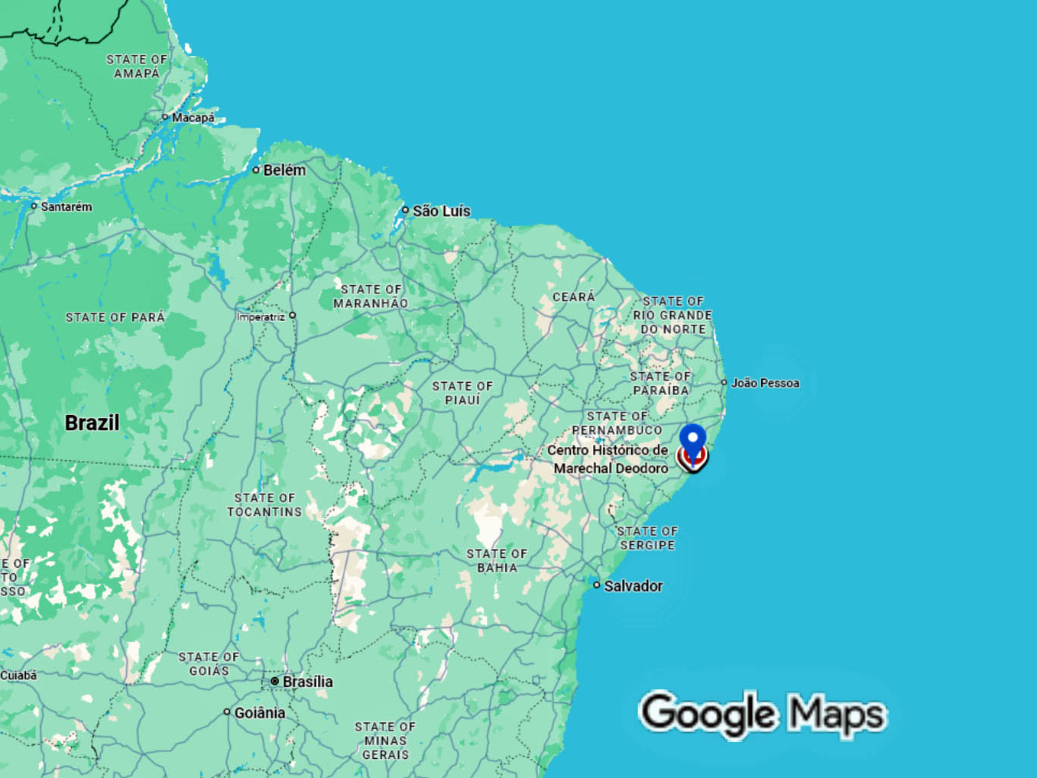

Slide 10
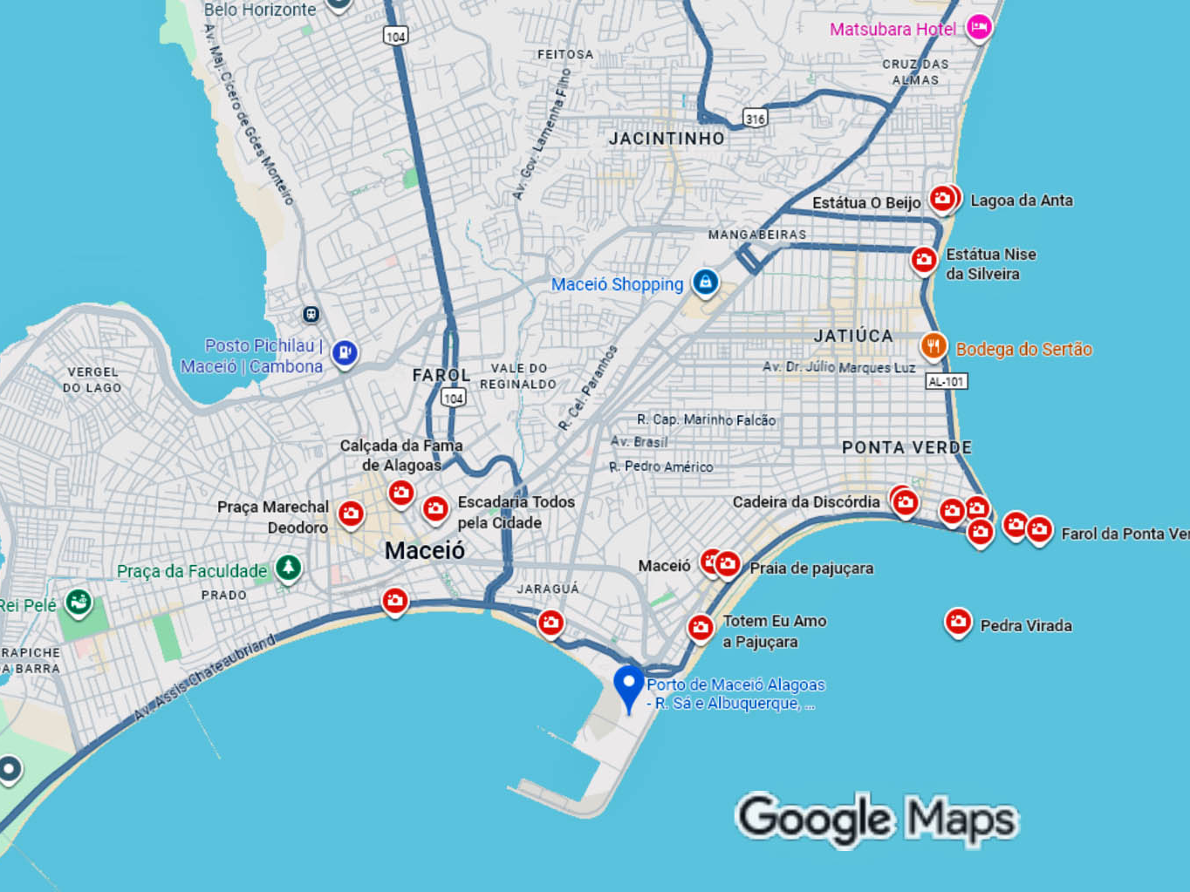

Slide 11
Getting Around
Hertz and Localiza car rental are available in the city.
Good option for visiting multiple beaches independently
Distances from Port
Ponta Verde Beach: 5 km (10 minutes)
Jatiúca Beach: 6 km (15 minutes)
Pajuçara Beach: Central (5 minutes)
Pontal da Barra: 8 km (15 minutes)
Marechal Deodoro: 20 km (30 minutes)

Slide 12
Top Beach Attractions
Pajuçara Beach – Natural tide pools accessible by jangada (traditional sailboat). Famous natural pools 2 km offshore. Perfect for snorkeling with colorful tropical fish
Ponta Verde – Most popular city beach with calm, clear waters. Famous for its coconut palms and calm waters. Excellent beachside cafés and restaurants. Try traditional Acarajé (bean fritters stuffed with shrimp)
Praia de Jatiúca – Beautiful white sand and emerald waters. Great for swimming and relaxing. Plenty of bars and umbrellas for rent
More Beach Destinations
Praia do Francês – Stunning natural beauty with divided areas. Surfing and beachside cafes. Calm side for families, wave side for surfers. Fresh seafood at beachside restaurants
Praia Gunga Beach – Palm-covered peninsula. Surrounded by coconut trees. Both ocean waves and calm lagoon waters. Colorful rock formations
Maragogi – The 'Brazilian Caribbean' with crystal-clear reefs. 90 km north (full day trip). Famous natural pools called "The Galés“. World-class snorkeling destination. Note: Only for longer port stays

Slide 13
Lagoon & Waterway Attraction
Mundaú Lagoon – Sunset cruises and local fishing villages
Peaceful waterfront setting
Watch local craftspeople at work
Beautiful views and photo opportunities
São Francisco River Mouth
Witness where the river meets the Atlantic Ocean
Full-day boat trip with local village visits
Swimming in natural pools along the way

Slide 14
Cultural & Historical Sites
Downtown Maceió
🏛️ Cathedral of Nossa Senhora dos Prazeres (1840)
Beautiful colonial architecture
Central landmark of the city
⛪ Church of Bom Jesus dos Martires (1870)
Historic religious site
🏰 Palácio do Governo
Houses religious art collection (Fundação Pierre Chalita)
🎭 Deodoro Theatre
Historic performing arts venue

Slide 15
Cultural & Lifestyle Sites
Maceió blends Afro-Brazilian, Indigenous, and Portuguese influences.
Crafts: Lacework (Maceió specialty), woodcarving, embroidered textiles, and ceramics
Music: Forró and samba de roda fill the beach bars
Locals, called alagoanos, are known for their warmth and hospitality
Shopping: Pontal da Barra and Cheiro de Terra Trade Complex for authentic handicrafts

Slide 16
Museums Worth Visiting
🎨 Museu do Comércio de Alagoas
Located in elegant port area building
Fascinating collection of 19th-20th century commercial equipment
Exhibits dating from 1866-1980
📚 Museu Théo Brandão
Folklore and anthropology exhibits
Showcases local Indigenous and Afro-Brazilian culture

Slide 17
Shopping for Authentic Crafts
Best Shopping Spots
Pontal da Barra (8 km/5 miles away)
Watch local craftspeople at work
Purchase authentic embroidered pieces and lace goods
Beautiful waterfront setting
Cheiro de Terra (Trade Complex)
Large selection of local handicrafts
Fine laces, woven clothes, curtains, jewelry
Colorful intricate designs unique to Maceió
What to Buy:
Hand-embroidered textiles and linens
Traditional lace work (Maceió specialty)
Local jewelry and beachwear

Slide 18
Cuisine
Seafood is the heart of Maceió's cuisine.
Try sururu (mussels), peixada (fish stew), and tapioca pancakes.
Moqueca – Flavorful seafood stew, a Brazilian specialty
Acarajé – Deep-fried bean balls with shrimp (African-Brazilian street food)
Fresh coconuts and tropical fruit juices are everywhere.
Don't miss local desserts made with sugarcane and coconut.
Where to Eat
Beachside cafés along Ponta Verde and Jatiúca
Pajuçara Beach – Lively restaurants and bars
Jaraguá Quarter – Historic warehouses converted to bars/restaurants

Slide 19
Nature and Adventure
Boat rides to natural pools at low tide – Check tide schedules for best timing
Snorkeling among coral reefs – Visibility up to 150 feet
Kayaking on Mundaú Lagoon – Peaceful paddle through protected waters
Eco-tours to mangroves and small islands
5-hour catamaran tours – Explore nearby islands and pristine reefs
Jangada raft rides – Traditional sailboats to offshore pools

Slide 20
Nature and Adventure
Day Trip Ideas
1. Maragogi (90 km north) - Stunning coral reefs and beaches
The famous "Galés" natural pools - Full day excursion
2. Barra de São Miguel (South) - Calm turquoise waters. Less crowded alternative
3. Praia do Gunga - Palm-covered peninsula. Dramatic coastal scenery
4. São Miguel dos Milagres - Secluded beach paradise. Pristine and peaceful
5. Marechal Deodoro (20 km south - 30 minutes) - Charming colonial town overlooking Lagoa Manguaba. Convento do São Francisco (17th century) – Stunning baroque monastery. Igreja Matriz de Nossa Senhora da Conceição (1783) – Historic church

Slide 21
Practical Tips
Currency: Brazilian Real (BRL).
Language: Portuguese.
Weather: Tropical and sunny most of the year.
Best time: September to March.
Souvenirs: lace, handicrafts, and local rum (cachaça).

Slide 22
Safety & Local Etiquette
Safety Tips
Stay along main beach boardwalks (Ponta Verde, Jatiúca, Pajuçara) Keep valuables secure in crowded tourist areas Don't stray far inland from beach areas Avoid: Praia do Sobral and Praia da Avenida (polluted) Only use official transportation from the port
Local Etiquette
Brazilians are warm and welcoming
Casual beach attire is perfectly acceptable
Tip 10% at restaurants if not included
Greet people warmly – it's expected and appreciated
I recommend always saying Tudoo Bem which means “All Good”

Slide 23
Emergency Information
Quick Reference
📞 International code for Brazil: +55 📞 Maceió area code: 82 🏥 Emergency services: Available at port and major hotels 🛳️ Port agents: Located at cruise terminal for assistance
If You Need Help
Contact your ship's port agent (info provided with cruise documents)
Visit the information desk at the cruise terminal
Hotel concierges and tourism offices are helpful
Police are present in tourist areas

Slide 24
Why Maceió Is Special
Maceió feels like a painting come to life, blue seas, white sands, and golden light.
Tucked along Brazil’s northeastern coast, it’s one of the country’s most beautiful and least crowded beach destinations, offering a truly authentic Brazilian experience.
The coastline is protected by coral reefs that create natural pools of turquoise water, perfect for swimming and snorkeling among colorful marine life.
Stroll along beaches consistently ranked among Brazil’s best, watch artisans craft traditional lace, and sample local seafood and tropical dishes that define Maceió’s cuisine.
The city’s colonial charm meets modern beach culture in a warm, laid-back atmosphere that welcomes visitors year-round. For many travelers, Maceió is Brazil’s hidden gem, a perfect blend of natural beauty, culture, and pure relaxation.

Slide 25
Thanks For Coming
If you have any more questions, please ask.
I will do my best to answer them for you.
Have a great visit to Manaus!

