Slide 1
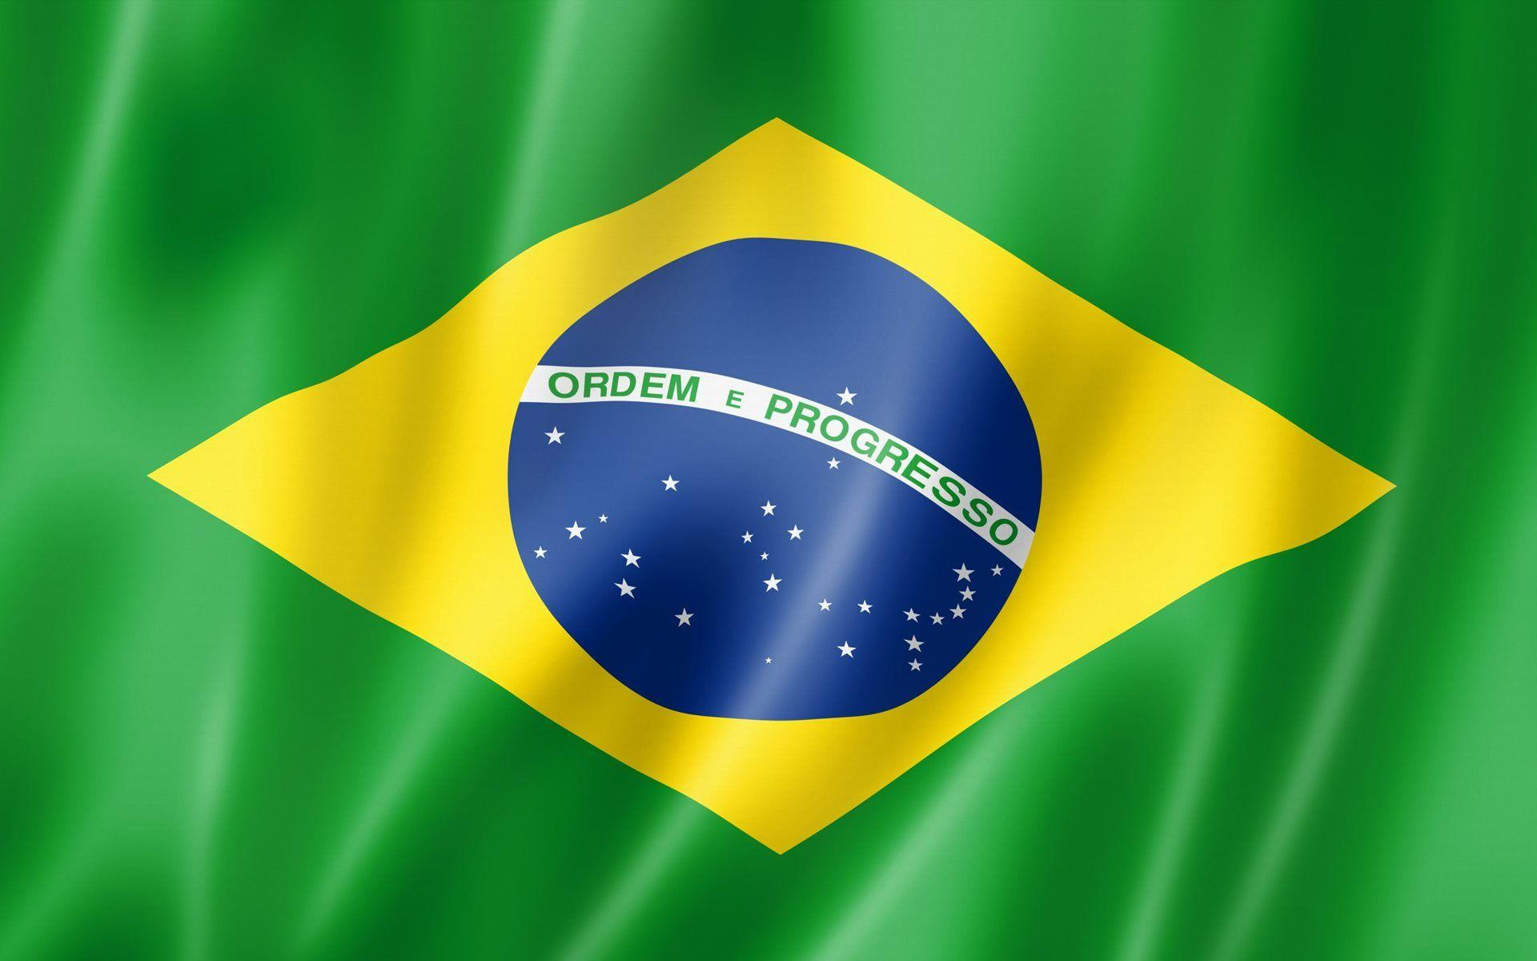
Macapá, Brazil Presented by Marc Silver

Slide 2
What I Will Cover
My Port Philosophy
Don’t Miss the Ship
Money
About Macapá
Macapá History
Area Map of Macapá
Map of Macapá
Macapá Transportation
Places to see or at least consider
A few restaurant recommendations
Conclusion

Slide 3
My Port Philosophy
I have been cruising for over 44 years and have taken over 200 cruises. So, I consider myself an experienced cruiser.
The information I will present is based on those many years of
experience.
When I am on a cruise where the city, I want to visit is not the port city,
I always recommend taking a ship’s tour.
But when I am in a port with multiple attractions nearby and easy to see
on my own - I will do it on my own.
This presentation is not like that.

Slide 4

Don’t Miss the Ship
How to Avoid Missing Your Ship
Pay attention to the time. - Ship time and local time are often different.
Put a return-to-ship reminder on your phone.
Choose excursions wisely.
If a ship-sponsored excursion is late returning to port, the ship will wait for you. If you are on your own.
Be Prepared
Have your Passport, Credit Card, and phone numbers for your ship port agent.
What to Do If You Miss the Ship Most cruise lines have port agents stationed in the port area to assist if your ship has left without you. If your are lucky, when cruisers are late returning to the vessel, the ship’s crew will often remove the passengers’ essential items – passports, cell phones, and medication -- from the ship to leave with the port agents.
The Port Officials can help you with contacting your ship and making necessary travel arrangements.

Slide 5
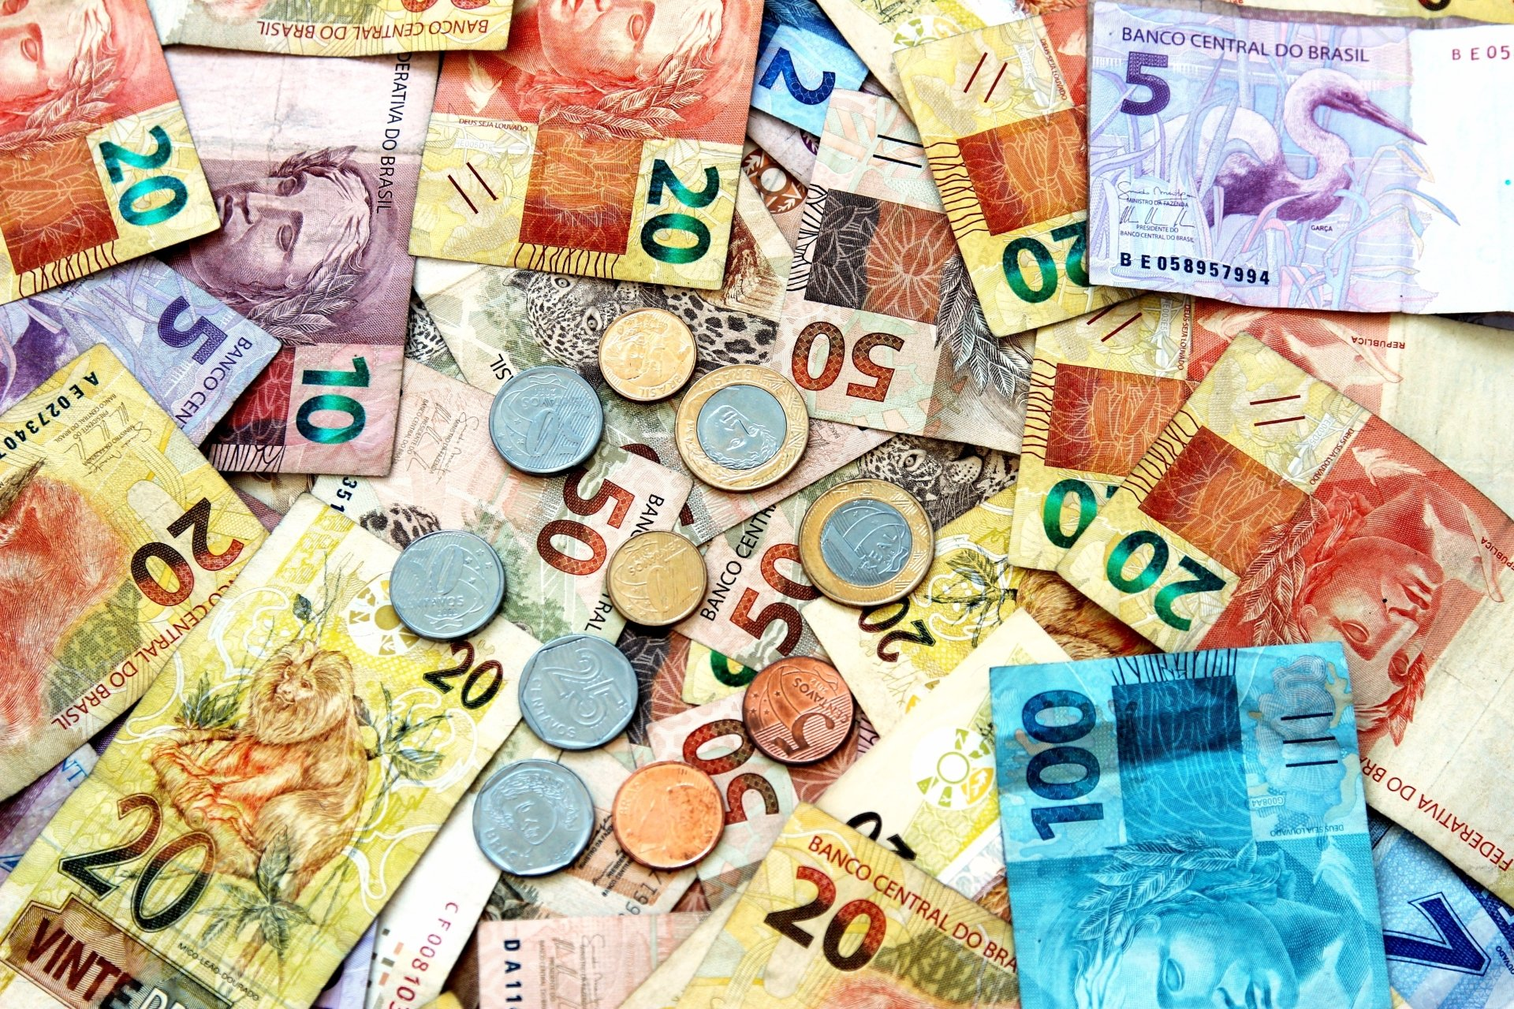
Money
The Brazilian Real
The official exchange rate is:
$1.00 US = 4.9310457 Real
1.00 Brazilian Real = 0.2028 US Dollars

Slide 6
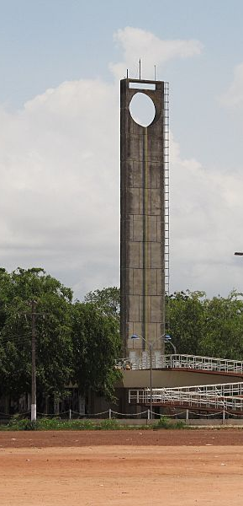
About Macapá, Brazil
Our first port in Brazil is Macapá (pronounced [makaˈpa]). It is the capital of Amapá state in Brazil's Northern Region. Located near the mouth of the Amazon Delta.
The equator runs through the middle of the city, leading residents to refer to Macapá as "The capital of the middle of the world.“
Macapá was given city status in 1856. A duty-free zone, it is the commercial, manufacturing, and transportation center of the state, exporting high-grade manganese, gold, iron, tin and lumber from Brazil’s interior.
Automobiles, timber, oils, pelts from jungle animals, and fish from both the river and the ocean are exported from Macapá’s port, Pôrto Sontana.

Slide 7
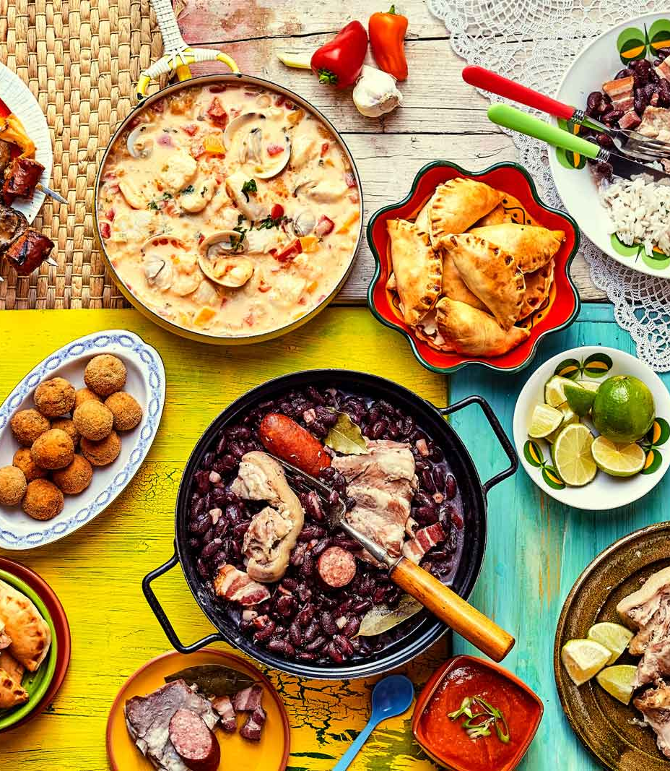
More About Macapá
Macapá is a melting pot of cultures. The beating of drums and the marabaixo dance, a kind of improvised choreography that is an ancient local tradition, combines African traditions with local rituals and beliefs, honoring the suffering slaves that helped build the city.
The local cuisine in Amapa is closely tied to the region’s native indigenous inhabitants. The dishes made with Amazonian products and spices, such as gurujiba, a common local fish, steamed shrimp, and vatapa delight residents and tourists alike.

Slide 8
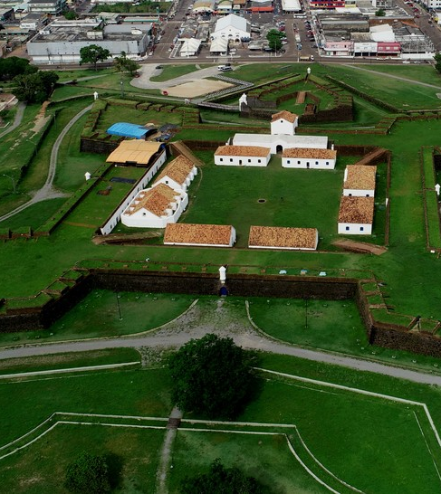
Macapá, Brazil History
Macapá is taken from the Tupi word Macapába, or "place of many bacabas", the fruit of the local palm tree. The Spaniard Francisco de Orellana claimed the region in 1544 and called it Nueva Andalucía (New Andalusia).
The modern town began as the base of a Portuguese military detachment, stationed there in 1738. It was named São José de Macapá, on February 4, 1758.
The fortress of São Joselito de Macapá was first laid out in 1764, but took 18 years to complete, due to illness among the Indian workers, and numerous escapes made by black slaves.
The fortress has never fired a shot in defense of the city.

Slide 9
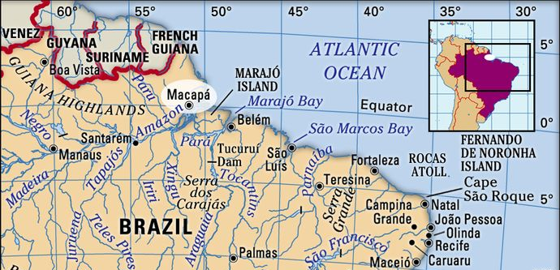
Area Map of Macapá, Brazil

Slide 10
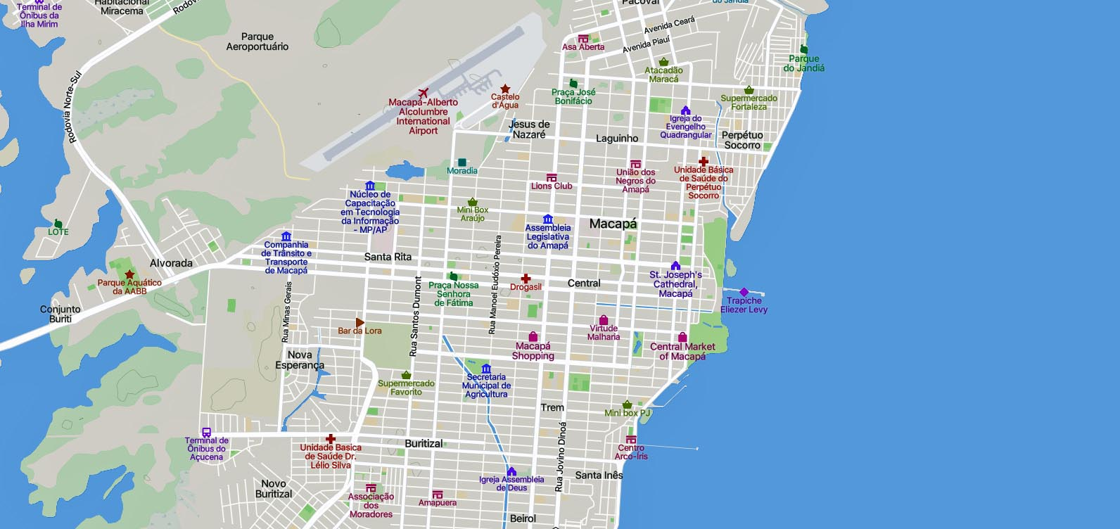
Map of Macapá

Slide 11
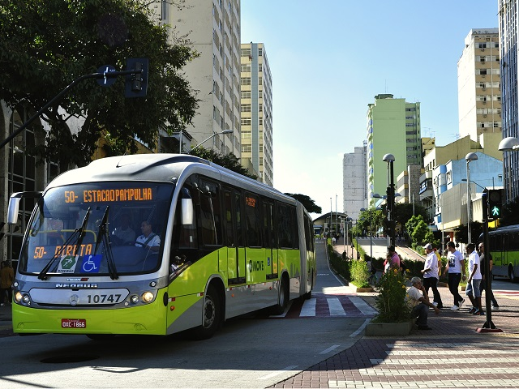
Macapá, Brazil Transportation
Sião Thur is a public transportation provider in Macapá which operates Bus routes.
The Sião Thur has 19 Bus routes in Macapá with 484 Bus stops.
Sião Thur line schedules (schedules, itineraries and service schedules) as well as departure and arrival times at stations are updated in, as well as departure and arrival times at stations, app in real time.
The costs and prices of different types of tickets can change, based on a number of factors.
Check the Moovit app for bus fares.

Slide 12
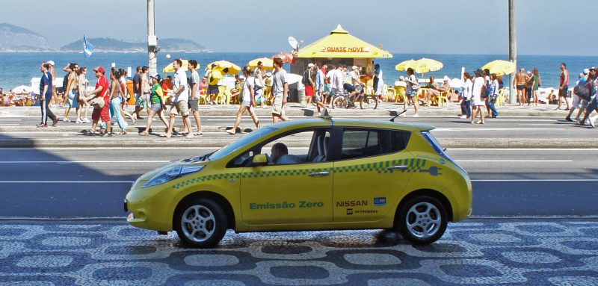
Macapá Taxis
Taxis and Ridesharing Companies are a comfortable way to get around the city of Macapá.
There are three ride-share companies in Brazil. #1 Uber #2 Easy Taxi #3 99 Taxi, but you need the app on your phone to use them.
My warning to you is to watch out for taxi scams. So, if you can use Uber, I recommend doing so. If you have to take a Taxi, then be sure they are from a reliable taxi company.

Slide 13
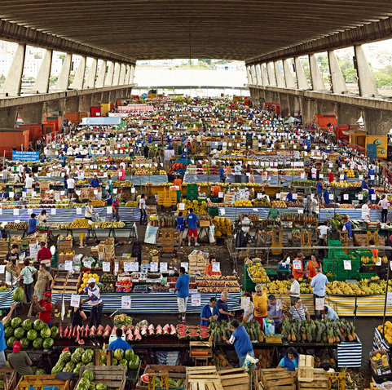
Central Market of Macapá
Mercado Central de Macapá is a public market across the street from the Fortress of São José de Macapá just a short walk from the dock. It is considered the shopping stronghold of the families of Amapá since the 1950s.
Nowadays, the market still preserves some services such as the sales of vegetables and shoe repairs, along with snack bars, fishmongers, and butchers.

Slide 14
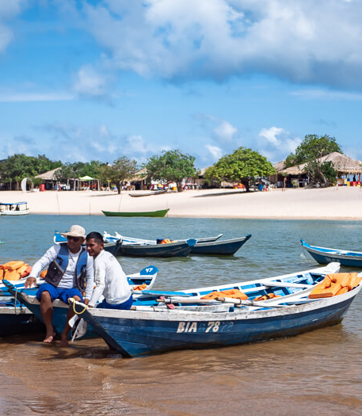
Take a Boat
A boat ride on the Amazon River is the most classic and traditional ecotourism activity in Macapá.
During the flood season, the Amazon River is great for all sorts of water sports.
It is also possible to visit Marajo Island and the cities of Belem and Santarem by boat.
You can charter a fishing boat to take you around the area while you search for wildlife such as playful river dolphins.
A half-day trip costs around 150 BRL (US$30) for up to four people.
If you go in the water, be especially careful of stingrays. They will only sting when stepped on, so shuffle your feet when you walk in the water.

Slide 15
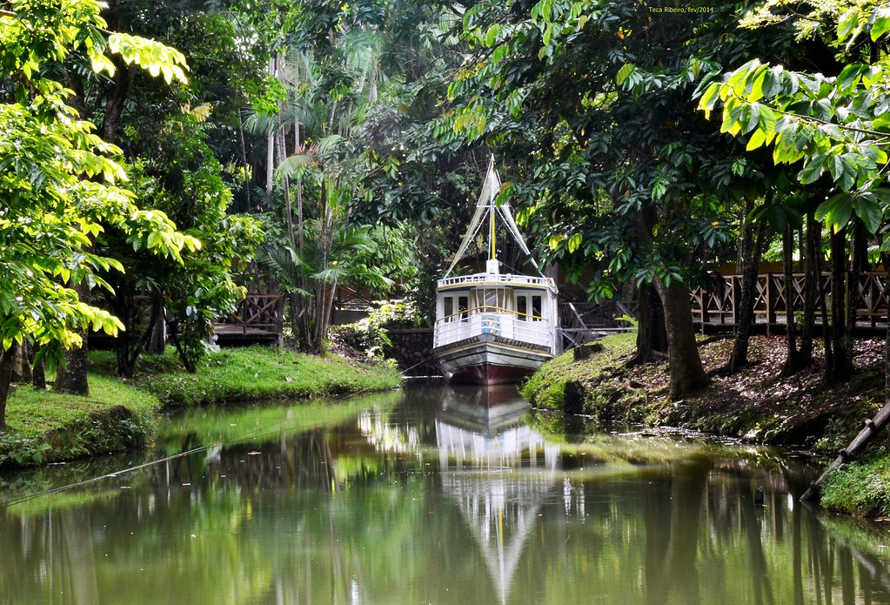
Sacaca Outdoor Museum
Very good environment to bring children to walk in the late afternoon. It is a peaceful and beautiful environment for those who like museums and history, this is a great place to get to know the history of the site.
It is a quiet and pleasant environment. Interesting place, worth stopping by and seeing a bit of local history, it is worth trying the ice cream on site.

Slide 16
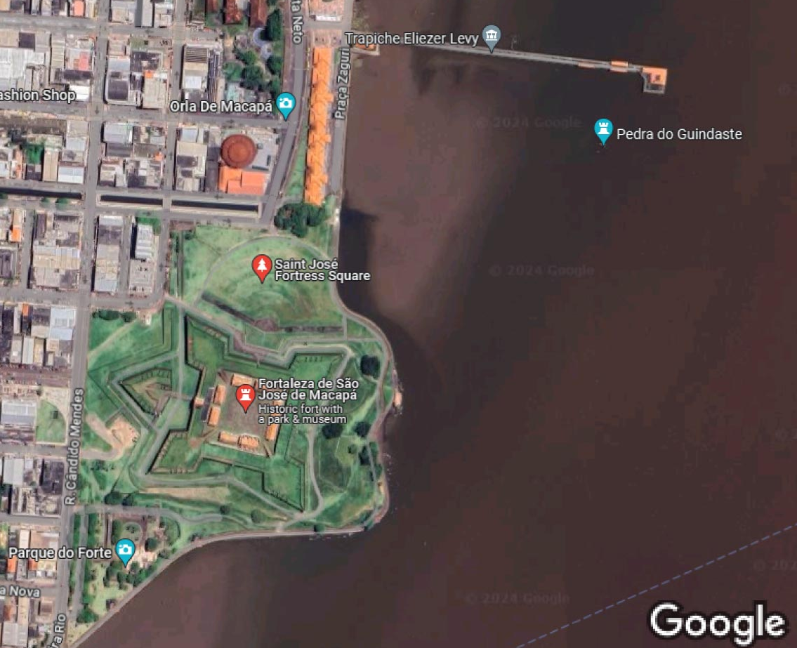
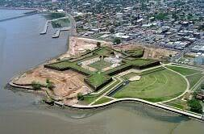
Fortress of São José de Macapá
The fortress of São Joselito de Macapá construction began in 1764, but took 18 years to complete, due to illness among the Indian workers, and numerous escapes made by black slaves.
The fortress was meant to protect the Amazon but never fired a shot to defend itself.
Outside the Fort is a beautiful park with greenery, flowers and a wonderful view of the Fort itself.

Slide 17
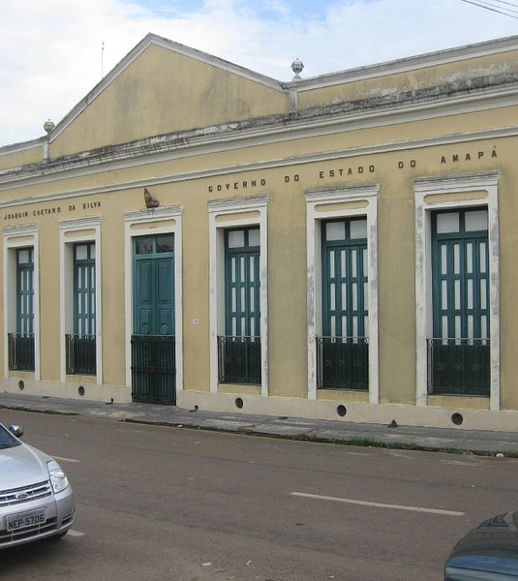
Historical Museum Joaquim Caetano Sa Silva
The Joaquim Caetano da Silva Museum is the right place for those who want to know more about the history of Amapá. You will find an expressive collection with archaeological pieces, manuscript documents, and objects dating from the nineteenth and twentieth centuries, as well as photographs that record the daily life of the rulers and the people of Amapá through the ages.
The space was revitalized by the State Government in 2022, with interventions in its structure, preserving the original characteristics.

Slide 18

Centro de Cultura Negra
Also known as the Center for Black Culture, It was created to foster the spread of black culture where dance, music, crafts, and everything about black culture in Brazil.
Recently renovated, this is the first update that the center has received since its inauguration in 1998. The revitalization cost more than R$ 1.3 million.
This center is located about three blocks West of the Fortress of São José de Macapá.

Slide 19
Thanks For Coming
If you have any more questions, please ask.
I will do my best to answer them for you.
Have a great visit to Macapá!

