Slide 1
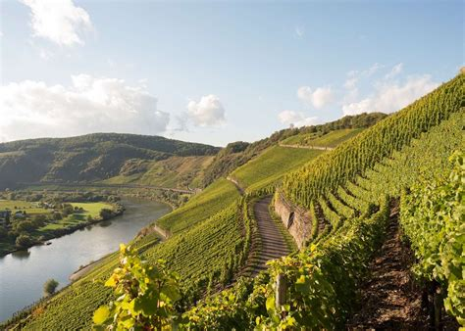
The Wines of Luxembourg A Journey Through Europe's Hidden Wine Gem Presented by Marc Silver

Slide 2
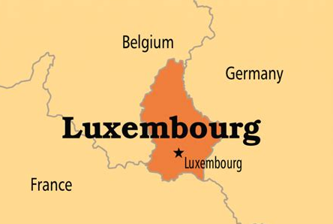
Wines Hidden Treasure
The world of Luxembourg wines, is a place were centuries old traditions meet modern-day innovation, all within one of Europe’s smallest yet most dynamic wine-producing countries.
Nestled between France and Germany, Luxembourg is a hidden treasure in the world of wine. This tiny nation packs a punch with its rich viticultural heritage and innovative winemaking techniques.
If you’re a wine enthusiast eager to explore beyond the famous vineyards of France, Italy, or Spain, then Luxembourg offers a delightful surprise.
I plan to take you through the rich history, unique terroir, and diverse varietals of Luxembourg's wine regions, along with some must-visit wineries. So, pour yourself a glass, and let’s dive into the hidden gem that is Luxembourg wine.

Slide 3
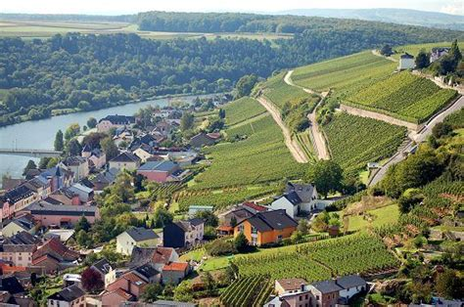
Wines Hidden Treasure
Despite its small size, Luxembourg's wine scene is anything but diminutive, offering a captivating blend of tradition and modernity that deserves far more recognition
Let's embark on an enchanting journey through Luxembourg's picturesque vineyards, uncovering the secrets of its winemaking history, exploring its unique terroir, and discovering the exceptional wines that are waiting to be savored
From ancient Roman roots to cutting-edge sustainable practices, Luxembourg's wine story is one of passion, perseverance, and unparalleled quality. As we delve into the heart of this remarkable country's wine regions, you'll discover why Luxembourg's wines are truly hidden gems, worthy of a place in the cellars of discerning wine enthusiasts worldwide
Prepare to be surprised and delighted by the depth, character, and sheer excellence of Luxembourg's viticultural offerings.

Slide 4
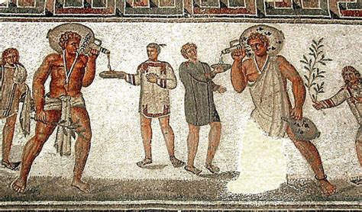
The History of Luxembourg's Wine
Wine production in Luxembourg dates back over 2,000 years, beginning with the Romans, who saw the Moselle River valley's potential. The region, bordering Germany and France, has seen its winemakers refine techniques over the centuries, heavily influenced by neighboring countries, particularly Germany, evident in the production of varietals like Riesling.
From Ancient Times to Modern Excellence
Roman Era (1st Century AD): The Romans planted the first vineyards in the Moselle Valley, recognizing its fertile soil and favorable climate. .
Luxembourg's wine history starts with the Romans, who planted vines along the Moselle River in the 1st century CE. Archaeological finds, including wine-making tools near Grevenmacher, confirm the early establishment of viticulture.

Slide 5
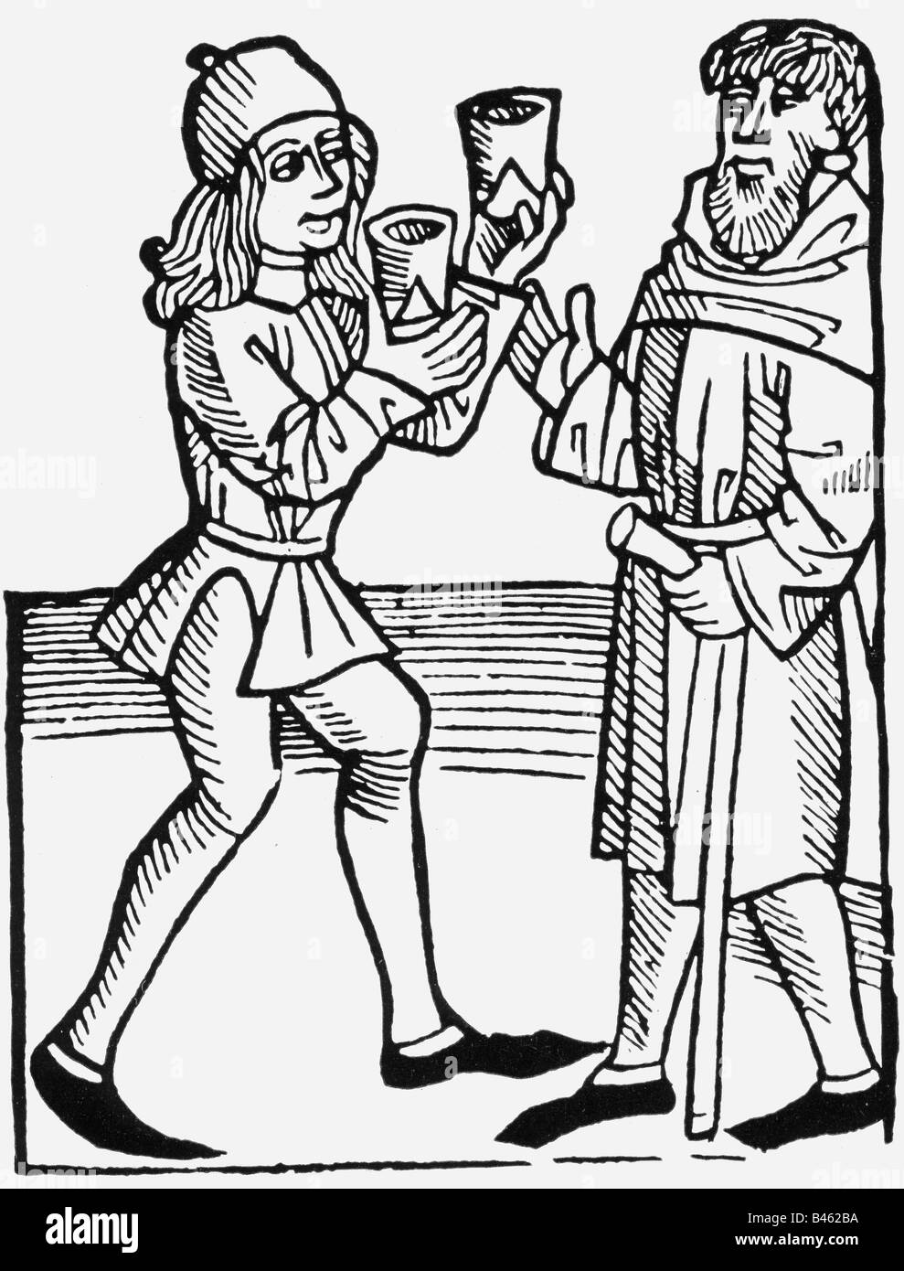
The History of Luxembourg's Wine
Medieval Development (5th-15th centuries)
Medieval Period: During this era, monasteries became important centers of viticulture, preserving and refining winemaking practices. Wine became a staple not only for religious rituals but also for the local economy.
The Abbey of Echternach, founded in 698, became a significant center for viticultural knowledge and wine production.
Early Modern Period (16th-18th centuries)
Luxembourg's wine industry faced numerous challenges during this period, including:
The Thirty Years' War (1618-1648), which devastated many vineyards
Climate fluctuations during the Little Ice Age
Competition from beer production

Slide 6
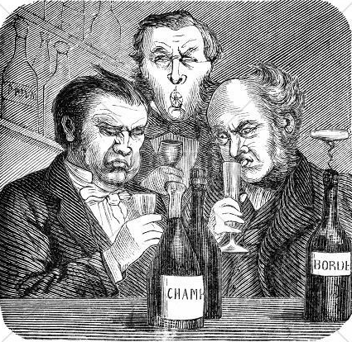
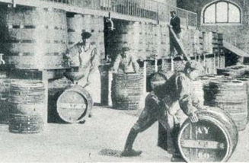
The History of Luxembourg's Wine
Industrial Age to Modern Era (19th-20th centuries)
19th Century: Luxembourg experienced a boom in wine production, but it was also marked by challenges, including the devastating phylloxera outbreak. This forced Luxembourgish winemakers to adopt new techniques and grape varieties to revitalize their vineyards.
The 19th century marked a turning point for Luxembourg's wine industry:
1893: Formation of the first wine cooperatives
1925: Establishment of the State Viticultural Institute
1935: Creation of the Marque Nationale system for quality control

Slide 7
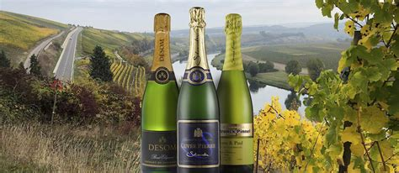
The History of Luxembourg's Wine
Contemporary Period (1945-Present)
Modern Era: Luxembourg’s wine industry has come into its own in the 20th and 21st centuries, gaining recognition for producing high-quality white wines. A significant milestone was the creation of the Appellation d'Origine Protégée (AOP) for Luxembourg wines in 1989, a mark of quality that emphasizes the unique terroir of the region.
Post-World War II developments include:
1950s: Modernization of wine-making techniques
1966: Official recognition of Luxembourg’s wines by the European Economic Community
2000s: Increasing focus on sustainable and organic viticulture

Slide 8
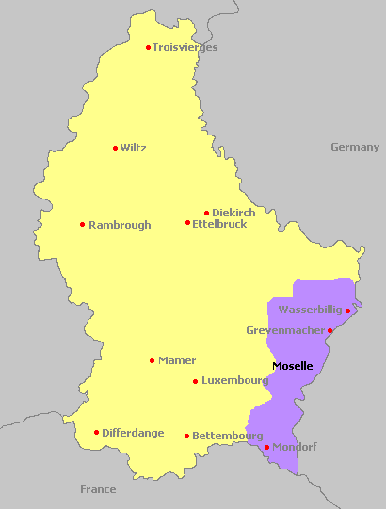
Wine Regions of Luxembourg
Moselle Valley (Largest Production Region)
The Moselle Valley, locally known as "Musel" in Luxembourgish, forms the backbone of Luxembourg's wine industry, accounting for approximately 92% of the country's total wine production.
This prestigious region stretches for 42 kilometers along the Moselle River, from Wasserbillig in the north to Schengen in the south, where Luxembourg meets France and Germany.

Slide 9
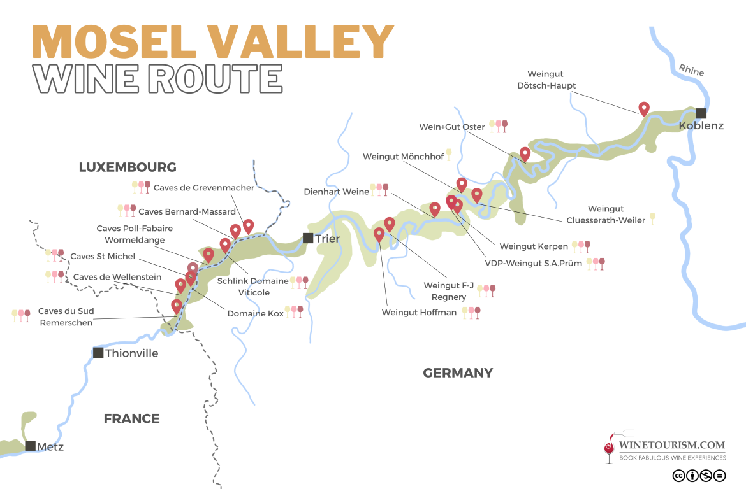
Wine Regions of Luxembourg
Moselle Valley:
The heart of Luxembourg’s wine production, with over 1,200 hectares of vineyards.
Known for its white wines, particularly Riesling, Auxerrois, and Pinot Gris.
Offers a mixture of limestone, clay, and marl soils, contributing to the complexity of its wines.
Luxembourg’s wine production is concentrated in one major region: The Moselle Valley, which runs along the eastern border with Germany. Though this is the country's sole significant wine region, it boasts distinct sub-regions, each with its own microclimate and soil composition. Here's how they stack up:

Slide 10
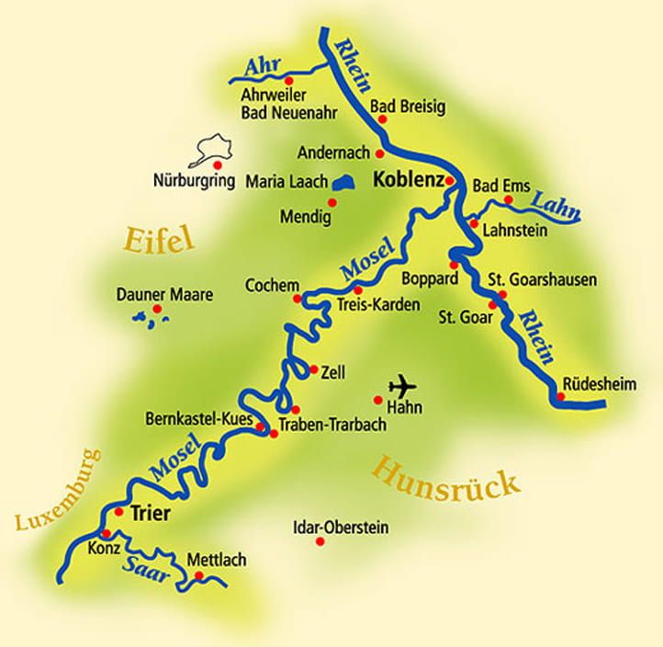
Wine Regions of Luxembourg
In-Depth Regional Breakdown
Northern Moselle
Location: The northernmost part of the Moselle region, bordering Germany.
Terroir & Climate: Cooler climate, with steep vineyards that benefit from extended sun exposure. The soils here are rich in clay and limestone, ideal for white varietals.
Grape Varieties: Predominantly Riesling, Elbling, and Pinot Blanc.
Wine Profile: Crisp, mineral-driven white wines with high acidity and bright fruit flavors.

Slide 11
Wine Regions of Luxembourg
In-Depth Regional Breakdown
Central Moselle
Location: The central stretch of the Moselle Valley, including the villages of Remich and Grevenmacher.
Terroir & Climate: A warmer microclimate with more fertile soils, including clay, marl, and limestone.
Grape Varieties: Auxerrois, Pinot Gris, and Gewürztraminer.
Wine Profile: Rich, full-bodied white wines with complex flavors and excellent aging potential.

Slide 12
Wine Regions of Luxembourg
In-Depth Regional Breakdown
Southern Moselle
Location: The southern part of the valley, closest to France.
Terroir & Climate: Warmer climate, with a mix of limestone and marl soils.
Grape Varieties: Pinot Noir, Rivaner, and Chardonnay.
Wine Profile: Elegant, fruit-forward wines, including some of Luxembourg’s best reds and sparkling wines.

Slide 13
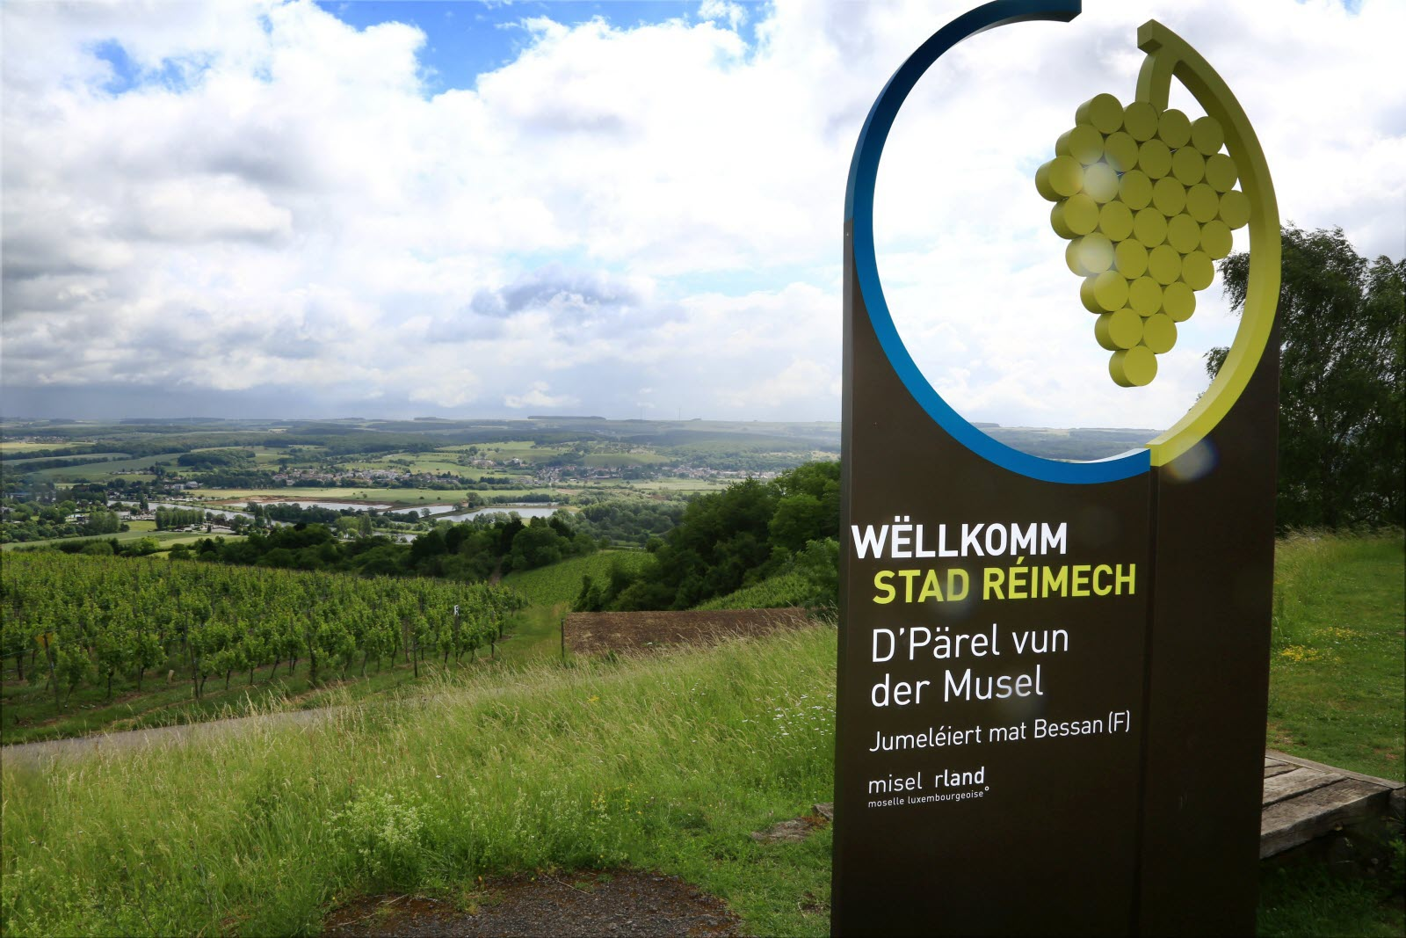
Terroir of Luxembourg
Luxembourg may be small, but its terroir is nothing short of remarkable. The country’s wine regions are largely shaped by the Moselle River, which creates a favorable microclimate for viticulture. Luxembourg’s vineyards are blessed with:
Soil Diversity: The soil varies greatly across the Moselle Valley, from limestone and clay in the north to more marl-based soils in the south.
This diversity allows for a wide range of wine styles, from crisp and mineral-driven to lush and fruity.

Slide 14
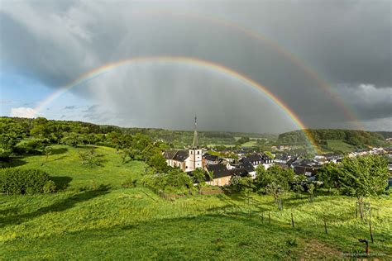
Unique Terroir of Luxembourg
Climatic Conditions: Luxembourg experiences a cool continental climate, but the Moselle River moderates temperatures, creating ideal conditions for slow grape ripening. This leads to wines with well-developed flavors and balanced acidity.
Geological Influence: The river’s proximity also contributes to the mineral complexity of the wines, with many producers taking advantage of the steep, sun-exposed slopes to grow their grapes.

Slide 15
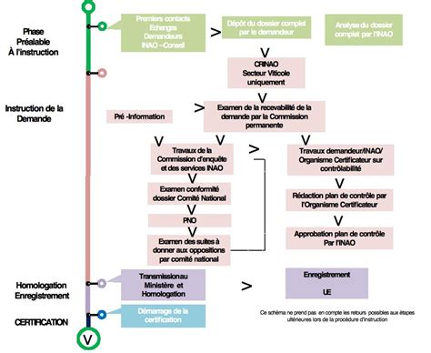
Wine Classification System
While Luxembourg doesn't have the same elaborate classification system as France, it does have its own quality system, known as "Appellation d'Origine Protégée" (AOP).
Introduced in 1989, the AOP ensures that wines are produced under strict guidelines regarding grape varieties, yield, and winemaking techniques. Wines that carry the AOP label are typically of high quality and reflect the unique characteristics of the Luxembourgish terroir.
Vins de Luxembourg: This designation applies to all wines produced in the country and serves as the base classification.
Crémant de Luxembourg: A prestigious classification reserved for Luxembourg's sparkling wines, made using the traditional method (similar to Champagne).

Slide 16
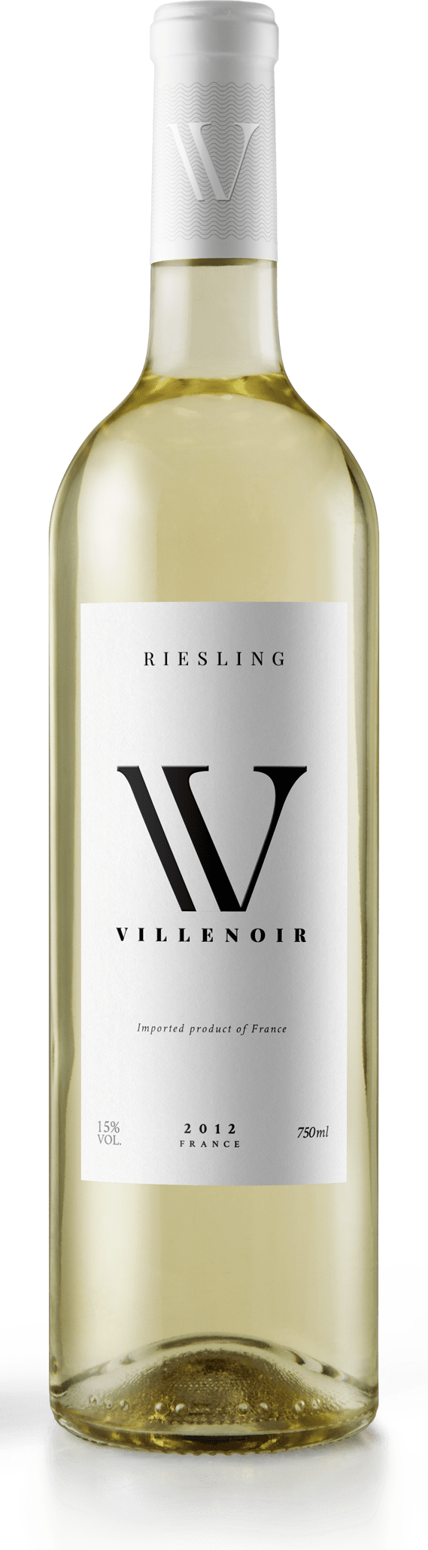
Major Varietals of Luxembourg
Luxembourg's vineyards are primarily dedicated to white varietals, but there are some reds and sparkling wines that have gained popularity in recent years. Let’s take a closer look at the major grape varieties:
Riesling
Characteristics: Crisp acidity, bright citrus and green apple flavors, with a mineral backbone.
Tasting Notes: Dry, with notes of lime, apricot, and wet stone. In some cases, floral and honeyed aromas develop with age.
Food Pairing: Perfect with seafood, particularly oysters and grilled fish, or light Asian dishes like sushi.

Slide 17
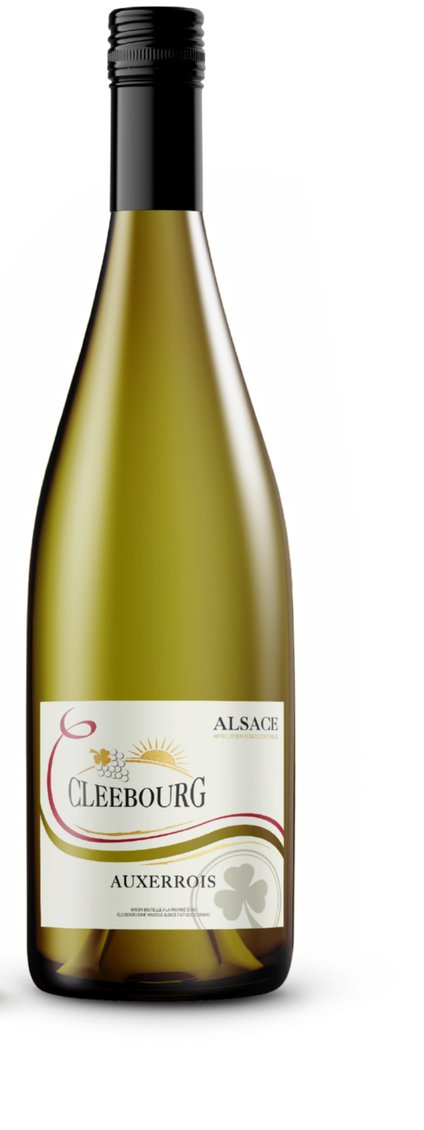
Major Varietals of Luxembourg
Auxerrois
Characteristics: A lesser-known variety often confused with Pinot Blanc, but it has a richer, fuller body.
Tasting Notes: Round and creamy, with notes of pear, honey, and almond.
Food Pairing: Excellent with roasted poultry, soft cheeses, and creamy sauces.
Pinot Gris
Characteristics: Fuller-bodied than its Italian cousin, Pinot Grigio, with richer fruit flavors.
Tasting Notes: Pear, peach, and honeydew, with a hint of spice and smoke.
Food Pairing: Ideal with richer dishes, such as pork, veal, or mushroom-based meals.

Slide 18
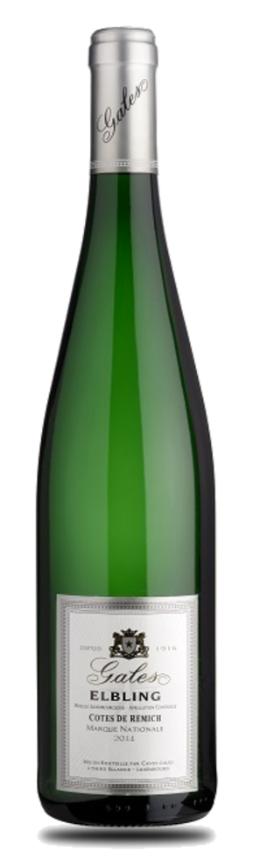
Major Varietals of Luxembourg
Elbling
Characteristics: One of the oldest grape varieties in the region, producing light, high-acid wines.
Tasting Notes: Zesty and refreshing, with notes of green apple, citrus, and a slight herbal edge.
Food Pairing: Pairs well with salads, light seafood dishes, or as a refreshing aperitif.
Some people compare Elbling to Resiling, but in fact they are very different wines. Elbling is for those who prefer straightforward, refreshing wines, while Riesling appeals to those seeking a more complex, aromatic experience. While Riesling: Richer, more aromatic, and versatile

Slide 19
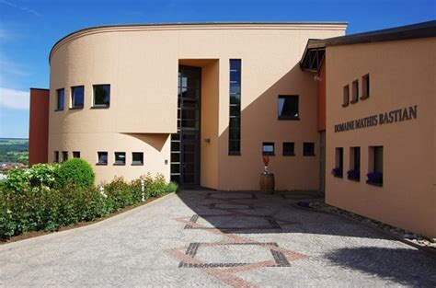
Notable Wineries
Luxembourg may be small, but it boasts some exceptional wineries. Here are a few standouts:
Domaine Mathis Bastian
Located in the heart of the Moselle Valley, this family-owned winery is renowned for its elegant Rieslings and Pinot Gris.
Notable Wine: Clos des Eglantiers – a rich and complex Pinot Gris with a distinctive smoky finish.

Slide 20
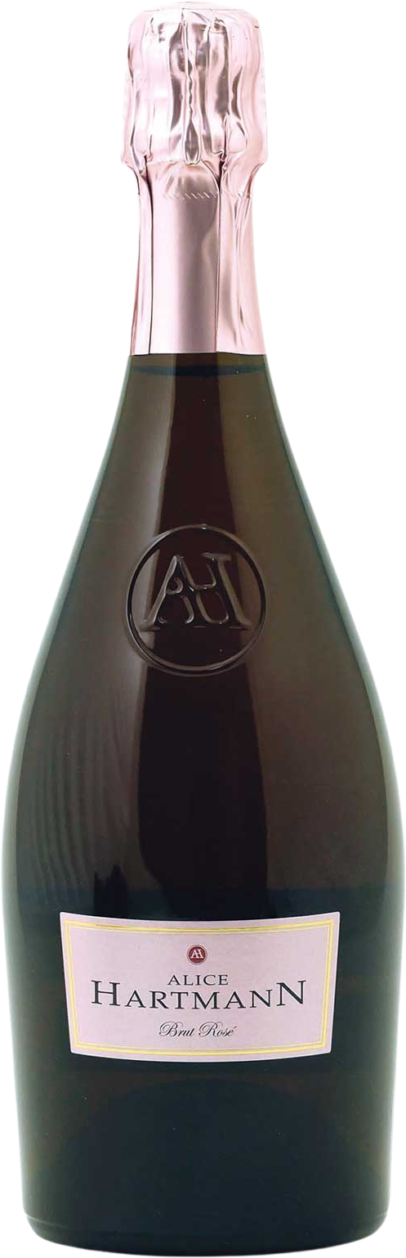
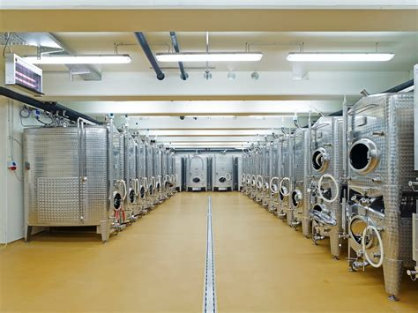
Notable Wineries
Domaine Alice Hartmann
One of the oldest and most prestigious wineries in Luxembourg, producing both still and sparkling wines.
Notable Wine: Crémant de Luxembourg – a beautifully balanced sparkling wine made from Chardonnay and Pinot Noir.

Slide 21
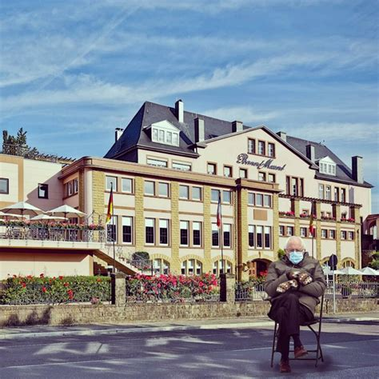
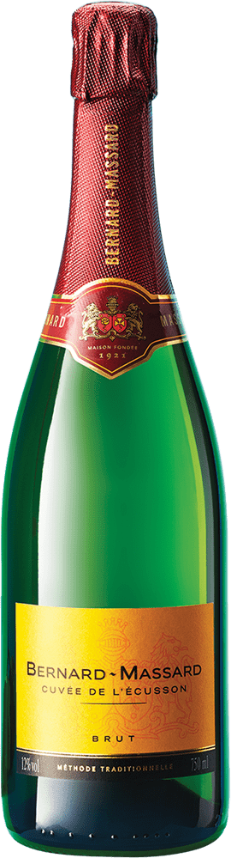
Notable Wineries
Caves Bernard-Massard
Famous for its sparkling wines, this winery is a must-visit for fans of Crémant.
Notable Wine: Bernard-Massard Brut – a crisp, refreshing Crémant with notes of green apple and brioche.

Slide 22
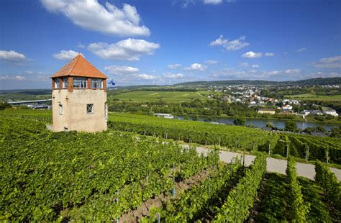
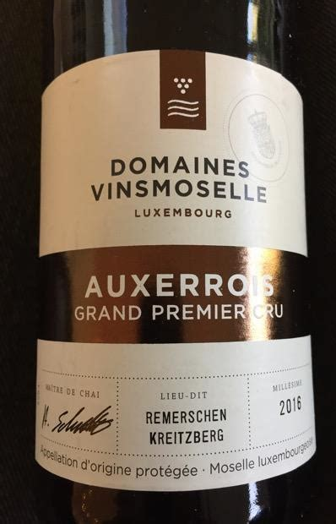
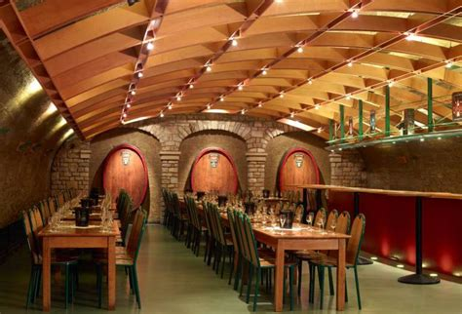
Notable Wineries
Domaine Vinsmoselle
Luxembourg’s largest producer, offering a wide range of wines from all the major varietals.
Notable Wine: Riesling Grand Premier Cru – a top-tier Riesling with intense minerality and citrus flavors.

Slide 23
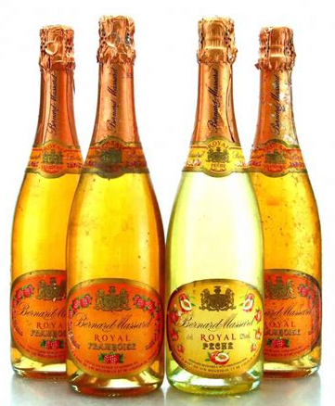
Final Thoughts
Luxembourg’s wine scene might not be as widely recognized as France’s Bordeaux or Italy’s Tuscany, but that’s exactly what makes it so special.
It offers an under-the-radar experience for wine enthusiasts looking to explore something new, without the tourist crowds or overhyped brands. The country’s diverse microclimates and rich terroir allow winemakers to craft distinctive wines that reflect the essence of the Moselle Valley—crisp, mineral-driven whites, elegant sparklings, and a few surprise reds.
One of the greatest charms of Luxembourgish wine is the intimacy of its production. The vineyards are often family-owned, with a deep sense of heritage and pride in their craft. Yet, despite its modest size, Luxembourg’s wine industry delivers an impressive range of high-quality wines that can stand shoulder-to-shoulder with some of the best in Europe.
So, as you expand your wine horizons, remember to give Luxembourg a try. Whether it’s the refreshing taste of a dry Riesling or the celebratory pop of a Crémant de Luxembourg, you’ll discover a region full of charm, character, and exceptional wines just waiting to be uncorked.

Slide 24
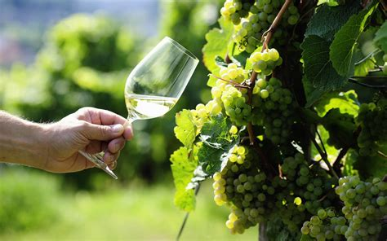
Conclusion
Luxembourg may not be the first country that comes to mind when you think of wine, but its rich history, unique terroir, and diverse grape varietals make it a must-try for any wine lover.
From the mineral-driven Rieslings of the Northern Moselle to the lush Pinot Gris of the south, there’s a lot to discover in this tiny yet dynamic wine-producing nation.
Whether you’re sipping a crisp Crémant or indulging in a full-bodied Auxerrois, Luxembourg's wines offer a taste of something truly special.
So next time you’re looking for a new wine adventure, consider reaching for a bottle from Luxembourg—you won’t be disappointed!

Slide 25
Acknowledgement
My seminars are the result of many years of experience combined with many hours of research over the internet.
I would like to acknowledge the many source I have accessed.
These include Wine Spectator, Wine Enthusiast, BKWine Magazine, Wine & Spirits Magazine, American Vineyard Magazine, The Grapevine Magazine, Wikipedia.com, Britannica.com, and the various Government websites.

Slide 26
Citations and References
:
"Wine in Luxembourg: A Hidden Gem in Europe," VinJournal, 2023.
"The History of Luxembourgish Wine," The Moselle Wine Society, 2022.
"Luxembourg Wine Regions and Terroirs," European Wine Experts, 2021.
"Crémant de Luxembourg: The Sparkling Wine of Choice," The Sparkling Wine Review, 2023.

