Slide 1
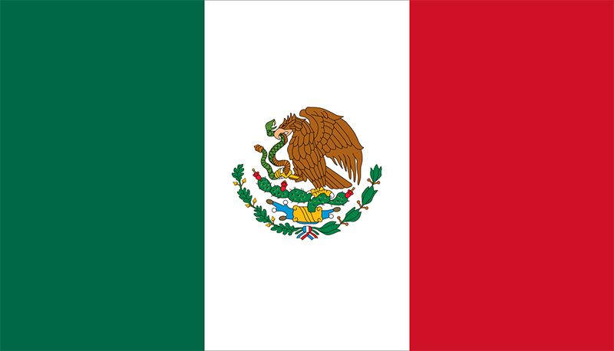
Loreto, Mexico Presented by Marc Silver

Slide 2
What I Will Cover
My Port Philosophy
Don’t Miss the Ship
Money
About Loreto
History of Loreto
Map of Loreto
Weather of Loreto
Getting Around
Points of Interest and things to do
A few restaurant recommendations
Conclusion

Slide 3
My Port Philosophy
I have been cruising for over 45 years and have taken over 100 cruises. So, I consider myself an experienced cruiser.
The information I will present is based on those many years of
experience.
When I am on a cruise where the city, I want to visit is not the port city,
I always recommend taking a ship’s tour.
But when I am in a port with multiple attractions nearby and easy to see
on my own - I will do it on my own.
This presentation is for that type of port.

Slide 4
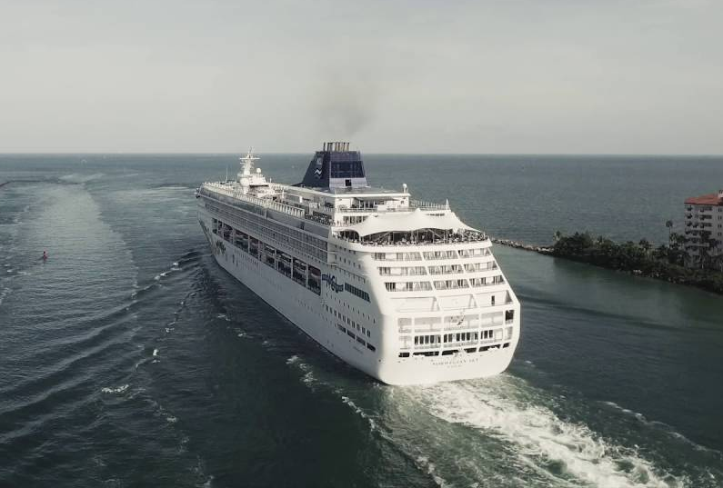
Don’t Miss the Ship
How to Avoid Missing Your Ship
Pay attention to the time. - Ship time and local time are often different.
Put a return-to-ship reminder on your phone.
Choose excursions wisely.
If a ship-sponsored excursion is late returning to port for, the ship will wait for you. If you are on your own???
Be Prepared
Have your Passport, Credit Card and phone numbers for your ship port agent.
What to Do If You Miss the Ship Most cruise lines have port agents stationed in the port area to assist if your ship has left without you. If you’re lucky, when cruisers are late returning to the vessel, the ship's crew will often remove the passengers' essential items -- passports, cell phones and medication -- from the ship to leave with the port agents.
The Port Officials can help you with contacting your ship and making necessary travel arrangements.

Slide 5
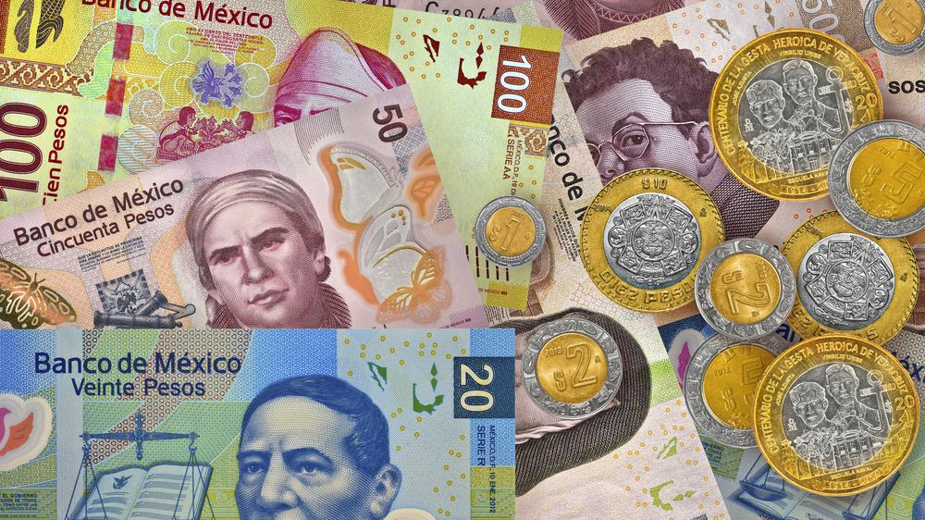
Money
The Peso is the official currency of Mexico
Official Exchange is 100 Pesos is $5.80 US
Or 17.35 Pesos to the US Dollar

Slide 6
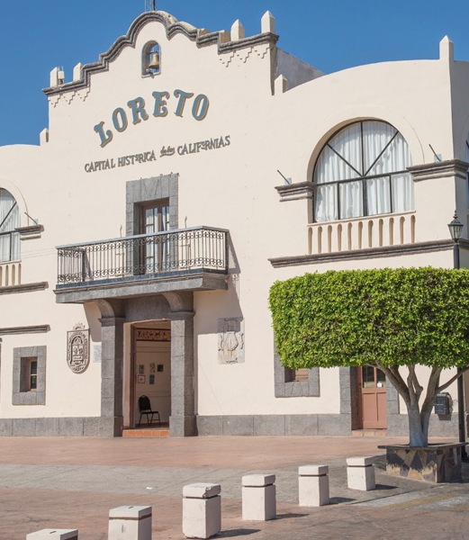
About Loreto Mexico
Loreto is a city located in the state of Baja California Sur on the west coast of Mexico. With only about 20,000 residents, it is the capital of the municipality of Loreto.
Just 6 hours north of Cabo San Lucas, Loreto it is a cute town with a central square, nearby Islands, Fishing, Snorkeling, Paddleboarding, and Kayaking.
Loreto is known for its rich history, cultural heritage, and beautiful natural surroundings, including the Sea of Cortez, the Loreto Bay National Marine Park, and the Sierra de la Giganta mountain range.
The city is home to many historical landmarks, including the Mission of Nuestra Señora de Loreto Conchó, founded in 1697 and considered the first Spanish settlement in Baja California.
In recent years, Loreto has become a popular tourist destination, with visitors coming to enjoy its beaches, water sports, hiking and biking trails, and cultural attractions.

Slide 7
Historical Loreto
Loreto is truly a Mexican city. Loreto was the first Spanish colonial settlement on the Baja California Peninsula.
The town was founded in 1697 by Jesuit missionaries, who found a steady spring of fresh water on this site, as the Misión Nuestra Señora de Loreto. The Jesuits were expelled in 1767, and the Franciscans were given control of the Baja California missions.
In 1769, the Franciscans were ordered to turn over the Baja missions to the Dominican Order and accompany the expedition of Gaspar de Portolá to establish new missions in the unexplored northern frontier that became Alta California. The expedition departed from Loreto on March 24, 1769.
The town served as the capital of the province of Las Californias from its founding until the capital was moved to Monterey on February 3, 1777. In 1768, the province had been split into Alta California (today's U.S. state of California) and Baja California. At first, the two provinces continued with a single governor. Later, the town became the headquarters for the Lieutenant Governor of California Viejo (the province of Baja California).

Slide 8
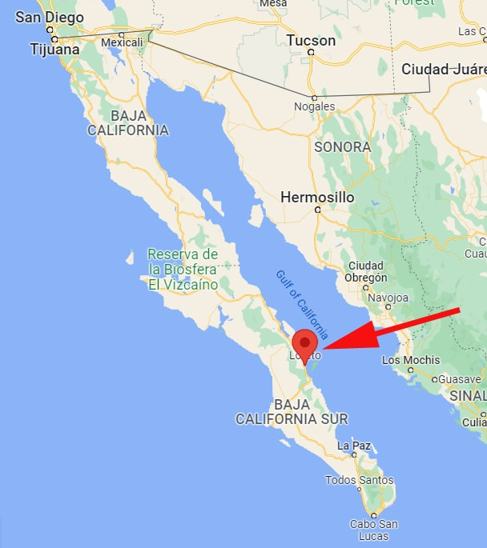
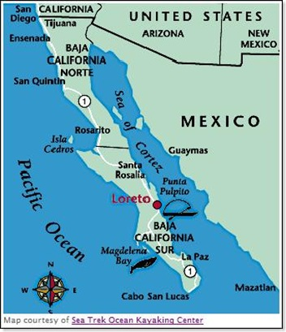
Map of Baja

Slide 9
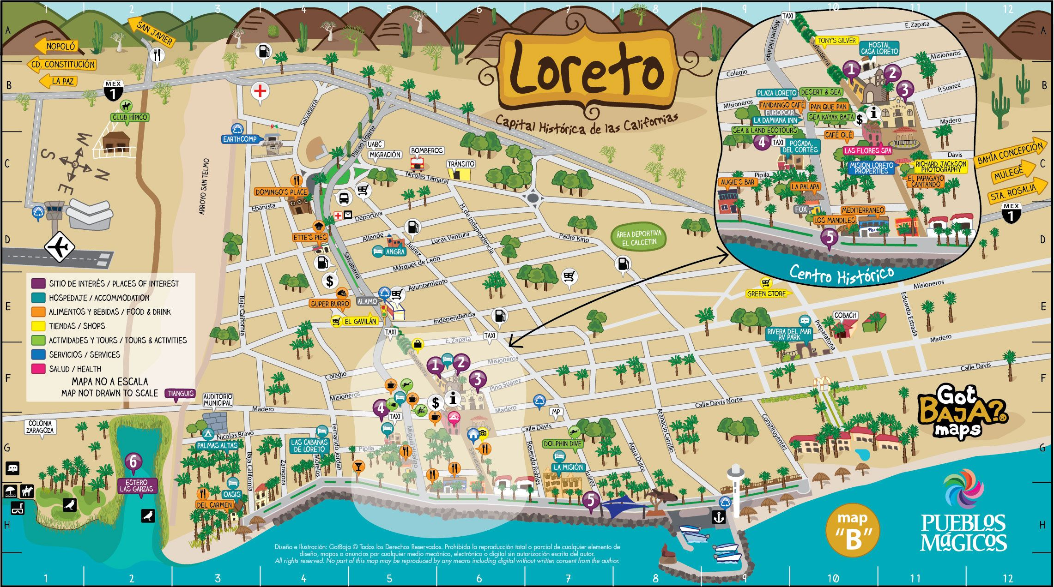
Map of Loreto

Slide 10
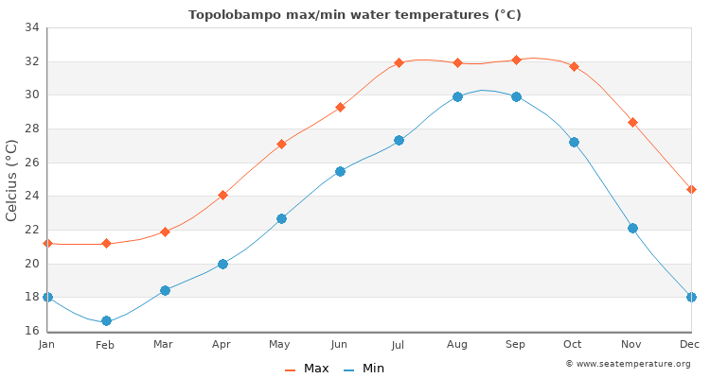
Weather in Loreto
Loreto sits at sea level and has a semi-arid climate. The temperature is usually warm or hot year-round.
April – October: daytime highs usually range from 32 to 38°C (90 to 100°F), night-time lows from 15 – 25°C (59 – 77°F). The rainy season is from July through September and the cities have occasionally been hit by hurricanes.
November – March: daytime highs range from 26 to 30°C (79 to 86°F), while nightly lows are
between 11 and 15°C (51 and 59°F).
The best time to go is in October as the landscape will be lush after the rain. However, as the weather is warm year-round, it’s easy to enjoy outdoor activities most of the year. It’s probably best to avoid July and August due to extreme temperatures and heavier rain.

Slide 11
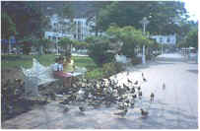
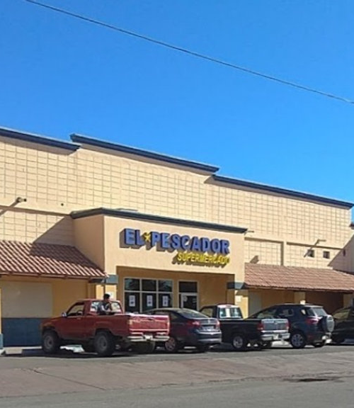
Getting Around Loreto
Because most of what you'll need and want in town is on or near the malecón, it's easy to get around Loreto on foot.
There is no local bus service around town. Taxis or walking are your only options, and, luckily, the town is quite small and manageable for walking. The main taxi stand is in front of the El Pescador supermarket.
Your best bet is to rent a car or hire a taxi. Several car-rental agencies have offices a few blocks off the malecón.

Slide 12
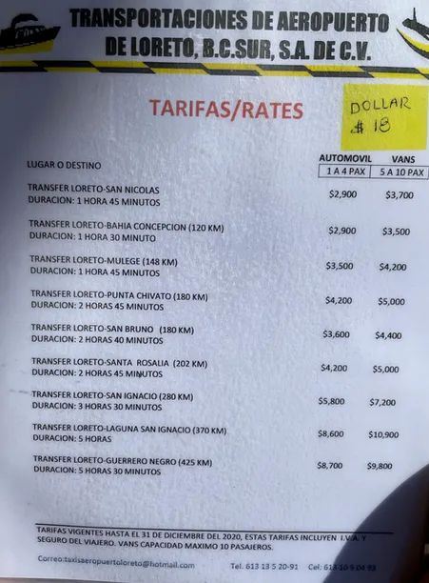
Loreto Taxis
Taxis in Loreto (not the airport) cost 300 Pesos ($15 USD). No credit cards are accepted by taxi drivers in Loreto, just cash.
The taxi drivers in Loreto prefer Pesos over US dollars.
Taxis in Loreto are plentiful. Taxis can be very reasonable, as long as you ask the price BEFORE you get in.
Be aware that Hotel taxis charge a premium rate because they've paid a higher union fee to sit in front of the hotel.
Tipping your taxi driver in Loreto is customary. A dollar or two is just fine.
Uber and Lyft are NOT available in Loreto!

Slide 13
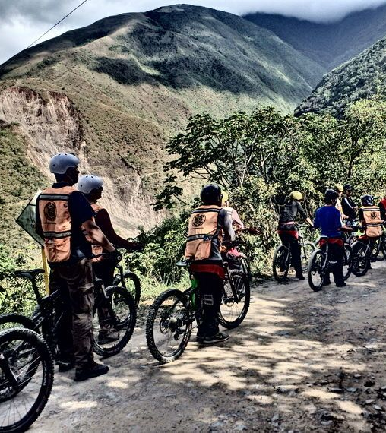
Bike In and Around Loreto
Susana's Bike and Kayak Rentals is located 2 blocks from the Marina, about a 15-minute walk SW from the dock.
Rent a bike for Bikes are 20 dollars US per day, and enjoy a leisurely ride on the Malecón, while enjoying the ocean views and stopping at the waterfront restaurants for a break.
They also offer short trips which are compatible with the cruise ship for $60 US per person.

Slide 14
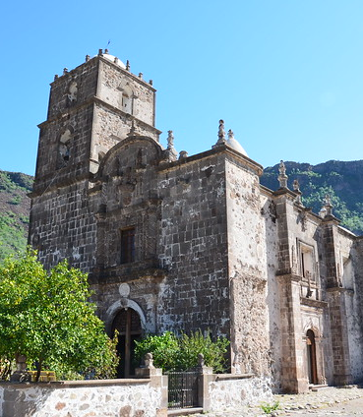
San Javier Mission
Stroll through the cobblestone streets of San Javier Mission lined with fruit orchards and the oldest olive gardens in Baja. Marvel at the architecture and beautiful cathedral views. Enjoy lunch at a local authentic restaurant in the old town.
This wonderful mission is well worth a daytime detour. The windy road passes some beautiful arroyos (streams) before arriving at the mission. Be sure to wander to the back garden to see the 300-year-old olive tree with rope-like bark that looks like something out of a fairytale.
The mission itself is almost unchanged from its look of three centuries ago.
Guides at the mission may offer to take you to see cave paintings (guide fee M$300; entry to the caves M$100). Note that this involves driving 15km on a very rough road and climbing a steep rocky hill to see a very small wall with several red paintings.

Slide 15
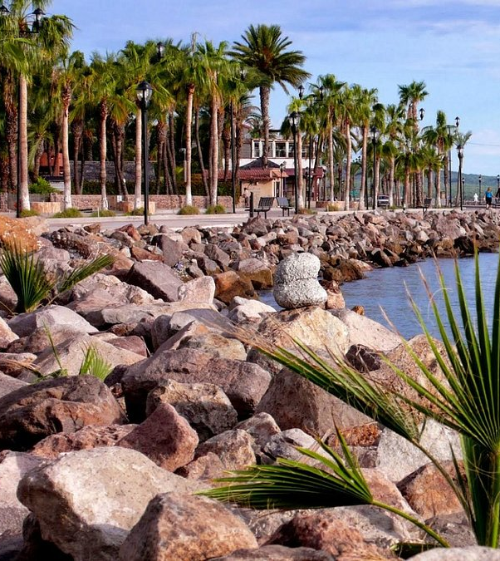
Stroll Around the Malecon
One enjoyable activity is to take a walk along the seafront Malecon. You will find an abundance of food trucks selling tacos, seafood, snacks and drinks. One local favorite is the “Crazy Coconut” which is a fun and refreshing drink.

Slide 16
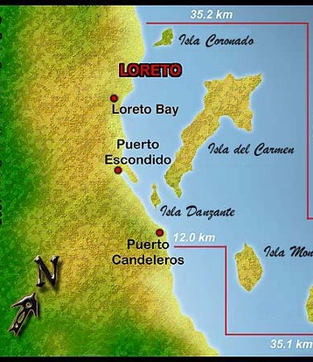
Loreto Bay National Marine Park
Loreto Bay National Park consists of five islands of the national park, between Baja California and mainland Mexico (officially called the Gulf of California and nicknamed the Sea of Cortez), almost 800 square miles of protected ecosystems are teeming with marine life.
You can see 43 species of marine mammals and 900 species of fish. 77 species are found nowhere else on the planet.
Loreto Bay is home to hundreds of dolphins and sea lions that populate these waters. Five of the seven marine turtle species can be found in these waters along with the elusive Blue-Footed Boobie contrasted against white rock.
Purchase a $4.50 marine park pass, at the marina snack shop.

Slide 17
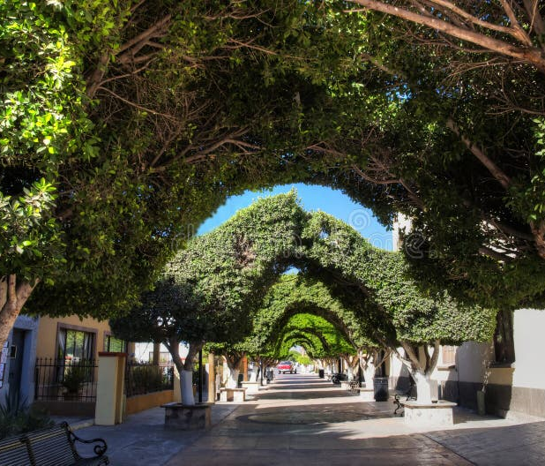
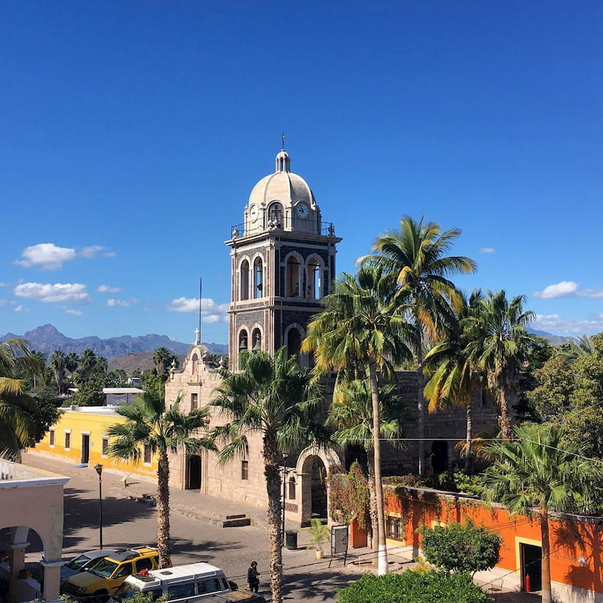
Visit Downtown
Downtown Loreto is tiny, it’s walkable and feels very safe. Most buildings are single-story tiendas (shops) and restaurants serving locals and visitors.
The Mission of Our Lady of Loreto is the most notable of the many things to enjoy downtown. Founded in 1697 by the Jesuits, it is the first mission created by Father Junipero Serra and is still a working church. The connecting museum teaches about the missionaries who helped develop the town in the 1700s.
Most of the shopping can be found along Salvatierra Street, with incredible arts and crafts. The area is well known for ironwood carvings,
There is a farmers market held in the arroyo to the north of downtown on Sunday.

Slide 18
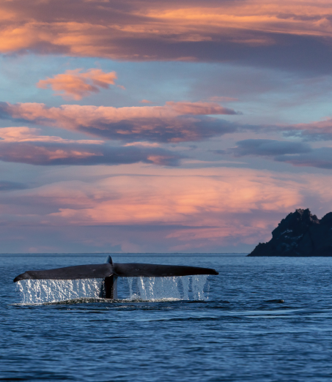
Whale Watching
Loreto is also one of the best places to see the rare blue whale, the largest living animal on Earth.
Whales come to the area to have their babies in February and March and any of the tour companies will bring you to see them. Loreto Bay is a natural reserve home to over 80 percent of the aquatic life that lives in the Pacific Ocean. You’ll also want to watch for fin whales, humpbacks, orcas, and dolphins.
The town is also a great jumping-off point to see the famously friendly gray whales who come to Baja’s lagoons on the Pacific side of the peninsula to have their calves.

Slide 19
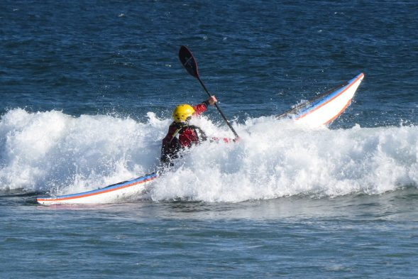
Snorkeling and Kayak Rental
For the active sports enthusiast try Sea Kayaking. Imagine paddling through the aquamarine water is unforgettable. Snorkeling is often included too, bringing the opportunity to witness a wide range of marine species in a place famous oceanographer Jacques Cousteau once called the “world’s aquarium.” It’s also possible to grab your gear and jump in or take a separate tour that will bring you to the best snorkeling sights.
I contacted Susana's Bike and Kayak Rentals.
Susana let me know that Kayak rates vary with different locations. She offers a couple of short trips which are compatible with the cruise ship for 60 dollars per person.
If you paddle here near town the rate is $40 US.
Half-Day Kayak Rental Prices:
Singles, $25 (2-3 hours) $30 (4 hours) Doubles, $35 (2-3 hours) $40 (4 hours)
Rental Prices are in US Dollars (includes i.v.a. tax)

Slide 20
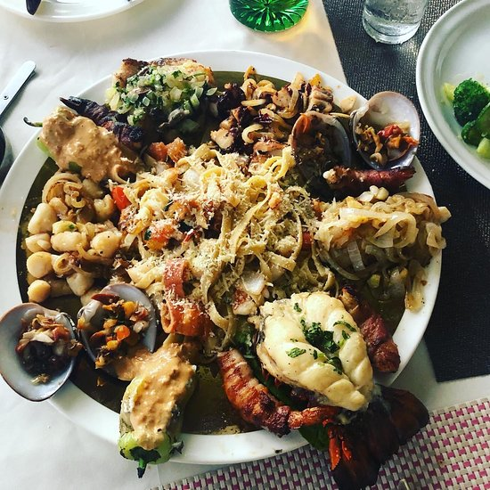
Loreto Restaurants
Loreto has many excellent restaurants, especially seafood restaurants. Many of us on the ship are foodies, so naturally, we’re always on the hunt to eat at the most exclusive spots anytime we travel.
Here are a few of the best restaurants to consider in downtown.
Los Olivos Restaurant $$-$$$ Mexican,Seafood,Vegetarian
Rosendo Robles s/n Hotel La Misión de Loreto
The Market Restaurant $$-$$$ Mexican,International,Mediterranean
Carretera Transpeninsular km 84
Pan Que Pan, Bistro & Bakery $ Mexican,PizzaCafe
Paseo Miguel Hidalgo entre Colegio e Independencia, junto a Dulceria Shekina
Mediterraneo Restaurant $$-$$$ Steakhouse,Seafood,Mediterranean
Malecon between Hidalgo and Salvatierra
Mita Gourmet $$-$$$ Mexican,Seafood, Calle Davis 13,
Also consider trying many of the street vendors.
For those of you who just like good food, you can’t go wrong with just about anywhere you go in Loreto.
GOOD EATING

Slide 21
Conclusion
Loreto is a beautiful City with a rich history and numerous attractions. Whether you're looking for stunning beaches, historic sites, or unique attractions, Loreto has something for everyone.
I hope this presentation will help when we visit Loreto!

Slide 22
Thanks For Coming
If you have any more questions, please ask.
I will do my best to answer them for you.
Have a great visit in Loreto!

