Slide 1


Livorno, Italy
Port Presentation
Presented by
Marc Silver

Slide 2
Livorno, Italy
Livorno is an Italian port city on the west coast of Tuscany. It's known for its seafood, Renaissance-era fortifications, and modern harbor with a cruise ship port. Its central Terrazza Mascagni, a waterside promenade with checkerboard paving, is the city's main gathering place. The bastions of the 16th-century Fortezza Vecchia face the harbor and open onto Livorno's canal-laced Venezia Nuova quarter.

Slide 3
What I Will Cover
My Port Philosophy
Money
The Founding of Livorno
Don’t Miss the Ship
Cruise Terminal Information
Where is the Tourist Office?
A few interesting facts about Livorno
Places to see or at least consider
A few restaurant recommendations
Best way to get around Livorno

Slide 4
My Port Philosophy
I have been cruising for over 45 years and have taken over 100 cruises. So I consider myself an experienced cruiser.
The information I will present is based on those many years of experience.
When I am on a cruise where the city I want to visit is not the port city, I always recommend taking a ship’s tour.
But when I am in a port with multiple attractions nearby and easy to see on my own - I will do it on my own.
This presentation is for that type of port.

Slide 5
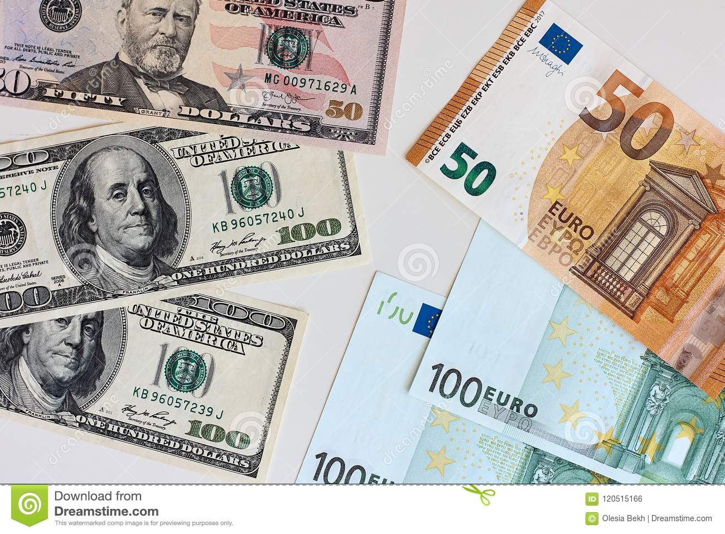
Money
The euro is the official currency of 20 European Union countries which collectively make up the euro area, also known as the euro zone.
Official Exchange is $1.079 US to €1

Slide 6
The Founding of Livorno
Livorno’s greatest importance dates from the rule of the Florentine Medici family. Cosimo I initiated the construction of the Medici Harbour in 1571; and Ferdinand I, grand duke of Tuscany from 1587 to 1609, gave asylum to many Roman Catholic refugees from England as well as Jews and Moors from Spain and Portugal. This launched the community as a commercial center. Among the princes of Habsburg-Lorraine who succeeded the Medicis, the last, Leopold II (1747–92), is of particular importance; he enlarged the city, gave privileges to foreign merchants, and had the great curved breakwater built to protect the port from the open sea. Livorno flourished as a free port from 1675 until it became part of the Kingdom of Italy in 1860. Much of the city has been rebuilt according to the original general plan after sustaining severe damage by bombing during World War II.

Slide 7
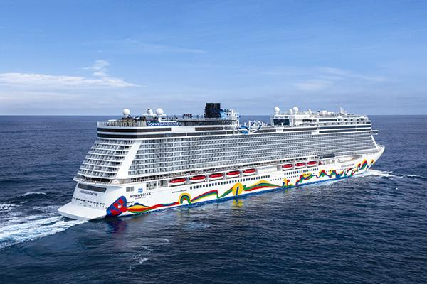
Don’t Miss the Ship
How to Avoid Missing Your Ship:
Pay attention to the time. - Ship time and local time are often different. Put a return-to-ship reminder on your phone.
Choose excursions wisely:
If a ship-sponsored excursion is late returning to port, the ship will wait, but not for excursions taken on your own.
Be Prepared:
Have your Passport, Credit Card, and phone numbers for the ship port agent.
What to Do If You Miss the Ship: Most cruise lines have port agents stationed in the port area to assist if your ship has left without you. Sometimes, when cruisers are late returning to the vessel, the ship's crew may remove the passengers' essential items -- passports, cell phones, and medication -- from the ship to leave with the port agents.
The Port Officials can help you with contacting your ship and making necessary travel arrangements.

Slide 8
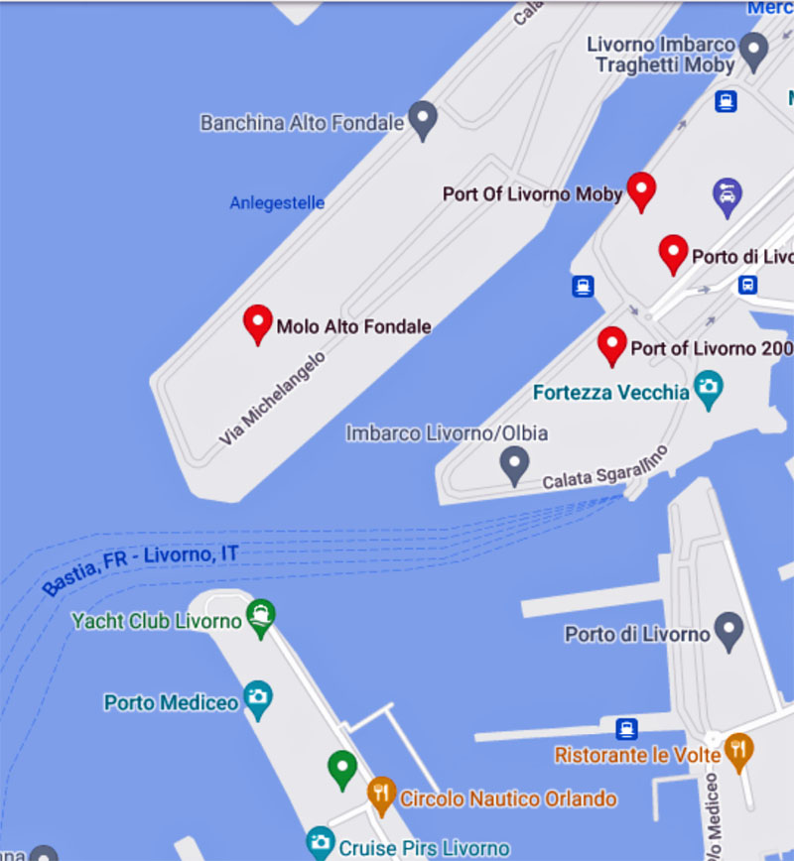
Cruise Terminal Info
As you walk off the ship, all you will most likely see is:
a few tables set up by car rental companies
a few taxis ready to take you to longer destinations (half-day tours to Florence, Pisa, around Tuscany)
Private tour vans that take you on the adventure you have always wanted.

Slide 9
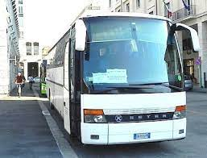
Cruise Terminal Bus
Our ship will dock far away from the cruise terminal buildings
Large ships dock at commercial piers in this large port. A shuttle will be provided to drop you off near Piazza Grande.
Cruise Bus Route The Cruise Bus runs from all of the cruise port terminals to the Piazza Grande.
The bus is wheelchair accessible.
Cruise Terminal Bus is FREE!

Slide 10
We’re Not Here Alone
Livorno is the gateway port to Florence, Pisa, San Gimignano, Lucca and Cinque Terre.
Expect to see cruise ships from several other lines in port with us.
The port may be very busy so…..
You may want to plan accordingly!

Slide 11
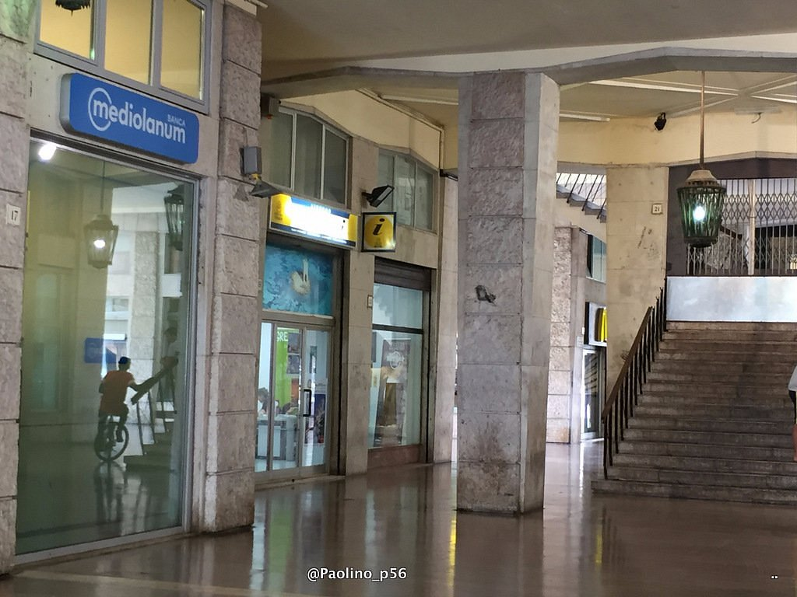
Official Livorno Tourist Offices
The Tourist information office is located at the Piazza del Municipio near the Cruise Port Bus Stop.
Staff are generally helpful and between them, speak several languages. You can get a free map of Livorno that marks the tourist offices and 37 things to see. The map isn’t great for finding your way round and you’ll need your glasses to read the names of the streets, but it gives you an idea.

Slide 12
Getting Around
Like most large European cities, getting mass transit system with both buses around is not difficult. Livorno has a very good, modern and efficient public bus network with 15 routes, which are very easy to navigate especially for tourist purposes.

Slide 13
Walking
Walking is possibly the best way to see the sites of Lavorno, it is free, and it allows you to take whichever route you want with as many stops as you please, allowing you to view only the things you really want to see and spend as long as you wish doing so.
There are a number of guide books available that suggest walking tours of Livorno, or equally if you go into any of the tourist information centers you will find leaflets offering suggested routes. It is also possible to book guided tours around Livorno which will offer you great views with insightful information, these however, are not free.

Slide 14
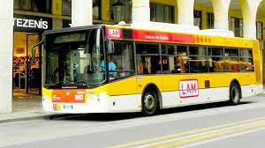
City Bus
Bus tickets can be acquired at tobacconists throughout the city.
I am not sure, but a multi-trip pass may be available at a discount.
Fares:
Single bus tickets cost € 1.20

Slide 15
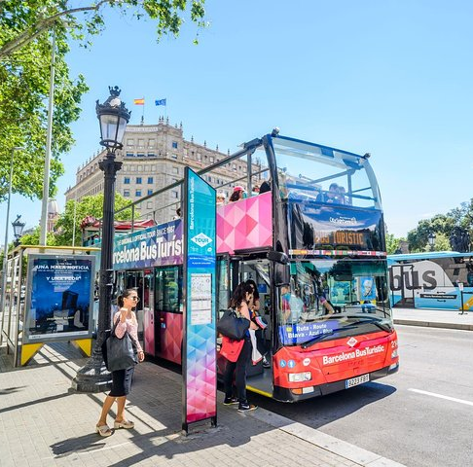
Hop-On Hop-Off Bus Tour
The bus route conveniently begins from the cruise port and takes you to the city’s top attractions, while providing an audio commentary. The route takes just 60-minutes, but you're free to hop on or off at any time to explore the city at your own pace over a 24 hour period. Create your own itinerary with the Hop-on Hop-off bus See the city’s top sights in a single day Begin and end the tour at the cruise terminal Enjoy an audio commentary on the open air bus Price: €17.00

Slide 16
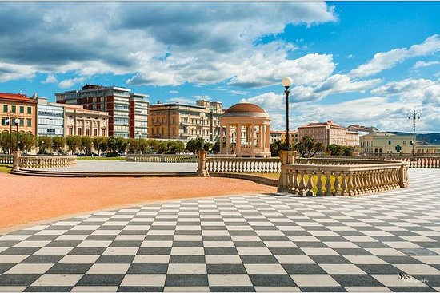
Terrazza Mascagni
Terrazza Mascagni is a large, open terrace overlooking the Tyrrhenian Sea. Providing a commanding view of the sunrise and the sunset, the terrace is an excellent spot for relaxing, enjoying the sights, or simply taking a leisurely stroll along the shore.
The terrace has an elegant winding path with black and white tiled paving that sets visitors up nicely for the gorgeous view of the bay. With its columned banisters and comfortable seats, the path is practically a tourist attraction unto itself, and is definitely a large part of the area’s appeal.

Slide 17
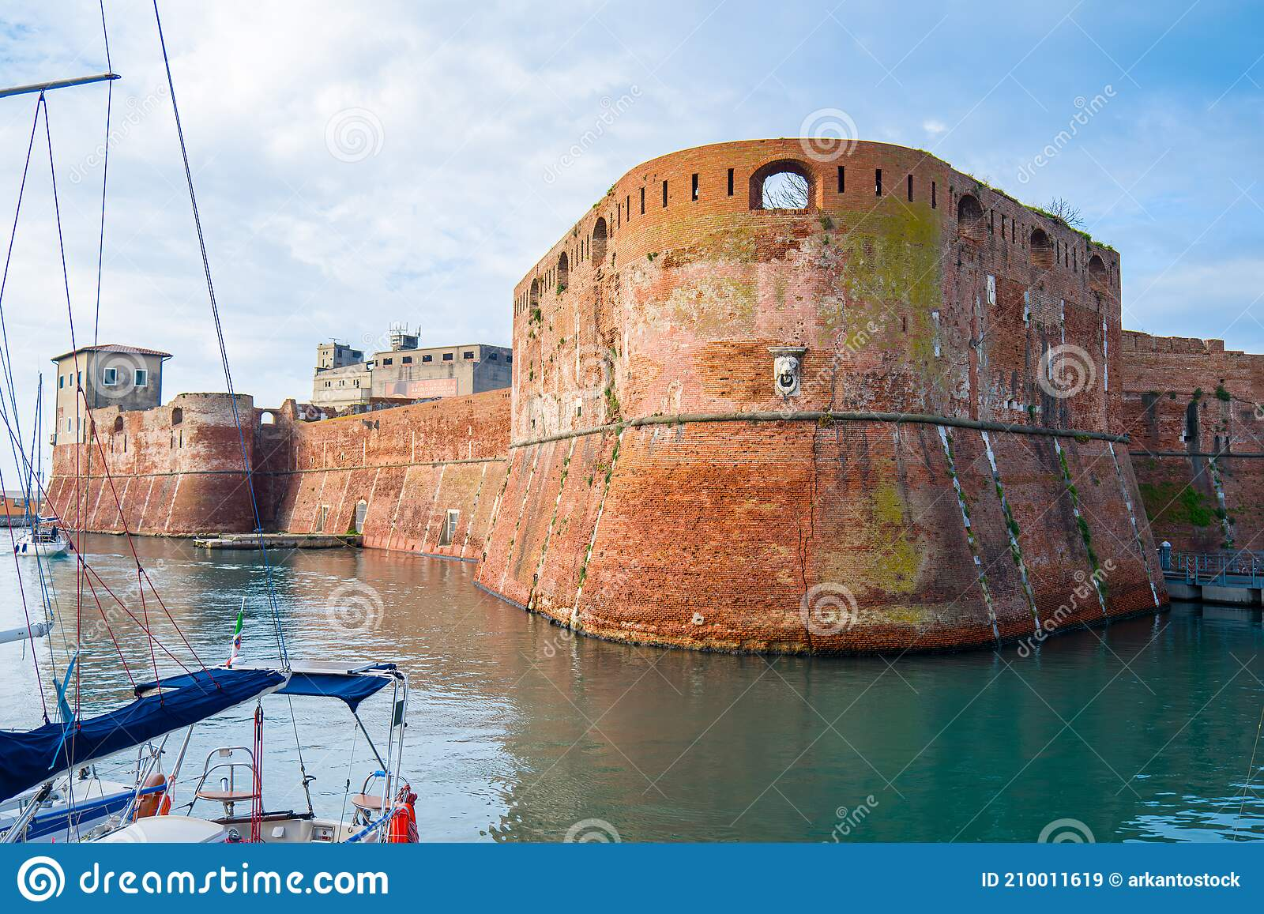
Fortezza Vecchia
Fortezza Vecchia or the Old Fortress is a castle built on the grounds of a medieval fort, which itself was erected on the foundation of an 11th century keep built by Tuscany's Countess Matilda. Built in the early 16th century, the fortress is considered one of the most important military structures from the period.
Traditionally, the Old Fortress served to guard the entrance to the old harbor.

Slide 18
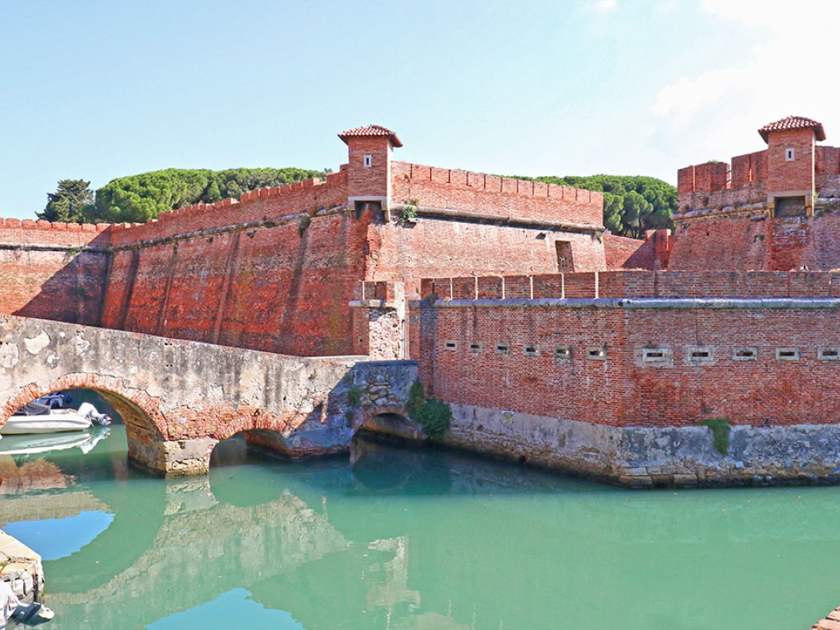
Fortezza Nuova
Fortezza Nuova or the New Fortress is a 16th century structure that dates back to the Medici period of Italy’s history. Built almost entirely of brick, the structure encloses a
park that attracts locals as well as
tourists from all over the world.
The park is actually an important
part of Livorno's history, as it
served as a refuge for port residents
who were forced out of their neighborhoods by the bombing of Allied forces during World War II. Construction of the fortress began in 1576.

Slide 19
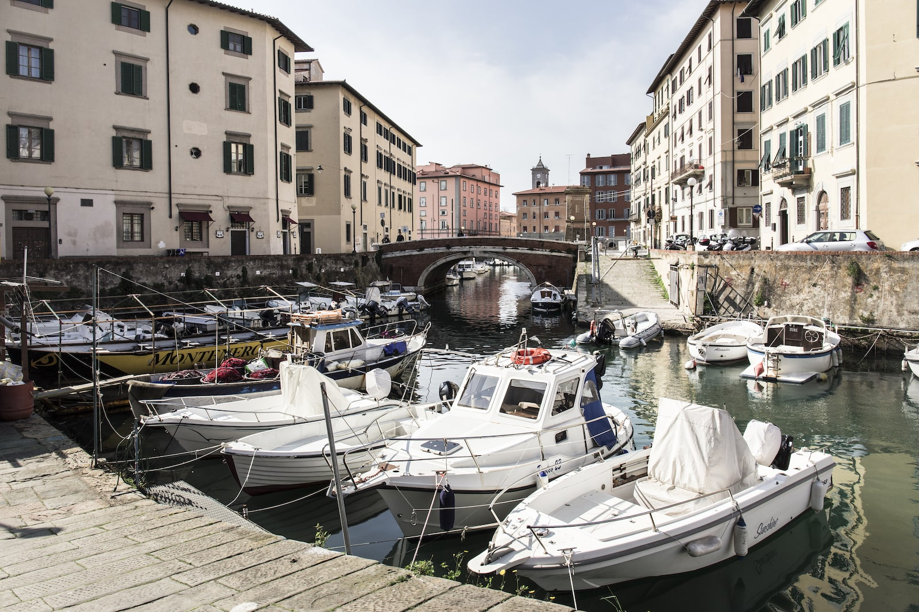
Little Venice
Venezia Nuova, the fascinating historic district of Livorno. Resembling a little Venice with its dense network of canals and bridges, the Venice district of Livorno was founded in 1629 under the Medici. The district retains much of its original town.
The lay-out and architectural features, which were designed to facilitate transportation of goods between its storehouses and the port, one of the most important ones of the Mediterranean at that time

Slide 20
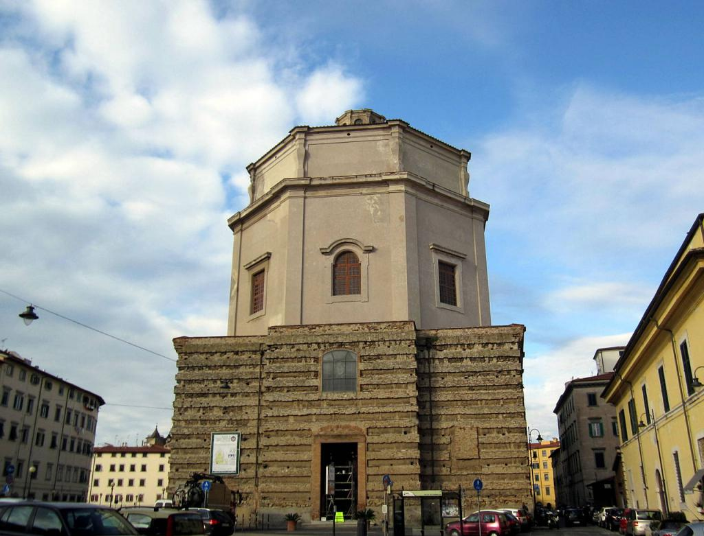
Chiesa Santa Caterina da Siena
Chiesa Santa Caterina da Siena or the Church of Saint Caterina is a baroque church located in Livorno's New Venice district. Located close to the city center, the church is pretty hard to miss due to the 63-meter towering dome that makes it an even taller structure than the famous Leaning Tower of Pisa.

Slide 21
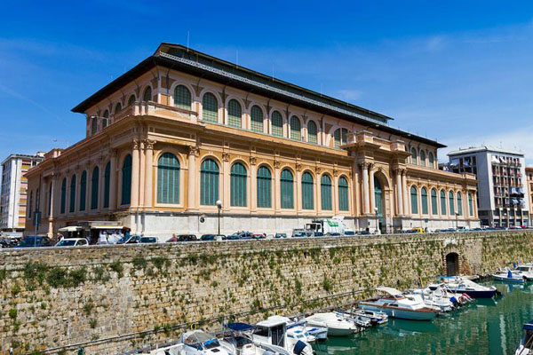
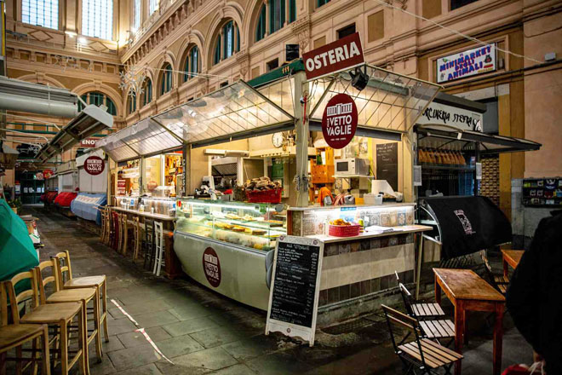
Central Market
Vettovaglie market or Central Market is an absolute must-see for anyone who has the slightest interest in Livorno cuisine. Widely considered a landmark in the local culinary scene, central market is one of Europe’s largest indoor markets. It was built in 1894, with its internal iron structure typical of most large buildings in the late 19th century. The design also incorporates elements of neo-classical and Liberty period architecture. Designed by Angiolo Badaloni.

Slide 22
Thanks For Coming
If you have any more questions, Please ask.
I will do my best to answer them for you.
Have a great visit in Lavorno!

