Slide 1


Lisbon Portugal
Port Presentation
Presented by
Marc Silver

Slide 2
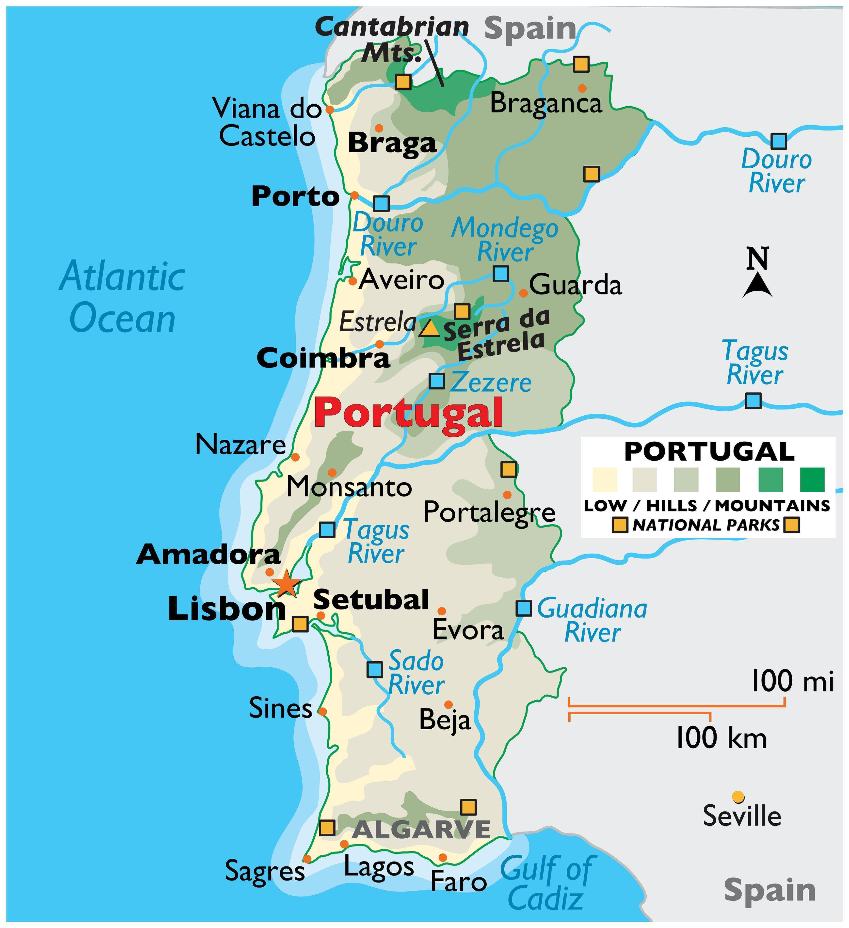
Lisbon Portugal
Lisbon is the capital of Portugal
Lisbon is the capital and the largest city of Portugal. Its estimated population is 54,4851 (as of 2022). It is the westernmost large city located in continental Europe. It’s also the westernmost capital city in continental Europe and the only one located along the Atlantic coast.

Slide 3
What I Will Cover
My Philosophy
Warning
Money
A few interesting facts about Lisbon.
Best way to get around Lisbon
Lisboa Card
Metro Card
Tram Route 28

Slide 4
My Port Philosophy
I have been cruising for over 45 years and have taken over 200 cruises. So, I consider myself an experienced cruiser.
The information I will present is based on those many years of
experience.
When I am on a cruise where the city, I want to visit is not the port city,
I always recommend taking a ship’s tour.
But when I am in a port with multiple attractions nearby and easy to see on my own - I will do it on my own.
This presentation is for that type of port.

Slide 5
Don’t Miss the Ship
How to Avoid Missing Your Ship:
Pay attention to the time. - Ship time and local time are often different.
Put a return-to-ship reminder on your phone.
Choose excursions wisely:
If a ship-sponsored excursion is late returning to port, the ship will wait, but not for excursions taken on your own.
Be Prepared:
Have your Passport, Credit Card, and phone numbers for the ship port agent.
What to Do If You Miss the Ship: Most cruise lines have port agents stationed in the port area to assist if your ship has left without you. Sometimes, when cruisers are late returning to the vessel, the ship's crew may remove the passengers' essential items -- passports, cell phones, and medication -- from the ship to leave with the port agents.
The Port Officials can help you with contacting your ship and making necessary travel arrangements.

Slide 6
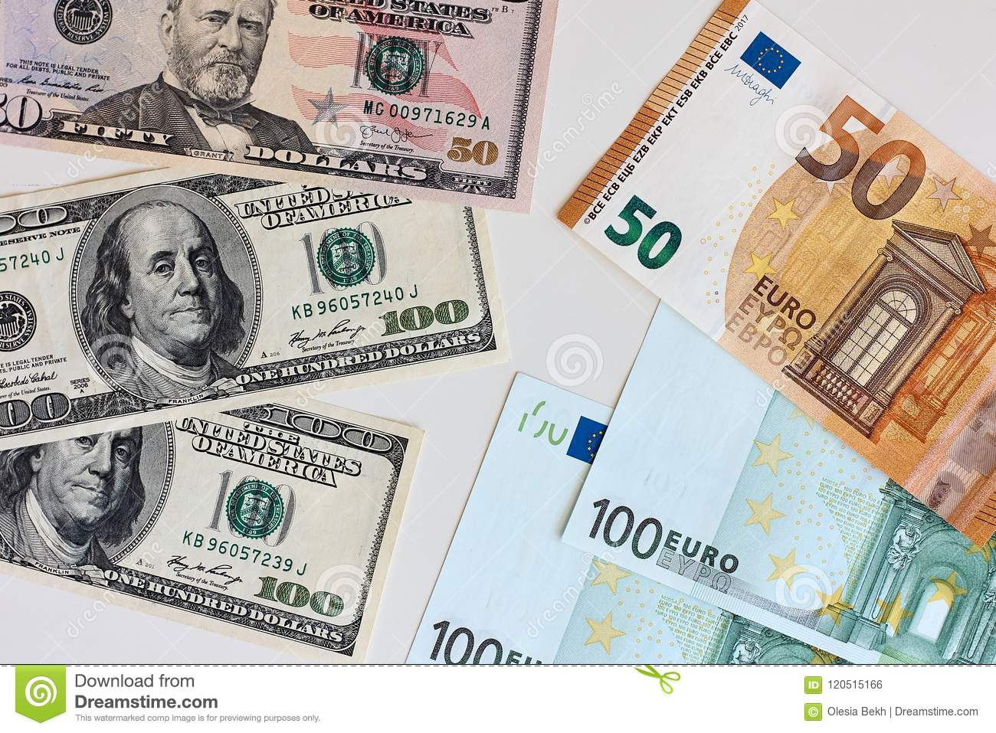
Money
The euro is the official currency of 20 European Union countries which collectively make up the euro area, also known as the euro zone.
Official Exchange is $1 to $1.079 US

Slide 7
Igreja de São Roque
Lisbon is home to one of the world’s most expensive chapels
Experts consider the 16th-century Igreja de São Roque in Lisbon to be one of the most outstanding examples of European art as well as one of the most expensive chapels in the world.
Inside the church, you’ll find the 18th-century Chapel of St. John the Baptist (Capela de São João Baptista), which was constructed in Rome of many precious stones. The chapel was then disassembled and shipped to Lisbon and reconstructed in the São Roque church. At the time it was reportedly the most expensive chapel in Europe.

Slide 8
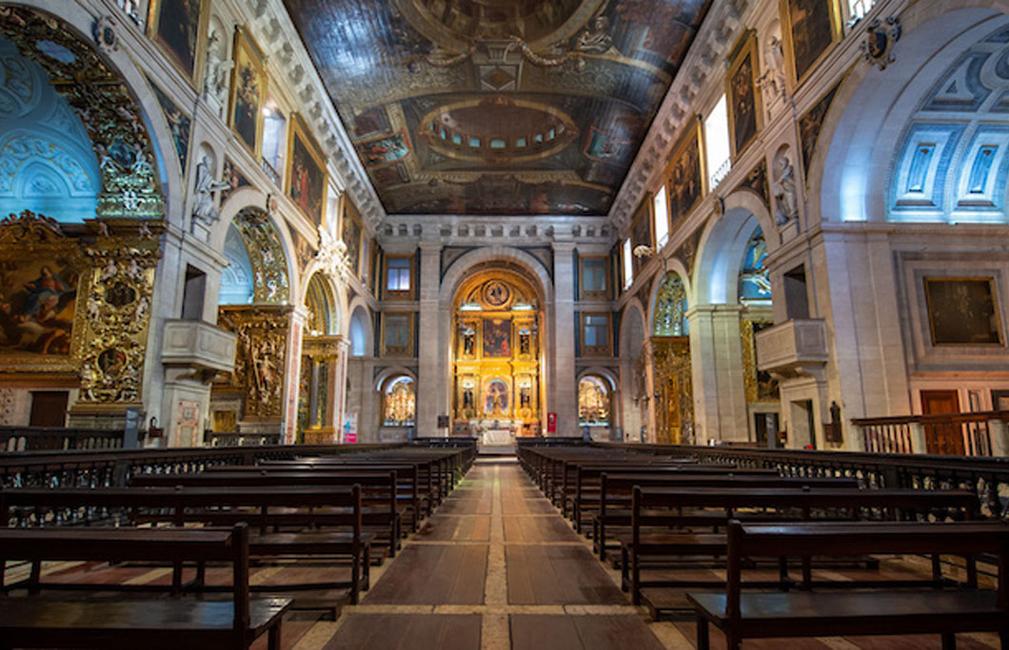
Igreja de São Roque

Slide 9
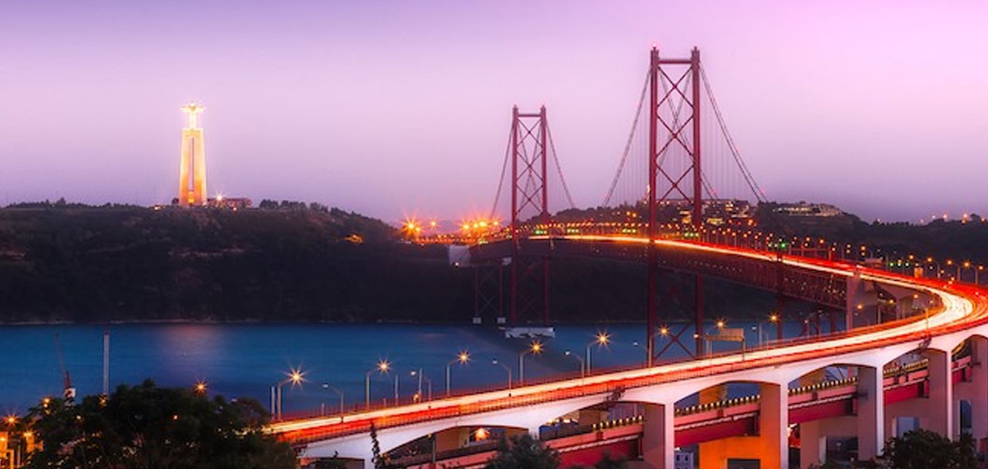
Vasco da Gama Bridge
Lisbon is home to the longest bridge in the European Union
Opened in 1998, the Vasco da Gama Bridge is the longest bridge in the European Union and the second-longest in Europe. It measures 7.6 miles (12km) long.

Slide 10
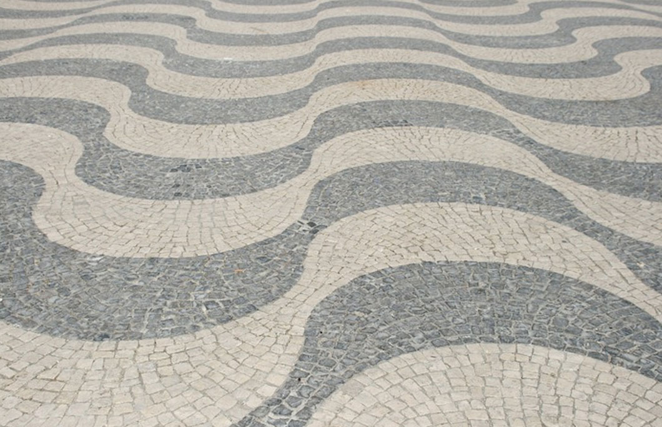
Calçada Portuguesa
The streets are paved with stone in Lisbon
Portuguese pavement, known in Portuguese as calçada Portuguesa is a traditional-style pavement that you’ll find in Lisbon. Look down and you’ll see black and
white, patterned stones
all over the sidewalks
and public squares. The
stone streets date back to
the 15th century

Slide 11
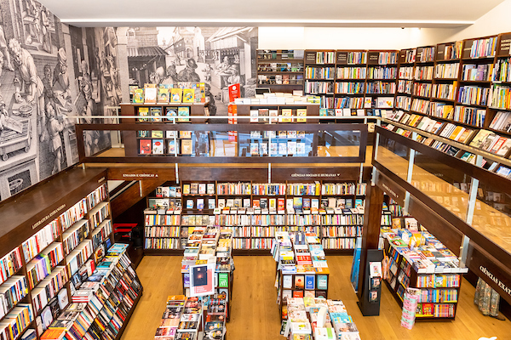
Livraia Bertrand
Lisbon has the most and the oldest bookstore in the world
Lisbon’s Livraria Bertrand in the Chiado neighborhood is in the Guinness Book of World Records as the oldest operating bookstore in the world. It has been in operation since 1732. But wait, there’s more for book lovers in this city. With 41.9 bookstores per 100,000 people, Lisbon holds the title of the city with the most bookstores per capita, according to the World Cities Culture Forum.

Slide 12
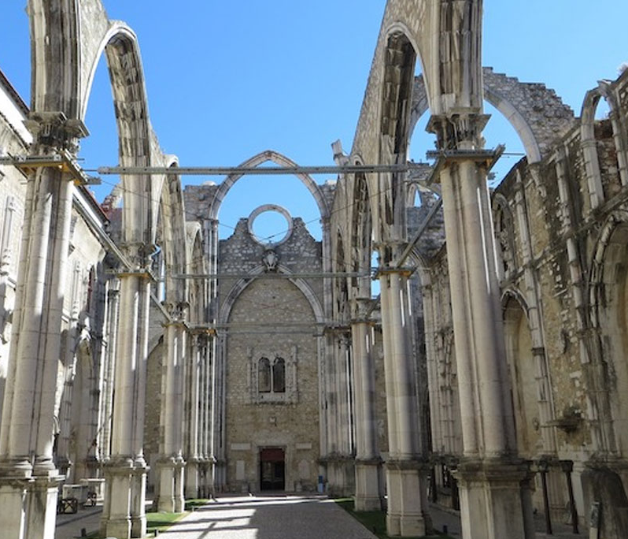
Carmo Convent
One of the deadliest earthquakes in history struck Lisbon
On All-Saint’s Day, November 1, 1755, one of the deadliest earthquakes in history struck Lisbon. The Great Lisbon Earthquake almost completely destroyed the
city. The death estimate was
between 12,000 and 50,000 people,
Making it one of the deadliest
earthquakes in history. You can
still see evidence of the
earthquake’s effects across the city.

Slide 13
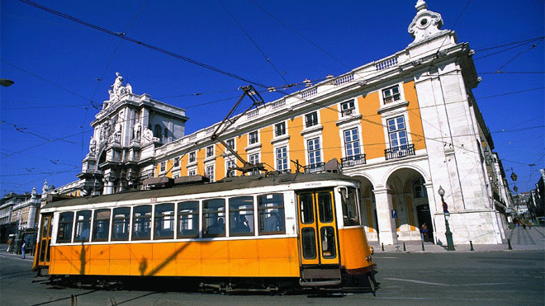
Lisbon Portugal
Trams are the ideal means to explore some of the most interesting spots of Lisbon’s historical and architectural heritage, or simply to tour the city.

Slide 14
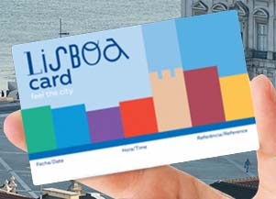
Lisboa Card
Trams are the ideal means to explore some of the most interesting spots of Lisbon’s historical and architectural heritage, or simply to tour the city. Route 28 has about 30 stops and allows you to see many of the best things to see in Lisbon.
1-Day Lisboa Card: €6.45
There is an alternative for those
of you looking for some exercise.
You can walk the same route as
Tram 28. The loop is about
seven kilometers or 4 1/3 miles.

Slide 15
Lisboa Card
Lisboa Card: Access up to 38 Attractions + Public Transportation
A 24 hour Lisboa Card is €19.95 on line or €21 on
Travel for free and enjoy free access to Lisbon’s best museums and attractions with
the Lisboa Card. The card
includes free admission to the
Torre de Belem, the Santa Justa
Elevator and Jeronimos Monastery among others.

Slide 16
Lisboa Card
Here are just a few of the locations you can reach with ease using Tram Route 28:
Se Cathedral
Thieves Market
São Jorge Castle
Basilica da Estrela
National Pantheon
Miradouro da Graça
Arco da Rua Augusta
Assembly of the Republic
Museum of Decorative Arts
Miradouro das Portas do Sol
And more!

Slide 17

24hr Metro Card
CARRIS/METRO
(24h) + card
From €7,10
Valid for unlimited journeys on Carris and Metro networks, during 24 hours following the first validation.

Slide 18
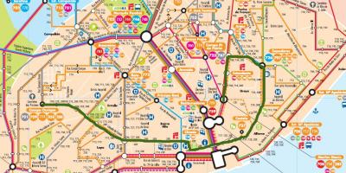
Tram Route 28
Trams are the ideal means to explore some of the most interesting spots of Lisbon’s historical and architectural heritage, or simply to tour the city.

Slide 19
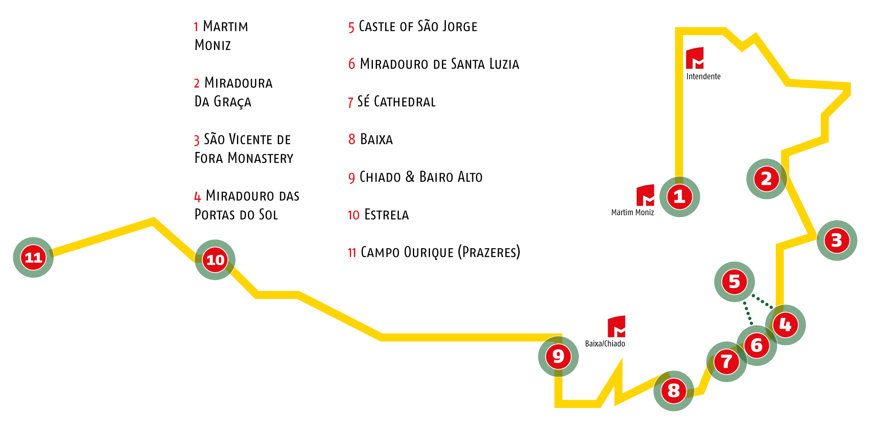
Tram Route 28
The vintage yellow ELECTRICO 28 that offers the most interesting route crossing the city center, going through some of the oldest quarters and many tourist attractions. Starting in front of the Cemitério dos Prazeres (Pleasure Cemetery) and passing between the Jardim and the Basilica da Estrela (romantic gardens and one of the city’s oldest churches).

Slide 20
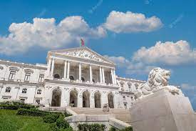
Tram Route 28
You will go downhill on the Calçada da Estrela past the parliament building of São Bento, toward the Praça do Camões and Bairro Alto (an area of trendy shops and great night life). Then it’s downhill again through the Chiado and Baixa shopping districts – worth a stop to admire the city’s majestic riverside square of Praça do Comercio.
Parliament building of São Bento

Slide 21
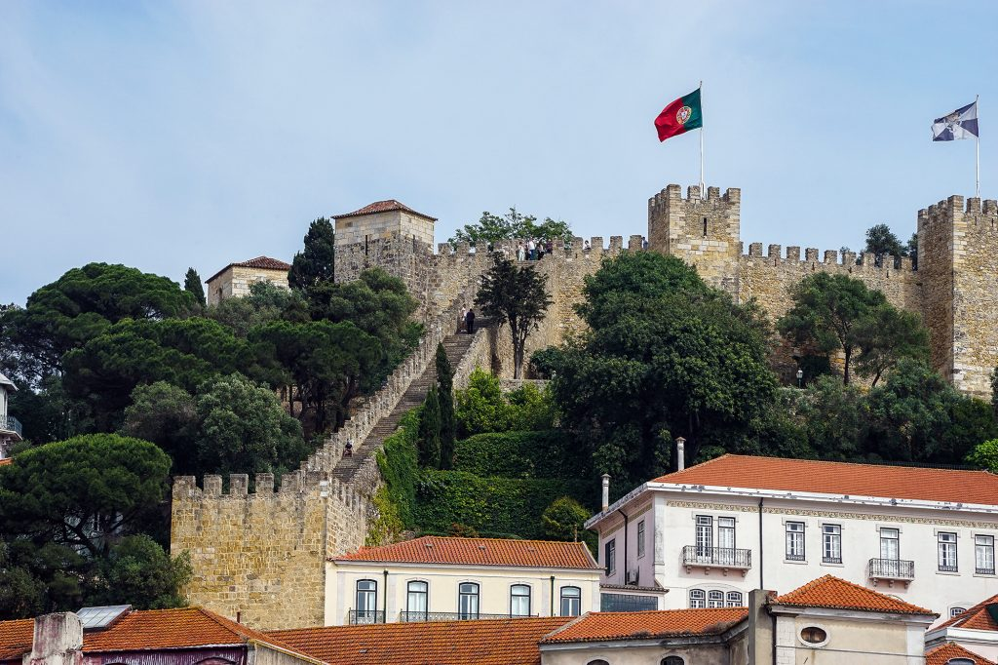
Tram Route 28
When you start going uphill, you will pass the Igreja de Santo António (church of Lisbon’s patron saint) and the Sé (Lisbon’s main cathedral) on the way to the Castelo de São Jorge (another recommended stop).
Castelo de São Jorge

Slide 22
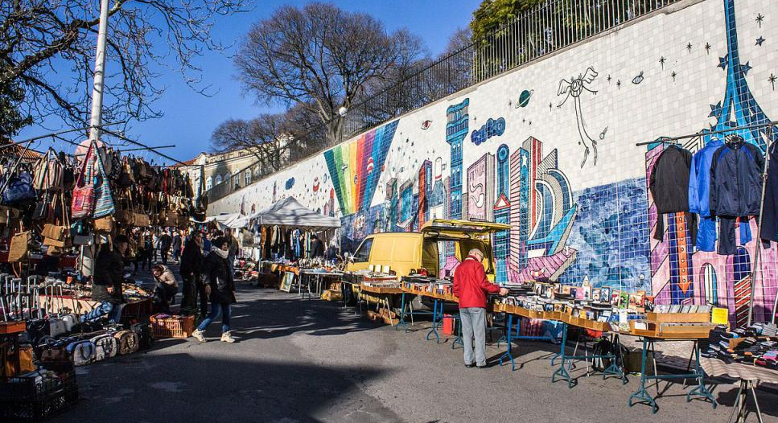
Tram Route 28
After strolling around this 16th century castle, we suggest relaxing with a beverage at a local café and admiring the views at Miradouro das Portas do Sol, a panoramic viewpoint. A bit farther up and just behind the Monastery of São Vicente de Fora, the Feira da Ladra is an open air flea market that runs from early morning till mid-afternoon
on Saturdays, making for
great browsing – don’t be
shy to join the locals and
haggle for a bargain!

Slide 23
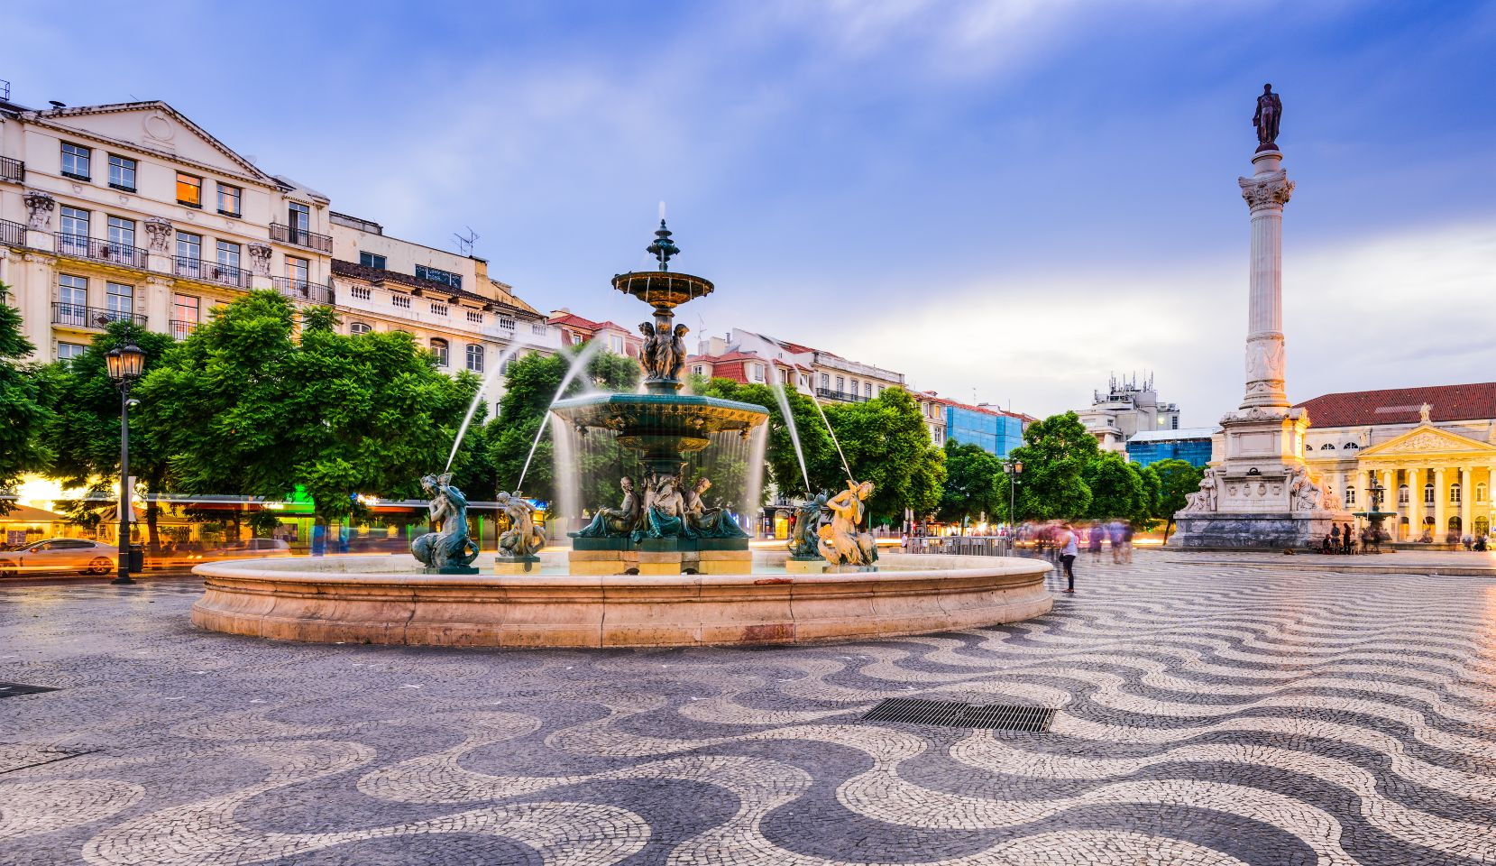
Tram Route 28
Back on the tram you will go past Graça (another quaint old residential area of Lisbon) and then start going downhill again to Martin Moniz, the last stop near the Rossio square. This service runs every 7 minutes (although it often runs late due to route obstructions like
badly parked cars),
early till 10pm daily.
Rossio square

Slide 24
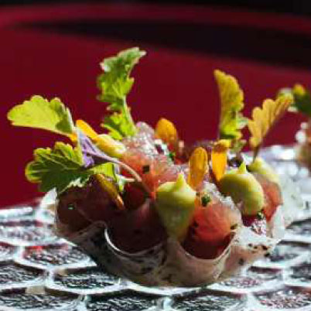
Michelin Star Restaurants
Lisbon is the home of 20 Michelin Star restaurants. Many of us on the ship are foodies, so naturally, we’re always on the hunt to eat at the most exclusive spots anytime we travel.
100 Maneiras - Rua do Teixeira 39, Lisbon, €€€€ · Creative
Marlene - Avenida Infante D. Henrique. Doca do Jardim do Tabaco, Lisbon, €€€€ · Modern Cuisine
EPUR - Largo da Academia Nacional de Belas Artes 14, Lisbon, €€€ · Creative
SÁLA de João Sá - Rua dos Bacalhoeiros 103, Lisbon, €€ · Modern Cuisine
Prado - Travessa Das Pedras Negras 2, Lisbon, 1100-404, Portugal €€ · Market Cuisine

Slide 25
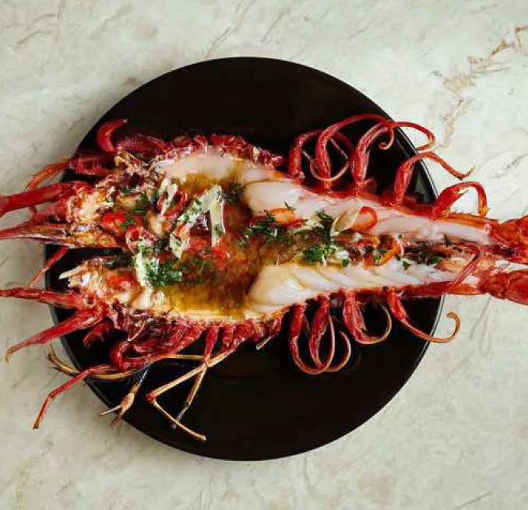
Michelin Star Restaurants
Tágide - Largo da Academia Nacional de Belas Artes 18-20, Lisbon, €€€ · Modern
Carnal - Rua da Misericordia 78, Lisbon, 273, Portugal €€ · Mexican
Taberna - Bairro do Avillez - Rua Nova da Trindade 18, Lisbon, € · Traditional Cuisine
Arkhe - Boqueirão Duro 46, Lisbon, €€ · Vegetarian
For those of you that just like good food, you can’t go wrong just about anywhere you go in Lisbon. After all this is Portugal!
GOOD EATING

Slide 26
Thanks for Coming
If you have any more questions, please ask.
I will do my best to answer them for you.
Have a great visit in Lisbon

