Slide 1
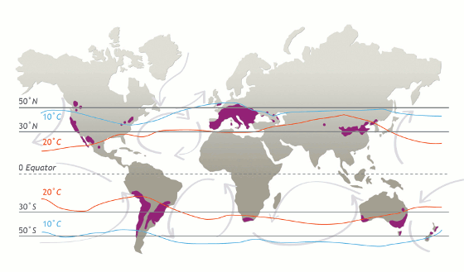
Lesser-Recognized Wine Regions of the World Pt 3 Presented by: Marc Silver

Slide 2
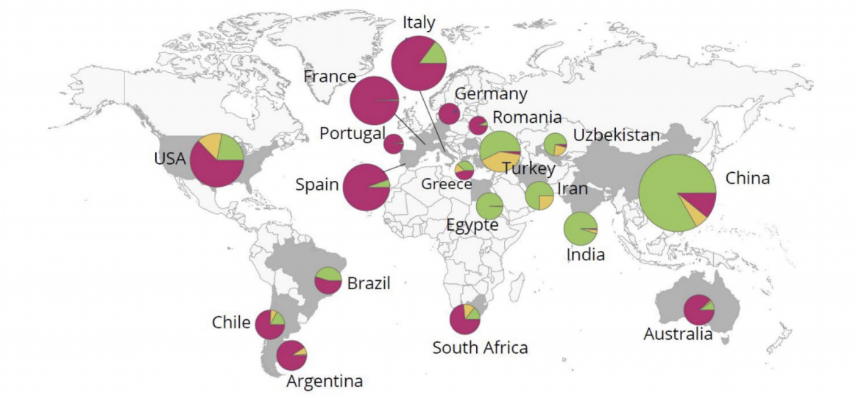
Wine Producing Countries Production in hectoliters
Argentina – 12.2 million
Australia – 11.4 million
Austria – 2.7 million
Brazil – 3.0 million
Bulgaria – 1.3 million
Canada – 0.6 million
Chile – 10.3 million
China – 5.4 million
Croatia – 0.7 million
Cyprus – 0.1 million
Czech Republic – 0.6 million
Egypt – 0.1 million
France – 46.1 million
Georgia – 2.0 million
Germany – 8.4 million
Greece – 2.1 million
Hungary – 2.7 million
India – 0.1 million
Italy – 49.8 million
Japan – 0.2 million
Lebanon – 0.1 million
Luxembourg – 0.1 million
Mexico – 0.4 million
Moldova – 1.3 million
Montenegro – 0.3 million
Morocco – 0.4 million
New Zealand – 3.2 million
Peru – 0.7 million
Portugal – 6.8 million
Romania – 4.0 million
Russia – 4.7 million
Serbia – 0.8 million
Slovakia – 0.3 million
Slovenia – 0.7 million
South Africa – 10.2 million
Spain – 37.0 million
Switzerland – 0.9 million
Tunisia – 0.4 million
Turkey – 1.4 million
Ukraine – 0.8 million
United States – 24.7 million
Uruguay – 0.8 million

Slide 3
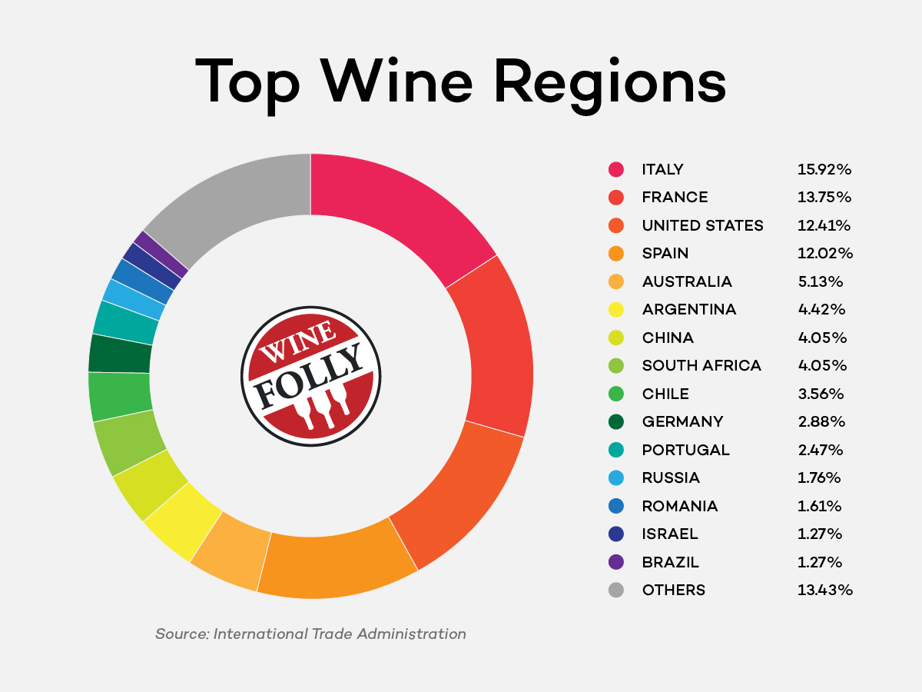
Wine Producing Countries
There are over 42 countries worldwide that produce wine, though only a select few dominate the global market.
The largest producers, such as France, Italy, Spain, the United States, and Argentina, consistently account for the majority of global wine output.
Together, these five countries produce more than half of the world’s wine.
Other significant contributors include Chile, Australia, and South Africa, each with thriving wine industries.

Slide 4
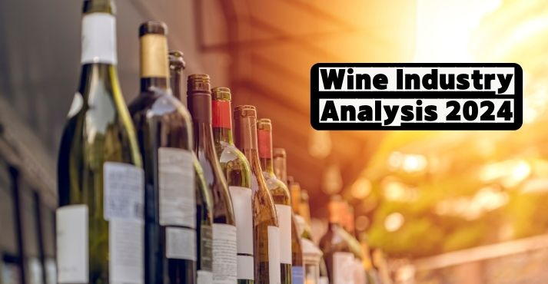
Wine Producing Countries
Global Wine Market Overview
The global wine market is valued at over $300 billion, and while traditional wine-producing regions like Europe continue to play a central role, New World producers (e.g., the U.S., Australia, and South America) have significantly expanded their influence.
Europe, led by France, Italy, and Spain, still represents a lion’s share of the market, particularly in terms of exports.

Slide 5
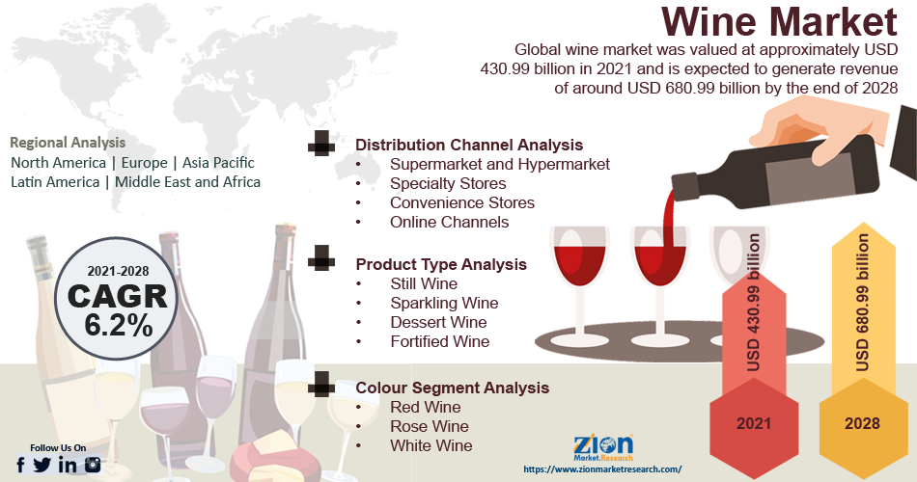
Wine Producing Countries
Key Market Trends
Sustainability and Organic Wines: There is a growing consumer demand for organic and sustainable wines, particularly among younger generations. Many producers have shifted towards eco-friendly practices, reducing pesticide use and embracing biodynamic farming.
New Consumer Preferences: Younger consumers are increasingly experimenting with new wine varietals and regions.
Sparkling wines, rosé, and low-alcohol options have surged in popularity. In contrast, traditional red and white wines face increasing competition from these emerging categories.

Slide 6
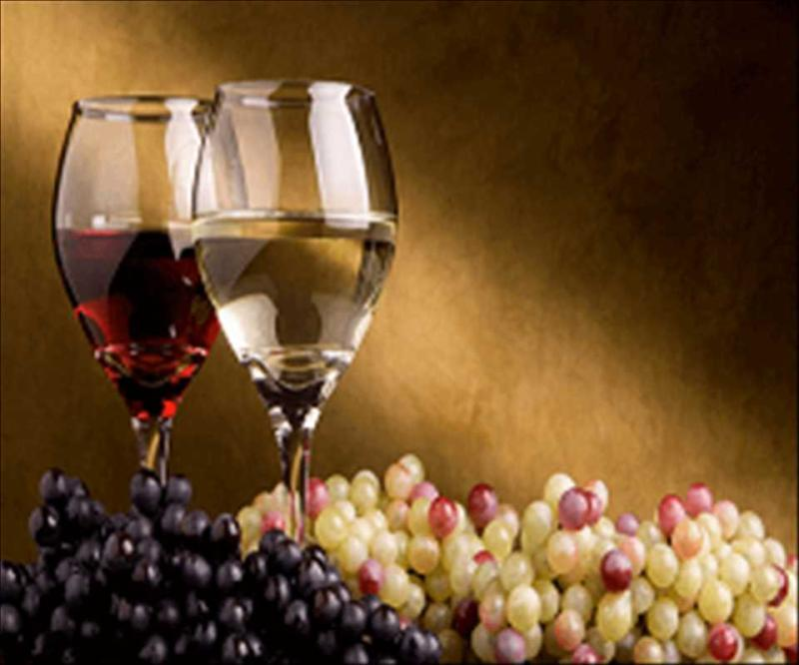
Wine Producing Countries
Key Market Trends
Emerging Markets: Regions like China and other parts of Asia are experiencing rapid growth in wine consumption. Although domestic production in China has slowed, imports from leading producers have grown. This diversification of wine consumption is reshaping global trade dynamics.
Climate Change Impact: Wine production is highly sensitive to climate conditions, and shifts in global temperatures have already impacted traditional wine regions. This has led to changes in harvest times, wine quality, and even the rise of new wine-producing regions in cooler climates like the U.K. and Canada.
In summary, the wine industry is evolving as it faces changing consumer preferences, sustainability challenges, and the impact of climate change. While the major players continue to dominate the market, new trends and regions are reshaping the future of wine production.

Slide 7
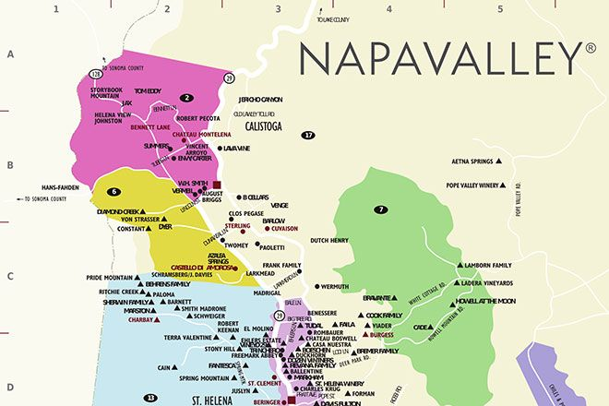
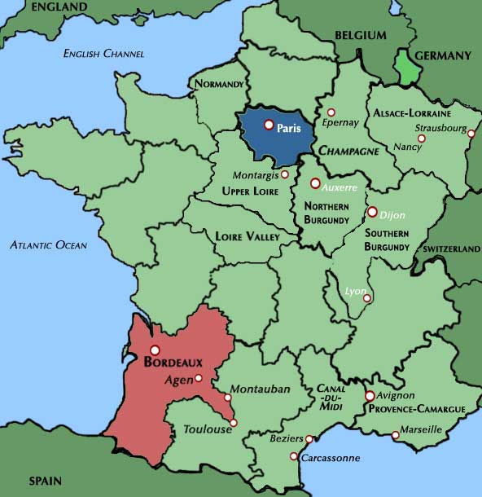
Introduction to Lesser-Recognized Wine Regions
Wine enthusiasts and novices alike often turn to familiar regions such as Bordeaux, Napa Valley, or Tuscany when thinking about the world's finest wines.
However, some of the most exciting and innovative winemaking is happening in lesser-known corners of the globe.
These regions, often overlooked, offer distinct styles, unique terroirs, and inventive winemaking techniques.
By expanding our knowledge of these hidden gems, we open the door to a world of new flavors and traditions that are reshaping the wine landscape.

Slide 8
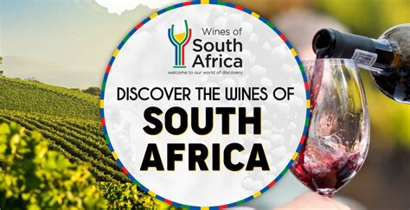
The Rich Legacy and Significance of South African Wine
South Africa is often celebrated for its stunning natural beauty and cultural diversity, but it is also home to a wine industry that dates back over three centuries.
South African wine reflects the country’s rich history, resilience, and innovation. The vineyards of Stellenbosch and the coastal plains of the Western Cape are home to some of the most iconic wines in the Southern Hemisphere.
However, the true charm of South African wine lies in its connection to the land and its deep-rooted traditions.

Slide 9
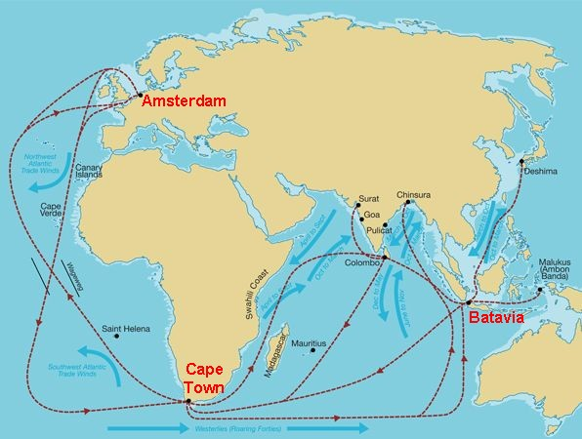
The Evolution of South African Wine
Dutch Beginnings
The story of South African wine begins in 1659, when the Dutch East India Company established a colony at the Cape of Good Hope.
Commander Jan van Riebeeck planted the first vines to produce wine for sailors as a remedy for scurvy.
Over time, South African wine has evolved to become a globally recognized industry, but not without challenges.

Slide 10
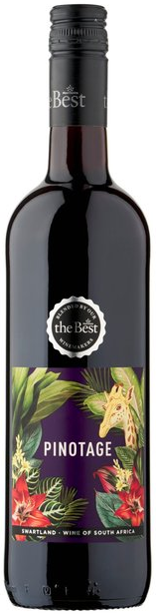
South Africa (Beyond Stellenbosch)
Beyond the historical heartland of Stellenbosch, other regions like Paarl, Franschhoek, and Swartland have emerged as important contributors to the country's wine diversity.
Signature varieties like Pinotage—a smoky, robust red wine—showcase the innovation of South African winemakers.
Similarly, Chenin Blanc from the Western Cape, with its crisp acidity and versatility, has earned global recognition.
South Africa is a country where tradition and modernity collide, producing wines that reflect both its tumultuous past and its hopeful future.

Slide 11
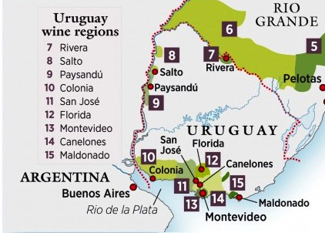
Uruguay: A Coastal Wine Treasure
While often overshadowed by Argentina and Chile, Uruguay is gaining attention as one of South America's most exciting wine regions.
Winemaking in Uruguay has deep roots, largely influenced by Spanish and Italian immigrants.
The coastal climate, with its maritime breezes and clay-limestone soils, provides ideal conditions for producing high-quality wines.

Slide 12
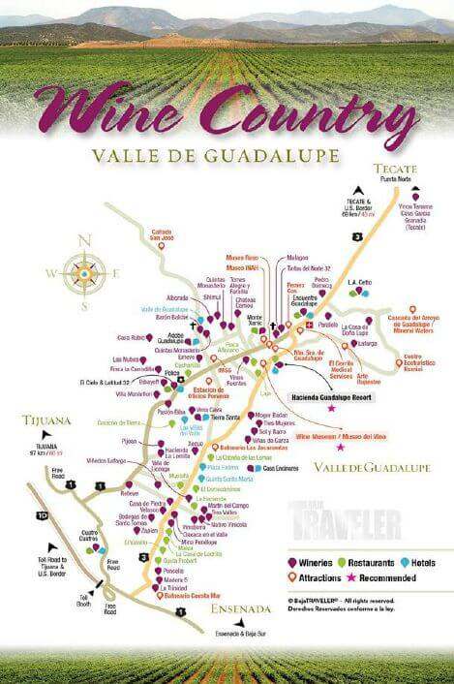
Mexico – Valle de Guadalupe A Revitalized Tradition
With over 500 years of winemaking tradition, Mexico’s Valle de Guadalupe is experiencing a renaissance.
This wine region, located just south of California, boasts a Mediterranean climate similar to Napa Valley.
Its dry summers and cool nights create ideal conditions for growing grapes like Nebbiolo, a rich, fruity red, and Tempranillo, a medium-bodied, spicy red.

Slide 13
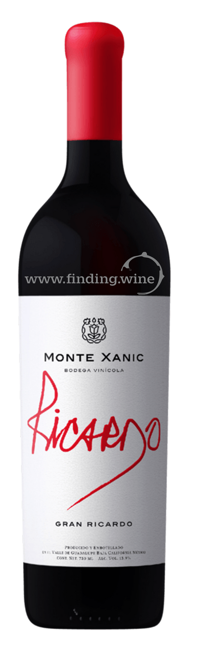
Mexico – Valle de Guadalupe A Revitalized Tradition
Wineries like Monte Xanic have led the charge in reviving Mexico's wine scene, while Casa Madero, the oldest winery in the Americas, remains a testament to the region’s longstanding tradition.
The wines from Valle de Guadalupe offer a perfect combination of modern innovation and historical depth.

Slide 14
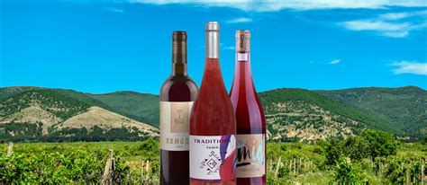
Bulgaria: An Ancient Wine Legacy
Bulgaria's winemaking history dates back to the Thracians, who were among the earliest viticulturists in the world.
Today, the country is undergoing a quiet wine revolution, with regions like the Thracian Valley and Danube Plains producing exceptional wines.

Slide 15
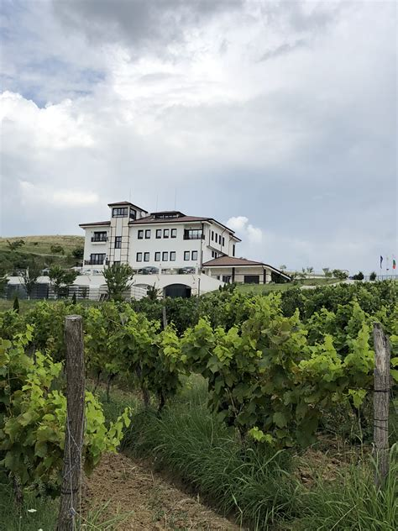
Bulgaria: An Ancient Wine Legacy
Key Varieties
Mavrud, a deep and structured red wine, is one of Bulgaria’s most cherished native grapes.
Another standout is Rubin, a cross between Nebbiolo and Syrah, offering a unique blend of flavors.
Wineries like Villa Melnik and Santa Sarah are leading the charge in bringing Bulgarian wine to the world stage, focusing on both native and international varieties.

Slide 16
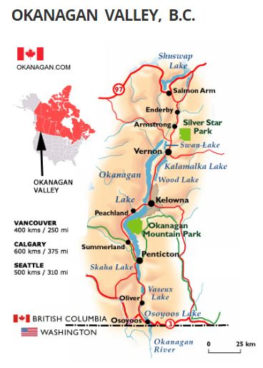
Canada – Okanagan Valley A Rising Star
Canada may not be the first country that comes to mind when thinking about wine, but the Okanagan Valley in British Columbia is quickly making a name for itself.
With its continental climate and volcanic soils, the Okanagan Valley produces world-class wines, particularly Icewine and Pinot Noir.

Slide 17
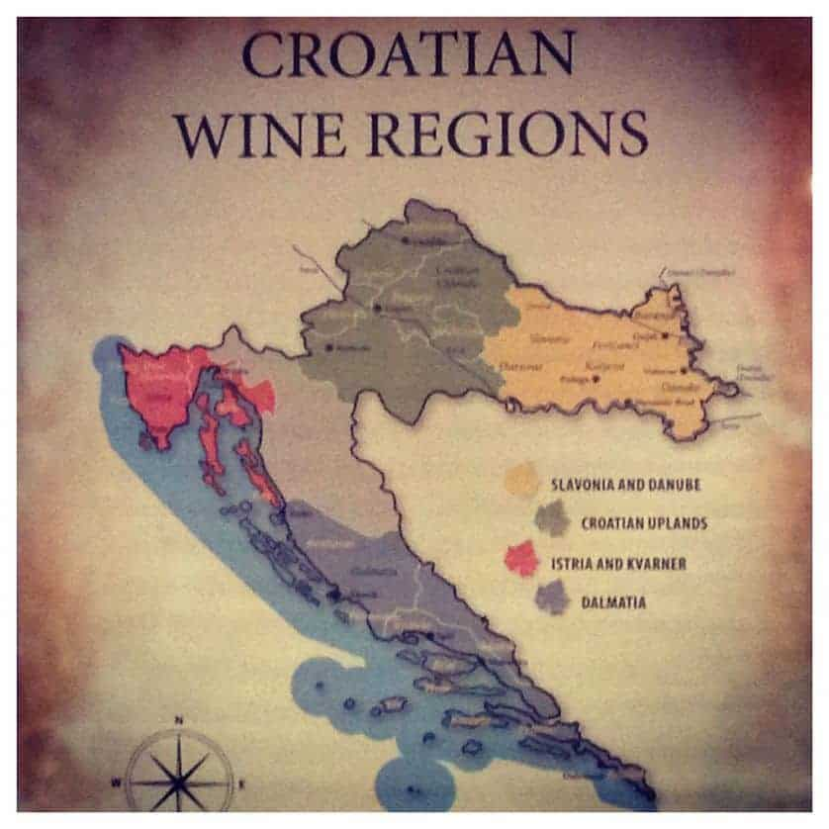
Croatia: A Mediterranean Haven
Croatia, with its ancient winemaking traditions dating back to the Greeks and Romans, is an emerging wine destination.
The country’s coastal Mediterranean climate and limestone-rich soils create a perfect environment for growing indigenous varieties.

Slide 18
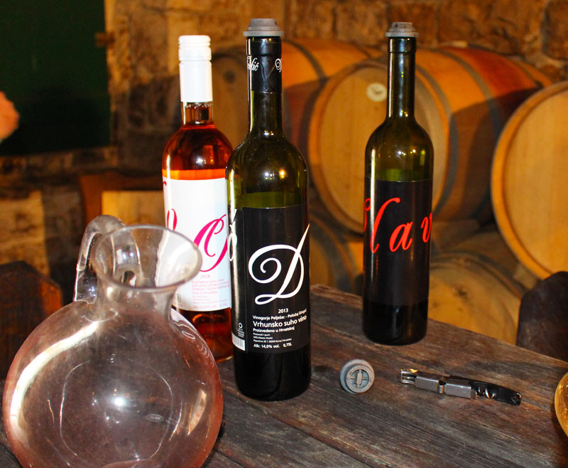
Croatia Varietals
Key Varieties
Plavac Mali, a robust red wine, is Croatia’s most famous variety, while Pošip, an aromatic white, is a must-try for those who enjoy crisp, minerally wines.
Wineries like Grgich Hills Estate and Korta Katarina are producing premium wines that reflect Croatia’s rich heritage and diverse terroir.

Slide 19
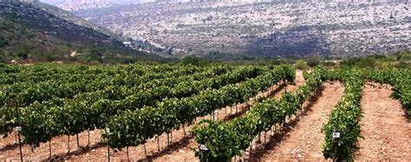
Israel – Judean Hills A Biblical Revival
Israel’s winemaking tradition goes back thousands of years, but modern times have seen a revitalization of this ancient craft.
The Judean Hills, with their limestone-rich soils and mountainous terrain, produce wines with bright acidity and rich flavors.

Slide 20
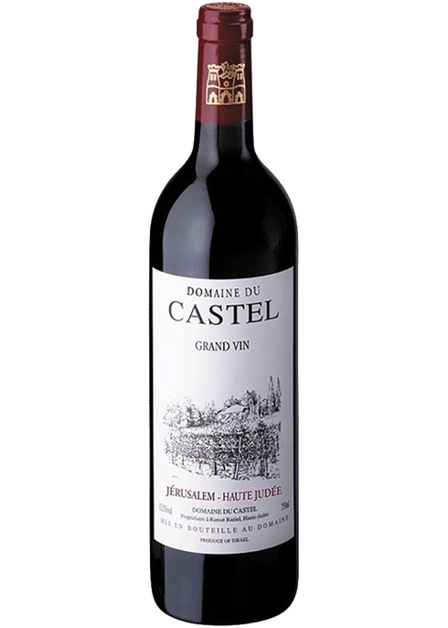
Israel – Judean Hills A Biblical Revival
Key Varieties
Cabernet Sauvignon and Chardonnay are standout varieties in this region, offering wines with a unique combination of elegance and minerality.
Family-run wineries like Flam and Domaine du Castel are known for their minimal intervention winemaking, allowing the terroir to shine through in every bottle.

Slide 21
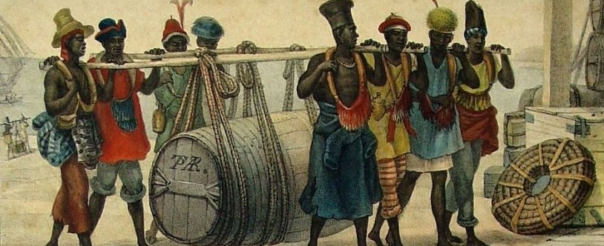
Brazil
Brazil’s winemaking history dates back to the 19th century when Italian immigrants introduced viticulture to the country's southern regions.
The state of Rio Grande do Sul became the heart of Brazilian wine production, where the immigrants’ expertise laid the foundation for the industry’s growth. Brazil’s winemaking developed steadily, eventually gaining international recognition for its unique styles.

Slide 22
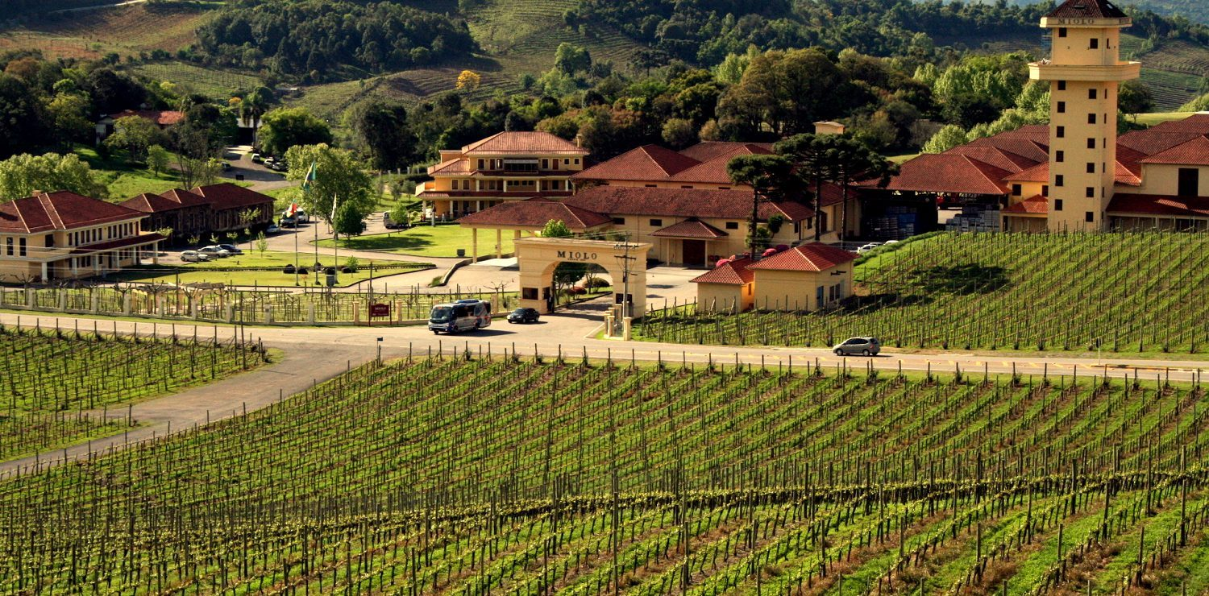
Brazil
The terroir in Brazil is diverse, ranging from subtropical climates to high-altitude vineyards.
These high-elevation vineyards in regions such as Serra Gaúcha provide cooler temperatures, which are ideal for producing high-quality wines. The cooling effect balances the warm Brazilian climate, resulting in wines with vibrant acidity and ripe fruit character.

Slide 23
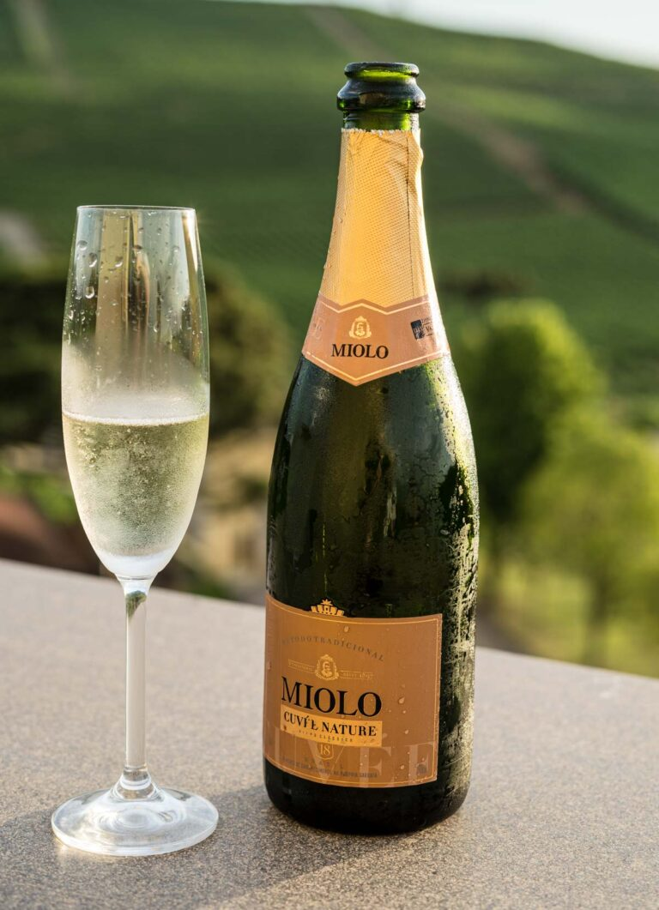
Brazil’s Varietals
Key varieties in Brazil include Merlot, known for its soft, fruit-forward profile, and sparkling wines, which are some of the country’s most renowned offerings.
Brazilian sparkling wines, often crafted in the traditional method, are celebrated for their fresh and vibrant acidity, making them a favorite both domestically and abroad.
Noteworthy wineries like Miolo, Brazil's largest producer, and Casa Valduga, famed for its high-altitude vineyards, lead the way in showcasing the quality and diversity of Brazilian wines, from robust reds to elegant sparkling varieties.
These wineries represent the future of Brazilian viticulture and continue to elevate the country's standing in the global wine scene.

Slide 24
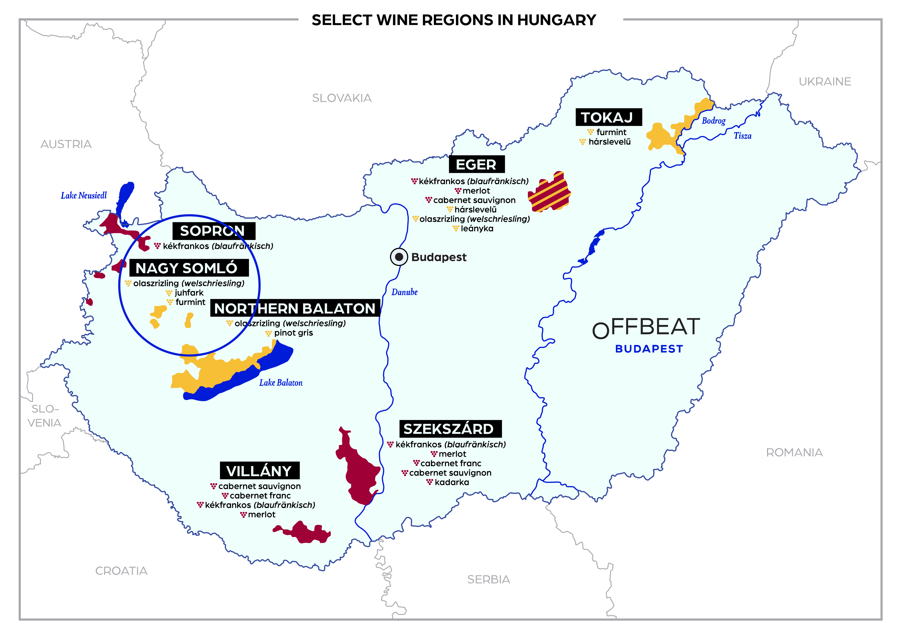
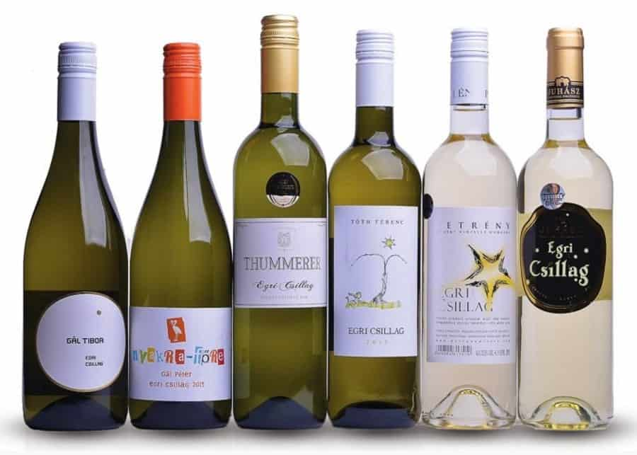
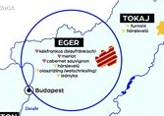
Hungary – Eger & Nagy Somló
Hungary’s winemaking history is deeply rooted in tradition, with Eger and Nagy Somlós emerging as key regions that are gaining global recognition.
While the country is famous for its sweet Tokaji wines, regions like Eger and Nagy Somlós are showcasing Hungary’s diversity in wine production.

Slide 25
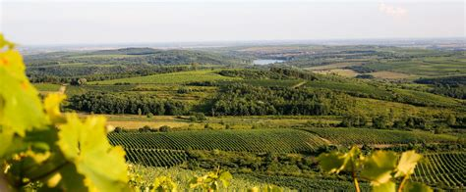
Hungary – Eger & Nagy Somló
Eger, often called the "Burgundy of Hungary," and Somlós, known for its volcanic terroir, both offer unique expressions of Hungarian viticulture.
The terroir of these regions is distinct. Eger benefits from a cool, continental climate and soils rich in limestone, creating ideal conditions for structured red wines.
Somlós, on the other hand, is defined by its volcanic soils, which give the wines a distinctive minerality and depth. This volcanic influence creates a unique, terroir-driven style that is difficult to replicate.

Slide 26
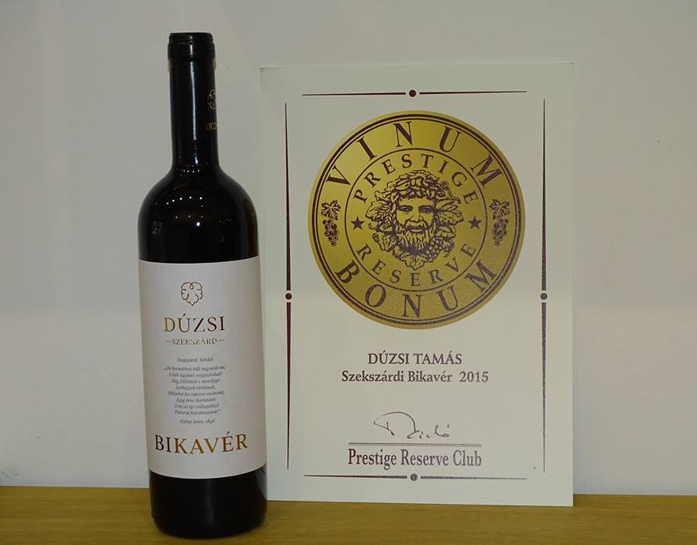
Hungary Varietals
Key varieties from Eger include Kékfrankos, a fruity and spicy red, and the famous Egri Bikavér, or "Bull's Blood," a robust red blend. Nagy Somlós is known for producing Furmint, a high-acid white with crisp, mineral-driven notes that reflect its volcanic origins.
Noteworthy wineries include St. Andrea in Eger, which focuses on elegant Egri Bikavér blends, and Somlói Apátsági, renowned for its Furmint that perfectly captures the volcanic terroir of the region.
These wineries are elevating Hungary’s reputation for producing world-class wines beyond just its famed Tokaji.

Slide 27
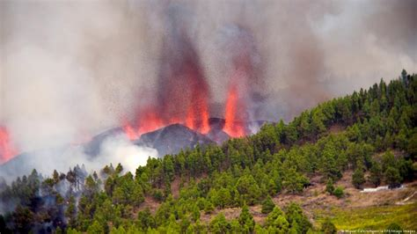
Canary Islands (Spain)
The Canary Islands, a volcanic archipelago off the coast of North Africa, is an emerging wine region with a history dating back to the 15th century.
Its winemaking tradition thrives on its unique terroir, where volcanic soils, combined with terraced vineyards and a subtropical climate, create conditions that are perfect for producing highly distinctive wines.
The volcanic soils of the Canary Islands impart a mineral-rich character to the wines, while the terraced vineyards help retain moisture.

Slide 28
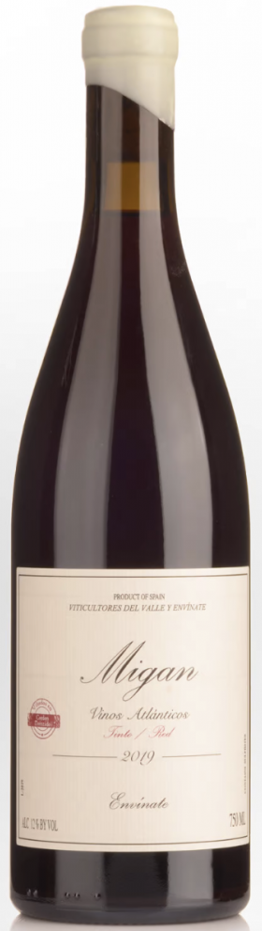
Canary Islands (Spain)
The high elevation of many vineyards, some of which are among the highest in Europe, further contributes to the complexity of the wines produced here.
Key grape varieties include Listán Negro, a light and spicy red wine with earthy undertones, and Malvasía, a rich, aromatic white known for its floral notes and fresh acidity.
These indigenous varieties thrive in the island's volcanic terrain, producing wines that are truly unique to the region.

Slide 29
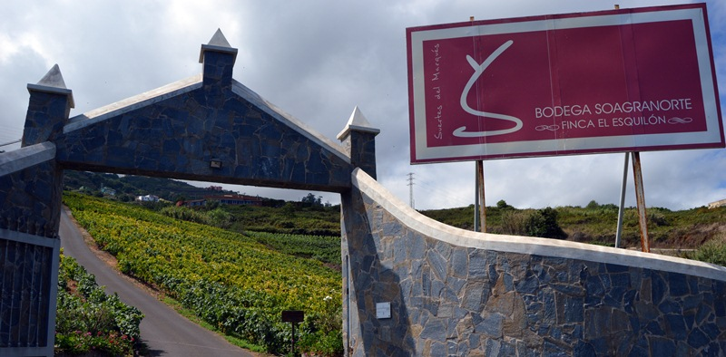
Canary Islands (Spain)
Noteworthy wineries include Suertes del Marqués, which is known for its single-vineyard wines that showcase the diversity of the island’s microclimates, and Envínate, a winery that focuses on reviving ancient winemaking techniques and creating wines with minimal intervention.
These wineries are leading the Canary Islands’ resurgence as a significant wine-producing region.

Slide 30
Acknowledgement
My seminars are the result of many years of experience combined with many hours of research over the internet.
I would like to acknowledge the many source I have accessed.
These include: Wine Spectator, Wine Enthusiast, BKWine Magazine, Wine & Spirits Magazine, American Vineyard Magazine, The Grapevine Magazine, Wikipedia.com, Britannica.com, and the various Government websites.

Slide 31
References
List of sources including wine publications, regional guides, and winery websites.
Wine and War: The French, the Nazis, and the Battle for France's Greatest Treasure by Don and Petie Kladstrup, Broadway Books, 2002.
The Oxford Companion to Wine, edited by Jancis Robinson, Oxford University Press, 2015.
The World Atlas of Wine, by Hugh Johnson and Jancis Robinson, Mitchell Beazley, 2019.
A History of Wine in Europe, 19th to 20th Centuries, Volume I: Winegrowing and Regional Features edited by Silvia A. Conca Messina, Palgrave Macmillan, 2021.
Terroir: The Role of Geology, Climate, and Culture in the Making of French Wines by James E. Wilson, University of California Press, 1998.

