Slide 1
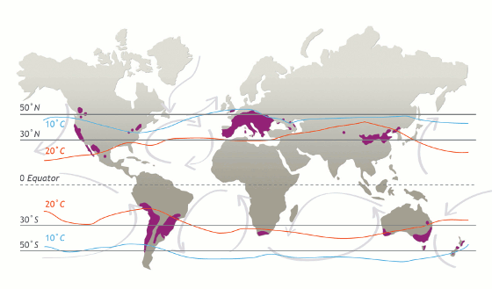
Lesser-Recognized Wine Regions of the World Pt 1 Presented by: Marc Silver

Slide 2
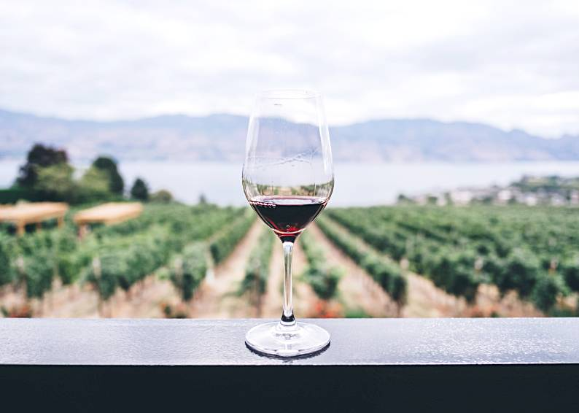
Hidden Gems in Viticulture
When one thinks of wine, regions like Bordeaux, Burgundy, Tuscany, or Napa Valley often come to mind.
Yet, the world of viticulture extends far beyond these renowned areas, with lesser-known regions offering equally remarkable wines, each shaped by unique terroirs, rich histories, and distinct varietals.
In this presentation, we explore five such wine regions, delving into their histories, best-known varietals, the characteristics of their terroirs, and the notable wineries putting them on the global wine map.

Slide 3
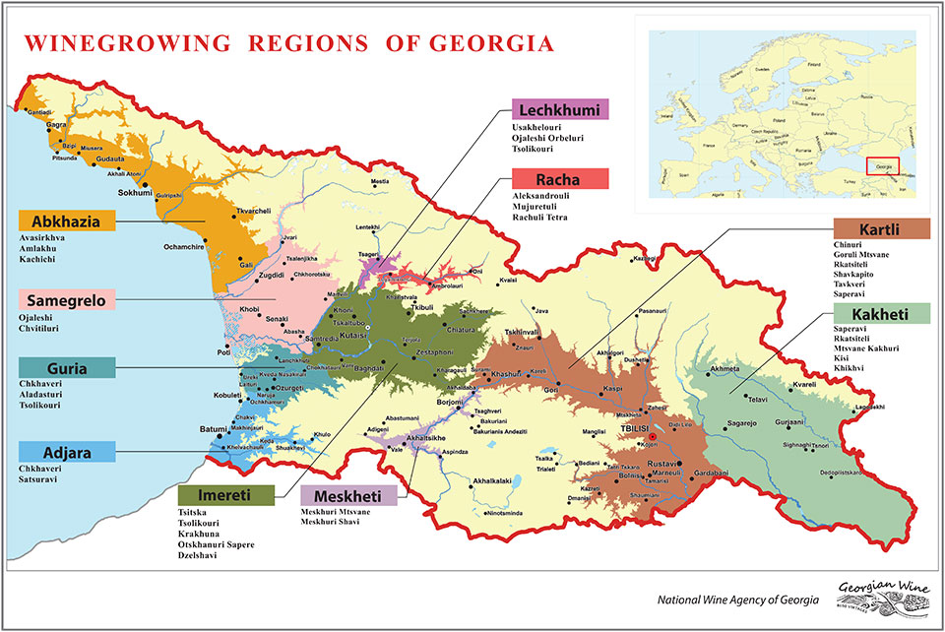
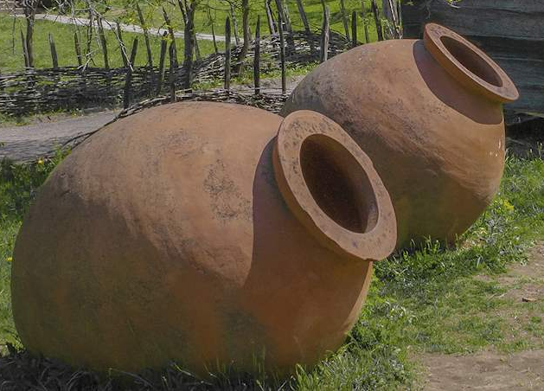
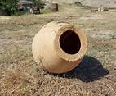
Georgia: The Birthplace of Wine
History and Viticulture
Georgia, located at the crossroads of Europe and Asia, is widely recognized as the "cradle of wine." Archaeological evidence suggests that winemaking in this region dates back over 8,000 years, making it one of the oldest wine-producing regions in the world.
Viticulture here is deeply intertwined with cultural traditions, particularly the use of large clay vessels called qvevri for fermenting and aging wines, a practice recognized by UNESCO as part of the world’s Intangible Cultural Heritage.

Slide 4
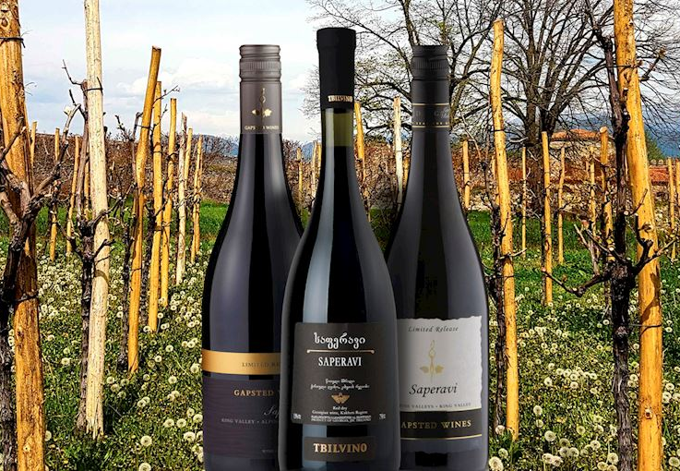
Georgia: The Birthplace of Wine
Varietals
Georgia is home to more than 500 indigenous grape varieties, but the most prominent include Saperavi (red) and Rkatsiteli (white). The country's diverse climate and topography, from the humid Black Sea coast to the cool, mountainous regions, provide an array of terroirs conducive to different styles of wine.
Saperavi produces deeply colored, dark skins and flesh produces full-bodied wines of a dark garnet color which are characterized by aromas of ripe red berries and pleasant acidity. Most wines produced from the Saperavi grapes are varietal and have a great tendency to age.
Sapervai wines are incredibly versatile and can match a variety of dishes, including delicate fish dishes, stews, grilled meat, or game.

Slide 5
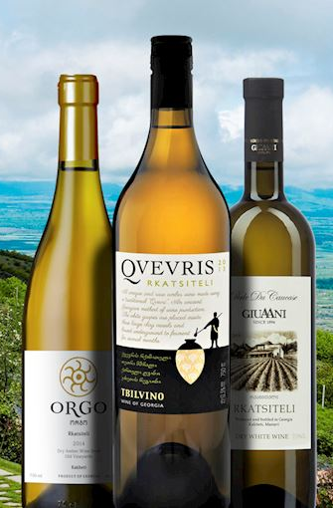
Georgia: The Birthplace of Wine
Varietals
Rkatsiteli is Arguably the most popular white grape in Georgia and possibly one of the oldest grapes in the world, Rkatsiteli is an incredibly versatile variety used in the production of brandy and dry, sparkling, fortified, and dessert wines.
Although it is grown in several other European countries, this ancient grape remains one of the flagship Georgian varieties.
Although it is grown in other regions, it is native to Kakheti. It is resilient to harsh weather conditions, retains excellent acidity, and achieves high sugars.
Dry Rkatsiteli wines are light and refreshing. They tend to have an excellent balance of crisp acidity and sweetness that is complemented by complex and subtly spicy aromas of flowers, green apple, quince, and white peaches.

Slide 6
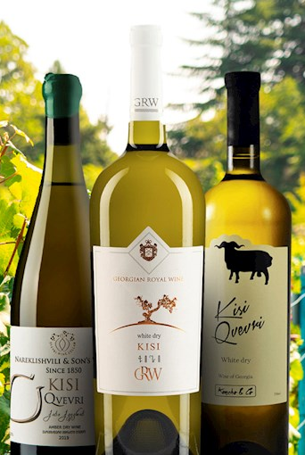
Georgia: The Birthplace of Wine
Varietals
Kisi is a native Georgian variety that is mainly associated with Kakheti. Like many Georgian grapes, this white variety is also used for classic dry styles and traditional Georgian amber wines made in large clay vessels (qvevri).
The grape is often blended with Rkatsiteli and Mtsvane Kakhuri.
By the 2000s, Kisi was almost extinct, but it is slowly being introduced as a local grape with excellent potential.
Classic dry wines are crisp and bright. They have a medium body and aromas reminiscent of flowers, citrus fruit, apples, pears, and peaches.

Slide 7
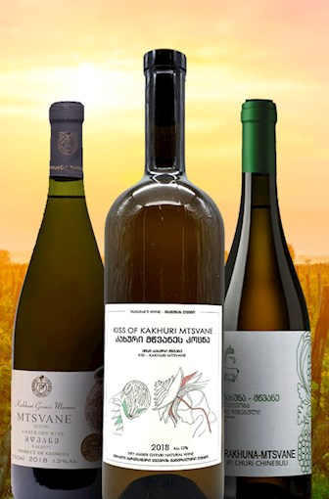
Georgia: The Birthplace of Wine
Varietals
Mtsvane Kakhuri, or simply Mtsvane, is an aromatic white grape native to Georgia.
The grape produces alcoholic and tannic white wines. It is mainly found in Kakheti, where it is used in varietals and blends and several regional appellations.
Although suitable for various styles, it is primarily used for dry wines and traditional wines made in qvevri—terracotta pots used for fermentation and maturation.
Dry white wines made from Mtsvane are fresh and light. They will usually have aromas reminiscent of white and yellow fruit, flowers, and citrus, often accompanied by herbal and mineral notes.

Slide 8
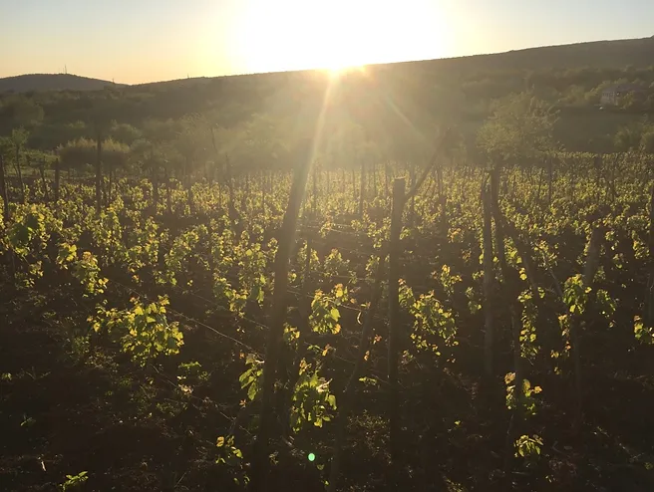
Georgia: The Birthplace of Wine
Notable Wineries
Pheasant’s Tears, set in a building that’s over 300 years old, enjoys a reputation as one of Georgia’s finest dining establishments.
It was opened by John Wurdeman, an American artist who discovered Georgia during his art studies in Moscow. Wurdeman has played a pivotal role in both preserving and revitalizing Georgia’s ancient winemaking traditions.
His organic, unfiltered wines, fermented and aged in Qvevri, have garnered international attention. The restaurant, helmed by chef Gia Rokashvili, offers a unique dining experience with no fixed menu; instead, Rokashvili crafts daily culinary creations using fresh, local market produce..

Slide 9
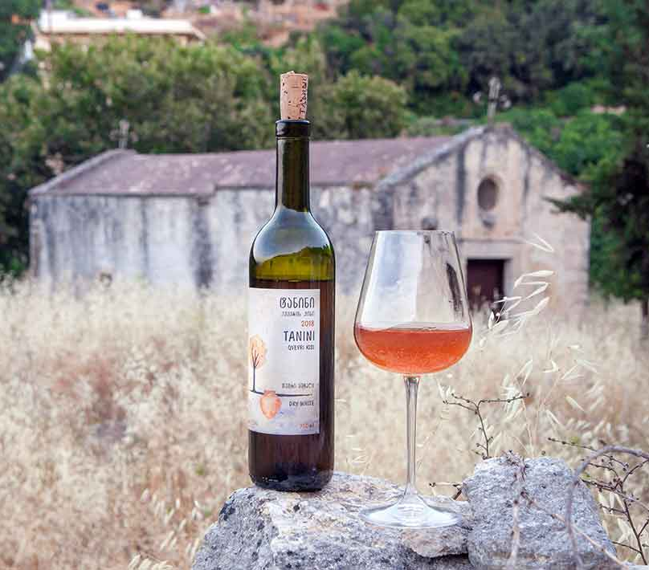
Georgia: The Birthplace of Wine
Notable Wineries
Schuchmann Winery was the biggest and most commercial winery in Georgia. It produces 1.5 million bottles of wine per year and has an incredible on-site restaurant, hotel, and spa.
Schuchmann produces two types of wine — producing around 70% of their wine via the “European” using stainless steel drums, and the other 30% using the traditional Georgian qvevri method.
The name “orange wine” does not refer to the flavor but simply the color of the wine which is a result of the way in which it is matured and fermented in the qvevris.
The method uses white grapes — by allowing the juice to maintain contact with the skins of the grapes during the fermentation process, a deep amber or orange color is produced, in much the same way red grapes produce rosé.

Slide 10
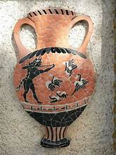
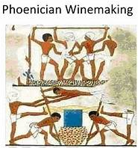
Lebanon: A Resilient Winemaking Tradition
History and Viticulture
Lebanon’s winemaking history dates back to antiquity, when the Phoenicians, who inhabited the region, were among the first to trade wine across the Mediterranean.
Despite the challenges posed by political instability and war, Lebanon's wine industry has persisted, particularly in the Bekaa Valley, a fertile region that has become the heart of the country's viticulture.

Slide 11
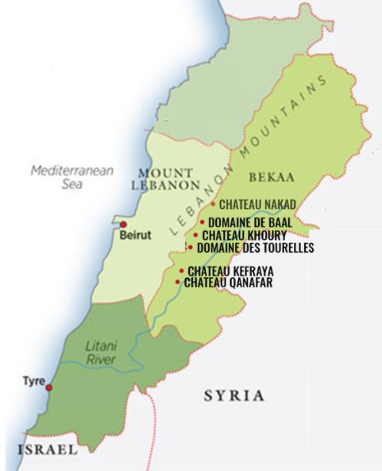
Lebanon: A Resilient Winemaking Tradition
Varietals and Terroir
The Bekaa Valley benefits from high-altitude vineyards, cool nights, and hot, dry summers, creating a perfect microclimate for growing grapes. The region's most notable wines are blends of Bordeaux varietals like Cabernet Sauvignon, Merlot, and Syrah, often with a Lebanese twist that makes them unique.
Cabernet Sauvignon and Merlot: These international varietals are crafted into bold red blends, with earthy, spicy, and herbaceous notes, reflective of the region’s limestone-rich soils.

Slide 12
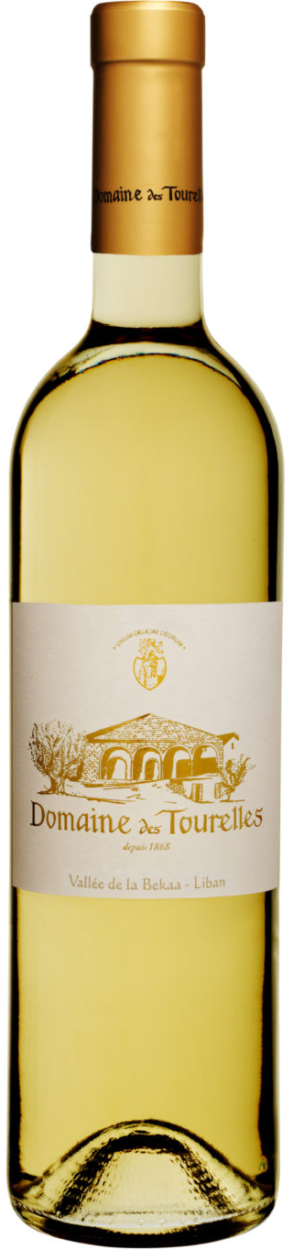
Lebanon: A Resilient Winemaking Tradition
Notable Wineries
Domaine des Tourelles: A historic winery producing elegant, terroir-driven wines with a focus on indigenous and international grape varieties.
Founded in 1868 by French ex-pat François-Eugène Brun, Domaine des Tourelles on the western edge of the Bekaa valley has changed little since its founding.
The low-slung buildings topped with red clay tiles have an ageless feel, and behind the cellar doors, you will discover a working museum of 19th-century winemaking technology.
The cement tanks used for fermentation and blending are original to the property and have a patina from nearly a century and a half of continual use.
That the estate survived the 20th century without having been completely remodeled and modernized is an absolute miracle, so when vignerons in France and Spain talk about returning to their roots, Domaine des Tourelles has the advantage of never having departed from them.

Slide 13
Lebanon: A Resilient Winemaking Tradition
Notable Wineries
Cave Kouroum, Winery Producing Superb Lebanese Wines in the Bekaa region’s heart, on the steep slopes of Barouk Mountain, lies a charming village of Kefraya where Cave Kouroum appears.
At the winery, the winemakers use a perfect blend of traditional methods and new technologies to make superb Lebanese wines.
The estate stretches over 7500 square meters, making it a special place for young wine lovers to enhance their wine knowledge.
In 1998, Mr. Bassim Rahal entered the wine world as a negotiator of the grape harvest sales. In the same year, he decided to begin producing wines in a new winery, and this gave rise to Cave Kouroum and a unique vintage Brut de Cuve. His first wine gained huge appreciation at Vinexpo Bordeaux in 2001.

Slide 14
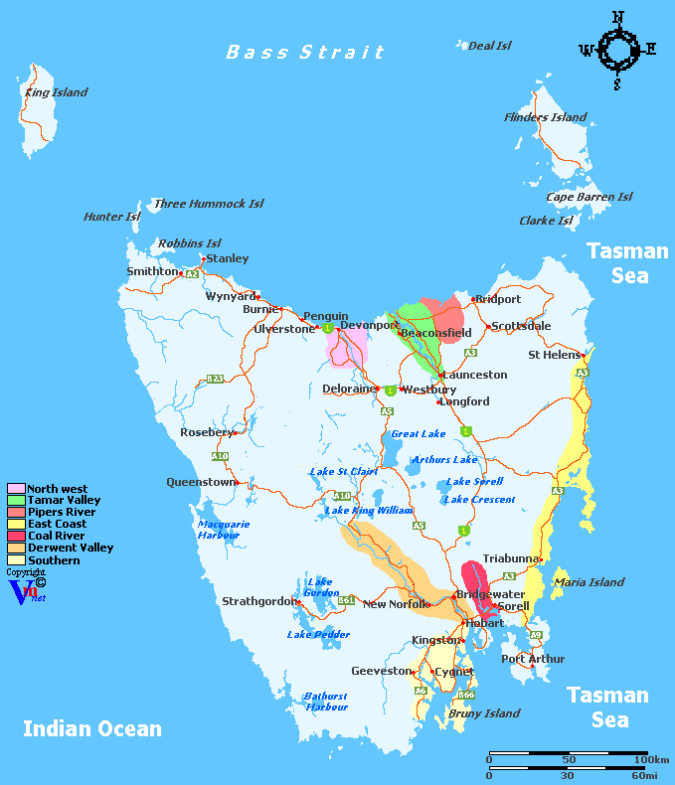
Tasmania, Australia: The Cool-Climate Contender
Tasmania
Tasmania, an island state, is gaining a reputation for its cool-climate wines, particularly Pinot Noir and sparkling wines.
The cool, maritime climate is ideal for producing crisp, delicate wines with great finesse.

Slide 15
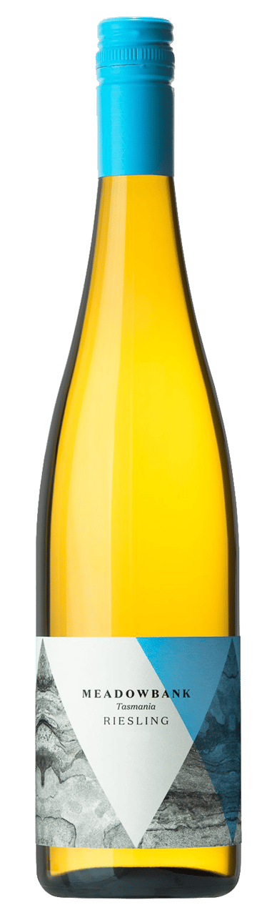
Tasmania, Australia: The Cool-Climate Contender
History and Viticulture
Tasmania has quietly become one of the world’s premier regions for cool-climate wines, particularly in the last few decades.
While viticulture began here in the early 19th century, it wasn’t until the 1970s that the modern wine industry took off, focusing on quality rather than quantity.
Tasmania’s unique terroir, characterized by ancient soils, cool maritime influences, and diverse topography, also played a significant role in the development of the region’s wine industry. The combination of these factors created the perfect environment for growing classic cool-climate grape varieties such as Pinot Noir, Chardonnay, and Riesling.

Slide 16
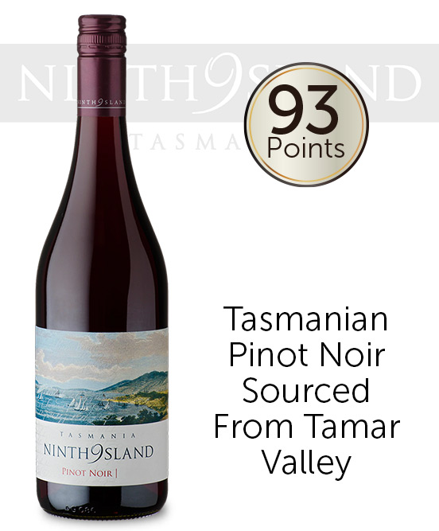
Tasmania, Australia
Varietals and Terroir
The island’s cool climate, moderated by the Southern Ocean, allows for the slow ripening of grapes, resulting in wines with elegance and complexity. Tasmania is especially renowned for its sparkling wines, often compared to Champagne, as well as its outstanding Pinot Noir and Chardonnay.
Pinot Noir: Tasmania’s signature grape, producing elegant wines with bright acidity, red berry flavors, and earthy undertones.
Chardonnay: Often used for both still and sparkling wines, it expresses mineral-driven, citrusy characteristics in this cool climate.

Slide 17
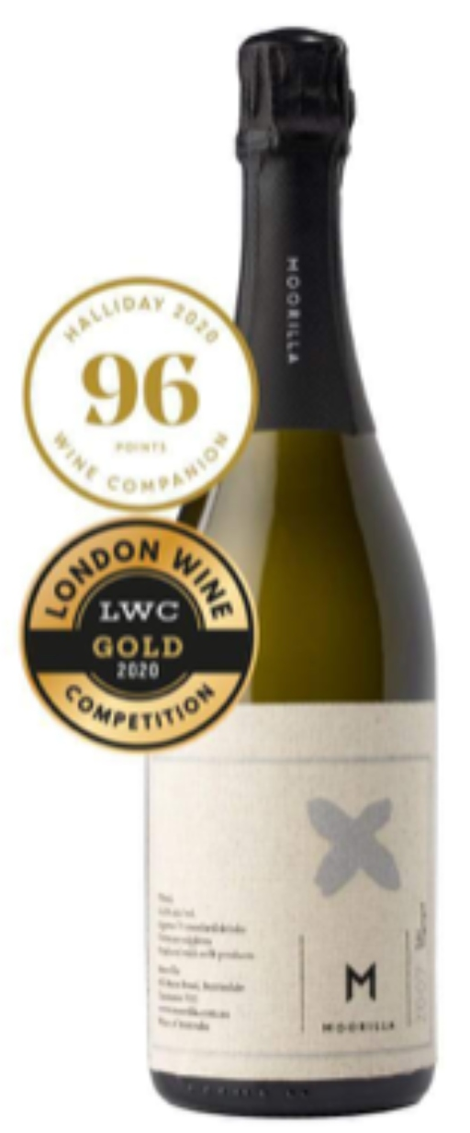
Tasmania, Australia
Notable Wineries
Moorilla Estate: A pioneering winery known for its innovative approach to both wine and art.
Moorilla is a winery with a modern art museum attached.
Moorilla creates small-batch, cool-climate wines with new-world fruit and old-world complexity, showcasing the terroir of its two vineyards.
wine varieties
Chardonnay, Pinot Noir, Riesling, Sauvignon Blanc, Cabernet Merlot, Syrah

Slide 18
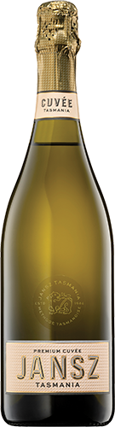
Tasmania, Australia
Notable Wineries
Jansz Tasmania: Famous for its high-quality sparkling wines made in the traditional method.
The name Jansz pays homage to Tasmania’s namesake, the Dutch explorer Abel Janszoon Tasman who first sighted the island in 1642.
When it was established in 1975, the Jansz vineyard was originally named after Tasman’s ship, the Heemskerk.
In 1986, esteemed Champagne house - Louis Roederer partnered with the owners of Heemskerk Wines to produce Tasmania’s first premium vintage sparkling wine.
They saw the similarities between the climate there and the famous wine region of their homeland. In 1997, the Hill-Smith family purchased the vineyard and began the journey that has seen Jansz Tasmania become the most highly regarded sparkling wine house in Australia.

Slide 19
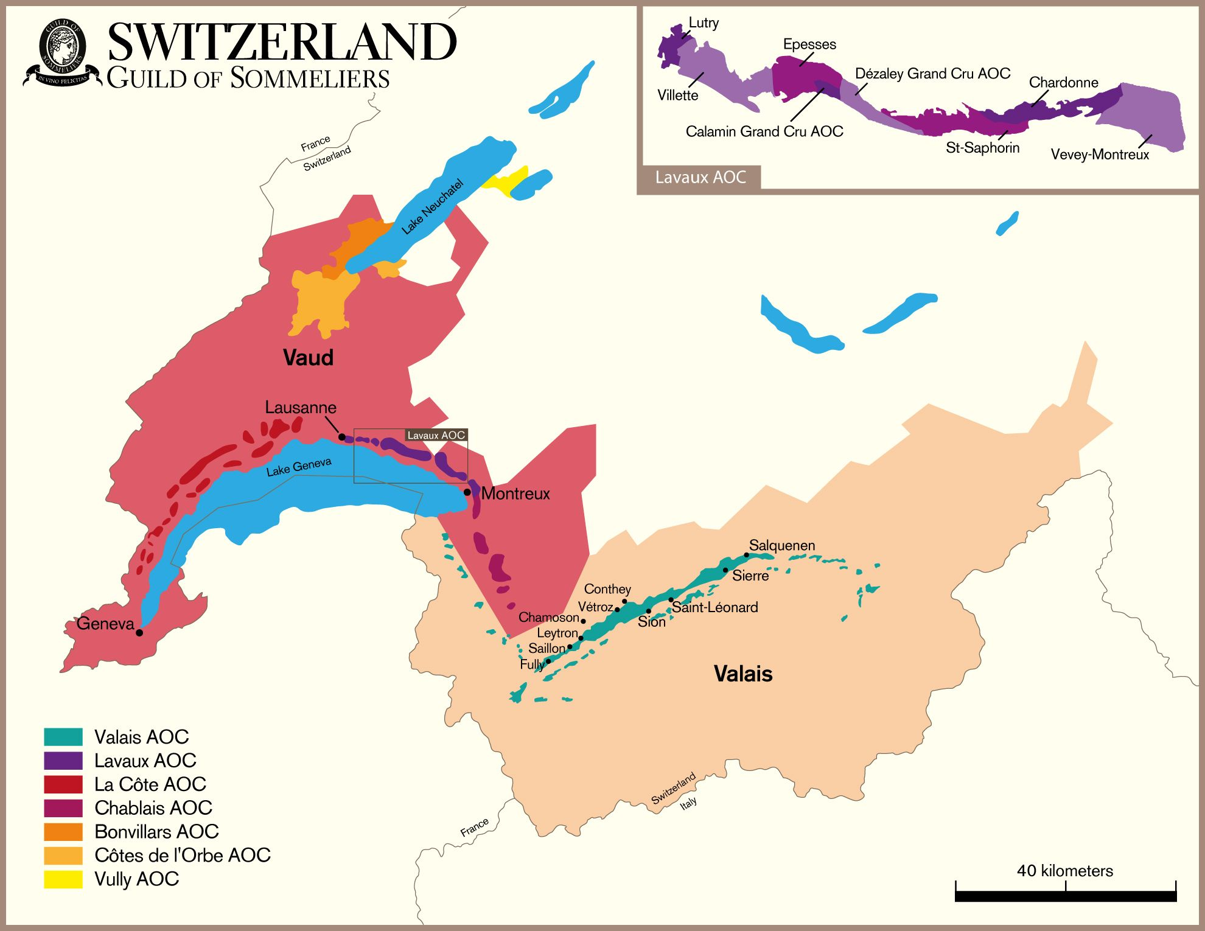
Switzerland: A Hidden Alpine Treasure
History and Viticulture
Switzerland’s wine industry is relatively small and largely focused on domestic consumption, which is why Swiss wines remain relatively unknown outside its borders.
The history of Swiss wine can be traced back to the Roman Empire. As early as the 2nd century AD, Roman settlers brought viticulture to their Swiss territories, planting grapevines along the shores of Lake Geneva and other fertile regions.
The practice of winemaking soon spread throughout the country, with monasteries playing a critical role in its development.
Today, the country's wine regions are concentrated in the French-speaking cantons of Vaud and Valais.

Slide 20
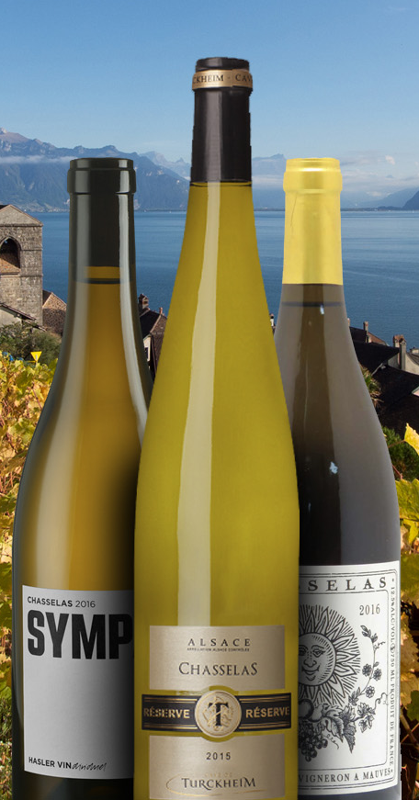
Switzerland
Varietals and Terroir
Switzerland’s vineyards are often terraced on steep, sun-drenched slopes, particularly along Lake Geneva and the Rhône River, benefiting from a unique Alpine climate. The most prominent varietal here is Chasselas, a white grape that produces delicate, mineral-driven wines with subtle fruit flavors.
Chasselas: The flagship white wine of Switzerland, known for its floral notes and minerality, often consumed young and enjoyed with local cuisine like fondue.
Pinot Noir: In the Valais region, Pinot Noir thrives in the warm, dry climate, producing elegant, medium-bodied red wines with red fruit and spice flavors.

Slide 21
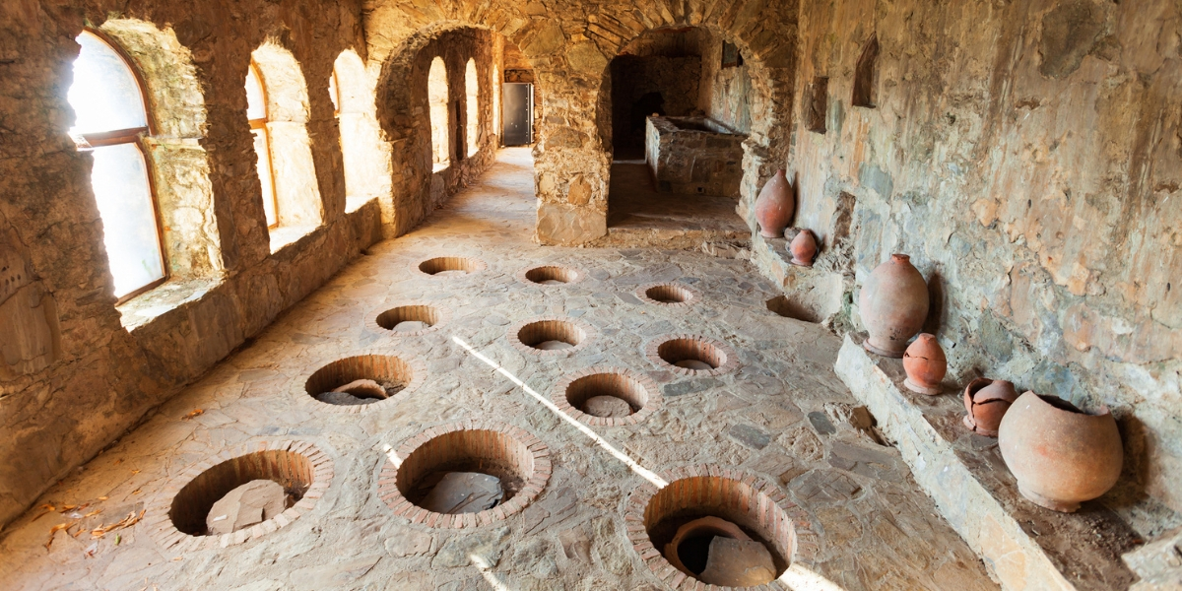
Conclusion
These lesser-known wine regions, each with its own unique history, terroir, and varietals, contribute to the global diversity of viticulture in ways that often go unrecognized.
From the ancient qvevri wines of Georgia to the crisp Chasselas of Switzerland, the wines from these regions reflect a deep connection to their landscapes and cultural heritage.
For adventurous wine enthusiasts, these hidden gems offer an opportunity to explore new flavors, styles, and winemaking traditions that are just waiting to be discovered.

Slide 22
Acknowledgement
My seminars are the result of many years of experience combined with many hours of research over the internet.
I would like to acknowledge the many source I have accessed.
These include Wine Spectator, Wine Enthusiast, BKWine Magazine, Wine & Spirits Magazine, American Vineyard Magazine, The Grapevine Magazine, Wikipedia.com, Britannica.com, and the various Government websites.

Slide 23
References
Wine and War: The French, the Nazis, and the Battle for France's Greatest Treasure by Don and Petie Kladstrup, Broadway Books, 2002.
The Oxford Companion to Wine, edited by Jancis Robinson, Oxford University Press, 2015.
The World Atlas of Wine, by Hugh Johnson and Jancis Robinson, Mitchell Beazley, 2019.
A History of Wine in Europe, 19th to 20th Centuries, Volume I: Winegrowing and Regional Features edited by Silvia A. Conca Messina, Palgrave Macmillan, 2021.
Terroir: The Role of Geology, Climate, and Culture in the Making of French Wines by James E. Wilson, University of California Press, 1998.

