Slide 1
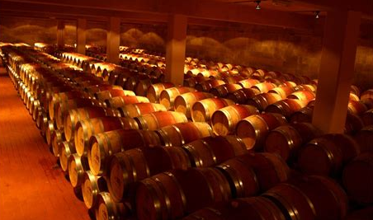
An Introduction to
Wine in Lebanon
Presented by
Marc Silver

Slide 2

A Rich Winemaking History
History of Lebanon’s Wine
Lebanon’s winemaking history is a journey through time, spanning over 5,000 years, making it one of the oldest wine-producing regions in the world.
From the Phoenician traders who spread their vines across the Mediterranean to the modern resurgence of high-quality wine production, Lebanon has continuously played a vital role in the evolution of viticulture.

Slide 3

History of Lebanon’s Wine
Ancient Times: The Phoenician Legacy
Lebanon's wine story begins with the ancient Phoenicians, a seafaring civilization that thrived along the Eastern Mediterranean coast.
These traders not only transported goods but also spread the art of winemaking throughout the Mediterranean, from Egypt to Spain, and even into parts of Europe.
Grapevines were central to their economy, and Lebanese wines were prized in the ancient world.
Key Events: Wine production flourished under the Phoenicians, who exported it as far as Greece and Rome. This era established Lebanon as a hub for viticulture and wine trade.

Slide 4

1st Century BCE - 5th Century CE
Roman Influence and the Spread of Christianity
Following the Phoenicians, the Romans expanded viticulture in Lebanon.
The Bekaa Valley, a central region in Lebanese winemaking today, became a major wine-producing area. Temples dedicated to Bacchus, the Roman god of wine, were built, indicating the importance of wine in local religious and cultural practices.
Key Developments: Roman advances in irrigation and viticulture helped expand production. The worship of Bacchus highlighted wine's central role in both everyday life and religious rituals.

Slide 5
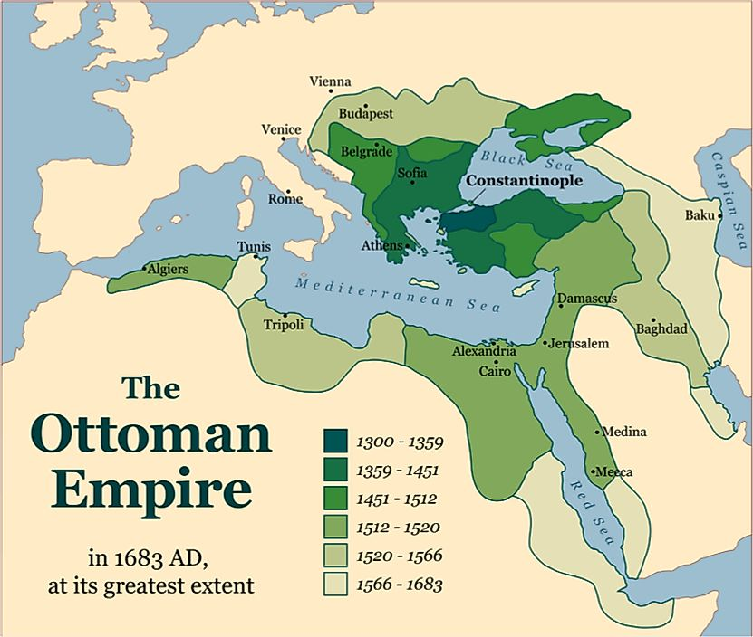
Medieval Period
Ottoman Rule and Wine Decline (16th - 19th Century)
During the Ottoman Empire, which ruled Lebanon from the 16th to 19th centuries, winemaking declined. Islamic laws prohibited alcohol consumption, which heavily impacted the wine industry.
However, Christian communities, particularly the Maronite monks, continued making wine for religious purposes.
Key Developments: Despite restrictions, some vineyards survived, thanks to the perseverance of the Maronite Church, which preserved Lebanon’s winemaking tradition.

Slide 6
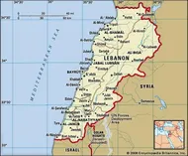

1920s
French Mandate and the Rebirth of Lebanese Wine
The 20th century marked the revival of winemaking in Lebanon, particularly during the French Mandate (1920–1943). The French influence brought new winemaking techniques and grape varieties, including Cabernet Sauvignon, Merlot, and Cinsault, which began blending with traditional Lebanese varietals.
Key Developments: The founding of Château Ksara in 1857 by Jesuit priests, and later wineries like Château Musar, were instrumental in modernizing Lebanese wine production and spreading its reputation globally.

Slide 7

1975–1990
The Lebanese Civil War and Its Aftermath
The Lebanese Civil War severely impacted the wine industry.
Vineyards were destroyed, and production came to a halt. However, resilient winemakers like Gaston Hochar of Château Musar continued producing wines despite the challenges, eventually gaining international acclaim.
Key Developments: Château Musar’s success during the war became legendary, putting Lebanon back on the global wine map. This perseverance inspired other wineries to rebuild in the post-war years.

Slide 8
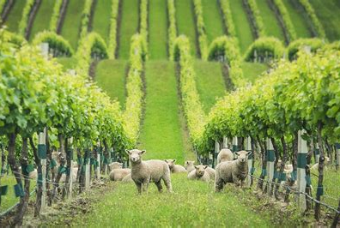
1990s–Present
Modern Day: A Growing Industry (Since the 1990s, Lebanon’s wine industry has seen a resurgence. With over 50 wineries now in operation, the country is producing wines that are not only celebrated locally but also gaining international recognition. Lebanese wines now compete on the global stage, with many receiving prestigious awards.
Key Breakthroughs: The development
of organic and biodynamic winemaking
practices has gained popularity in
Lebanon, as winemakers seek to
produce wines that express the unique
terroir of the region.

Slide 9
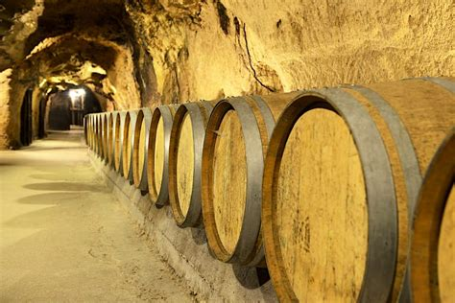
Modern Era 1990s–Present
Modern Day: A Growing Industry
Since the 1990s, Lebanon’s wine industry has seen a resurgence. With over 50 wineries now in operation, the country is producing wines that are not only celebrated locally but also gaining international recognition.
Lebanese wines now compete on the global stage, with many receiving prestigious awards.

Slide 10
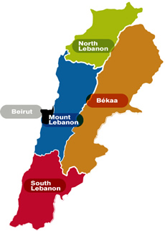
Wine Regions in Lebanon
Lebanon may be a small country, but its diverse geography and Mediterranean climate make it an ideal location for growing a wide variety of grapes.
The following regions represent the heart of Lebanese wine production, ranked by their significance in production volume and unique characteristics.
Bekaa Valley
Batroun (North Lebanon)
Mount Lebanon
South Lebanon

Slide 11
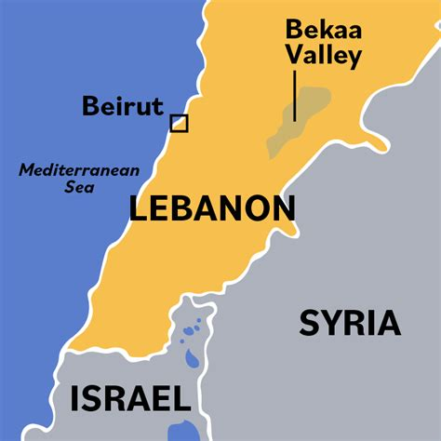
Wine Regions in Lebanon
Bekaa Valley
The Bekaa Valley is undoubtedly the epicenter of Lebanon’s wine production, accounting for over 80% of the country’s vineyards.
This fertile plateau lies between Mount Lebanon and the Anti-Lebanon mountains, creating a perfect microclimate for grape growing.
Key Qualities: High altitudes, hot days, and cool nights make for wines with excellent acidity and complexity.
Red grape varieties like Cabernet Sauvignon, Syrah, and Merlot dominate, though some white grapes like Chardonnay and Sauvignon Blanc are also cultivated.

Slide 12
Wine Regions Regional Breakdown
Bekaa Valley: A Winemaking Powerhouse
Location: Central Lebanon, stretching between Mount Lebanon and the Anti-Lebanon range.
Terroir: The Bekaa Valley’s altitude (900 to 1,200 meters above sea level), combined with its well-draining gravel and limestone soils, creates an ideal environment for both red and white grapes.
Climate: Hot, dry summers and cool, wet winters. The diurnal temperature shifts help preserve acidity in the grapes, creating balanced wines.
Grape Varieties: Cabernet Sauvignon, Merlot, Syrah, Cinsault, Chardonnay, Sauvignon Blanc.
The Bekaa Valley is the beating heart of Lebanese wine, producing the country’s most powerful and age-worthy wines.

Slide 13
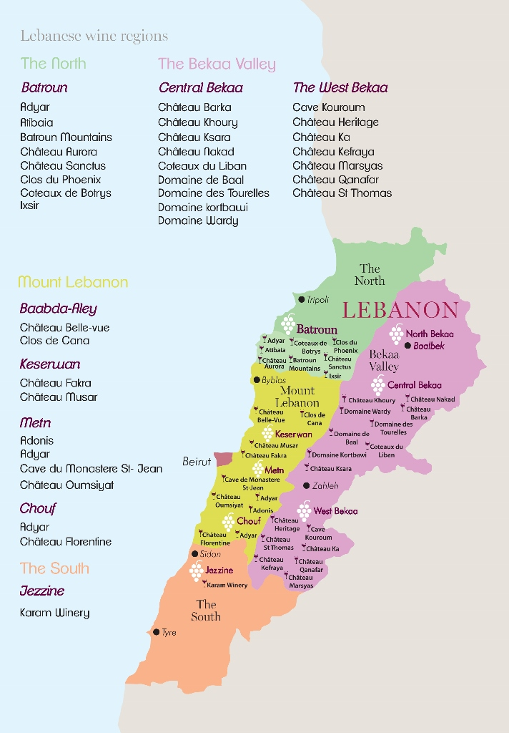
Wine Regions in Lebanon
Batroun
Located along the northern coast, Batroun is a rapidly growing wine region.
Its proximity to the sea creates a maritime climate, and the region’s limestone soils contribute to the minerality of its wines.
Though smaller in production compared to the Bekaa, Batroun’s wineries are known for their artisanal approach.
Key Qualities: Crisp whites and fresh reds that often carry herbal and floral notes, reflecting the region’s Mediterranean influence.

Slide 14
Wine Regions Regional Breakdown
Batroun: A Coastal Gem
Location: Northern Lebanon, along the Mediterranean coast.
Terroir: Limestone-rich soils contribute to the mineral backbone of the wines, while the proximity to the sea ensures a cooling maritime influence.
Climate: Mediterranean, with warm summers and mild winters.
Grape Varieties: Sauvignon Blanc, Chardonnay, Merlot, Syrah, Mourvèdre.
Batroun is a rising star in Lebanese wine. The region’s unique blend of coastal influence and limestone soils gives its wines a distinctive character, often marked by freshness, minerality, and elegant floral notes. Batroun is known for producing crisp white wines and smooth, fruit-forward reds.

Slide 15
Wine Regions in Lebanon
Mount Lebanon
The high-altitude slopes of Mount Lebanon have become home to a number of boutique wineries.
While production is smaller here, the cooler temperatures and varied soil types allow for the cultivation of unique and expressive wines.
Key Qualities: Wines from this region are often more refined, with delicate aromas and softer tannins, particularly for red varietals.

Slide 16
Wine Regions in Lebanon
Jezzine and the South
Jezzine, located in the southern part of the country, is one of Lebanon’s emerging wine regions. Though it produces a smaller
volume, the region is known for its organic
vineyards and emphasis on sustainable
practices.
Key Qualities: Fruity reds and aromatic
whites, often produced with minimal
intervention.

Slide 17
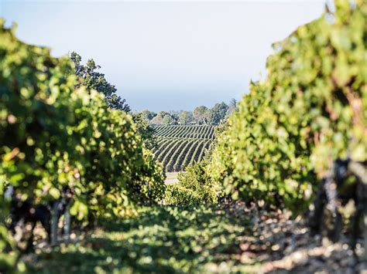
Lebanon’s Unique Terroir
Lebanon’s terroir is as diverse as the country itself.
From the high-altitude Bekaa Valley to the coastal vineyards of Batroun, each region offers a distinct combination of soil, climate, and geography that shapes the wines produced there.

Slide 18
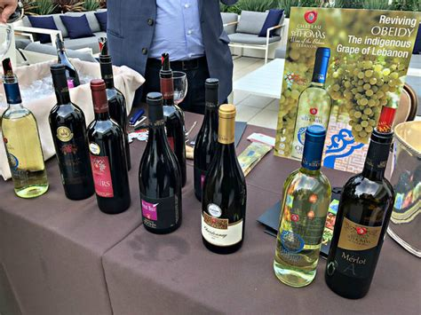
Lebanese Wine Categories
Lebanese wines can generally be categorized into several types based on grape varieties, winemaking techniques, and styles.
Lebanon, particularly the Bekaa Valley, has a long history of winemaking, and modern Lebanese wines have been gaining international recognition.
The categories reflect both the French winemaking influence and the country’s unique terroir. Here are some common Lebanese wine categories:

Slide 19
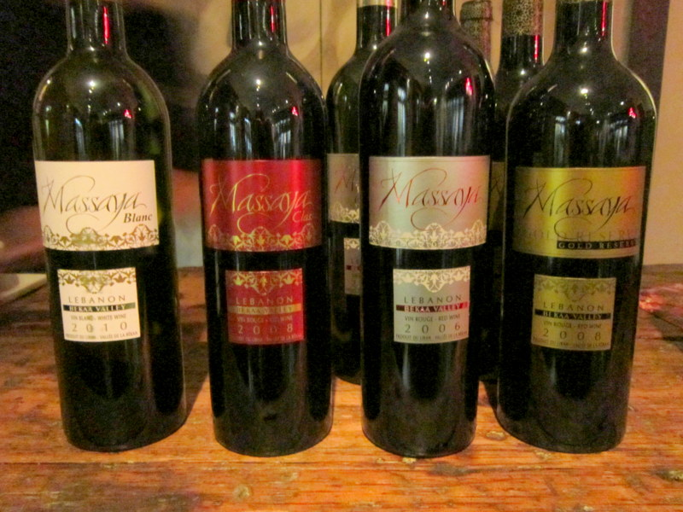
Lebanese Wine Categories
Red Wines
Lebanese red wines are typically bold, full-bodied, and rich in flavor. The winemakers often blend international varieties with native grapes, creating a unique taste.
Grape Varieties: The most popular red grape varieties include Cabernet Sauvignon, Syrah, Merlot, and Cinsault. Some wineries are also experimenting with indigenous varieties like Obeidi (often used for white but can show up
in blends) and other rarer local grapes.
Tasting Notes: Lebanese reds often have dark fruit flavors like blackberry, black cherry, and plum, with earthy, spicy notes due to the Mediterranean climate.
Many exhibit a minerality and a balance of acidity that can pair well with lamb or grilled meats.

Slide 20
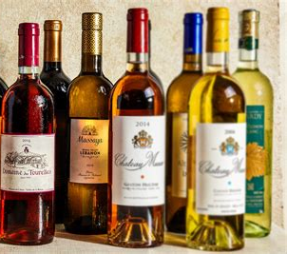
Lebanese Wine Categories
White Wines
While red wines dominate the production in Lebanon, white wines are also crafted with care, offering refreshing and aromatic profiles.
Grape Varieties: Common white grape varieties include Chardonnay, Sauvignon Blanc, Viognier, and Muscat. Indigenous varieties such as Obeidi (also known as Obaideh) are making a comeback.
Tasting Notes: Lebanese whites tend to be crisp and
aromatic, with flavors of citrus, stone fruit, and floral notes.
Many of these wines pair beautifully with Mediterranean
seafood dishes and fresh salads.

Slide 21
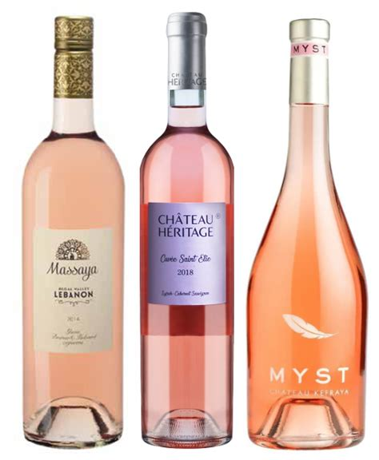
Lebanese Wine Categories
Rosé Wines
Rosé wines from Lebanon are becoming increasingly popular due to their refreshing, lighter style, perfect for the Mediterranean climate.
Grape Varieties: Rosé wines in Lebanon are often made from Cinsault, Grenache, and Syrah.
Tasting Notes: These wines are usually dry with bright acidity and flavors of red berries, watermelon, and sometimes citrus. They are great for pairing with light appetizers, mezze, or summer dishes.

Slide 22
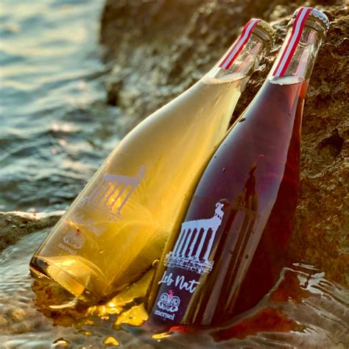
Lebanese Wine Categories
Sparkling Wines
While less common than the still wines, some Lebanese wineries produce sparkling wines, typically using the traditional method (same as Champagne) or Charmat method.
Grape Varieties: Sparkling wines are often made from Chardonnay, Pinot Noir, or local grape varieties.
Tasting Notes: These wines are often crisp with fine bubbles, featuring flavors of green apple, pear, and citrus.

Slide 23
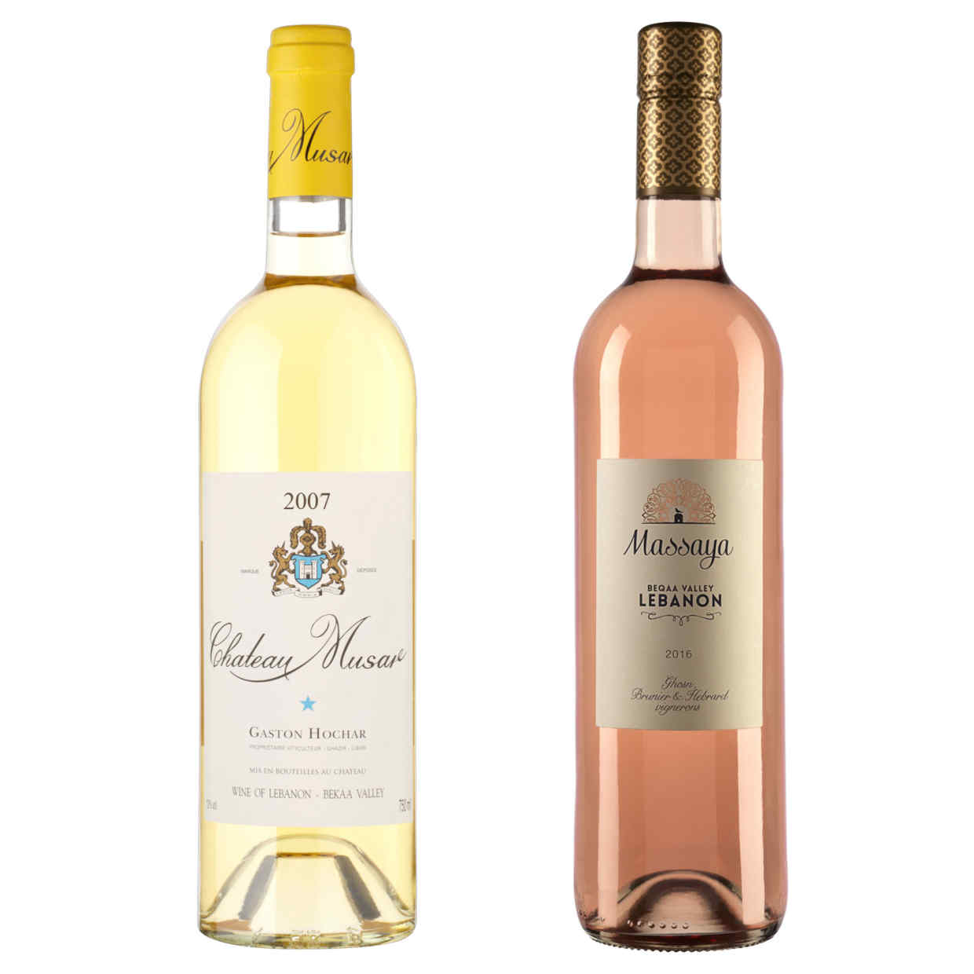
Lebanese Wine Categories
Sweet Wines
Lebanon also has a tradition of producing sweet or dessert wines, often from overripe or sun-dried grapes.
Grape Varieties: These wines may be made from
Muscat, Viognier, or Chardonnay.
Tasting Notes: Lebanese sweet wines are luscious and
rich, with flavors of dried apricots, honey, and tropical
fruits. They can be an excellent match for pastries or
traditional Lebanese sweets.

Slide 24
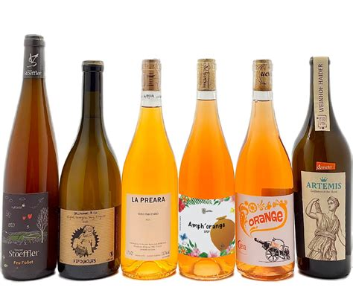
Lebanese Wine Categories
Orange Wines
Some wineries are experimenting with orange wines, made by fermenting white grapes with their skins, similar to red wine production.
Grape Varieties: Indigenous varieties such as Obeidi and international white grapes are used.
Tasting Notes: Orange wines from Lebanon are complex, with herbal, citrusy, and nutty flavors. They are gaining popularity for their unique structure and versatility with food pairings.
Lebanese wines, due to their Mediterranean climate, tend to reflect a robust sun-ripened fruit character balanced with good acidity and minerality from the mountainous terroir. Have you tried any Lebanese wines or have any preferences for a specific type?

Slide 25
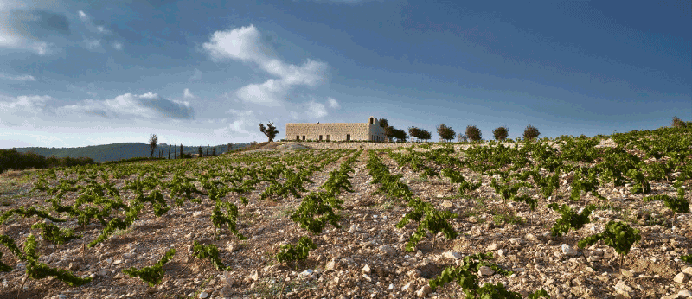
Lebanon’s Unique Terroir
Geological Factors:
The combination of limestone, clay, and
gravel soils in many regions provides
excellent drainage and mineral content,
which contribute to the complexity and
minerality of wines.
Climatic Factors: Lebanon enjoys a Mediterranean climate with hot, dry summers and mild, wet winters. The diurnal temperature variation—hot days and cool nights—helps grapes retain acidity while ripening fully, leading to well-balanced wines.
Geographical Factors: The varied altitudes of Lebanon’s wine regions, ranging from 300 meters in coastal areas to over 1,200 meters in the Bekaa Valley, create diverse microclimates that allow for the cultivation of a wide range of grape varieties.

Slide 26
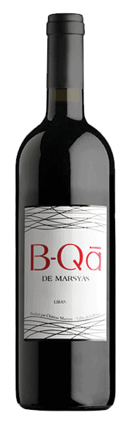
Major Grape Varieties and Characteristics
Lebanon’s vineyards are home to both indigenous and international grape varieties, each offering unique flavors and characteristics. Let’s dive into some of the most significant grape varieties and explore their flavor profiles, characteristics, and ideal food pairings.
Cabernet Sauvignon
Characteristics: This bold and structured red wine is a true star of Lebanon's wine scene, offering deep, rich flavors of blackcurrant, plum, and cassis.
Over time, layers of cedar, tobacco, and hints of leather emerge, making it a wine that gets more complex with age. The firm tannins and high acidity create a solid backbone, giving this wine excellent aging potential and a refined finish.
Food Pairings: A perfect companion to hearty, flavorful dishes. Think grilled ribeye steaks, slow-cooked lamb, or beef stew. For something local, pair it with Lebanese lamb kebabs or a rich moussaka—its tannins cut through the richness beautifully.

Slide 27
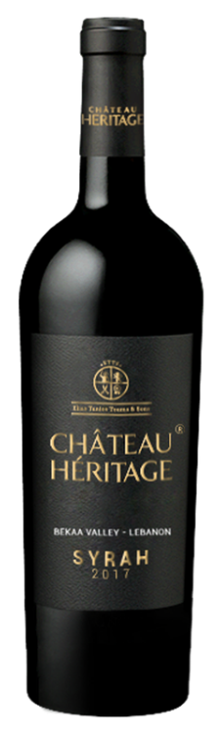
Major Grape Varieties and Characteristics
Syrah
Characteristics: Syrah (or Shiraz in some regions) thrives in Lebanon’s hot, sun-drenched climate, resulting in a powerful, full-bodied wine with intense flavors of blackberries, dark cherries, and ripe plums.
This wine often carries spicy notes of cracked black pepper and earthy, smoky undertones, creating an intriguing complexity. Syrah from Lebanon is bold yet balanced, with smooth tannins and a lingering, savory finish.
Food Pairings: Syrah’s robust flavors and spicy profile make it a natural fit for barbecued meats, whether it’s a simple grilled burger or a spiced beef shawarma.
It also pairs excellently with spicy dishes like harissa-marinated chicken or Lebanese sausages (makanek), and bold cheeses like aged cheddar or Roquefort.

Slide 28
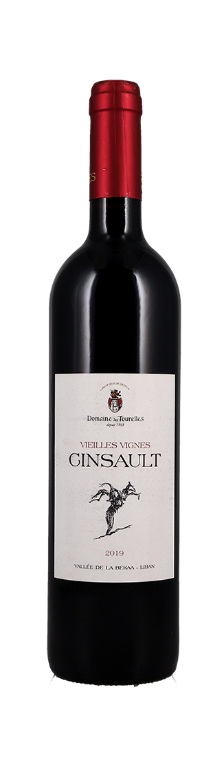
Major Grape Varieties and Characteristics
Cinsault
Characteristics: Known for its soft tannins and light, fresh personality, Cinsault is a versatile varietal that shines both in blends and as a single-varietal wine.
It’s an easy-drinking red with a bouquet of red berries—strawberries, raspberries, and a touch of cranberry—often accompanied by subtle floral notes like violet or rose. Cinsault’s delicate body and gentle finish make it a lovely choice for lighter meals or casual sipping.
Food Pairings: This wine pairs beautifully with Mediterranean cuisine, particularly mezze like hummus, baba ghanoush, and grilled halloumi.
For heartier dishes, try it with roasted chicken or grilled vegetables drizzled in olive oil and herbs. It’s also excellent with a classic Lebanese tabbouleh or fattoush salad.

Slide 29
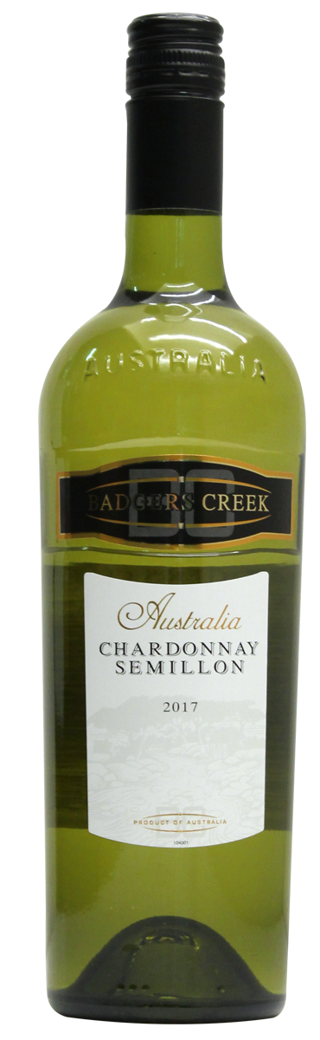
Major Grape Varieties and Characteristics
Chardonnay
Characteristics: A highly adaptable white grape, Chardonnay in Lebanon showcases crisp, refreshing acidity with flavors of green apple, pear, and citrus like lemon or grapefruit.
Depending on the winemaking style, it can also develop creamy, buttery notes from oak aging, with hints of vanilla or almond on the finish. It strikes a beautiful balance between freshness and richness, making it a favorite among white wine enthusiasts.
Food Pairings: Chardonnay’s versatility makes it a fantastic partner for a wide range of dishes. It shines with seafood—like grilled shrimp, sea bass, or Lebanese-style fish with garlic and lemon. It’s also great with poultry dishes, such as lemon chicken or a creamy chicken pasta. For something more indulgent, try it alongside a rich seafood risotto or buttery lobster.

Slide 30
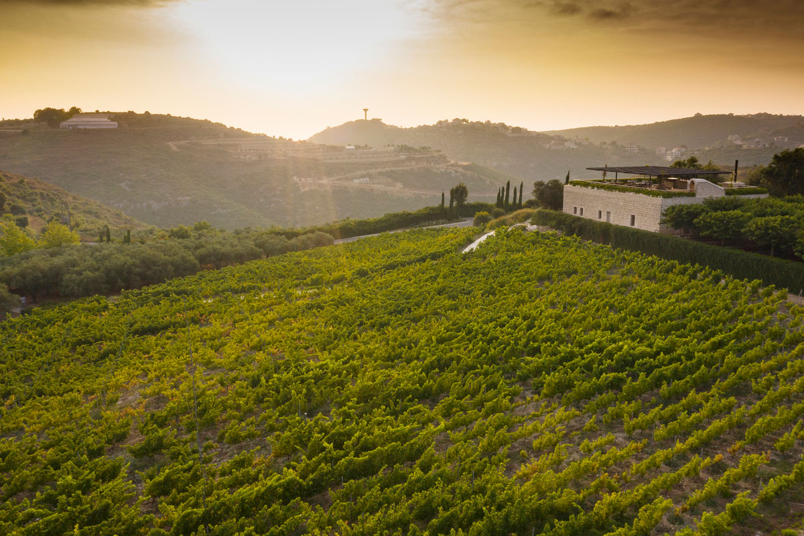
Notable Wineries
Lebanon’s wine industry, while compact in size, is a treasure trove of world-class wineries that rival some of the best from more established wine regions. Though small in scale, Lebanese wineries stand out for their dedication to craftsmanship, their connection to centuries-old winemaking traditions, and their innovative spirit that embraces both classic and modern techniques.
Many of these wineries have overcome immense challenges, including economic crises, political instability, and even war, to continue producing exceptional wines that capture the essence of Lebanon’s unique terroir.

Slide 31
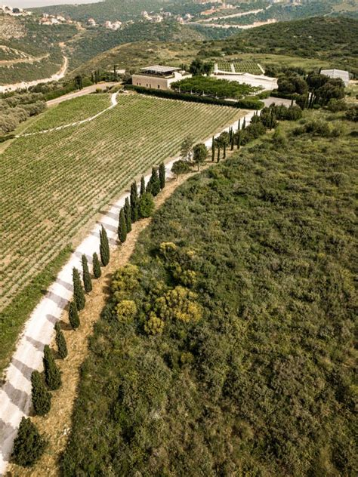
Notable Wineries
Whether nestled in the sun-drenched Bekaa Valley or perched on the cool mountain slopes of Mount Lebanon, these wineries are producing wines that are gaining international acclaim, winning prestigious awards, and delighting wine enthusiasts around the world.
From bold, complex reds to aromatic, refreshing whites, these wineries embody the rich diversity of Lebanon’s viticultural landscape. Let’s take a closer look at a few of the most notable wineries that have not only put Lebanese wine on the map but are also pushing boundaries and setting new standards in the world of winemaking:

Slide 32

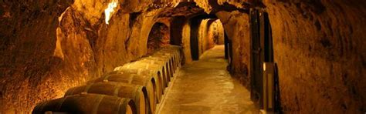
Notable Wineries
Château Ksara
Notable Wines: Château Ksara Reserve du Couvent
Awards: Château Ksara has won numerous international awards, including gold medals at the Concours Mondial de Bruxelles.

Slide 33

Notable Wineries
Château Musar
Notable Wines: Château Musar Red
Awards: Château Musar’s wines have been highly acclaimed internationally, with Robert Parker giving its red wine 90+ point scores.

Slide 34
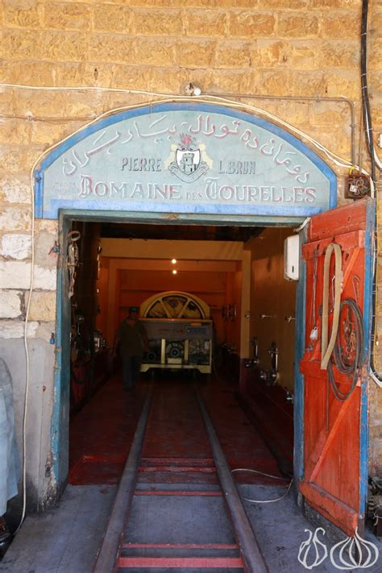

Notable Wineries
Domaine des Tourelles
Notable Wines: Domaine des Tourelles Red Blend
Awards: Domaine des Tourelles is recognized for its bold, terroir-driven wines that reflect the unique characteristics of Lebanon’s vineyards.

Slide 35
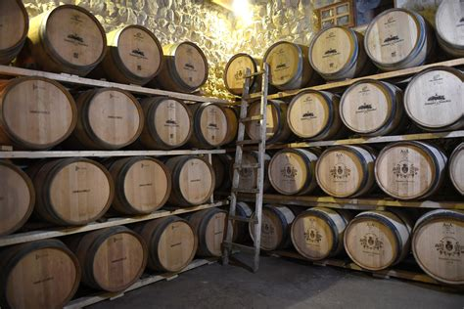
Last Thoughts
Lebanon’s wine industry is truly a blend of the old and the new. The country’s ancient winemaking traditions, dating back thousands of years, still resonate in the vineyards today, even as modern technology and innovative winemaking techniques are shaping the future of its wines.
The resilience of Lebanese winemakers,
especially in the face of historical
challenges like war and political turmoil,
speaks volumes about their passion and
dedication to crafting wines of
exceptional quality.

Slide 36

Last Thoughts
Whether you’re drawn to the full-bodied reds of the Bekaa Valley or the crisp whites of coastal Batroun, Lebanon offers an exciting variety of wines that are deeply tied to their terroir. And while the country is small, its influence in the global wine scene is steadily growing, proving that Lebanese wines can stand shoulder to shoulder with the best in the world.
As you explore Lebanon’s diverse wines, you’ll not only taste the complexity of its terroirs but also connect with the history, culture, and people who made this wine.
So, whether you’re a long-time wine lover or a newcomer to the world of Lebanese wines, there’s always something new and exciting to discover in every glass.

Slide 37

Conclusion
Lebanon’s rich winemaking history, diverse terroir, and commitment to quality have positioned it as a rising star in the global wine industry.
From the ancient Phoenicians to the resilient modern winemakers, Lebanon’s wines are a reflection of the country’s unique climate, geography, and culture.
As the industry continues to grow, wine enthusiasts around the world are discovering the magic of Lebanese wines—bold, vibrant, and full of character.
Whether you're savoring a glass of Cabernet
Sauvignon from the Bekaa Valley or enjoying a
crisp Chardonnay from Batroun, one thing is
certain: Lebanese wines offer an unforgettable
tasting experience that connects you to thousands
of years of history and a bright, promising
future. Cheers to the wines of Lebanon!

Slide 38
Acknowledgement
My seminars are the result of many years of experience combined with many hours of research over the internet.
I would like to acknowledge the many source I have accessed.
These include Wine Spectator, Wine Enthusiast, BKWine Magazine, Wine & Spirits Magazine, American Vineyard Magazine, The Grapevine Magazine, Wikipedia.com, Britannica.com, and the
various Government websites.

Slide 39
Citations and References
The Oxford Companion to Wine, Fourth Edition, Jancis Robinson – For historical context on Lebanese wine production.
Lebanese Wines and Vineyards: An Introduction by Michael Karam – Provides in-depth insights into Lebanese wine culture and its French influence.
Wine Grapes: A Complete Guide to 1,368 Vine Varieties, Jancis Robinson – For information on grape varieties such as Obeidi and other indigenous grapes.
Wine Folly: The Essential Guide to Wine, Madeline Puckette and Justin Hammack – Overview of German and Austrian wine classifications and the Prädikat system.
Bekaa Valley Wineries: Exploring Lebanese Wines by Michael Karam – Discusses the influence of terroir and winemaking techniques in Lebanon.

