Slide 1

Le Havre, France
Port Guide
Presented by
Marc Silver

Slide 2
What I Will Cover
My Port Philosophy
Don’t Miss the Ship
Money
Exchanging Money
A Brief History of Le Havre
Maps
Transportation
Top Attractions & Points of Interest
Local Cuisine & Dining Options
Important Tips & Practical Advice
Conclusion

Slide 3
My Port Philosophy
I have been cruising for over 46 years and have taken over 100 cruises.
So, I consider myself an experienced cruiser.
The information I will present is based on those many years of
experience.
When I am on a cruise where the city, I want to visit is not the port city,
I always recommend taking a ship’s tour.
But when I am in a port with multiple attractions nearby and easy to see
on my own -
I will do it on my own.
This presentation is not like that.

Slide 4

Don’t Miss the Ship
How to Avoid Missing Your Ship
Pay attention to the time. - Ship time and local time are often
different.
Put a return-to-ship reminder on your phone.
Choose excursions wisely.
If a ship-sponsored excursion is late returning to port, the ship will
wait for you. If you are on your own???
Be Prepared
Have your Passport, Credit Card, and phone numbers for your ship
port agent.
What to Do If You Miss the Ship
Most cruise lines have port agents stationed in the port area to assist if your ship has left without you. If your are lucky, when cruisers are late returning to the vessel, the ship’s crew will often remove the passengers’ essential items – passports, cell phones, and medication -- from the ship to leave with the port agents.
The Port Officials can help you with contacting your ship
and making necessary travel arrangements.

Slide 5
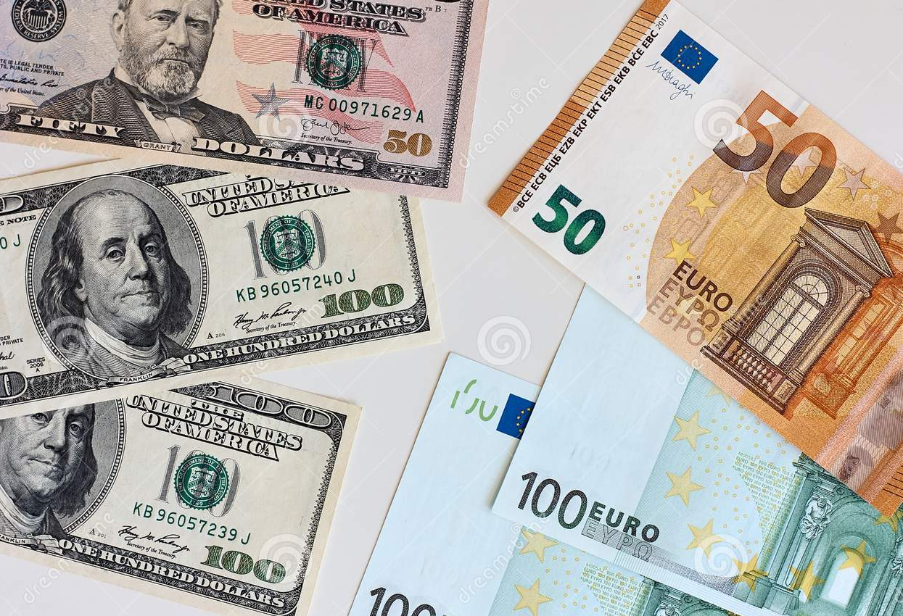
Money
France uses the Euro (€) as its official currency.
As of January 2026, the exchange rate between
the Euro and the U.S. Dollar (USD) is about
1 EUR = 1.17 USD.
This means U.S. travelers should anticipate slightly
higher prices in terms of conversion, but Spain remains a relatively affordable destination compared to many other Western European countries.
When exchanging money, it’s best to avoid doing so at the port exchange kiosks, as they tend to have higher fees and less favorable rates.
Instead, consider using ATMs to withdraw Euros directly, as they often offer better rates. Additionally, credit and debit cards are widely accepted throughout Alicante, though having some cash on hand is always a good idea for smaller purchases or tips.

Slide 6
A Brief History of Le Havre
Le Havre, founded in 1517 by King Francis I of France, was built as a strategic port on the English Channel.
The city flourished through maritime trade and became a major transatlantic gateway. During World War II,
Allied bombing devastated Le Havre, destroying much of its historic center.
Architect Auguste Perret led its postwar reconstruction using innovative reinforced concrete, creating a distinctive modernist cityscape.
This remarkable rebuilding earned UNESCO World Heritage status in 2005, recognizing Le Havre's unique 20th-century urban architecture.

Slide 7
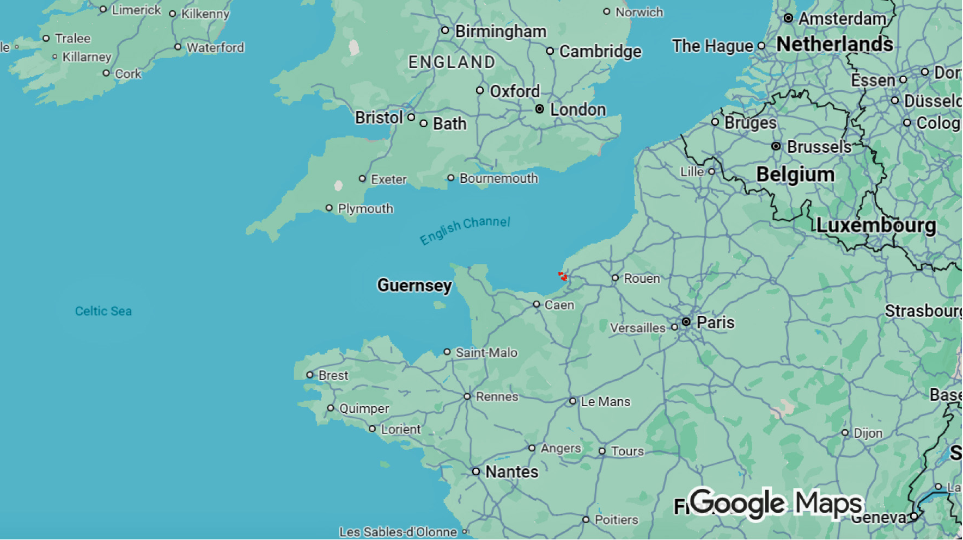
Le Havre

Slide 8
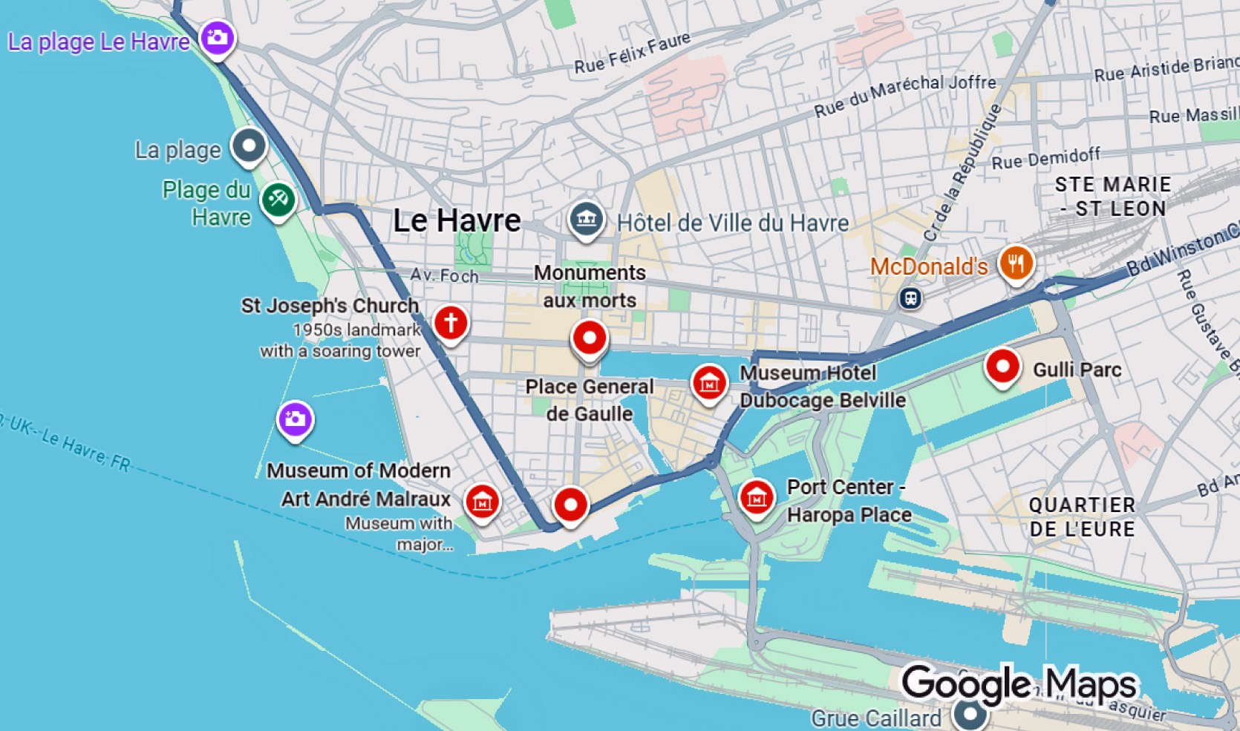
Cruise Terminal

Slide 9
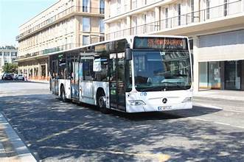
Getting Around Le Havre
Public Transit: Le Havre has an efficient bus network operated by LIA (Transports en Commun de l'Agglomération Havraise) with over 30 lines covering the city and surrounding areas. Tickets can be purchased on buses or at kiosks. The system includes both regular buses and express lines.
Tram: The city features a modern tramway line that connects key areas including the city center, beach, and main transportation hubs. It's convenient for tourists visiting major attractions.

Slide 10
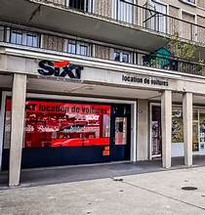
Transportation
Car Rental: Daily rental rates start around €130-€150 for basic vehicles, plus fuel costs (approximately €20-€30 for the round trip) and potential tolls on the A13 motorway (around €10-€15 each way).
The nearest car rental dealer is the Sixt Le Havre Centre/Cruise Terminal office which is less than two miles from the cruise dock.

Slide 11
Shuttle Buses To Le Havre
Shuttle buses are available from Le Havre cruise port to the city center. They typically operate every 30 minutes, providing convenient access to key locations such as the city center, Le Havre Train Station, and Les Docks shopping center.
Departure Points: Shuttles leave from the Cruise Terminal and return from the city center and other stops.
Free Options: Some tour services, like Bee Le Havre, offer free shuttle transfers for those with reservations for their tours, departing at 10:00 AM on cruise ship call days.
Route: These shuttles often make multiple stops or take indirect routes, adding to journey time compared to taxis or direct transit options.
Cost: Shuttle fares are generally affordable, ranging from €2-€5 per person, making them budget-friendly despite the convenience trade-off.

Slide 12
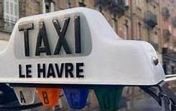
Options from Port to Downtown
Taxis: Available at the cruise terminal and ferry
port, offering direct transport to your destination
in 10-15 minutes for around €15-€25.
Public Buses: Regular LIA buses connect the
port area to downtown, offering more frequent
service than dedicated shuttles, with tickets
around €1.80-€2.00.
Walking: Depending on your location in downtown, the port can be 20-40 minutes on foot—feasible for those without heavy luggage who want to see the city.

Slide 13
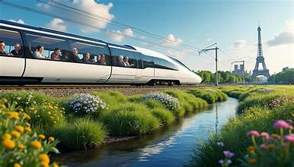
Transportation to Paris
Train: The fastest and most popular option is the SNCF train from Le Havre station to Paris Saint-Lazare. Direct trains take approximately 2 to 2.5 hours, with frequent daily departures. This is the recommended choice for most tourists.
Train (SNCF): Prices vary significantly.
Advance booking: €15-€35 for standard class. Last-minute or peak times: €30-€60+
First class: €40-€80+ Booking early online typically offers the best rates.

Slide 14
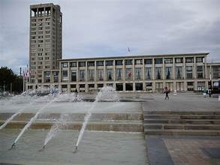
Points of Interest in Le Havre
UNESCO World Heritage Architecture
The Reconstructed City Center: The star attraction is Auguste Perret's post-WWII reconstruction, a UNESCO World Heritage Site since 2005.
The innovative use of reinforced
concrete created a unique modernist
urban landscape with wide boulevards,
geometric buildings, and monumental
spaces that represent a revolutionary
approach to urban planning.

Slide 15
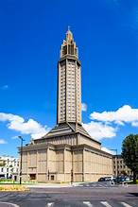
Points of Interest in Le Havre
St. Joseph's Church (Église Saint-Joseph): This striking modernist masterpiece designed by Perret features a soaring 107-meter octagonal tower that serves as a beacon and war memorial.
Inside, over 12,000 pieces of colored glass create a breathtaking kaleidoscope of light.
It's one of Le Havre's most iconic landmarks.

Slide 16
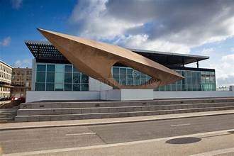
Points of Interest in Le Havre
Museums & Culture
MuMa (André Malraux Museum of Modern Art): Located on the waterfront with floor-to-ceiling windows offering stunning sea views, MuMa houses one of France's finest Impressionist collections, second only to Paris's Musée d'Orsay. Works by Monet, Renoir, Pissarro, and Boudin are highlights.

Slide 17
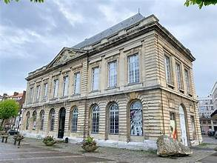
Points of Interest in Le Havre
Natural History Museum: Features collections of ethnography, natural sciences, and regional history in a beautiful 18th-century building
Appartement Témoin Perret: This preserved 1950s show apartment demonstrates how residents lived in Perret's reconstructed buildings, offering fascinating insight into postwar domestic life and design.

Slide 18
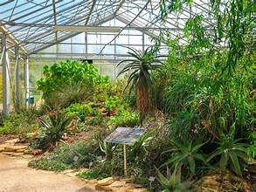
Points of Interest in Le Havre
Les Jardins Suspendus (Hanging Gardens): Built on the site of a 19th-century fort overlooking the Seine estuary, these terraced botanical gardens feature plants from around the world organized by geographic origin. The views over the port and coastline are spectacular.

Slide 19
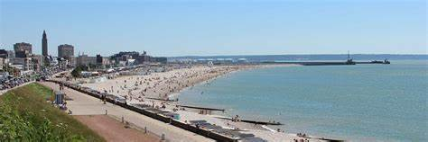
Points of Interest in Le Havre
Waterfront & Beach
Le Havre Beach: A long pebble beach stretching along the English Channel promenade is perfect for strolls, with beach clubs, cafés, and water sports available in summer. The beach offers views of container ships entering the port.
Port Area: As one of Europe’s
largest container ports, watching
the maritime activity is
fascinating. The Docks Vauban
area has been transformed into a modern shopping and leisure district.

Slide 20
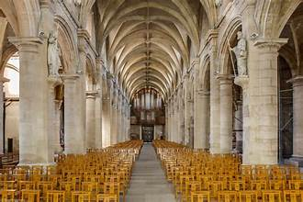
Points of Interest in Le Havre
Historic Quarter
Quartier Saint-François: One of the few areas to survive WWII bombing, this charming old district features narrow streets, traditional Norman houses, and the original 16th-century harbor basin (Bassin du Commerce).
Notre-Dame Cathedral: Originally built in the 16th-17th centuries, this Renaissance-Baroque cathedral survived the
war and was later renovated. Its mixture of old
stonework and modern concrete additions
symbolizes Le Havre's blend of history and
modernity.

Slide 21
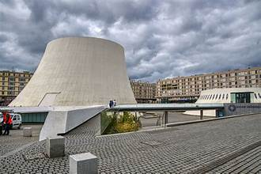
Points of Interest in Le Havre
Contemporary Landmarks
Le Volcan (The Volcano): Designed by
Brazilian architect Oscar Niemeyer, this
striking white cultural center resembles
a volcano and houses theaters and
performance spaces. Its futuristic design
contrasts beautifully with Perret’s
geometric modernism.
Catène de Containers: Artist Vincent Ganivet's colorful installation of stacked shipping containers creates an arch near the beach, celebrating Le Havre's maritime heritage in a playful contemporary way.

Slide 22
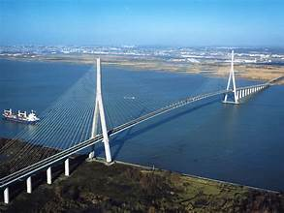
Points of Interest in Le Havre
Pont de Normandie: While technically outside Le Havre, this engineering marvel is a cable-stayed bridge spanning the Seine estuary, connecting Le Havre to Honfleur. At 2.1 kilometers, it was the longest cable-stayed bridge in the world when completed in 1995.
Le Havre offers a unique experience for visitors interested in modernist architecture, maritime history, Impressionist art, and coastal leisure, all wrapped in a city that rose from devastation to become a testament to postwar renewal.

Slide 23
Le Havre Local Cuisine & Dining Options
Must-Try Dishes
Seafood Specialties: As a major port city on the Normandy coast, Le Havre excels in fresh seafood. Look for moules marinières (mussels in white wine), sole meunière (Dover sole in butter sauce), and fresh oysters from nearby beds. Fish soup and seafood platters are staples.
Norman Classics: Try the region's famous dishes including tripes à la mode de Caen (slow-cooked tripe in calvados and cider), canard à la rouennaise (pressed duck), and teurgoule (a cinnamon-spiced rice pudding baked for hours).
Marmite Dieppoise: This creamy fish stew with white wine, cream, mussels, and various fish is a Normandy coastal favorite found throughout Le Havre.
Notes:
Cheese: Sample local Norman cheeses like Camembert, Pont-l'Évêque, Livarot, and Neufchâtel. These pair perfectly with crusty bread and Norman cider.
Quick Snacks: Grab galettes (savory buckwheat crêpes) filled with ham, cheese, and eggs, or sweet crêpes with salted caramel or apple compote. Crêperies are everywhere and perfect for casual meals.

Slide 24
Le Havre Where to Eat
Le Grignot: Located in the Saint-François quarter, this bistro serves traditional Norman cuisine with emphasis on fresh, local ingredients and seafood in a cozy atmosphere.
Jean-Luc Tartarin: An upscale Michelin-starred restaurant offering refined Norman and French cuisine with creative presentations and exceptional wine.
La Petite Auberge: A charming spot for authentic regional dishes including excellent moules-frites and local fish preparations at reasonable prices.
Marché Central (Central Market): Visit this indoor market for fresh produce, cheeses, charcuterie, and prepared foods. Several stalls offer ready-to-eat items perfect for picnics by the beach.
Les Halles Centrales: This covered market area features food vendors and small eateries where you can sample local specialties and enjoy the authentic market atmosphere.
Notes:
Cheese: Sample local Norman cheeses like Camembert, Pont-l'Évêque, Livarot, and Neufchâtel. These pair perfectly with crusty bread and Norman cider.
Quick Snacks: Grab galettes (savory buckwheat crêpes) filled with ham, cheese, and eggs, or sweet crêpes with salted caramel or apple compote. Crêperies are everywhere and perfect for casual meals.

Slide 25
Important Tips & Practical Advice
Time to visit attractions: Most of the major sites can be visited in 1-2 hours, but plan for 3-4 hours at the Vatican if you want to see it all.
Booking excursions: Cruise lines offer packages, but you’ll find better value booking independently through reputable tour companies.
Safety: Rome is generally safe, but watch out for pickpockets in crowded tourist areas. Stick to tap water—it's safe to drink and widely available.

Slide 26
Thanks For Coming
If you have any more questions, please ask.
I will do my best to answer them for you.
Have a great visit in Le Havre!

