Slide 1

La Paz, Mexico Presented by Marc Silver

Slide 2
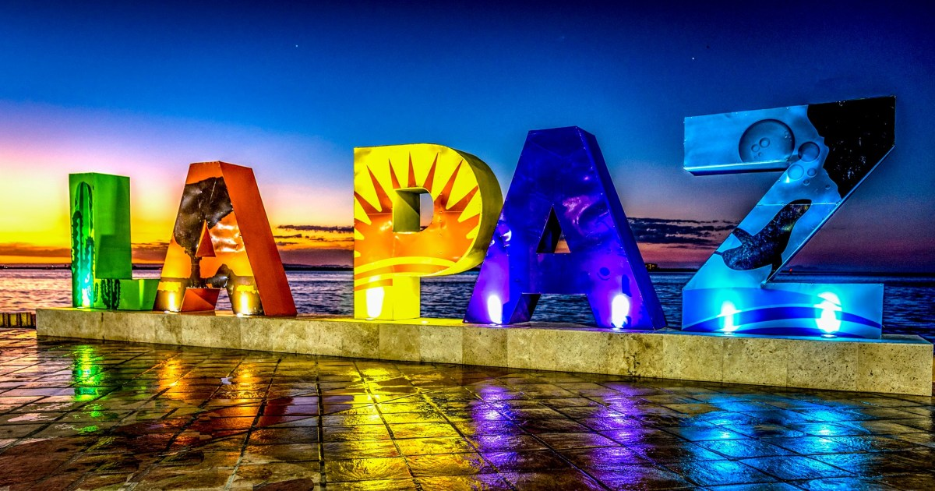
What I Will Cover
My Port Philosophy
Don’t Miss the Ship
Money
About La Paz
History of La Paz
Map of La Paz
Weather of La Paz
Getting Around
Points of Interest and things to do
A few restaurant recommendations
Conclusion

Slide 3
My Port Philosophy
I have been cruising for over 45 years and have taken over 100 cruises. So, I consider myself an experienced cruiser.
The information I will present is based on those many years of
experience.
When I am on a cruise where the city, I want to visit is not the port city,
I always recommend taking a ship’s tour.
But when I am in a port with multiple attractions nearby and easy to see
on my own - I will do it on my own.
This presentation is for that type of port.

Slide 4
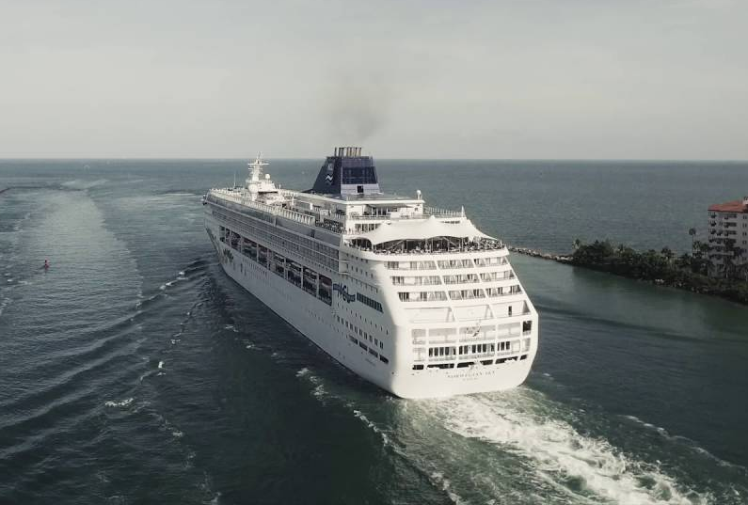
Don’t Miss the Ship
How to Avoid Missing Your Ship
Pay attention to the time. - Ship time and local time are often different.
Put a return-to-ship reminder on your phone.
Choose excursions wisely.
If a ship-sponsored excursion is late returning to port for, the ship will wait for you. If you are on your own???
Be Prepared
Have your Passport, Credit Card and phone numbers for your ship port agent.
What to Do If You Miss the Ship Most cruise lines have port agents stationed in the port area to assist if your ship has left without you. If you’re lucky, when cruisers are late returning to the vessel, the ship's crew will often remove the passengers' essential items -- passports, cell phones and medication -- from the ship to leave with the port agents.
The Port Officials can help you with contacting your ship and making necessary travel arrangements.

Slide 5
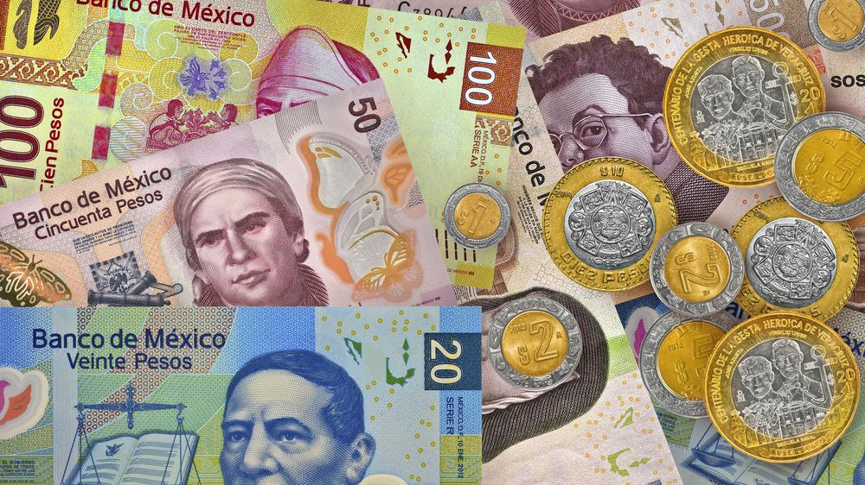
Money
The Peso is the official currency of Mexico
Official Exchange is 100 Pesos is $5.80 US
Or 17.35 Pesos to the US Dollar

Slide 6
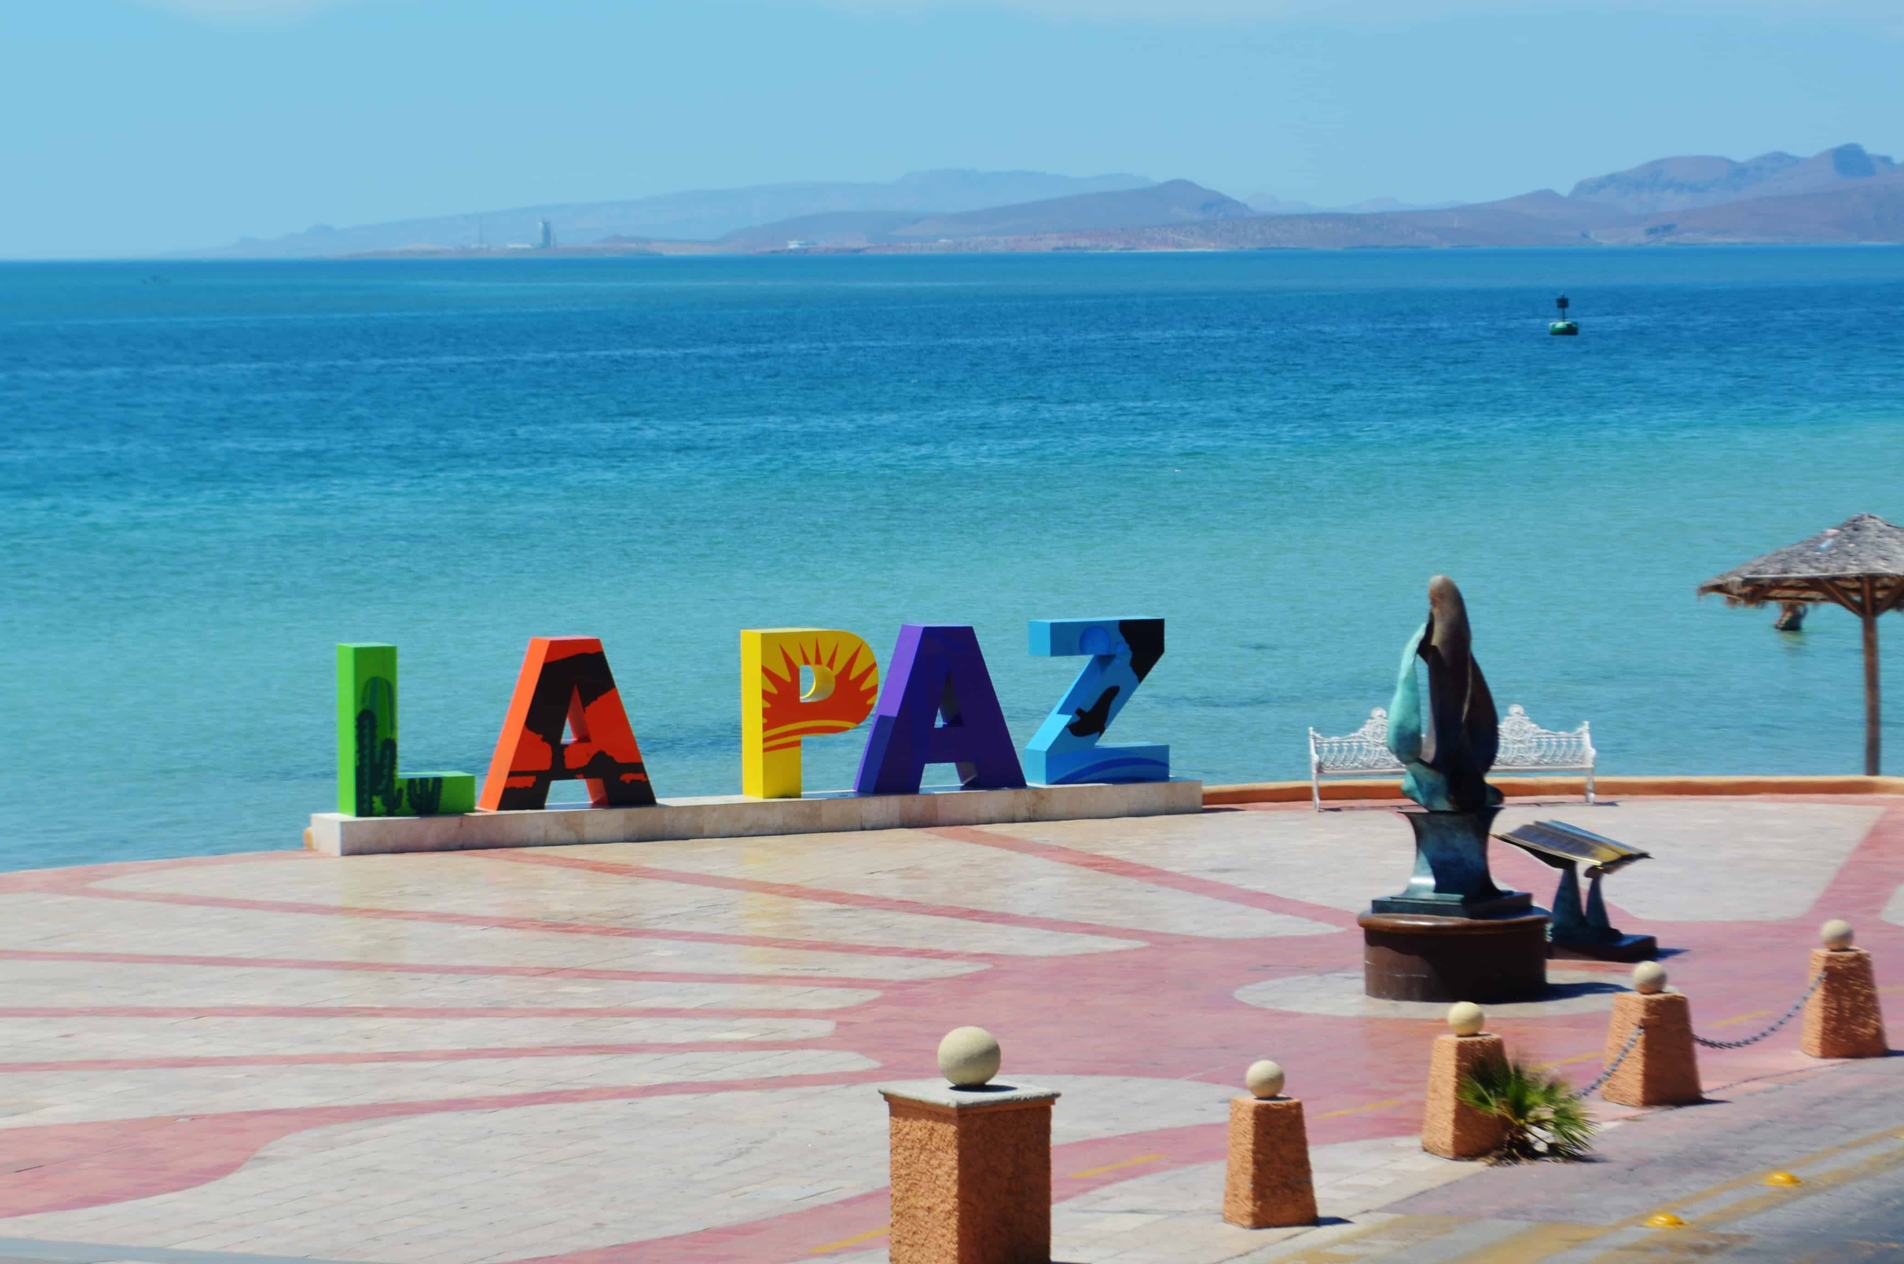
About La Paz Mexico
La Paz is truly a Mexican city. Except in the malecón area, be ready to use your Spanish skills. Although everyone is helpful and friendly, English is not as well known here as in other parts of BCS.
The Baja California peninsula consists of two states, Baja California to the north and Baja California Sur at the lower end of the peninsula. La Paz is the state capital of Baja California Sur (BCS). Much of the BCS population lives in either La Paz or the combined cities of Cabo San Lucas and San Jose known as Los Cabos.
Located on the peninsula’s east coast, La Paz hugs an inlet from the Sea of Cortez and expands in rings to the south. Starting at the water is the famous Malecón which stretches three-and-a-half miles east to west providing a beautiful area to stroll and enjoy the sunshine. Surrounding the Malecón are boardwalk restaurants, artisans selling off carts, hotels, and marinas. This is the most tourist and English-speaking-friendly part of La Paz.

Slide 7
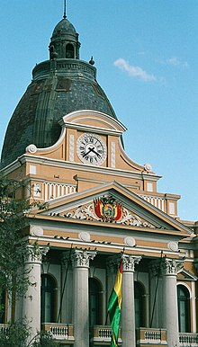
Historical La Paz
La Paz was founded by the Spanish conquistadors at the site of the Native American settlement Laja; the full name of the city was originally Nuestra Señora de La Paz (meaning Our Lady of Peace). Control over the former Inca lands had been entrusted to Pedro de la Gasca by the Spanish king (and Holy Roman Emperor) and the city of La Paz was founded on October 20, 1548.
Spain controlled La Paz with a firm grip and the Spanish king had the last word in all matters political. In 1781, for a total of six months, a group of Aymara people laid siege to La Paz and destroyed churches and government property.
In 1809, the struggle for independence from the Spanish rule brought uprisings against the royalist forces. It was on July 16, 1809, formally marked the beginning of the Liberation of South America from Spain.
In 1825, after the decisive victory of the Republicans at Ayacucho over the Spanish army during the Spanish-American wars of independence, the city's full name was changed to La Paz de Ayacucho (meaning The Peace of Ayacucho).

Slide 8
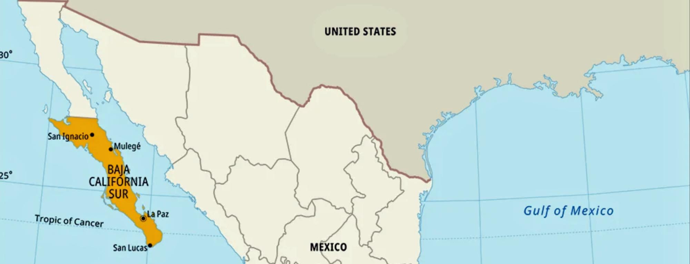
Map of Baja

Slide 9
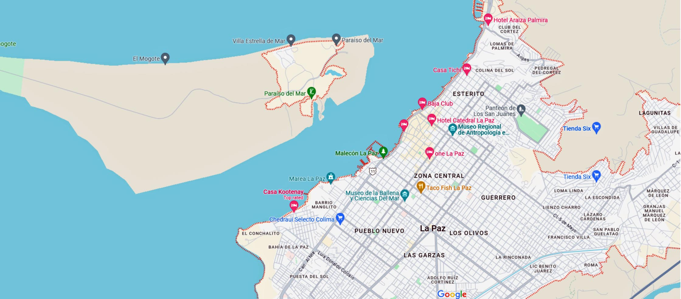
Map of La Paz

Slide 10
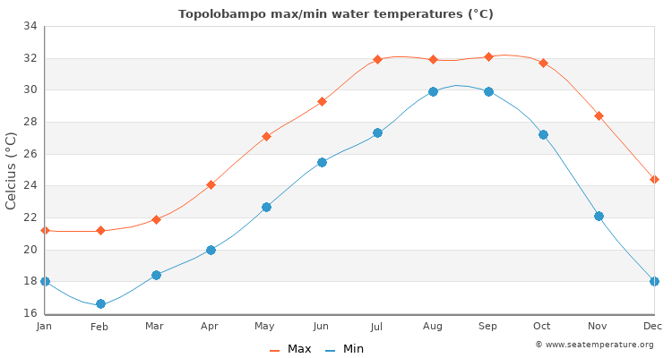
Weather in La Paz
La Paz sits at sea level and has a semi-arid climate. The temperature is usually warm or hot year-round.
April – October: daytime highs usually range from 32 to 38°C (90 to 100°F), night-time lows from 15 – 25°C (59 – 77°F). The rainy season is from July through September and the cities have occasionally been hit by hurricanes.
November – March: daytime highs range from 26 to 30°C (79 to 86°F), while nightly lows are
between 11 and 15°C (51 and 59°F).
The best time to go is in October as the landscape will be lush after the rain. However, as the weather is warm year-round, it’s easy to enjoy outdoor activities most of the year. It’s probably best to avoid July and August due to extreme temperatures and heavier rain.

Slide 11
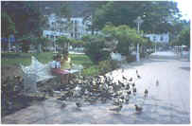
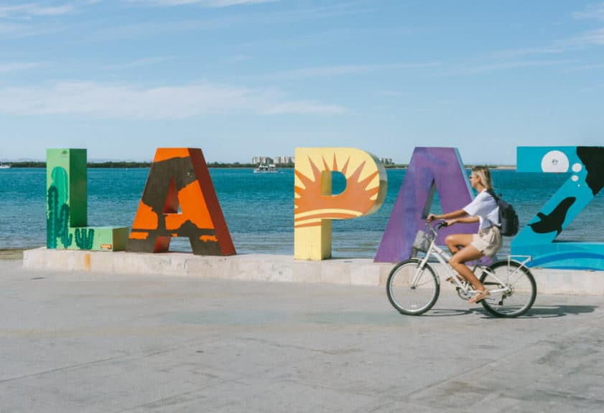
Getting Around La Paz
Because most of what you'll need and want in town is on the malecón, or a few blocks inland, it's easy to get around La Paz on foot.
Public buses go to some of the beaches north of town, but to explore the many beaches within 81km (50 miles) of La Paz, your best bet is to rent a car or hire a taxi. Several car-rental agencies have offices on the malecón.

Slide 12
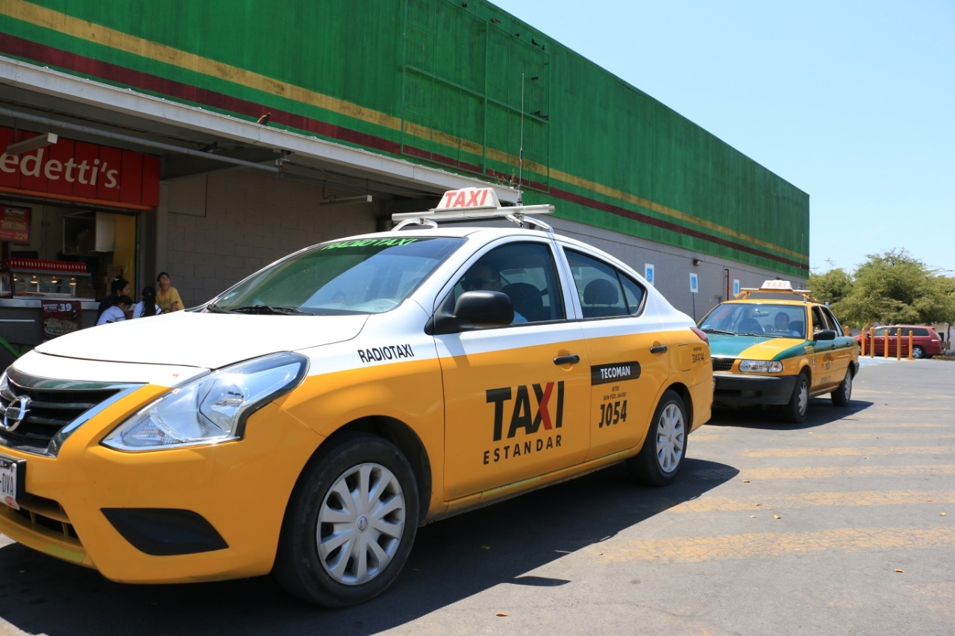
La Paz Taxis
Taxis in La Paz are plentiful. Taxis can be very reasonable, as long as you ask the price BEFORE you get in.
Be aware that Hotel taxis charge a premium rate because they've paid a higher union fee to sit in front of the hotel.
Make sure you have small change. Taxis will not carry change so they can keep yours.
You do not tip taxi drivers. The tip is included in the price.
Uber is also available if you have phone service and the app.

Slide 13
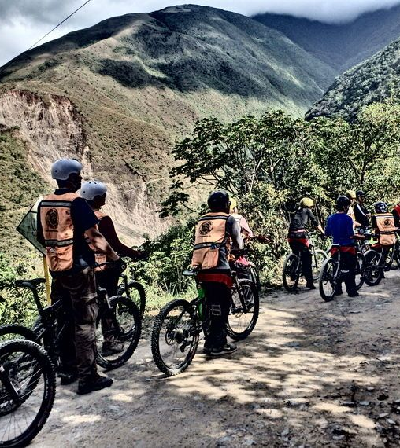
Bike In and Around La Paz
Rent a bike for 30 pesos an hour ($1.50) and enjoy a leisurely ride on the 5 km (3 mile) bike lane along the Malecón, while enjoying the ocean views and stopping at the waterfront restaurants for a break.
Or, hit the coastal or mountain trails of Baja California for a day of mountain biking.
For something more strenuous, try a mountain biking tour starting from $60 depending on trails and duration. For those wanting some exercise, mountain biking is one of the best things to do in La Paz.

Slide 14
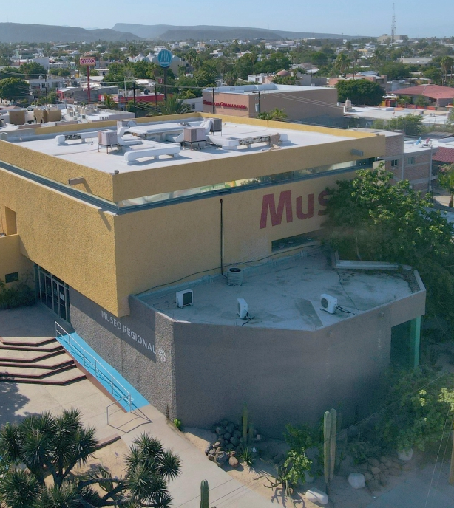
Museo de Antropologia e Historia de Baja California Sur
The Regional Museum of Anthropology and History of Baja opened in March 1981. The collection includes fossils that allow you to understand the natural diversity of the Californian peninsula 60 million years ago. Archaeological objects give an account of the presence of the first inhabitants.
The exhibition includes stones with inscriptions, photographs of paintings caves, mission books, regional handicrafts, details of diving pearls and forms of gold and copper extraction, as well as weapons and objects of the time.
General entrance: $70.00 MXN

Slide 15
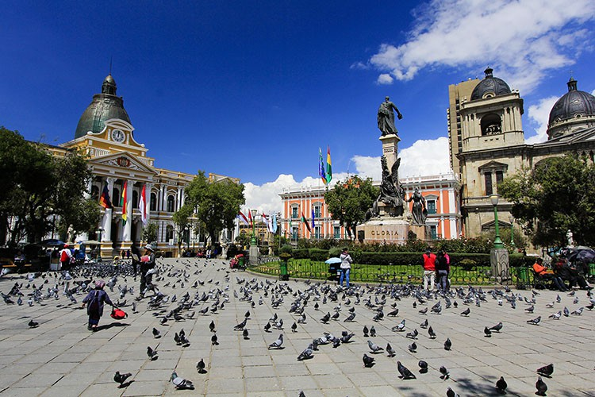
Stroll Around Old Town
The old town and Jardín Velazco are centered around Revolución de 1910 and Calle 5 de Mayo. You can wander the area independently or go on a 2-hour free English walking tour that locals offer. This is an excellent thing to do in La Paz and a great way to get your bearings.
The main square of Jardín Velazco, also called the Plaza Constitución, is one of the places in La Paz popular with the locals. It’s a great place for people-watching.

Slide 16
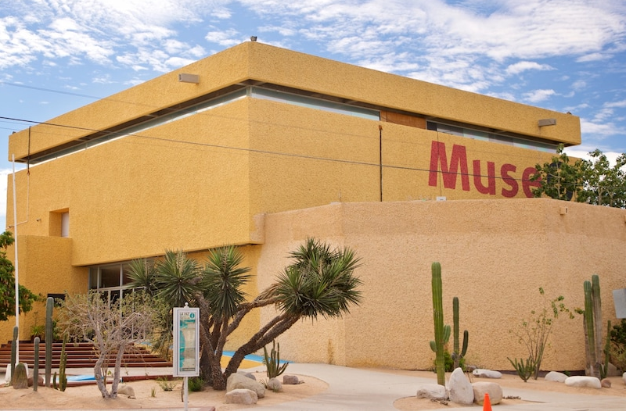
Museum of Anthropology & History
The Museo Regional de Antropología e Historia is an engaging museum located at Altamirano and 5 de Mayo. It features well-researched exhibitions of La Paz and Baja Sur history, from the Paleolithic era to the time of the missions, covering the influence of the Spanish colonization and how it impacted the original inhabitants.
If you’re a history buff, this is one of the things to
do in La Paz that you won’t want to miss. Note
that most (if not all) descriptions are in Spanish,
which I thought was a good way to practice the
language. Entrance costs 65 pesos (around $3)
and is open Monday to Sunday 9 am – 6 pm.
Address: Calle Ignacio Altamirano s/n, Zona
Central, 23000, La Paz, B.C.S., Mexico

Slide 17
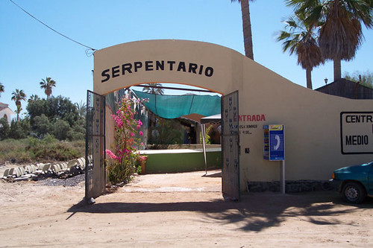
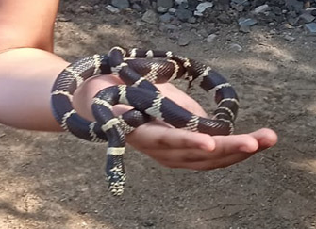
El Serpentario De La Paz
The El Serpentario is a non-profit organization that will show you a selection of typical fauna of the region, some even in danger of extinction. In this place to visit you will find a wide variety of snakes, reptiles, fish, turtles and spiders, also has a rehabilitation area for animals. If you are interested, you can even adopt an animal and your contribution will help to maintain the center.
Admission: $3 USD Adults
$ 1 USD Children
Brecha California, Blvrd Margarita Maza de Juárez s/n, 23090 La Paz, B.C.S., Mexico

Slide 18
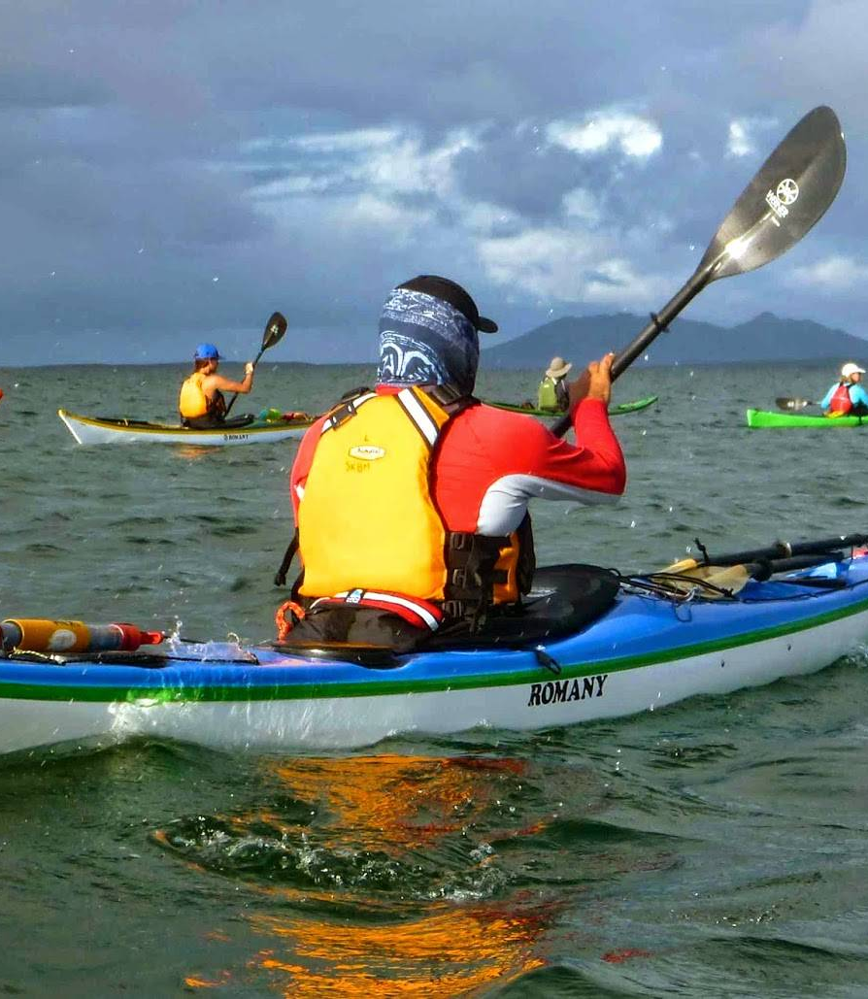
Kayak Rental
For the active sports enthusiast try Sea & Adventures locally called Mar Y Aventuras Baja offers sea kayaking rental.
Half-Day Kayak Rental Prices:
Singles, $25 (2-3 hours) $30 (4 hours) Doubles, $35 (2-3 hours) $40 (4 hours)
Rental Prices are in US Dollars (includes i.v.a. tax)
Calle Topete, E/ 5 de Febrero y Navarro 564, La Paz, MX 23060
+1 406 219 4181

Slide 19
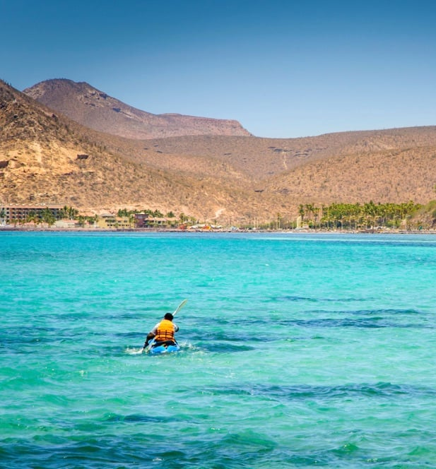
Rent a Kayak at Balandra Beach
Several beaches north of La Paz are easily accessible within an hour drive, but Balandra Beach is probably the most protected and ideal for kayakers. Free of motorboats, you can enjoy kayaking through the inland mangroves, explore the shallow bay, and even get out to the sea.
Kayak rental is possible from $15 USD / hour. The mouth of the bay tends to see strong waves and currents and can be challenging for novice kayakers. Watch for the stingrays that sometimes hide in the sandy bay floor.
Another option is to book a tour with a local and enjoy a small group kayak adventure with food, drinks, and equipment included.

Slide 20
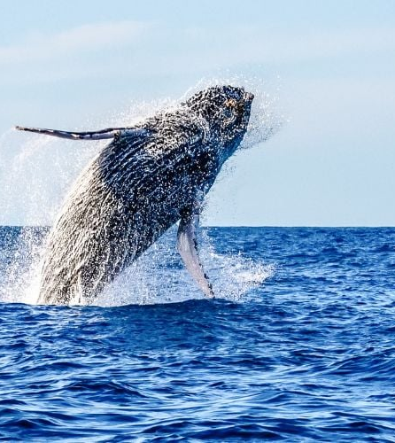
Visit the Whale Museum
The Museo de la Ballena is at the corner of Corner Calle Obregón and 16 de Septiembre, a short distance from the Malecón. You can’t miss it thanks to the massive whale skeleton exhibited in front of the.
The Whale Museum is on the small side but provides extensive information on whales, porpoises, and dolphins. A worthy stop for everyone, and I enjoyed it very much.
Entrance tickets are 120 to 160 Mexican Pesos ($6 – $8), which includes a 45-minute guided tour (English-speaking guide available).
Address: Antonio Navarro 855, Zona Central, 23000, La Paz, B.C.S., Mexico building

Slide 21
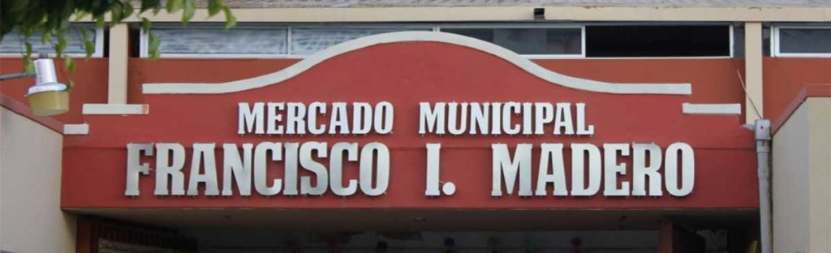
Smell the flavors of Mexico as local people shop for fresh fruits, meats, and vegetables at the Mercado Francisco I. Madero.
Grab snacks and fresh juices from the food stalls (comedors) at the entrance of the market and take a few minutes to admire the outside mural. Check out the leather goods, hats, quinceañera dresses and much more.
The Mercado is a long-standing institution in La Paz, and among one of the places to visit in La Paz to enjoy a cheap and tasty Mexican breakfast and lunch. Head to the corner of Revolucion De 1910 and Santos Degollado Monday to Sunday for your fill Mexico,
Mercado Francisco I. Madero.

Slide 22
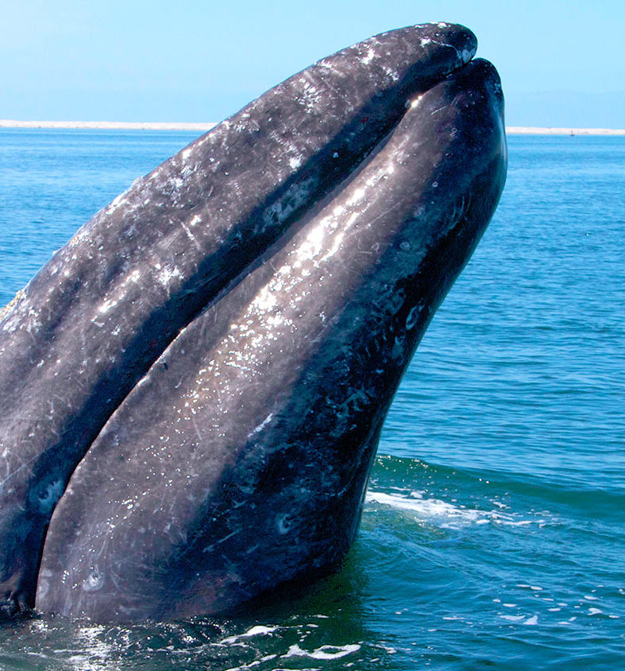
Whale-Watching in Magdalena Bay
From January to March, gray whales come to Baja California to enjoy the warm water of Magdalena Bay’s protected lagoon where they give birth to their young.
Going on a whale-watching cruise gives you the best chance of seeing the whales breed and raise their offspring. Other whales migrate to the Gulf of California throughout the year: March to July to see the blue whale (the largest whale in the world), February to June for the humpback whale, and October to February for the pilot whale This is one of the things to do in La Paz you won’t want to miss.
Day cruises start around $130

Slide 23
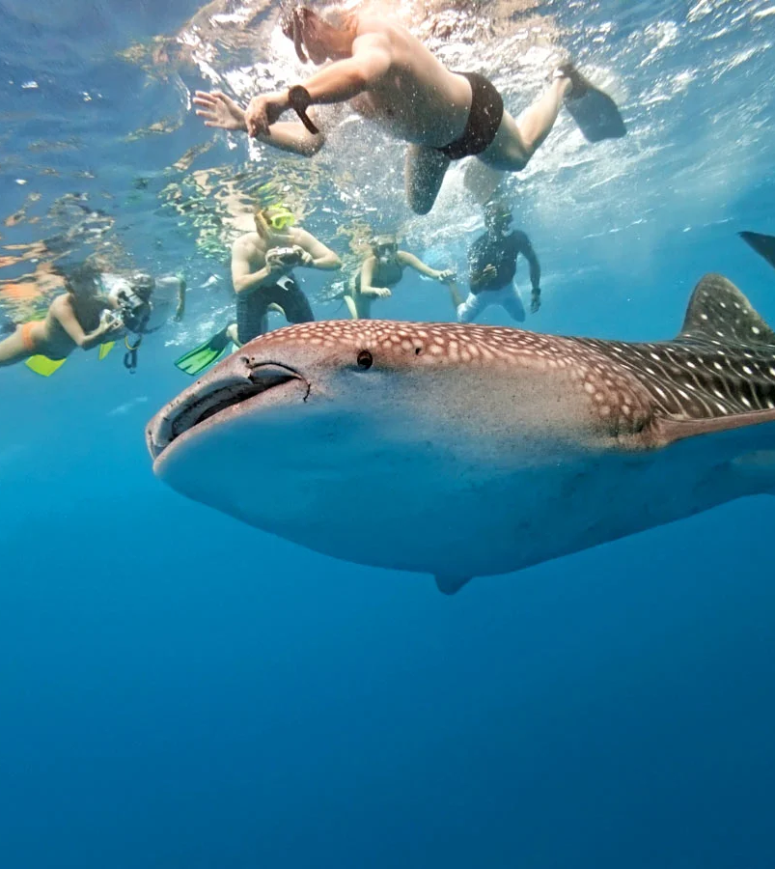
Snorkel with Whale Sharks
One of the top things to do in La Paz is snorkeling with whale sharks. Whale sharks – tiburón ballenas in Spanish – are the largest known fish, up to 13 m (42 ft) long. They are present around La Paz between October to March.
While it sounds scary, whale sharks only eat plankton and care little about humans. They are big, though, especially when you’re in the water with them.
Swimming by the giant fish is a fantastic experience. However, make sure the tour operator respects the regulations that protect the welfare of the animals, including the strict “no touching” policy, as well as a limited amount of people in the water at one time.

Slide 24
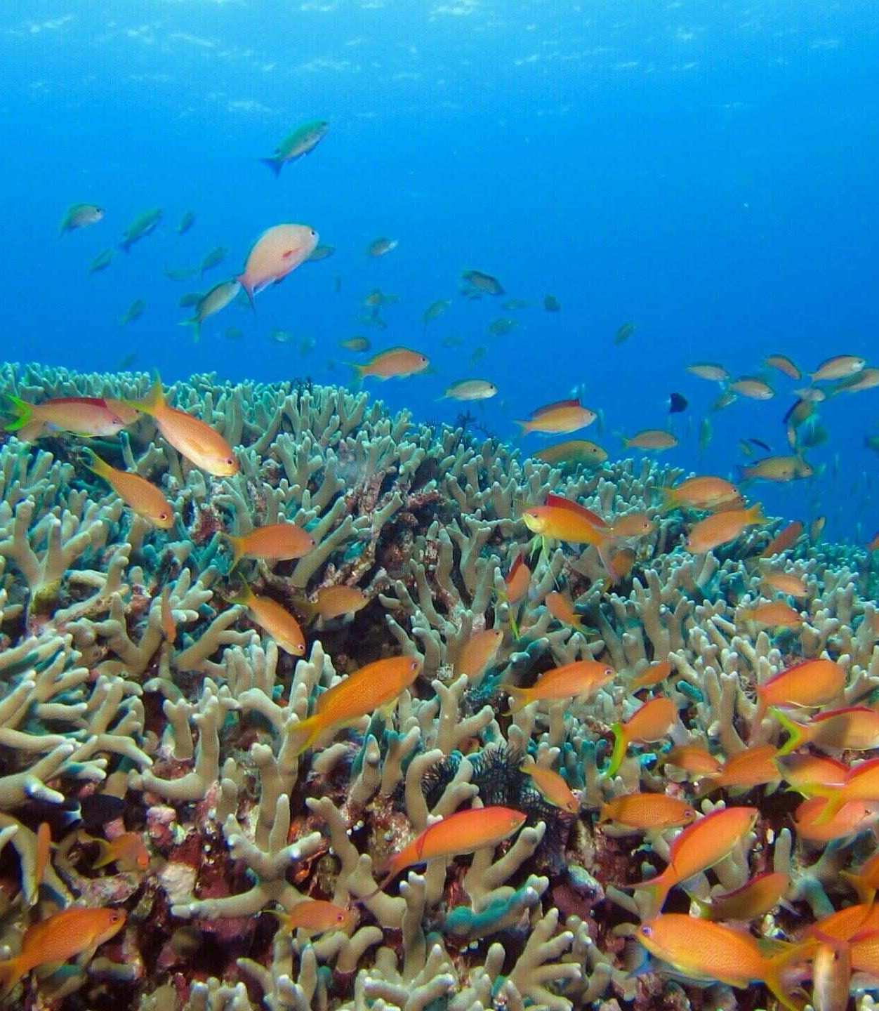
Dive in the Sea of Cortez
Jacques-Yves Cousteau named the area “the world’s aquarium,” and by all standards, the Sea of Cortez offers stunning diving opportunities. You’ll see manta rays, dolphins, healthy reefs, shipwrecks, sea lions, and more.
Top diving spots include Espíritu Santo Island and Los Islotes.
Water temp will be around 65 degrees while we are here.
This is great whether you snorkel or scuba dive. You can find tours on the Malecón.

Slide 25
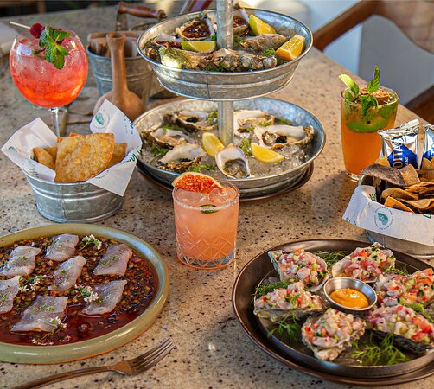
La Paz Restaurants
La Paz has many excellent restaurants, especially seafood restaurants. Many of us on the ship are foodies, so naturally, we’re always on the hunt to eat at the most exclusive spots anytime we travel.
Here are a few of the best restaurants to consider in downtown.
Quinta La Peregrina $$$$ Mexican Seafood Vegetarian Avenida 5 de Mayo # 12 (near the Malecón) Tailhunter Restaurant at Sea Level $$ - $$$ Mexican Bar Seafood
Calle Paseo Álvaro Obregón 755
Mack Fisher $ Latin Seafood Vegetarian Calle Jose Maria Morelos y Pavon Entre revolución y madero
Taco Fish la Paz $ Mexican Latin Seafood
Boulevard General Manuel Marquez de Leon S/N Esquina Con Heroes de Independencia, Zona Central
Also consider trying many of the street vendors.
For those of you who just like good food, you can’t go wrong with just about anywhere you go in La Paz.
GOOD EATING

Slide 26
Conclusion
La Paz is a beautiful City with a rich history and numerous attractions. Whether you're looking for stunning beaches, historic sites, or unique attractions, La Paz has something for everyone.
I hope this presentation will help when we visit La Paz!

Slide 27
Thanks For Coming
If you have any more questions, please ask.
I will do my best to answer them for you.
Have a great visit in La Paz!

