Slide 1

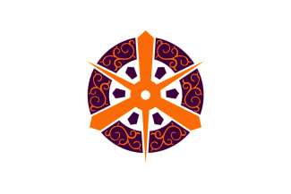
Kyoto, Japan Presented by fellow Cruiser Marc Silver

Slide 2
What I Will Cover
My Port Philosophy
Don’t Miss the Ship
Money
About Kyoto, Japan
History of Kyoto
Transportation
Points of Interest
Places to see or at least consider
A few restaurant recommendations
Conclusion

Slide 3
My Port Philosophy
I have been cruising for over 45 years and have taken over 100 cruises. So, I consider myself an experienced cruiser.
The information I will present is based on those many years of
experience.
When I am on a cruise where the city, I want to visit is not the port city,
I always recommend taking a ship’s tour.
But when I am in a port with multiple attractions nearby and easy to see
on my own - I will do it on my own.
This presentation is for that type of port.

Slide 4

Don’t Miss the Ship
How to Avoid Missing Your Ship
Pay attention to the time. - Ship time and local time are often different.
Put a return-to-ship reminder on your phone.
Choose excursions wisely.
If a ship-sponsored excursion is late returning to port, the ship will wait for you. If you are on your own???
Be Prepared
Have your Passport, Credit Card, and phone numbers for your ship port agent.
What to Do If You Miss the Ship Most cruise lines have port agents stationed in the port area to assist if your ship has left without you. If your are lucky, when cruisers are late returning to the vessel, the ship’s crew will often remove the passengers’ essential items – passports, cell phones, and medication -- from the ship to leave with the port agents.
The Port Officials can help you with contacting your ship and making necessary travel arrangements.

Slide 5
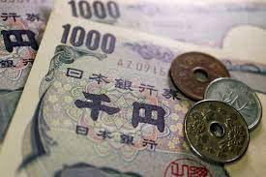
Money
The Yen is the official currency of Japan
Official Exchange is 100 Yen is 72 cents US
Or 142.15 Yen to the US Dollar

Slide 6
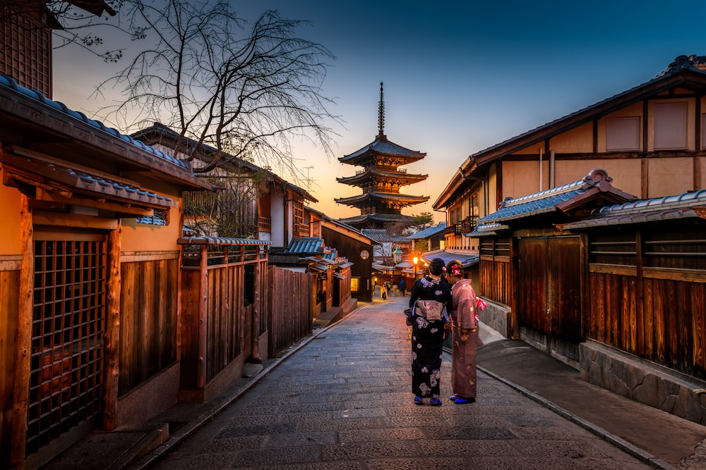
Kyoto, Japan
Kyoto, once the capital of Japan, is a city on the island of Honshu. It's famous for its numerous classical Buddhist temples, as well as gardens, imperial palaces, Shinto shrines, and traditional wooden houses. It’s also known for formal traditions such as kaiseki dining, consisting of multiple courses of precise dishes, and geisha, female entertainers often found in the Gion district

Slide 7
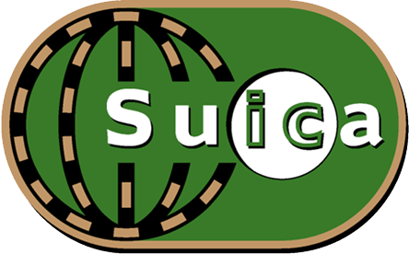
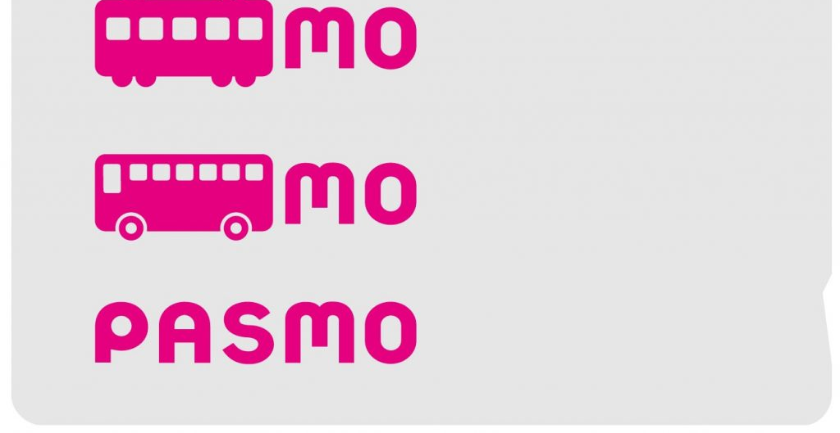
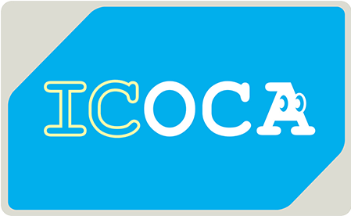
PASMO, Suica, & ICOCA Cards
The PASMO, Suica, and ICOCA Cards are e-money IC cards that can be used for travel and shopping across Japan.
Cashless fare payment
Use it for shopping
No waiting for change
Get special privileges
Apple phone users can also link with all three cards.
PASMO refunds - If you no longer need your PASMO, it can be refunded. Suica and ICOA cards do not offer refunds.

Slide 8
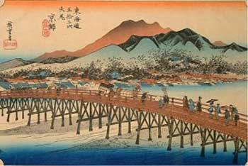
History of Kyoto
The history of Kyoto started as early as the eighth century CE when the city became the capital of Japan and home to the imperial court from 794 to 1868. Today, it is the capital of Kyoto Prefecture. Rich in historical sites, relics, and monuments, the city attracts more than 30 million visitors every year. Kyōto translates to “Capital City” but has had numerous names through the centuries—Heian-kyō (“Capital of Peace and Tranquility”), Miyako (“The Capital”), and Saikyō (“Western Capital”)., its name after the Meiji Restoration (1868) when the imperial household moved to
Tokyo. Kyōto is the center of traditional Japanese culture and of Buddhism, as well as fine textiles and other Japanese products. The deep feeling of the Japanese people for their culture and heritage is represented in their special relationship with Kyōto—all Japanese try to go there at least once in their lives, with almost a third of the country’s population visiting the city annually. Several of the historic temples and gardens of Kyōto were collectively added as a UNESCO World Heritage site in 1994. Area 320 square miles (828 square km). Pop. (2020) 1,463,723.

Slide 9
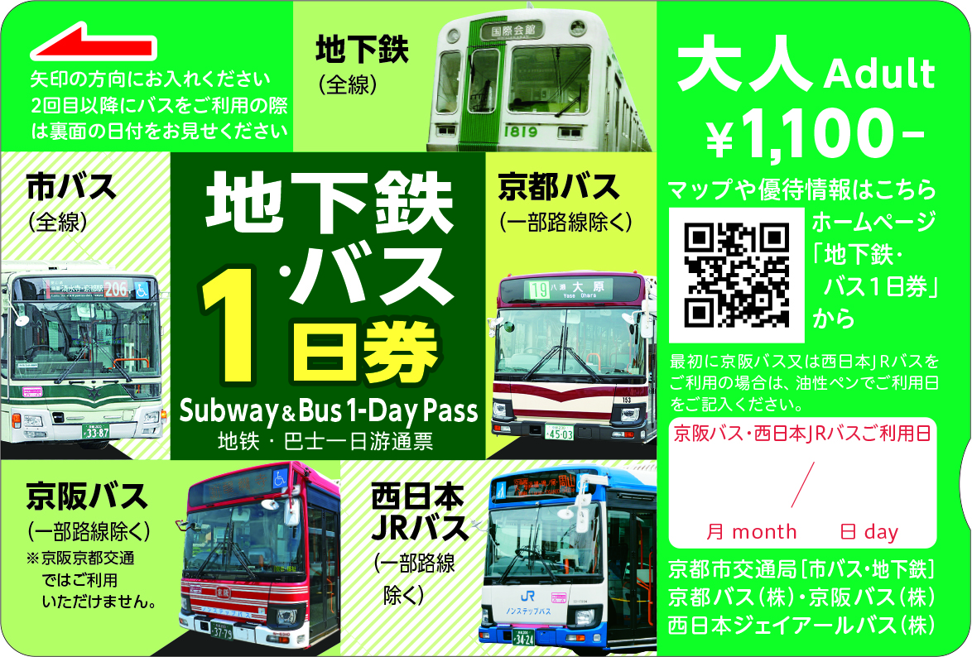
Transportation Tickets & Passes
Subway, Bus One-Day Pass is recommended to get to your destinations.
KANSAI ONE PASS - This card will let you use all train and bus lines in the Kansai region, which includes cities Kyoto, Osaka, and Kobe.
This pass will let you visit almost all the major sightseeing spots within the city and are more reasonable than buying only the Bus One-Day Pass and Subway One-Day Pass individually.
Can be used for subways, municipal buses, Kyoto Bus (some routes), Keihan Bus (some routes) and West Japan JR Bus.
Price: 1,100 Yen - Child 550 Yen

Slide 10
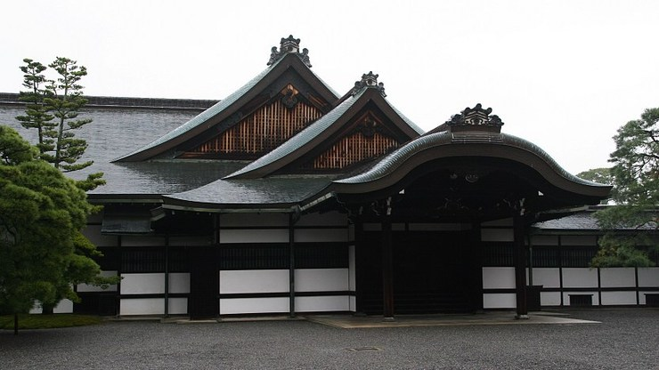
Sento Imperial Palace
Sento Imperial Palace with beautiful gardens is a secondary palace complex across from the Kyoto Imperial Palace in Kyoto Imperial Park. It was built in 1630 as the retirement palace of Emperor Gomizuno and became the palace for subsequent retired emperors.
The original palace buildings burned down in 1854 and were not rebuilt. Instead, Omiya Palace was constructed on the Sento grounds in 1867 and now serves as the lodging place for the current prince and princess during their visits to Kyoto.
The Palace is located within the Kyoto Imperial Park.
Free tours of held several times per day

Slide 11
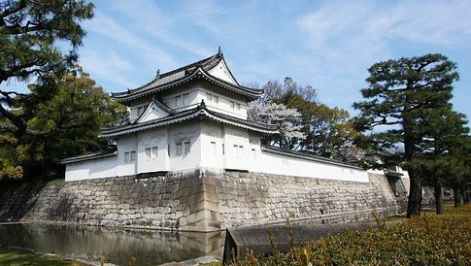
Nijo Castle (Nijojo)
Nijo Castle was the Former Kyoto residence of the shogun built in 1603 as the Kyoto residence of Tokugawa Ieyasu, the first shogun of the Edo Period (1603-1867). His grandson Lemitsu completed the castle's palace buildings 23 years later and further expanded the castle by adding a five-story castle keep. After the Tokugawa Shogunate
fell in 1867, Nijo Castle was used as an imperial palace for a while before being donated to the city and opened up to the public as a historic site. Its palace buildings are arguably the best-surviving examples of castle palace architecture of Japan's feudal era, and the castle was designated a UNESCO World Heritage Site in 1994.

Slide 12
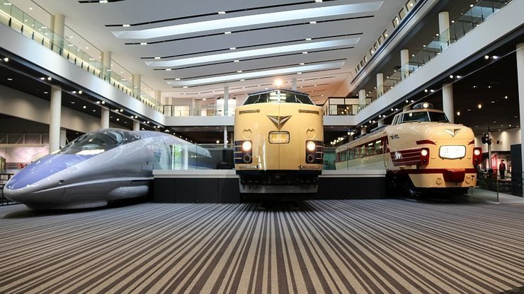
Kyoto Railway Museum
The Kyoto Railway Museum was opened in 2016 by JR West on the former site of the Umekoji Train and Locomotive Museum, about a twenty-minute walk west of Kyoto Station. It is one of Japan's three great railway museums alongside JR East's
Railway Museum in Saitama and JR Central's SCMAGLEV and Railway Park in Nagoya. Covering three floors on a 30,000 square meter site, the museum exhibits over 50 retired trains, from steam locomotives to more recent electric trains and Shinkansen.
General admission 1500 Yen

Slide 13
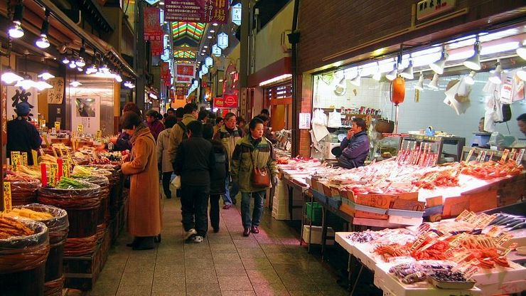
Nishiki Market
Nishiki Market (Nishiki Ichiba) is a narrow, five-block-long shopping street lined by more than one hundred shops and restaurants. Known as "Kyoto's Kitchen", this lively retail market specializes in all things related, like fresh seafood, produce, knives and cookware, and is a great place to find seasonal foods and Kyoto
specialties, such as Japanese sweets, pickles, dried seafood, and sushi. Nishiki Market has a pleasant but busy atmosphere that is inviting to those who want to explore the variety of culinary delights that Kyoto is famous for. The stores range from small narrow stalls to larger two-story shops. Most specialize in a particular type of food.

Slide 14
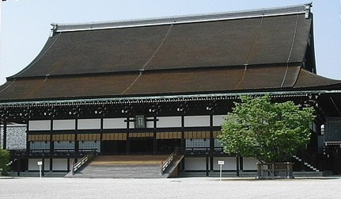
Kyoto Imperial Palace
The Kyoto Imperial Palace used to be the residence of Japan's Imperial Family until 1868, when the emperor and capital were moved from Kyoto to Tokyo. It is located in the spacious Kyoto Imperial Park an attractive park in the center of the city that also encompasses the Sento Imperial Palace, which served retired emperors, and a few other attractions.
The 1300-meter-long and 700-meter-wide park also serves as recreational space for both tourists and residents, featuring attractive, broad gravel paths, lawns, and tree groves. A pretty group of weeping cherry trees stands beside Konoe Pond in the park's northwestern corner and is usually in bloom for two to three weeks from late March to mid-April.
Admission is Free

Slide 15
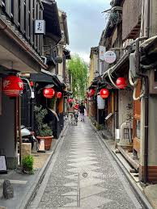
Pontocho
Pontocho is one of Kyoto's most atmospheric dining areas. It is a narrow alley running from Shijo-dori to Sanjo-dori, one block west of Kamogawa River. The alley is packed with restaurants on both sides offering a wide range of dining options from inexpensive yakitori to traditional and modern Kyoto cuisine, foreign cuisine, and highly exclusive establishments that require the right connections and a fat wallet.
Business hours and closing days of the restaurants, bars and shops along Pontocho vary by establishment, but most places are usually open from around 17:00 to 23:00. Some also open for lunch. Many establishments offer English menus.
The closest bus stop to Pontocho is Shijo Kawaramachi, which is served by numerous bus lines, including lines 17 and 205 from Kyoto Station. The closest train stations are Kyoto-Kawaramachi Station on the Hankyu Line and Shijo Station on the Keihan Line.

Slide 16
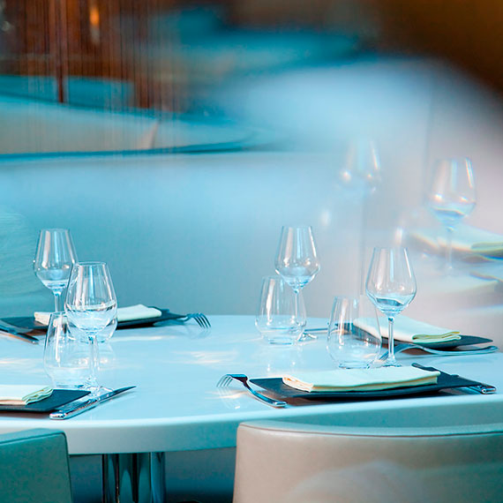
Kyoto Michelin Star Restaurants
Kyoto has many Michelin-star restaurants. Many of us on the ship are foodies, so naturally, we’re always on the hunt to eat at the most exclusive spots anytime we travel.
Here are a few of the Michelin Star Restaurants to consider.
Ection D’or 84-1 Okazaki Nishitennocho, Sakyo-ku, Kyoto, ¥ · Chicken
Ramen Touhichi - 8-6 Yamabana Itchodacho, Sakyo-ku, Kyoto, ¥ · Ramen
Ortensia - 274 Demizucho, Kamigyo-ku, Kyoto, ¥¥ · Italian
Sambongi Shoten - 478 Shincho, Kamigyo-ku, Kyoto, ¥¥ · Izakaya
Reine des prés - 537-1 Komanocho, Kamigyo-ku, Kyoto, ¥¥¥ · French
Kyoboshi - 347-92 Giommachi Kitagawa, Kyoto, ¥¥¥ · Tempura
LURRA˚-396 Sekisenincho, Higashiyama-ku, Kyoto, ¥¥¥¥ · Innovative
Kodaiji Wakuden - 512 Washiocho, Kyoto, ¥¥¥¥ · Japanese
For those of you that just like good food, you can’t go wrong just about anywhere you go in Kyoto.
GOOD EATING

Slide 17
Conclusion
Kyoto is a beautiful City with a rich history and numerous attractions. Whether you're looking for stunning beaches, historic sites, or unique attractions, Kyoto has something for everyone.
I hope this presentation will help when we visit Kyoto!

Slide 18
Thanks For Coming
If you have any more questions, please ask.
I will do my best to answer them for you.
Have a great visit in Kyoto!

