Slide 1
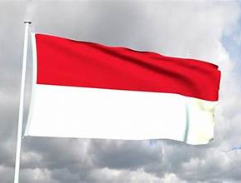
Komodo Indonesia Presented by Marc Silver

Slide 2
What I Will Cover
My Port Philosophy
Don’t Miss the Ship
Indonesia's Money
Komodo Land of Dragons
Maps
Getting Around
Highlights for Visitors
Food and Drink
Reflection

Slide 3
My Port Philosophy
I have been cruising for over 46 years and have taken over 100 cruises. So, I consider myself an experienced cruiser.
The information I will present is based on those many years of
experience.
When I am on a cruise where the city, I want to visit is not the port city,
I always recommend taking a ship’s tour.
But when I am in a port with multiple attractions nearby and easy to see
on my own - I will do it on my own.
This presentation is not like that.

Slide 4

Don’t Miss the Ship
How to Avoid Missing Your Ship
Pay attention to the time. - Ship time and local time are often different.
Put a return-to-ship reminder on your phone.
Choose excursions wisely.
If a ship-sponsored excursion is late returning to port, the ship will wait for you. If you are on your own???
Be Prepared
Have your Passport, Credit Card, and phone numbers for your ship port agent.
What to Do If You Miss the Ship Most cruise lines have port agents stationed in the port area to assist if your ship has left without you. If your are lucky, when cruisers are late returning to the vessel, the ship’s crew will often remove the passengers’ essential items, but it is not guaranteed. – passports, cell phones, and medication -- from the ship to leave with the port agents.
The Port Officials can help you with contacting your ship and making necessary travel arrangements.

Slide 5
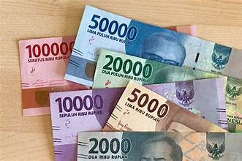
Money
As of January 2026, the exchange rate for USD to IDR is approximately
$1 US dollar = 16,838.59 IDR.
Don’t be misled, The big numbers don't mean their money is worthless - Indonesia just never 'reset' their currency.
Think of it like this: their smallest practical bill is like our $1, it just says 1,000 instead of 1.
Indonesia's inflation is actually lower than the US right now at around 3%.
Coins technically exist, but in practice most transactions use paper bills.

Slide 6
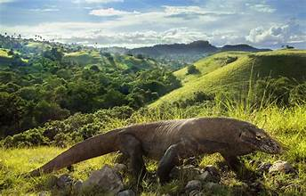
Komodo Land of Dragons
Welcome to Komodo, one of Indonesia’s most dramatic and mysterious islands.
Best known as the home of the Komodo dragon, the world’s largest lizard, the island is part of the Komodo National Park, a UNESCO World Heritage Site.
From rugged hills and pink-sand beaches to coral reefs teeming with life, Komodo offers a raw, untamed beauty unlike anywhere else in Asia.

Slide 7
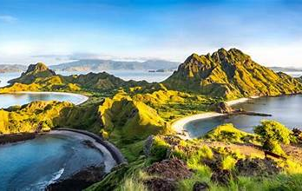
A Port with a Story
Komodo was once a small fishing harbor, but today it serves as the gateway for cruise ships and ferries.
Beyond the port lies Bali’s unique culture, Hindu in a country that is mostly Muslim, and deeply spiritual in its daily rituals.
Bali has long attracted artists, travelers, and seekers, becoming a crossroads of tradition and modern tourism.

Slide 8
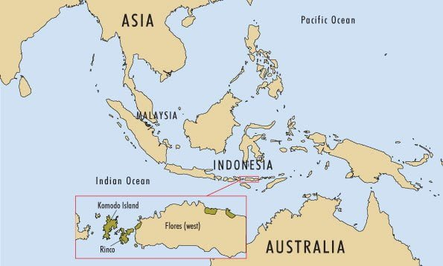
Komodo

Slide 9
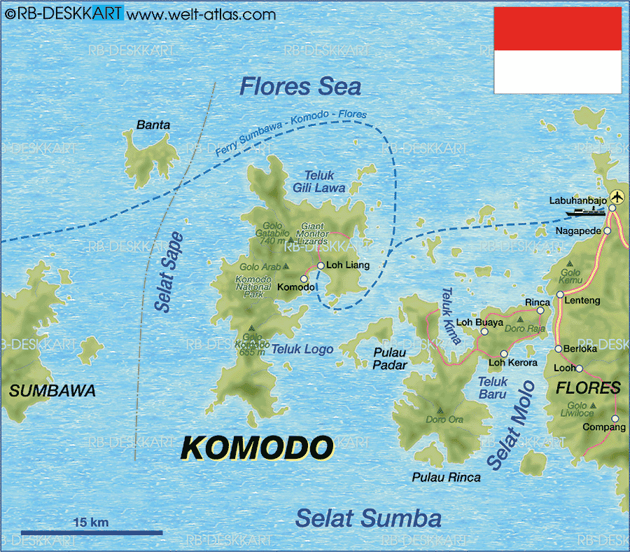
<Cruise Port

Slide 10
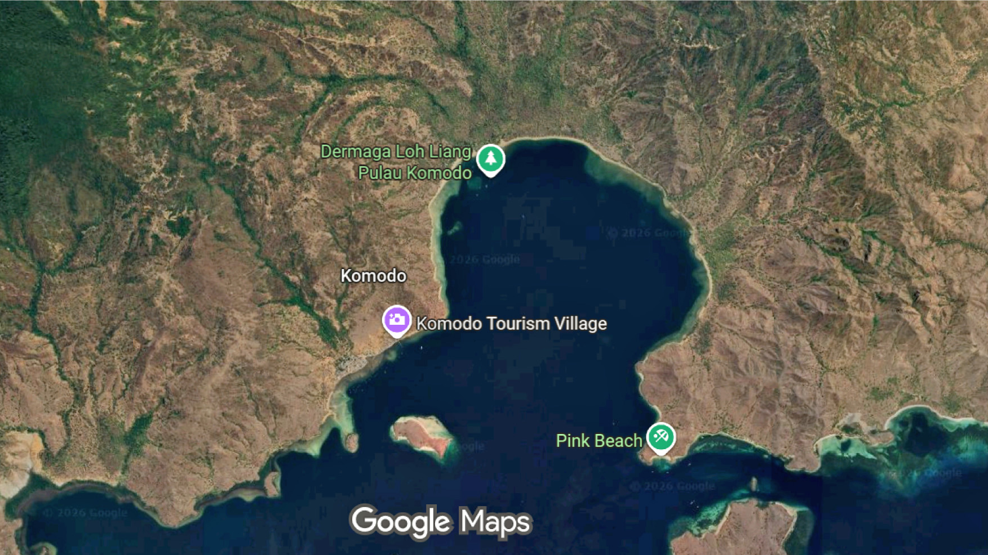
<Cruise Port

Slide 11
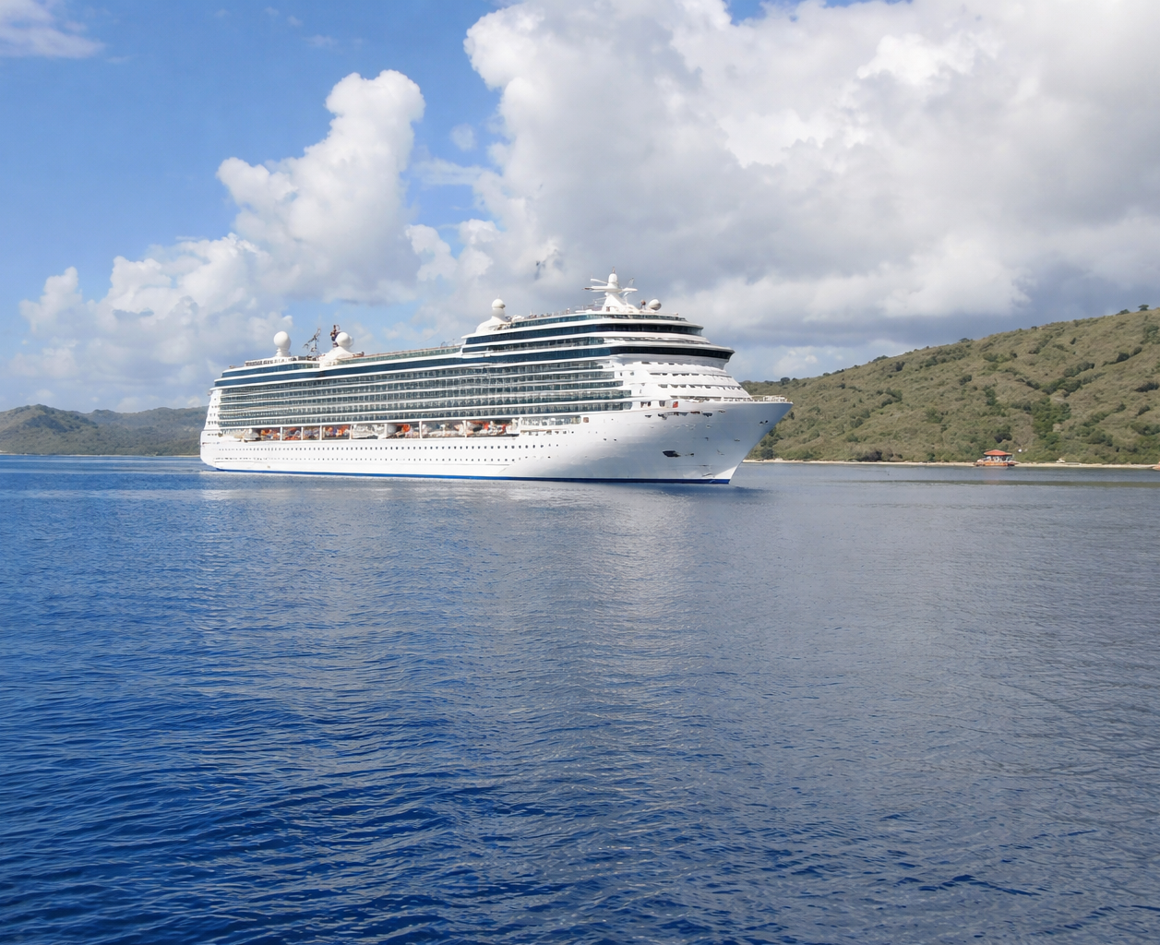
Getting Around
Cruise ships typically anchor offshore, with tenders bringing passengers to designated landing points.
From there, excursions are required, whether trekking with rangers, snorkeling, or visiting nearby islands.
Independent wandering is not possible, as the dragons are wild and potentially dangerous.

Slide 12
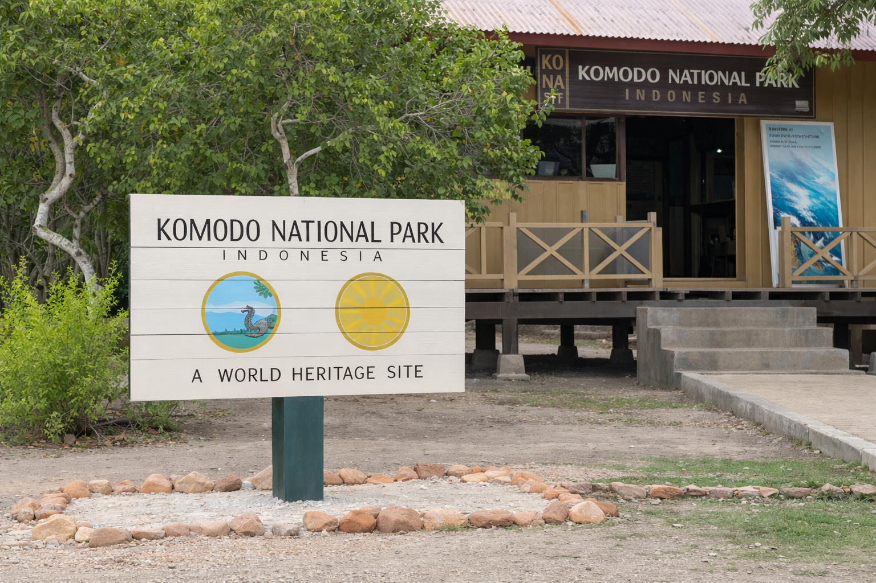
Getting Around
Walking Tour Option
A typical guided walk begins at the ranger station, follows marked trails into the savannah and forested areas where dragons bask or hunt, and loops back for safety.
Short, medium, and long trek options are available, each accompanied by park rangers.

Slide 13
Highlights for Visitors
Guided Walks to See Komodo Dragons: Rangers lead treks where you can observe the dragons in their natural habitat.
Pink Beach: Relax or snorkel in the crystal-clear waters of one of the world’s few pink beaches.
Marine Life: The park is famous for manta rays, turtles, and colorful fish—perfect for divers and snorkelers.
Padar Island: Often included on excursions, this island offers iconic panoramic views of curved bays and beaches.

Slide 14
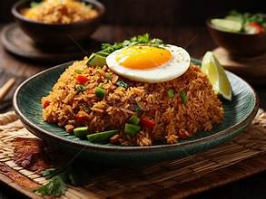
Food and Drink
Komodo itself is sparsely populated, so food and drink are usually arranged as part of organized tours.
Fresh grilled fish, tropical fruit, and Indonesian classics like nasi goreng (fried rice) or mie goreng (fried noodles) are common

Slide 15
Reflection
Komodo is a rare chance to step into a prehistoric world.
Whether you come face to face with a dragon, swim above pristine coral reefs, or stand on a hilltop gazing across turquoise bays, this stop is about raw nature at its most unforgettable.
It’s a reminder that the wild still has a place in our modern world.

Slide 16
Thanks For Coming
If you have any more questions, please ask.
I will do my best to answer them for you.
Have a great visit in Komodo!

