Slide 1
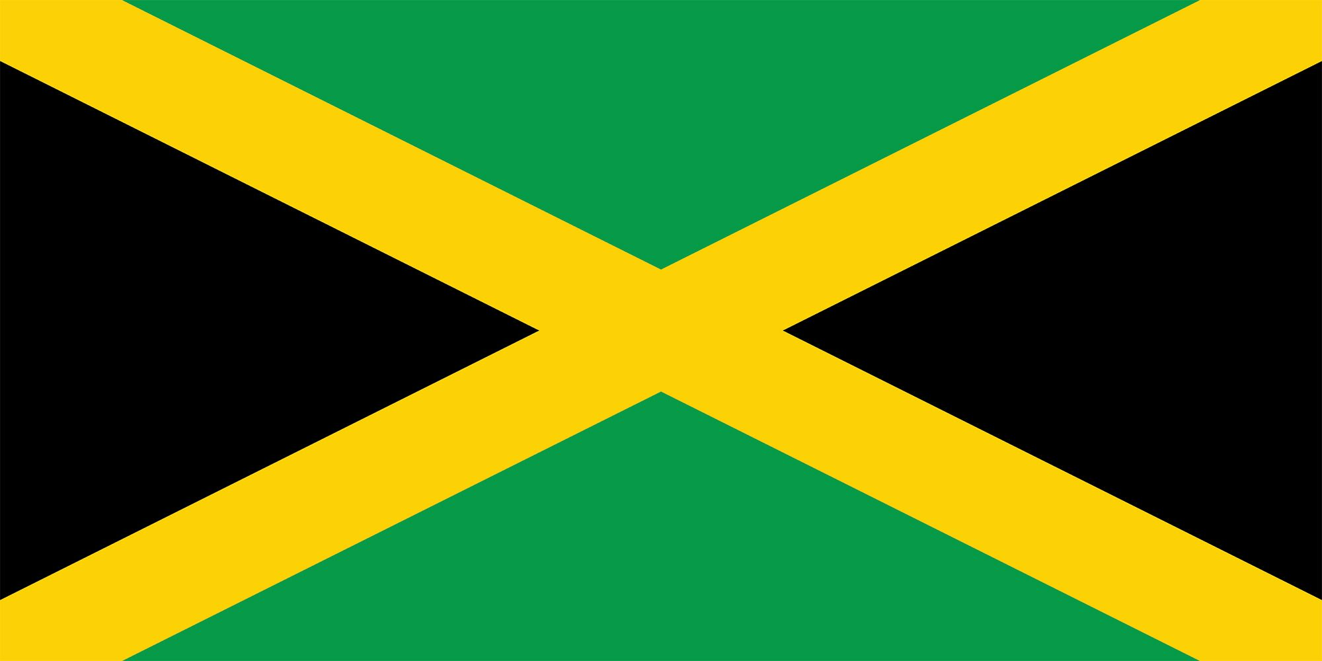
Kingston Jamaica Presented by Marc Silver

Slide 2
What I Will Cover
My Port Philosophy
Don’t Miss the Ship
Money
About Kingston, Jamaica
Area Map of Jamaica
Map of Kingston
Kingston Transportation
Places to see or at least consider
A few restaurant recommendations
Conclusion

Slide 3
My Port Philosophy
I have been cruising for over 45 years and have taken over 100 cruises. So, I consider myself an experienced cruiser.
The information I will present is based on those many years of
experience.
When I am on a cruise where the city, I want to visit is not the port city,
I always recommend taking a ship’s tour.
But when I am in a port with multiple attractions nearby and easy to see
on my own - I will do it on my own.
This presentation is for that type of port.

Slide 4

Don’t Miss the Ship
How to Avoid Missing Your Ship
Pay attention to the time. - Ship time and local time are often different.
Put a return-to-ship reminder on your phone.
Choose excursions wisely.
If a ship-sponsored excursion is late returning to port, the ship will wait for you. If you are on your own???
Be Prepared
Have your Passport, Credit Card, and phone numbers for your ship port agent.
What to Do If You Miss the Ship Most cruise lines have port agents stationed in the port area to assist if your ship has left without you. If your are lucky, when cruisers are late returning to the vessel, the ship’s crew will often remove the passengers’ essential items – passports, cell phones, and medication -- from the ship to leave with the port agents.
The Port Officials can help you with contacting your ship and making necessary travel arrangements.

Slide 5
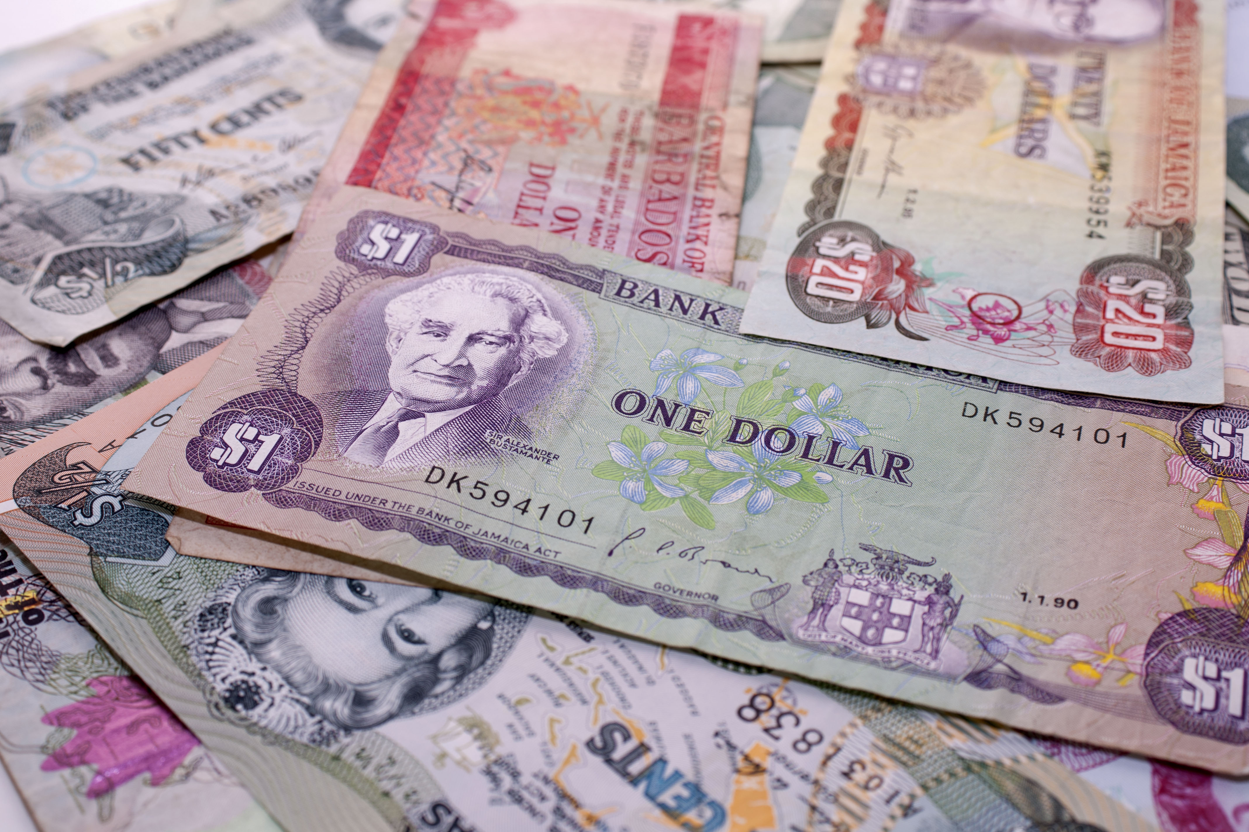
Money
The Jamaican Dollar is the official currency of Jamaica
The official Exchange is 155.06 Jamaican Dollars for $1 US Dollar.
The Jamaican Dollar symbol is JMD

Slide 6
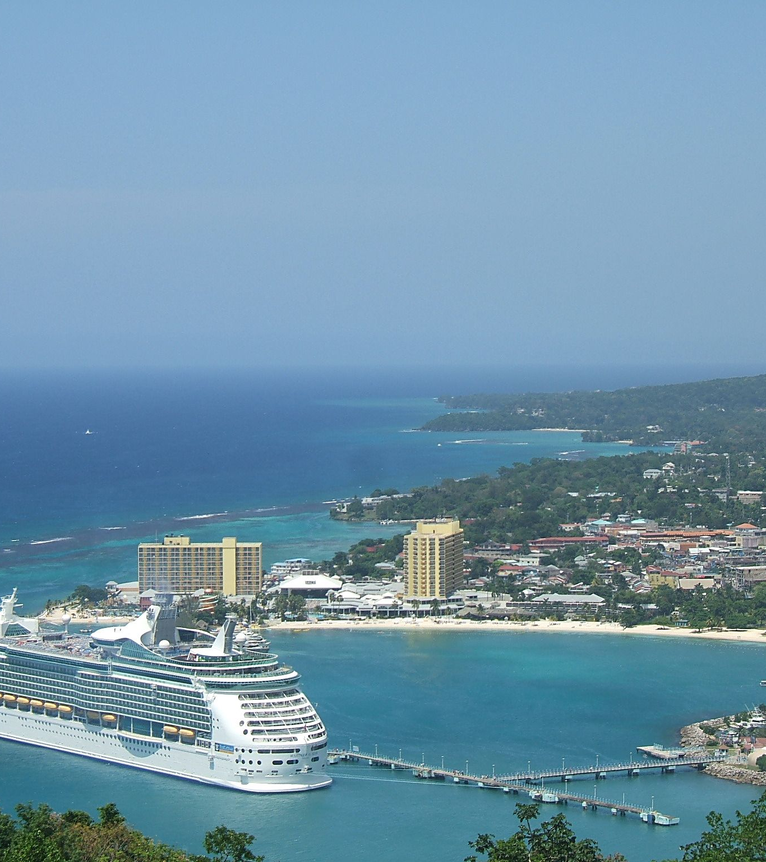
About Kingston
Kingston is the capital and largest city of Jamaica. It faces a natural harbor protected by the Palisadoes, a long sand spit that connects the town of Port Royal and the Airport to the rest of the island.
Kingston is also the largest predominantly English-speaking city in the Caribbean. The majority of the population of Kingston is of African descent. Large minority ethnic groups include East Indians and Chinese, who came to the country as indentured servants in the late 19th century.
There is also a minority of Europeans, mostly descending from immigrants from Germany and Great Britain.

Slide 7
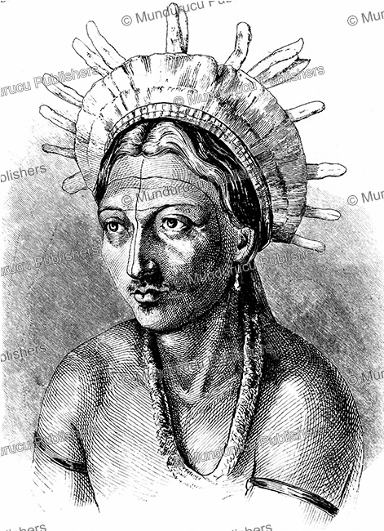
Jamaican Natives
The Caribbean Island of Jamaica was initially inhabited in approximately 600 AD or 650 AD by the Redware people, often associated with redware pottery, By roughly 800 AD, a second wave of inhabitance occurred by the Arawak tribes, including the Tainos, before the arrival of Columbus in 1494.
Early inhabitants of Jamaica named the land "Xaymaca", meaning "land of wood and water". The Spanish enslaved the Arawak, who were ravaged further by diseases that the Spanish brought with them. Early historians believe that by 1602, the Arawak-speaking Taino tribes were extinct.
However, some of the Taino escaped into the forested mountains of the interior, where they mixed with runaway African slaves, and survived free from first Spanish, and then English, rule.

Slide 8
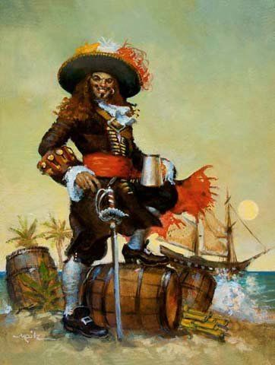
Jamaican Early Settlements
In 1655, the English invaded Jamaica and defeated the Spanish. Some African enslaved people took advantage of the political turmoil and escaped to the island's interior mountains, forming independent communities that became known as the Maroons.
Meanwhile, on the coast, the English built the settlement of Port Royal, a base of operations where piracy flourished as so many European rebels had been rejected from their countries to serve sentences on the seas.
Captain Henry Morgan, a Welsh plantation owner and privateer, raided settlements and shipping bases from Port Royal, earning him his reputation as one of the richest pirates in the Caribbean.

Slide 9
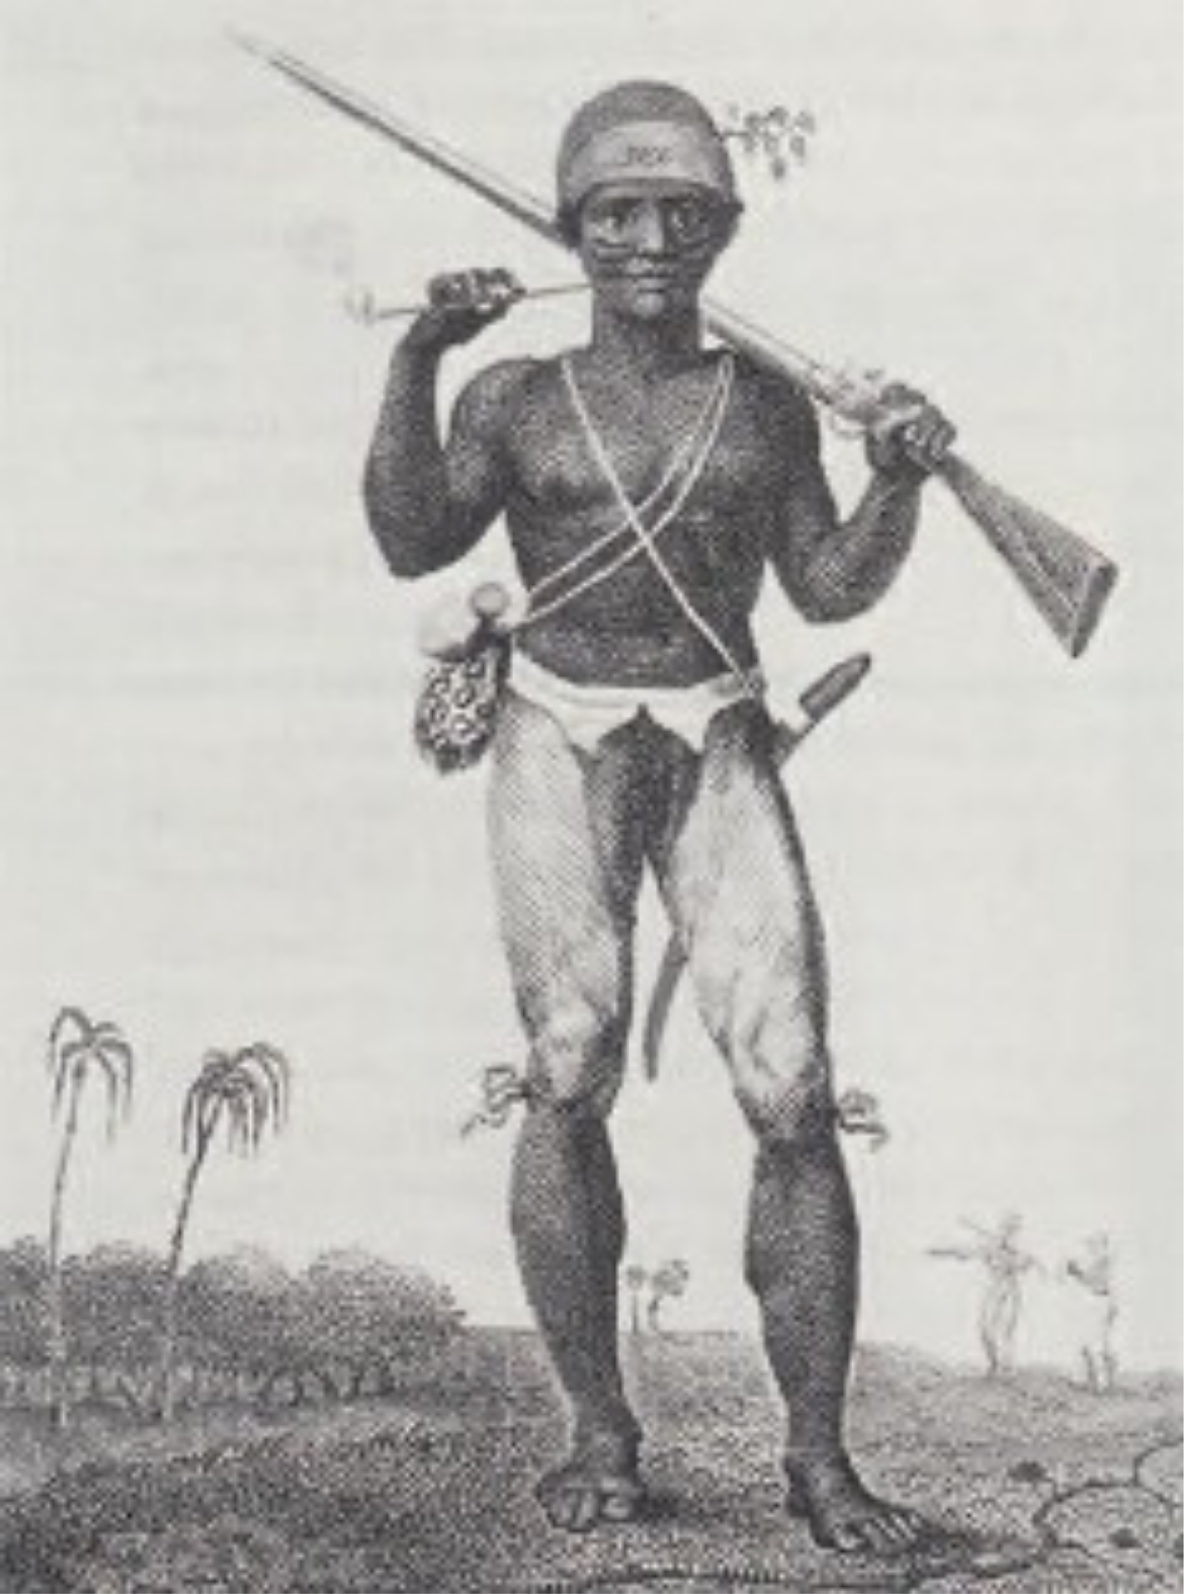
Jamaican Colonization
In the 18th century, sugar cane replaced piracy as British Jamaica's main source of income. The sugar industry was labor-intensive, and the British brought hundreds of thousands of enslaved black Africans to the island. By 1850, the black and mulatto Jamaican population outnumbered the white population by a ratio of twenty to one.
Enslaved Jamaicans mounted over a dozen major uprisings during the 18th century, including Tacky's Revolt in 1760. There were also periodic skirmishes between the British and the mountain communities of the Jamaican Maroons, culminating in the First Maroon War of the 1730s and the Second Maroon War of 1795–1796

Slide 10
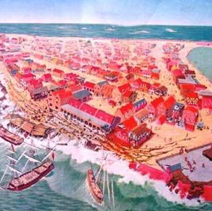
Port Royal
Port Royal, Jamaica, was commonly referred to as "the wickedest city on earth" with marauding pirates and daring naval conquests.
When the Spanish arrived in Jamaica in the 1500s, they discovered that the cay was an ideal spot for careening, that is, a place to clean and refit boats and scrape the hulls clean. They named the area Cayo de Carena but built nothing more than a few timber warehouses at the site.
At the height of its wealth, on June 7, 1692, Port Royal was consumed by an earthquake and two thirds of the town sank into the sea. A series of fires and hurricanes followed and the town was never restored to its former glory. Port Royal lived out its days as a British naval station and remains as a small fishing village today.

Slide 11
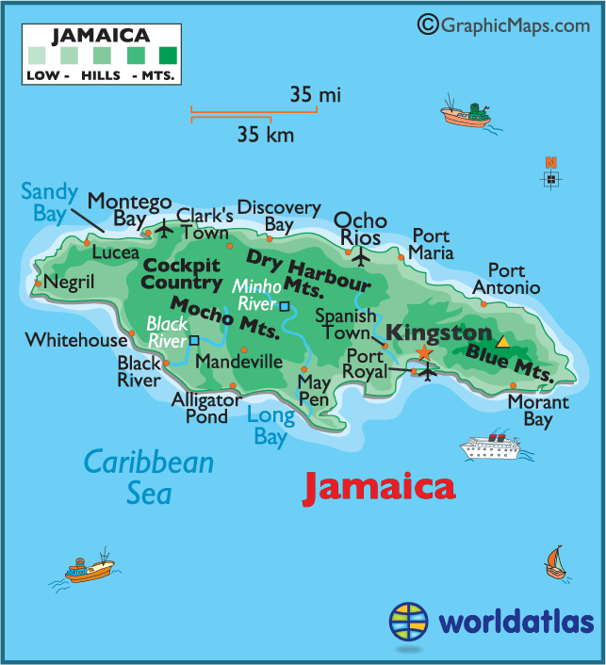
Map of Jamaica

Slide 12
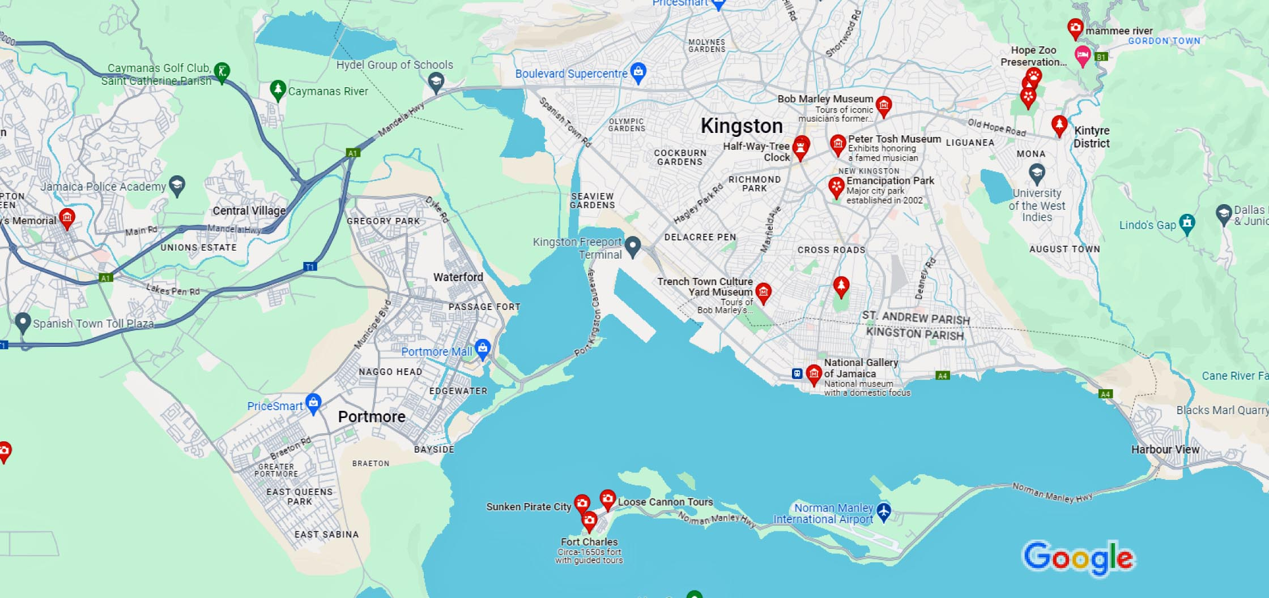
Map of Kingston

Slide 13
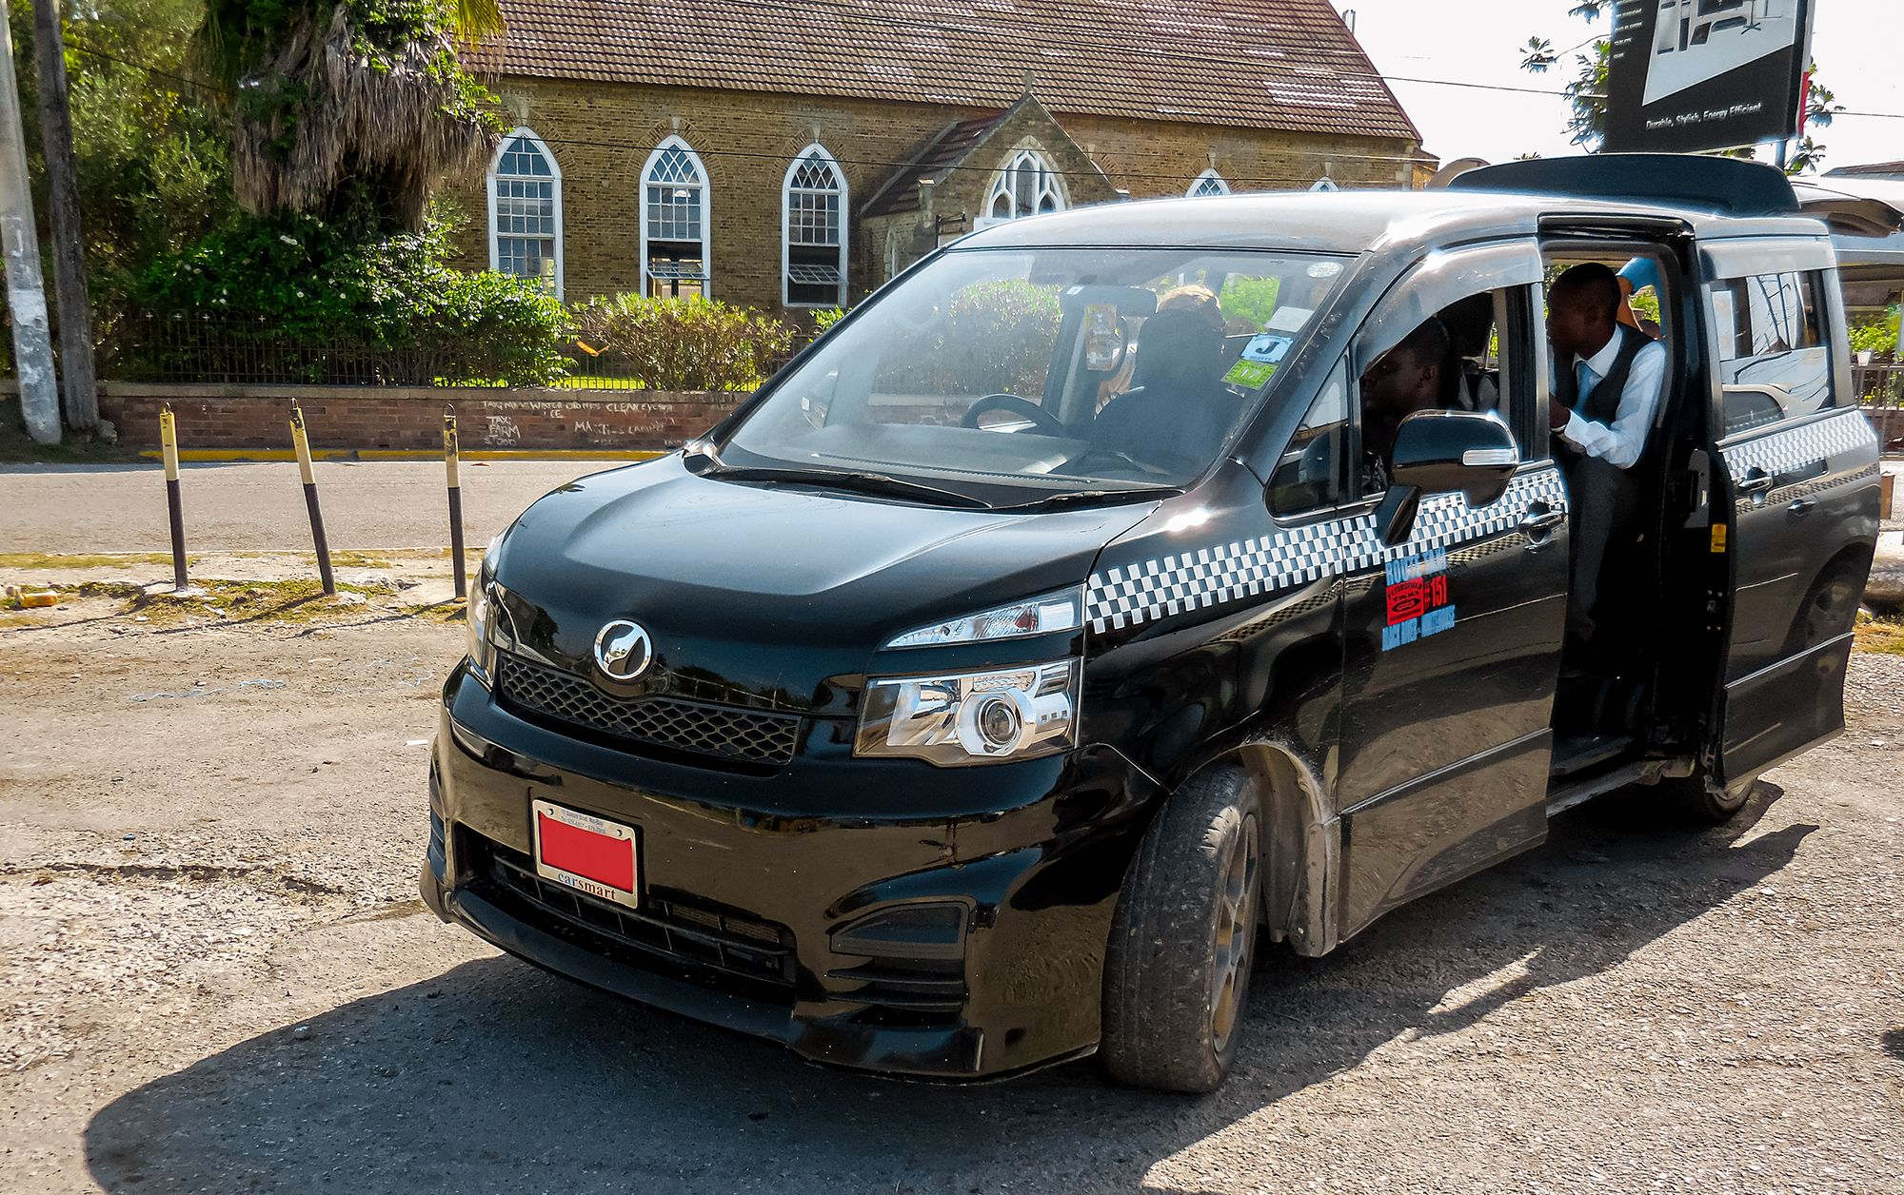
Kingston Taxis
Getting around Jamaica by taxi is very easy. Private taxis are provided for visitors to Jamaica, while Route Taxis are designed for locals and operate similarly to buses with specific routes they travel. These drivers are only licensed to drive in a specific area. These taxis can stop anywhere to pick up and drop off passengers and usually carry multiple people at any time.
You can tell a taxi by its Red license Plate. Also, their route will be shown on the side of the taxi.
The prices are set by the government. Typically, $1 or $2 US.
Because the Route Taxis make more money the more people they carry, often they will over pack the car. If the Taxi is packed just wait for another.
Chartered Route Taxi, means you will be the only passengers but you need to agree to a price before getting in the taxi. They will then post a Chartered Sign in the window.
The Mini Route Buses run from city to city. Prices run between $3 and $6 US depending upon the distance.

Slide 14
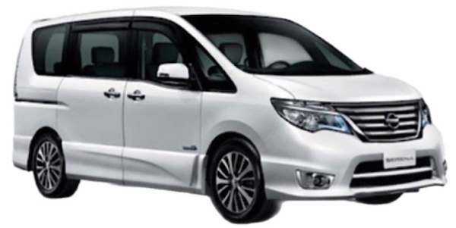
Kingston Tourist Taxis
You can Recognize a tourist taxi by its Red license plate, and they will have the name of their company on the front and back of the taxi. All tourist taxis must’ to be less than 5 years old and in good condition. They are also all air-conditioned and insured.
JUTA, are private taxis that primarily due tours for tourists. They are knowledgeable and drive much safer than the Route Taxis. A tour could run $200 US for an all-day tour but realize the taxi expenses could run as high as $150 for fuel, license fees, maintenance, and commission fees.
If you do take a taxi tour, and had a great time, remember to tip your driver.

Slide 15
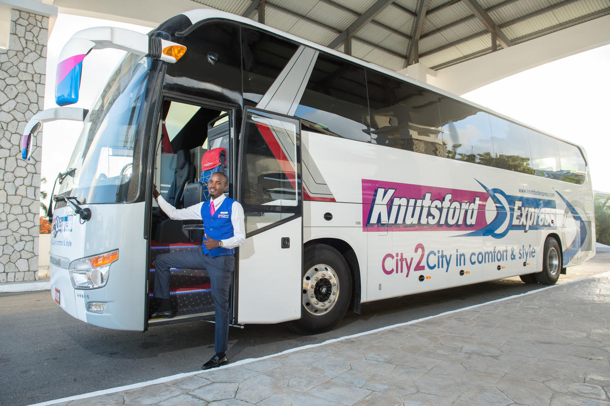
Knutford Express
Knutford Express is a luxury passenger and courier transportation company offering safe, reliable, comfortable, and cost-effective scheduled services.
They offer scheduled services from convenient locations on Jamaica's north and south coasts Passengers can traverse the island to points in Portland, St. Mary, Manchester, Negril, Trelawny and Kingston in spacious, air-conditioned coaches.
Most tickets run $10 to $30 US. Chances are you won’t use this service, but I hope it’s good information.
If you want to travel from Kingston to Negril this bus makes sense, otherwise, a Route Taxi is a better choice.

Slide 16
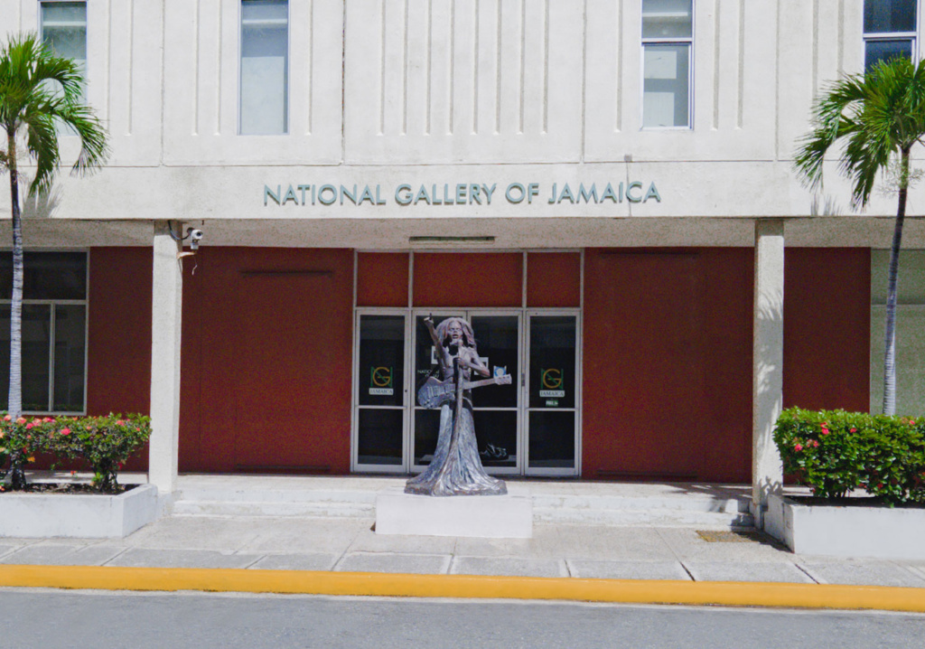
National Gallery of Jamaica
Located on the Kingston Waterfront, the National Gallery of Jamaica (NGJ) was established in 1974 and is the oldest and largest public art museum in the Anglophone Caribbean.
Established in 1974, the National Gallery of Jamaica is the oldest and largest public art museum in the English-speaking Caribbean. It has a comprehensive collection of early, modern, and contemporary art from Jamaica along with smaller Caribbean and international holdings.
Admission: Adults $400.00 JMD
Senior Citizens (65+) $200.00 JMD
Children (0 – 16) FREE

Slide 17
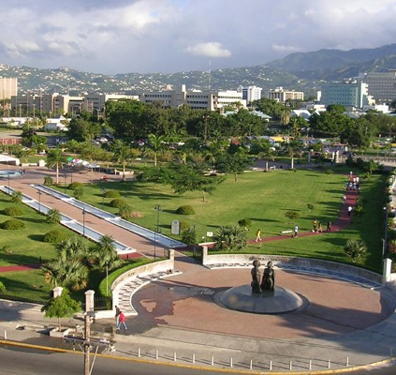
Emancipation Park
The park is located in New Kingston and is themed “Tribute to Freedom” with a pair of 11-foot bronze statues, titled “Redemption Song”. It depicts a black man and woman looking towards the sky and is located at the southeast entrance of the park.
Embedded in the statue’s symbolic meaning is the triumph over the tragedies of slavery.
West African spiritual symbols can be seen throughout the design of the park and the colorful tropical plants and flowers make for a relaxing day. It’s a symbol of hope and freedom to the Jamaican people.

Slide 18
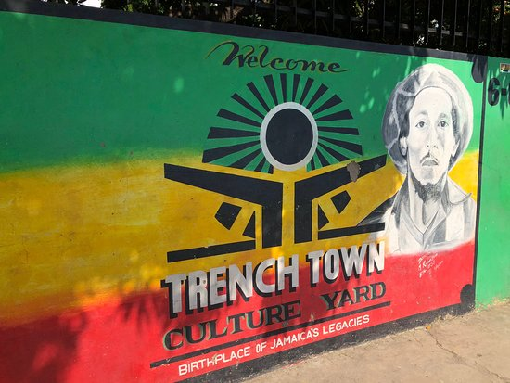
Trench Town Culture Yard Museum
The Culture Yard should be your first destination on First Street.
This museum was the home of Bob Marley when he first came to Kingston.
The museum represents the authenticity and the History of the community of Trench Town and is also about the other Artists and different Personalities that contributed their time to the music and putting the Trench Town name on the Map.
Displays of artifacts, live music and conversation with TT residents, and a bright mural await your inquiry.
Culture Yard - $30 US Culture Yard & Bob's Mother's house $28 US

Slide 19
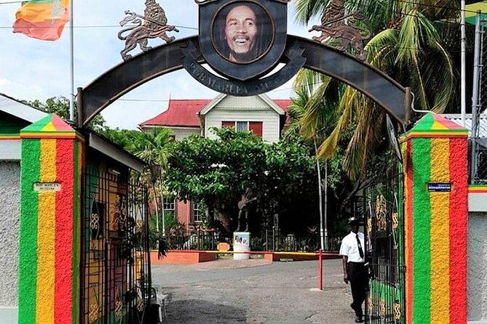
Bob Marley Museum
The Bob Marley museum is situated on the site of the legendary musician’s home, which he purchased in 1975. This house, featuring 19th-century architecture, was Marley’s home until his transition in 1981. It was converted into a museum six years later by his wife, Mrs Rita Marley. The main museum displays Marley’s personal treasures.
The property also features a well-equipped 80-seat theatre, a photographic gallery, a record shop, and a gift shop filled with a wide array of Bob Marley memorabilia.
Relax and enjoy a sumptuous meal from the One Love Café after you’ve completed your tour which offers a peek into every aspect of Bob Marley’s life.
Admission Prices: US $25

Slide 20
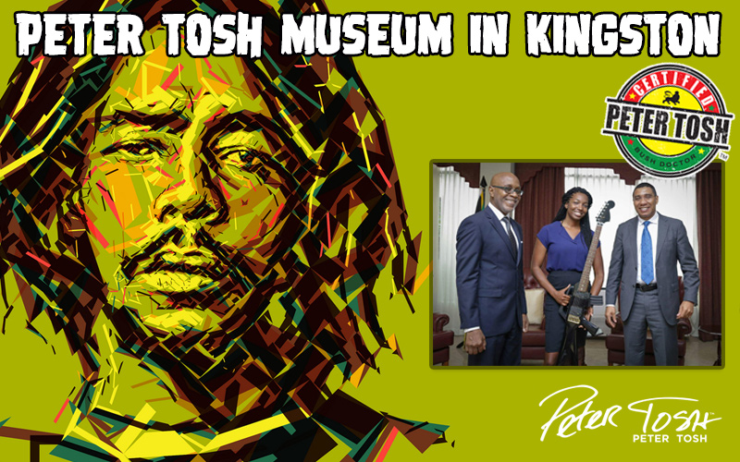
Peter Tosh Museum
Peter Tosh exploded onto the world stage as an activist and solo artist with his 1976 release, Legalize It! Tosh worked to promote the legalization of herbs, and equal rights, and to expand Jamaica’s cultural and musical influence.
Peter was no stranger to oppression in his homeland and knew the fight for legalization and equal rights well.
His music served as a catalyst for a generation to fight for what they believed in.
Admission Prices: US $20

Slide 21
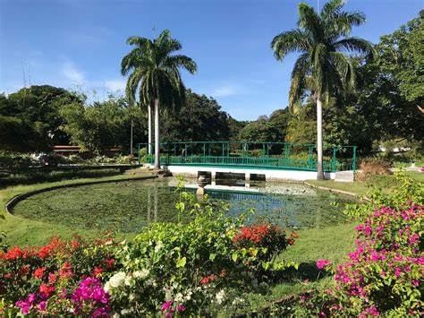
Chinese Garden, Hope Gardens and Zoo
The Chinese Garden reminds me of the gardens I visited on my trips to China.
It is situated on 11 acres of land as part of the Hope Royal Botanic Gardens and Hope Estate. It was built and given to the people of Jamaica as a gift for Jamaica’s 50th Independence Anniversary (1962-2012).
It was a gift to Jamaica by the Chinese Government marking the 43 years of diplomatic relations between Jamaica and the People’s Republic of China.
It is the only one of its kind in the Caribbean, Central and South America.
Chinese Garden Tour Adults – $300.00 JMD Teens – $100.00 Children -$50.00 JMD
Nursery and General Garden Tour $3000 JMD

Slide 22
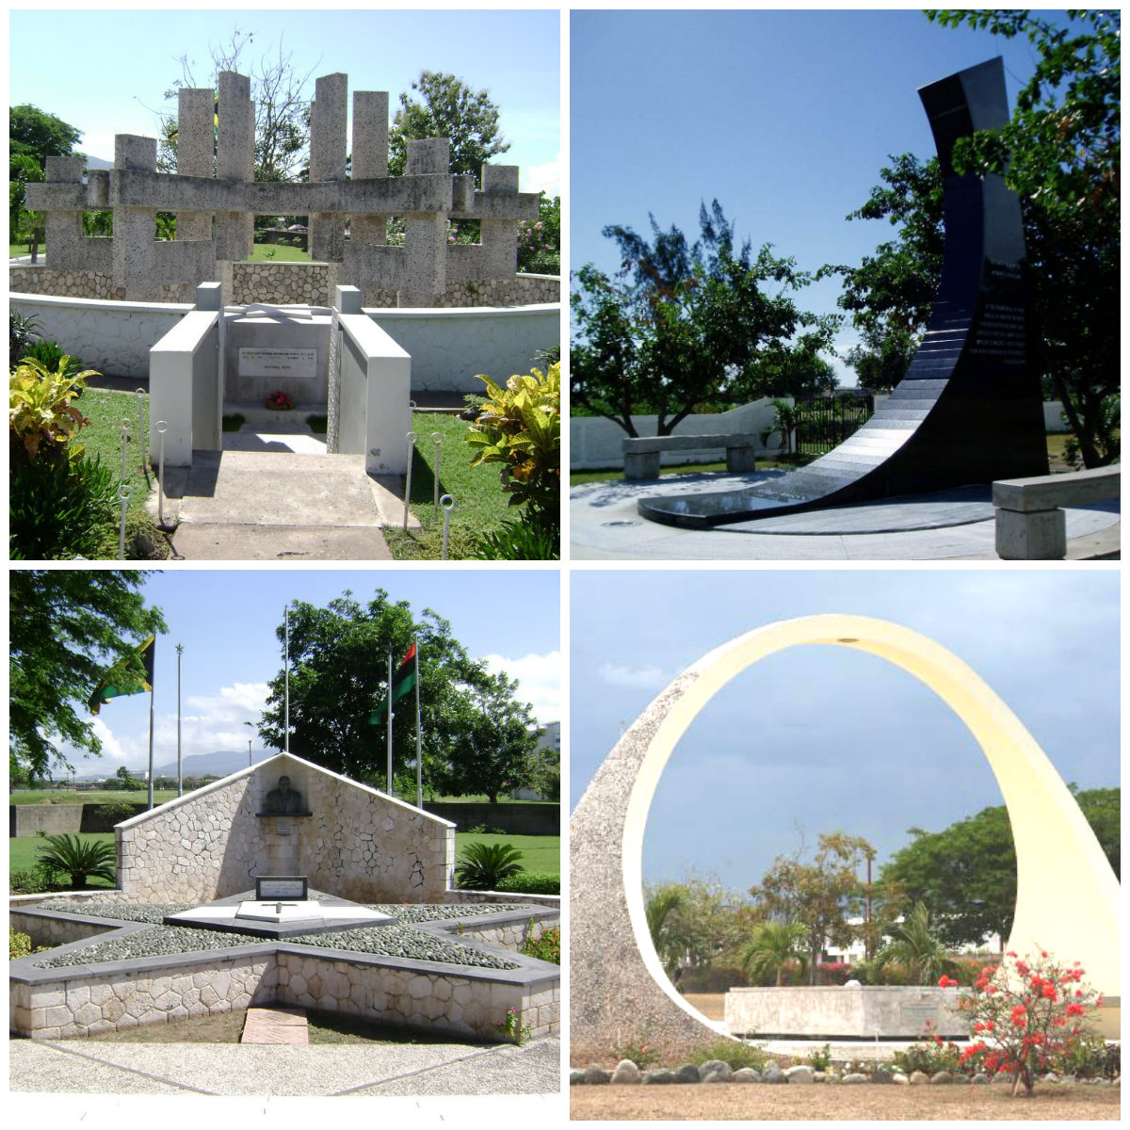
National Heroes Park
National Heroes Park is 50 acres located in Downtown Kingston. The park serves as a memorial to Jamaica’s national heroes and other important figures in the country’s history.
The park has several monuments and memorials of prominent Jamaican political leaders and proponents of black nationalism, and the National Heroes Monument.
There are also tributes to the seven national heroes of Jamaica.
The park is open to the public seven days a week and admission is free

Slide 23
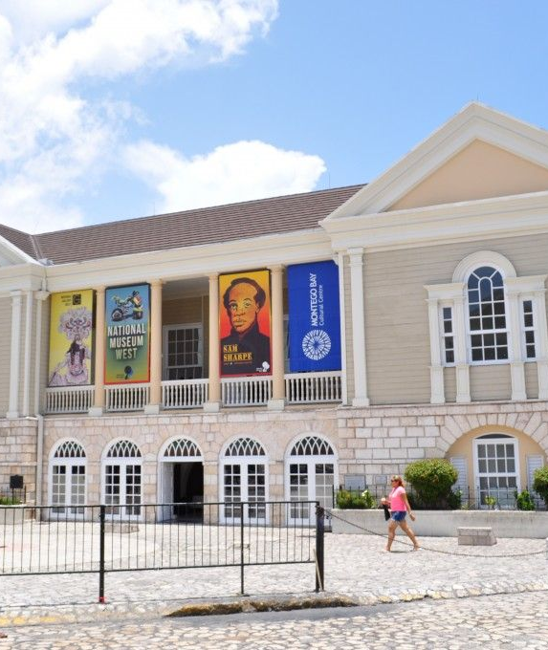
Museums of History and Ethnography
The Museums of History and Ethnography at the Institute of Jamaica in Kingston can be found at Port Royal Collection, Museums of History and Ethnography, Institute of Jamaica 10-16 East Street Kingston, Jamaica
The museum is dedicated to the history of Port Royal as well as the history of the Jamaican people.
Fort Charles & Fort Charles Maritime Museum: Originally built by the English as Fort Cromwell after seizing the land from the Spanish, the fort is in good shape largely due to extensive preservation and rebuilding efforts over the years.

Slide 24
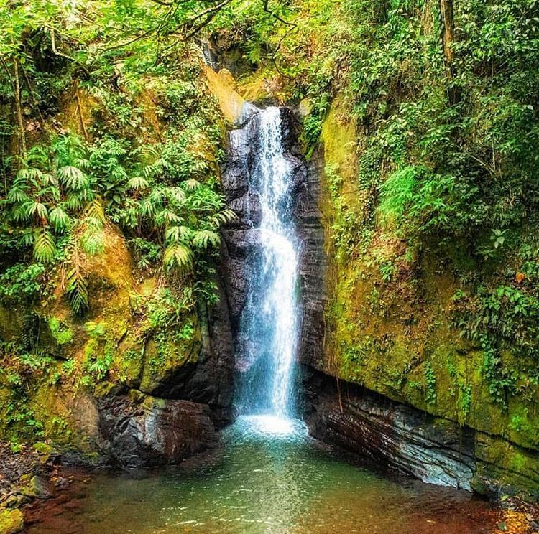
Falling Edge Waterfalls
Tucked away in the chilly, tranquil hills of Stony Hill; Falling Edge Waterfalls, also called the Bowden Hill Falls, is a majestic cascading waterfall that lies just 30 minutes outside Kingston City.
The hidden escape has gained more popularity over the years but still remains relatively secluded enough that it isn’t uncommon to see little to no other visitors there on your trip, especially if you go there during the week or early on the weekends.

Slide 25
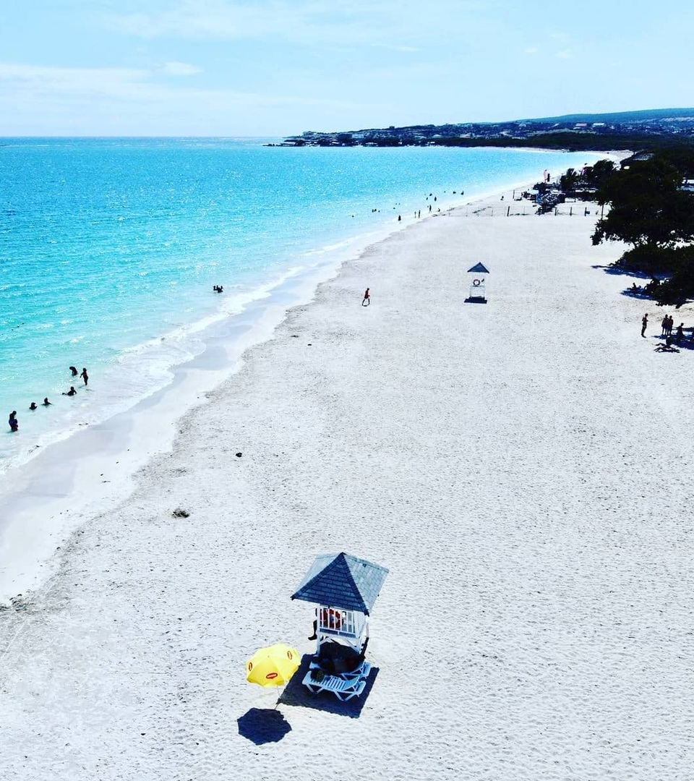
Fort Clarence Beach
This is a beautiful beach with azure blue water. There are security guards at the entrance, who direct you to the entrance where need to pay $10 (US) each.
There are lifeguards every 50 meters, so you feel safe in the ocean.
The area also has clean toilets and showers.
Sunbeds are included in the admission price but there are no umbrellas available.
You can find a nearby restaurant/snack bar that serves freshly cooked traditional Jamaican food all day They even offer a lobster dish.

Slide 26
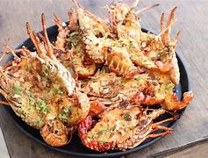
Restaurants
There are a lot of excellent restaurants in Kingston. Especially for seafood.
Here are some recommendations:
Cru Bar & Kitchen $$ - $$$ Caribbean, Bar, International
71 Lady Musgrave Road, Kingston
Spanish Court Café $$ - $$$ Café, Jamaican, Vegetarian
1 St. Lucia Avenue Spanish Court Hotel, Kingston
Tastee Patties $ Quick Bites, Caribbean, Fast Food
Constant Spring & Hagley Park Rds, Kingston
Nirvana Restaurant & Lounge $$ - $$$ Indian, Asian, Vegetarian
80 Lady Musgrave Road Shop 1A, Kingston
South Avenue Grill $$ - $$$ Caribbean, International, Barbecue
20A South Avenue, Kingston
For those of you who just like good food, you can’t go wrong just about anywhere you go in Kingston.

Slide 27
Conclusion
Kingston is a beautiful Area with a rich history and seemingly endless attractions.
Regardless of what you're looking for, Kingston has something for everyone.
I hope this presentation will help when we visit Kingston

Slide 28
Thanks For Coming
If you have any more questions, please ask.
I will do my best to answer them for you.
Have a great visit in Kingston !

