Slide 1
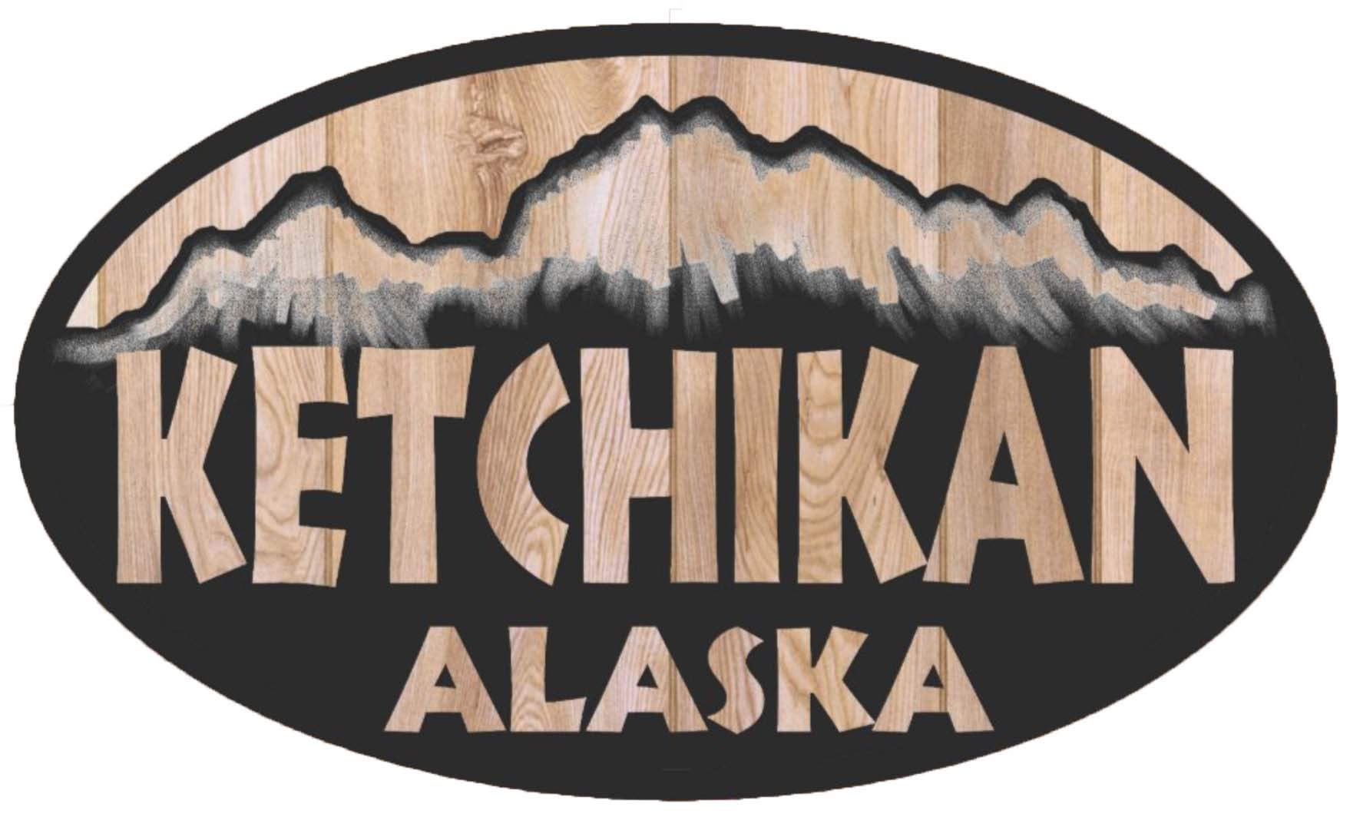
Ketchikan Alaska Presented by Fellow Cruiser Marc Silver

Slide 2
What I Will Cover
My Port Philosophy
Don’t Miss the Ship
About Ketchikan
Getting around Ketchikan
Points of Interest
Places to see or at least consider
Conclusion

Slide 3
My Port Philosophy
I have been cruising for over 45 years and have taken over 100 cruises. So, I consider myself an experienced cruiser.
The information I will present is based on those many years of
experience.
When I am on a cruise where the city, I want to visit is not the port city,
I always recommend taking a ship’s tour.
But when I am in a port with multiple attractions nearby and easy to see
on my own - I will do it on my own.
This presentation is for that type of port.

Slide 4
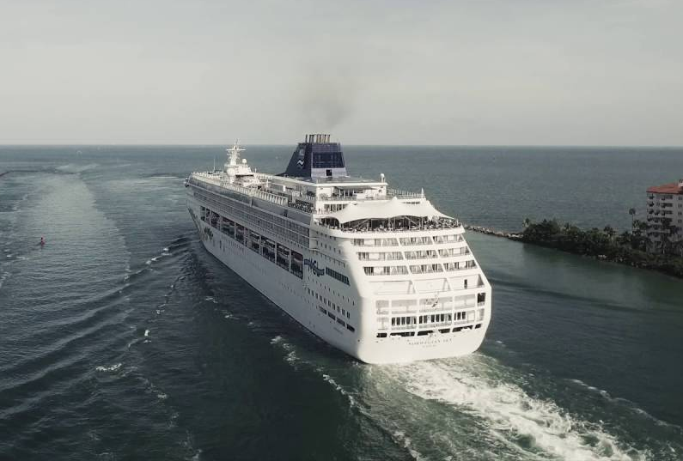
Don’t Miss the Ship
How to Avoid Missing Your Ship
Pay attention to the time. - Ship time and local time are often different.
Put a return-to-ship reminder on your phone.
Choose excursions wisely.
If a ship-sponsored excursion is late returning to port for, the ship will wait for you. If you are on your own???
Be Prepared
Have your Passport, Credit Card and phone numbers for your ship port agent.
What to Do If You Miss the Ship Most cruise lines have port agents stationed in the port area to assist if your ship has left without you. If you’re lucky, when cruisers are late returning to the vessel, the ship's crew will often remove the passengers' essential items -- passports, cell phones, and medication -- from the ship to leave with the port agents.
The Port Officials can help you with contacting your ship and making necessary travel arrangements.

Slide 5
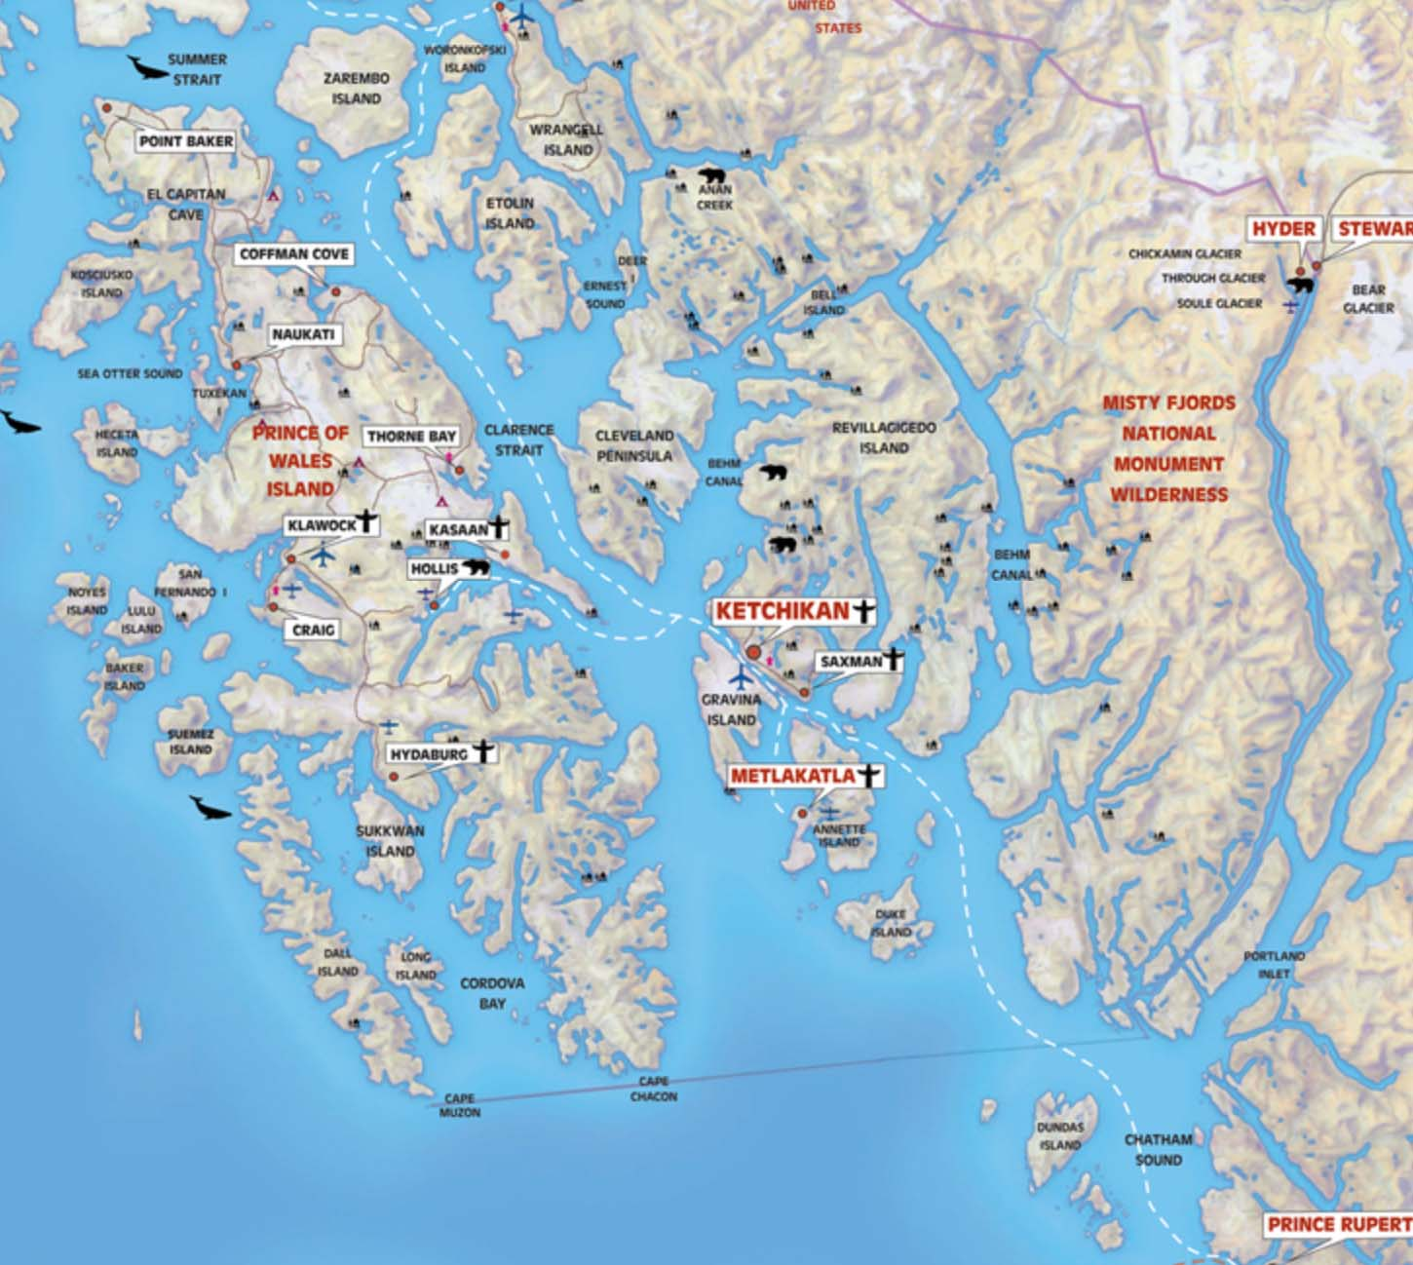
About Ketchikan
Ketchikan, Alaska is truly the beginning of the last frontier.
Set at the southernmost entrance to Alaska's famed Inside Passage—a network of waterways that snake through some of the most jaw-droppingly beautiful wilderness in the world.
Ketchikan is best known for three things: feisty salmon, idyllic scenery, and an incredibly rich Alaska Native culture.

Slide 6
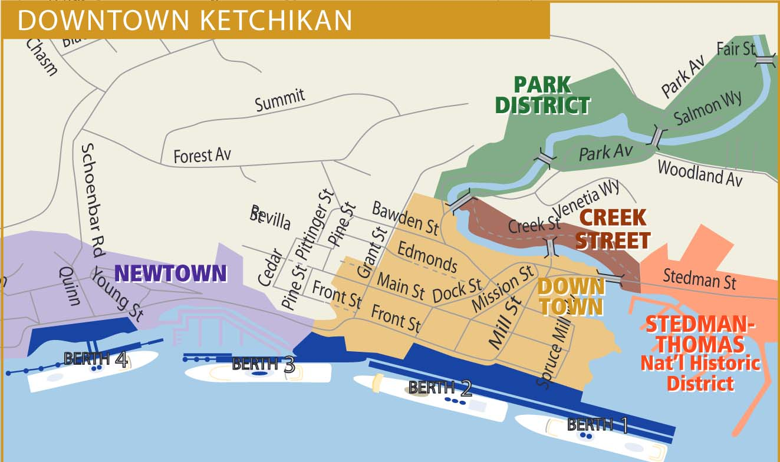

Slide 7
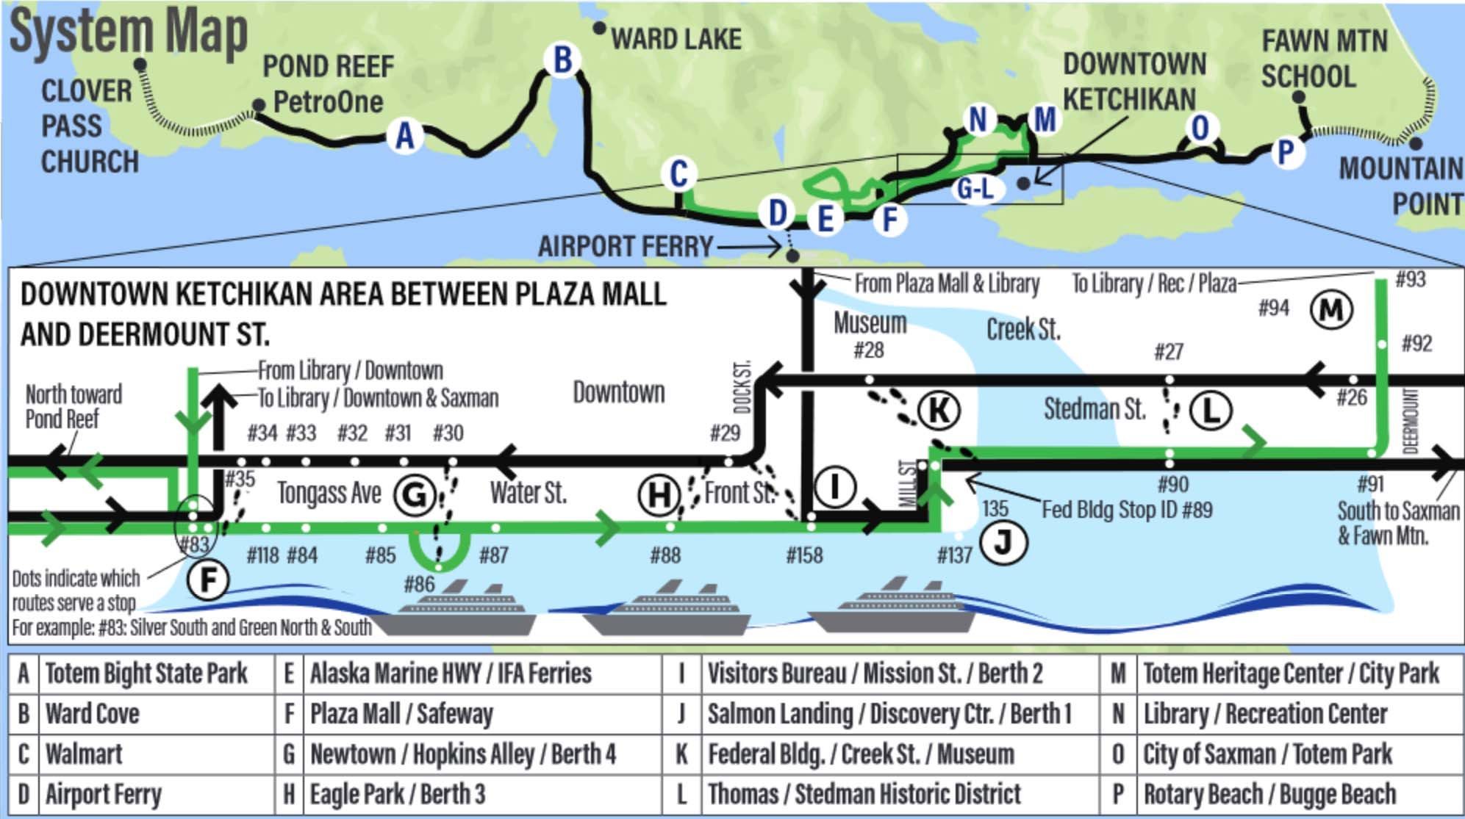
Getting Around Ketchikan
The Ketchikan Gateway Borough Transit System operates and maintains three bus routes, one of which is sure to take you where you want to go.
Bus prices certainly beat taxis by a mile.
If it's a taxi you want, a taxi you can have (dry or wet).
One benefit of taking a taxi is that some services offer tours for an added fee.
Adult fare is $2 Unlimited day pass is $8

Slide 8
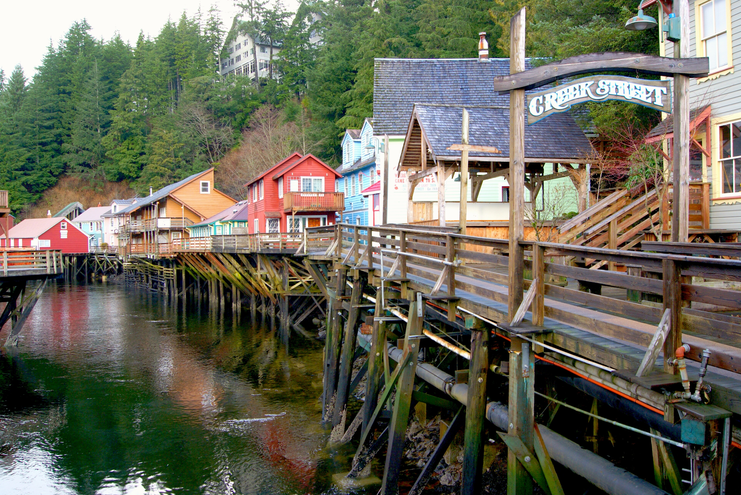
Creek Street
Get insights into the town’s natural and cultural treasures at the Southeast Alaska Discovery Center, full of interactive exhibits and displays, along with a movie theater.
Lighthouse lovers will want to check out the 100-year-old Guard Island Lighthouse, which you can see from the North Tongass Highway or a charter boat.
Then duck into fun shops as you stroll Creek Street Boardwalk, home to the town’s red-light district until the 1950s.

Slide 9
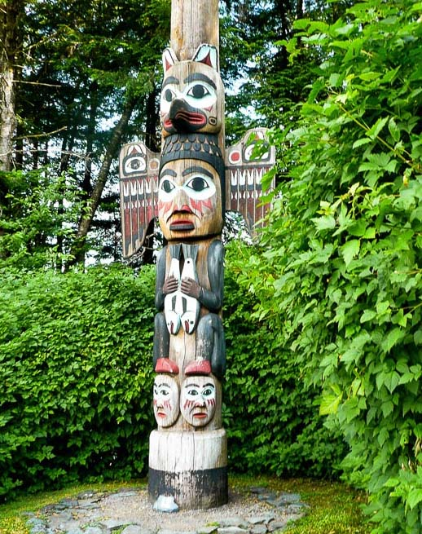
View Totem Poles
Admire beautiful works of art and Alaskan Native culture like this at Totem Bight State Park.
Check out the world’s largest collection of 19th-century totem poles—and learn their rich history and meaning—at the Totem Heritage Center.
Want to see more of these unique carvings? Head to Totem Bight State Park, located on the ocean north of town, or go just south of town to Saxman Totem Park.

Slide 10
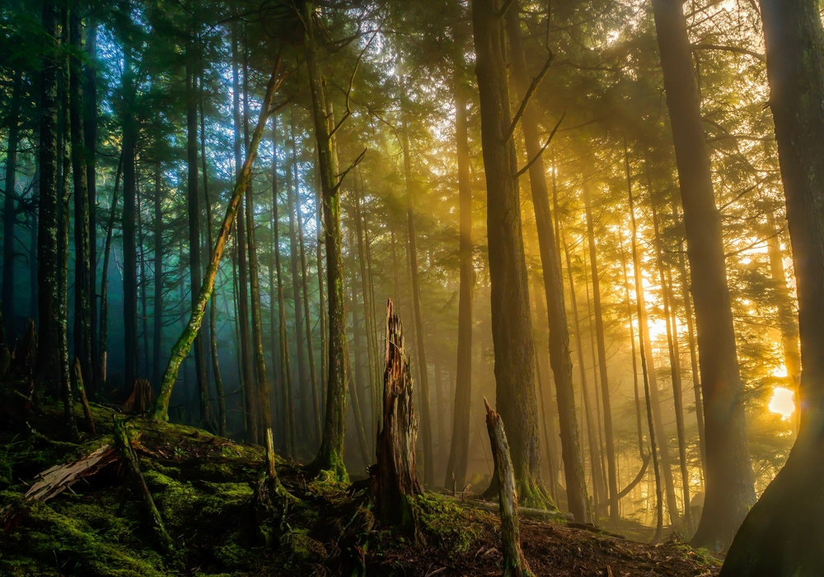
Visit the Forest
Ketchikan sits on the fabled Inside Passage and is surrounded by old-growth forest; in other words, it’s the perfect place to find scenic views and lush woods.
See it all on a Jeep or ATV tour. Drive around old logging roads and enjoy nature.
Another option: is a guided hiking trip, which you can combine with biking or kayaking, making for the ultimate Ketchikan adventure.
If you’re more of a DIY traveler, pick a hiking trail and set off! You’ll find a wealth of views and wildlife around the area.

Slide 11
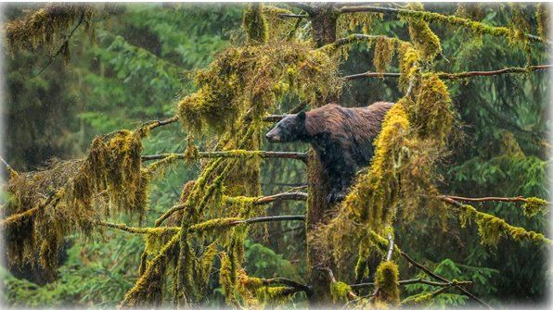
Tongass National Forest.
Whatever the weather you should arrange to hike in this forest. The trails go miles into the Tongass National Forest so consulting a ranger or guide is a good idea.
Sometimes if you get out early enough, you’ll have the whole trail to yourself.
The whole forest covers 17 million acres and is the largest forest in the US. You don’t want to get lost here, so stay on the trails.
Wildlife that resides here includes beavers, otters, moose, and bears. You will also see thousands of salmon in the streams and perhaps whales on the coast.

Slide 12
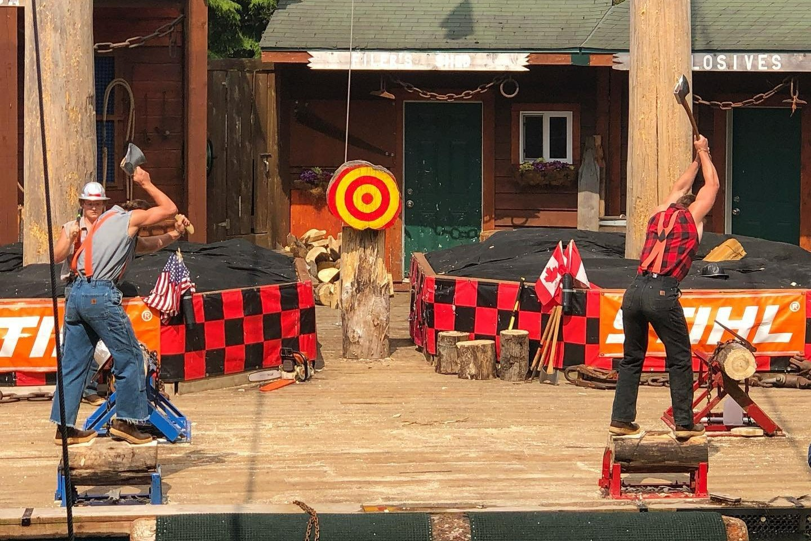
Great Alaskan Lumberjack Show
This show is a staple of Ketchikan and brings guests a thrilling competition of skill and strength that highlights Southeast Alaska’s logging history.
These world champion athletes are sure to impress all ages with 7-pound axes, 6-foot razor-sharp saws, tree-climbing gaffs, and more. The one-hour performance is packed with action. Audience members will be on the edge of their seats as they watch burly lumberjack's freefall from towering trees, scamper across floating logs, and show off their strength as they chop and saw.
Get in on the “axe-tion” with a group of friends and try your own hand at the axe-throwing competition. The lumberjacks meet up with participants after the show and demonstrate the art of the throw in a head-to-head battle. Don’t forget your flannel — you’ll want to look the part when you’re in the boisterous crowd.
The full show is offered three to four times daily, giving guests plenty of opportunities to add it to their schedule.

Slide 13
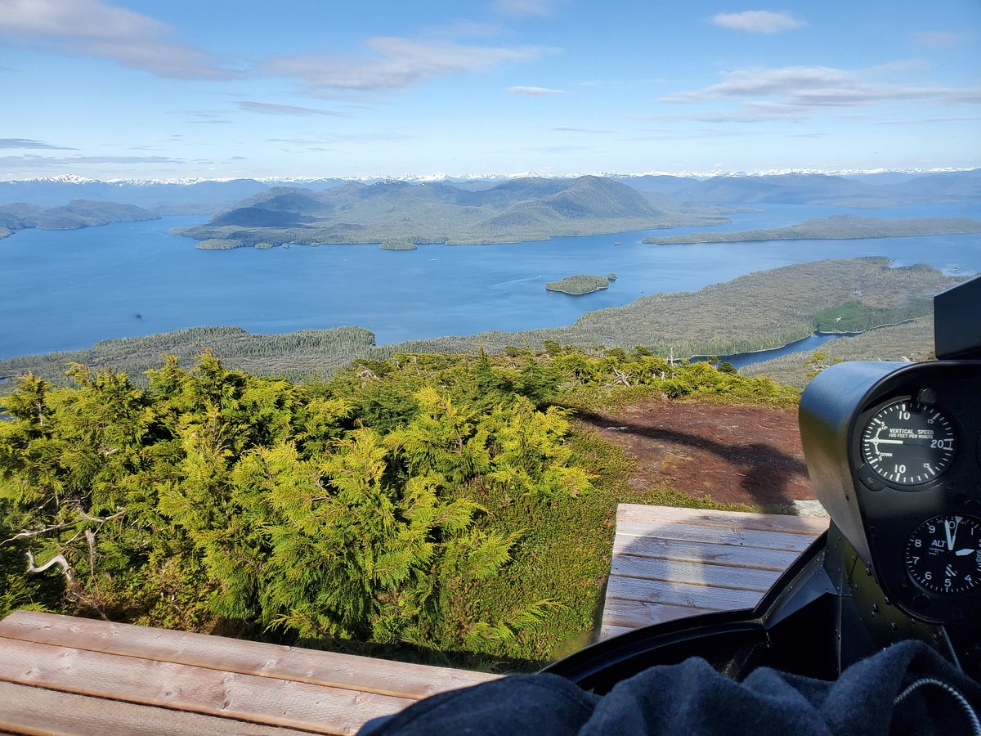
Misty Fjords Air Tour
For the more adventurous and willing to spend $450 each.
Climb aboard a helicopter or floatplane and get ready to get a different view of Ketchikan with this Misty Fjords National Monument Floatplane Tour.
As you fly over the Tongass National Forest and Misty Fjords National Monument, your pilot will share commentary via your headset.

Slide 14
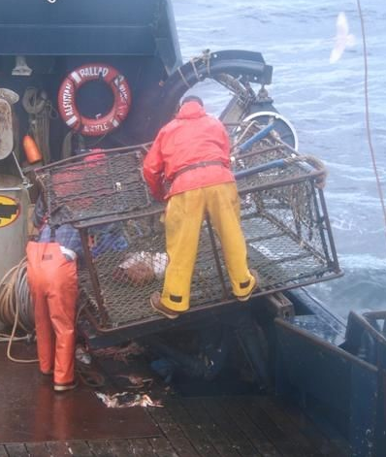
Go Crab Fishing
Get close-up and personal with the crew of the Aleutian Ballad – a commercial fishing boat seen on Discovery Channel’s ‘Deadliest Catch’.
This Bering Sea Crab Fisherman’s Tour from Ketchikan is your opportunity to experience what it’s like to be a commercial fisherman in Alaska.
You will learn about the Aleutian Ballad’s history. You get to see how the crew bait the fishing gear with salmon and squid. Then, watch in wonder as sea creatures are hauled up in 700-pound crab pots.
There are not only king crabs, but also Dungeness crab, rockfish, ratfish, wolf eel, box crab, octopus, gray cod, prawn, and more.
The crew sorts through the catch in different tanks on the deck.
Tour Pricing: Adult - $209 - Child - $129

Slide 15
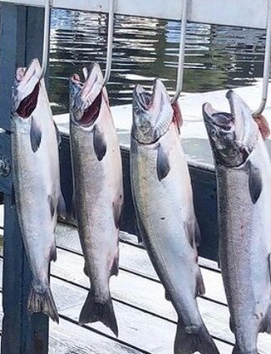
Fishing
Whether you’re interested in a private fishing charter, or you want to try your luck fishing for salmon off the bridge next to Creek Street.
This iconic location is a perfect spot to drop a line right outside of town.
Visiting anglers won’t necessarily need a guide to catch a fish in Ketchikan, it’s recommended to use a local expert.
The various outfitters in Ketchikan provide everything you need from fishing tackel to kayaks, boats, and rain gear — meaning visitors will have everything they need for a successful fishing trip.

Slide 16
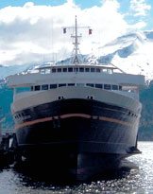
Ketchikan Ferry
Riding the Ketchikan Ferry offers breathtaking views of the Tongass Narrows. The ferry runs every half-hour providing a convenient and scenic mode of transportation.
Ferry runs from 6:15 am to 9:30 pm from the airport side. The ferry ride may be short, but the views are truly spectacular.
You will never know what you may run into in Ketchikan, so keep your camera ready.
It could be a whale by the port, a bear by the creek, a bald eagle by the trail or a seaplane land on the water near the ferry.
Round-trip ticket: Adult $12
Child $6

Slide 17
Conclusion
Ketchikan is a beautiful City with a rich history and numerous attractions. Whether you're looking for stunning views, historic sites, or unique attractions, Ketchikan has something for everyone.
I hope this presentation will help when we visit Ketchikan.

Slide 18
Thanks For Coming
If you have any more questions, please ask.
I will do my best to answer them for you.
Have a great visit in Ketchikan!

Slide 19
Acknowledgement
My seminars are the result of many years of travel experience combined with many hours of research over the internet.
I would like to acknowledge the many source I have accessed.
These include: Wikipedia.com, Britannica.com, Trip Advisor and the various Museum, Park and Government websites.

