Slide 1
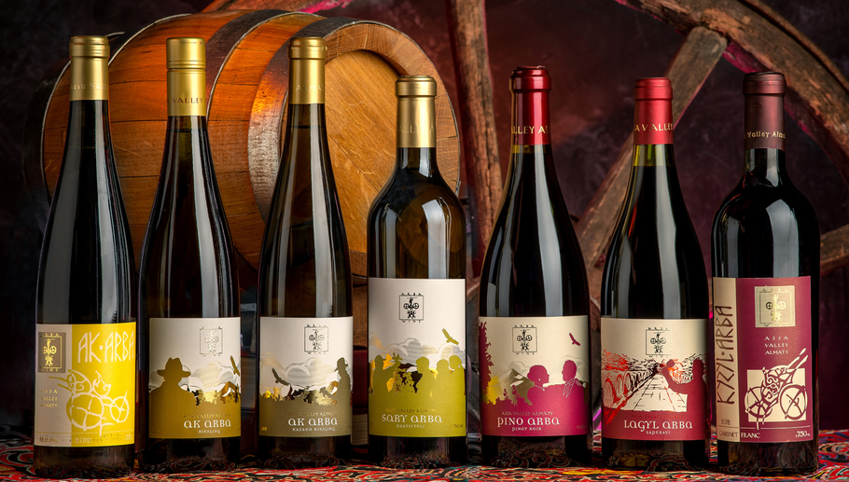
Wine Regions of the World An Introduction to Wine in Kazakhstan Presented by Marc Silver

Slide 2

Wine in Kazakhstan
Kazakhstan Uncorked
Overview of Kazakhstan’s Wine
History of Wine in Kazakhstan
Kazakhstan’s Wine Classification System
Introduction to Kazakhstan’s Wine Regions
Major Varietals of Kazakhstan
Notable Wineries in Kazakhstan
Kazakhstan’s Wine Culture and Traditions
Sustainable Winemaking Practices in Kazakhstan
Final Thoughts
Conclusion

Slide 3

Kazakhstan Uncorked
Exploring the Emerging Wine Regions of Central Asia
Kazakhstan’s wine industry is steadily gaining global attention. While still small compared to major wine-producing countries, Kazakhstan’s wines are increasingly sought after, especially in Europe and Central Asia.
The country’s unique climate and varied terroir provide ideal growing conditions for both indigenous and international grape varieties, and the recent resurgence of quality wine production is positioning Kazakhstan as an emerging player on the world wine stage.
Kazakhstan’s modern wine industry is focused on innovation while embracing the traditions of the past.
Local winemakers are experimenting with both new techniques and old methods, raising the quality of Kazakhstani wines and establishing a reputation that is just beginning to reach beyond its borders.

Slide 4

History of Wine in Kazakhstan
Ancient Beginnings
Winemaking in Kazakhstan has ancient roots, with evidence of grape cultivation dating back thousands of years. Situated along the Silk Road, Kazakhstan played a pivotal role in the exchange of ideas, goods, and viticulture.
Early nomadic tribes adopted grape growing techniques from neighboring cultures, adapting them to the region’s challenging continental climate.
The wine that resulted from this blending of cultures was distinctive, marking the start of Kazakhstan’s deep winemaking history.

Slide 5
History of Wine in Kazakhstan
Outside Influence in the Middle Ages
During the medieval period, Kazakhstan's wine industry was shaped by Persian traders, Russian settlers, and various nomadic tribes who introduced new grape varieties and winemaking methods.
These outside influences played a crucial role in refining local winemaking techniques, eventually contributing to a more sophisticated approach to viticulture.

Slide 6

History of Wine in Kazakhstan
Modern Revitalization and Global Recognition
After the dissolution of the Soviet Union, Kazakhstan’s wine industry began to regain its footing.
Local winemakers focused on modernizing their techniques, investing in education, and building international partnerships.
Today, Kazakhstan's wine industry is one of the fastest-growing in Central Asia, gaining recognition at wine competitions and gaining a growing place in global markets.

Slide 7
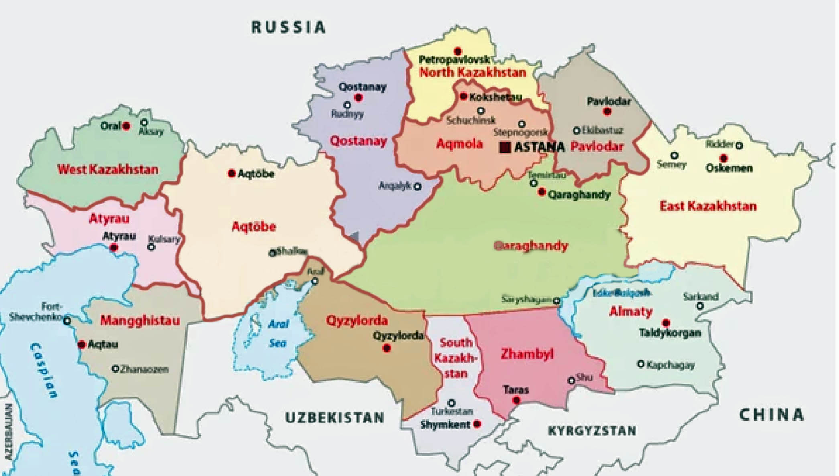
Kazakhstan’s Wine Regions
Kazakhstan’s diverse geography provides a variety of wine-growing conditions, allowing for a range of wine styles and flavor profiles.
The most significant wine-producing areas are concentrated in the southern and eastern regions, where the climate is ideal for grape cultivation.

Slide 8
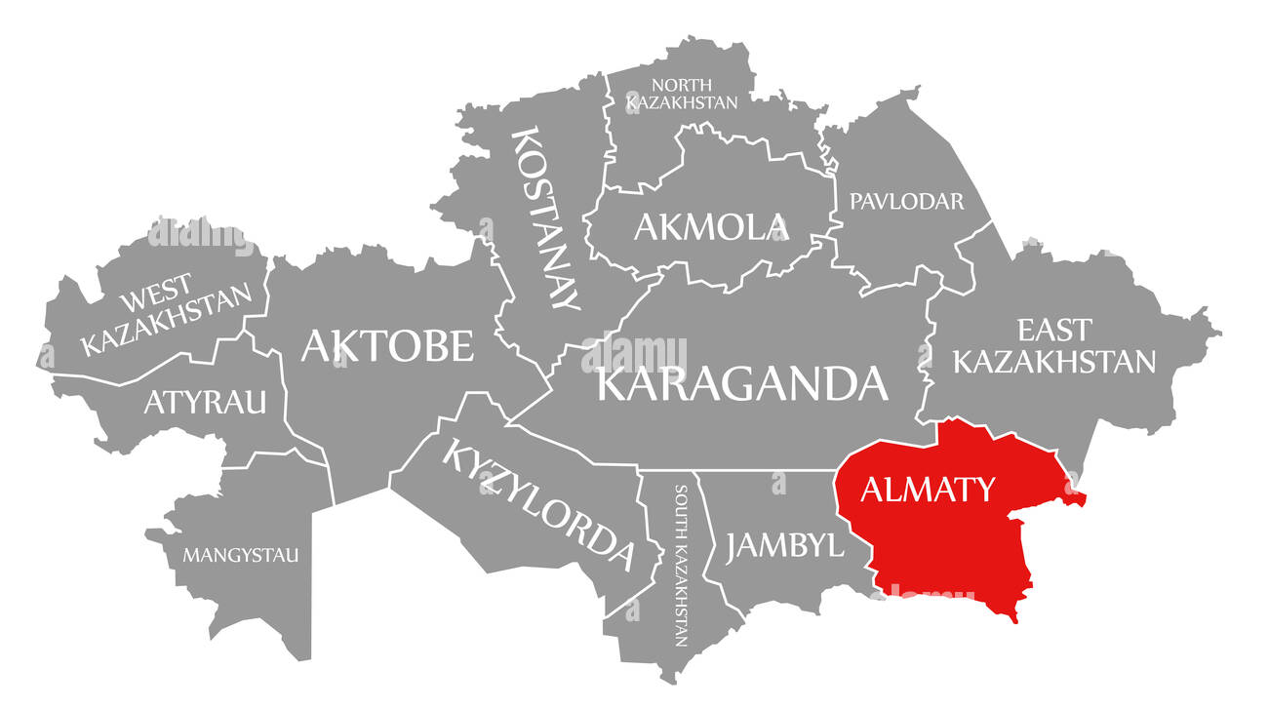
Wine Regions of Kazakhstan
Almaty Region
The Almaty region, located in southeastern Kazakhstan, is the most significant wine-producing area.
This region’s protected valleys and favorable microclimates make it perfect for cultivating a wide range of grapes.
Picture lush vineyards nestled beneath the snow-capped peaks of the Tien Shan mountains, soaking up the sun by day and cooling down by night—creating wines that are fresh, balanced, and full of life.

Slide 9
Wine Regions of Kazakhstan
Zhambyl Region
Known for its diverse terrain and extreme climate, the Zhambyl region produces wines that reflect the challenges of the landscape.
The winemakers here have developed specialized techniques to adapt to the heat and dry conditions, resulting in bold, distinctive wines.

Slide 10
Wine Regions of Kazakhstan
East Kazakhstan Region: This emerging region is quickly becoming known for its unique climatic conditions, which give its wines a distinct character.
The cool temperatures, especially in higher altitudes, allow for the production of wines with refreshing acidity and vibrant flavors.

Slide 11
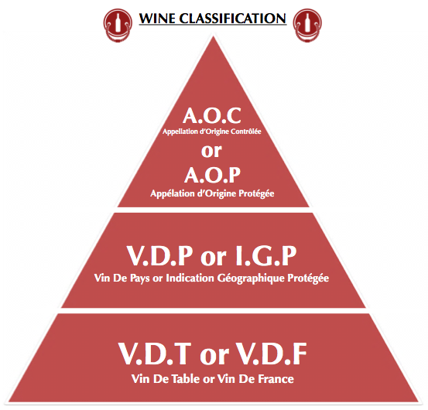
Comment on Classification System
While Kazakhstan doesn’t yet have an official wine classification system like those found in France or Italy, the industry is working on developing one.
This would include recognizing the influence of geographic origin, grape varieties, and production methods.
As the industry continues to grow, a more structured classification system may emerge to help standardize and promote the wines of Kazakhstan.

Slide 12
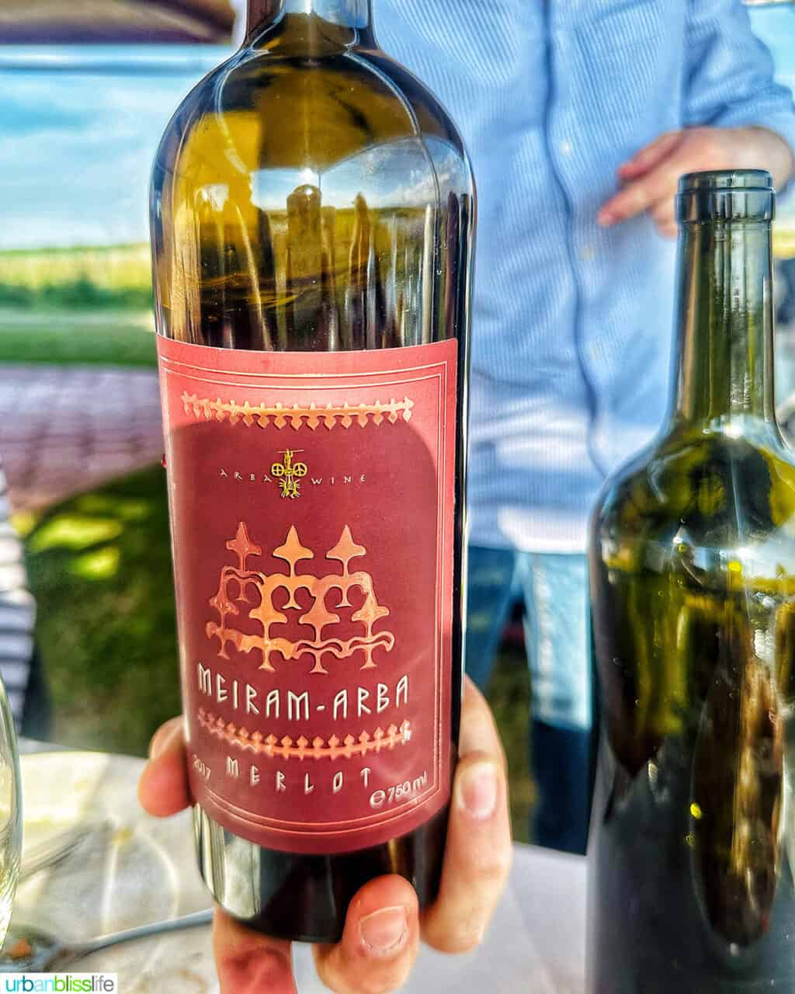
Major Varietals of Kazakhstan
Kazakhstan’s vineyards are home to both indigenous and internationally recognized grape varieties.
The country’s varied terroirs and climates allow for a range of wine styles, from bold reds to crisp whites.

Slide 13
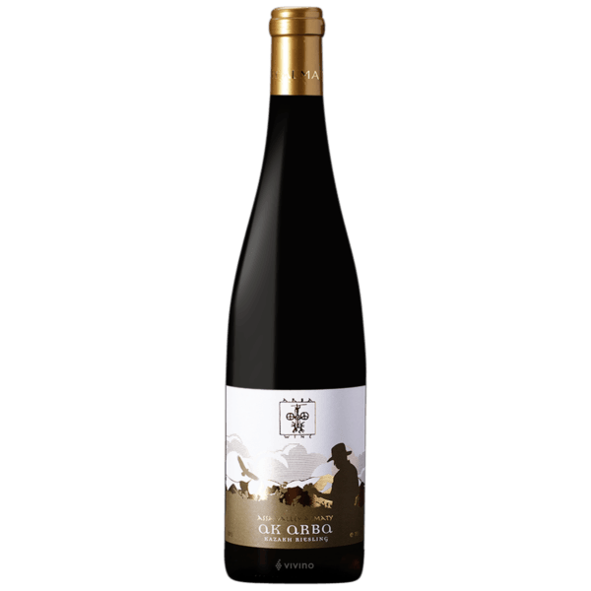
Indigenous Grapes of Kazakhstan
Akmola White
This indigenous white grape variety thrives in Kazakhstan’s cool climate, known for its crisp acidity and fresh, citrus-driven profile.
The wine produced from Akmola White is light and refreshing, perfect for pairing with seafood or light salads.
Its clean, mineral-driven finish is a signature characteristic of wines from Kazakhstan’s northern regions.

Slide 14
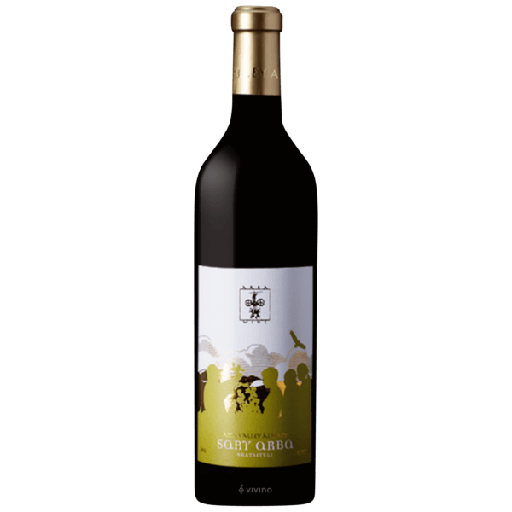
Indigenous Grapes of Kazakhstan
Sary-Arka
Sary-Arka is a red grape variety grown in Kazakhstan’s southern regions, where the warm, dry climate helps produce wines with rich, bold flavors.
The wine made from Sary-Arka is full-bodied, with intense fruit flavors and a touch of spice.
It pairs beautifully with grilled meats and hearty stews, making it a perfect match for traditional Kazakh dishes like beshbarmak.

Slide 15
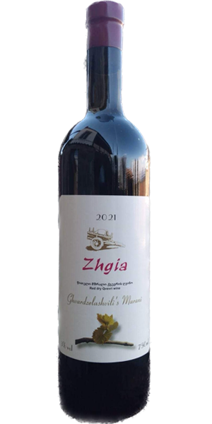
Indigenous Grapes of Kazakhstan
Zheti-Zhardem
Zheti-Zhardem is a red grape known for producing wines with deep color and strong fruit flavors.
The grape’s robust tannins make it ideal for blending with other varietals, producing wines with a good structure and complexity.
Wines made from Zheti-Zhardem pair well with game meats, grilled steaks, and rich cheeses.

Slide 16
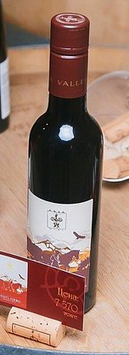
Internationally Recognized Varietals
Merlot
Known for its smooth texture and fruit-forward flavor, Merlot is widely planted in Kazakhstan.
The wines are medium to full-bodied, with soft tannins and notes of ripe cherries and plums.
Merlot pairs well with a wide variety of dishes, from roasted chicken to pasta with tomato sauce.

Slide 17

Internationally Recognized Varietals
Cabernet Sauvignon
Cabernet Sauvignon is one of the most popular red varieties in Kazakhstan, thriving in the warm, sunny climates of the southern wine regions.
This grape produces wines that are deep, tannic, and full of dark fruit flavors like blackcurrant and plum.
Cabernet Sauvignon from Kazakhstan also shows earthy undertones, reflecting the local terroir. It is ideal for pairing with grilled meats and rich dishes.

Slide 18
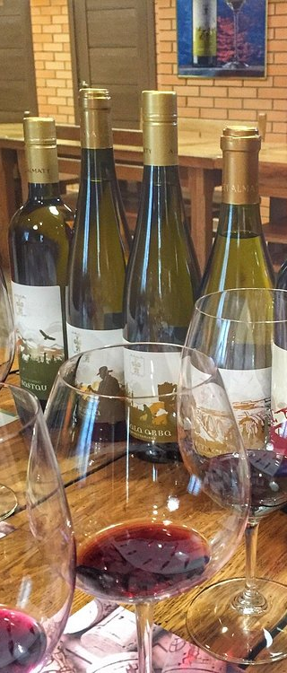
Internationally Recognized Varietals
Chardonnay
Chardonnay is a versatile white grape that performs well in Kazakhstan’s cooler wine regions.
The wines produced from Chardonnay are fresh and crisp, with citrus and green apple notes. In warmer areas, the grape produces fuller-bodied wines with tropical fruit flavors.
Chardonnay pairs perfectly with seafood or light pasta dishes.

Slide 19
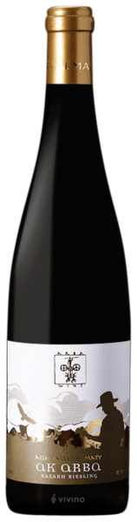
Internationally Recognized Varietals
Riesling
Riesling thrives in Kazakhstan’s cooler regions, producing wines with high acidity and vibrant aromas.
These wines often feature floral notes with a hint of sweetness, making them a perfect match for spicy dishes such as shashlik or kazy.
Riesling is also an excellent choice for pairing with soft cheeses and light, aromatic dishes.

Slide 20
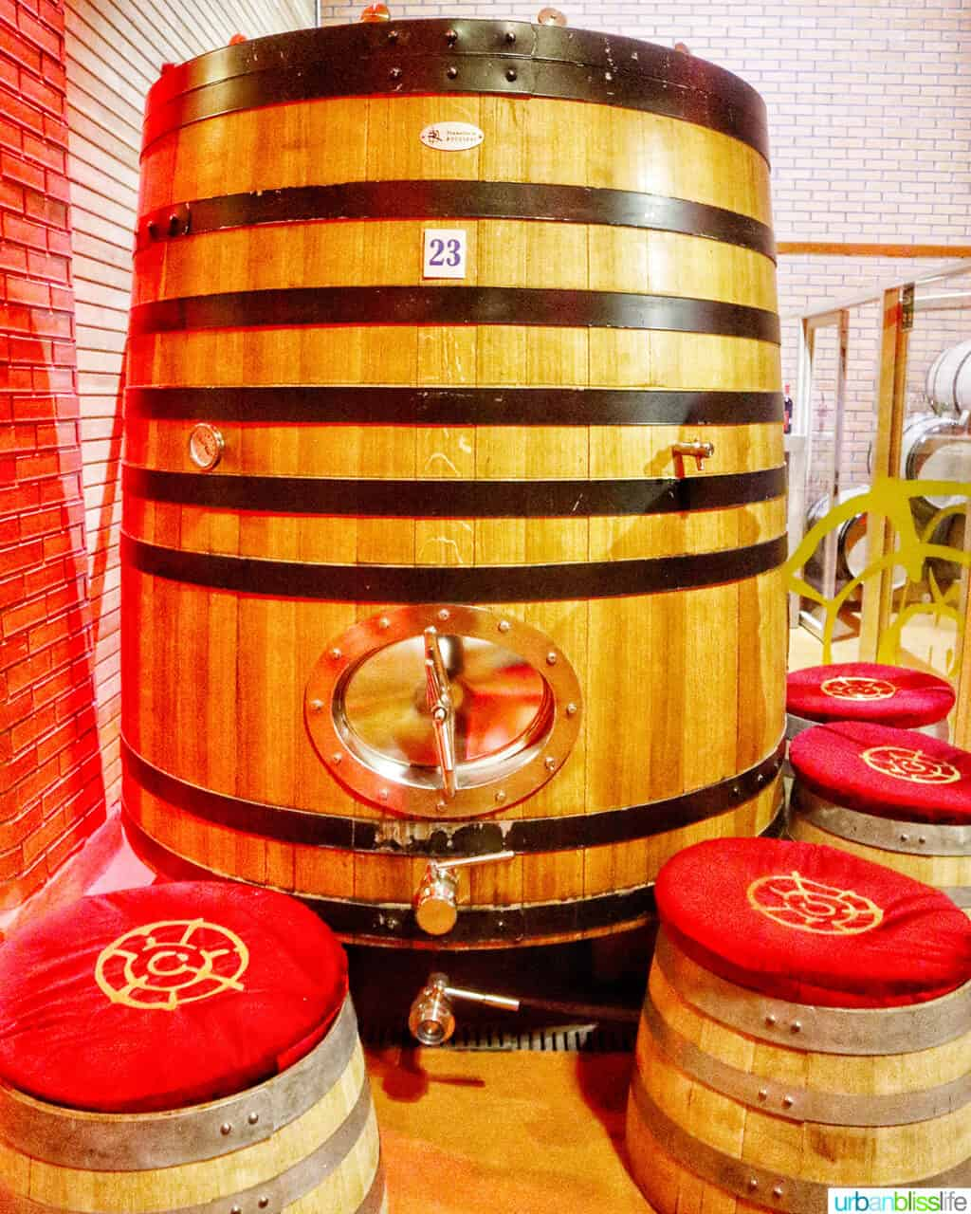
Notable Wineries in Kazakhstan
Notable Wineries in Kazakhstan
Kazakhstan’s wine industry is home to several prestigious wineries that have earned both domestic and international recognition.
Here are three of the most celebrated and awarded wineries in the country:

Slide 21
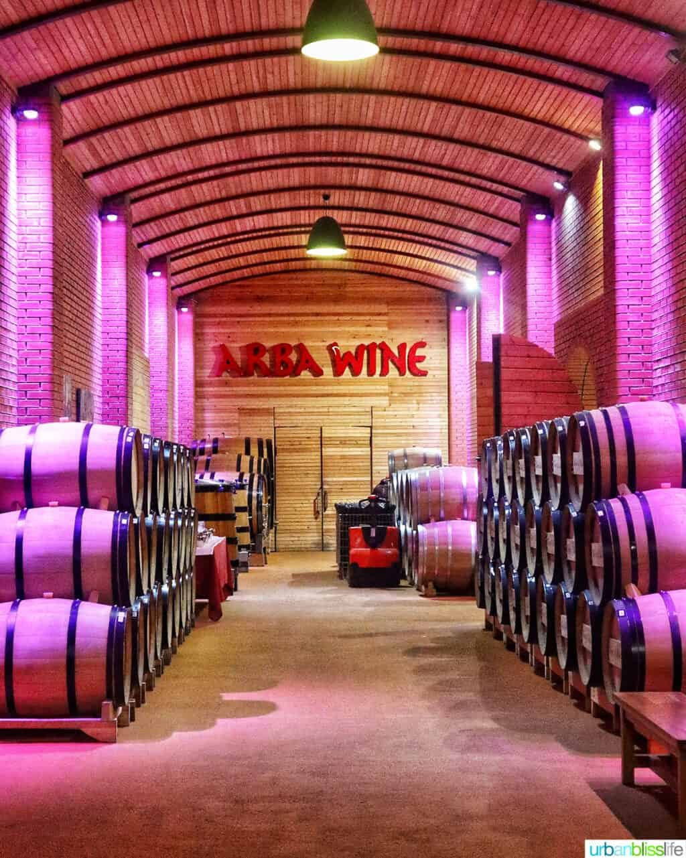
Notable Wineries in Kazakhstan
Shymbulak Winery (Almaty Region)
Shymbulak Winery is one of the most renowned wineries in Kazakhstan, known for its exceptional wine production and innovative approach.
Located in the Almaty region, the winery sits at the foothills of the Tien Shan mountains, providing an ideal environment for cultivating various grape varieties.
Shymbulak has won multiple awards for its Cabernet Sauvignon and other wines, praised for their bold tannins and rich, complex profiles.
The winery blends modern techniques with sustainable practices, ensuring that each wine produced reflects the unique terroir of the region.

Slide 22
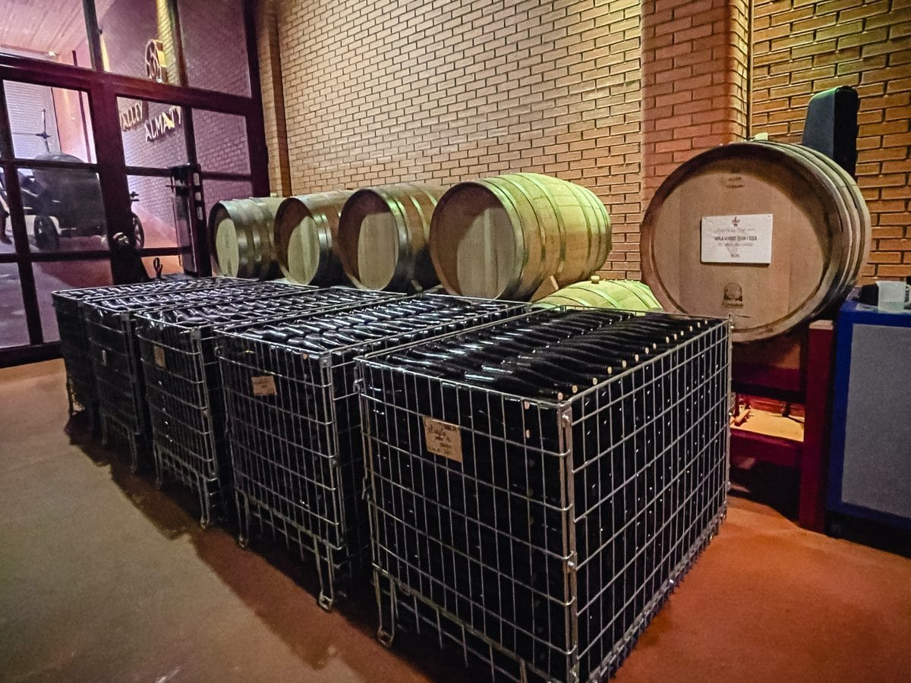
Notable Wineries in Kazakhstan
Baqyt Winery (Zhambyl Region)
Baqyt Winery is known for its commitment to organic and biodynamic viticulture.
The winery has gained attention for its sustainable approach and the exceptional quality of its wines.
Baqyt’s Riesling and Chardonnay have received international acclaim for their freshness and minerality, while their reds, made from local varieties like Zheti-Zhardem, are celebrated for their depth and complexity.
Baqyt is a leader in the movement toward sustainable winemaking in Kazakhstan.

Slide 23

Notable Wineries in Kazakhstan
Arba Wine (Almaty Region)
Founded in the early 2000s, Arba Wine has earned a reputation as one of Kazakhstan’s most prestigious wineries.
Known for its Cabernet Sauvignon and Syrah, Arba has won numerous international awards, cementing its position as a leader in the Kazakhstani wine industry.
The winery combines traditional techniques with cutting-edge technology to create wines that highlight the best of Kazakhstan’s terroir. Arba Wine continues to be a key player in the country's wine renaissance.

Slide 24
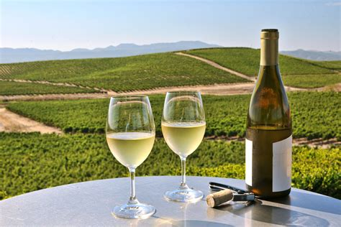
Kazakhstan’s Wine Culture and Traditions
Kazakhstan’s Wine Culture and Traditions
Wine in Kazakhstan is deeply intertwined with the country’s culture and traditions.
While vodka has long been the drink of choice, wine is gaining popularity and is now seen as a symbol of sophistication.
In Kazakhstan, wine is often shared at family gatherings, celebrations, and special occasions, and local wines are a point of pride.

Slide 25
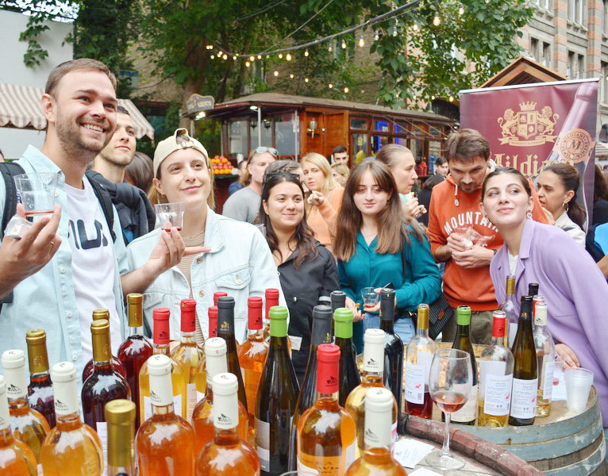
Kazakhstan’s Wine Culture and Traditions
Winemaking Festivals
Kazakhstan hosts several wine festivals, with the Kazakhstan Wine Festival in Almaty being the most notable.
This event brings together local winemakers and wine lovers, offering a chance to taste the best Kazakhstani wines, attend workshops, and enjoy cultural performances.

Slide 26
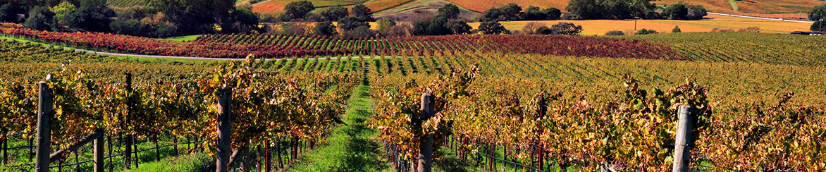
Sustainable Winemaking
Sustainable Winemaking Practices in Kazakhstan
Kazakhstan’s wine industry is increasingly focusing on sustainability.
Many wineries are adopting organic and biodynamic practices, including water conservation, organic farming, and reducing chemical interventions.
These efforts help protect the environment and enhance the quality of the wines, ensuring that Kazakhstan’s wine industry can continue to grow while preserving its natural resources.

Slide 27
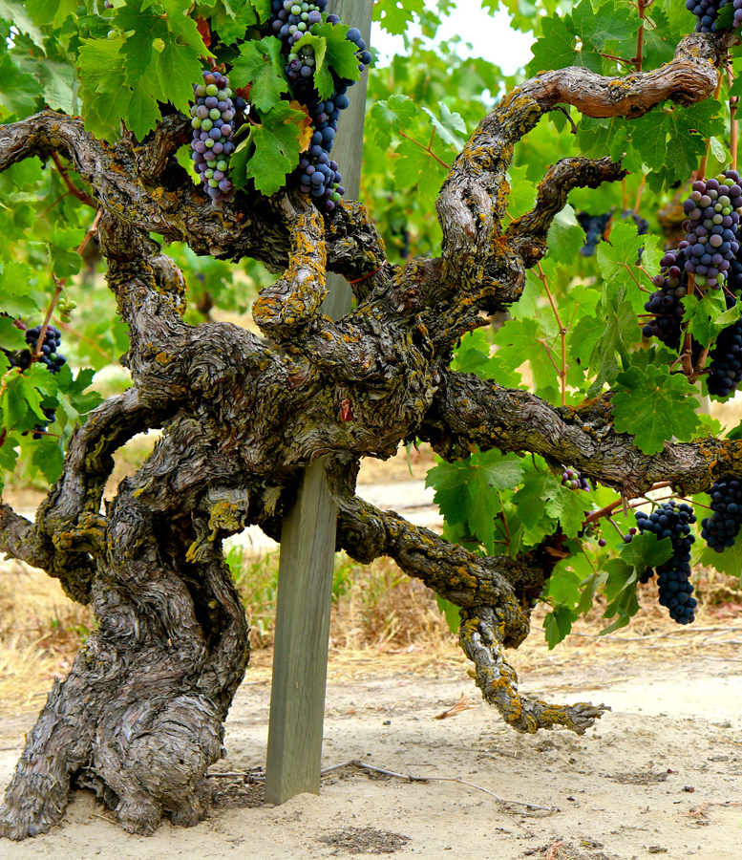
Final Thoughts
Kazakhstan’s wine industry is a fascinating blend of ancient traditions and modern innovation. The country’s diverse terroir, rich history, and forward-thinking winemakers make Kazakhstan a rising star in the global wine scene. From the snowy peaks of the Tien Shan mountains to the arid expanses of the steppes, the country’s wine regions are producing wines that are beginning to attract serious attention on the international stage.
The journey of Kazakhstan’s wines is one of transformation—what was once a hidden gem is now a destination for wine lovers seeking something unique and exciting. With an increasing focus on sustainability, the use of indigenous grapes, and the rise of award-winning wineries like Shymbulak, Baqyt, and Arba Wine, Kazakhstan is poised to continue its ascent as a major player in the world of wine.
As Kazakhstan’s wine industry grows, so too does its reputation for producing wines that embody both tradition and modernity. Whether you’re exploring its bold reds or crisp whites, the wines of Kazakhstan offer an adventurous and rewarding experience for those willing to venture off the beaten path.

Slide 28
Acknowledgement
My seminars are the result of many years of experience combined with many hours of research over the internet.
I would like to acknowledge the many source I have accessed.
These include Wine Spectator, Wine Enthusiast, BKWine Magazine, Wine & Spirits Magazine, American Vineyard Magazine, The Grapevine Magazine, Wikipedia.com, Britannica.com, and the various Government websites.

Slide 29
References and Citations
Kazakhstan Wine Institute Research Papers (2020-2023)
Central Asian Agricultural Journal, Viticulture Edition
International Organization of Vine and Wine (OIV) Regional Reports
Wines of Central Asia by Elena Petrova (2022)
Almaty Regional Agricultural Development Report

