Slide 1
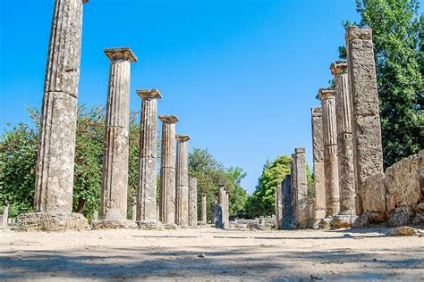
Katakolon Greece
Port Presentation
Presented by
Marc Silver

Slide 2
What I Will Cover
My Port Philosophy
Don’t Miss the Ship
Money
Katakolon Greece
Where is Katakolon and the cruise port
Getting Around
Katakolon History.
Map Of Katakolon
Things to do in Katakolon
Mercouri Estate Winery
Olympia
Michelin Restaurants

Slide 3
My Port Philosophy
I have been cruising for over 45 years and have taken over 100 cruises. So I consider myself an experienced cruiser.
The information I will present is based on those many years of experience.
When I am on a cruise where the city I want to visit is not the port city, I always recommend taking a ship’s tour.
But when I am in a port with multiple attractions nearby and easy to see on my own - I will do it on my own.
This presentation is for that type of port.

Slide 4
Don’t Miss the Ship
How to Avoid Missing Your Ship:
Pay attention to the time. - Ship time and local time are often different.
Put a return-to-ship reminder on your phone.
Choose excursions wisely:
If a ship-sponsored excursion is late returning to port, the ship will wait, but not for excursions taken on your own.
Be Prepared:
Have your Passport, Credit Card, and phone numbers for the ship port agent.
What to Do If You Miss the Ship: Most cruise lines have port agents stationed in the port area to assist if your ship has left without you. Sometimes, when cruisers are late returning to the vessel, the ship's crew may remove the passengers' essential items -- passports, cell phones, and medication -- from the ship to leave with the port agents.
The Port Officials can help you with contacting your ship and making necessary travel arrangements.

Slide 5
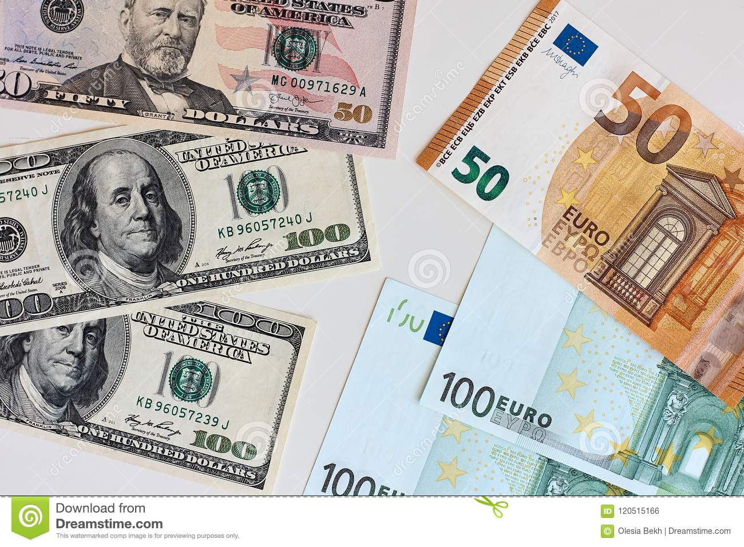
Money
The euro is the official currency of 20 European Union countries which collectively make up the euro area, also known as the eurozone.
Official Exchange is €1 to $1.079 US

Slide 6
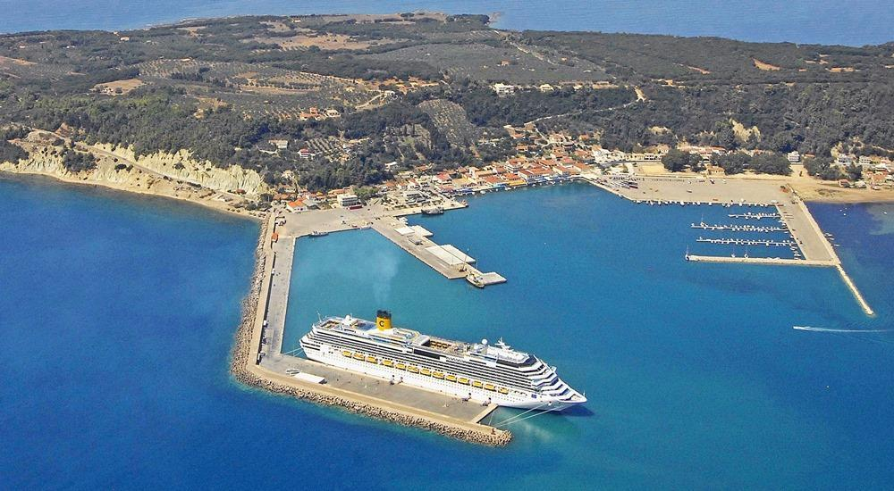
Katakolon Greece
The cruise port has capacity to handle larger ships at a dedicated pier. The terminal building is 2-story and has security and administrative facilities. A duty-free shop is also available at the pier. The closest beach is Plakes
(aka Renata Beach). A car rental office is also located close to the cruise terminal, as well as taxis. The train station is 15-min away from the port.

Slide 7
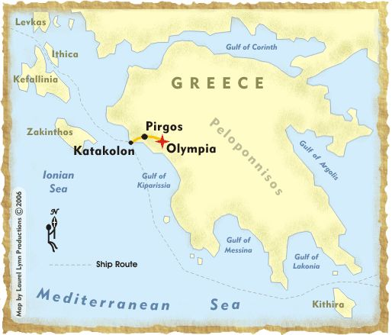
Where is Katakolon and the cruise port
The small port village of Katakolon, with a local population of 600, is located in a historical region known as Peloponnese, on the Western coast of Greece, on the shore of the Ionian Sea, 195 miles (313 km) west of Athens.

Slide 8
Katakolon History
Katakolon Port is the gateway to Olympia and has a lighthouse in the southwest that was opened in 1865.
Katakolon has been a port town for many years but its glory days were at the end of the 19th to the mid 20thcentury. Construction of the port was entirely funded by the local Pyrgos authorities and it was built to facilitate the transportation of goods to all other major ports in Europe.
In 1881 the Pyrgos- Katakolon rail link was completed. The old Katakolon can still be seen thanks to the presence of the old warehouse buildings along its back streets, some of which have been nicely restored to preserve the history of Katakolon Port.

Slide 9
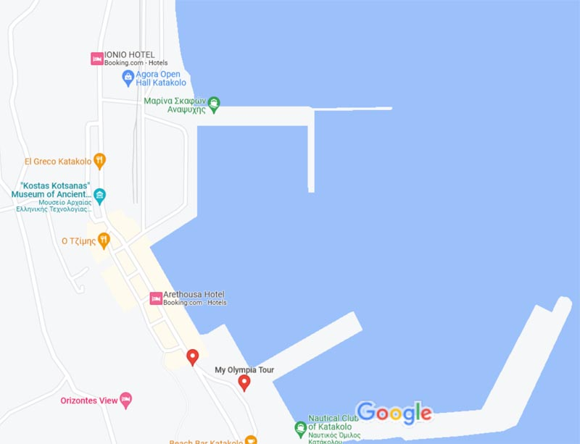
Map Of Katakolon

Slide 10
Getting Around
For the most part Katakolon is an easy city to walk, because it is so compact. But remember this is bacically a gateway village.
There is a regular public bus service between Katakolon and Pyrgo (cost: €1.70 euro that takes about 30 minutes), and from here to Olympia (cost: €2.20 euros another 30 minutes trip). There are 2 buses in the morning (7:40 AM and 9:30 AM) which allow enough time to travel to Olympia (via Pyrgo) and back to Katakolon. The bus stop is close to the cruise port, just before the start of the main street - lookout for the KTEA bus sign.

Slide 11
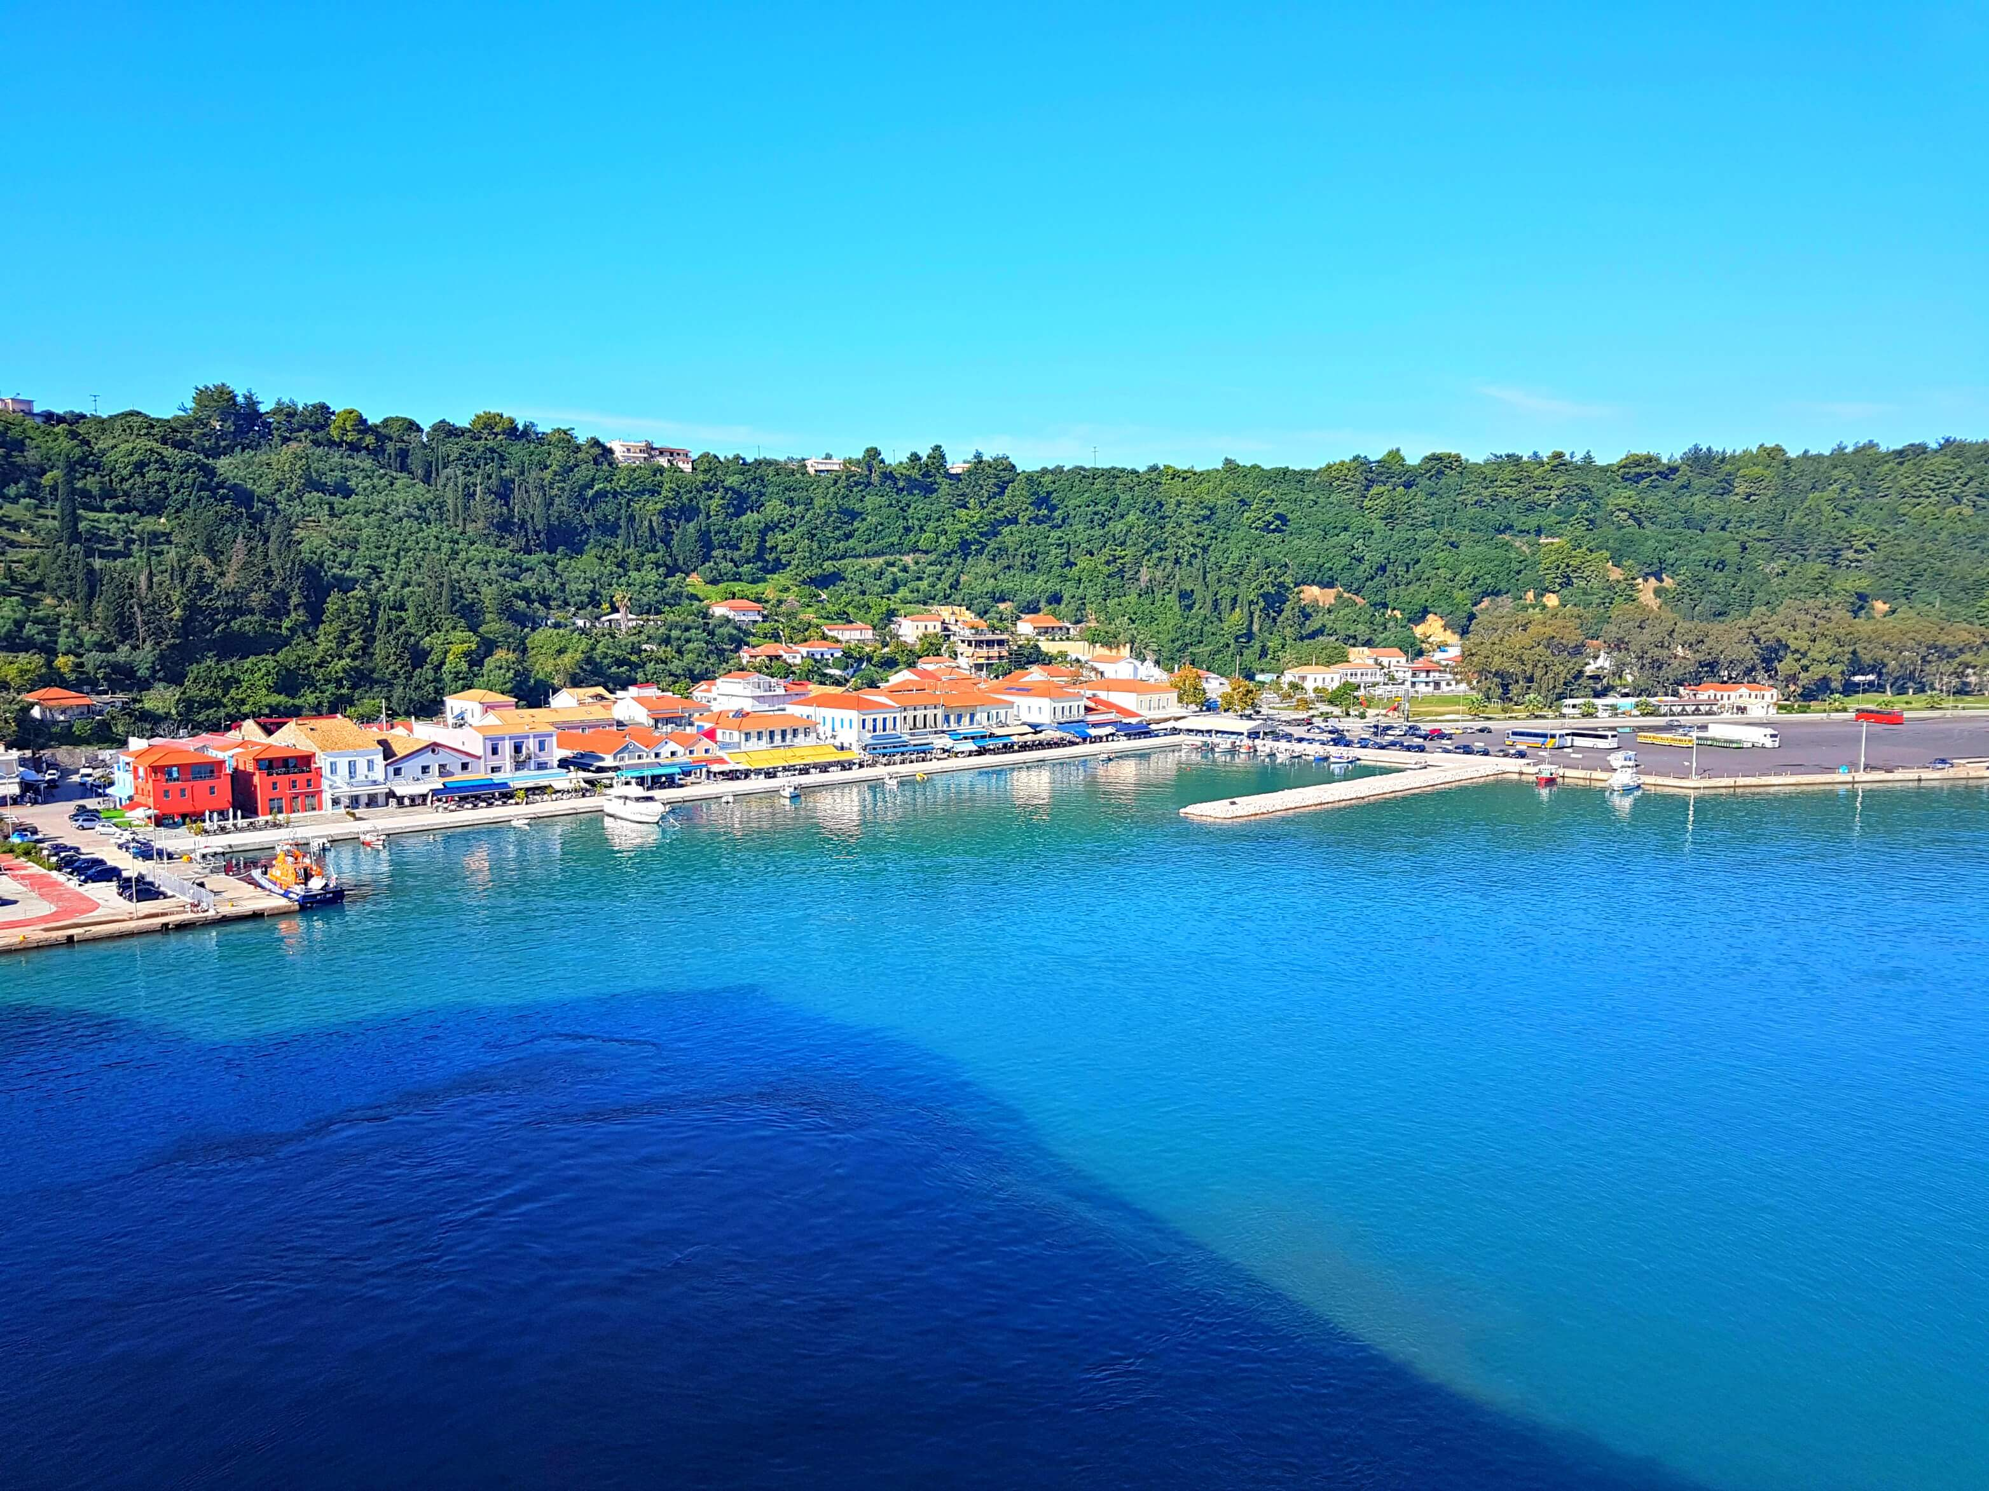
Things to do in Katakolon
Katakolon: the town is small, you can relax really well. There are good places to eat, to buy some souvenirs or jeweler. You can also visit the Museum of Ancient Greek Technology. The museum has reconstructed inventions of the ancient Greek world! Interactive exhibits-replicas from the 7th c. BC. It is always open when a cruise ship arrives. Admission is 5€.
Walk on the promenade in the harbor and watch the small fishing boats and the fishermen. Katakolon has a seafront ideal for a sit or a stroll. If there is time, walk up the hill and have a wonderful view from above!
Beaches: the town has several nice beaches. They all are within walking distance from the cruise port. Other famous in the area are Aghios Andreas Beach (3 km from Katakolon cruise port), Kourouta Beach (20 km from Katakolon cruise port) and Zacharo Beach (42 km from Katakolon cruise port).

Slide 12
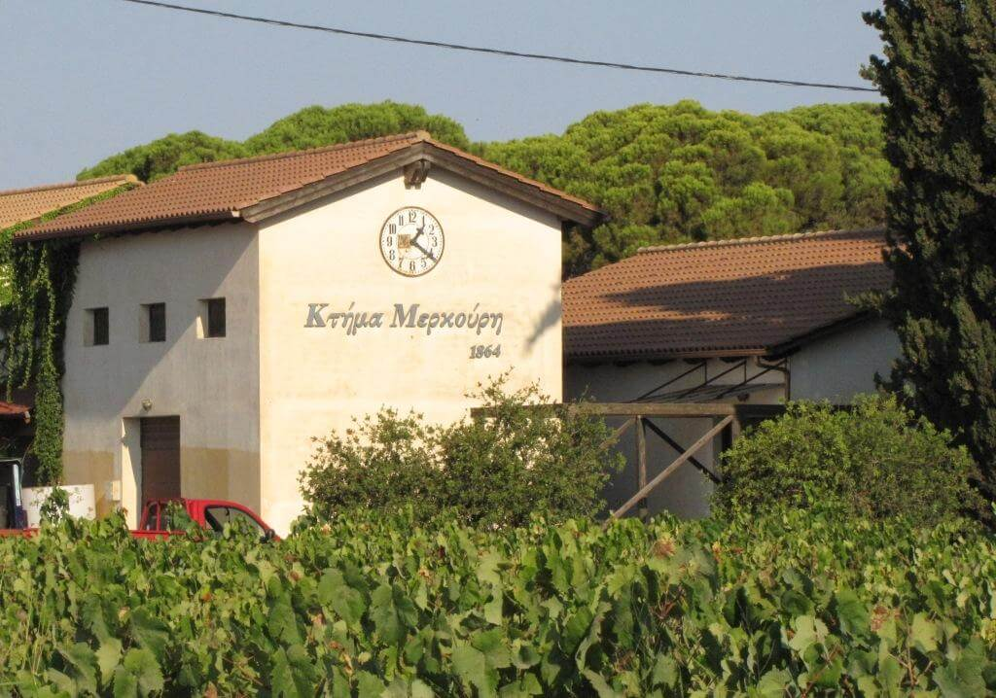
Mercouri Estate Winery
Mercouri Estate Winery: located 4 km from Katakolon cruise port. The winery dates back more than 150 years. The wines produces there are among the most renowned in Greece. Popular are the red Ktima Mercouri (dominates the Refosco blend) and the white Foloi.
The estate grows more than 15 varieties of grape of both Greek and international origin, from which the
wines are produced.
The Refosco Mercouri grown in the estate since 1870
The essential Greek red varieties Mavrodaphne, Agiorgitiko and Avgoustiatis.
Many French varietials like Syrah, Mourvedre and Grenache rouge and Italian varitals as well.
Mercouri Estate Winery

Slide 13
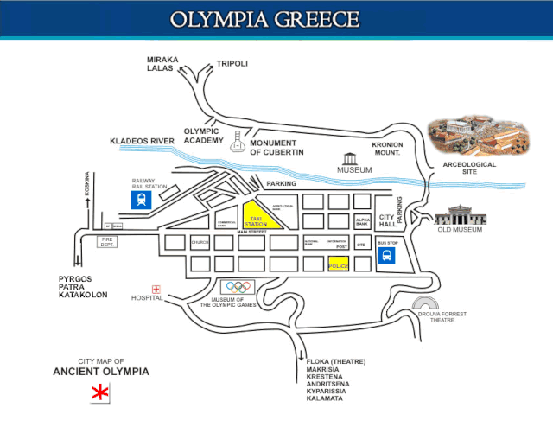
Olympia
Katakolon is the port for Olympia, the ancient birthplace of the Olympic Games. Katakalon is very small with only one main street. Olympia is approximately 20 miles to the east.
There is infrequent train service to Olympia which may be disrupted by strikes. The train station is a small building by the tracks just past the edge of town. Several private tour companies runs buses to Olympia for €10 return

Slide 14
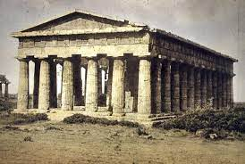
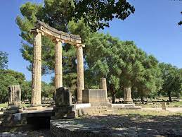
Olympia Early History
Olympia: located 34 km from Katakolon cruise port. The place is the most famous site that tells the history of the Greeks. This is the place, where the Olympic games began (back in 776 BCE). Most of the site was built during the Classical period (5th-4th centuries BCE). The attraction with top popularity is the Temple of Zeus.Olympia: located 34 km from Katakolon cruise port. The place is the most famous site that tells the history of the Greeks. This is the place, where the Olympic games began (back in 776 BCE). Most of the site was built during the Classical period (5th-4th centuries BCE). The attraction with top popularity is the Temple of Zeus.

Slide 15
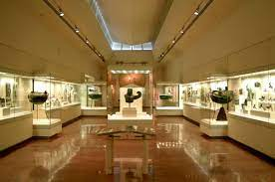
Things to do in Olympia
The Archaeological Museum of Olympia, one of the most important museums in Greece, presents the long history of the most celebrated sanctuary of antiquity, the sanctuary of Zeus, father of both gods and men, where the Olympic games were born. The museum's permanent exhibition contains finds from the excavations in the sacred precinct of the Altis dating from prehistoric times to the Early Christian period.
Among the many precious exhibits the sculpture collection, for which the museum is most famous, the bronze collection, the richest collection

Slide 16
Museum of the History of the Olympic Games of Antiquity
Once Olympia’s first Archaeological Museum—completed in 1888 after the first excavations—it housed exquisite finds of the sanctuary until the 1970s. With the Athens 2004 Olympiad, this magnificent spot became the Museum of the History of the Ancient Olympic Games. More than 400 exhibits, which date from the prehistoric period to the 5th century
Admission: €12

Slide 17
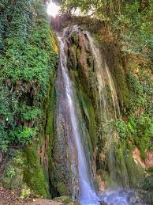
Nemouta Falls
About 17 miles from Ancient Olympia brings you to the small village of Nemouta. Unknown to many, about 30 waterfalls can be found in this forest of plain and fruit trees and dense foliage along the Erymanthos river. The river cuts through two regions of the Peloponnese — Ilia and Arcadia — and makes for stunning hiking scenery. Persist in trying to find the area as it’s worth it, especially as a day away from the heat of the Peloponnese beaches.

Slide 18
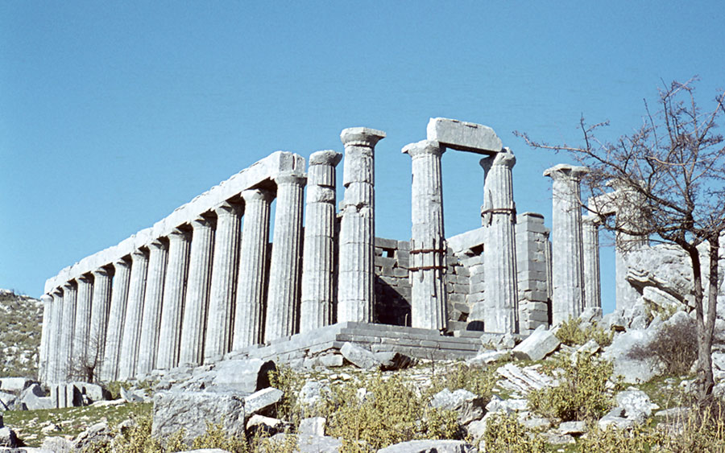
Temple Of Apollo Epicurius
There’s more than one ancient site in the region of Ancient Olympia, although admittedly that may be the most popular. Head into the mountains of Arcadia near the Bassae region of the Peloponnese and you’ll come to the small village of Abeliona. It’s dedicated to Apollo, God of Healing, as myth has it that during his time, he helped the residents of the region overcome a great plague, prefixing it with the name “Epicurius” which means “the one who helps or cures.”

Slide 19
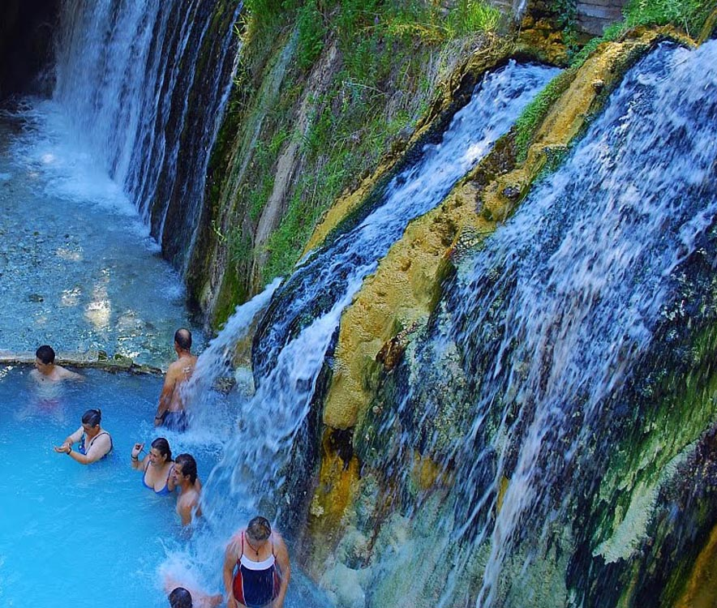
Thermal Baths And Lake Of Kaiafas
12 Miles South Of Ancient Olympia isanother underrepresented destination. The thermal baths and lake of Kaiafas. Greeks flock to this location in the western Peloponnese region known as Zacharo in the summer months to relax and kick back, and you maywant to as well.
The baths themselves are formed from a hot spring bubbling to the surface in a
cave at the foot of Mount Lapitha, full of minerals and sulfur with healing properties. Addmission: €100

Slide 20
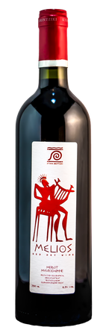
Brintziki Estate Winery
The Brintziki Estate is a producer of indigenous, rare varietals and is considered to be Greece’s first green winery. Located in the Ilian region of the Peloponnese near the sacred town of Ancient Olympia, the family-owned property is certified organic and completely carbon-neutral through the use of renewable solar and geothermal energy.
They grow indigenous varietals.Their 15 hectare, clay-soil property sits 300 m above sea level near the river Enipeas.
They produce varietals that I honestly have never heard of.
Tasting and tour: €15.00 / per Adult Minimun Charge: €39.00

Slide 21
Thanks For Coming
If you have any more questions, Please ask.
I will do my best to answer them for you.
Have a great visit in Katakolon!

Slide 22
Acknowledgement
My seminars are the result of many years of travel experience combined with many hours of research over the internet.
I would like to acknowledge the many source I have accessed.
These include: Wikipedia.com, Britannica.com, Trip Advisor and the various Museum, Park and Government websites.

