Slide 1

Kangaroo Island Australia Presented by Marc Silver

Slide 2
What I Will Cover
My Port Philosophy
Don’t Miss the Ship
Money
About Kangaroo Island
Area Map of Kangaroo Island
Map of Kangaroo Island
Kangaroo Island Transportation
Places to see or at least consider
A few restaurant recommendations
Conclusion

Slide 3
My Port Philosophy
I have been cruising for over 45 years and have taken over 200 cruises. So, I consider myself an experienced cruiser.
The information I will present is based on those many years of
experience.
When I am on a cruise where the city, I want to visit is not the port city,
I always recommend taking a ship’s tour.
But when I am in a port with multiple attractions nearby and easy to see
on my own - I will do it on my own.
This presentation is for that type of port.

Slide 4

Don’t Miss the Ship
How to Avoid Missing Your Ship
Pay attention to the time. - Ship time and local time are often different.
Put a return-to-ship reminder on your phone.
Choose excursions wisely.
If a ship-sponsored excursion is late returning to port, the ship will wait for you. If you are on your own???
Be Prepared
Have your Passport, Credit Card, and phone numbers for your ship port agent.
What to Do If You Miss the Ship Most cruise lines have port agents stationed in the port area to assist if your ship has left without you. If your are lucky, when cruisers are late returning to the vessel, the ship’s crew will often remove the passengers’ essential items – passports, cell phones, and medication -- from the ship to leave with the port agents.
The Port Officials can help you with contacting your ship and making necessary travel arrangements.

Slide 5
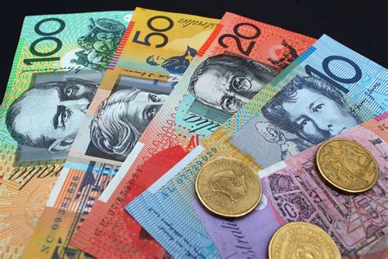
Money
The currency for Kangaroo Island is the Australian Dollar.
The conversion at the rate is $1.48 AUD to $1.00 U.S.
Or $1 AUD $.67 U.S.

Slide 6
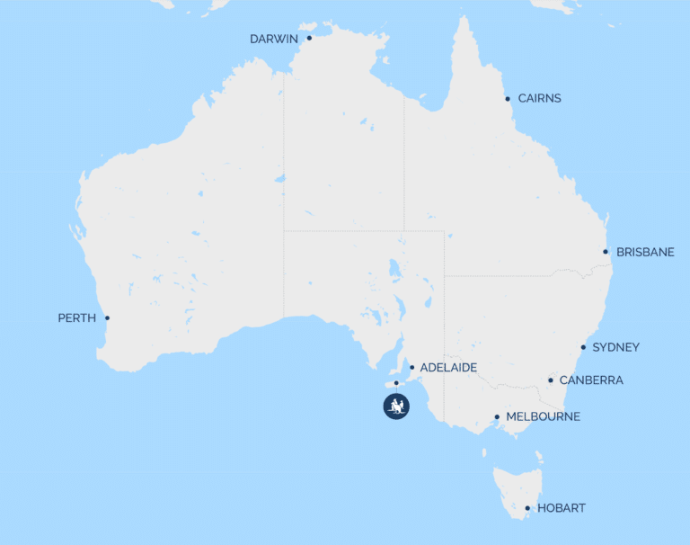
About Kangaroo Island
Kangaroo Island is a large Island located off the coast of South Australia.
Whether you're interested in wildlife, photography, food & wine, the local art scene, celebrating a honeymoon or bringing the family, there is something for everybody.
Kangaroo Island is Australia’s third-largest Island 90×35 miles covering over 3,400 square miles and to the surprise of many, is similar size to Long Island (New York) or Bali.
Kangaroo Island is located 9 miles from the tip of the Fleurieu Peninsula, separated by a narrow strait called Backstairs Passage.
Further west the Investigator Strait separates the north coast from the Yorke Peninsula and far to the west, is Eyre Peninsula.
Kangaroo Island

Slide 7
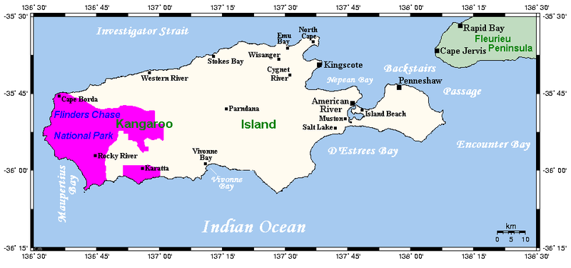
About Kangaroo Island
Cultural elements support this physical evidence, with oral histories of adjacent mainland Aboriginal people referencing locations on Kangaroo Island and recording long-term environmental change.
One such change is the rising sea levels which ultimately cut the Island off from the mainland after the last Ice Age.
Geological evidence marks this event at about 12,000 years ago which is just a fraction of the time Australian indigenous people have lived in this land.

Slide 8
Kangaroo Island Indigenous History
At least three Aboriginal groups (Kaurna, Narungga, and Ngarrindjeri) maintain an active cultural reference to Kangaroo Island, and there is plenty of evidence of a long pre-contact occupation of Kangaroo Island.
No Aboriginals remained on the island at the time of European exploration in 1802.
Even so, the Indigenous interest in Kangaroo Island from both a spiritual and physical perspective remains strong.
There have been archaeological investigations of cave shelters on the coast and alongside inland waterways.
Other evidence includes many thousands of artefacts, middens (ceremonial sites marked by piles of shells and animal bones), campfire hearths and stone tool industrial sites characterized by aggregations of stone tools and discarded shards of sharp stone flakes.

Slide 9
Kangaroo Island Area Map

Slide 10
Map of Kangaroo Island

Slide 11
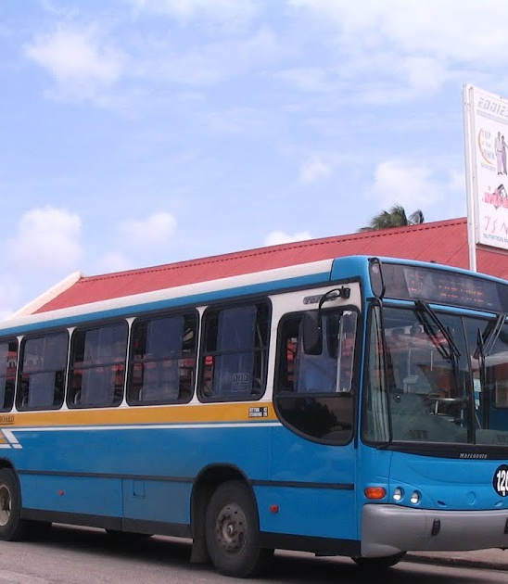
Kangaroo Island Buses
Kangaroo Island has one of the most comprehensive and user-friendly public transport Pay with cash in exact change.

Slide 12
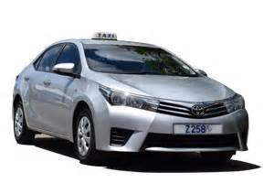
Kangaroo Island Taxis
Standard taxis provide a safe and reliable way to explore the city or for transport between the cruise port and various attractions.
Taxis are easily identified by the XXX designation on their license plates.
Like taxis in most locations the cost is significantly more expensive than other modes of transport.

Slide 13
Kangaroo Island Walking Tour
Take a Kangaroo Island walking tour of the interesting points and historic buildings in the capital city of Kangaroo Island.
Places You Will See in Kangaroo Island:
St. Mary's Church
The Jewish Synagogue
St. Michael's Cathedral
Queen's Park
Heroes Square
Parliament Buildings

Slide 14
Church
Church

Slide 15
The
The tours are guided by a volunteer Docent from the community.
ADULTS: $12.50 USD / $25.00 BBD
CHILDREN 5 -12: $6.25 USD / $12.50 BBD
CHILDREN UNDER 5 - FREE

Slide 16
St. Cathedral
XXX

Slide 17
Queen's Park
Queen's Park is located in the capital city of Kangaroo Island. This historic site dates back to the 1780's when it was purchased by the British Government as the residence of the commanding General of the British troops in the West Indies.
Today the area is a designated park, and it is lovely to stop by if you are visiting Kangaroo Island. The park is run by the National Conservation Commission and includes washroom facilities and a children's play park.

Slide 18
Heroes Square
Kangaroo Island, known for its stunning beaches and vibrant culture, holds a significant historical landmark known as National Heroes Square otherwise known as Kangaroo Island National Monument. This iconic monument stands as a testament to the nation’s rich heritage and pays tribute to the remarkable individuals who have shaped its history.
National Heroes Square holds immense cultural and historical significance for the people of Kangaroo Island. It serves as a reminder of the nation’s resilience and the struggles endured by its heroes.

Slide 19
Andromeda Botanic Gardens
The Oldest and the Largest Garden in Kangaroo Island this 8 acres of cultivated gardens with over 500 plant

Slide 20
Kangaroo Island Wildlife Reserve
Kangaroo Island Wildlife Reserve is a walk-through zoo opposite Farley Hill, with short paths that meander through a mahogany forest
Admission Fee: Adults US$15, Children US$7.50

Slide 21
Park
Farley Hill National Park is located in the parish of St. Andrew, on the east coast of Kangaroo Island. The park is a forest of Mahogany Trees, which sits high up on a hill mission, but if you walk up from the public bus, it's free.

Slide 22
Restaurants in Kangaroo Island
There are a lot of excellent restaurants in Kangaroo Island. Here are some recommendations:

Slide 23
Conclusion
Kangaroo Island is a beautiful City with a rich history and numerous attractions. Regardless of what you're looking for, Kangaroo Island has something for everyone.
I hope this presentation will help when we visit Kangaroo Island!

Slide 24
Thanks For Coming
If you have any more questions, please ask.
I will do my best to answer them for you.
Have a great visit to Kangaroo Island!

Slide 25
Acknowledgement
My seminars are the result of many years of travel experience combined with many hours of research over the internet.
I would like to acknowledge the many source I have accessed.
These include: Wikipedia.com, Britannica.com, and the various Museum, Park and Government websites.

