Slide 1
Wine Regions of the World Jordanian Wines Presented by Marc Silver

Slide 2
An Introduction to Wine in Poland
Table of Contents
Jordan’s Ancient Traditions Meet Modern Winemaking
History of Wine in Jordan
Jordan’s Wine Regions
Major Varietals of Jordan
Notable Wineries in Jordan
Jordan’s Wine Culture and Traditions
Sustainable Winemaking Practices
Final Thoughts
Citations & References

Slide 3
Jordan’s Ancient Traditions
Meet Modern Winemaking
Jordan’s winemaking story weaves together history, culture, and innovation. With roots stretching back thousands of years, this legacy is deeply intertwined with some of humanity’s earliest civilizations.
Jordan’s winemaking story weaves together history, culture, and innovation. With roots stretching back thousands of years, this legacy is deeply intertwined with some of humanity’s earliest civilizations.
The story of Jordan’s wine begins with the Nabataean Kingdom, where wine was not only a cultural symbol but also a critical part of the economy. Archaeological discoveries have unveiled numerous winepresses scattered across the Petra hinterland, with at least ten recorded to date. These ancient winepresses, such as the one found north of Malghan, serve as a testament to the region’s winemaking legacy.

Slide 4
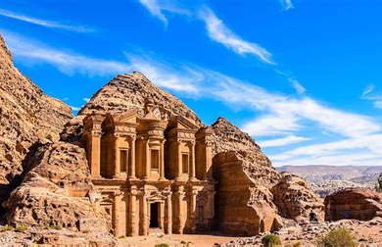
Jordan A Land of Contrasts
The Hashemite Kingdom of Jordan boasts a strikingly diverse geography.
Fertile stretches of the Jordan Valley contrast sharply with the dry, rocky expanses of the eastern desert.
This varied landscape, coupled with elevation differences that create unique microclimates, offers intriguing possibilities for winemaking.
Jordan’s Mediterranean-inspired climate—with its long, hot summers and mild winters—demands ingenuity from vintners, who craft wines that reflect the land’s essence.

Slide 5
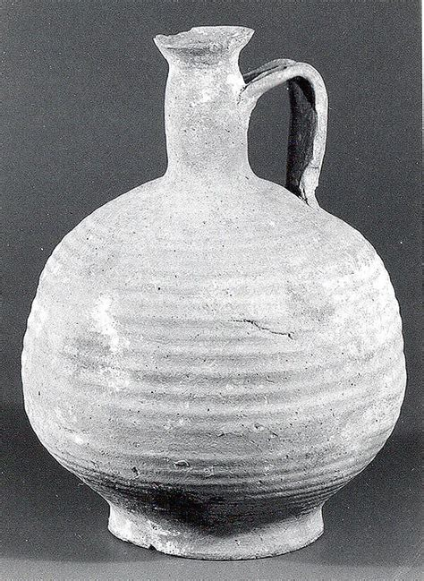
History of Wine in Jordan
The Ancient World (4th Century BCE – 5th Century CE)
During the Nabataean period, Jordan became a thriving center of trade and culture.
As the Nabataeans carved their monumental city of Petra into the rose-red cliffs, they also cultivated the surrounding lands.
Sophisticated wine presses, discovered at archaeological sites like Umm Qais and Petra, reveal that winemaking was already a refined craft.
The region’s position along ancient trade routes allowed Jordanian wine to travel far and wide, contributing to the cultural and economic exchanges of the Mediterranean and Near East.
Globally, this era saw the rise and dominance of empires like the Greeks and Romans, both of which valued wine as a symbol of civilization.
Roman influence in the region further enhanced viticulture, as advanced irrigation systems and agricultural techniques were introduced, setting the stage for centuries of winemaking.

Slide 6

History of Wine in Jordan
The Islamic Golden Age (7th – 13th Century)
With the rise of Islam in the 7th century, the cultural role of wine shifted dramatically.
While Islamic teachings discouraged alcohol consumption, Jordan’s vineyards weren’t abandoned. Instead, they adapted to produce grapes for non-alcoholic uses, such as table grapes and syrups.
This period also marked a time of scientific advancement, as Islamic scholars preserved and expanded upon agricultural knowledge.
Their innovations in irrigation and farming would later benefit Jordanian viticulture.
This intellectual and cultural flourishing influenced agriculture and trade, indirectly shaping the development of wine-related practices in the Levant.

Slide 7

History of Wine in Jordan
The Ottoman Era (16th – 19th Century)
Under Ottoman rule, viticulture in Jordan largely remained dormant due to stringent alcohol regulations and shifting economic priorities.
However, local vineyards survived, sustained by the production of raisins and other grape-based products.
Despite these constraints, the Levant continued to trade in wine and spirits, particularly in regions with Christian populations, keeping the winemaking tradition alive.
Globally, the Ottoman Empire acted as a bridge between East and West.
European powers were expanding their colonial reach, and Jordan’s position as part of the empire connected it to a broader network of trade and cultural exchange.

Slide 8
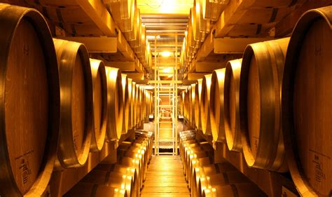
History of Wine in Jordan
Modern Resurgence (20th – 21st Century)
Jordan’s wine industry began its revival in the late 20th century, fueled by visionary entrepreneurs who recognized the potential of the country’s unique terroir.
The establishment of modern wineries, particularly in the Jordan Valley and Mountain Heights, marked a turning point.
Investment in contemporary equipment, sustainable practices, and international expertise helped Jordanian wines gain recognition on the global stage.
This resurgence coincided with a broader global movement toward quality-driven, boutique wine production.
As traditional wine powers like France and Italy competed with rising producers from the New World, Jordan entered the conversation as a distinctive voice.
Today, Jordan’s wines are celebrated for their ability to balance ancient heritage with modern innovation.

Slide 9
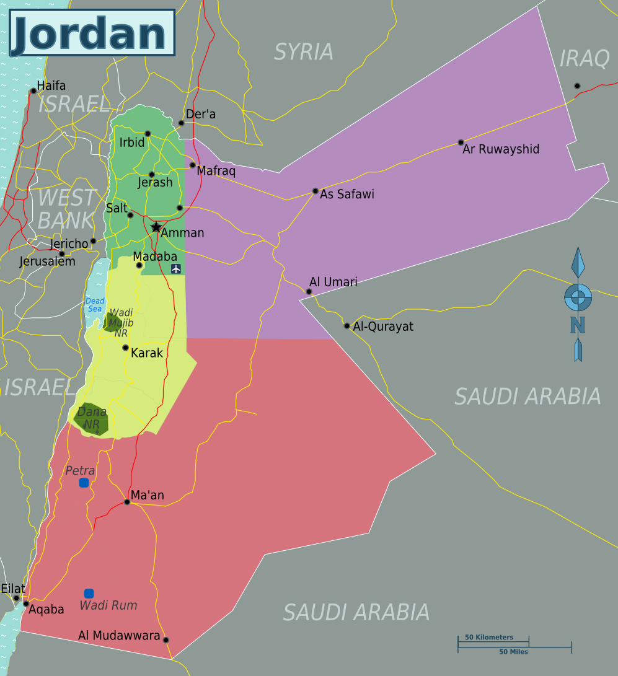
Jordan’s Wine Regions
Jordan’s diverse geography gives rise to three distinct wine regions, each offering unique conditions for viticulture.
From the lush lowlands of the Jordan Valley to the rugged mountain ranges and the experimental plots of the desert plateau, these regions reflect the country’s varied terrain and innovative spirit.

Slide 10
Jordan’s Wine Regions
The Jordan Valley
Located in the western part of the country, the Jordan Valley is Jordan’s primary wine-growing region.
Stretching along the eastern edge of the Jordan River, this area sits at elevations between 200 to 400 feet below sea level, making it one of the lowest wine-producing areas in the world.
The region’s hot days and cool nights create ideal growing conditions, while the rich alluvial soils contribute to the intense flavor profiles of its wines.
Notable red varietals, including Cabernet Sauvignon, Merlot, and Syrah, thrive here, producing bold and structured wines that reflect the valley’s unique terroir.

Slide 11
Jordan’s Wine Regions
The Mountain Heights
East of the Jordan Valley and rising into the central highlands, the Mountain Heights region offers a dramatic contrast in climate and elevation.
Vineyards here are planted between 600 and 1,200 feet above sea level, benefiting from cooler temperatures and a Mediterranean-influenced climate.
The limestone-rich clay soils provide excellent drainage and mineral content, ideal for growing elegant white varietals such as Chardonnay.
This region is also home to experimental plantings of indigenous grape varieties, which add a distinct local character to the wines.
The Mountain Heights region’s combination of altitude and moderate temperatures results in wines with crisp acidity and refined complexity.

Slide 12
Jordan’s Wine Regions
The Desert Plateau
Stretching into the eastern part of Jordan, the Desert Plateau is a newer frontier for the country’s wine industry.
Known for its arid climate and vast open landscapes, this region showcases innovation in desert viticulture.
Winemakers here are experimenting with drought-resistant grape varieties and advanced irrigation methods to adapt to the challenging environment.
Although still in its early stages of development, the Desert Plateau is producing wines that highlight the ingenuity of Jordanian winemaking.
The potential for this region lies in its ability to create distinctive, terroir-driven wines under some of the most extreme growing conditions in the world.

Slide 13
Indigenous Grapes of Jordan
Jandali
Jandali is one of Jordan’s prized white grape varieties, perfectly adapted to the region’s hot, arid conditions.
Known for its ability to retain acidity even in extreme heat, this grape produces wines with a crisp, mineral-driven profile.
Jandali wines often showcase delicate citrus notes and a refreshing character, making them an ideal pairing for Jordan’s vibrant Mediterranean cuisine.

Slide 14
Indigenous Grapes of Jordan
Dabuki is another cornerstone of Jordan’s indigenous viticulture.
This versatile grape is used in both table wines and traditional local spirits, reflecting its deep ties to Jordanian culture.
Dabuki wines tend to have a soft, rounded mouthfeel, with subtle floral aromas and a touch of stone fruit.
Its adaptability and resilience have made it a staple in Jordanian vineyards for centuries.

Slide 15
European Grapes Modern Influence
Red Varietals
Among the international red grapes cultivated in Jordan, Cabernet Sauvignon, Syrah, and Merlot lead the way.
These varietals have been carefully selected for their ability to thrive in the country’s sun-drenched vineyards.
Cabernet Sauvignon delivers bold wines with rich blackcurrant and spice notes, while Syrah offers a more peppery, smoky profile.
Merlot, with its softer tannins and lush berry flavors, provides balance and versatility.
Together, these red varietals form the backbone of Jordan’s robust wine offerings.

Slide 16
European Grapes Modern Influence
White Varietals
For white wines, Chardonnay and Sauvignon Blanc have proven to be exceptional choices.
Chardonnay in Jordan often displays vibrant tropical fruit flavors, balanced by a subtle buttery richness.
Sauvignon Blanc, on the other hand, leans toward zesty citrus and herbal notes, offering a bright, lively expression that pairs well with seafood and lighter fare.

Slide 17
European Grapes Modern Influence
Unique Characteristics of International Varietals in Jordan
What sets these European varietals apart in Jordan is the region’s climate and terroir.
The intense sunlight and dry conditions contribute to high sugar levels in the grapes, resulting in wines with fuller body and concentrated flavors.
At the same time, the cool nights—especially in regions like the Mountain Heights—help maintain good acidity, striking a balance that is essential for high-quality wine production.

Slide 18
Notable Wineries in Jordan
Jordan’s winemaking landscape is shaped by a small but remarkable group of wineries, each contributing its own unique approach to the craft.
These wineries embody the blend of ancient tradition and modern innovation that defines the country’s wine industry.

Slide 19
Notable Wineries in Jordan
Jordan River Winery
Nestled in the heart of the Jordan Valley, Jordan River Winery is one of the country’s most renowned producers. Its vineyards benefit from the region’s low-altitude climate, where hot days and cool nights contribute to the development of bold, expressive flavors in the grapes.
Jordan River Winery is particularly celebrated for its Reserve Cabernet Sauvignon, a wine known for its depth, structure, and rich black fruit aromas. Visitors to the winery can enjoy guided tours that highlight the winemaking process, from grape to glass.
With its modern facilities and a commitment to blending traditional techniques with cutting-edge practices, Jordan River Winery has become a flagship for Jordanian winemaking on the global stage.

Slide 20
Notable Wineries in Jordan
Mount Nebo Vineyards
Perched in the Mountain Heights region, Mount Nebo Vineyards takes its name from the historic site believed to be where Moses viewed the Promised Land.
This winery embraces the region’s limestone-rich soils and moderate Mediterranean climate, which provide an ideal setting for growing both indigenous and international grape varieties.
Mount Nebo is particularly focused on showcasing Jordan’s native grapes, such as Jandali and Dabuki.
These varietals form the cornerstone of its portfolio, offering wine enthusiasts a true taste of Jordan’s heritage.
The winery is also dedicated to sustainability, employing eco-friendly practices such as water conservation and organic farming.
Visitors can participate in educational tastings that delve into the unique challenges and rewards of winemaking in Jordan’s highlands.

Slide 21
Notable Wineries in Jordan
Zara Vineyards
Located in the southern Jordan Valley, Zara Vineyards represents the forefront of Jordanian innovation in winemaking.
This winery is known for its experimental spirit, particularly in adapting international grape varieties to Jordan’s unique terroir.
Its vineyards take advantage of the valley’s fertile soils and long growing season, producing wines with a distinctive balance of ripe fruit and refreshing acidity.
Zara Vineyards is particularly celebrated for its Syrah, a wine that captures the spicy, smoky character of the grape while reflecting the richness of the Jordan Valley.
Beyond its wines, Zara is deeply committed to community engagement, offering local employment opportunities and investing in sustainable agricultural practices.

Slide 22
Jordan’s Wine Culture and Traditions
A Modern Wine Culture on the Rise
In recent years, Jordan has experienced a growing appreciation for wine, especially among younger generations.
This emerging interest is fueled by increased exposure to global wine trends and a blossoming wine tourism industry. Wineries across the country now offer curated experiences, from guided vineyard tours to interactive tastings, providing visitors with a deeper connection to Jordan’s wine story.
Wine is also finding its place in modern Jordanian cuisine. Pairings with traditional dishes, such as lamb mansaf or mezze platters, have introduced new dimensions to local dining.
As wine bars and events become more popular in urban centers like Amman, the country’s wine culture is gradually becoming an integral part of contemporary life.

Slide 23
Cultural and Historical Significance
The role of wine in Jordanian culture goes beyond its modern resurgence.
Historically, wine was a cornerstone of trade and social gatherings, especially during the Nabataean and Roman eras.
It was prized not only for its flavor but also for its symbolic connection to prosperity and community.
Even in periods when alcohol production faced cultural and religious restrictions, wine remained a subtle but persistent part of Jordan’s heritage.
Grapes cultivated for wine often found new uses, such as syrups and dried fruits, ensuring the preservation of viticultural practices through the centuries.
Today, wine serves as a bridge between Jordan’s ancient traditions and its evolving identity in a globalized world.

Slide 24
Wine Tourism and Education
Wine tourism is fast becoming a key element of Jordan’s cultural and economic landscape.
Visitors to the country’s wineries can experience more than just tastings; many wineries offer educational programs that explore the art and science of winemaking.
These initiatives aim to demystify the process while fostering an appreciation for the craftsmanship involved.
Additionally, wine festivals and events are helping to promote Jordanian wine both locally and internationally. These gatherings celebrate the diversity of Jordan’s winemaking traditions, showcasing not only the wines but also the culinary and artistic heritage of the region.

Slide 25
Sustainable Winemaking Practices in Jordan
Jordan’s wine industry has embraced several environmental initiatives, particularly in response to the country’s arid climate and limited natural resources.
Sustainability has become a cornerstone of Jordanian winemaking, with wineries adopting innovative practices to minimize environmental impact while ensuring long-term viability.

Slide 26
Sustainable Winemaking Practices in Jordan
Water Conservation
Water scarcity is a significant challenge in Jordan, and wineries have responded by employing advanced irrigation techniques such as drip irrigation.
These systems deliver water directly to the roots of the vines, reducing waste and optimizing usage.
Some wineries are also experimenting with drought-resistant grape varieties, which require less water to thrive.

Slide 27
Sustainable Winemaking Practices in Jordan
Organic and Sustainable Farming
Many Jordanian wineries are transitioning to organic farming practices, avoiding chemical fertilizers and pesticides.
This not only protects the local ecosystem but also enhances the quality of the grapes, allowing the wines to reflect the true character of the terroir.
Cover cropping and composting are also being used to improve soil health and reduce erosion.

Slide 28
Sustainable Winemaking Practices in Jordan
Renewable Energy
The use of solar power is gaining traction in Jordan’s wine industry.
Wineries are harnessing the country’s abundant sunlight to power their operations, from vineyard irrigation systems to production facilities.
This shift toward renewable energy is helping to reduce the carbon footprint of Jordanian winemaking.

Slide 29
Sustainable Winemaking Practices in Jordan
Waste Reduction and Recycling
Efforts to reduce waste are another focus for Jordanian wineries.
Many have implemented recycling programs for glass bottles and packaging materials, as well as systems for reusing wastewater in vineyard irrigation.
These measures are not only environmentally friendly but also cost-effective in the long run.

Slide 30
Sustainable Winemaking Practices in Jordan
Looking Ahead
Jordanian winemakers recognize that sustainability is not just a trend but a necessity, particularly in the face of climate change.
By embracing these environmental initiatives, Jordan’s wine industry is not only preserving its natural resources but also positioning itself as a responsible and forward-thinking player in the global wine community.

Slide 31
Final Thoughts
Jordan’s wines offer more than just a taste—they provide a story, a journey through time and place that connects the ancient with the modern.
This small but dynamic wine industry stands as a testament to resilience and ingenuity, transforming challenges like arid climates and limited resources into opportunities for innovation.
Each bottle reflects the nation’s unique terroir, with wines that balance bold flavors and elegance, inviting drinkers to experience the essence of Jordan.
For wine enthusiasts, Jordan offers a treasure trove of discovery.
Whether exploring the lush vineyards of the Jordan Valley or the experimental plots on the Desert Plateau, there’s a sense of adventure in every sip.
Pairing these wines with the country’s rich cuisine only deepens the appreciation for its culture and traditions. As sustainability becomes a cornerstone of its industry, Jordan is not just preserving its heritage but paving the way for a vibrant, innovative future.

Slide 32
Acknowledgement
My seminars are the result of many years of experience combined with many hours of research over the internet.
I would like to acknowledge the many source I have accessed.
These include Wine Spectator, Wine Enthusiast, BKWine Magazine, Wine & Spirits Magazine, American Vineyard Magazine, The Grapevine Magazine, Wikipedia.com, Britannica.com, and the various Government websites.

Slide 33
Citations and References
Abdullah, M. (2023). Modern Viticulture in Jordan. Middle Eastern Agricultural Journal, 15(2), 45-60.
Thompson, R. (2022). Ancient Winemaking Techniques of the Levant. Archaeological Review, 28(4), 112-125.
International Wine Organization. (2024). Global Wine Production Report. Retrieved from www.iwo.org
Jordan Ministry of Agriculture. (2023). Agricultural Census Report. Government Publication.
Smith, J. & Brown, A. (2023). Sustainable Viticulture in Arid Regions. Wine Technology Quarterly, 42(3), 78-92.

