Slide 1
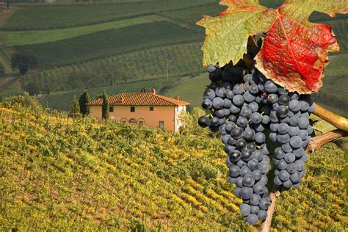
The Wines of Italy Presented by Marc Silver

Slide 2
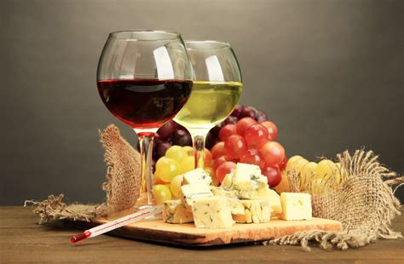
The Wines of Italy
Italy, a country synonymous with rich history, culture, and cuisine, is equally renowned for its diverse and exquisite wine offerings.
Italian wine is not just a beverage but a reflection of the country's geography, climate, and traditions.
This talk will delve into the world of Italian wines, exploring the regions, key grape varieties, wine styles, and notable producers.

Slide 3
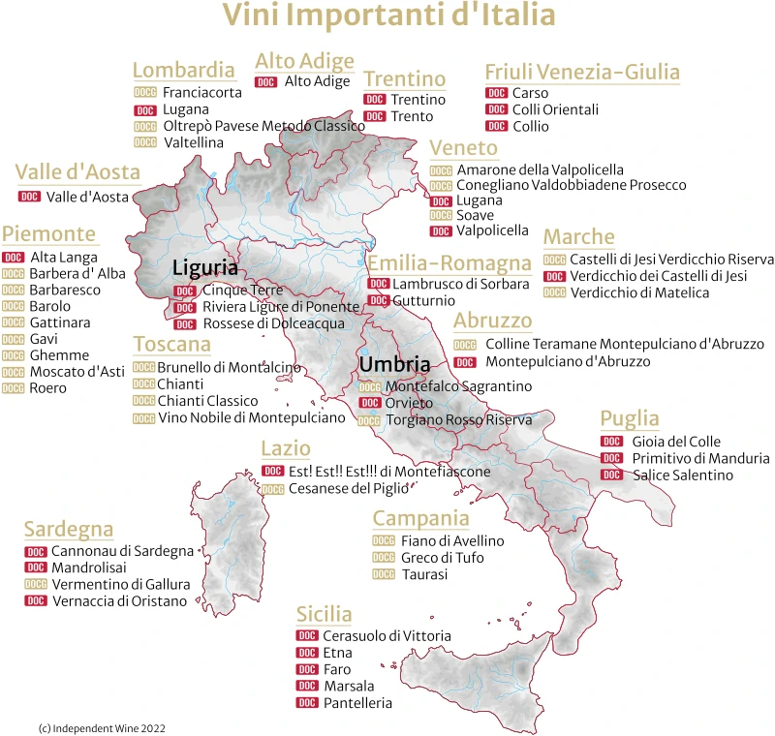
An Overview of Italian Wine Regions
Italy’s wine regions are as diverse as its landscape, ranging from the Alpine north to the Mediterranean south.
Each region boasts unique terroirs and climate conditions that contribute to the distinctiveness of its wines.
The result is a diverse range of wine types to suit every taste.

Slide 4
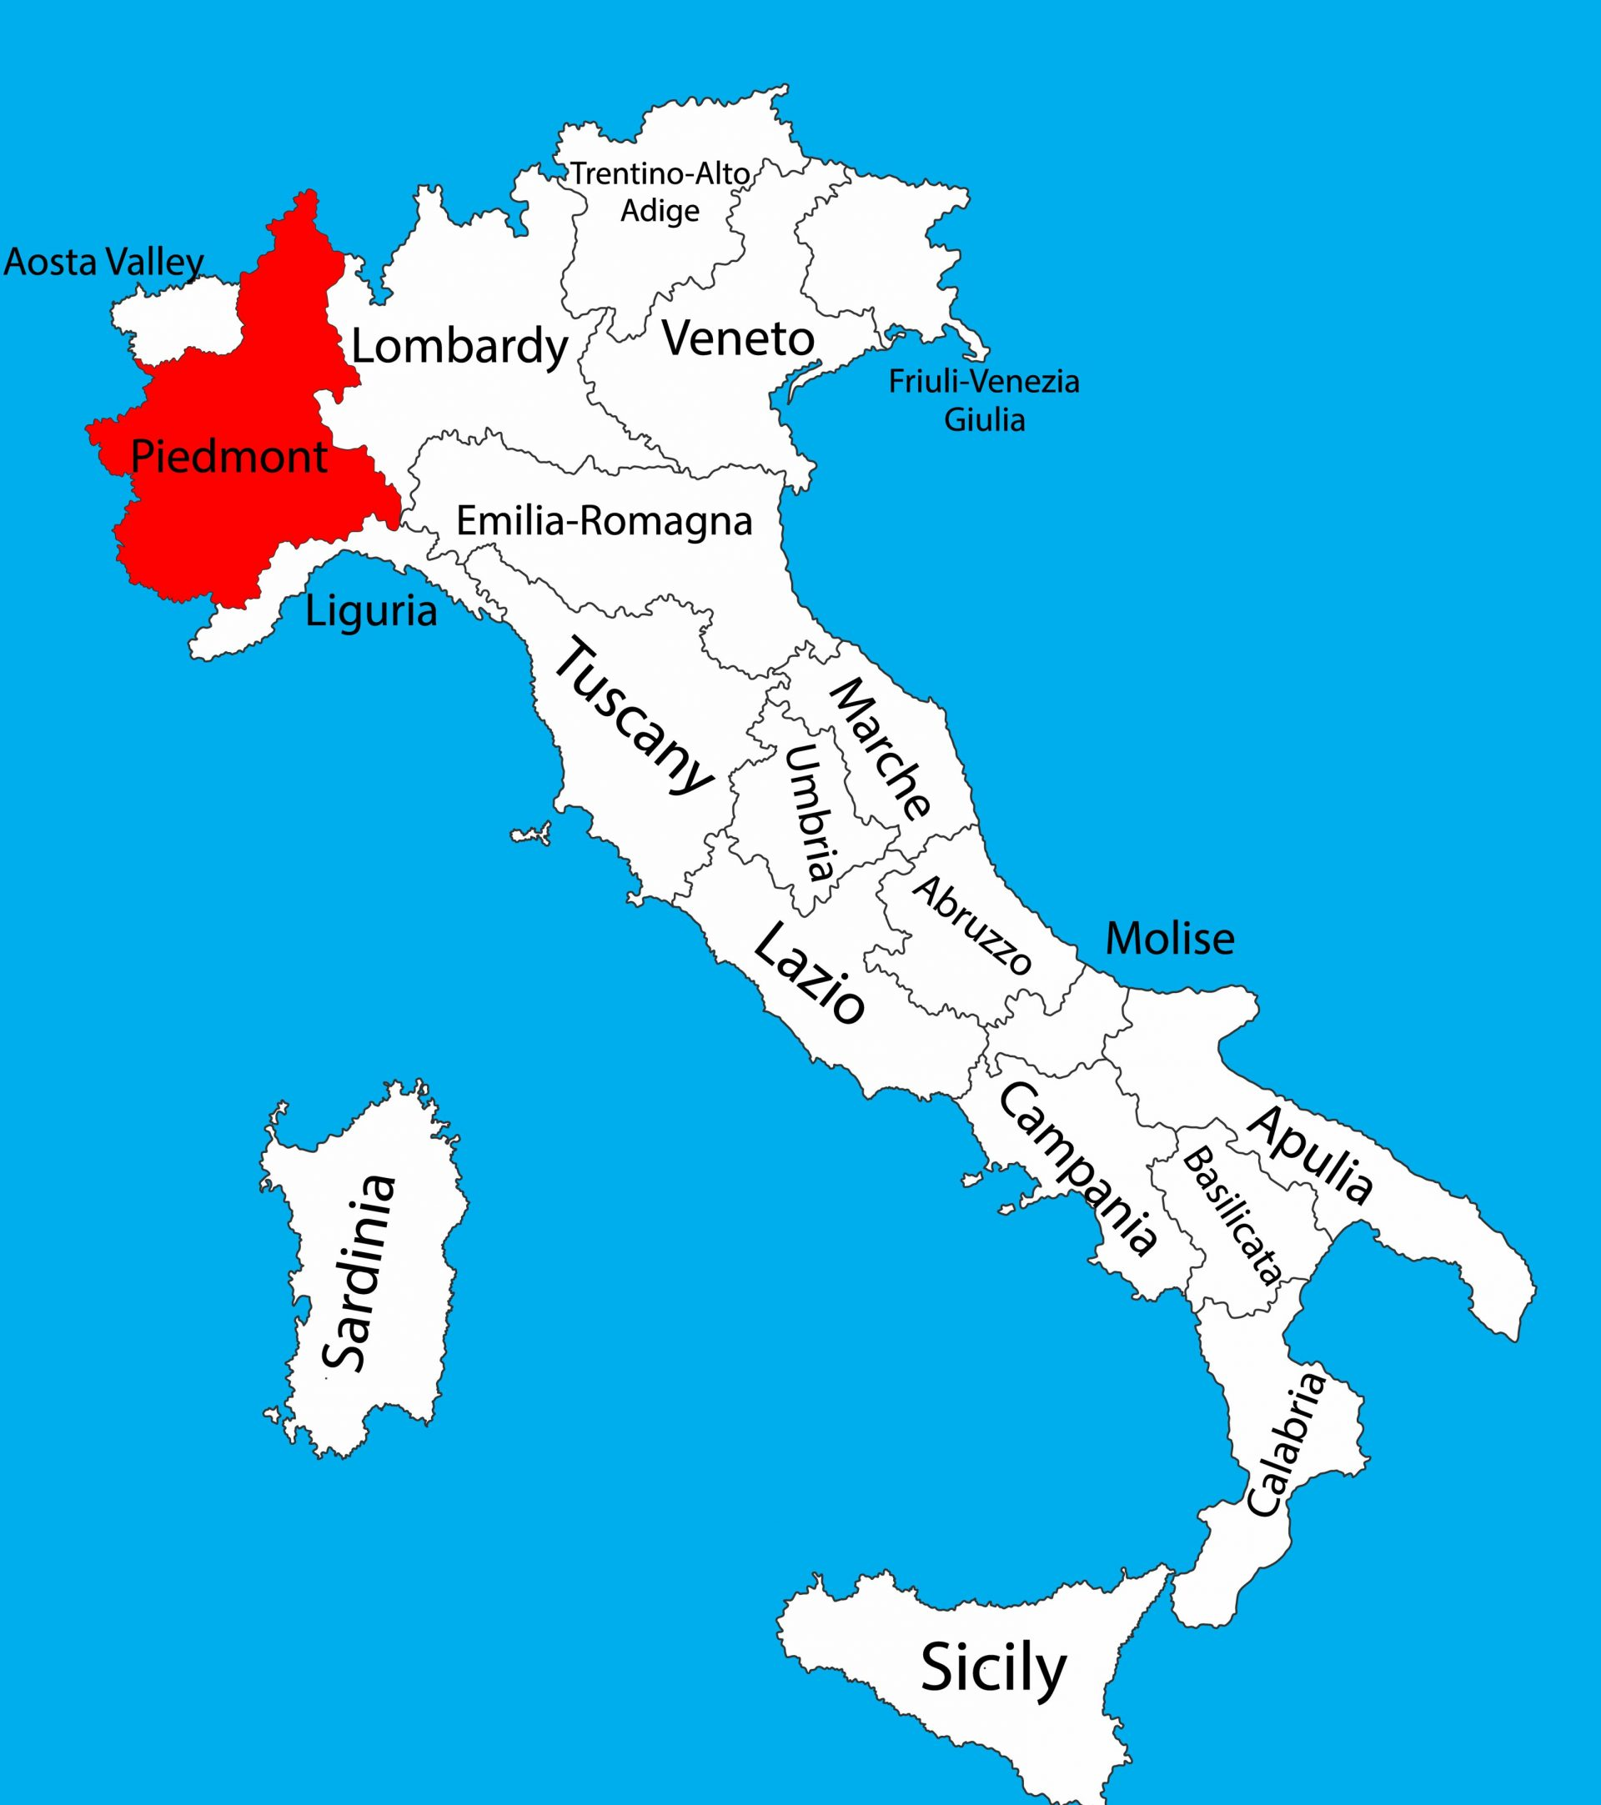
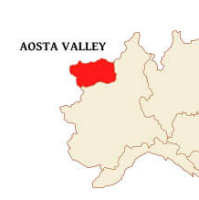
Northern Italy Wine Regions
Piedmont: Known for its prestigious Barolo and Barbaresco wines made from the Nebbiolo grape, Piedmont also produces excellent Barbera and Dolcetto wines.
The region's cool climate and mountainous terrain create ideal conditions for these full-bodied reds.
Valle d’Aosta: Wedged in Alpine northwestern Italy between Switzerland and France, the valley lies in the shadows of some of Europe’s tallest peaks: ice-capped Mont Blanc and the Matterhorn.
It is Italy’s smallest appellation, with a mere 750 acres of vineyards, and the highest, with vines climbing lower mountainsides to 4,000 feet in altitude.

Slide 5
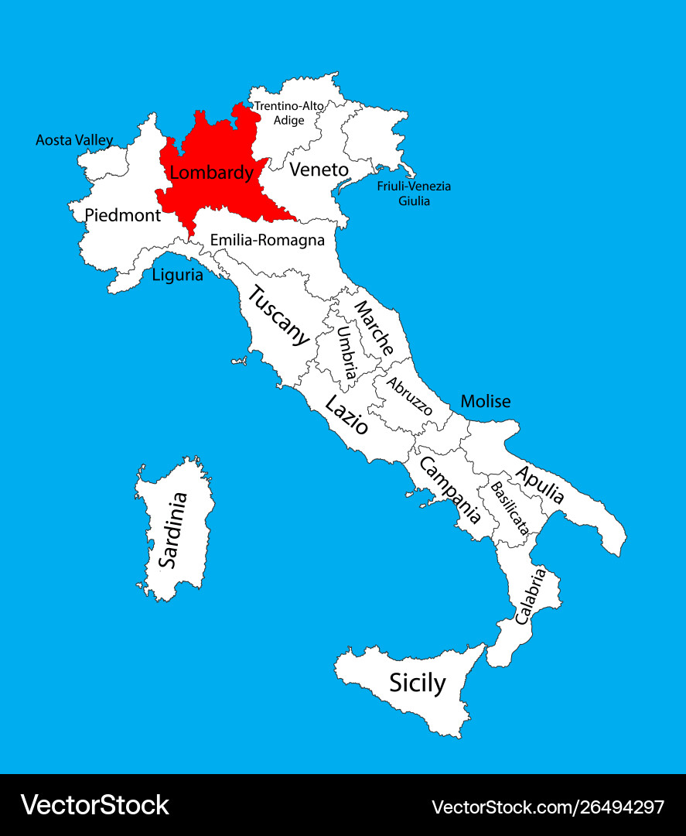
Northern Italy Wine Regions
Lombardia: Renowned for its exceptional wines that reflect the region’s diverse terroir. Nestled in the heart of northern Italy, this region is bordered by the swathes of the Alps, which provide a scenic backdrop and a unique microclimate for viticulture.
In Lombardy, your palate will be treated to Franciacorta, a prestigious sparkling wine that rivals the best champagnes. Made with the metodo classico technique, Franciacorta is primarily produced from Chardonnay and Pinot Noir grapes, creating a sophisticated and layered drinking experience.

Slide 6
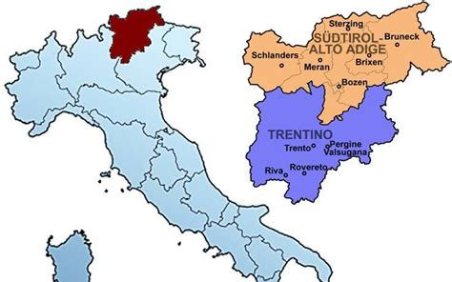
Northern Italy Wine Regions
Trentino Alto Adige: Trentino-Alto Adige are actually two distinct regions in Italy's northernmost wine region, located right on the border with Austria.
Trentino is an autonomous province in the far north of Italy, bordering Lombardy to the west and Veneto to the south and east.
The province forms the southern half of the Trentino-Alto Adige region. The other half is Alto Adige (Südtirol to its largely German speaking population).
Production was once dominated by the local Lagrein and Schiava red grape varieties. But today white wines are now more important in volume terms and are increasingly made from well-known international varieties such as Pinot Grigio, Pinot Bianco, and Chardonnay.

Slide 7
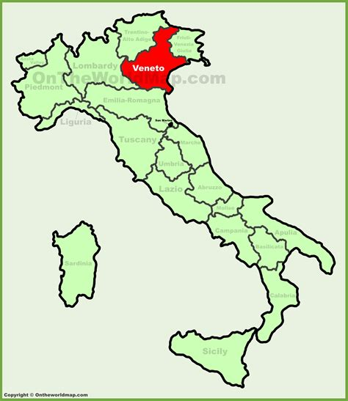
Northern Italy Wine Regions
Veneto: The Veneto is the 8th largest region of Italy. It’s situated in the northeast of the country and bordered to the west by Lombardia and to the south by Emilia-Romagna. Well known for Soave, Valpolicello, Amarone, Recioto, Prosecco and Bardolino.
Two unique varietals include: Cornalin, an ancient red grape and Roussin de Morgex a rare red Italian grape that had almost completely disappeared from the vineyards.
The area is best known for medium-bodied red wines from Petit Rouge grapes.

Slide 8
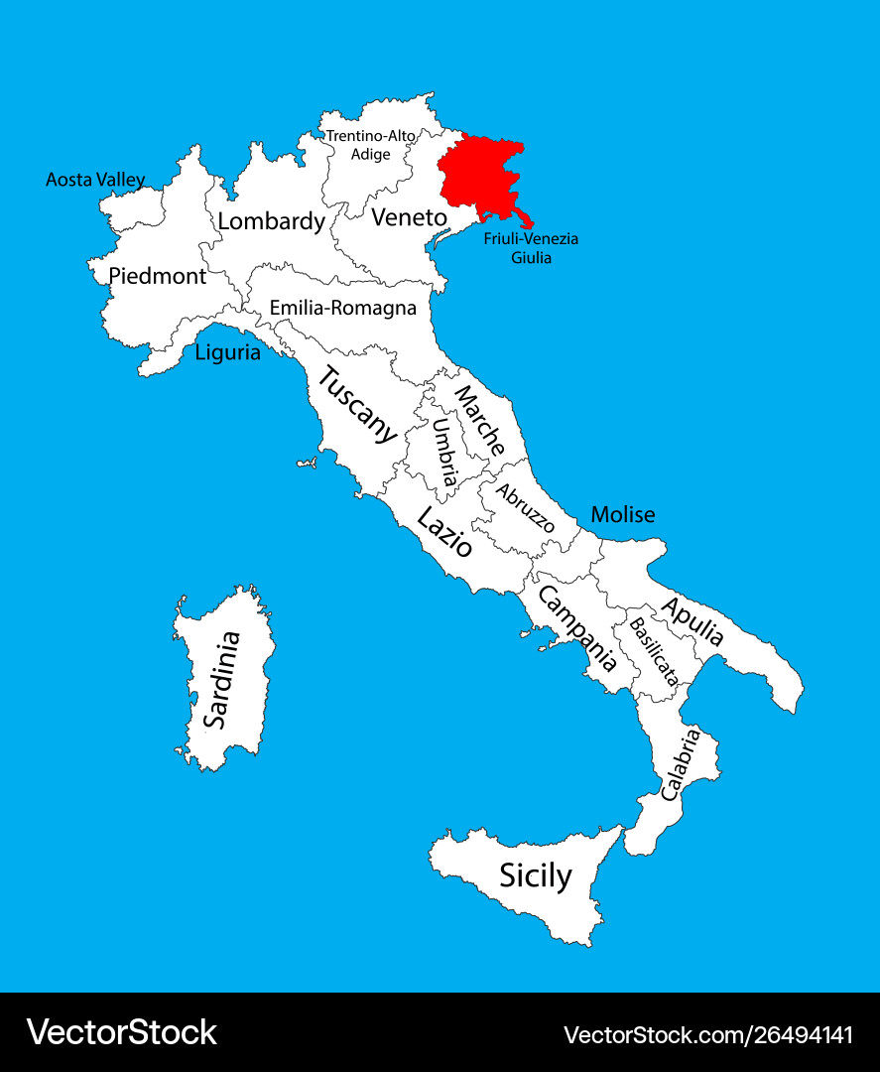
Northern Italy Wine Regions
Fruili Venezia Giulia: In the top part of Italy’s Friuli-Venezia Giulia region, near Austria and Slovenia, you’ll find a place famous for making (white) wine.
It has different weather and landscapes, with some parts being influenced by the ocean and others having a colder Alpine climate. These conditions are great for making unique Italian wines.
Particularly famous white wines including: Pinot Grigio, Friulano, Ribolla Gialla and Sauvignon Blanc. They also produce lesser-known reds like, Refosco dal Peduncolo, Malvasia Istriana, and Schioppettino.

Slide 9
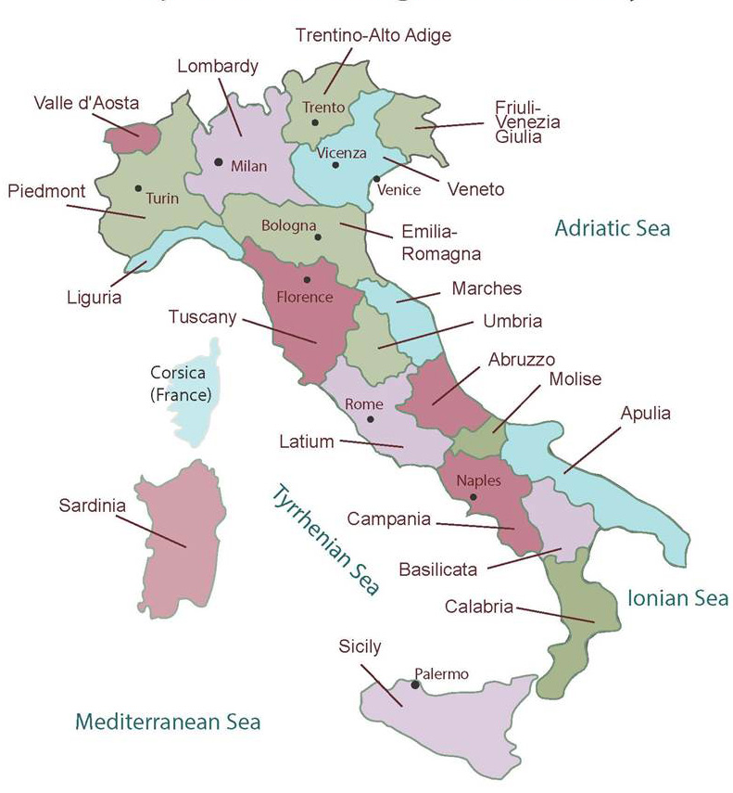
Northern Italy Wine Regions
Veneto: The area surrounding Venice, this region is most famous worldwide for its Prosecco, a sparkling wine made primarily from the Glera grape.
Veneto also produces Amarone della Valpolicella, typically rich dry red wine made from the partially dried grapes of the Corvina, Rondinella and other approved red grape varieties.
Soave is another well-known variety from the region, but it’s not all about white wine here either.
A trip to Veneto will also leave you with a taste for its big-bodied reds like Amarone and some of its delicious dessert wines or passiti.
The region's diverse offerings range from light and sparkling to deep and complex.

Slide 10
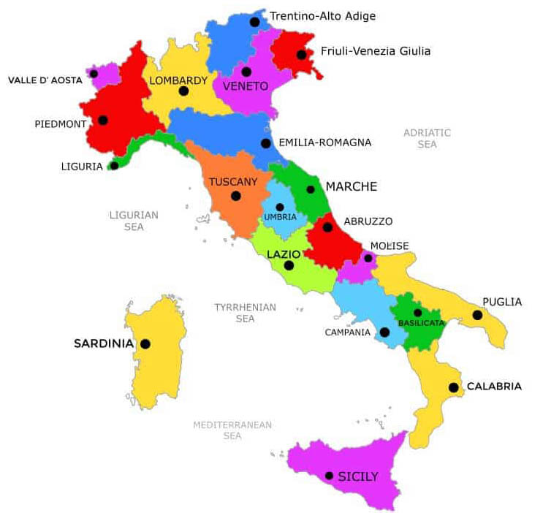
Central Italy Wine Regions
Liguria: The wines from Liguria may not be as well-known as those from Tuscany or Piedmont, but they encapsulate the true spirit of Italian wine.
Nestled between the Ligurian Sea and rugged Apennine Mountains, Liguria, a crescent-shaped coastal region in northwest Italy, offers a unique viticultural experience.
Known for its steep terraces and scenic beauty of the Cinque Terre, the maritime influence shapes the character of each bottle of its wines.
Liguria is celebrated for its white wines, which often exhibit crispness and are ideally paired with the local seafood.

Slide 11
Central Italy Wine Regions
Emilia Romagna: Emilia-Romagna is a rich, fertile region of northern Italy. It is one of the country's most prolific wine regions and home to the fizzy red wines from the Lambrusco grape variety.
It borders the Adriatic Sea to the east and the Alps to the north, making it blessed with an abundance of micro-climates that are perfect to produce high-quality grapes.
The climate in Emilia-Romagna is varied, with hot summers and cold winters in the inland areas, and milder temperatures along the coast. This varied climate allows for a wide range of grape varieties to be grown, including whites such as Trebbiano and Albana, and reds like Barbera, Bonarda, and Sangiovese.

Slide 12
Central Italy Wine Regions
Marche: (or Le Marche) is a region on the eastern side of central Italy. It is most readily associated with Trebbiano and Verdicchio white wines as well as Montepulciano-based red wines.
The area produces the notable Verdicchio, a white wine that offers crisp acidity and flavors of citrus and green apple. The region also makes Rosso Conero, a red wine based on Montepulciano.
Marche has several terroirs very well suited to the cultivation of vines. The rolling coastal hills such as those around Ancona are a notable example.
Due to the influences of the Apennines, the Adriatic and the region's rivers (the Metauro, Potenza, Tronto and Nera), there are various climates at work in Marche.

Slide 13
Central Italy Wine Regions
Umbria: Bordering on Tuscany and right above Rome is the lesser-known and lesser-traveled region of Umbria.
Known for its Sangiovese-based wines and the unique Sagrantino grapes. Sagrantino di Montefalco is a robust red wine with considerable aging potential.
Umbria also, produces more truffles than any other part of Italy.
They produce a wide range of wines including: Sangiovese, Lambrusco, Sagrantino , Cabernet - Sangiovese, Barbera - Bonarda, Refosco to name but a few. The area is also known for Brandy.

Slide 14
Central Italy Wine Regions
Lazio: Best know for Rome and the Vatican, Lazio is not that well known for its wine, even thou the region has 798 wineries in it’s fifteen wine districts.
Wines from Lazio are still relatively hard to find outside of the region. Most of Lazio’s vineyards are planted to white grapes, most notably several different cultivars of Malvasia and Trebbiano, which are blended to make regionally labeled wines such as Frascati, and Castelli Romani.
There is also a Super Lazio, which is a blend of Cabernet Sauvignon, Merlot, Syrah, Sangiovese, and Montepulciano.

Slide 15
Central Italy Wine Regions
Abruzzo: The Abruzzo wine region is in the central part of Italy’s wine country, along the Adriatic coast. The region is known for its rugged terrain, with the Apennine Mountains running through the heart of it.
Known for its rugged beauty and rich history, Abruzzo produces wines that are a true reflection of the land they come from. From the crisp white wines of Trebbiano d’Abruzzo to the bold reds of Montepulciano d’Abruzzo, the wines of Abruzzo are sure to please even the most discerning palate.

Slide 16
Central Italy Wine Regions
Molise: It is a predominantly mountainous area of Italy located in the south-central part of the Italian peninsula that extends from the Apennines to the Adriatic Sea.
The Molise region has historically been so neglected that you can hardly find the origin of its name. It's believed to have originated from the Middle Ages, where a Norman family, the Moulins, owned large portions of the area as a county.
Evidence suggests that people have lived in this region for several thousand years.
Although there are some excellent wines here, Molise is a region that has been overshadowed by its neighbor, Abruzzo, which borders it to the north.

Slide 17
Central Italy Wine Regions
Tuscany: (Toscana) is a region in central Italy, bordered by the Tyrrhenian Sea to the west, Liguria, and Emilia-Romagna to the northwest and northeast, respectively, and Umbria to the south.
Tuscan wines have long held a reputation for producing some of the best wines in Italy.
As a prolific central region encompassing many notable subregions like Chianti, Montalcino, and Montepulciano, Tuscany is the fifth-largest region in Italy. It ranks third in total DOC and DOCG appellations, just behind Piedmont and Veneto.

Slide 18
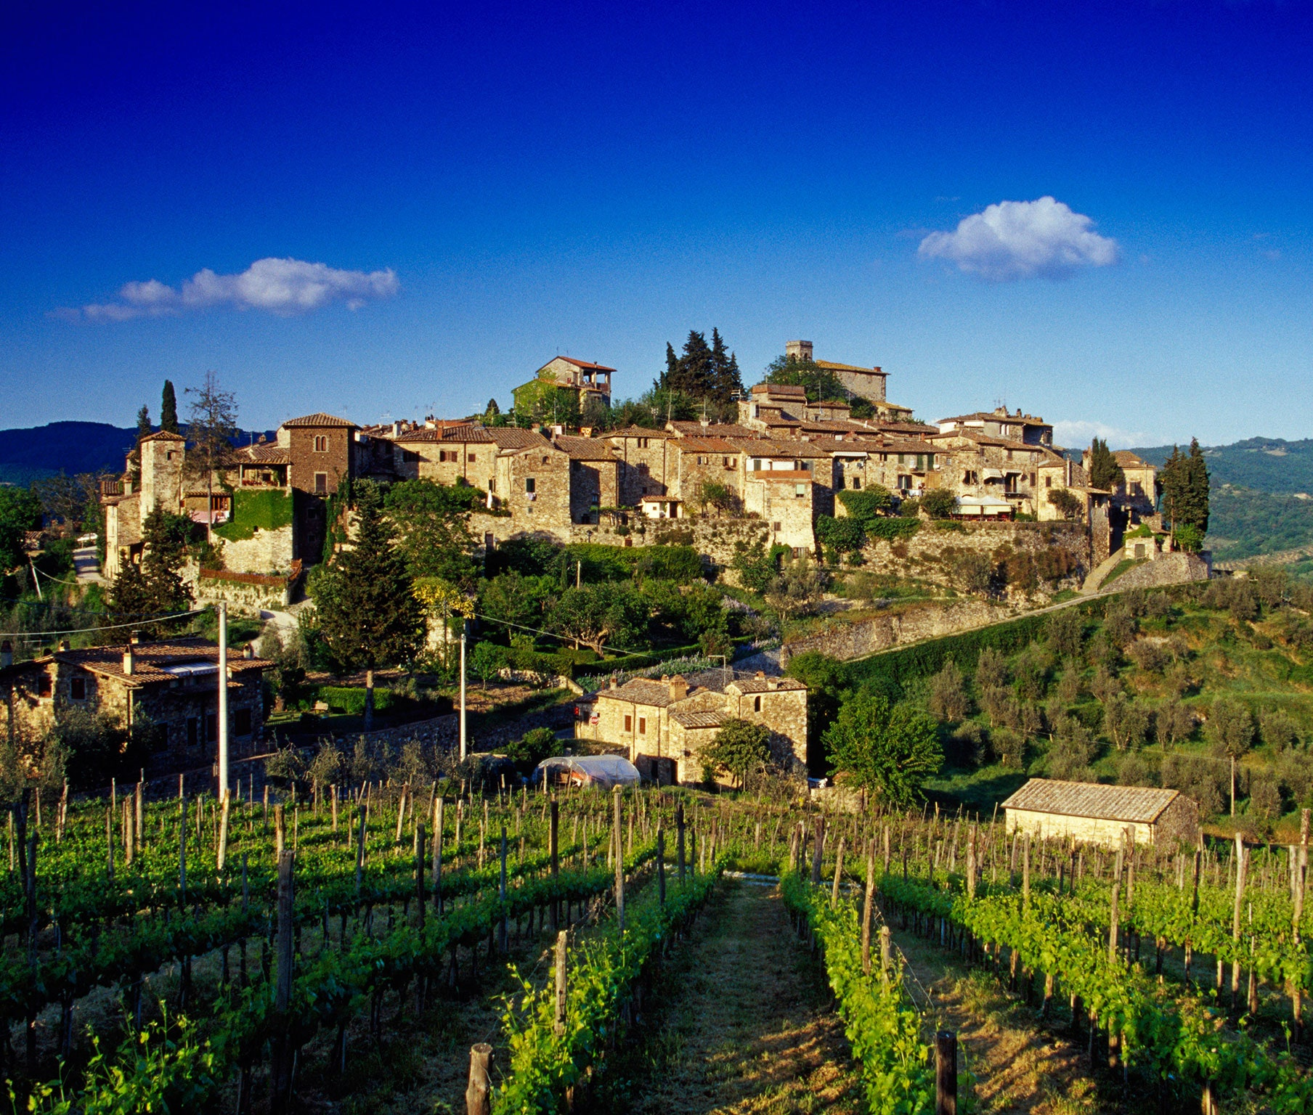
Central Italy Wine Regions
Because Tuscany is one of the most popular wine regions of Italy, I want to highlight it a little.
Due to the tradition of Super Tuscans, Tuscan winemakers don’t shy away from internationally popular grapes like cabernet sauvignon, Syrah, Pinot Noir, and Sauvignon Blanc; instead, they blend them with Italian grape varietals.
While 80 percent of wine production in Tuscany is dedicated to red wine, its white wines have also garnered worldwide acclaim throughout viticultural history.

Slide 19
Southern Italy and the Islands
Puglia: is a long, thin wine region in the far south-eastern corner or heal of the 'boot' of Italy.
The most cultivated grape varieties here are Sangiovese, Primitivo, Negroamaro and Trebbiano.
Known for robust reds the region's warm climate is ideal for producing these full-bodied wines with rich, fruity flavors.
In terms of terroir, Puglia has a formidable array of natural tools to help encourage prolific vine growth.
The region’s geology shows a bias towards cretaceous limestone under layers of iron-rich deposits.

Slide 20
Southern Italy and the Islands
Basilicata: Located in southern Italy, is a region whose name crops up only very rarely in wine circles. It is best known for red wines from the Aglianico variety, and in particular the Aglianico del Vulture appellation.
The main area for viticulture lies in the heart of the fertile Vulture Massif in the north. Vineyards are located around Mount Vulture on volcanic soils.
The mountainous terrain and harsh weather makes vine-growing a challenge. But the area still enjoys an abundance of sunshine throughout the growing season and cool temperatures around harvest, thanks to climatic variations.

Slide 21
Southern Italy and the Islands
Campania: This wine region forms the "shin" of Italy's boot, and whose largest city is Naples. Its name comes from Campania felix, a Latin phrase roughly meaning "happy land".
Famous for its Aglianico grape, which produces powerful reds like Taurasi. The region also offers excellent whites such as Fiano di Avellino and Greco di Tufo.
Campania, like many Italian regions, is home an impressive array of grape varieties, some of which are found almost nowhere else on earth.
Its most important variety is arguably Aglianico, the grape behind the region's two most famous and respected red wines: Taurasi and Aglianico del Taburno. Aglianico was introduced to the area by the Greeks and later cultivated by the Romans.

Slide 22
Southern Italy and the Islands
Calabria: The way Puglia is called the heel of the boot, Calabria is the Toe. The first vineyards appeared thanks to the Oenotrians and later by ancient Greeks.
Vineyards in Calabria wine region covers only 22,239 acres. No other area have so manyancient indigenous varieties as here.
Because of the warm and mild climate, some growers are experimenting with international varieties such as Chardonnay, Sauvignon Blanc, Cabernet Sauvignon, and Cabernet Franc.
The expansion of wines in small oak barrels is enjoying increasing interest.

Slide 23
Southern Italy and the Islands
Sicily: Beginning with the Greeks, who arrived on the eastern part of Sicily in the 8th century BCE, the idea of grape growing practices for the purpose of quality winemaking firmly took root on the island.
Rivaling Veneto as Italy’s largest wine producing region, notable for its Marsala, Port styles, and Nero d'Avola, a versatile red that ranges from fruity to spicy. Sicily also produces high-quality white wines from the Grillo and Catarratto grapes.
Nero d’Aola is an indigenous grape with it’s deep ruby color, has aromas of red flowers, strawberry, sour cherry, and sweet spices.

Slide 24
Southern Italy and the Islands
Sardinia: Sardinia, the second-largest island in the Mediterranean Sea, after Sicily.
Known for Cannonau, a local expression of Grenache, and Vermentino, a white wine with aromatic qualities and a refreshing character.
DNA studies have found that the Cannonau grape (local name for Grenache), which is also found throughout France and Spain, has been traced back to Sardinia from the Venetians, 3,000 years ago.
Most vineyards in Sardinia are family owned, with vines that reach an average age of 30 to 60 years old. There is also a super Sardinian Cabernets, utilizing the Carignano grape.

Slide 25
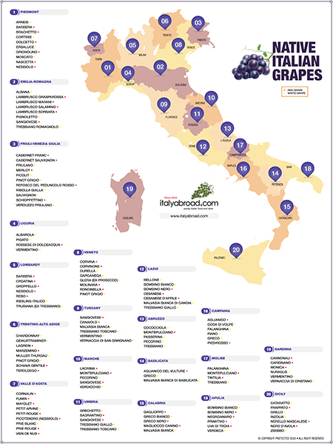
Italy’s Key Grape Varietals
Italy is home to some of the best wines in the world, and for good reason
Italian wine production revolves around a multitude of grape varieties, each contributing unique characteristics to the wines.
. With an impressive number of 545 different grape varieties grown throughout the country, there is something for everyone.
From the classic Chianti and Barolo to the full-bodied Barbera, to the light and crisp Pinot Grigio, to the lesser-known Nero d’Avola and Vermentino, Italy’s wine diversity is simply awe-inspiring.

Slide 26
Italy’s Key Grape Varietals
Sangiovese: Italy’s best known and most widely planted type of grape, Sangiovese, is native to Tuscany. Sangiovese grapes have thin skins, a light color, fine tannins, and a long growing season. Wines made from Sangiovese grapes are medium to full-bodied, dry, and highly acidic, with fruity and savory flavors. Common Sangiovese wine flavors and aromas include plum, cherry, violets, tobacco, and leather. In Montalcino, the local Sangiovese variety is known as Brunello.
Canaiolo: Canaiolo is a mellow red wine grape thought to be native to the Tuscany region and has historically been a dominant grape in the production of chianti and a crucial component of Vino Nobile di Montepulciano, accenting the more herbaceous notes in Sangiovese with its ripe strawberry and savory dried spice flavor.
Colorino: Like its name might suggest, Colorino grapes have a deep, dark purple-black hue that winemakers use to impart color to their blends. Its flavor is correspondingly dark and jammy, with primary notes of boysenberry and huckleberry.

Slide 27
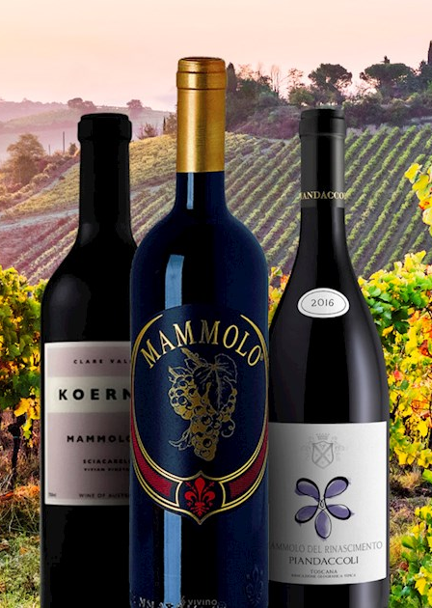
Italy’s Key Grape Varietals
Mammolo: Known as Sciaccarello in Corsica, France, red Mammolo grapes are soft and light, with distinct peppery notes that bring a floral tone—specifically, violets—to blends like Chianti and Vino Nobile di Montepulciano.
Malvasia: Malvasia refers to a group of related grape varieties, including Malvasia nera, and Malvasia bianca, the most widely planted type of Malvasia in Italy. While some regions like Piedmont does produce varietal wines using the red Malvasia nera, in Tuscany it plays more of a supporting role; Malvasia bianca, with its notes of ripe, honeyed pear, is used to make vin santo, a dessert wine.
Vernaccia: Vernaccia is an ancient white wine grape used to make Vernaccia di San Gimignano. It has a fairly acidic profile, with softer notes of yellow apple and almond underlying its crisp, citrus-forward character.

Slide 28

Italy’s Key Grape Varietals
Trebbiano: Trebbiano is an all-purpose grape in Tuscany, and regional variations of the grape account for a third of all white wine in Italy. Trebbiano Toscano is even included in some red blends, thanks to its neutral flavors and high levels of bright acidity.
Vermentino: White wine grape Vermentino carries a similar flavor profile to Vernaccia, with salty minerality and soft hints of almond weaving through the main note of floral, bitter citrus, like grapefruit. It is more common in places like Sardinia, but it is used in the Tuscan region of Bolgheri.
Nebbiolo: A noble grape from Piedmont, Nebbiolo is known for its complex aromas of rose, tar, and truffle, and its ability to age gracefully.
Barbera: A versatile grape from Piedmont, Barbera produces wines with high acidity and flavors of red fruit and spice.

Slide 29
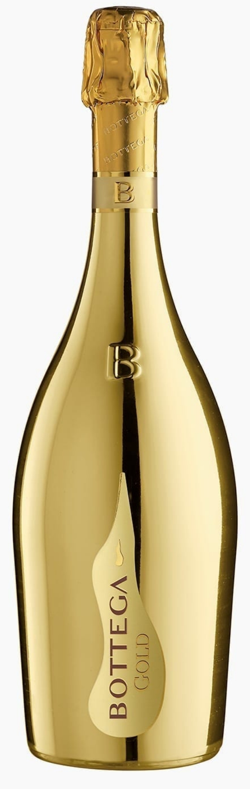
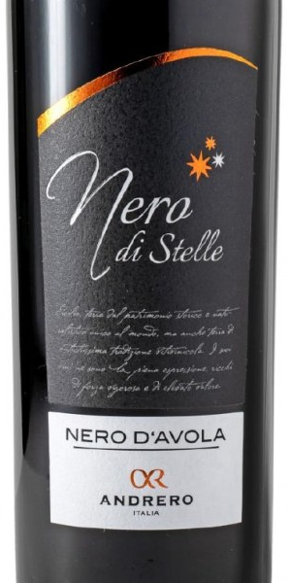
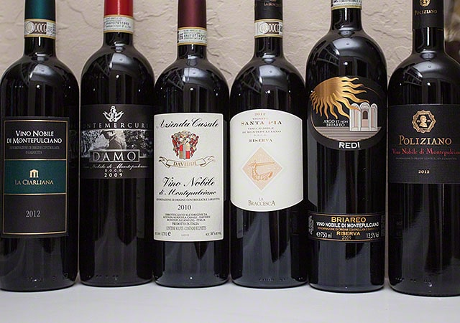
Italy’s Key Grape Varietals
Montepulciano: Predominantly grown in Abruzzo, Montepulciano produces full-bodied reds with dark fruit flavors and a robust structure.
Nero d'Avola: Sicily’s flagship red grape, Nero d’Avola offers rich, ripe flavors of blackberry and plum.
Prosecco (Glera): A sparkling white wine from Veneto, Prosecco is known for its bright, fruity flavors and effervescence.

Slide 30
Wine Styles and Classification
Italian wines are classified under various designations that indicate their quality and origin.
DOCG (Denominazione di Origine Controllata e Garantita) in English -Ccontrolled and Guaranteed Designation of Origin.
This is the highest classification, guaranteeing the wine’s origin and quality. Examples include Barolo, Brunello di Montalcino, and Chianti Classico.
DOC (Denominazione di Origine Controllata): A step below DOCG, DOC wines still adhere to strict regulations but do not have the additional guarantee of quality.
IGT (Indicazione Geografica Tipica or Typical Geographical Indication): Allows for more flexibility in grape varieties and winemaking techniques. Tuscan and Super Tuscan blends often fall under this classification.
VdT (Vino da Tavola or Table Wine): The most basic classification, indicating table wine without specific geographic or quality designations.

Slide 31
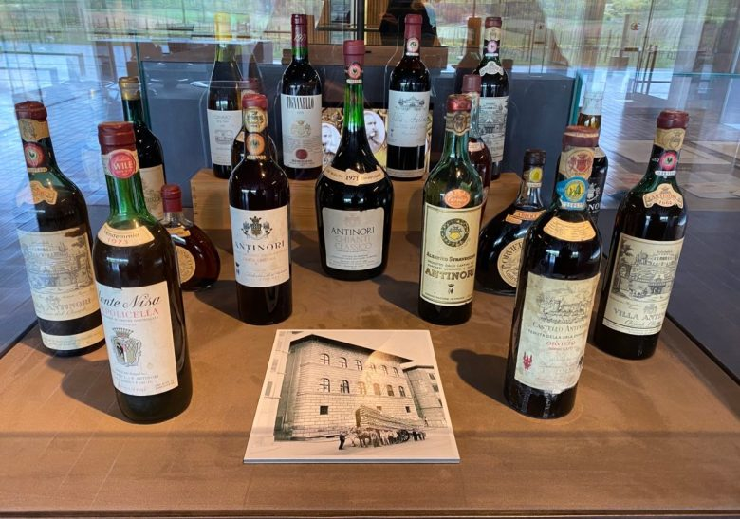
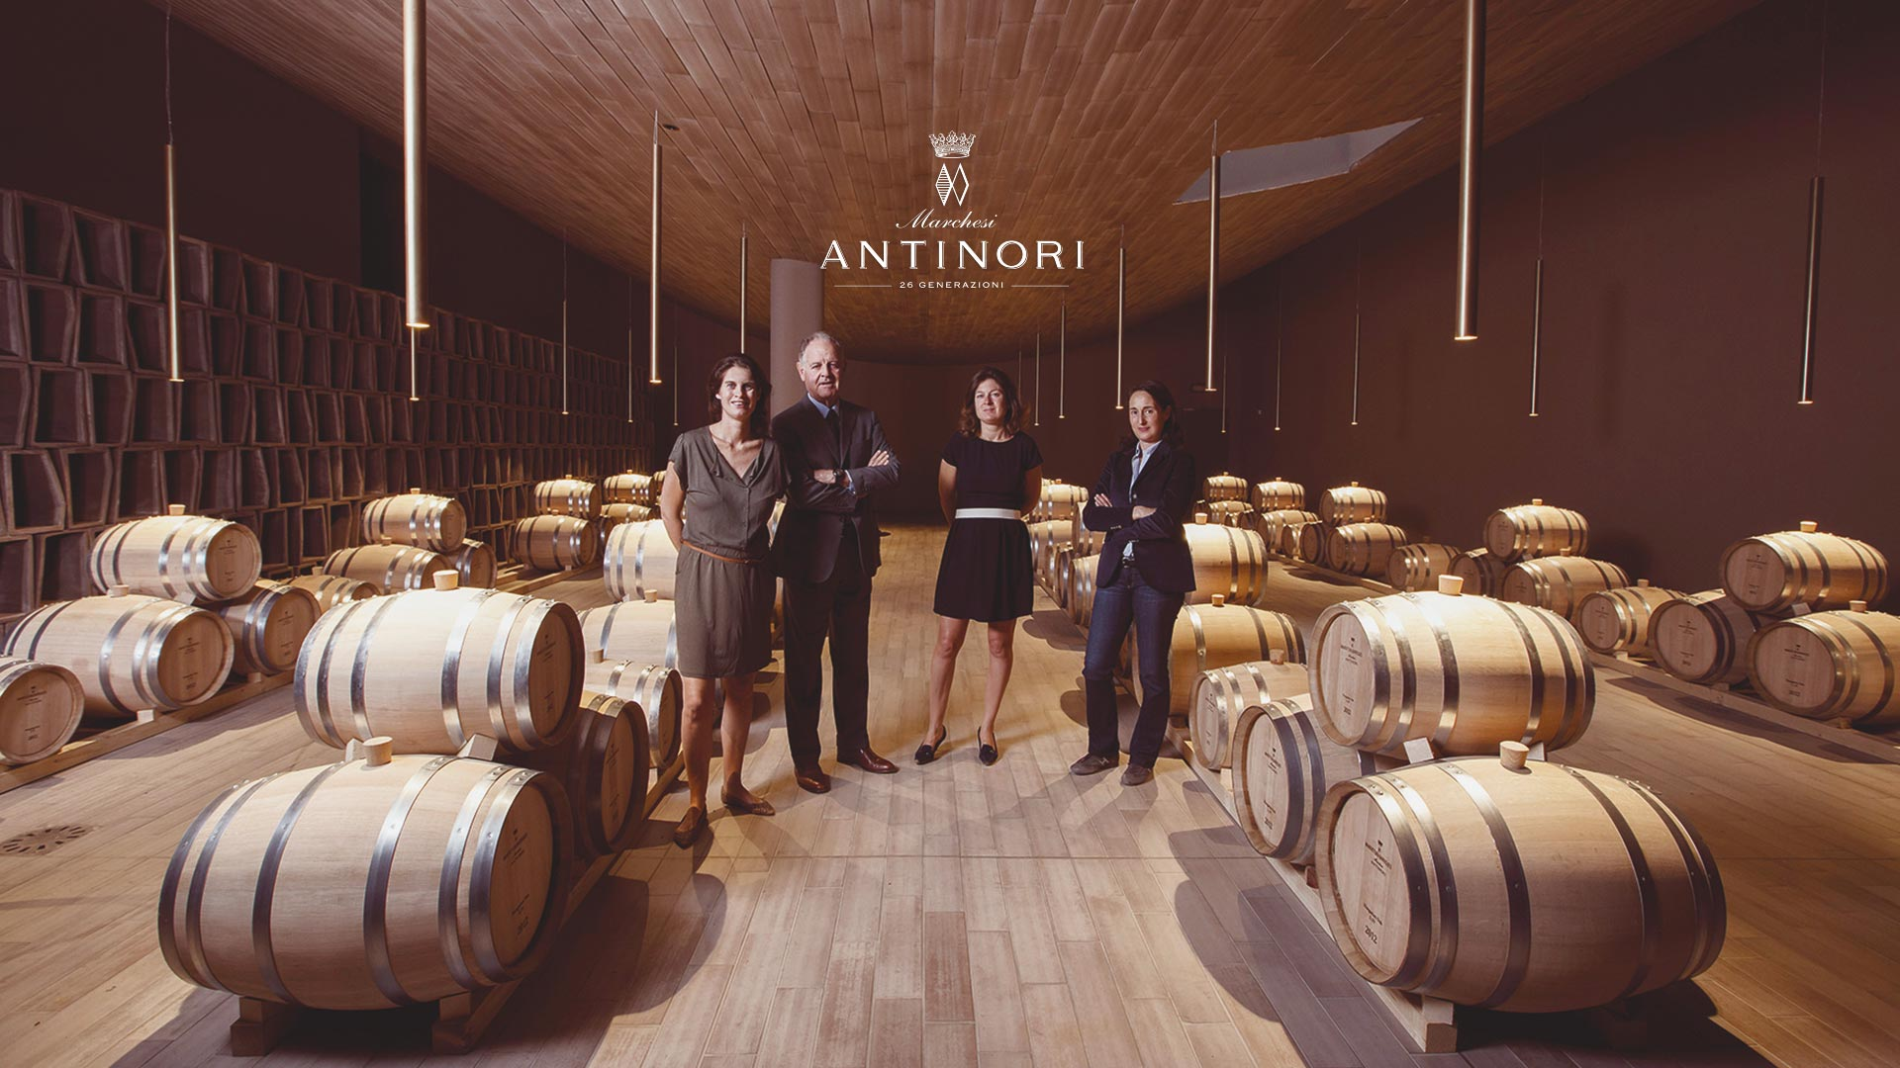
Notable Producers and Wineries
Italy is home to numerous prestigious wineries and producers, each contributing to the country’s rich wine heritage.
Antinori: A leading Tuscan producer known for its innovative Super Tuscans and traditional Chianti Classico.
Antinori has a total of 9 estates spread across Tuscana and Umbria primarily producing Very high quality Chiantis.

Slide 32
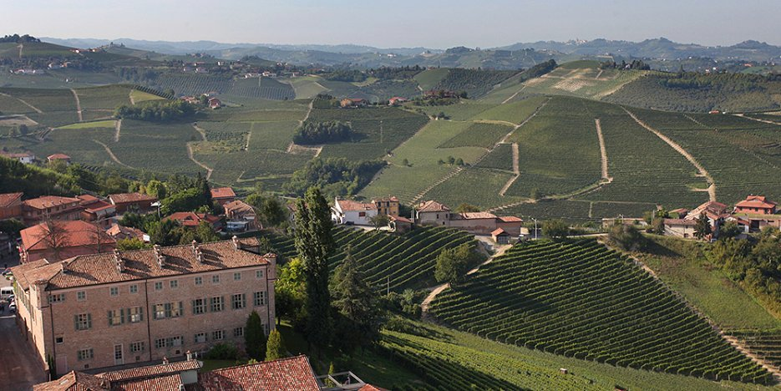
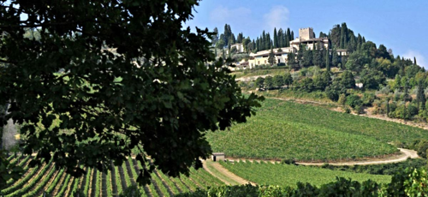
Notable Producers and Wineries
Gaja: Barbaresco winery, founded in 1859 and now run by the fifth generation of the Gaja family.
Renowned for its Barbaresco and Barolo wines, Gaja is a historic name in Piedmont.
Castello di Verrazzano: Famous for its Chianti Classico and contributions to the Tuscan wine renaissance.

Slide 33
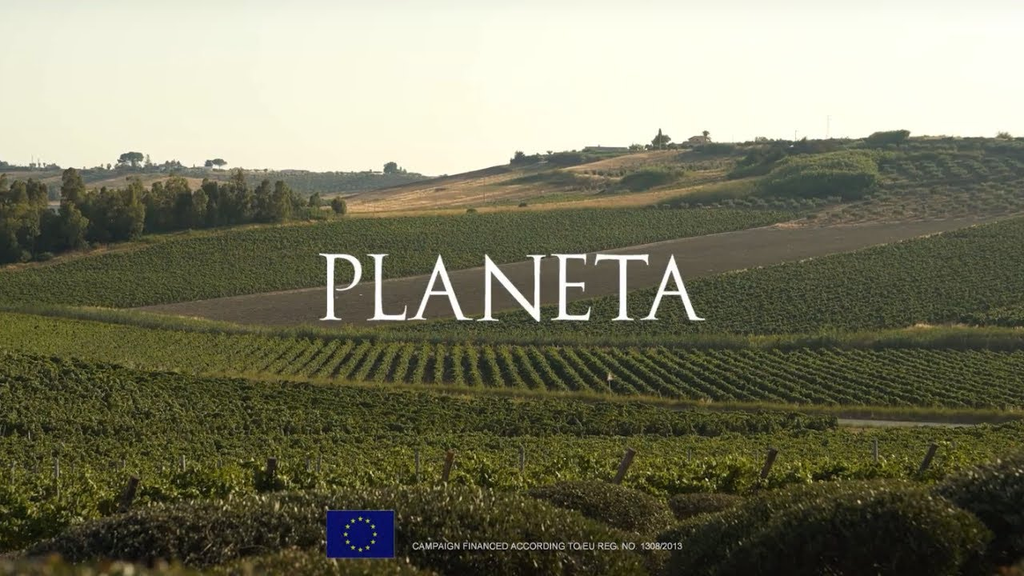
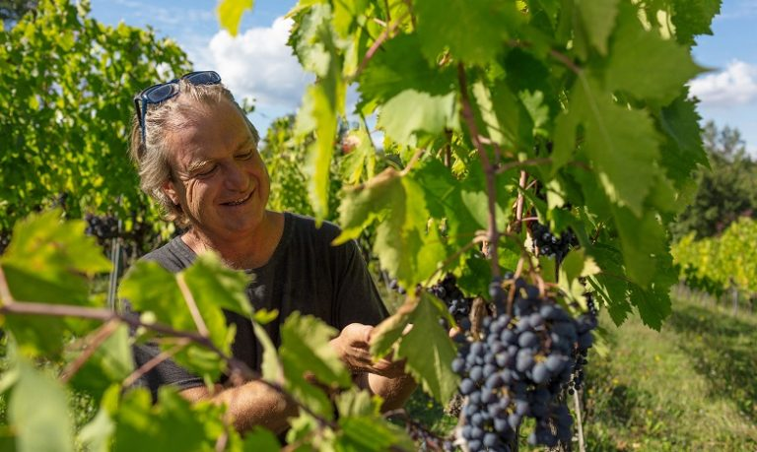
Notable Producers and Wineries
Planeta: A prominent producer in Sicily, known for its Nero d'Avola and fine whites. The entire cultivated area including their vineyards, olive groves, almond orchards, and grains is certified organic.
Bibi Graetz: A boutique producer in Tuscany celebrated for its lively and artisanal wines. The winery was founded in 2000, but Bibi has purchased a vast collection of Old Vine Estates. The varietals include Sangiovese, Canaiolo and Colorino.

Slide 34
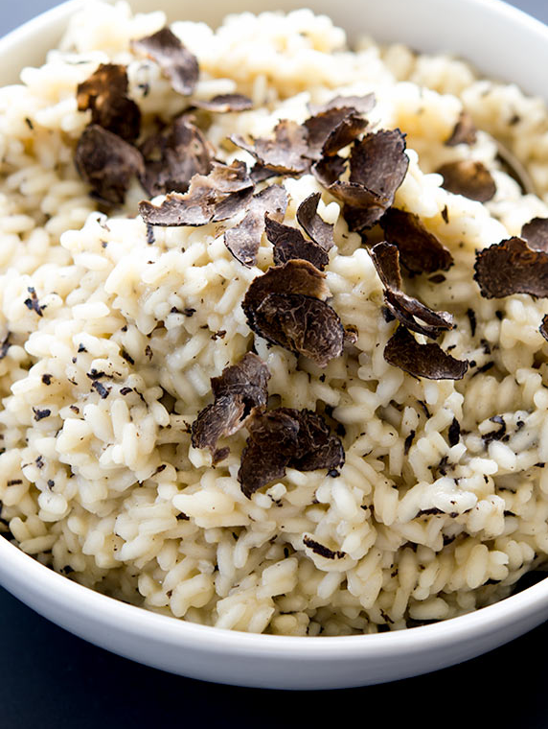
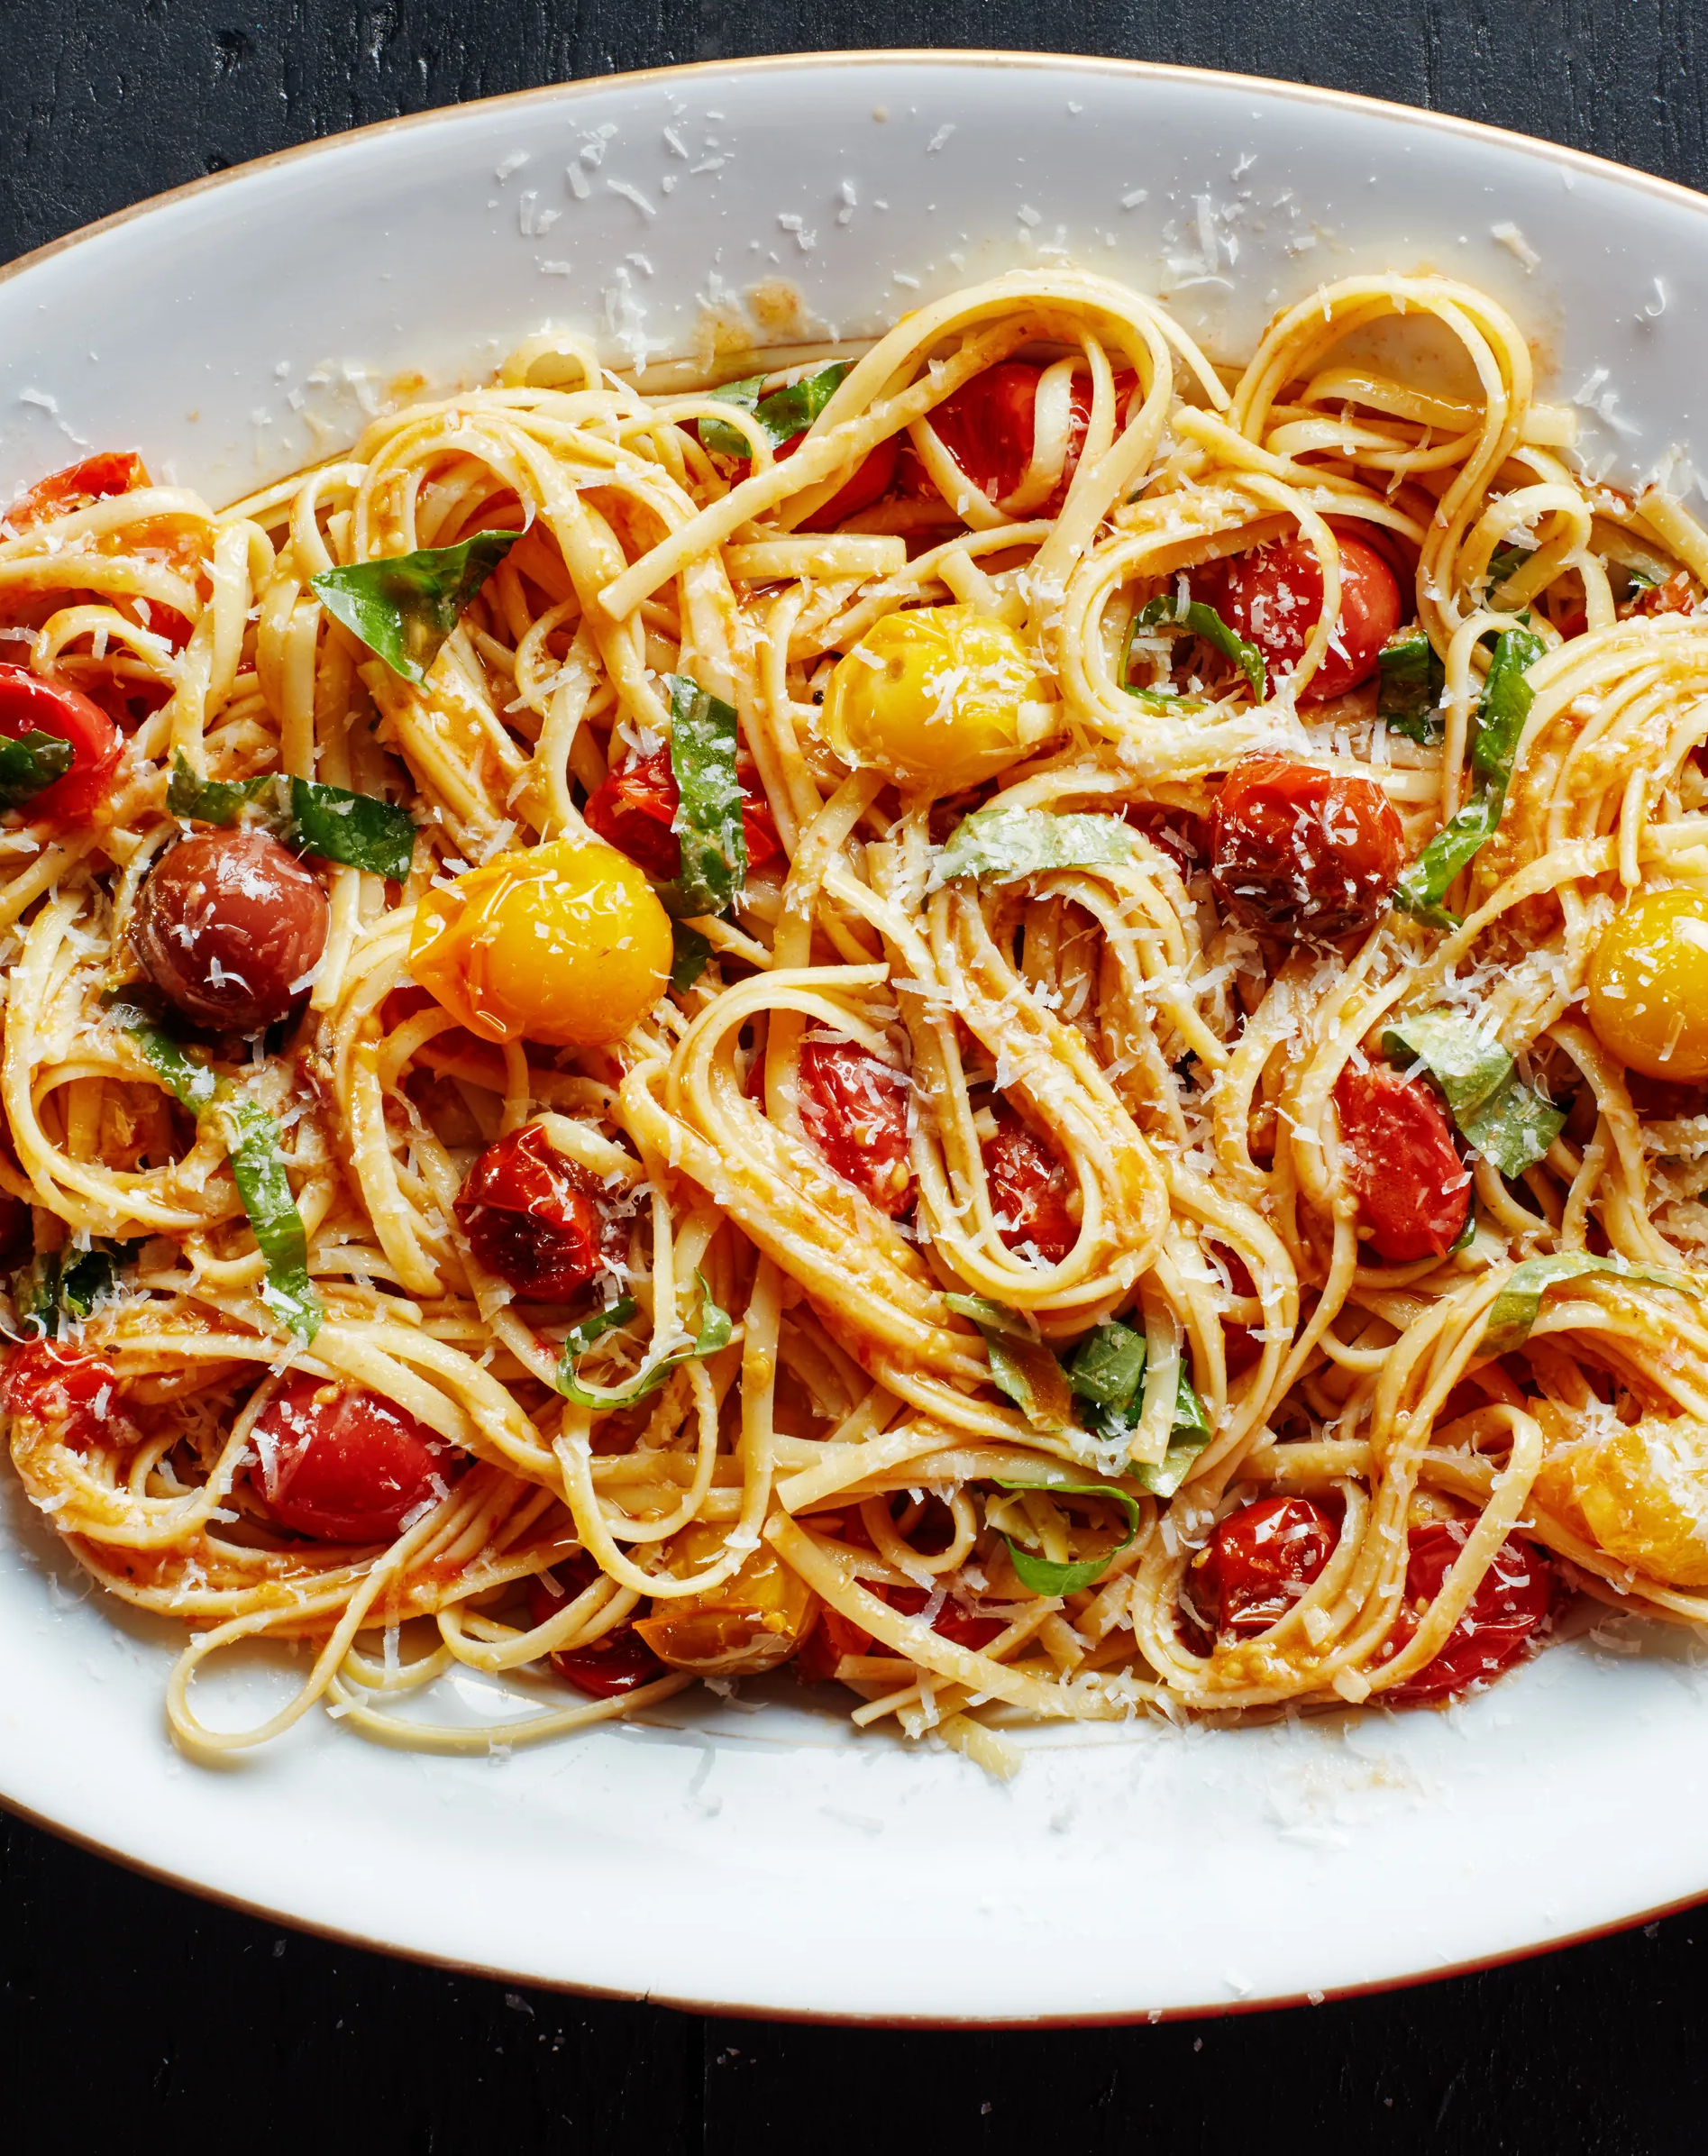
Wine and Food Pairings
Italian wines are deeply integrated into the country’s culinary traditions. Here are some classic pairings:
Chianti: Pairs well with traditional Italian dishes such as pasta with tomato sauce, pizza, and grilled meats.
Barolo: Complements rich dishes like truffle risotto, braised beef, and aged cheeses.
Prosecco: Ideal as an aperitif or paired with light appetizers, seafood, and fresh salads.

Slide 35
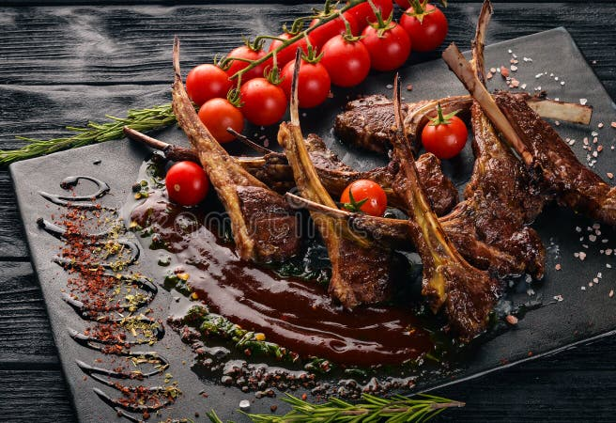
Wine and Food Pairings
Nero d'Avola: Matches well with hearty dishes like grilled lamb, barbecue, and rich pasta sauces.
When pairing wine what matters more than pairing white wine with fish and red wine with meat is pairing wine you like to drink with your food of choice.

Slide 36
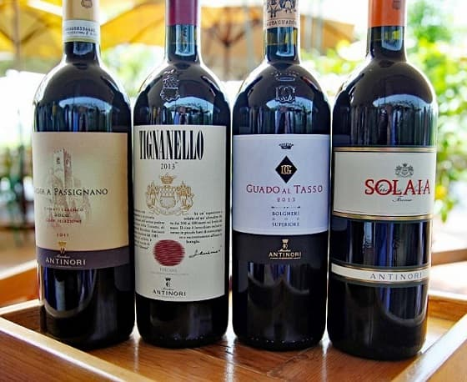
Conclusion
Italian wines offer a rich tapestry of flavors, styles, and traditions, reflecting the diverse terroirs and cultural heritage of the country.
Whether you’re exploring the bold reds of Piedmont, the crisp whites of Veneto, or the sparkling delights of Prosecco, Italy’s wine regions provide a treasure trove of experiences for enthusiasts and connoisseurs alike.
Understanding the regions, grape varieties, and classifications can enhance your appreciation of Italian wines and guide you in discovering the perfect bottle to enjoy.

Slide 37
Acknowledgement
My seminars are the result of many years of travel experience combined with many hours of research over the internet.
I would like to acknowledge the many source I have accessed:
These include: Wikipedia.com, Britannica.com, Wine Spectator, Wine Enthusiast, The Great Atlas of Italian Wines by Author Alessandro Avataneo and Vittorio Manganelli, The Essential Guide to Real Italian Wine Kindle Edition, by Joe Campanale and Joshua David Stein, The Everyday Guide to Wines of Italy, Vino Italiano: The Regional Wines of Italy by Joseph Bastianich with Mario Batali, VinoDelVida.com, Wines of Italy by Burton Anderson, Wines of Italy: Il Gusto Italiano Del Vino by Patricia Guy

