Slide 1
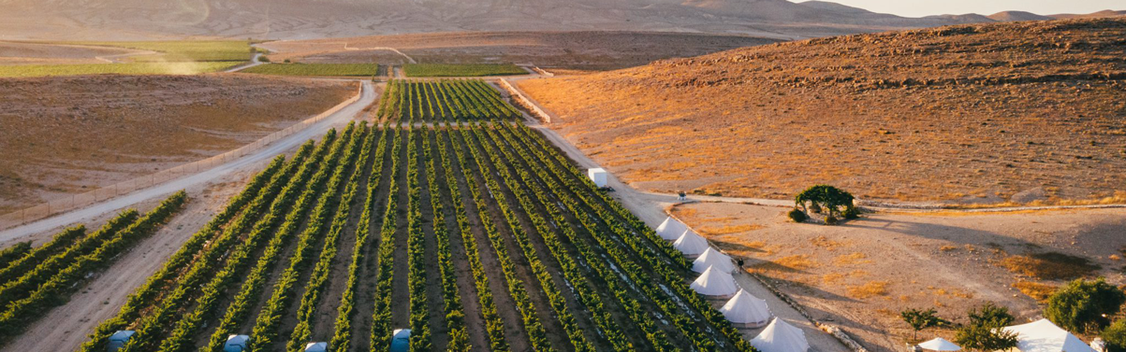
From Ancient Vines to Modern Wines Presented by Marc Silver

Slide 2
An Introduction to Wine in Isreal
Exploring Israel's World-Class Wine Heritage
History of Wine in Isreal
Isreal’s Wine Classification System
Wine Regions of Isreal
Isreal’s Unique Terroir
Major Varietals of Isreal
International Varietals
Notable Wineries in Isreal
Cultural Significance
Isreal’s Wine Culture and Traditions
Final Thoughts
References

Slide 3
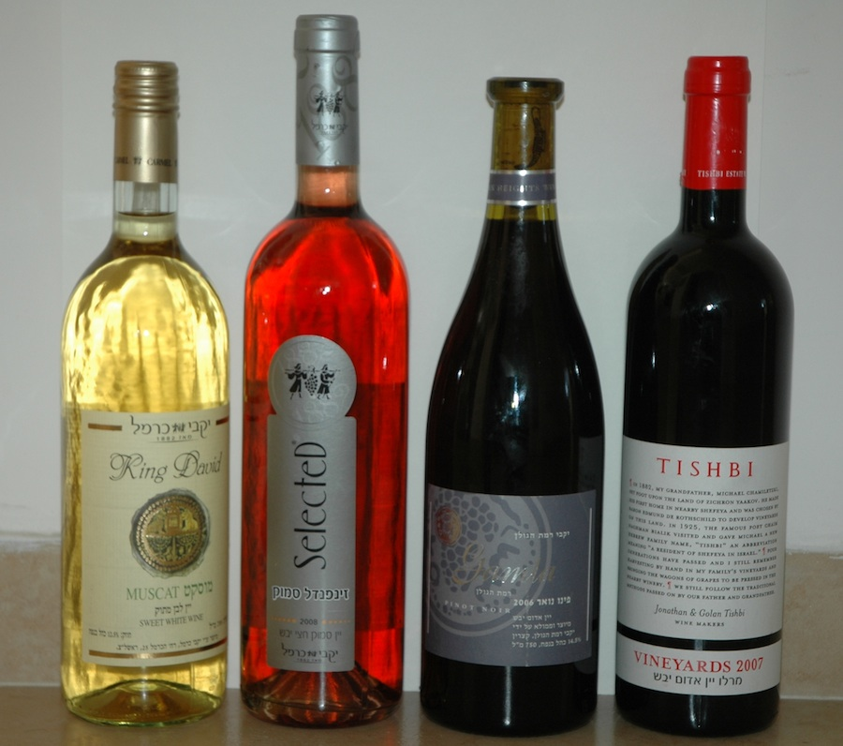
Exploring Israel's World-Class Wine Heritage
In a land where history and innovation meet, Israel’s wine industry is crafting a story as rich and diverse as its landscapes.
From the rolling hills of Judea to the cool climates of Galilee, winemakers are blending ancient traditions with cutting-edge techniques to produce wines that are capturing the attention of connoisseurs worldwide.
Whether it’s bold reds or crisp whites, the wines of Israel are a testament to the resilience and creativity of its people.
Let’s delve into this fascinating world of flavors, heritage, and artistry.

Slide 4
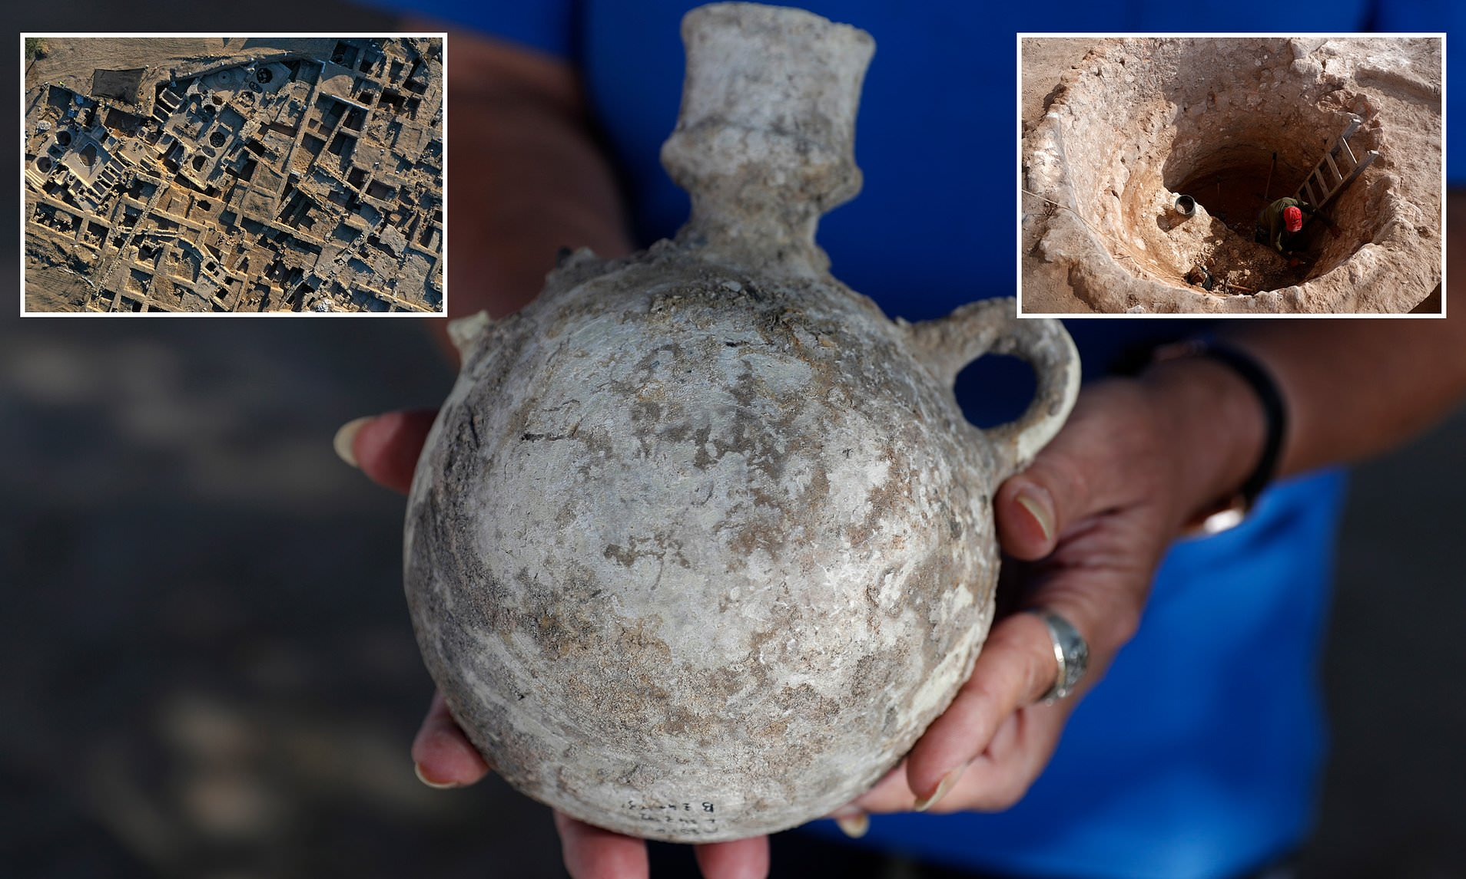
History of Wine in Israel
Ancient Beginnings
Winemaking in Israel traces its origins back over 5,000 years, to biblical times when wine was integral to daily life, religious rituals, and trade. Archaeological evidence of ancient wine presses and amphorae points to a thriving viticultural tradition.
Wine has always held a profound role in Jewish culture and religious traditions. From the blessings over wine during Shabbat meals to its symbolic use in festivals like Passover, wine embodies joy, spirituality, and community.
This deep connection ensured its continued cultivation even through challenging periods.

Slide 5
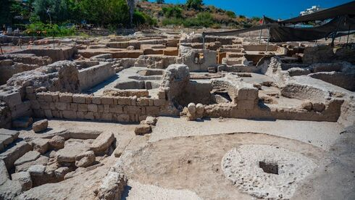
History of Wine in Israel
Ancient Beginnings
During the Roman and Byzantine periods, winemaking flourished, with wines from Judea celebrated across the Mediterranean.
However, with the Islamic conquests in the 7th century, winemaking declined, as alcohol production was largely prohibited under Islamic law.
Israeli archaeologists discovered massive ancient winemaking complex.

Slide 6
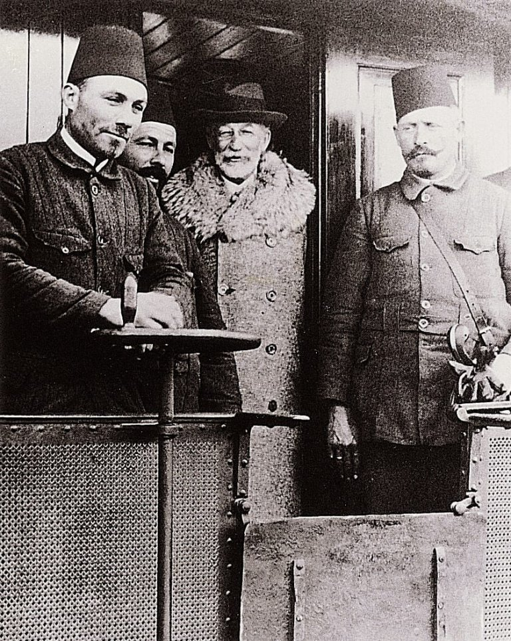
The Modern Revival
The modern Israeli wine industry began in the late 19th century when Baron Edmond de Rothschild, owner of the renowned Château Lafite Rothschild in Bordeaux, took a personal interest in reviving viticulture in the region.
Recognizing the historical significance and potential of Israeli vineyards, Rothschild provided significant financial support and expertise.
He sent agronomists and winemaking experts from France to Israel, introduced high-quality French grape varietals such as Cabernet Sauvignon and Merlot, and established two of Israel's earliest modern wineries in Rishon LeZion and Zichron Yaakov.

Slide 7
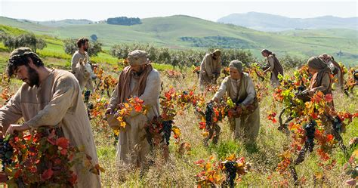
The Modern Revival
Rothschild also invested in research, creating an agricultural school to train local farmers in vineyard management and modern winemaking techniques. His contributions not only revitalized the wine industry but also laid the groundwork for the vibrant and innovative scene we see today.
His legacy continues to inspire winemakers across Israel, many of whom still draw on his vision of combining tradition with innovation.

Slide 8
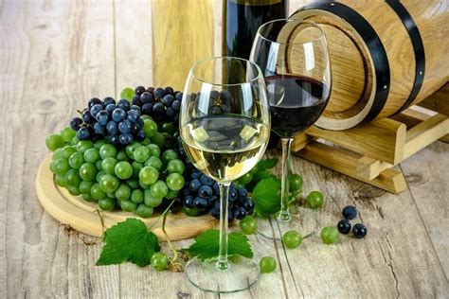
The Modern Revival
In the late 20th century, a wave of boutique wineries and cutting-edge technology transformed Israeli wine, elevating its quality and reputation on the global stage.
These boutique wineries began focusing on small-batch production, allowing winemakers to experiment with techniques and varietals that highlighted Israel's unique terroir.
Advanced viticultural practices, such as precision irrigation and soil analysis, further improved grape quality. The introduction of modern fermentation technologies and oak aging techniques helped craft wines that were not only technically excellent but also reflective of the region's distinct character.
This combination of innovation and artistry captured the attention of international critics, earning Israeli wines top awards and a growing presence in global markets.

Slide 9
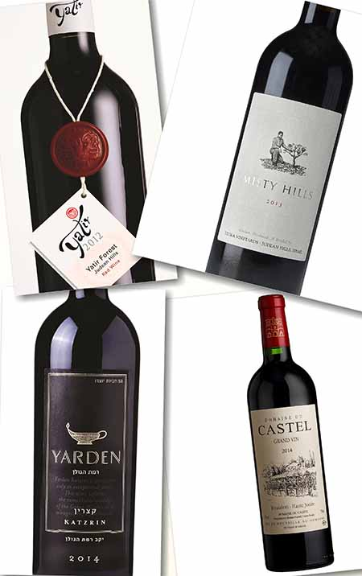
Wine Classification System in Israel
Israel does not have a formalized wine classification system like France or Italy. However, wines are often categorized by region and style.
Most wineries adhere to international standards of labeling, including varietal designation and vintage.
Kosher certification is also significant, as many wines are produced under strict religious guidelines to meet kosher requirements.

Slide 10
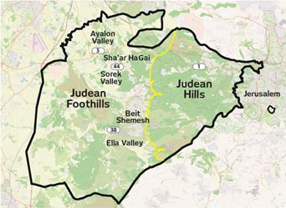
Wine Regions of Isreal
Judean Hills
The Judean Hills, located west of Jerusalem, are often referred to as the "Tuscany of Israel" due to their rolling landscapes and high-quality wines.
The region’s limestone-rich soils and moderate Mediterranean climate create ideal conditions for growing grapes like Cabernet Sauvignon, Syrah, and Chardonnay.
Notable wineries here produce elegant, full-bodied reds and crisp whites with complex minerality.

Slide 11
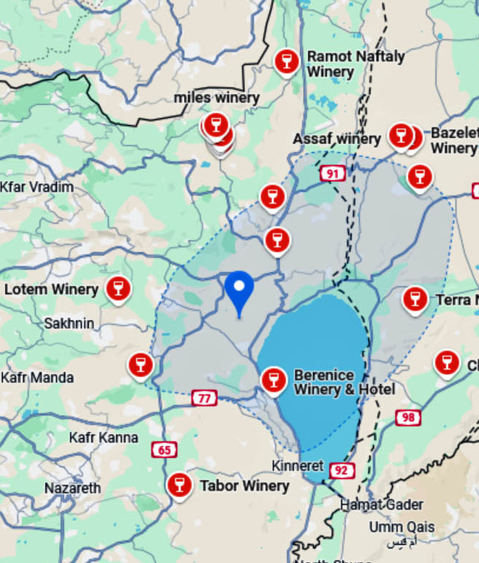
Wine Regions of Isreal
Galilee
The Galilee region, particularly the Upper Galilee, is a cool-climate area that produces some of Israel’s finest wines.
The volcanic soils and elevation create a unique terroir for varietals like Merlot, Sauvignon Blanc, and Viognier.
The wines from Galilee often display bright acidity, bold flavors, and exceptional aging potential.

Slide 12
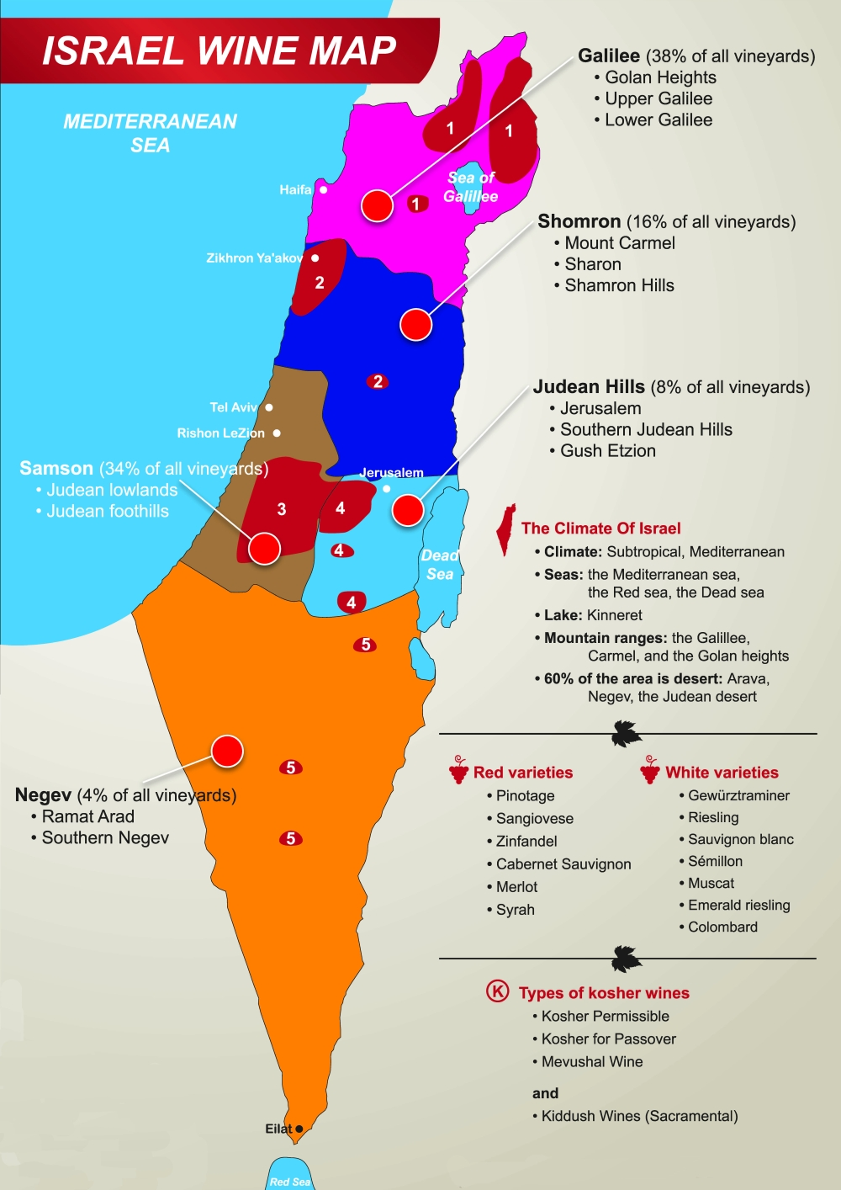
Wine Regions of Isreal
Negev Desert
While unconventional, the Negev Desert has emerged as an exciting wine region.
Using advanced irrigation techniques, vineyards thrive in the arid climate, producing distinctive wines with rich, concentrated flavors. Varietals like Shiraz and Petit Verdot shine here.

Slide 13
Wine Regions of Isreal
Shomron (Samaria)
This historic region includes areas like Mount Carmel and offers a mix of traditional and modern styles.
The region’s Mediterranean influence is evident in its approachable, fruit-forward wines made from varietals like Carignan and Cabernet Franc.

Slide 14
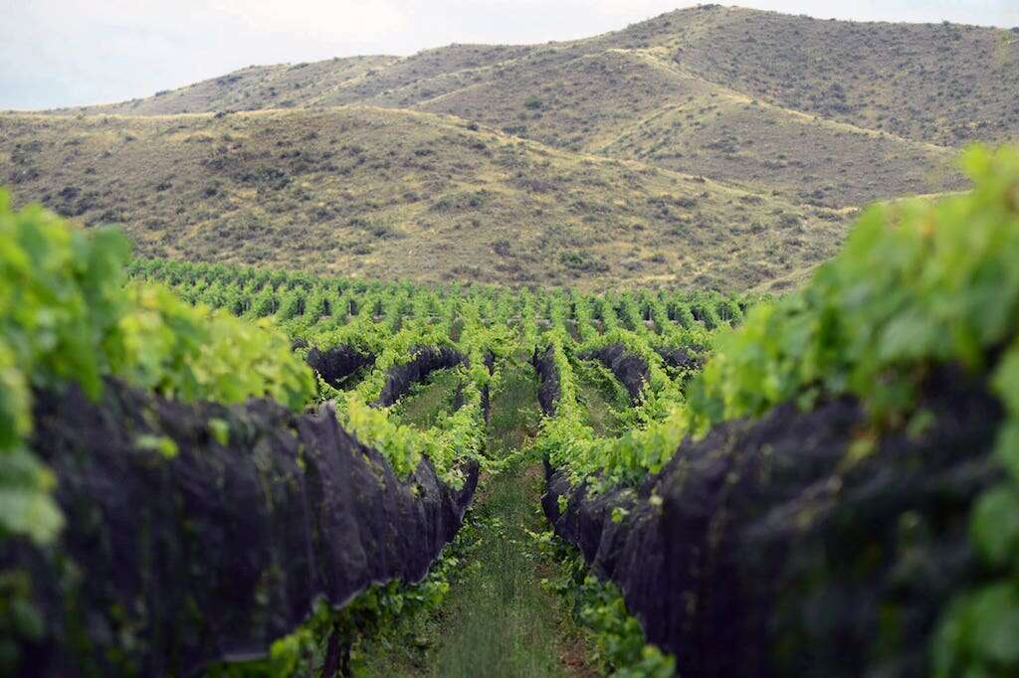
Unique Terroir
Israel’s diverse terroir is one of its greatest assets. From the high-altitude vineyards of Galilee to the arid plains of the Negev, the country’s geography provides a variety of microclimates and soil types.
This diversity enables winemakers to experiment and produce a broad range of styles, from robust reds to aromatic whites.

Slide 15

Major Varietals
Indigenous Grapes
Israel is rediscovering its ancient grape varieties, such as Marawi and Dabouki, which are gaining attention for their unique profiles and historical significance.
These wines often feature bright acidity, floral aromas, and notes of stone fruit.

Slide 16
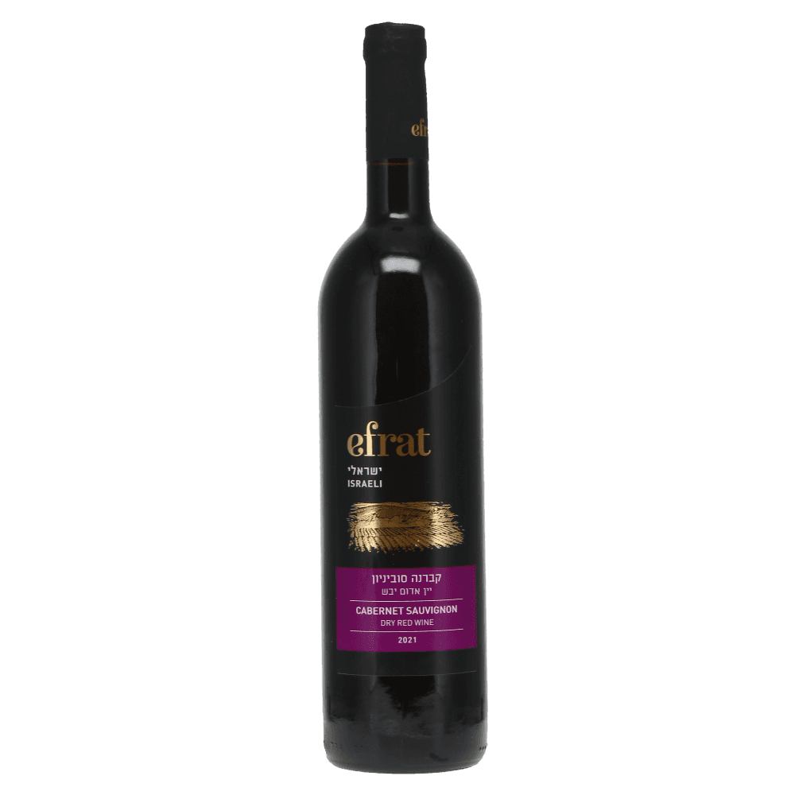
International Varietals
International grape varietals dominate Israeli vineyards, with Cabernet Sauvignon and Syrah leading the reds, and Chardonnay and Sauvignon Blanc among the whites.
Cabernet Sauvignon thrives in Israel’s warm climate, producing wines with deep black fruit flavors, firm tannins, and hints of Mediterranean herbs.
Syrah, meanwhile, develops a rich and spicy profile with notes of dark berries, pepper, and smoked meat. These robust reds often have excellent aging potential.
Chardonnay is crafted into a range of styles, from crisp and unoaked to lush and barrel-aged, with flavors of citrus, apple, and tropical fruit.

Slide 17
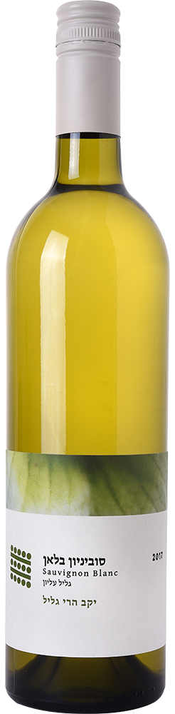
International Varietals
Sauvignon Blanc is celebrated for its refreshing acidity and aromas of green apple, passion fruit, and grass, making it a popular choice for white wine enthusiasts.
Other international varietals, like Merlot and Petit Verdot, also play a significant role, often blended to create complex, balanced wines.
Winemakers continually innovate, tailoring these classic varietals to the unique microclimates and soils of Israel, resulting in wines that are both globally recognizable and distinctly Israeli.

Slide 18
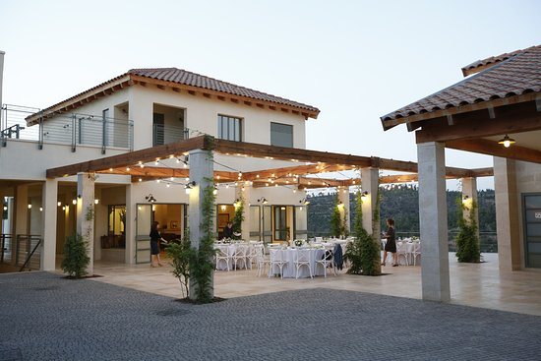
Notable Wineries
Domaine du Castel
Nestled in the picturesque Judean Hills, Domaine du Castel is a must-visit for wine enthusiasts.
Renowned for its Bordeaux-style blends and elegant Chardonnays, this winery combines Old World sophistication with Israeli innovation.
Their flagship wine, “Grand Vin,” consistently earns high marks from critics and has received gold medals in prestigious competitions like the Decanter World Wine Awards.
Visitors can enjoy guided tours through the scenic vineyards, explore the cellar, and indulge in a curated tasting experience.

Slide 19
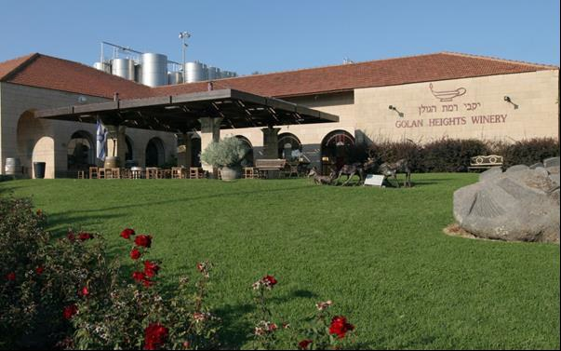
Notable Wineries
Golan Heights Winery
Located in the breathtaking Galilee region, Golan Heights Winery is a pioneer in modern Israeli winemaking.
Their Yarden label, featuring award-winning Cabernet Sauvignon and sparkling wines, has garnered international acclaim, including top honors at the International Wine Challenge.
A visit to the winery offers a blend of education and indulgence, with tours highlighting the volcanic soils, state-of-the-art facilities, and an exceptional tasting room showcasing their finest vintages.

Slide 20
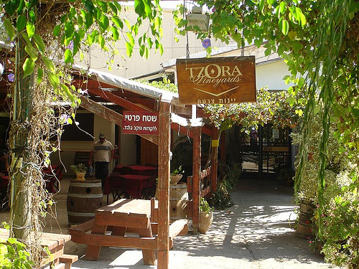
Notable Wineries
Tzora Vineyards
Tzora Vineyards, another gem in the Judean Hills, is celebrated for its terroir-driven approach.
Their meticulously crafted wines, such as the acclaimed Misty Hills blend, reflect the unique limestone and clay soils of the region.
Tzora’s wines have won accolades at competitions like Mundus Vini, cementing their status as a leader in Israeli viticulture.
Visitors can explore the vineyard, learn about sustainable practices, and enjoy intimate tastings guided by knowledgeable staff.

Slide 21
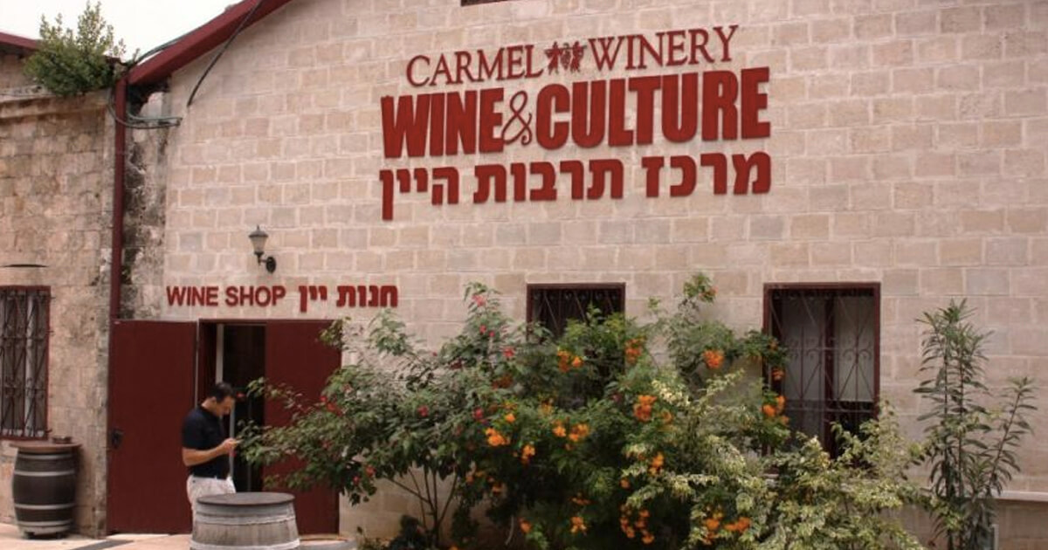
Notable Wineries
Carmel Winery
As one of Israel’s oldest and largest wineries, Carmel combines a rich history with a modern vision.
Established in 1882 by Baron Edmond de Rothschild, Carmel has evolved into a powerhouse of innovation and quality.
Their diverse portfolio ranges from everyday table wines to premium offerings like “Limited Edition,” which has received multiple awards at the Berlin Wine Trophy.
Visitors can tour the historic cellars in Zichron Yaakov, participate in blending workshops, and savor a variety of wines paired with gourmet local cuisine.

Slide 22
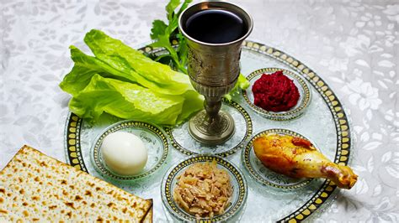
The Cultural Significance of Wine in Isreal
Wine holds a special place in Israeli culture, deeply tied to religious practices and celebrations. From Sabbath meals to Passover seders, wine is a symbol of joy and tradition.
In recent years, sustainability has become a priority for many wineries.
Practices like organic farming, water conservation, and solar energy usage are increasingly common, reflecting a commitment to preserving the land for future generations.

Slide 23
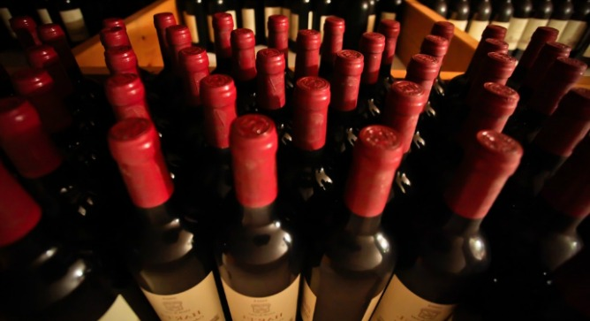
Final Thoughts
Israel’s wine industry stands as a remarkable blend of resilience, tradition, and innovation. From ancient vineyards rooted in history to modern wineries pushing the boundaries of winemaking, Israel offers an unparalleled journey through its diverse landscapes and flavors.
Each wine region brings its unique character to the table, whether it’s the elegant reds of the Judean Hills, the vibrant whites of Galilee, or the bold experiments in the Negev Desert.

Slide 24
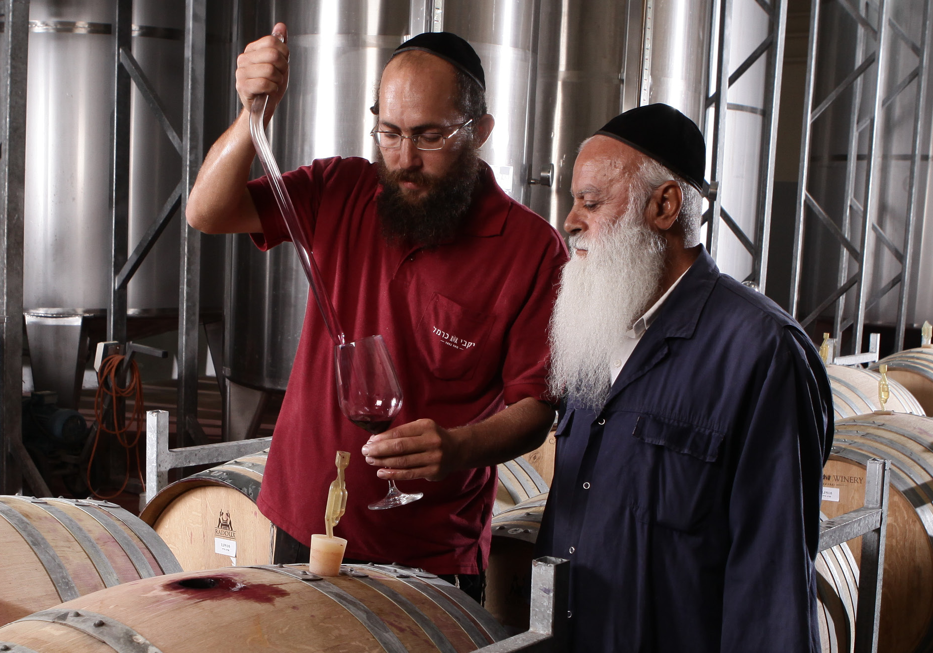
Final Thoughts
Visiting Israel’s wineries is more than a tasting experience—it’s a dive into the stories, traditions, and passion of the people behind each bottle.
The combination of groundbreaking techniques and respect for the land creates wines that are both globally recognized and deeply connected to their roots.
Whether you’re savoring a glass of award-winning Cabernet Sauvignon or exploring the nuances of indigenous varietals like Marawi, Israeli wine invites you to celebrate the spirit of innovation and cultural richness that defines this extraordinary region.

Slide 25
Acknowledgement
My seminars are the result of many years of experience combined with many hours of research over the internet.
I would like to acknowledge the many source I have accessed.
These include Wine Spectator, Wine Enthusiast, BKWine Magazine, Wine & Spirits Magazine, American Vineyard Magazine, The Grapevine Magazine, Wikipedia.com, Britannica.com, and the various Government websites.

Slide 26
Citations and References
: The Next Great Wine Destination."

