Slide 1
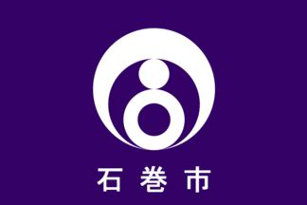
Ishinomaki Japan Presented by Fellow Cruiser Marc Silver

Slide 2
What I Will Cover
My Port Philosophy
Don’t Miss the Ship
Money
About Ishinomaki
Area Map of Ishinomaki
Map of Ishinomaki
Places to see or at least consider
A few restaurant recommendations
Conclusion

Slide 3
My Port Philosophy
I have been cruising for over 45 years and have taken over 100 cruises. So I consider myself an experienced cruiser.
The information I will present is based on those many years of
experience.
When I am on a cruise where the city I want to visit is not the port city,
I always recommend taking a ship’s tour.
But when I am in a port with multiple attractions nearby and easy to see
on my own - I will do it on my own.
This presentation is not like that.

Slide 4
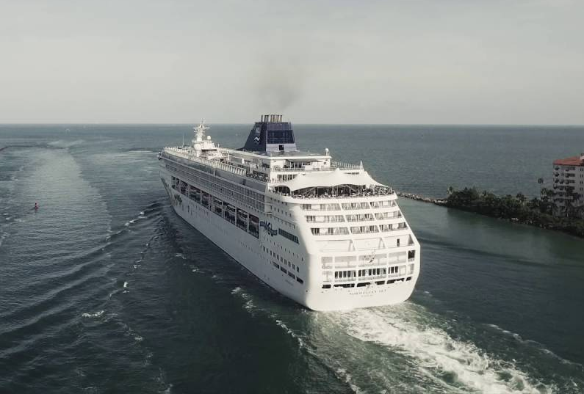
Don’t Miss the Ship
How to Avoid Missing Your Ship
Pay attention to the time. - Ship time and local time are often different.
Put a return-to-ship reminder on your phone.
Choose excursions wisely.
If a ship-sponsored excursion is late returning to port for, the ship will wait for you. If you are on your own???
Be Prepared
Have your Passport, Credit Card and phone numbers for your ship port agent.
What to Do If You Miss the Ship Most cruise lines have port agents stationed in the port area to assist if your ship has left without you. If you’re lucky, when cruisers are late returning to the vessel, the ship's crew will often remove the passengers' essential items -- passports, cell phones, and medication -- from the ship to leave with the port agents.
The Port Officials can help you with contacting your ship and making necessary travel arrangements.

Slide 5
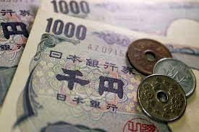
Money
The Yen is the official currency of Japan
Official Exchange is 100 Yen is 72 cents US
Or 142.15 Yen to the US Dollar

Slide 6
About Ishinomaki
The area of present-day Ishinomaki was part of ancient Mutsu Province. During the Sengoku period, (in the 15th and 16th centuries) the area was contested by various samurai clans before the area came under the control of the Date clan of Sendai Domain during the Edo period.
The town prospered as a major port and transshipment center for coastal shipping. The town of Ishinomaki was established within Oshika District in 1889, with the establishment of the modern municipalities system.
The city was founded on April 1, 1933. On April 1, 2005, Ishinomaki absorbed the 6 neighboring towns to more than quadruple its area and add nearly 60,000 people to its population.
The town of Ogatsu is famous for its annual scallop festival in the summer

Slide 7


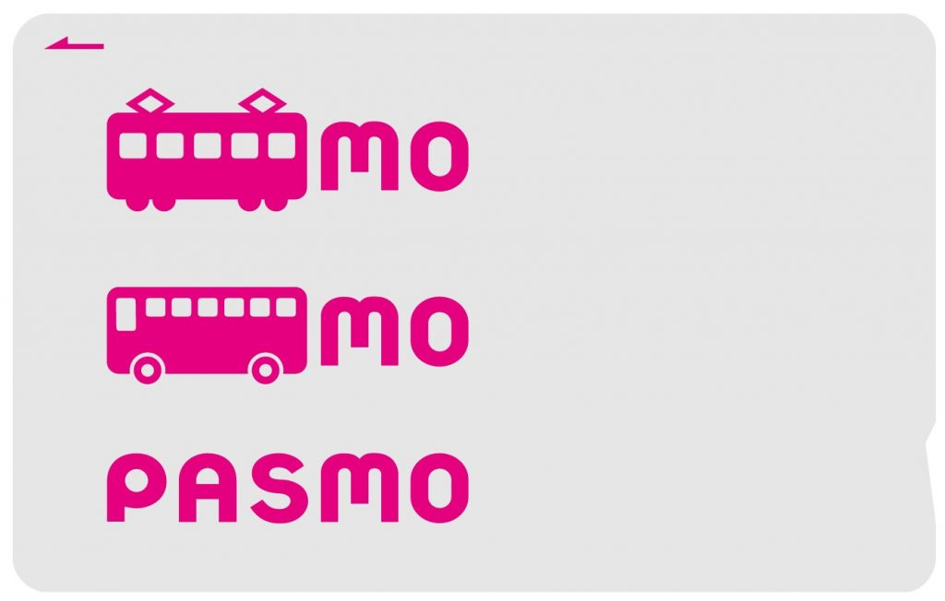
PASMO, Suica, & ICOCA Cards
The PASMO, Suica, and ICOCA Cards are e-money IC cards that can be used for travel and shopping across Japan.
Cashless fare payment
Use it for shopping
No waiting for change
Get special privileges
Apple phone users can also link with all three cards.
PASMO refunds - If you no longer need your PASMO, it can be refunded. Suica and ICOA cards do not offer refunds.

Slide 8
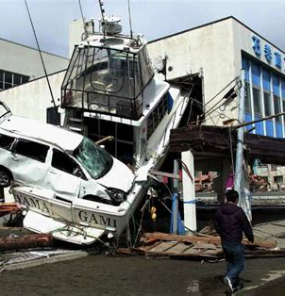
2011 Earthquake & Tsunami
Ishinomaki was among the municipalities most seriously affected by the 2011 Tōhoku earthquake and tsunami. Several tsunamis, up to about 33 ft high, traveled inland up to 3.1 miles from the coast. The tsunami destroyed around 80% of the 700 houses in the coastal port of Ayukawa, and the Kadonowaki neighborhood was largely leveled. Approximately 46% of the city was inundated by the tsunami. Following the tsunami, a Kamen Rider statue was found completely intact despite damage to the surrounding area.
The earthquake shifted the city southeast and downward, lowering it by as much as 1.2 meters in some areas and causing it to flood twice daily at high tide.
Since 2011, Ishinomaki and other municipalities have been focusing on rebuilding and attracting residents back into the area. In 2019, eight years after the tragedy, Okawa Elementary School remains in ruins, as a memorial to those that were lost in the tsunami.

Slide 9
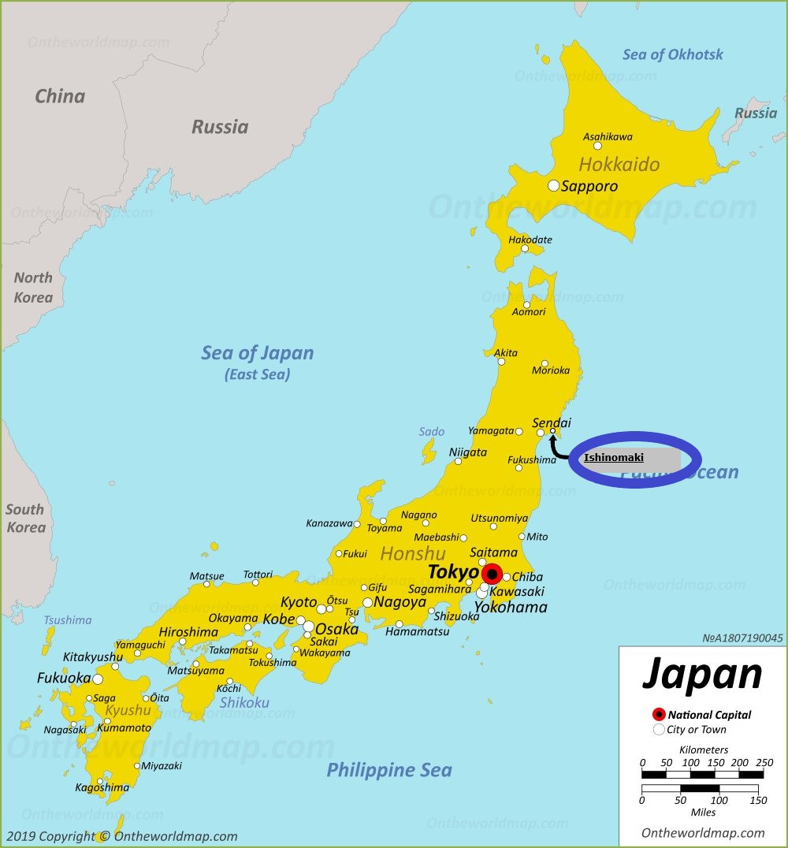
Area Map of Ishinomaki

Slide 10
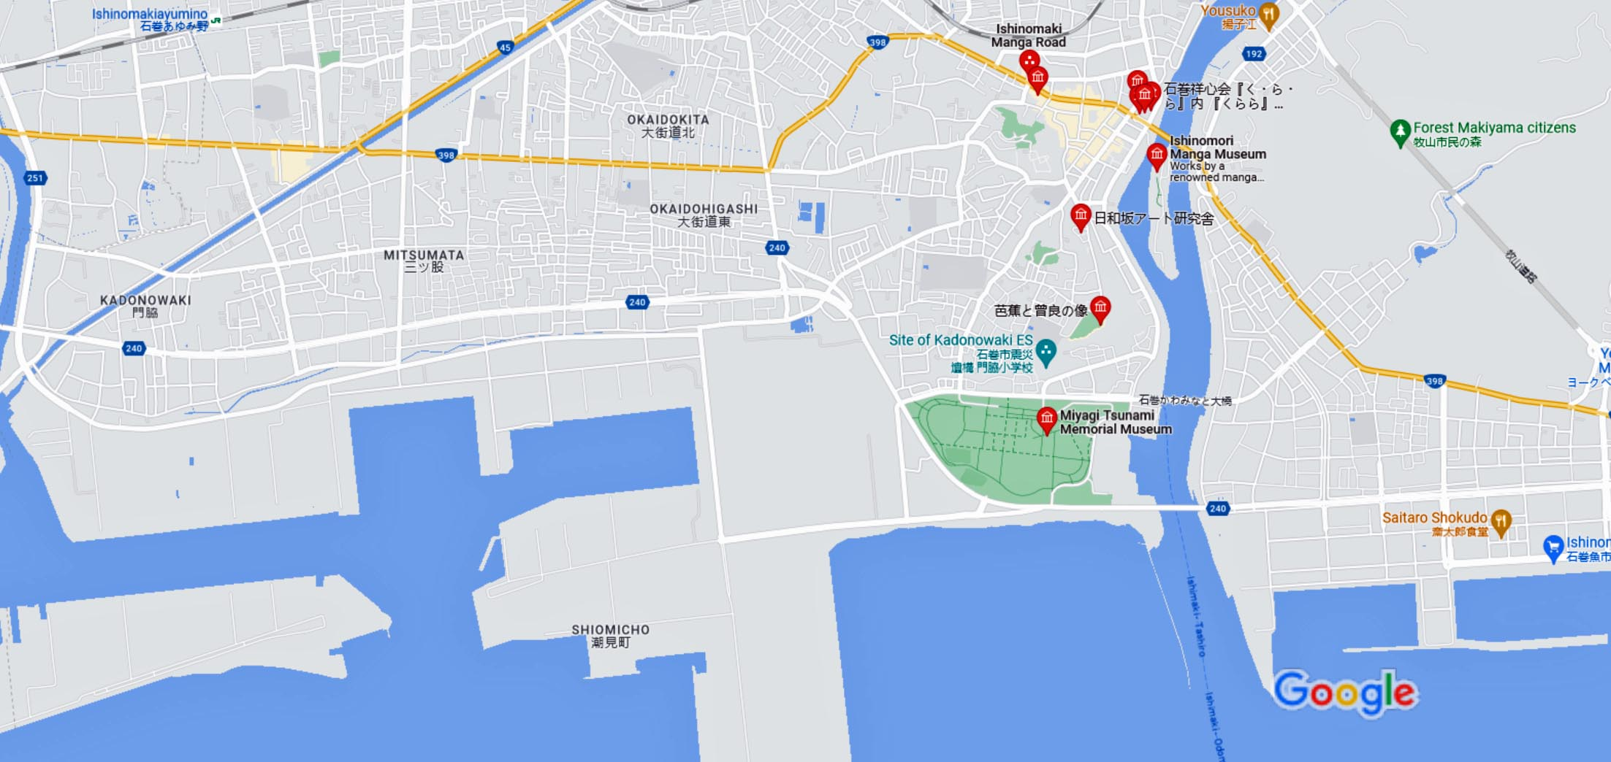
Map of Ishinomaki

Slide 11
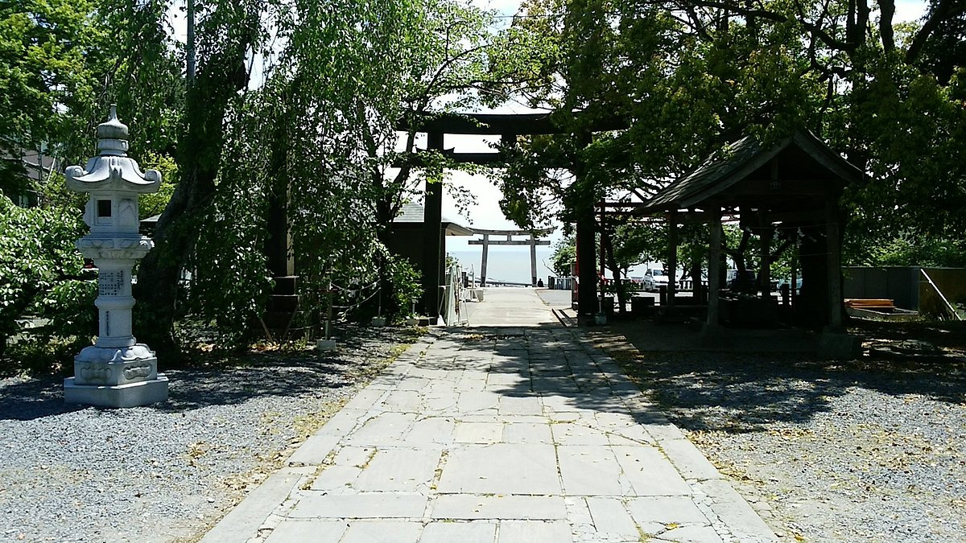
Kashimamiko Shrine
This Shrine commemorates those lost in the 2011 tsunami. It is small but there is a cleansing water ceremony that can be done and several smaller shrines around it. The Shrine can be walked to, up lots of steps from the Manga Museum in about 20 minutes.
From here you have an overview of Ishinomaki.
You have an amazing view over Ishinomaki and the bay.

Slide 12
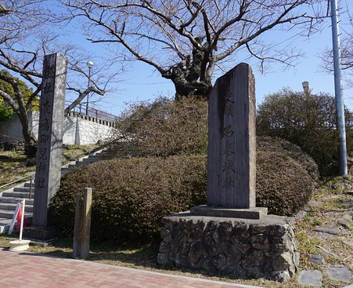
Hiyoriyama Park
The Hiyoriyama Park is located about 2 miles from the cruise terminal not far past the Ishinomaki Minamihama Tsunami Memorial Park.
It's about a 20-minute hike to the top. You will be rewarded with sweeping views of the ocean and the river.
There are benches placed throughout and lots of signs in Japanese and English that show some of the "before" and "after" photos of various vantage points (pre-quake/tsunami and after).
It is sobering to look down upon the flatlands adjacent to the ocean/river and realize the magnitude of the tragedy that struck this community. Well worth the hike.

Slide 13
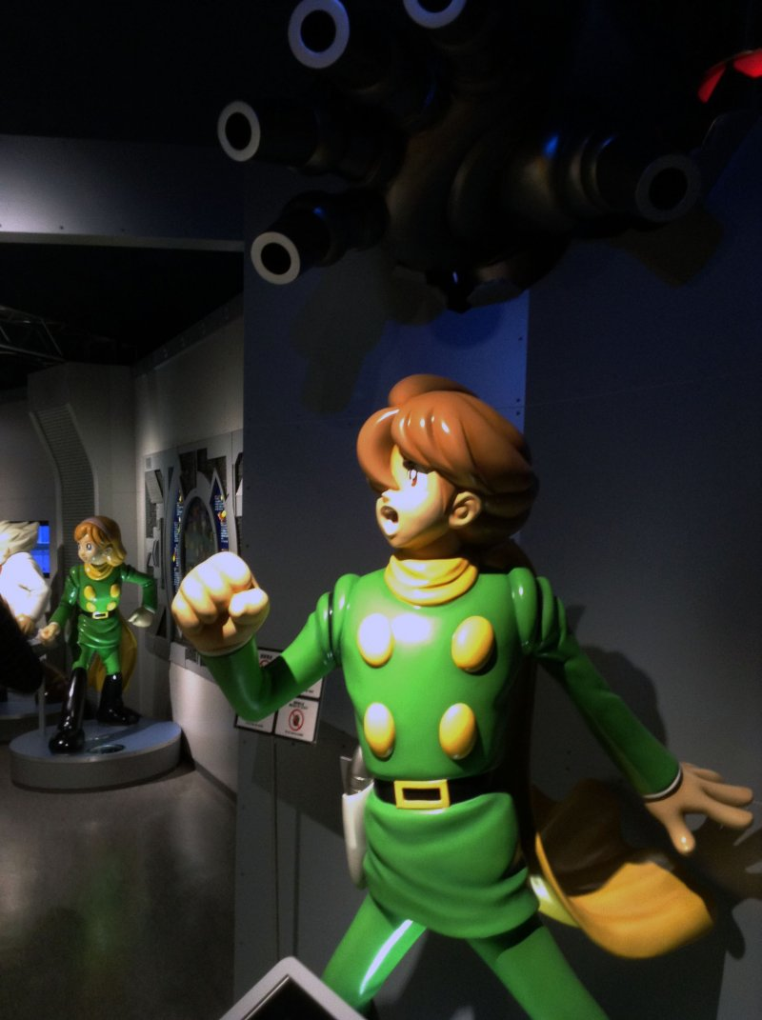
Ishinomaki Mangattan Museum
Japanese animation and comic books are icons of Japanese popular culture and have been praised as an easily accessed medium that is capable of introducing casual reading, fantastical literature, traditional ideals, and futuristic wonders.
Perhaps no one knew this better than Ishinomori Shotaro: The King of Manga (The King of Comics).
Sadly, passing away at just 60 years old, he is the legendary creator of series such as Cyborg009 and Kamen Rider.

Slide 14
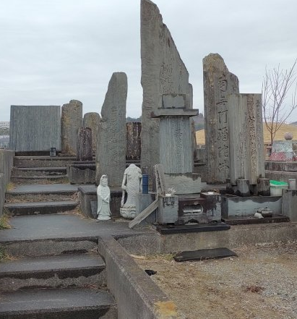
Ishinomaki Minamihama Tsunami Memorial Park
Ishinomaki is located at the mouth of the Kitakami River in Miyagi Prefecture.
This location also makes it one of the most exposed cities in times of natural disasters.
Ishinomaki is easy to reach on the E-45 highway.
Take the Ishinomaki exit, then go on R-108 east until you see R-33 south.
Follow R-33 along the river south and you'll end up at the memorial park.

Slide 15
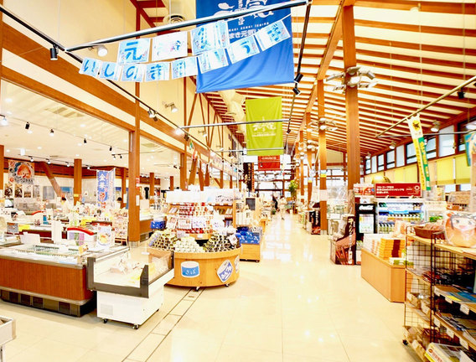
Ishinomaki Genki Market
Located along the river across from the manga museum, the Genki Market (Genki Ichiba) is an indoor market selling local specialties, including seafood products and produce.
On the second floor is a food fair where a variety of dishes, including seafood donburi and noodle dishes are served.
The 2nd floor has a spacious food court, which serves seafood from around Kinkazan Island.
Hours: 9:00 to 19:00 (shops), 11:00 to 20:00 Closed: No closing days

Slide 16
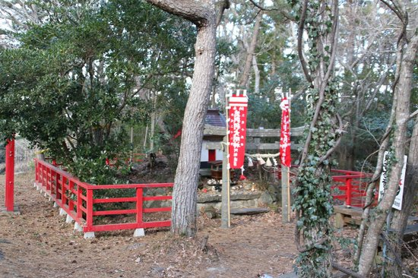
Tashiro Island
Also called Cat Island, Tashiro Island is all about Cats and their relationship with humans and our cultures are as old as civilization itself.
The Japanese culture is no exception. Cats are revered by the Japanese, and different types of good luck charms and temples are devoted to cats.
The Maneki Neko “good fortune” cat, depicted as a sitting cat waving one paw, is seen in most Japanese business establishments because it is believed to draw in good business.

Slide 17
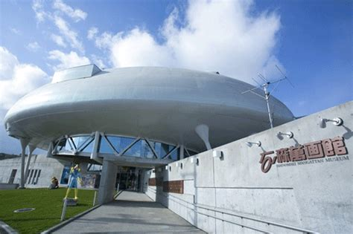
Sant Juan Bautista Museum
The Sant Juan Bautista is a Spanish style galleon that embarked on a diplomatic mission across the Pacific Ocean during the Edo Period.
A museum about the ship and journey is located south of Ishinomaki's city center.
A replica of the ship used to be on display but has since been removed.
The museum offers excellent displays and an interesting motion simulator video that explains the history of Japan during the Age of Exploration.

Slide 18
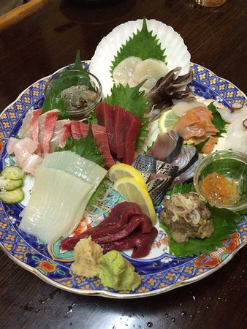
Ishinomaki Restaurants
Ishinomaki has many excellent seafood restaurants. Many of us on the ship are foodies, so naturally, we’re always on the hunt to eat at the most exclusive spots anytime we travel.
Here are a few of the best restaurants to consider not far from the terminal.
Watanoha $$ - $$$ Japanese Seafood Barbecue
75-5 Iwaida, Watanoha, Ishinomaki
Sakanadokoro Sankichi $$ - $$$ Japanese Izakaya (Japanese Style Tavern)
1-3 Sengokucho, Ishinomaki
Shiraken $$ - $$$ Japanese
2-4-29 Tachimachi, Ishinomaki
Tonkatsu Shonai Ishinomaki $$ - $$$ Japanese
2-2-9 Nakasato, Ishinomaki
For those of you who just like good food, you can’t go wrong just about anywhere you go in Ishinomaki.
GOOD EATING

Slide 19
Final Thoughts
Ishinomaki is a beautiful City with a rich history and numerous attractions.
Regardless of what you're looking for, Ishinomaki has something for everyone.
I hope this presentation will help when we visit Ishinomaki!

Slide 20
Thanks For Coming
If you have any more questions, please ask.
I will do my best to answer them for you.
Have a great visit in Ishinomaki !

