Slide 1
Wine Regions of the World The Wine Desert of Iran Presented by Marc Silver

Slide 2
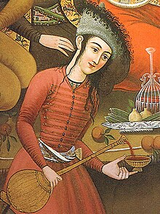
The Wines of Iran
Table of Contents
Wine Desert Not Dessert Wine
Iran's Wine Constraints
History of Wine in Iran
Iran's Wine Regions
Iran's Wine Culture and Traditions
Major Varietals of Iran
Underground Wine Production in Iran
Culture and Traditions
Final Thoughts and Conclusion
Citations and References
A wine-pourer or saghi, Safavid court painting, 17th century Isfahan.

Slide 3
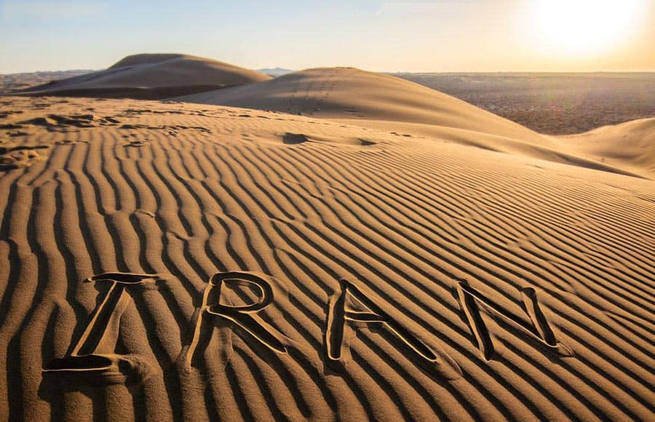
Wine Desert not Dessert Wine
Wine has been woven into the fabric of human civilization for thousands of years, serving as a bridge between cultures and landscapes.
Iran, with its profound historical connection to viticulture, once stood as a cradle of winemaking.
Yet today, it is a stark 'Wine Desert’, a place where stringent religious prohibitions have transformed this rich tradition into a distant memory.
The remnants of this legacy linger in ancient poetry and underground production, quietly resisting erasure."
While Iran boasts a profound historical connection to viticulture, contemporary religious restrictions have effectively eliminated wine production, transforming a once-vibrant tradition into a vestigial cultural memory.
Today, Iran stands as a stark "Wine Desert"—a geographical and cultural landscape where millennia of viticultural expertise have been systematically erased by stringent religious prohibitions.

Slide 4

Iran's Wine Constraints
Iran presents a unique and complex landscape for wine production. Geographically diverse, with regions ranging from mountainous terrains to high plateaus, the country offers intriguing potential for viticulture.
However, significant cultural and legal constraints severely restrict wine production:
Islamic Religious Prohibition: After the 1979 Islamic Revolution, Sharia law strictly forbids alcohol production, sale, and consumption.
Legal Penalties: Individuals producing or selling wine can face: Corporal punishment, Substantial fines, Imprisonment and Public lashings.
While Iran faces significant constraints today, its historical contributions to viticulture reveal a legacy that shaped the region's identity for millennia.

Slide 5
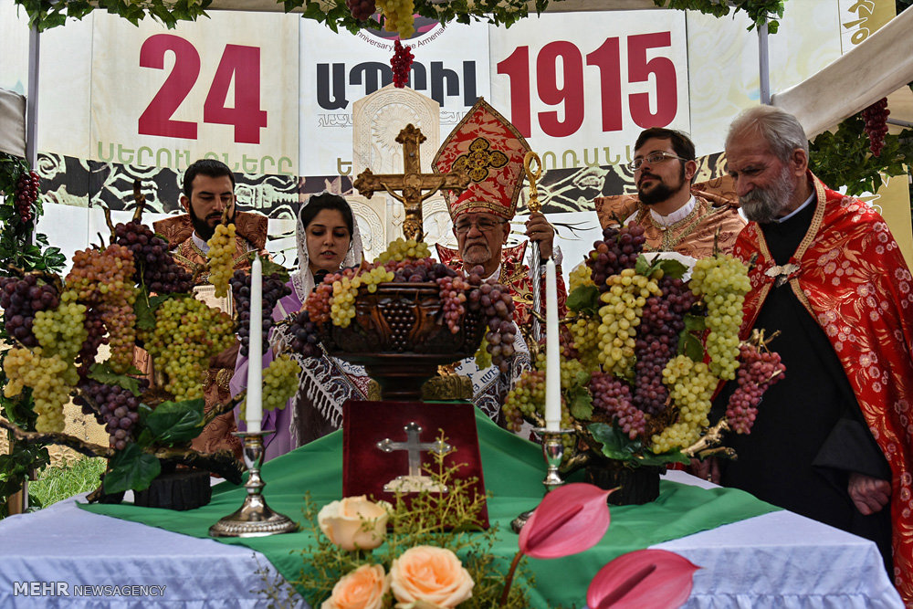
Overview of Iran's Wine Constraints
Cultural Restrictions:
Wine production is a strong social taboo, making it socially unacceptable and potentially dangerous.
Narrow Exceptions: Only non-Muslim religious minorities (Armenian and Assyrian Christians) may produce extremely limited quantities of wine under strict regulations.
Economic Barriers: The comprehensive ban effectively eliminates commercial wine production, preventing any meaningful viticultural industry from developing in the country.
These constraints create a comprehensive barrier to wine production in Iran, transforming what could be a potentially fertile viticultural landscape into a region where wine cultivation is essentially nonexistent from a commercial and cultural perspective.
These restrictions effectively eliminate commercial wine production in Iran, rendering the country's viticultural potential essentially unrealized.

Slide 6
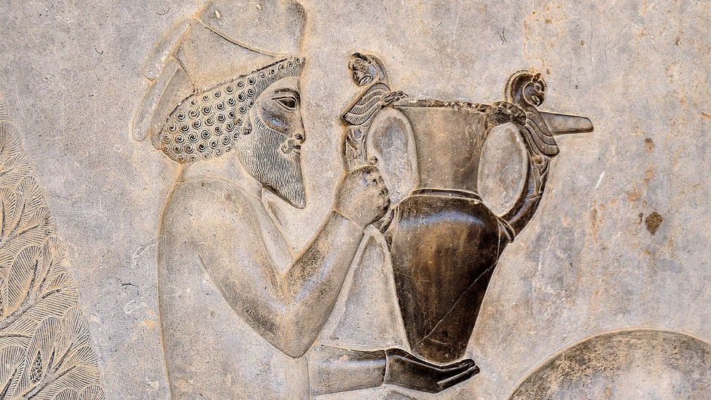
History of Wine in Iran
Early Beginnings
Archaeological evidence reveals a profound viticultural heritage in the region spanning millennia. Grape cultivation flourished in the diverse landscapes between the Caspian Sea and Persian Gulf, where unique geographical conditions created an exceptional environment for wine production.
Excavations have uncovered wine-related artifacts dating back to 5000-6000 BCE, demonstrating that ancient Persian civilizations were sophisticated viticulturalists.
The Achaemenid Empire, in particular, developed advanced agricultural techniques that enabled complex grape cultivation and early winemaking processes.
These fertile lands, and rich soil compositions, provided optimal conditions for developing diverse grape varieties and complex wine production techniques.

Slide 7
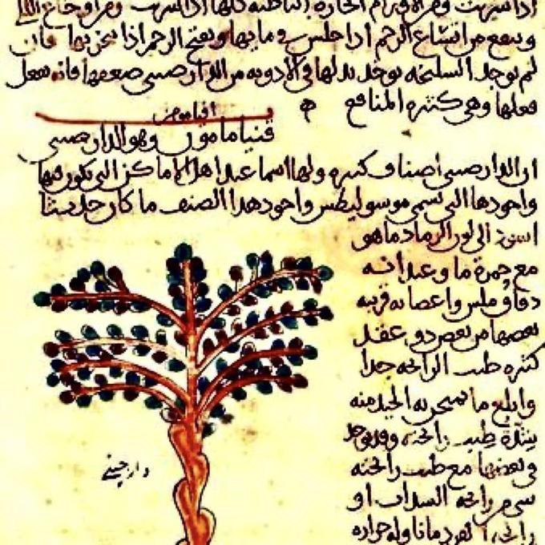
History of Wine in Iran
Medieval Period During the Islamic Golden Age (8th-14th centuries)
Persian scholars made remarkable contributions to viticulture and winemaking, despite emerging religious prohibitions:
Scientific Contributions:
Persian polymath Ibn Sina (Avicenna) documented extensive wine and grape cultivation techniques
Scholars like Al-Dinawari produced detailed botanical texts describing grape varieties and cultivation methods
Comprehensive agricultural treatises included sophisticated discussions of vineyard management, grape selection, and wine production

Slide 8
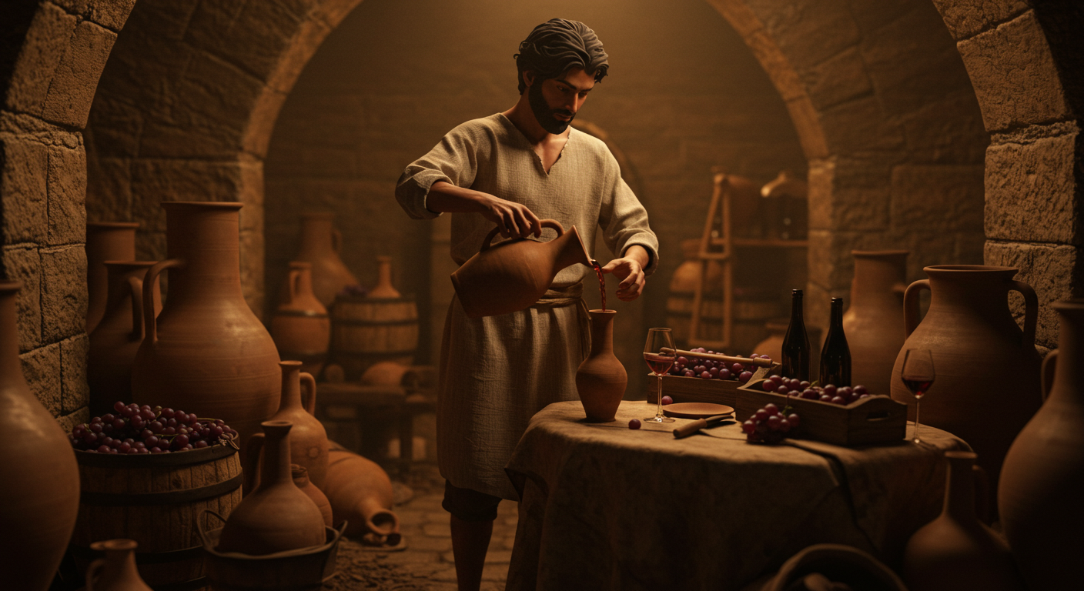
History of Wine in Iran
Medieval Period During the Islamic Golden Age (8th-14th centuries)
Cultural Context:
Pre-Islamic Persian culture had a long, rich tradition of winemaking dating back to Achaemenid times
Early Islamic period initially maintained some tolerance for wine production, particularly among educated elites
Persian poetry frequently celebrated wine, with poets like Omar Khayyam referencing wine's cultural significance.
Technological Innovations:
Persian scholars developed advanced fermentation techniques
Refined glass-making processes improved wine storage and preservation
Sophisticated botanical knowledge enabled selective grape breeding and cultivation strategies

Slide 9
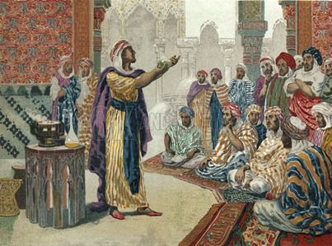
History of Wine in Iran
Medieval Period During the Islamic Golden Age (8th-14th centuries)
Gradual Religious Transformation:
Increasing religious restrictions progressively marginalized wine production
Wine transitioned from a celebrated cultural product to a prohibited substance
Non-Muslim communities increasingly became the primary wine producers
This period represents a complex transitional era where scientific understanding of viticulture coexisted with growing religious constraints, ultimately leading to the comprehensive prohibition that characterizes modern Iranian alcohol policies.

Slide 10
History of Wine in Iran
The Renaissance and Wine Development
Despite religious restrictions, wine continued to play a cultural role, with underground and limited production maintaining traditional winemaking knowledge.
Modern Revitalization and Global Recognition
Contemporary Iran faces significant challenges in developing a global wine presence due to religious and legal restrictions.
In short – they have no Global recognition at all, and until they either soften their religious restrictions concerning wine production or the religious zealots are removed and replaced with a democratic government this will not change.
The historical roots of Iranian viticulture remain visible in its geography, where regions once flourished with grape cultivation

Slide 11
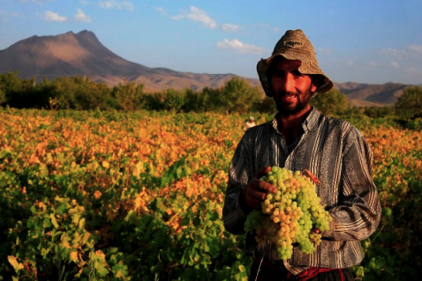
Iran's Wine Regions
Iran's varied geography offers ideal conditions for grape cultivation, with diverse climates ranging from the lush Caspian Sea region to the high-altitude plateaus of the Zagros Mountains.
Provinces like Fars, Qazvin, and Khorasan Razavi lead the way in grape production, benefiting from fertile soils and favorable weather.
These regions could potentially host internationally renowned vineyards if restrictions were lifted, but for now, they primarily produce table grapes and raisins.
The Jowzan Valley, with its microclimate, remains a standout example of Iran's untapped potential for viticulture.
Jowzan Valley Grape Farmer

Slide 12
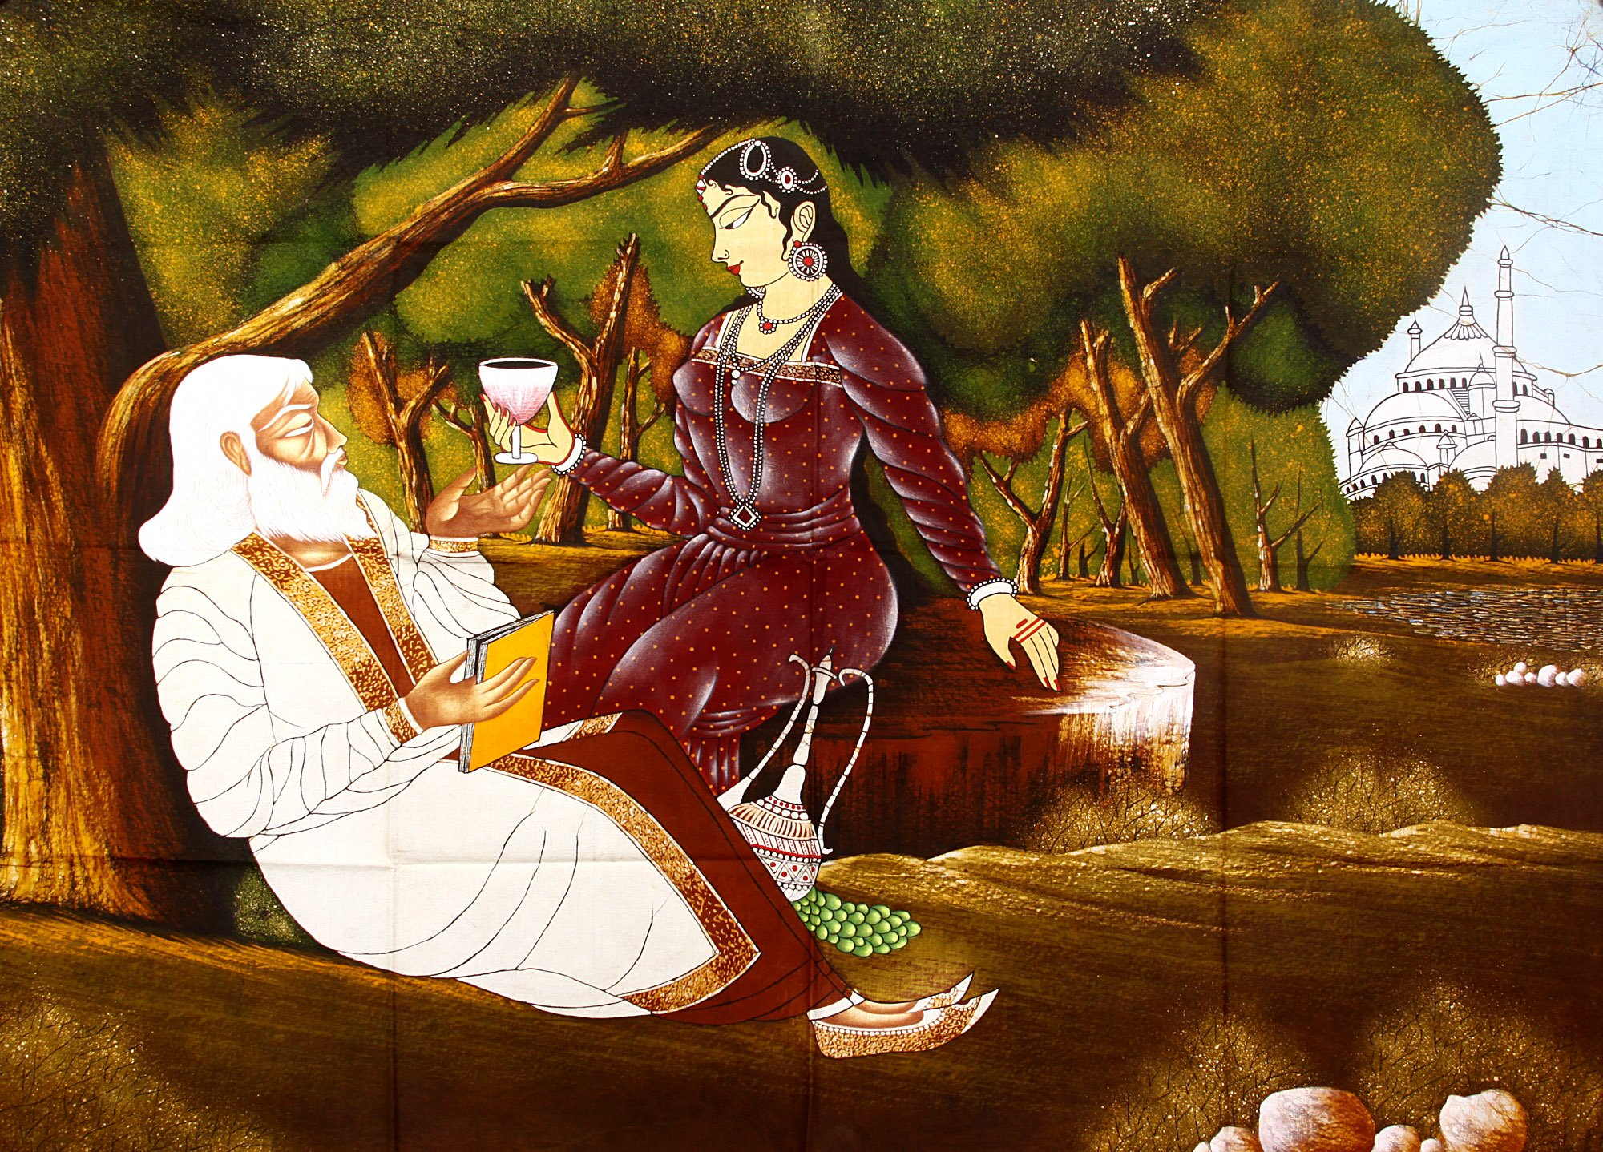
Iran’s Wine Culture
Wine has long been celebrated in Persian poetry, art, and mythology, symbolizing beauty, wisdom, and the fleeting nature of life.
Renowned poets like Omar Khayyam wove vivid imagery of wine and companionship into their verses, making it an enduring motif in Persian culture.
Modern Iran’s strict religious and legal restrictions have nearly eradicated public wine production and consumption.
Under Sharia law, wine is banned, with severe penalties for those caught producing or consuming it, confining viticulture to an underground existence.

Slide 13
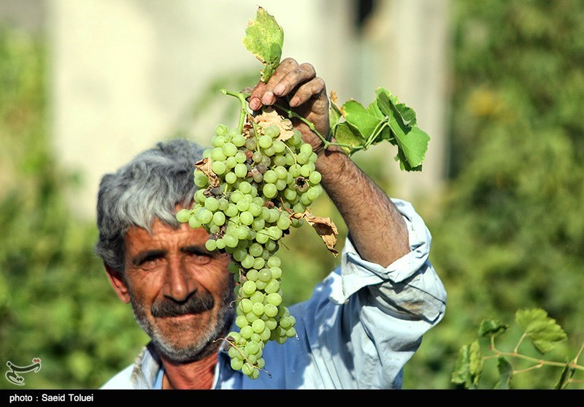
Major Varietals of Iran
Iran grows over 40 grape varieties, many of which are unique to its soil and climate.
Cultivars like Asgari and Keshmeshi are staples of the country's agricultural output, serving as fresh table grapes or raisins.
Indigenous varietals, such as Khalili Siah and Marandi, reflect a deep-rooted history of viticulture.
While modern wine production is limited, historical texts suggest that these grapes were central to ancient winemaking practices.
International varietals, like Shiraz and Chardonnay, could thrive in Iran’s diverse climates, but their cultivation remains speculative due to legal and cultural barriers
Asgari and Keshmeshi, in particular, play dual roles, serving as fresh table grapes and as essential ingredients for raisin production.
Their adaptability and high yield make them cornerstones of Iranian agriculture.

Slide 14
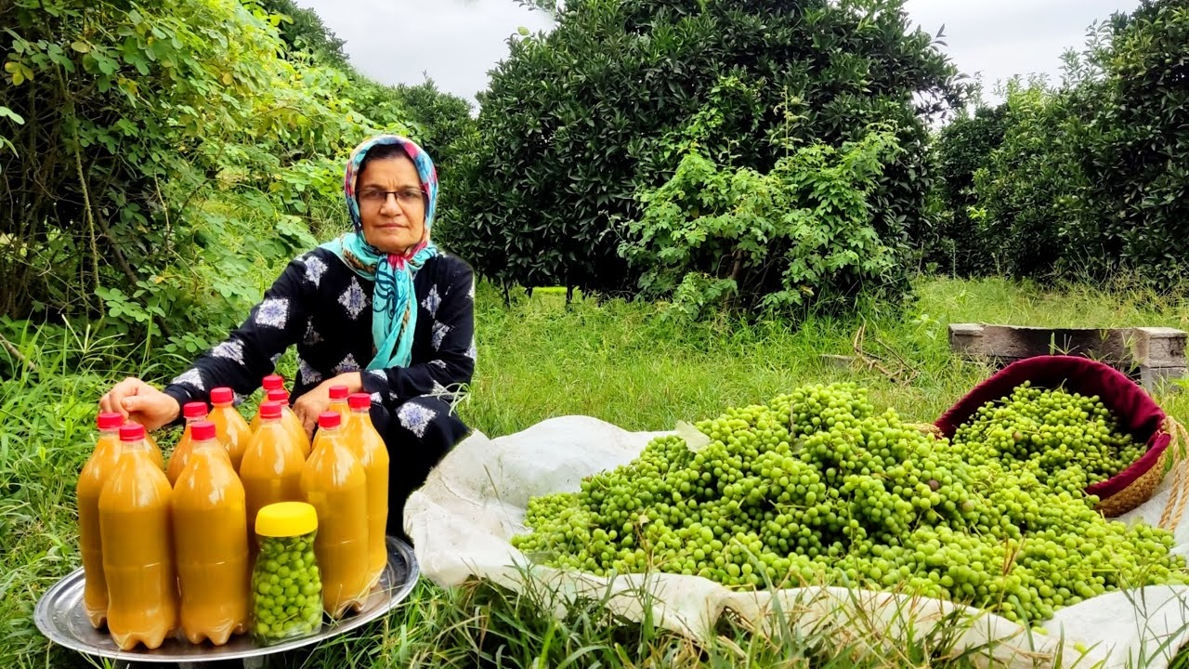
Major Varietals of Iran
Beyond ripe grapes, Iranian culinary traditions also embrace the use of unripe grapes, or Ghooreh.
These tart, green grapes are beloved for their sharp flavor and versatility in cooking.
Whether enhancing the tang of a salad, adding complexity to stews, or simply enjoyed fresh, Ghooreh reflects the resourcefulness and culinary creativity of Iranian culture.
In terms of production, Iran cultivated an impressive 800,000 tons of grapes in 2017—roughly 5% of the global total.
Grape-growing regions such as Fars, Qazvin, Khorasan Razavi, Hamadan, and East and West Azerbaijan provinces thrive thanks to their varied climates, fertile soils, and historical expertise.
These regions reflect the untapped potential of Iran’s viticultural landscape.
Picking Sour Grapes And Making Sour Grape Juice

Slide 15
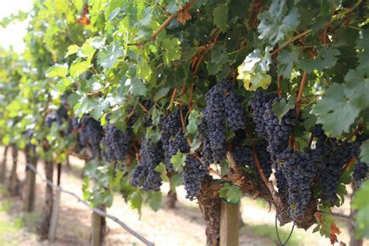
Major Varietals of Iran
Indigenous Grapes
The limited contemporary wine production in Iran makes it challenging to definitively identify indigenous grape varieties.
However, historical and archaeological evidence suggests a few that may have been central to Persian winemaking traditions.
Varietals such as Khalili Siah, with its dark skin, and Rizvan, linked to traditional viticulture, are part of Iran’s rich grape heritage.
Marandi, another variety potentially native to the Azerbaijan region, hints at the diversity of grapes that once flourished here.

Slide 16
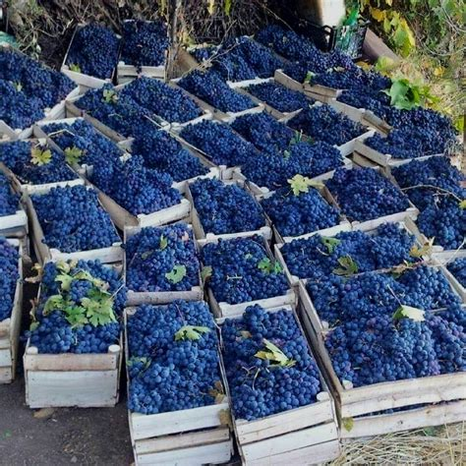
Major Varietals of Iran
Internationally Recognized Varietals
While most wine production is curtailed,
Iran's climatic diversity suggests it could support an array of internationally recognized grape varietals if restrictions were lifted.
For example, cooler mountainous areas could suit Cabernet Sauvignon, while Shiraz or Syrah could thrive in Iran’s warmer zones.
Chardonnay, a versatile white grape, might also adapt well to the country's higher altitudes and moderate climates.
Grapes Beyond Wine
Iran's grape cultivation is not solely focused on wine or raisins.
The deep integration of grapes into everyday life underscores their cultural and economic importance.
From fresh consumption to Ghooreh in cooking, grapes are more than a crop—they’re part of the fabric of Iranian identity.

Slide 17
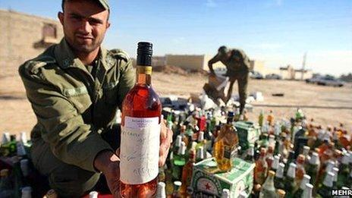
Iran’s Wine Culture
Despite these restrictions, underground wine production continues to preserve elements of Iran’s rich viticultural heritage.
Small-scale efforts by non-Muslim minorities and hidden family operations keep ancient traditions alive.
These clandestine winemakers use techniques passed down for generations, blending modern ingenuity with ancestral knowledge.
Although their production is minimal and often ceremonial, it reflects the resilience of a culture | deeply tied to the vine.
From traditional Armenian wines in the northwest to hidden cellars in historic towns, these efforts honor Iran’s legacy, quietly defying the constraints imposed on a once-thriving practice.
Despite the challenges in identifying Iran's indigenous varietals, underground wine production continues to preserve elements of its vinicultural heritage

Slide 18
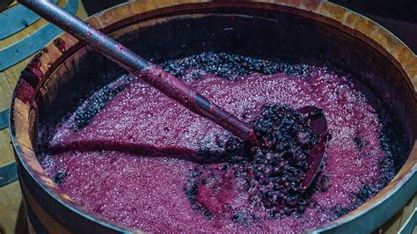
Underground Wine Production in Iran
Clandestine Wine Production Outlets
Given the current legal restrictions, wine production occurs through extremely limited channels:
Armenian Christian Communities
Armenian Christian communities in the northwest produce minimal traditional wines, primarily for religious ceremonies, under heavy governmental scrutiny.
Hidden Family Enterprises
Similarly, hidden family enterprises in historic settlements like Urmia and Isfahan preserve ancestral winemaking techniques but operate on a non-commercial scale.
These efforts are less about commerce and more about preserving Iran’s ancient viticultural legacy against significant legal and cultural barriers.

Slide 19
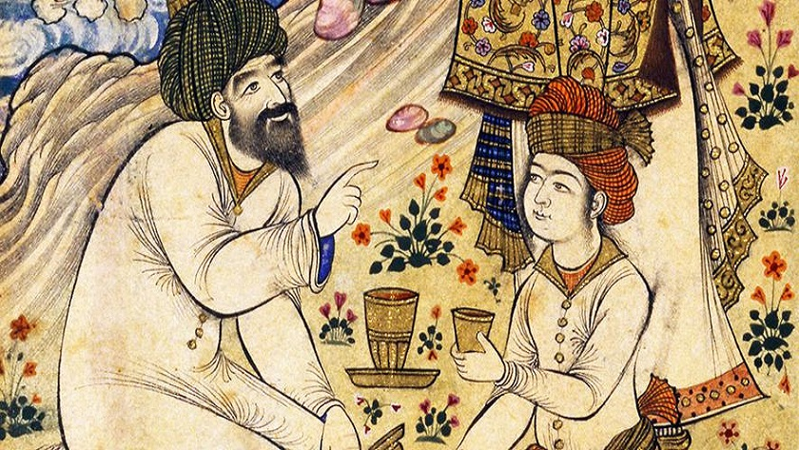
Culture and Traditions
Iran's Wine Culture and Traditions
Wine was more than a drink in ancient Persia—it symbolized refinement and intellect, celebrated in poetry by Omar Khayyam and depicted in miniature paintings. This cultural significance persists through minority communities and historical records.
Celebrated in Persian poetry and art by figures like Omar Khayyam, wine symbolized hospitality and intellectual discourse in Zoroastrian and pre-Islamic traditions.
Persian literature and art often romanticized wine, reflecting its refinement.
Advanced cultivation and fermentation techniques emerged during the Islamic Golden Age, even as cultural interpretations shifted, transforming wine from a celebrated symbol to a prohibited substance.
Today, this rich history lives on through historical records and the practices of minority communities, preserving the legacy of Iran’s profound relationship with viticulture.

Slide 20
Final Thoughts and Conclusion
Iran’s viticultural legacy is a complex tapestry of innovation, tradition, and restriction.
While its geography and history suggest immense potential, current legal and cultural frameworks stifle its ability to reclaim its place on the global wine stage.
Neighboring countries have demonstrated that economic and cultural growth can coexist with tradition, yet Iran remains constrained by its own policies.
The country's fertile lands and rich heritage represent not just untapped economic opportunities but also a chance to reconnect with a cultural identity deeply tied to the vine.
Iran's wine story is one of resilience, where whispers of the past echo through underground cellars and historical texts, while the future of Iran’s wines are still waiting to be rediscovered.

Slide 21
Acknowledgement
My seminars are the result of many years of experience combined with many hours of research over the internet.
I would like to acknowledge the many source I have accessed.
These include Wine Spectator, Wine Enthusiast, BKWine Magazine, Wine & Spirits Magazine, American Vineyard Magazine, The Grapevine Magazine, Wikipedia.com, Britannica.com, and the various Government websites.

Slide 22
Citations and References
Note: This article requires comprehensive research and verification. The content presented is speculative and would need significant scholarly investigation to confirm details about contemporary Iranian wine production.
Recommended Research Sources:
Archaeological journals
Historical texts on Persian agriculture
Contemporary agricultural research
Ethnographic studies of Iranian culture

