Slide 1
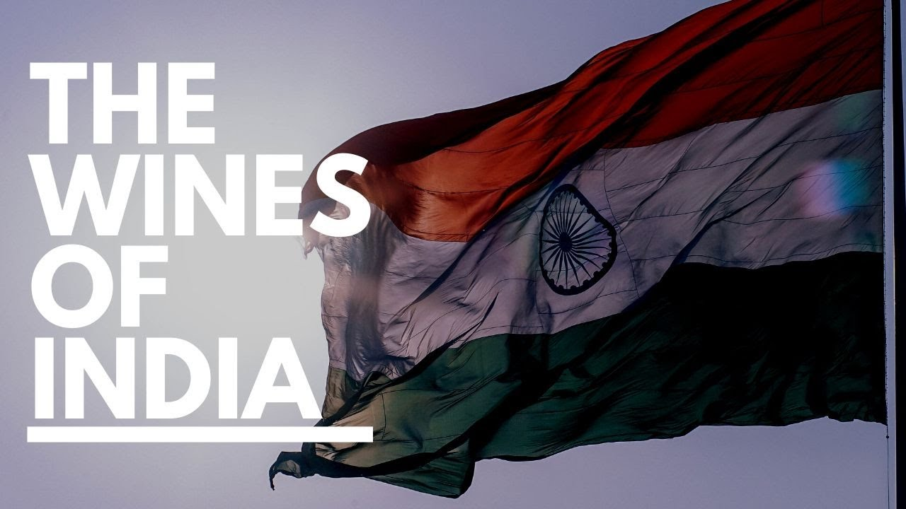
Presented by:
Marc Silver

Slide 2

A Brief History of Indian Wine
India's wine history is as complex and dynamic as the nation itself. It stretches back over 5,000 years to the Indus Valley Civilization, where Persian traders first introduced the concept of viticulture.
While early records of Indian wine drinking are scarce, it is known that by the 4th century BCE, the Maurya Empire's chief advisor,
Chanakya, expressed a disdain for wine,
viewing it as a distraction to the strict
governance required at the time.
This ambivalence toward wine in ancient
India would foreshadow a long, winding
journey for the country’s wine industry.

Slide 3
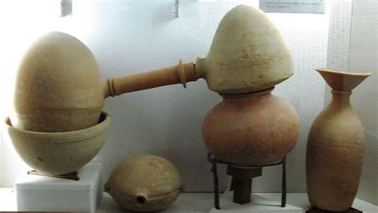
A Brief History of Indian Wine Cont.
Wine production in India faced several obstacles during the Mughal era (16th to 19th centuries), where alcohol consumption was largely prohibited under Islamic law.
Portuguese settlers in Goa kept the wine culture alive by introducing port-style wines, a tradition that remains central to Goa’s identity today. British colonization in the 19th century offered another opportunity for growth.
The British, with their penchant for European wine, encouraged wine production in regions like Baramati, Surat, and Kashmir.
However, the global phylloxera epidemic in the late 19th century, which decimated vineyards worldwide, also affected India, leading to a sharp decline in viticulture.

Slide 4

A Brief History of Indian Wine Cont.
The real death knell for India’s fledgling wine industry came after independence in 1947, when a nationwide prohibition on alcohol severely restricted wine production.
Vineyards were repurposed for table grapes, and it would take several decades before the industry could recover. The 1980s, however, marked the start of a revival.
Fueled by international investment, a growing middle class, and an increasing appreciation for wine, India’s wine industry slowly began to regain its footing.
The real catalyst came in the 1990s, when key players like Sula Vineyards in Nashik took the lead in modernizing the industry, focusing on quality over quantity and fostering a domestic wine culture that had previously been absent.
Today, India’s wine industry is blossoming, with wines that compete on the global stage and a burgeoning wine tourism sector that introduces millions to Indian wines each year.

Slide 5
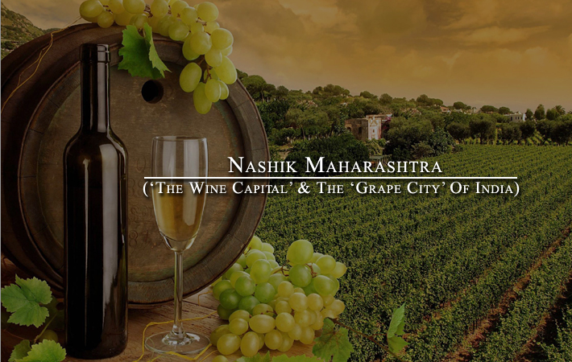
India’s Wine Regions
India’s diverse geography and climate create a unique environment for viticulture, with certain regions standing out as particularly well-suited for wine production. The primary wine regions in India include Maharashtra, Karnataka, Goa, and emerging areas in the north such as Punjab and Himachal Pradesh.
Each region offers distinct terroirs and climates that influence the types of grapes grown and the styles of wine produced.
Maharashtra: The Wine Capital of India
When discussing Indian wine, one cannot begin anywhere other than Maharashtra, home to the country’s most significant wine region, Nashik.
Often referred to as the "Wine Capital of India," Nashik accounts for over 90% of India’s wine production.
Located approximately 100 miles northeast of Mumbai, the region enjoys a favorable climate and altitude that are critical to its success in winemaking.

Slide 6
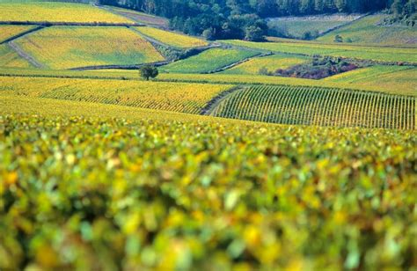
Maharashtra: The Wine Capital of India
Maharashtra’s Terroir and Climate: Nashik sits at around 600–700 meters above sea level in the Western Ghats, benefiting from cooler nighttime temperatures that help preserve acidity in the grapes.
The soils here are primarily volcanic, rich in minerals that impart complexity to the wines.
Nashik also faces challenges from its tropical
climate, especially during the monsoon season
from June to September, which requires
winemakers to adopt innovative practices, such
as double pruning and single cropping.
This technique allows vines to rest during the
rainy season and focus on grape production
during the cooler months from November to
March.

Slide 7


Maharashtra: The Wine Capital of India
Maharashtra Wines:
Varietals such as Shiraz, Sauvignon Blanc, Chenin Blanc, and Cabernet Sauvignon thrive in Nashik.
Shiraz wines here are particularly spicy and robust, often with hints of dark fruit, pepper, and earth, pairing excellently with grilled meats and spicy Indian curries.
Sauvignon Blanc, meanwhile, is citrusy and fresh, offering a perfect match with seafood and lighter vegetarian dishes.
The most iconic wineries in Nashik include Sula.

Slide 8

Maharashtra: The Wine Capital of India
Key Varietals: Maharashtra’s climate is conducive to a variety of grapes, both indigenous and international. Shiraz (Syrah), Chenin Blanc, Sauvignon Blanc, Cabernet Sauvignon, and Zinfandel are the standout varietals in this region.
Shiraz: Known for its rich, peppery profile, Nashik’s Shiraz often features notes of dark fruit, tobacco, and black pepper. These wines are robust and pair beautifully with grilled meats or spicy Indian dishes like tandoori lamb.
Chenin Blanc: A versatile grape, Nashik's Chenin Blanc can range from dry to off-dry styles, featuring flavors of green apple, pear, and honey. It pairs exceptionally well with seafood and spicy vegetarian curries.
Sauvignon Blanc: Bright, zesty, and citrus-forward, Sauvignon Blanc from Nashik offers a refreshing acidity, making it a great match for lighter fare such as grilled fish or salads with citrus dressings.

Slide 9
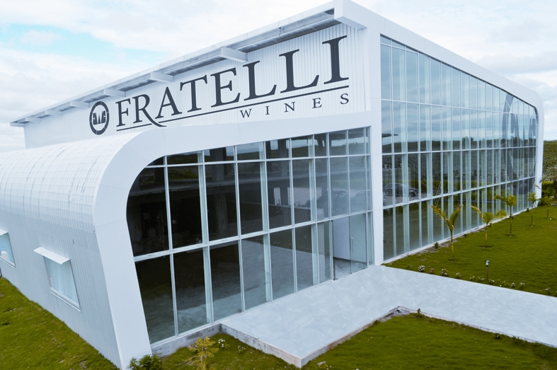
Maharashtra: The Wine Capital of India
Maharashtra Notable Wineries:
Sula Vineyards: A pioneer in Indian wine, Sula was established in 1997 and has grown to become the most recognized name in the Indian wine industry. Known for its Chenin Blanc and Shiraz, Sula's wines reflect the growing sophistication of Indian winemaking. Its Rasa Shiraz, a flagship offering, is celebrated for its deep, complex flavors and aging potential.
Fratelli Wines: Located in Akluj, Fratelli is renowned for its international-style blends, particularly Sette, a premium red blend of Sangiovese and Cabernet Sauvignon. Fratelli focuses on meticulous viticulture, producing wines with remarkable structure and finesse.
York Winery: Situated in the heart of Nashik, York Winery produces well-balanced wines, with its Cabernet Sauvignon and Chardonnay being particularly celebrated for their vibrant fruit flavors and refined acidity.

Slide 10
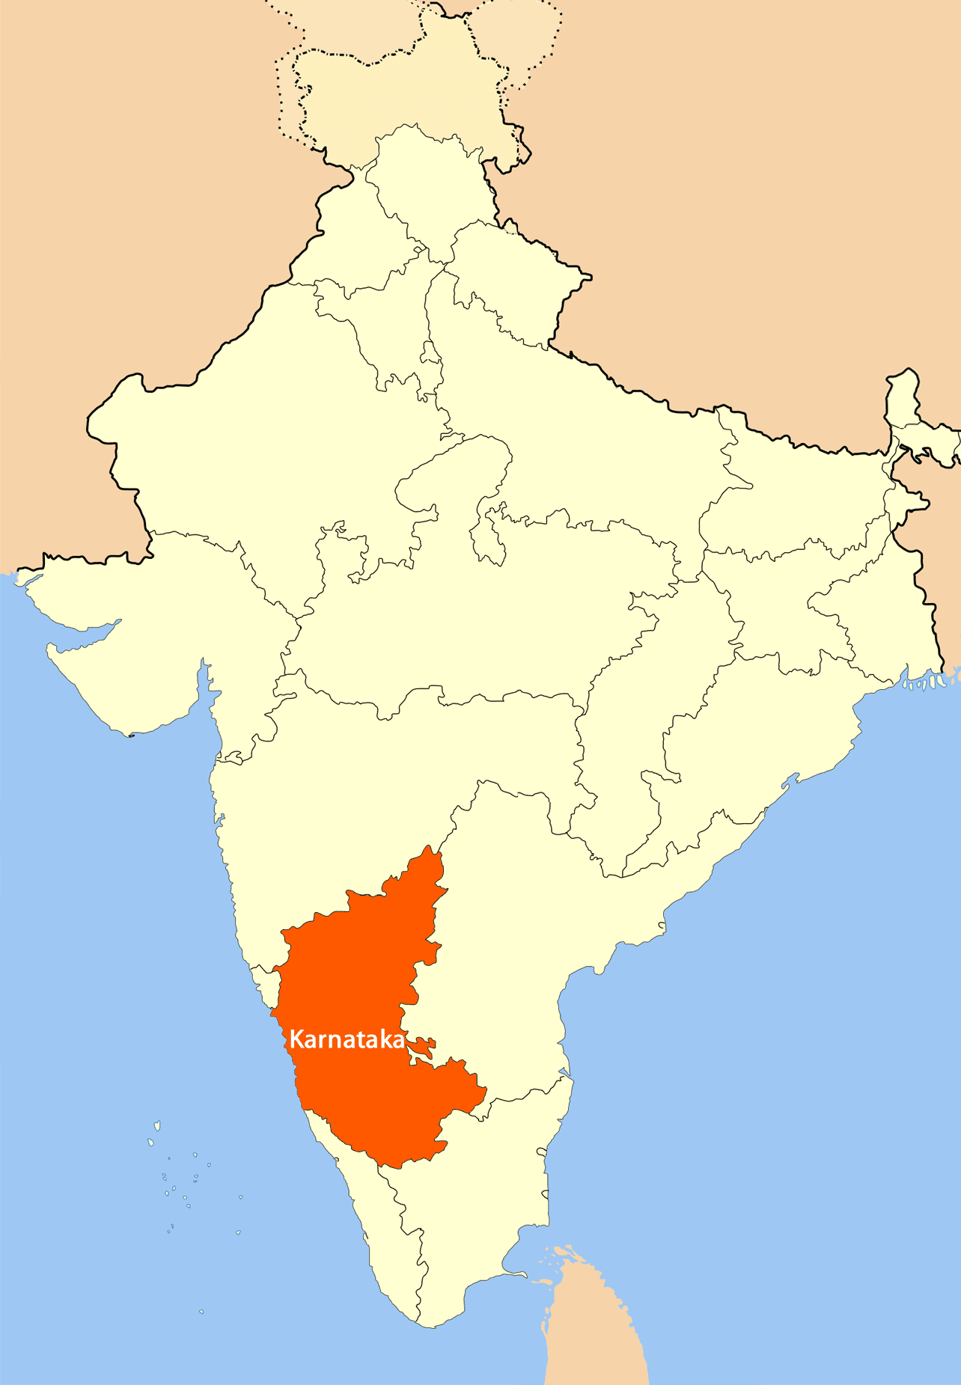
Karnataka: A Rising Star in Indian Wine
Karnataka, located south of Maharashtra, is quickly gaining recognition for its high-quality wines.
The primary wine regions here include Nandi Hills, known for its cooler climate, and Hampi Hills, with its rich volcanic soils.
These regions benefit from their higher altitudes, which temper the heat and allow for a slower, more even ripening process.
Terroir and Climate: At elevations ranging from 600 to 900 meters above sea level, the vineyards in Karnataka enjoy cooler nights that preserve acidity, much like Nashik.
The soils vary from sandy loams to iron-rich red soils, especially in Nandi Hills, where the terroir is often compared to parts of Tuscany due to its scenic landscapes and wine-friendly conditions.

Slide 11
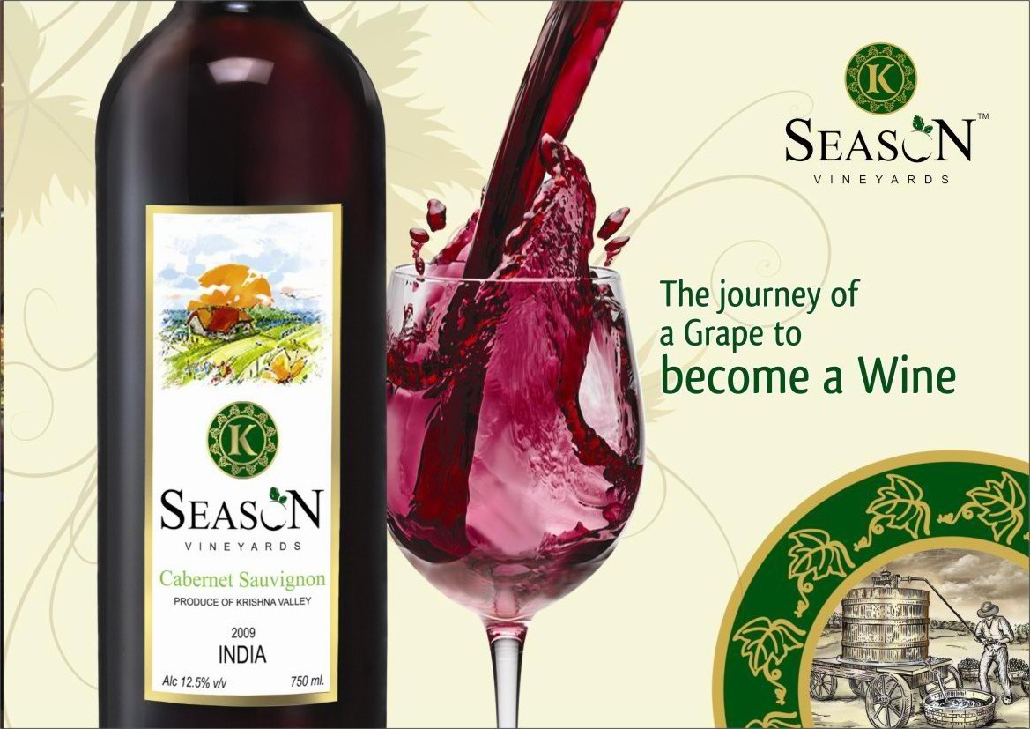
Karnataka: A Rising Star in Indian Wine
Key Varietals:
Cabernet Sauvignon: Known for its firm structure and rich flavors of blackcurrant, cherry, and spices, Karnataka’s Cabernet Sauvignon is full-bodied and age-worthy, often pairing well with hearty dishes like lamb biryani or grilled kebabs.
Viognier: This aromatic white grape flourishes in Karnataka’s cooler climate, producing wines with tropical fruit notes, floral undertones, and a creamy mouthfeel.
Viognier pairs wonderfully with richer Indian dishes such as butter chicken or paneer makhani.

Slide 12
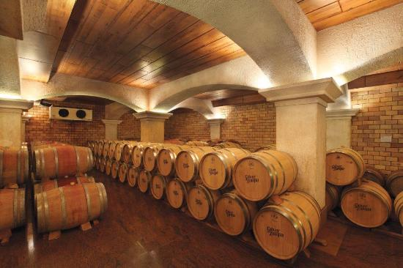
Karnataka: A Rising Star in Indian Wine
Notable Wineries:
Grover Zampa Vineyards: One of India’s most respected wineries, Grover Zampa, located in the Nandi Hills, has been producing premium wines since the early 1990s.
Their La Réserve, a blend of Cabernet Sauvignon and Shiraz, is widely regarded as one of the best red wines in India, known for its deep, complex flavors and smooth finish.
Grover Zampa's focus on French winemaking techniques adds an international flair to their wines.

Slide 13
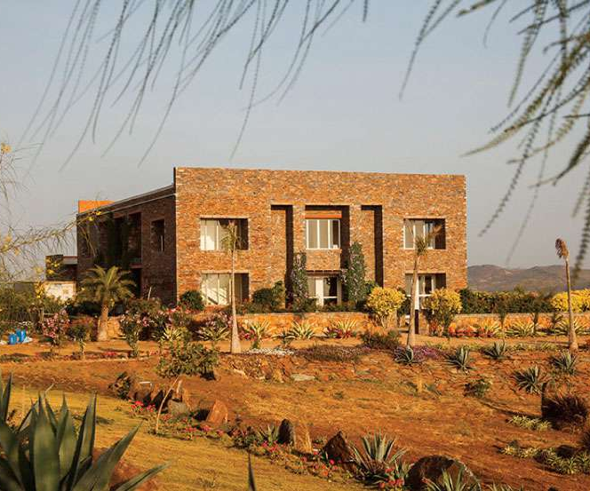
Karnataka: A Rising Star in Indian Wine
Notable Wineries:
Krsma Estates: Near Hampi, Krsma Estates is known for producing small-batch, boutique wines that emphasize quality over quantity.
Their Sangiovese and Cabernet Sauvignon are particularly noteworthy, with the former offering earthy, herbaceous tones and the latter boasting rich, dark fruit flavors.

Slide 14
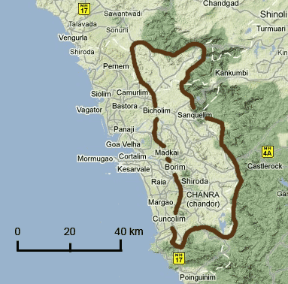
Goa: A Coastal Wine Haven
Goa’s wine culture has deep roots, thanks to its Portuguese colonial past, which introduced fortified, port-style wines to the region.
While Goa’s hot, humid climate is less conducive to large-scale wine production, the region’s wineries have adapted, focusing on niche markets and fortified wines.
Terroir and Climate: Coastal Goa is characterized by sandy soils and high humidity, which can make grape growing challenging.
The region has carved out a niche by focusing on port-style wines and experimenting with varietals like Zinfandel and Chenin Blanc. The warm climate lends itself well to sweeter, fortified wines, which pair perfectly with Goa's spicy, flavorful cuisine.

Slide 15
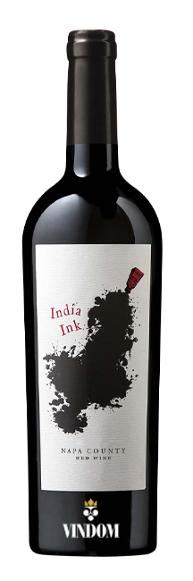

Goa: A Coastal Wine Haven
Key Varietals:
Goan Port: A fortified wine that is often sweet, rich, and full-bodied, Goan port wines are best enjoyed as an aperitif or dessert wine.
They pair beautifully with the region’s bold, spicy dishes like pork vindaloo or prawn balchao.
Zinfandel: Some wineries in Goa are experimenting with Zinfandel, producing lighter, fruit-forward reds that reflect the tropical terroir.

Slide 16
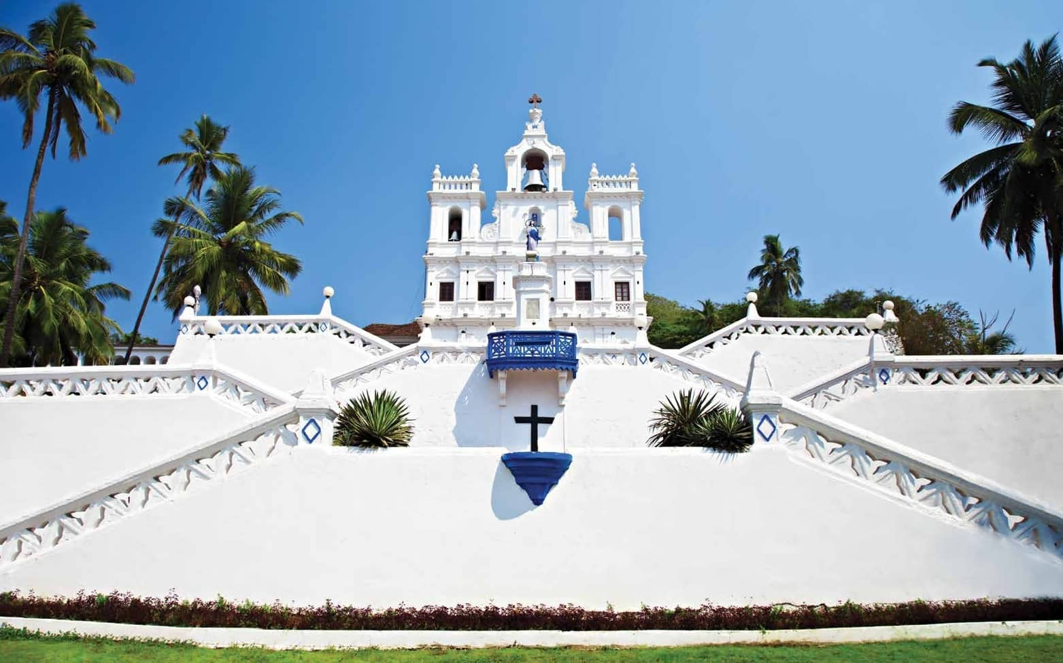
Goa: A Coastal Wine Haven
Notable Wineries:
Susegado Wines: A relatively new winery, Susegado is gaining a reputation for its artisanal, small-batch wines.
Their Chenin Blanc and Zinfandel offer fresh, vibrant flavors, embodying the laid-back, tropical spirit of Goa.
Vinicola Wines: One of Goa’s oldest wineries, Vinicola is known for its port-style wines.
These fortified wines are rich, sweet, and an excellent match for Goan desserts like bebinca.

Slide 17
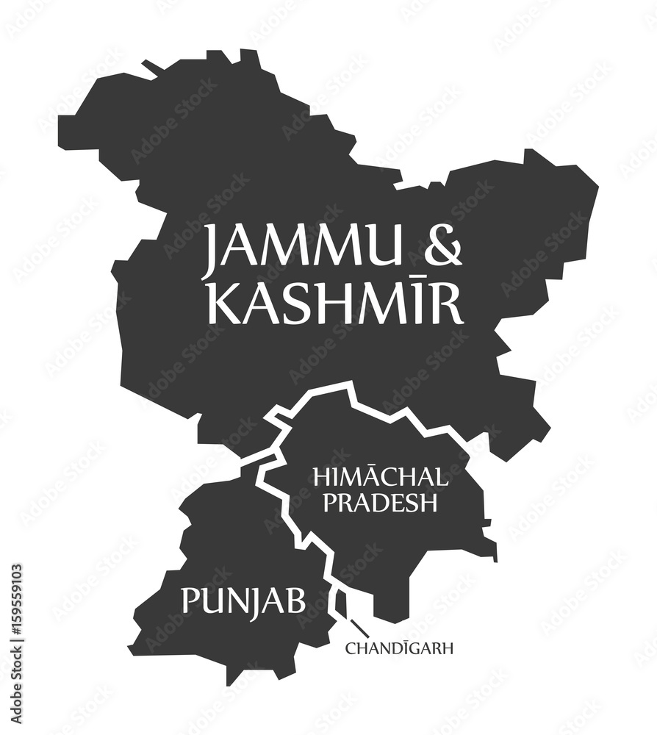
Punjab and Himachal Pradesh
The Northern Frontier
In northern India, Punjab and Himachal Pradesh are emerging as promising wine regions, especially for cooler-climate varietals like Riesling, Pinot Noir, and Chardonnay.
The cooler temperatures and high altitudes offer a stark contrast to the tropical climates of Maharashtra and Karnataka, providing ideal conditions for growing aromatic whites and light-bodied reds.

Slide 18

Punjab and Himachal Pradesh
The Northern Frontier
Terroir and Climate:
Himachal Pradesh’s mountainous vineyards sit at elevations of 1,200 to 1,500 meters above sea level, allowing for slow ripening and the development of complex flavors.
The soils are varied, ranging from gravelly loams to clay, adding to the diversity of wines produced in the region.

Slide 19
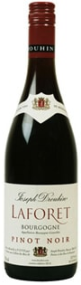
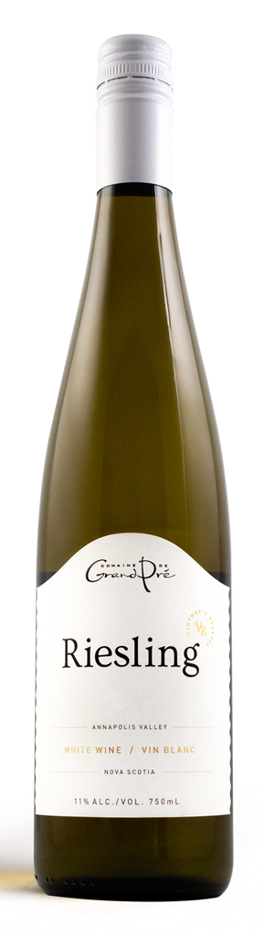
Punjab and Himachal Pradesh
The Northern Frontier
Key Varietals:
Riesling: Himachal’s cool climate is perfect for Riesling, a grape that thrives in colder temperatures.
The region’s Rieslings are known for their crisp acidity and floral aromas, with flavors of green apple, peach, and honey.
These wines pair well with light, delicate dishes such as steamed fish or salads.
Pinot Noir: Still in its early stages of production, Pinot Noir from Himachal Pradesh shows promise with its light body, bright acidity, and flavors of red berries and earthy undertones. It is a natural match for grilled vegetables or roasted chicken.

Slide 20


Punjab and Himachal Pradesh
The Northern Frontier
Notable Wineries:
Chateau Indage: One of India’s oldest wineries, Chateau Indage is known for experimenting with cool-climate varietals in Himachal Pradesh. Their sparkling wines, made from Chardonnay and Pinot Noir, are particularly noteworthy, offering a crisp, refreshing alternative to India’s typically warmer climate wines.
Himachal Vineyards: A boutique winery in the Kullu Valley, Himachal Vineyards is focused on producing high-quality Riesling and Sauvignon Blanc, with an emphasis on organic farming and sustainable practices.

Slide 21

Indian Wine’s Global Ambition
India’s wine industry is still young compared to Old World wine giants like France or Italy, but it is rapidly evolving.
In the last decade, Indian wines have begun to receive international recognition, with some even winning awards at global wine competitions.

Slide 22

Conclusion
Indian Wine’s Bright Future
India’s wine industry has come a long way from its ancient roots, surviving centuries of prohibition, colonial influence, and environmental challenges.
Today, with regions like Maharashtra, Karnataka, and Goa leading the way, and emerging areas like Himachal Pradesh showing great promise, Indian wine is carving out a unique identity on the global stage.
The country’s diverse terroir, innovative
winemakers, and growing appreciation
for quality wines are all contributing to
a renaissance in Indian viticulture.

Slide 23

Conclusion
Indian Wine’s Bright Future
As international recognition grows and domestic wine culture flourishes, India is set to become a significant player in the global wine industry.
Whether it’s a bold Shiraz from Nashik, a refined Cabernet from Karnataka, or a crisp Riesling from Himachal Pradesh, Indian wines now offer a diversity of styles and flavors that reflect the country’s rich cultural and geographical tapestry.
With continued innovation and a focus on quality, the future of Indian wine is undoubtedly bright, promising new flavors and experiences for wine lovers both in India and around the world.

Slide 24
Acknowledgement
My seminars are the result of many years of experience combined with many hours of research over the internet.
I would like to acknowledge the many source I have accessed.
These include Wine Spectator, Wine Enthusiast, BKWine Magazine, Wine & Spirits Magazine, American Vineyard Magazine, The Grapevine Magazine, Wikipedia.com, Britannica.com, and the
various Government websites.

Slide 25
References
Wine Enthusiast - Provides insights into the modern Indian wine industry, including consumer trends and the cultural shift towards wine consumption in India.
Wine-Searcher - Contains detailed information about India’s wine regions, grape varietals, and notable wineries. It also offers specific data on Maharashtra’s significance within the Indian wine industry.
The Back Label - Offers an in-depth guide to India’s various wine regions, detailing their terroir, climatic conditions, and the types of grapes that thrive there.
Grover Zampa Vineyards Website - Shares specific information on the winery’s history, their flagship wines, and their approach to winemaking.
Sula Vineyards Website - Provides data on the company’s contributions to India’s wine culture, their varietals, and their leading role in promoting wine tourism in India.
Fratelli Wines Website - Includes detailed descriptions of their premium wines like Sette, and the international collaborations that influence their winemaking style.
Vinicola Wines - Features information about Goa’s famous port-style wines and the role of Portuguese influence on winemaking in the region.
Wine Enthusiast, 2024. “India’s Wine Culture Is Shifting Dramatically.”
Wine-Searcher, 2022. “Maharashtra Wine Region.”
The Back Label, 2023. "A Guide to India’s Wine Regions."

