Slide 1

Ibiza Spain
Port Presentation
Presented by
Marc Silver

Slide 2
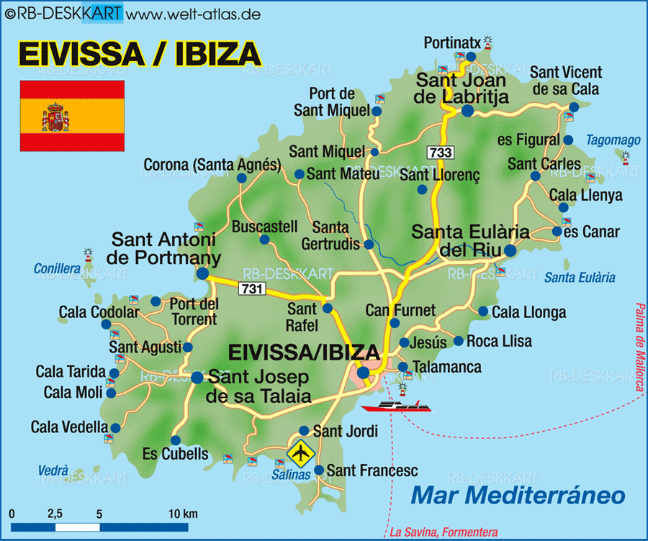
Ibiza Spain
Ibiza is a multifaceted Balearic Island known globally for its intense summer club scene, but it also offers a rich ancient history (including a UNESCO site), stunning natural beauty, distinct towns, a peaceful off-season atmosphere with spiritual roots, and a unique local Catalan culture,
creating a fascinating duality.
It’s Climate:
Midsummer temps: high 70s to low 80s °F / mid‑20s °C.
Spring and autumn are warm and comfortable.
Sunscreen and a hat are must-haves—sun shines most days.

Slide 3
What I Will Cover
What I Will Cover
My Port Philosophy
Don’t Miss the Ship
Money
Where is the Tourist Office?
A few interesting facts about Cadiz.
Places to see or at least consider
A few restaurant recommendations
Best way to get around Cadiz

Slide 4
My Port Philosophy
I have been cruising for over 45 years and have taken over 100 cruises.
So, I consider myself an experienced cruiser.
The information I will present is based on those many years of experience.
When I am on a cruise where the city I want to visit is not the port city, I always recommend taking a ship’s tour.
But when I am in a port with multiple attractions nearby and easy to see on my own -
I will do it on my own.
This presentation is for that type of port.

Slide 5
Don’t Miss the Ship
How to Avoid Missing Your Ship:
Pay attention to the time. - Ship time and local time are often different.
Put a return-to-ship reminder on your phone.
Choose excursions wisely:
If a ship-sponsored excursion is late returning to port, the ship will wait, but not for excursions taken on your own.
Be Prepared:
Have your Passport, Credit Card, and phone numbers for the ship port agent.
What to Do If You Miss the Ship:
Most cruise lines have port agents stationed in the port area to assist if your ship has left without you. Sometimes, when cruisers are late returning to the vessel, the ship's crew may remove the passengers' essential items -- passports, cell phones, and medication -- from the ship to leave with the port agents.
The Port Officials can help you with contacting your ship
and making necessary travel arrangements.

Slide 6

Money
The euro is the official currency of 20 European Union countries which collectively make up the euro area, also known as the eurozone.
Official Exchange is $1 to $1.079 US
Cards accepted almost everywhere; bring cash for local markets and small cafés. A drink in Dalt Vila or a beach bar will cost you a bit more, especially the more scenic spots.

Slide 7
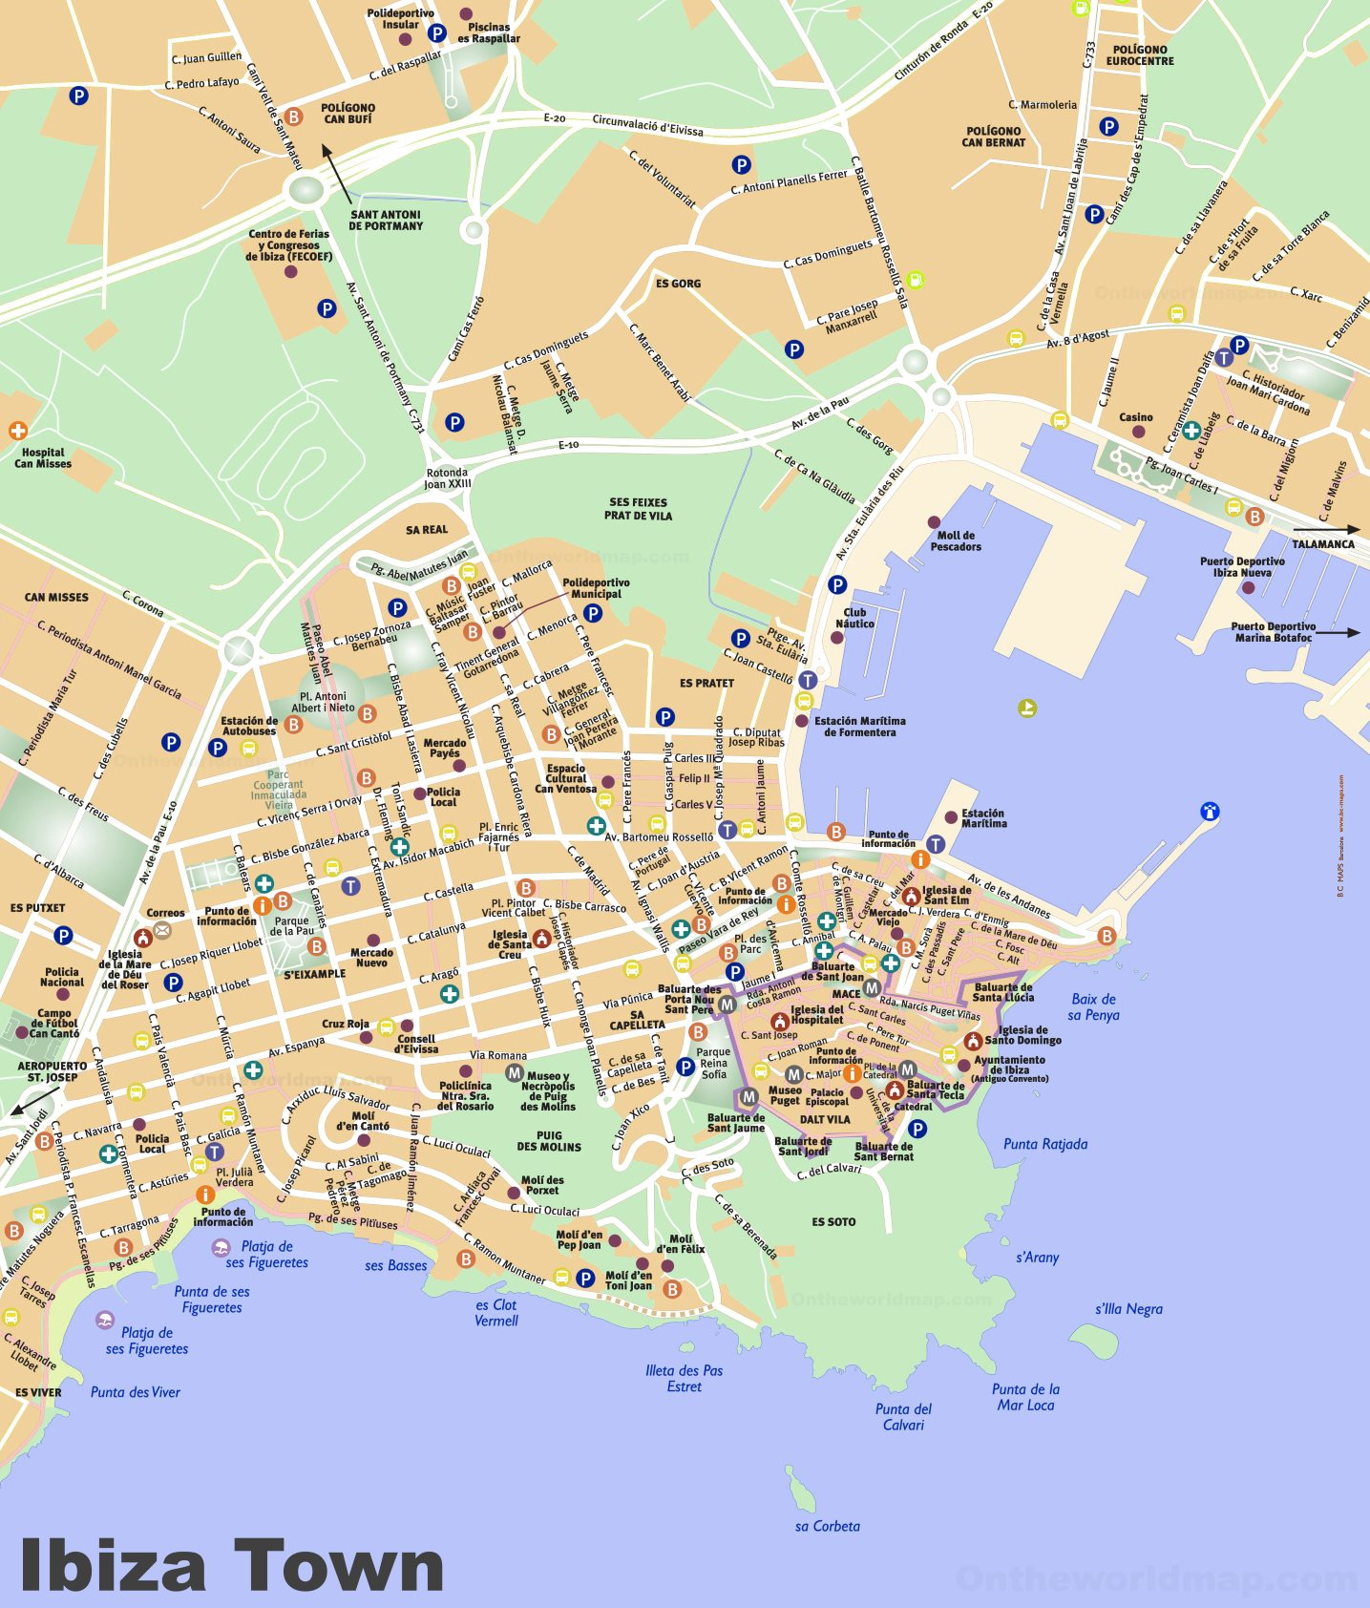
Things You Should Know
Ibiza Town, known locally as Eivissa, is a UNESCO‑listed site with roots back to the Phoenicians (~650 BC)
The fortified Dalt Vila (Old Town) remains one of Europe’s best-preserved medieval citadel.
The crystal-clear Mediterranean waters—especially around Talamanca beach—offer great snorkeling opportunities over ancient seagrass meadows.

Slide 8
Ibiza’s History
Ibiza's (Eivissa's) history spans millennia, defined by its strategic Mediterranean location. Founded by Phoenician settlers around 654 BC as Ibossim, it became a vital trading post. Carthage later expanded it significantly. After the Punic Wars, it fell under Roman rule.
Following the Roman Empire's decline, it endured brief Vandal and Byzantine periods before becoming part of the Islamic Caliphate in 902 AD, heavily influencing agriculture and language.

Slide 9
Ibiza’s History
The Catalan conquest in 1235 AD, led by King Jaume I, integrated it into the Crown of Aragon, establishing the Catalan language and culture still present today.
Its exposed position made it a target for pirates, prompting the massive Renaissance fortification of Dalt Vila (Upper Town) in the 16th century – now a UNESCO World Heritage Site. For centuries, it was relatively isolated. The 20th century saw transformation: attracting artists and hippies in the 1960s, evolving into the world-renowned electronic music and club destination it is today, while retaining its ancient heart and unique identity.

Slide 10
Walking Tour
Dalt Vila's History & Charm (Starting at Cruise Dock)
Theme: History, Panoramic Views, Local Culture
Distance: Approx. 2-3 km (moderate inclines, steps involved)
Duration: 1.5 - 2 hours (allows for photo stops & brief browsing)
Difficulty: Moderate (due to cobblestones, stairs, and hills)
End Point: Close to the port, near Plaça de la Vila.
Start: Cruise Ship Terminal (Portal de la Mar)
  Exit the terminal and walk directly towards the imposing medieval walls of Dalt Vila (Upper Town).
  Immediately see the Portal de ses Taules, the city main gate.
Portal de ses Taules & Drawbridge (5 mins)
  Walk through this grand Renaissance entrance (built 1585). Notice the Roman statue replicas atop the gate and the original drawbridge mechanism grooves.
  Photo Op: The iconic view looking back towards the port and modern town.

Slide 11
Walking Tour
Carrer Major (Main Street) & Plaça de la Vila (15 mins)
  Ascend the charming, sloping Carrer Major, lined with boutiques, art galleries, and cafes housed in historic buildings.
  Reach Plaça de la Vila, the main square of the old town.
  See: The 15th-century Ajuntament (Town Hall) building.
  Feel: Soak in the authentic Ibizan vibe. Grab a quick coffee or ice cream here if desired.
Catedral d'Eivissa (Ibiza Cathedral) (15 mins)
  Continue uphill from the square along Carrer de la Cúria.
  Reach the Cathedral of Our Lady of the Snows
  See: The impressive Gothic-Catalan facade (14th century, modified later). Step inside briefly for the serene atmosphere and views over the nave.
  Viewpoint: The plaza in front offers stunning vistas over the lower town and sea.

Slide 12
Walking Tour
Castle & Archaeological Museum - Exterior (15 mins)
  Walk behind the Cathedral to the highest point.
  See: The imposing Castell d'Eivissa (Castle), primarily military buildings from different eras. (Note: Interior access often requires more time/tickets).
  See: The Museu Arqueològic d'Eivissa i Formentera building (housed in the former University). Admire the architecture; peek into the courtyard if accessible.
  Viewpoint: The absolute best panoramic views on the island! See the port, Formentera island, the modern town, and the surrounding countryside. Allow time here.
Baluard de Santa Llúcia (Bastion) (10 mins)
  Walk along the ramparts towards the Baluard de Santa Llúcia.
  See: Marvel at the massive Renaissance fortifications designed by Italian engineer Calvi. Look down at the dropoff to the sea.

Slide 13
Walking Tour
Hippodrome & Descend via Ramparts (15 mins)
  Continue walking the walls towards the Hippodrome area (near Portal Nou).
  See: Imagine chariot races in Roman times! Interpretive panels explain the history.
  Begin your descent, following the outer path along the walls. Enjoy different perspectives of the town and port below.
Portal Nou & Return to Port (15 mins)
  Pass through or near Portal Nou, another historic gate.
  Follow the path downwards, either skirting the base of the walls or taking a parallel street like Carrer de Sant Ciriac.
  You'll emerge near the Marina area, filled with yachts and waterfront cafes/restaurants.
  Stroll along the Passeig Marítim (waterfront promenade) back towards the cruise terminal. End: Back at the Cruise Terminal.

Slide 14
Key Considerations & Tips
Footwear: Essential! Wear very comfortable, sturdy walking shoes with good grip. Cobblestones are uneven and can be slippery.
Sun Protection: Hat, sunglasses, and high-SPF sunscreen are crucial, even in spring/autumn. Shade is limited on the ramparts.
Water: Bring a bottle, especially in warmer months.
Pace: This tour involves significant uphill walking and steps, especially at the start. Take it slow and enjoy the views.
Shopping/Breaks: Allow extra time if you want to browse shops in Carrer Major or linger at a cafe in Plaça de la Vila.
Museums: Entering the Cathedral is usually quick and free. The Archaeological Museum and Castle interior require more time (likely exceeding 2 hours). This tour focuses on the exterior and views.
Flexibility: You can shorten the ramparts walk slightly if time is tight, but don't miss the main viewpoints near the Cathedral and Castle.

Slide 15
Irresistible Spots

Slide 16
Castles and Cathedrals
From the 16th-century star-shaped Castle of Santa Catalina to the beautiful 18th-century Cadiz Cathedral to the 18th-century Torre Tavira (the best viewpoint in the city), there are more than enough historical spots in Cadiz.
Castle of Santa Catalina

Slide 17
Castles and Cathedrals
From the 16th-century star-shaped Castle of Santa Catalina to the beautiful 18th-century Cadiz Cathedral to the 18th-century Torre Tavira (the best viewpoint in the city), there are more than enough historical spots in Cadiz.
Cadiz Cathedral

Slide 18
Castles and Cathedrals
From the 16th-century star-shaped Castle of Santa Catalina to the beautiful 18th-century Cadiz Cathedral to the 18th-century Torre Tavira (the best viewpoint in the city), there are more than enough historical spots in Cadiz.
Torre Tavira

Slide 19
Home to Amazing Restaurants
Ibiza has a wide variety of restaurants of extraordinary quality offering fresh, natural products, such as fish and seafood, or traditional dishes such as seafood rice or bullit de peix.
There are also restaurants that offer typical Ibizan dishes made primarily with meat. For example, "arròs de matances" (rice from the slaughter of pigs), "frita de porc" (fried pork), and "sofrit pagès" (sofrit pagès), hearty recipes from the local cuisine.
Ibizan pastries are also very elaborate. Typical desserts include "flaó" (a delicious cake made with goat and sheep cheese and mint), "greixonera" (a pudding made with ensaimadas, milk, and egg), and it is customary to enjoy "orelletes" (small ear-shaped pastries) at social gatherings.

Slide 20
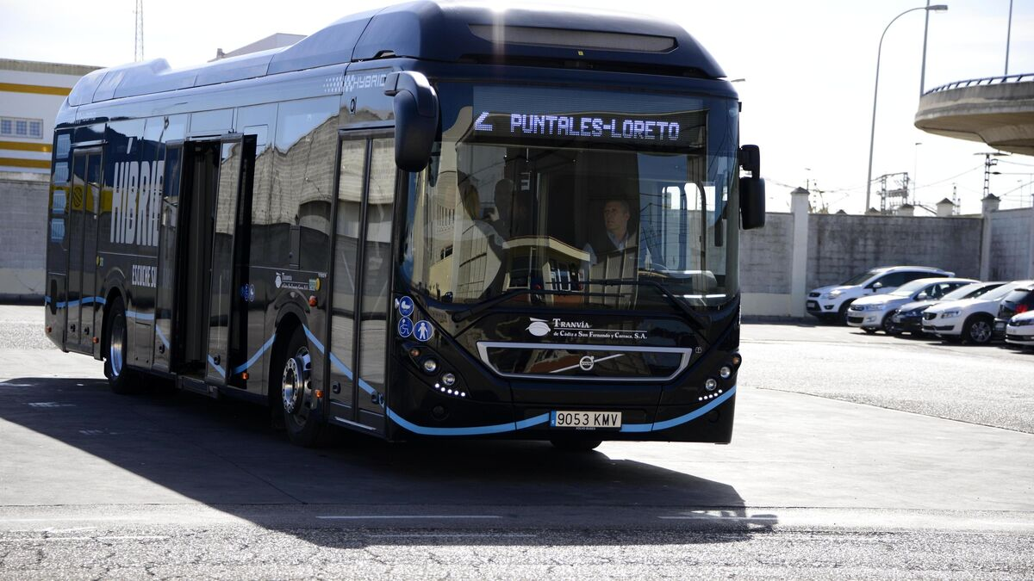
Getting Around Cadiz
For the most part Cadiz is an easy city to walk, but for those who want to avoid exercise as much as possible, There are the city buses run by Urbanos de Cádiz. There are 5 lines with fairly new buses and all have air conditioning.
City bus cost of a single journey is 1,10€. Changing bus is permitted within 45minutes.
You can also buy a 'Bonobus’ from newsagent kiosks for 7€ for ten journeys.

Slide 21
Thanks For Coming
If you have any more questions, Please ask.
I will do my best to answer them for you.
Have a great visit in Cádiz!

