Slide 1
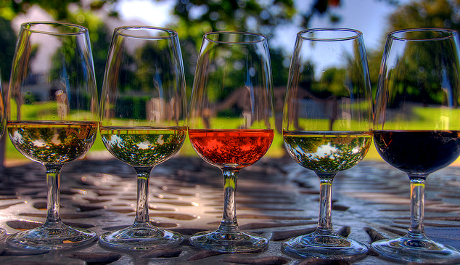
Hungarian Wine A Journey Through History Presented by Marc Silver

Slide 2
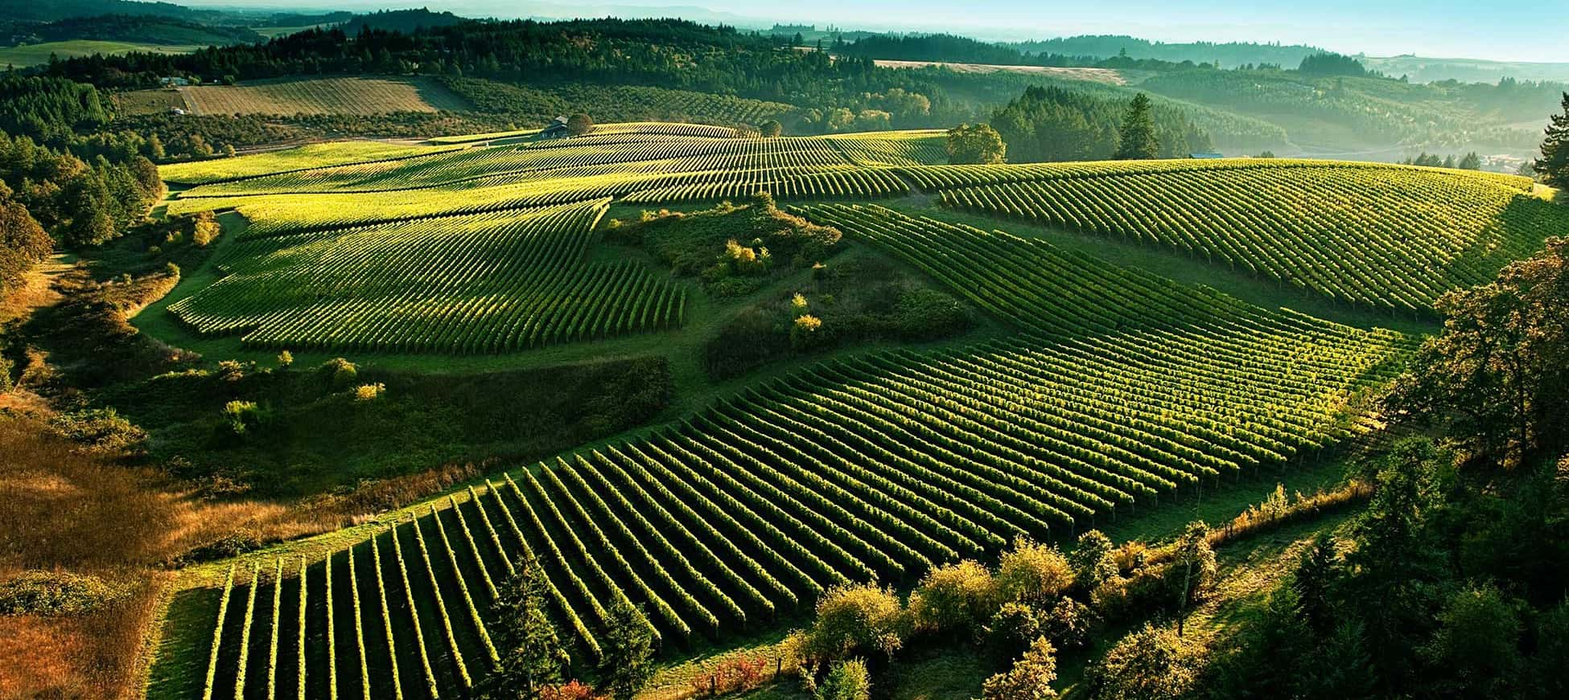
Tradition Meets Innovation
Hungary, though often overshadowed by its Western European counterparts, has a rich winemaking tradition that dates back over a thousand years.
Wine has been a central part of Hungarian culture since Roman times, evolving through centuries of political and environmental change.
Today, Hungary is regaining its place in the global wine scene, with a diverse range of wines characterized by its unique terroir.

Slide 3
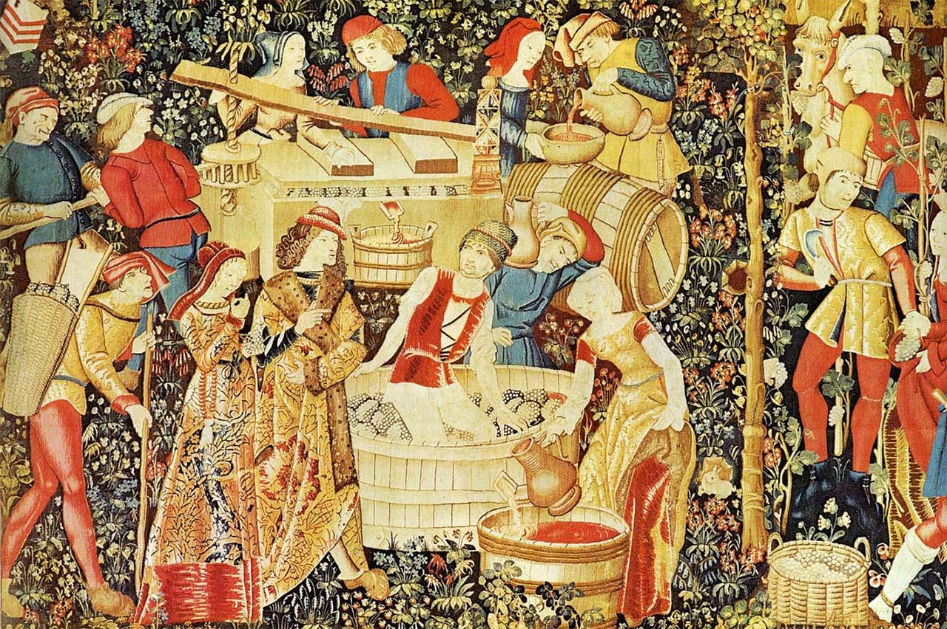
A Brief History of Hungarian Wine
Hungary's winemaking history stretches over 1,000 years, starting with the Roman Empire, which introduced vine cultivation in the Pannonian Basin, the heart of modern-day Hungary. This laid the foundation for one of Europe’s most renowned winemaking traditions.
In the Middle Ages, particularly during the 12th century under King Béla IV, the industry began to flourish as French and Italian monks introduced advanced viticultural techniques. Hungary's vineyards expanded, and new grape varieties were introduced, setting the stage for Hungary’s golden age of winemaking during th Renaissance.
It was during this period that Tokaji Aszú, the country's most famous sweet wine, gained international acclaim. By the early 18th century, Louis XIV of France praised Tokaji as “the wine of kings, and the king of wines,” cementing its reputation among European royalty.

Slide 4
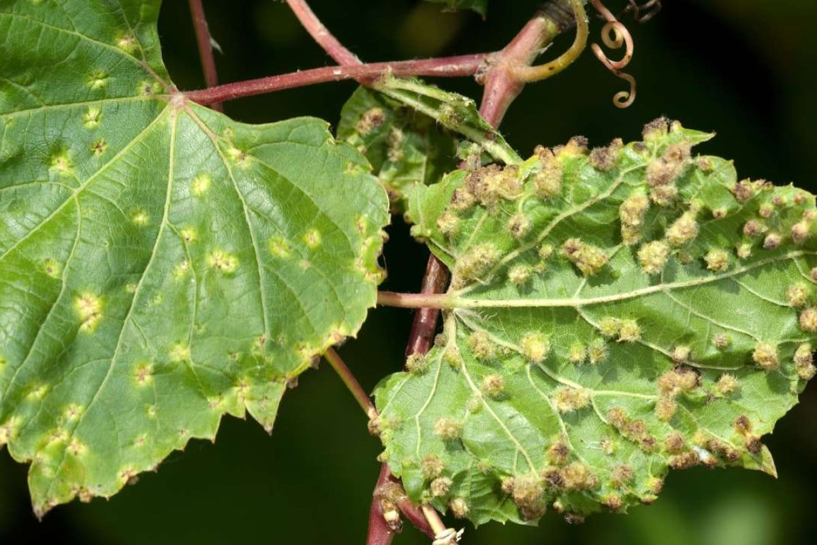
A Brief History of Hungarian Wine
The 19th century brought phylloxera, the vine disease that devastated vineyards across Europe. Hungary’s vineyards were no exception, and the wine industry took decades to recover. The post-World War II communist era further stifled the industry, as collectivization and state control prioritized quantity over quality.
Since the fall of communism in 1989, Hungary’s winemakers have revived traditional methods while embracing modern techniques.
This has led to a renaissance in Hungarian winemaking, and today, the country produces world-class wines that compete on the international stage.

Slide 5
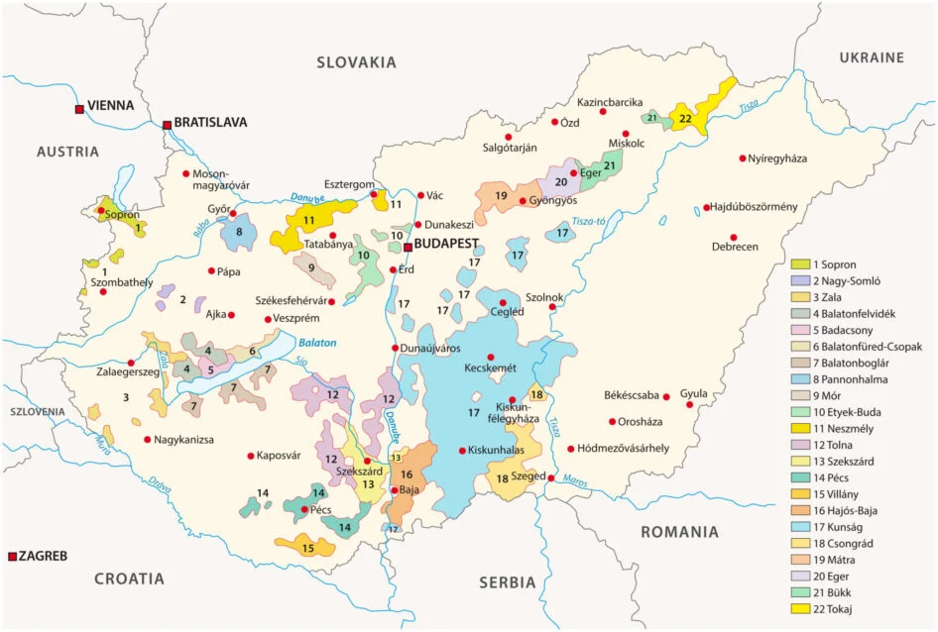
Hungary’s Unique Terroir
Hungary’s terroir is as varied as its wines. The country lies at the crossroads of Europe, between the continental and Mediterranean climate zones, with a diverse landscape of rolling hills, river valleys, and volcanic mountains.
The country’s location at the crossroads of Mediterranean and continental climates creates a perfect balance of warm summers and cold winters, with long, sunny autumns that are ideal for ripening grapes.
The country’s wine regions are scattered across 22 wine appellations, each with distinct climates and soils that lend unique characteristics to the wines.

Slide 6
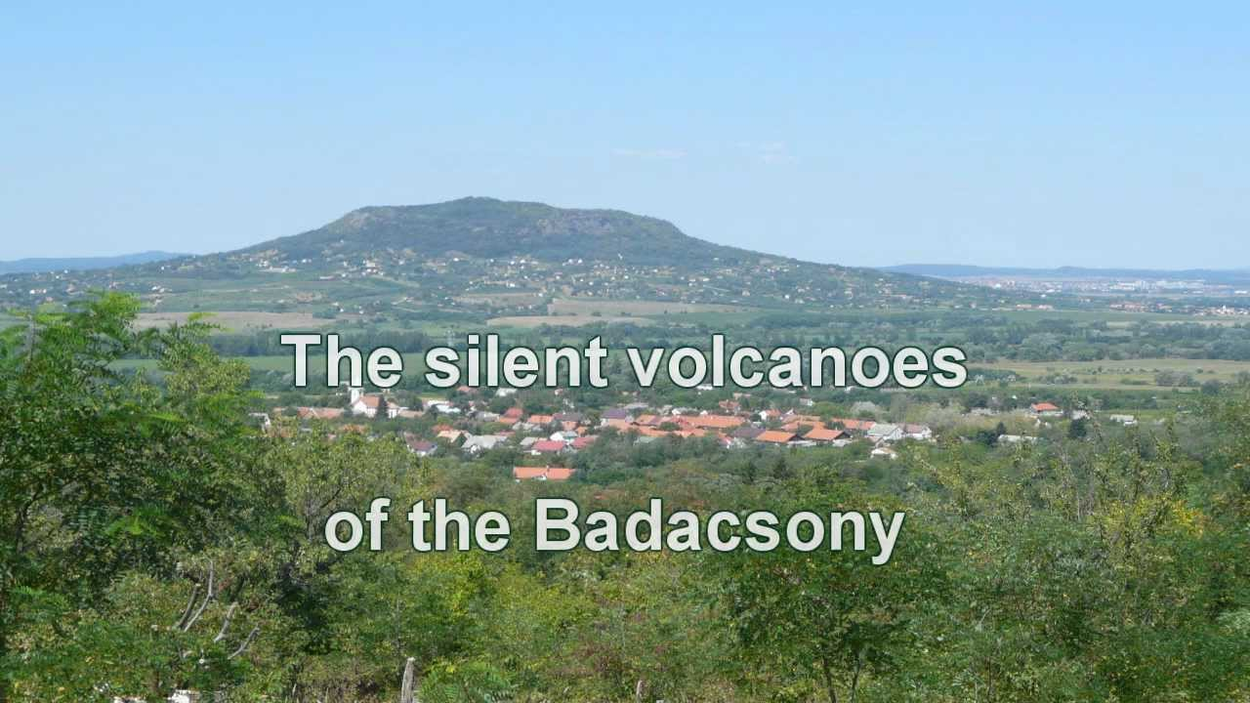
Hungary’s Unique Terroir
The terroir in Hungary is heavily influenced by volcanic soils, which are found in regions such as Tokaj, Somló, and Badacsony.
These soils contribute to the minerality and complexity of many Hungarian wines.
Additionally, the presence of rivers like the Danube and Tisza creates microclimates conducive to viticulture, especially for the production of botrytized (noble rot) wines.

Slide 7
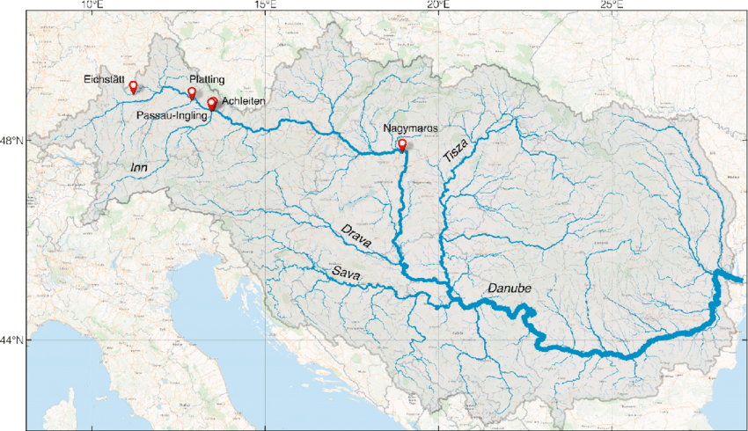
Hungary’s Unique Terroir
What makes Hungarian wines stand out is their terroir—a French term encompassing the climate, soil, and geography that influence the character of a wine.
Hungary’s wine regions are also influenced by the proximity to rivers like the Danube and Tisza, which create microclimates that are particularly conducive to botrytized wines, such as those from Tokaj.
Additionally, volcanic soils in regions like Tokaj and Somló impart a distinctive minerality and complexity to the wines, making them truly unique.

Slide 8
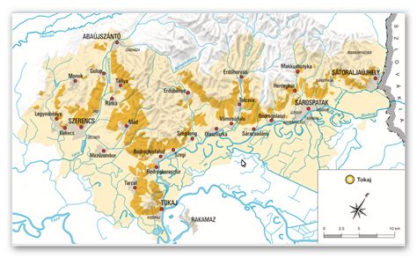
Hungary’s Wine Regions
Hungary’s diverse landscape and climate have shaped a rich variety of wine regions, each with its own unique characteristics, grape varieties, and winemaking traditions.
These regions are deeply rooted in the country's history, with many dating back centuries and producing wines that are celebrated both locally and internationally.

Slide 9
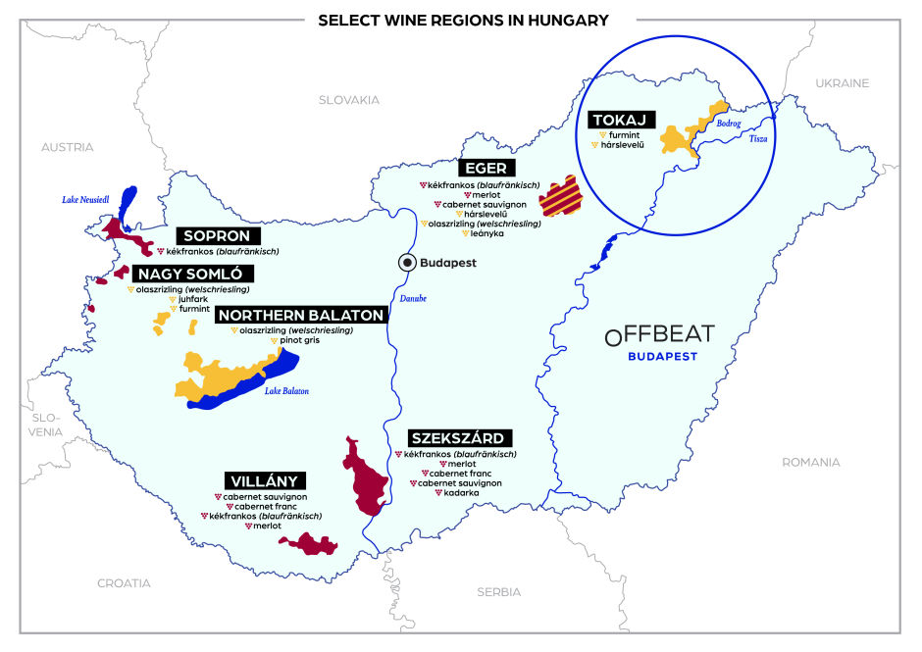
Hungary’s Wine Regions
Hungary is perhaps most famously known for its Tokaj region, home to the legendary sweet wine Tokaji Aszú.
However, beyond Tokaj, Hungary boasts numerous other regions that produce a wide array of wines, from bold reds to crisp whites, and everything in between.
Regions like Eger, Villány, and Szekszárd have gained recognition for their robust reds, while Somló and Badacsony offer distinct, mineral-rich white wines.

Slide 10
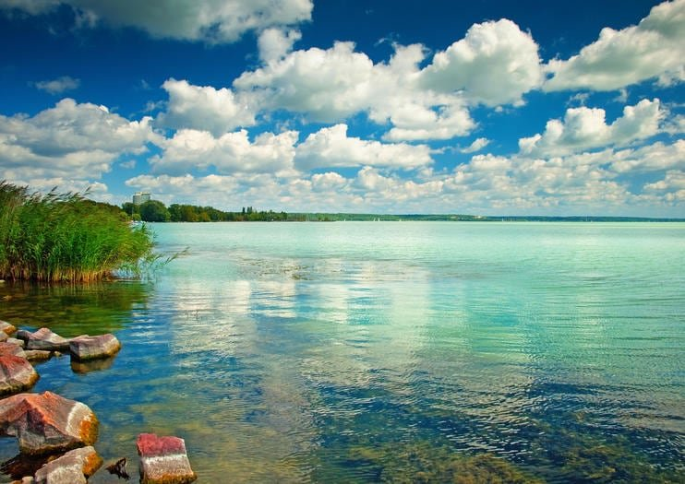
Hungary’s Wine Regions
The country’s varied topography—from volcanic hills and limestone soils to river valleys—combined with its continental climate, creates ideal conditions for viticulture.
Whether it’s the cooling winds of Lake Balaton influencing the surrounding vineyards or the sun-soaked southern slopes of Villány, each region has its own microclimate that contributes to the distinctive flavors and styles of the wines.
Lake Balaton
In the following sections, we will explore a few of these regions, looking at their history, terroir, and the wines that have made them stand out in Hungary’s thriving wine culture.

Slide 11
The Major Wine Regions of Hungary
Tokaj-Hegyalja
Location: Northeastern Hungary, nestled between the Tisza and Bodrog Rivers.
Terroir: Volcanic soils, long warm autumns, and the influence of river mists create perfect conditions for noble rot.
Prominent Varietals: Furmint, Hárslevelű, Muscat Blanc, Zéta.
Wine Characteristics: Tokaj is world-famous for Tokaji Aszú, a botrytized sweet wine with intense flavors of apricot, honey, and spices. Dry Furmints from Tokaj are highly mineral-driven, with bright acidity and flavors of green apple and stone fruits.
Tasting Notes: Tokaji Aszú is luscious, with flavors of candied citrus, apricots, and honey. It pairs beautifully with foie gras, blue cheese, or desserts. Dry Furmint, on the other hand, is crisp and refreshing, perfect for pairing with seafood.

Slide 12
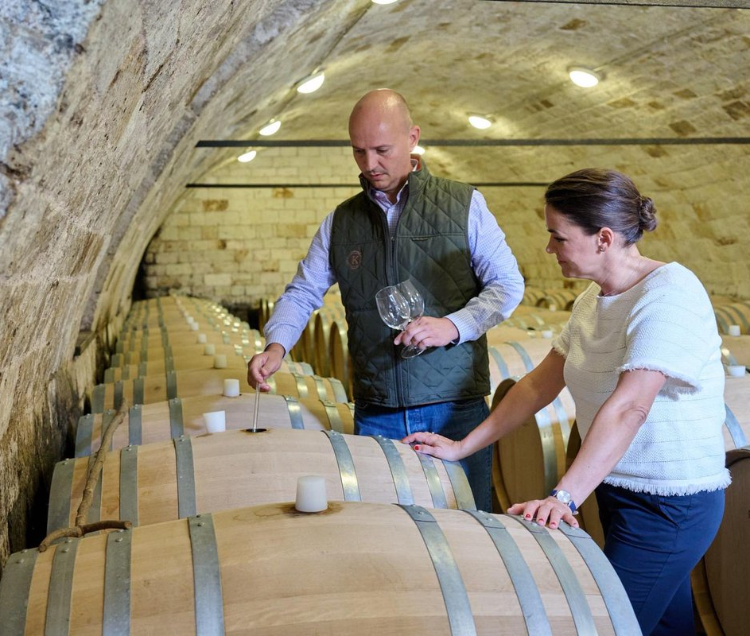
Tokaj-Hegyalja Notable Winery
István Szepsy Winery:
The Szepsy family, renowned winemakers in Hungary's Tokaj region since the late 16th century, are credited with creating the first Tokaji Aszú wine in 1631.
István Szepsy carries the same surname as the ancestor who pioneered the complex Aszú technique, which involves the labor-intensive hand-picking of noble rot-affected berries. This method helped put Tokaji on the map, and the wine was famously praised by French king Louis XV as the "wine of kings and king of wines."
Today, István continues this rich legacy, managing 52 hectares of vineyards around the town of Mád. The volcanic soil, rich in quartz and clay, provides the ideal terroir for local grapes such as Furmint, a variety the Szepsy family has explored extensively over the years.
István’s dedication to winemaking played a crucial role in restoring Tokaj's former glory. His expertise has earned him accolades both in Hungary and France.

Slide 13
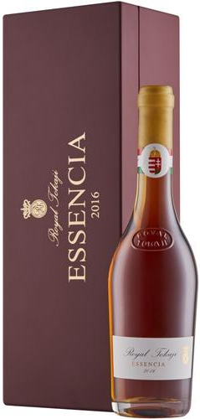
Royal Tokaji Notable Winery
Royal Tokaji specializes in the production of the world-famous Tokaji Aszú wines. Established in 1990, the winery played a pivotal role in revitalizing Tokaj's reputation as a premier wine region after the fall of communism.
Royal Tokaji is celebrated for its meticulous approach to crafting sweet wines made from grapes affected by noble rot, particularly Furmint, Hárslevelű, and Muscat. Their wines are known for their exceptional complexity, balance, and longevity, and have earned international acclaim for preserving the rich winemaking traditions of Tokaj while appealing to modern palates.
Wine Enthusiast Magazine has given their Royal Tokaji 2016 Essencia Furmint (Tokaj) 99 pts. “Luxurious enough to be poured onto a spoon rather than in a glass—and Royal Tokaji had crystal sipping spoons designed for this very purpose—Essencia is a marvel no matter how you serve or sip it. Ripe and stewed figs headline the aromas, with notes of clementine, white peach and lemon verbena. The palate is structured with rich fruit and tart acidity, while the finish is citric and mind-bendingly long. “ Emily Saladino Price: $1320

Slide 14
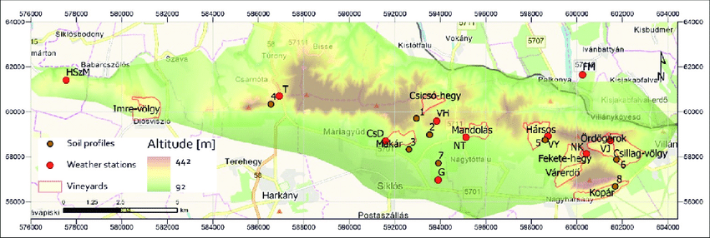
Villány Wine Region
Location: Southern Hungary, near the Croatian border.
Terroir: Warm, sub-Mediterranean climate with volcanic soils.
Prominent Varietals: Cabernet Franc, Merlot, Kékfrankos (Blaufränkisch), Portugieser.
Wine Characteristics: Villány is renowned for its bold, full-bodied red wines. The region has been dubbed "the home of Cabernet Franc," producing wines with deep blackcurrant and plum flavors, velvety tannins, and a long finish.
Tasting Notes: Villány's Cabernet Franc is known for its opulent fruit flavors, balanced by earthy notes and subtle spice.
These wines pair wonderfully with grilled meats, hearty stews, or aged cheeses.

Slide 15
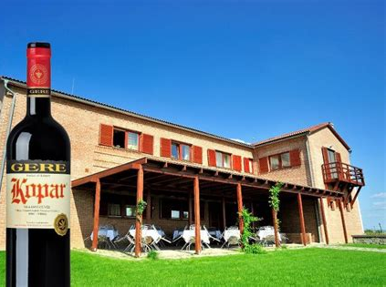
Villány Notable Wineries
Notable Wineries: Attila Gere Winery is one of Hungary's most prestigious wineries.
Founded by Attila Gere, the estate is known for producing world-class red wines, particularly from Bordeaux varieties like Cabernet Franc, Merlot, and Cabernet Sauvignon, as well as indigenous Hungarian grapes like Kékfrankos.
The winery focuses on sustainable viticulture and traditional winemaking methods, producing wines that reflect the unique terroir of Villány. Attila Gere Winery has earned international recognition for its full-bodied, elegant wines and its role in elevating Hungarian winemaking on the global stage.
Their most acclaimed wine is "Kopar", a Bordeaux-style blend. This wine is made primarily from Cabernet Franc, Merlot, and Cabernet Sauvignon, showcasing the richness and depth of the Villány region's terroir.

Slide 16
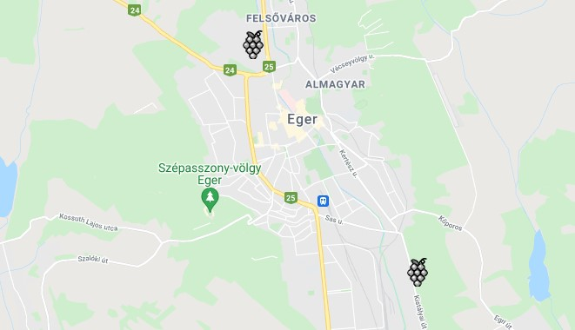
Eger Wine Region
Location: Northeastern Hungary, in the foothills of the Bükk Mountains.
Terroir: Limestone soils and a cooler climate contribute to more elegant, structured wines.
Prominent Varietals: Kékfrankos, Kadarka, Pinot Noir, Cabernet Sauvignon.
Wine Characteristics: Eger is best known for Egri Bikavér (Bull’s Blood), a red blend that typically includes Kékfrankos, Kadarka, and several other red grapes. These wines are medium to full-bodied, with notes of red berries, spices, and earthy undertones.
Tasting Notes: Egri Bikavér has flavors of sour cherry, black pepper, and a touch of smoke. It pairs well with rich, meaty dishes such as lamb or beef stew.

Slide 17
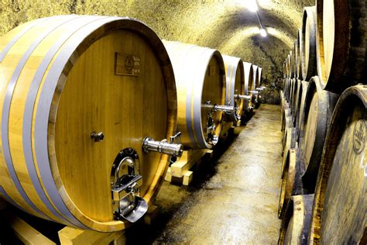
Eger Notable Wineries
Notable Wineries: St. Andrea and Bolyki are key players in the region, producing top-notch Bikavér as well as single-varietal wines that highlight the cool climate elegance of Eger.
St. Andrea Winery is a prestigious family-owned estate located in Hungary's Eger wine region, known for producing both elegant red and white wines. Founded by Dr. György Lőrincz, a celebrated winemaker, St. Andrea has become famous for its commitment to quality and its deep connection to the unique terroir of the Eger region.
The winery specializes in indigenous Hungarian grape varieties like Kékfrankos and Kadarka for its reds, and Olaszrizling and Leányka for its whites, while also producing exceptional blends such as Egri Bikavér (Bull’s Blood) and Egri Csillag (Star of Eger).
Dr. Lőrincz and his family have earned numerous accolades both in Hungary and internationally, solidifying their reputation as leaders in Hungarian winemaking.
The estate is also a popular destination for wine tourism, offering tastings and events that highlight the rich cultural and winemaking heritage of the Eger region.

Slide 18
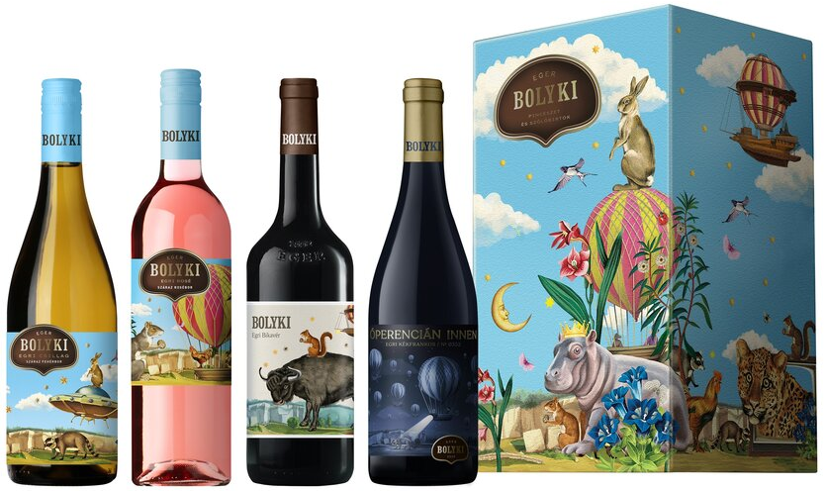
Eger Notable Wineries
Notable Wineries: Bolyki Winery is a dynamic and modern wine estate located in Hungary's Eger wine region, known for its bold approach to winemaking and unique setting.
Founded by János Bolyki, a self-taught winemaker, the winery is built in a former stone quarry, giving it a striking and unconventional atmosphere.
Bolyki Winery is celebrated for producing a range of high-quality wines, including both reds and whites, with a focus on local varieties like Kékfrankos, Kadarka, and Leányka, as well as popular blends like Egri Bikavér (Bull’s Blood).
János Bolyki is known for his innovative spirit, combining traditional techniques with creative flair to craft wines that are expressive and balanced.
His playful and artistic wine labels also reflect his personality and approach to winemaking.
Bolyki Winery has garnered attention both domestically and internationally for its standout wines and distinctive brand identity.

Slide 19
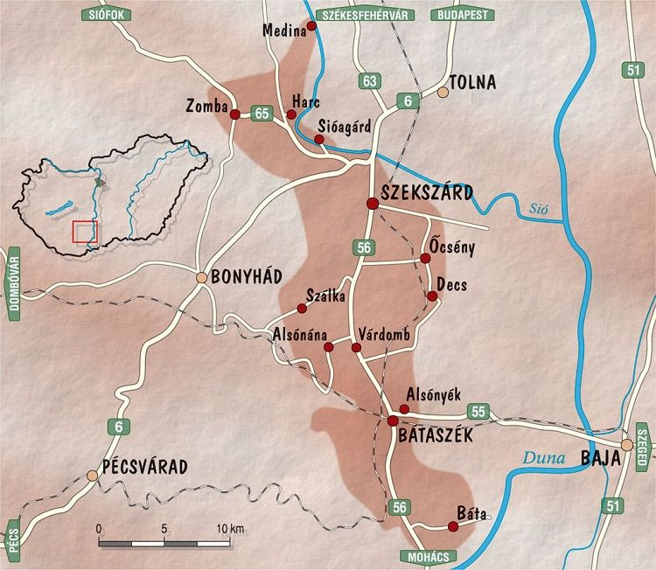
Szekszárd Wine Region
Location: Southern Hungary, south of Budapest.
Terroir: Loess soils and a warm continental climate.
Prominent Varietals: Kékfrankos, Kadarka, Merlot, Cabernet Sauvignon.
Wine Characteristics: Like Eger, Szekszárd is also known for producing Bikavér, though Szekszárdi Bikavér tends to be rounder and more fruit-forward than its Eger counterpart. The region also excels in Kékfrankos and Kadarka, producing wines with soft tannins and vibrant acidity.
Tasting Notes: Szekszárdi Bikavér is rich and velvety, with flavors of black cherry, plum, and spice. Kadarka, a native grape, offers lighter, more delicate red wines with bright red fruit and peppery notes. Both pair well with pork dishes, paprika-spiced foods, and Hungarian sausages.

Slide 20
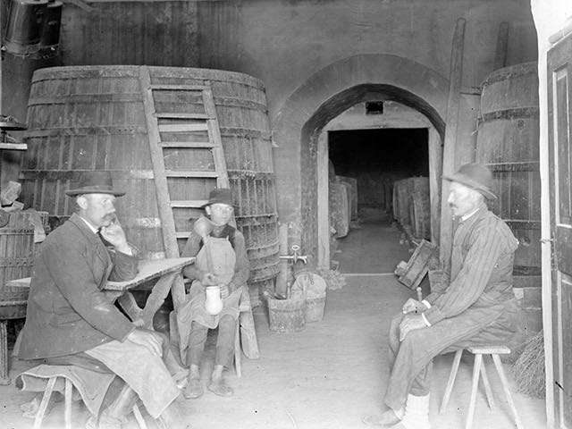
Szekszárd Notable Wineries
Notable Wineries: Heimann and Sebestyén are two of the region’s leading wineries, known for their expressive Kadarka and polished red blends.
Heimann Winery is a family-owned estate in Hungary’s Szekszárd wine region, known for its focus on native grape varieties like Kékfrankos and Kadarka. The Heimann family has a long history in viticulture, and the current generation, led by Zoltán Heimann, along with his son, blends tradition with modern winemaking.
They emphasize organic farming and minimal intervention to produce expressive wines that showcase the terroir.
Kékfrankos, their flagship grape, produces fresh, vibrant wines with red fruit and spice, while their efforts to revive Kadarka have led to elegant, aromatic wines. The winery also cultivates international varieties like Merlot and Syrah for structured blends.
Heimann Winery practices organic and biodynamic farming, earning recognition for its sustainable approach. Their award-winning wines, both domestically and internationally, position them as a key player in Hungary's premium wine industry.

Slide 21
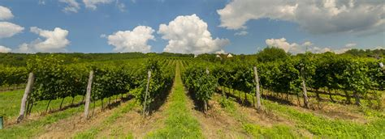
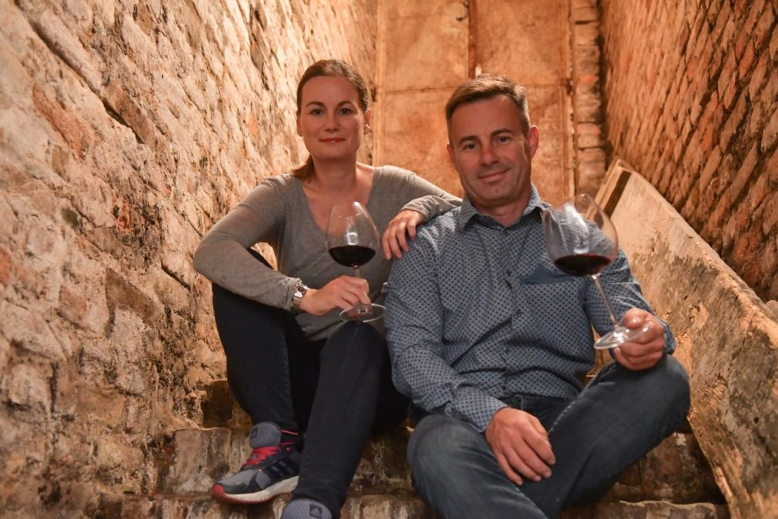
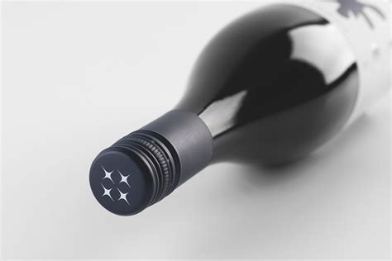
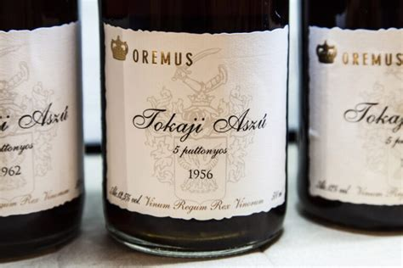
Szekszárd Notable Wineries
Sebestyén Winery is a family-run estate located in the Szekszárd wine region of Hungary, known for producing high-quality wines with a focus on local grape varieties. The winery is led by Csaba Sebestyén and his sister, Csilla, who have built a reputation for crafting elegant wines that highlight the terroir of Szekszárd.
Their signature varieties include Kékfrankos and Kadarka, both key grapes of the region. Sebestyén Winery is particularly known for its single-vineyard wines, showcasing the diversity of Szekszárd’s soils and microclimates. They also produce Bordeaux-style blends, adding complexity and depth to their portfolio.
The winery emphasizes sustainability and minimal intervention in winemaking, aiming to express the natural character of the grapes. Sebestyén’s wines are well-regarded both in Hungary and internationally for their quality and authenticity.

Slide 22
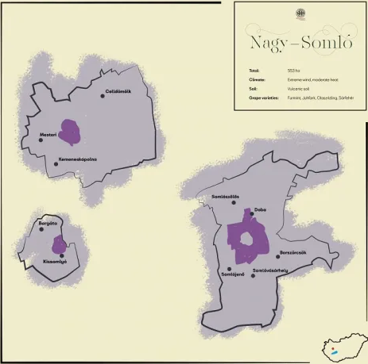
Nagy-Somló Wine Region
Location: Western Hungary, on the slopes of an extinct volcano.
Terroir: Volcanic basalt soils give the wines a distinctive minerality.
Prominent Varietals: Juhfark, Furmint, Olaszrizling.
Wine Characteristics: This small but mighty region produces fiery, mineral-driven white wines.
Juhfark, the flagship grape of Somló, is known for its high acidity and unique smoky, flinty character.
Tasting Notes: Juhfark is a sharp, intensely mineral wine with flavors of green apple, citrus, and a hint of smoke.
It pairs beautifully with shellfish, roasted vegetables, or creamy goat cheese.

Slide 23

Nagy-Somló Wine Region
Notable Wineries: Kreinbacher and Somlói Vándor are leading producers, known for their powerful, age-worthy white wines that reflect the volcanic terroir of the region.
Kreinbacher Winery is a prestigious estate located in Hungary’s Somló wine region, renowned for its production of high-quality sparkling wines, particularly traditional méthode champenoise sparkling wines. Founded by József Kreinbacher in 2002, the winery focuses on combining modern winemaking techniques with the unique volcanic terroir of Somló.
Kreinbacher’s sparkling wines are crafted primarily from Furmint, a native Hungarian grape, known for its high acidity and minerality, making it ideal for sparkling wine production.
The winery also produces still wines, focusing on Juhfark, Furmint, and Olaszrizling, which reflect the distinct minerality of the volcanic soil.
Because of their commitment to quality, Kreinbacher has gained both regional and international acclaim.

Slide 24
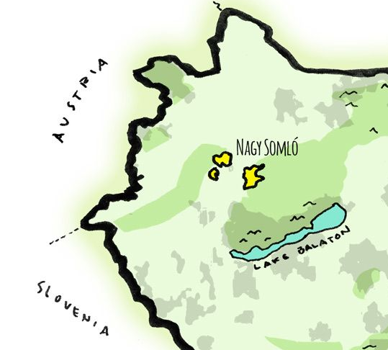
Nagy-Somló Wine Region
Notable Wineries Somlói Vándor:
Somlói Vándor is a small, artisanal winery located in Hungary's Somló wine region, founded by winemaker Ádám Fekete. The winery focuses on producing natural, terroir-driven wines that showcase the unique characteristics of Somló’s volcanic soils. Somlói Vándor primarily works with native Hungarian grape varieties, such as Furmint, Hárslevelű, and Juhfark.
Ádám practices organic viticulture and minimal intervention in winemaking, aiming to create wines that authentically express the land and its microclimates.
His wines are known for their rich minerality, complexity, and ability to age gracefully.
Somlói Vándor has earned a strong reputation for producing elegant, handcrafted wines that highlight the distinctiveness of the Somló region.

Slide 25
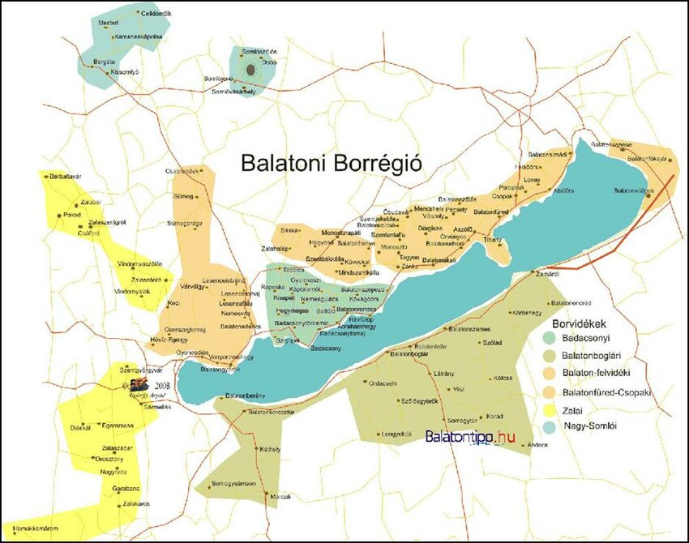
Balaton Wine Region
Location: Surrounding Lake Balaton, Central Hungary.
Terroir: Volcanic soils, tempered by the cooling effect of the lake.
Prominent Varietals: Olaszrizling, Szürkebarát (Pinot Gris), Kéknyelű.
Wine Characteristics: The Balaton region is Hungary’s largest and most diverse wine-producing area, offering everything from light, aromatic whites to more complex, structured wines.
Tasting Notes: Olaszrizling from Balaton is light and crisp, with floral aromas and a refreshing acidity. Szürkebarát is fuller-bodied with ripe stone fruit flavors. Both pair well with fish from Lake Balaton or light poultry dishes.

Slide 26
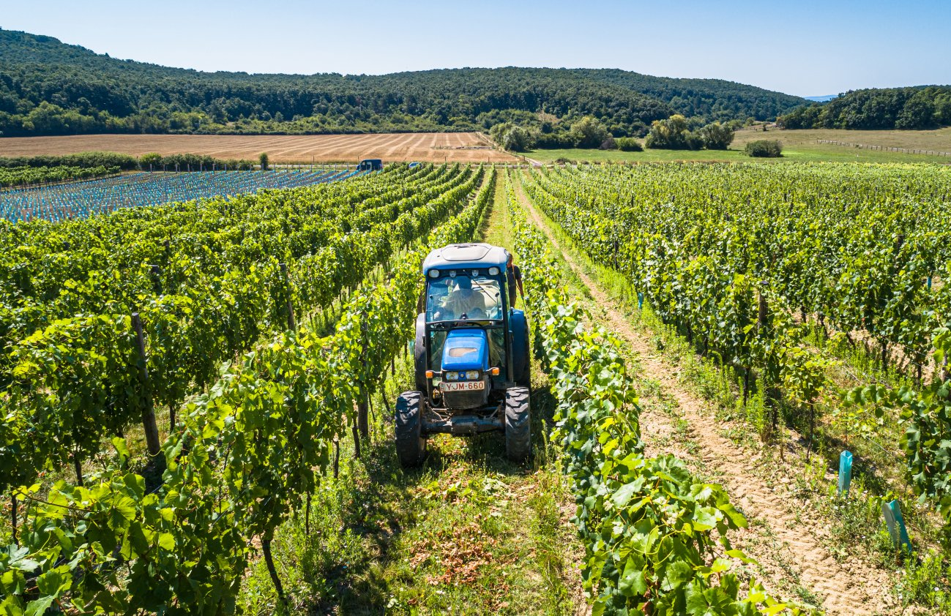
Balaton Wine Region
Notable Wineries: Figula and Szeremley are prominent wineries, known for their expressive white wines that showcase the maritime influence of Lake Balaton.
Figula Winery is a respected family-owned estate located in Hungary's Balatonfüred-Csopak wine region, near Lake Balaton. Founded by Mihály Figula in 1993, the winery is now run by his son, Mihály Figula Jr., who continues the family tradition of crafting high-quality wines with a focus on native grape varieties.
The winery is best known for its Olaszrizling, a signature grape of the region, along with other varieties like Sauvignon Blanc, Chardonnay, and Szürkebarát (Pinot Gris). Figula Winery emphasizes sustainable farming and minimal intervention winemaking to produce fresh, elegant, and terroir-driven wines.

Slide 27
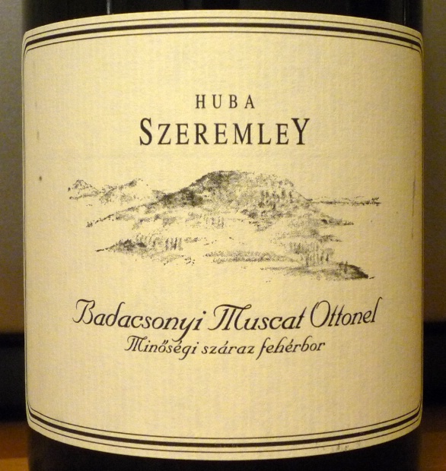
Balaton Wine Region
Notable Wineries: Szeremley Winery is a prominent estate located in Hungary’s Badacsony wine region, near Lake Balaton. Founded by renowned winemaker and businessman Huba Szeremley, the winery is known for producing high-quality wines that reflect the volcanic soils and unique microclimate of the area.
The winery specializes in native Hungarian grape varieties, with a focus on Olaszrizling, Kéknyelű, and Szürkebarát (Pinot Gris). Szeremley Winery’s wines are celebrated for their minerality, freshness, and complexity, traits that are characteristic of the Badacsony region.
Szeremley is recognized both in Hungary and internationally, helping to elevate the reputation of Hungarian wines on the global stage.
The winery has earned numerous awards for its commitment to quality and innovation in winemaking.

Slide 28
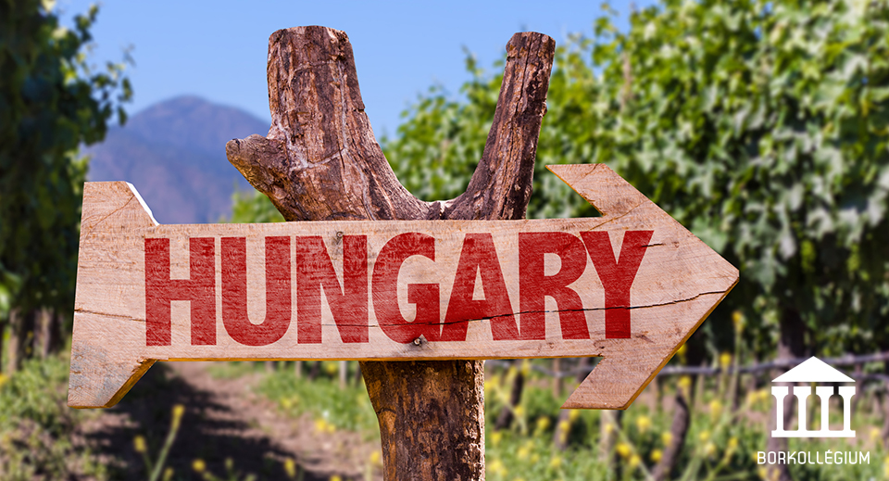
Conclusion: The Spirit of Hungarian Wine
Hungary’s wine regions are as diverse as its history,
Hungary’s wine landscape offers an exciting journey through its rich history and distinct wine regions.
Though the full article on the nation's wine regions and terroir is not possible to retrieve in this tool, Hungary’s Tokaj region, with its volcanic soils and famed Tokaji Aszú sweet wines, undoubtedly tops the list of the most important regions.
Villány and Szekszárd in the south are renowned for their bold, robust reds like Cabernet Franc and Kékfrankos, while Eger's cooler climate gives rise to the elegant Egri Bikavér.
Each region is shaped by unique terroir factors such as volcanic soils, varied climates, and the influence of nearby rivers.

Slide 29
Acknowledgement
My seminars are the result of many years of experience combined with many hours of research over the internet.
I would like to acknowledge the many source I have accessed.
These include Wine Spectator, Wine Enthusiast, BKWine Magazine, Wine & Spirits Magazine, American Vineyard Magazine, The Grapevine Magazine, Wikipedia.com, Britannica.com, and the various Government websites.

Slide 30
Citations
Tokaj-Hegyalja Region: The prominence of Tokaj and its unique terroir was detailed based on information from renowned wine resources like Wine Enthusiast and Decanter, which frequently highlight the significance of this volcanic region in Hungary's wine culture​(Wine Folly).
Villány Region: The description of Villány’s climate and terroir, with an emphasis on Cabernet Franc, is drawn from interviews and profiles of wineries like Attila Gere and publications that focus on the southern wine regions of Hungary​(Travel Notes & Beyond)​(Wine Folly).
Eger and Szekszárd Regions: These regions were researched using winemaking guides from Hungary’s tourism and viticulture publications. Egri Bikavér’s history and its comparison with Szekszárdi Bikavér are well-documented in sources like the Hungarian Wine Society​(Wikipedia).
Nagy-Somló and Balaton: The volcanic terroir of Nagy-Somló and the influence of Lake Balaton are covered extensively in Hungarian wine travel guides, which emphasize the uniqueness of local grapes like Juhfark and Kéknyelű​(Wikipedia)​(Wine Folly).
These references are a mix of online wine publications, expert opinions, and Hungarian wine industry sources, which are known to provide the latest and most accurate information about the country's wine regions.

