Slide 1
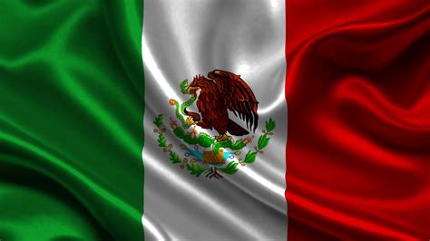
Huatulco, Mexico Presented by Marc Silver

Slide 2
What I Will Cover
My Port Philosophy
Don’t Miss the Ship
Money
About Huatulco, Mexico
History of Huatulco, Mexico
Transportation
Points of Interest
Places to see or at least consider
A few restaurant recommendations
Conclusion

Slide 3
My Port Philosophy
I have been cruising for over 45 years and have taken over 100 cruises. So, I consider myself an experienced cruiser.
The information I will present is based on those many years of
experience.
When I am on a cruise where the city, I want to visit is not the port city,
I always recommend taking a ship’s tour.
But when I am in a port with multiple attractions nearby and easy to see
on my own - I will do it on my own.
This presentation is for that type of port.

Slide 4
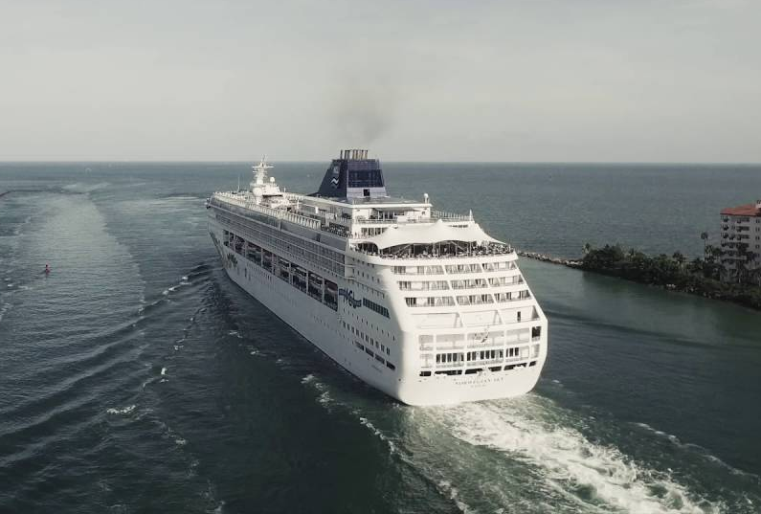
Don’t Miss the Ship
How to Avoid Missing Your Ship
Pay attention to the time. - Ship time and local time are often different.
Put a return-to-ship reminder on your phone.
Choose excursions wisely.
If a ship-sponsored excursion is late returning to port for, the ship will wait for you.
If you are on your own Be Prepared
Have your Passport, Credit Card and phone numbers for your ship port agent.
What to Do If You Miss the Ship
Most cruise lines have port agents stationed in the port area to assist if your ship has left without you. If you’re lucky, when cruisers are late returning to the vessel, the ship's crew will often remove the passengers' essential items -- passports, cell phones and medication -- from the ship to leave with the port agents.
The Port Officials can help you with contacting your ship and making necessary travel arrangements.

Slide 5
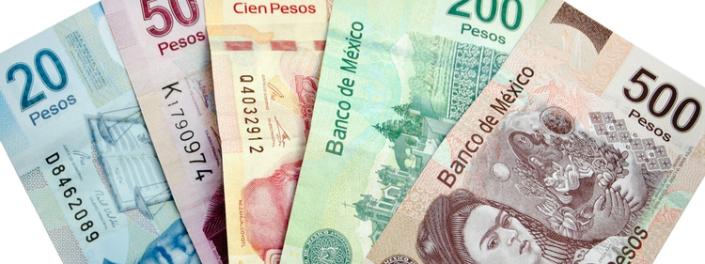
Money
The Peso is the official currency of Mexico
Official Exchange is 100 Pesos is $5.80 US
Or 17.35 Pesos to the US Dollar

Slide 6
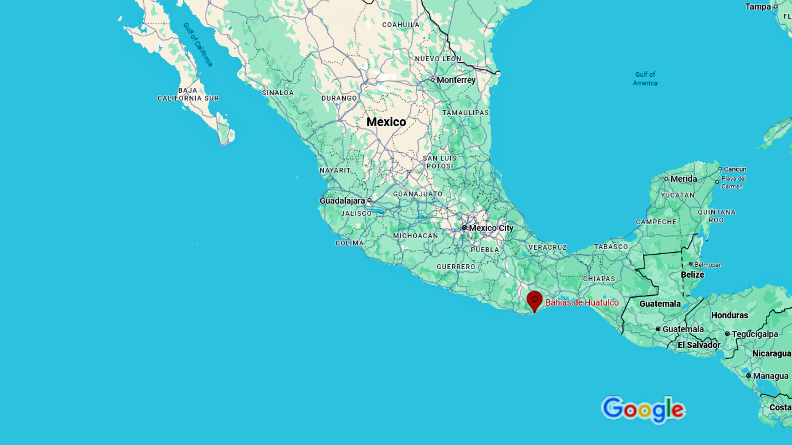

Slide 7
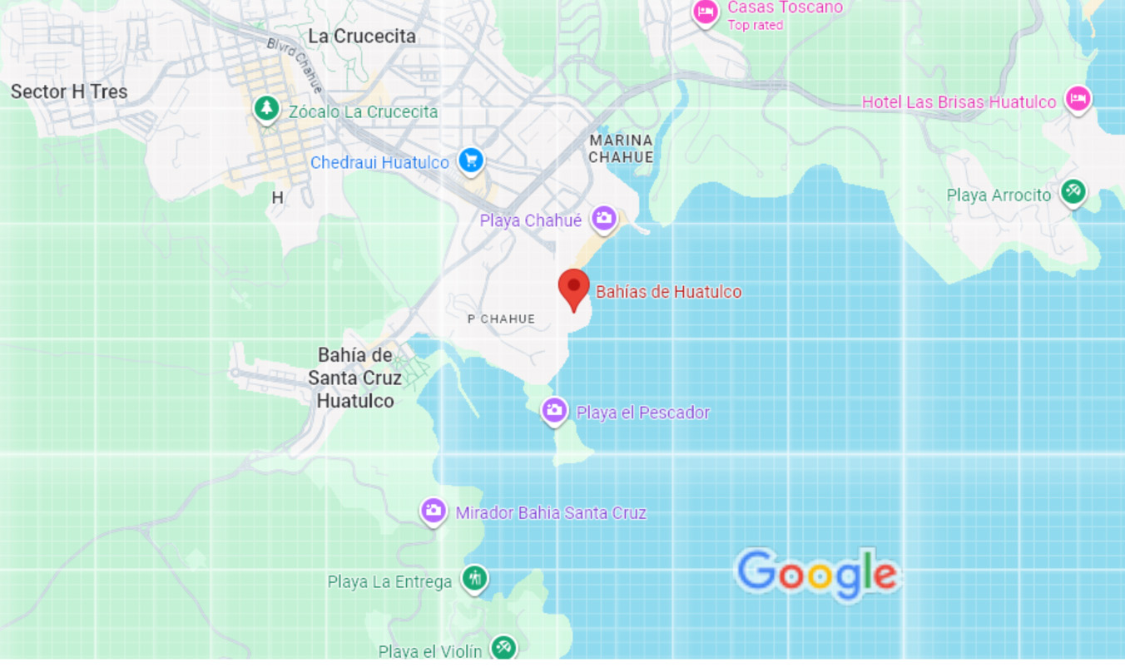
Bahías de Huatulco
Dock

Slide 8
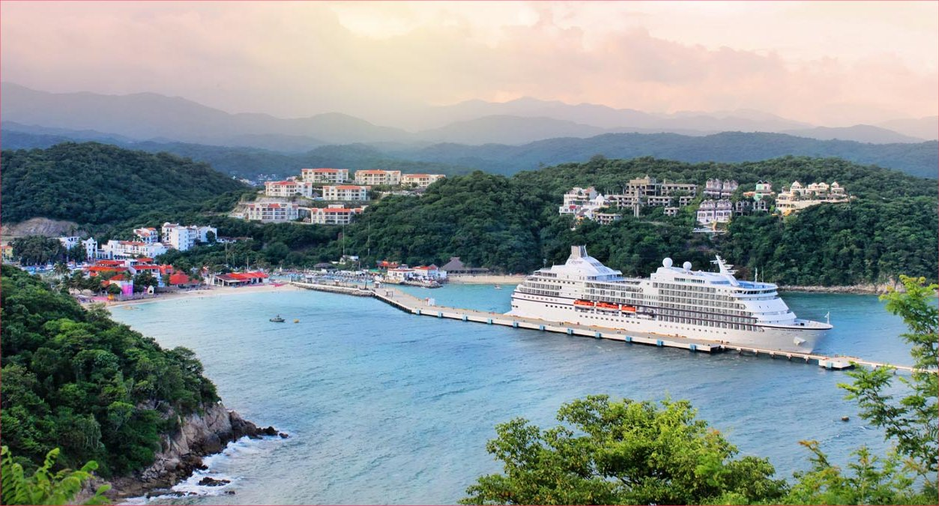
About Huatulco, Mexico
The official name is Bahía de Santa Cruz Huatulco and is located in Oaxaca on Mexico’s southern Pacific coast.
It is famous for nine bays and 36 beaches, many inside a national park.
Bahía de Santa Cruz is the heart of the Huatulco region, serving as the main commercial and tourist hub. Tourism is managed carefully—smaller scale than Cancun or Puerto Vallarta. Laid-back, authentic feel.

Slide 9
History of Huatulco
Huatulco has deep Indigenous roots. The Zapotec and Mixtec peoples used these bays as trade and fishing centers for centuries.
Spanish conquistadors arrived in the 1500s. Hernán Cortés sent ships along this coast, and Sir Francis Drake and other pirates targeted the area.
The port became a supply point for Spanish galleons traveling between Acapulco and the Philippines.
Legend has it that pirates buried treasure in the bays, though none has been found.
For centuries, Huatulco remained a quiet fishing village, isolated from Mexico’s main trade routes.
In the 1980s, the Mexican government, through FONATUR, developed Huatulco as an eco-friendly tourism project with a focus on sustainability.
Today, it blends Indigenous traditions, colonial echoes, and a modern, carefully managed resort community.

Slide 10
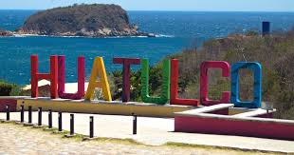
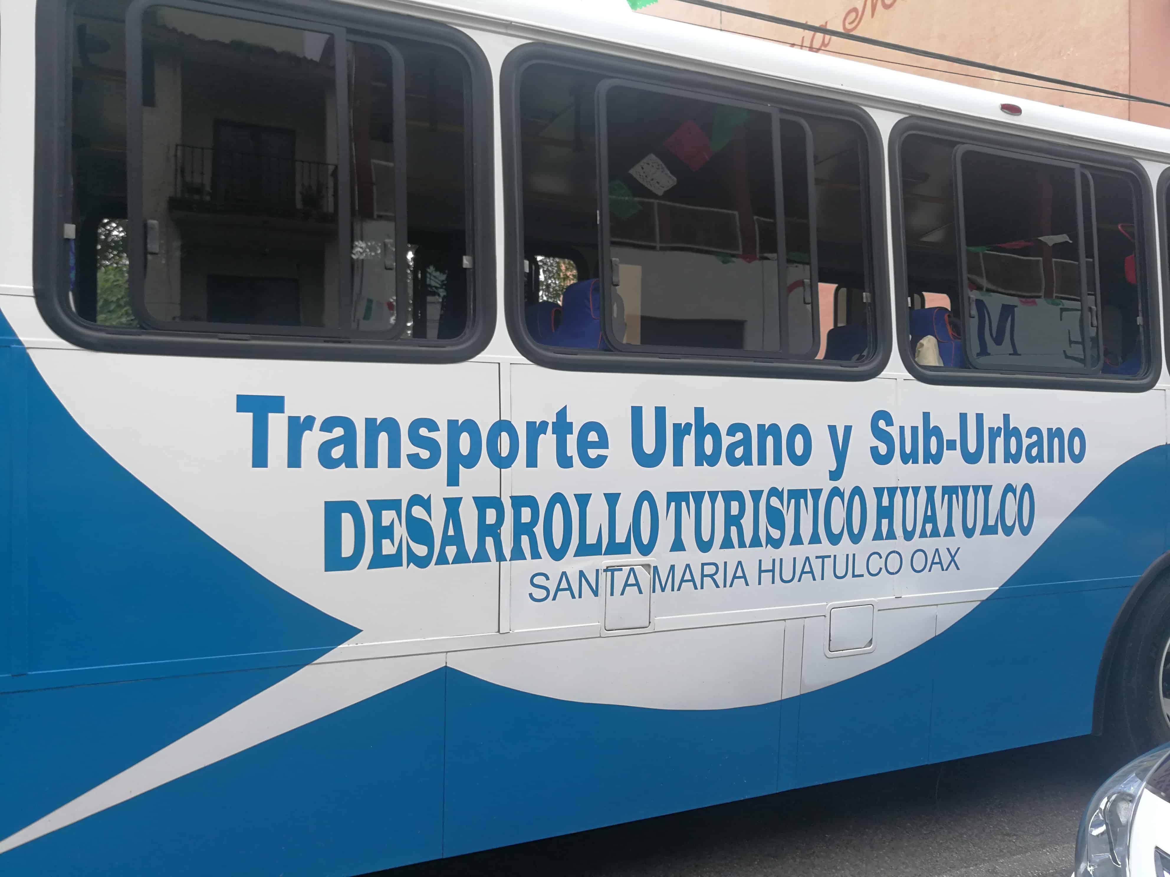
Huatulco City Bus
The city Buses are cheap, colorful, but not luxurious.
Traveling by bus is safe and is an interesting experience if you like to mingle with the locals.
Fares are 12.5 pesos per ride on an Air-conditioned Bus.

Slide 11
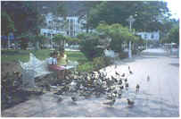

Huatulco Taxis
Taxis in Huatulco are plentiful.
They are easy to find at the pier.
Taxis can be very reasonable, as long as you ask the price BEFORE you get in.
Fares are fixed by zones; rates for trips in town and to more distant points should be posted at local hotels.
Make sure you have small change. Taxis will not carry change so they can keep yours.
You do not tip taxi drivers. The tip is included in the price.

Slide 12
Points of Interest
Bahías de Huatulco National Park – A UNESCO Biosphere Reserve with coral reefs, mangroves, and rich marine life. Perfect for snorkeling, diving, and eco-tours.
La Crucecita – A charming town square with colorful markets, handicrafts, and the famous church ceiling mural of the Virgin of Guadalupe, one of the largest of its kind in the world.
Playa Santa Cruz – The main beach by the pier, excellent for swimming, kayaking, and enjoying seafood restaurants along the shoreline.
Playa La Entrega – Calm, shallow waters ideal for snorkeling, with vibrant coral reefs just steps from shore. A favorite for families and first-time snorkelers.
Coffee Plantations – Nestled in the Sierra Madre del Sur mountains, tours showcase how Oaxacan coffee is grown, harvested, and roasted. Many include tastings.
Copalita Eco-Archaeological Park – Ancient ruins and petroglyphs near the Copalita River, offering a glimpse into Zapotec culture and history.
Waterfalls in the Sierra Madre – Day trips inland reveal lush jungle landscapes, hidden cascades, and natural swimming pools for adventurous travelers.

Slide 13
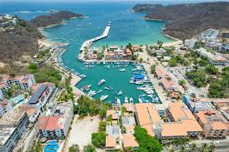
Huatulco Walking Tour
This walking tour will take you through the charming marina area, beautiful beaches, local markets, and cultural sites while experiencing the laid-back coastal atmosphere of this Oaxacan paradise.
Stop 1: Santa Cruz Marina (Starting Point)
Location: Marina Santa Cruz Time: 30 minutes
Begin your journey at the picturesque Santa Cruz Marina, the beating heart of the bay. This modern marina hosts fishing boats, pleasure craft, and tour vessels.
Take time to:
Admire the yachts, colorful fishing boats and watch local fishermen preparing their nets
Book boat tours for later (snorkeling, dolphin watching, or bay hopping)
Visit the small shops selling marine supplies and souvenirs
Pro Tip: This is an excellent spot for sunrise photos if you're an early riser!

Slide 14
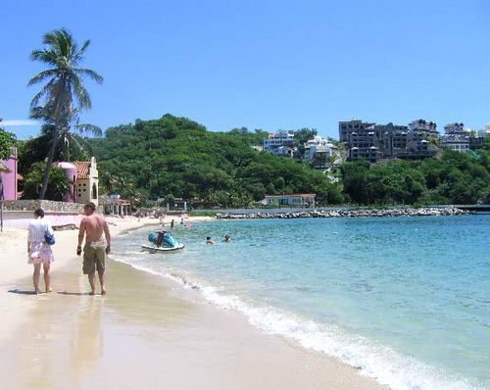
Huatulco Walking Tour
Stop 2: Playa Santa Cruz
Location: Main beach adjacent to the marina Time: 45 minutes
Walk along the golden sand of Santa Cruz Beach, the most accessible and popular beach in the area. The calm, protected waters make it perfect for swimming and snorkeling.
Here you can:
Take a refreshing swim in the gentle waves
Rent snorkeling gear from beachside vendors
Try stand-up paddleboarding or kayaking
Relax under a palapa with a cold cerveza or fresh coconut water
What to Look For: The clear waters often reveal tropical fish near the rocky areas on either end of the beach.

Slide 15
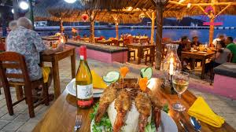
Huatulco Walking Tour
Stop 3: Beachfront Restaurants & Bars
Location: Along the Santa Cruz beachfront Time: 45 minutes
Stroll along the beachfront promenade lined with restaurants and bars offering fresh seafood and traditional Oaxacan cuisine.
Popular spots include:
Restaurant Noches Oaxaqueñas: Traditional Oaxacan dishes with ocean views
Grilled Fish Beach Restaurants: Various palapa-style eateries serving catch-of-the-day
Beach Bars: Perfect for afternoon cocktails
Must Try: Fresh red snapper, shrimp ceviche, or pescado a la veracruzana (Veracruz-style fish)

Slide 16
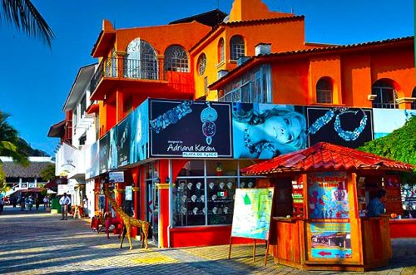
Huatulco Walking Tour
Stop 4: Santa Cruz Town Center
Location: Walking inland from the beach Time: 1 hour
Head inland about 10 minutes on foot to explore the charming town center of Santa Cruz.
This area offers:
Local Markets: Browse handicrafts, textiles, and local products
Artisan Shops: Find unique Oaxacan pottery, textiles, and wood carvings
Small Cafés: Sample traditional coffee and pastries
Town Plaza: A peaceful square perfect for people-watching
Shopping Highlights: Look for traditional huipiles (embroidered blouses), black pottery from San Bartolo Coyotepec, and local mezcal.

Slide 17
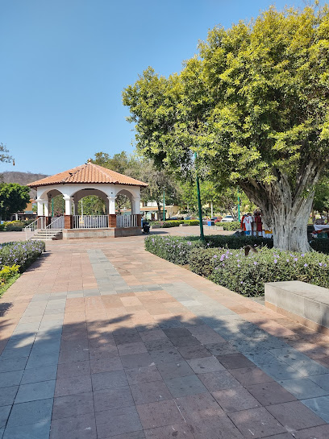
Huatulco Walking Tour
Stop 5: Walk to La Crucecita (Optional Extension)
Location: 15-minute walk inland Time: 1.5 hours
If you have energy and time, extend your tour with a walk to La Crucecita, the cultural heart of Huatulco:
Parque Central: Beautiful central plaza with the iconic Guadalupe Church
Mercado Municipal: Vibrant local market with food stalls and local products
Traditional Architecture: Colorful colonial-style buildings
Authentic Restaurants: More budget-friendly local eateries
Highlight: The stunning mural inside the Iglesia de Guadalupe depicting the Virgin of Guadalupe

Slide 18
Huatulco Walking Tour
Stop 6: Scenic Viewpoints
Location: Various elevated points around Santa Cruz Time: 30 minutes
As you walk back toward the bay, take advantage of several scenic viewpoints:
Marina Overlook: Panoramic views of the entire bay and marina
Cliff Paths: Natural lookouts offering dramatic coastal vistas
Hotel Terraces: Some hotels welcome visitors to their scenic terraces (with purchase)
Photography Tip: Late afternoon light (4-6 PM) provides the best lighting for bay photography.

Slide 19
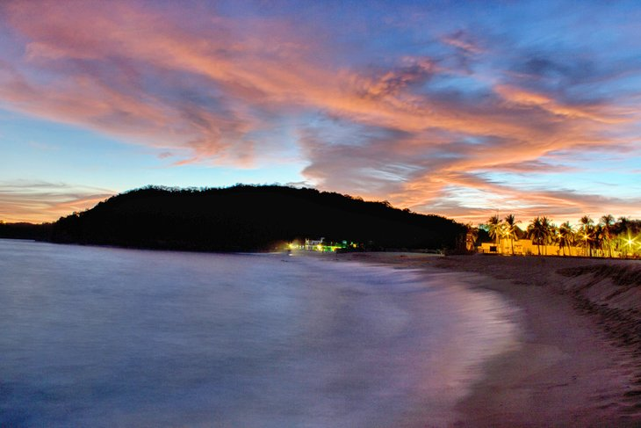
Huatulco Walking Tour
Stop 7: Sunset at the Beach (End Point)
Location: Return to Playa Santa Cruz Time: 1 hour
End your walking tour back at Santa Cruz Beach for one of Mexico's most beautiful sunsets. The western exposure provides spectacular sunset views over the Pacific Ocean:
Find a comfortable spot on the beach or at a beachfront restaurant
Order a cocktail or fresh fruit agua fresca
Watch fishing boats return with the day's catch
Enjoy the changing colors of sky and water

Slide 20


Essential Information
What to Bring:
Comfortable walking shoes with good grip
Sunscreen (SPF 30+) and hat
Water bottle (stay hydrated!)
Mexican pesos for purchases and tips
Camera or smartphone for photos
What to Wear:
Light, breathable clothing
Comfortable walking sandals or sneakers
Cover-up for visiting churches or local markets
Light jacket for early morning or evening

Slide 21
Essential Information
Safety Tips:
Stay hydrated - the coastal sun can be intense
Apply sunscreen regularly, especially after swimming
Keep valuables secure and consider using hotel safes
Respect local customs, especially when visiting religious sites
Budget Estimates (Per Person):
Food & Drinks: $15-30 USD
Activities: $10-20 USD (equipment rental, entrance fees)
Shopping: $20-50 USD (souvenirs, handicrafts)
Transportation: $5-10 USD (if using taxis back to hotel)

Slide 22
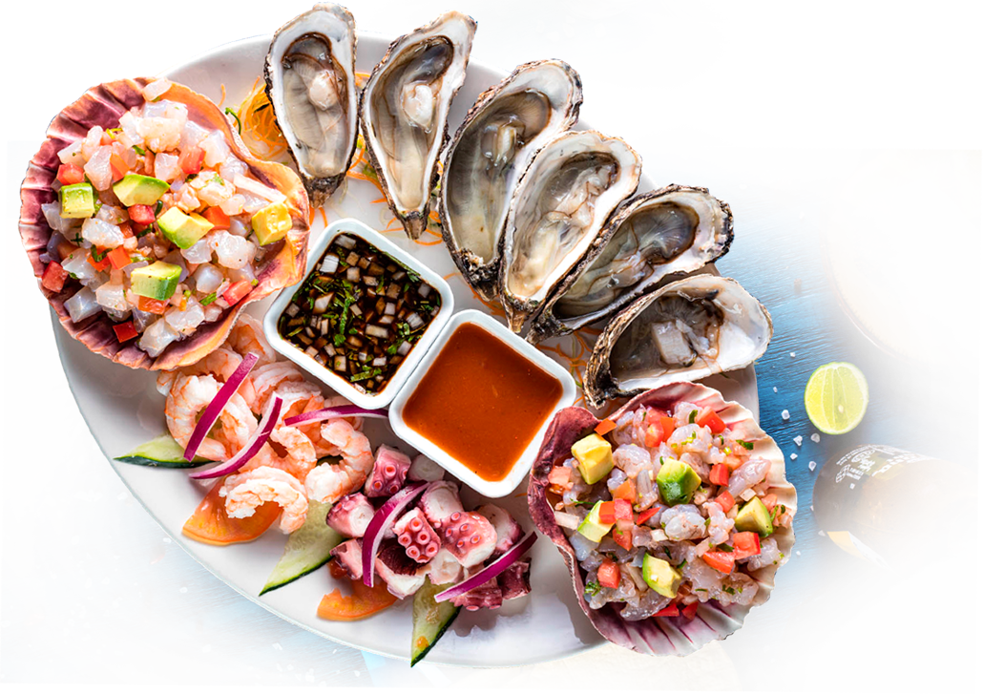
Huatulco Restaurants
Huatulco has many excellent restaurants.
Many of us on the ship are foodies, so naturally, we’re always on the hunt to eat at the most exclusive
spots anytime we travel.
Here are a few of the best restaurants to consider.
El Sabor de Oaxaca (La Crucecita): Try mole sauces and tlayudas.
Terra-Cotta (La Crucecita): Popular with travelers, international & Mexican mix.
Beach Palapas: Simple seafood shacks at Santa Cruz and La Entrega.
For those of you who just like good food, you can’t go wrong just about anywhere you go in Huatulco.
GOOD EATING

Slide 23
Final Thoughts
Huatulco is a gem: authentic Mexican culture, stunning beaches, and eco-conscious tourism.
Spend the day snorkeling at La Entrega, sipping mezcal in La Crucecita, or relaxing under a palapa.
Enjoy your visit to Huatulco!

Slide 24
Thanks For Coming
If you have any more questions, please ask.
I will do my best to answer them for you.
Have a great visit in Huatulco!

