Slide 1


Hualien, Taiwan
Presented by
Marc Silver

Slide 2
What I Will Cover
My Port Philosophy
Don’t Miss the Ship
Money
About Hulien, Taiwan
Hualien’s History
Getting Around
Points of Interest
Places to see or at least consider
A few restaurant recommendations
Conclusion

Slide 3
My Port Philosophy
I have been cruising for over 45 years and have taken over 100 cruises.
So, I consider myself an experienced cruiser.
The information I will present is based on those many years of
experience.
When I am on a cruise where the city, I want to visit is not the port city,
I always recommend taking a ship’s tour.
But when I am in a port with multiple attractions nearby and easy to see
on my own -
I will do it on my own.
This presentation is for that type of port.

Slide 4

Don’t Miss the Ship
How to Avoid Missing Your Ship
Pay attention to the time. - Ship time and local time are often
different.
Put a return-to-ship reminder on your phone.
Choose excursions wisely.
If a ship-sponsored excursion is late returning to port, the ship will
wait for you. If you are on your own???
Be Prepared
Have your Passport, Credit Card, and phone numbers for your ship
port agent.
What to Do If You Miss the Ship
Most cruise lines have port agents stationed in the port area to assist if your ship has left without you. If your are lucky, when cruisers are late returning to the vessel, the ship’s crew will often remove the passengers’ essential items – passports, cell phones, and medication -- from the ship to leave with the port agents.
The Port Officials can help you with contacting your ship
and making necessary travel arrangements.

Slide 5
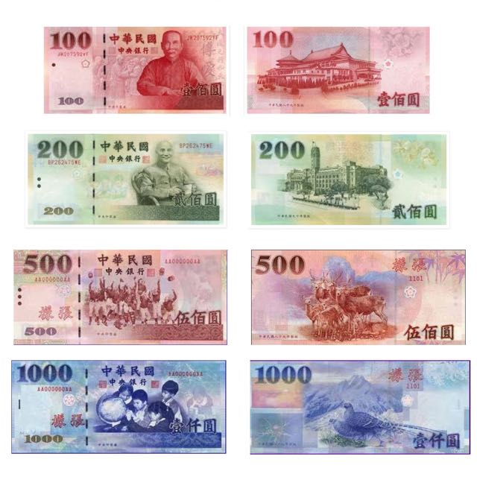
Money
The Taiwan Dollar is the official currency of Taiwan.
Sometimes called New Taiwan Dollar.
The official Exchange is
31.68 TWD to the US Dollar
100 TWD = $3.16

Slide 6
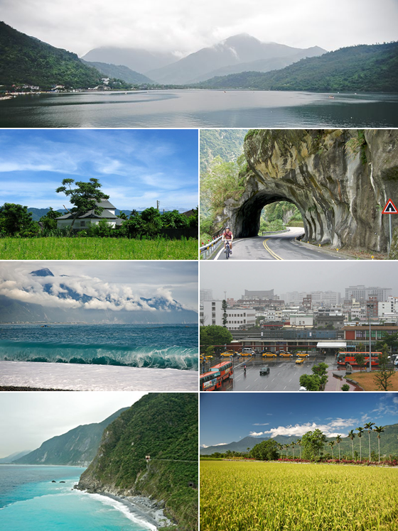
About Hualien
Hualien is both a City and a County located in the eastern part of Taiwan. Hualien is the largest county in Taiwan in terms of area, with a long, narrow, and mountainous terrain. Hualien's beautiful environment with the mountains and the sea has created countless beautiful landscapes.
Most of the population resides in the Huadong Valley, which runs north to south, sandwiched between the Central and Hai'an mountain ranges. Due to the rural nature of the county, Hualien attracts many visitors for its natural environment, which includes Taroko Gorge, Qingshui Cliff, and Qixingtan Beach.

Slide 7
Hualien’s History
The Spaniards built mines for gold in Hualien in 1622. Permanent settlements began in 1851, when 2,200 Han Chinese farmers led by Huang A-fong from Taipei arrived at Fengchuan (now the area near Hualien Rear Station). In 1875, more farmers, led by Lin Cang-an from Yilan, settled at Fengchuan.
Settlements in the area remained small by the start of Japanese rule. The city was expanded circa 1912 by its Japanese governors to incorporate Guohua and Guoan Villages, a region later known as Old New Port. In 1920, Karenkō Town was established, and around 1923 it was extended to Riran Port today known as "New Port“ including the Guowei and Guoji Villages. In 1940, the town was upgraded to Karenkō City, Karenkō Prefecture.
On 25 October 1945, Taiwan was handed over from Japan to the Republic of China under the Kuomintang government. In January 1946, the incoming Kuomintang designated Hualien City a county-administered city of Hualien County and to be the county seat.

Slide 8
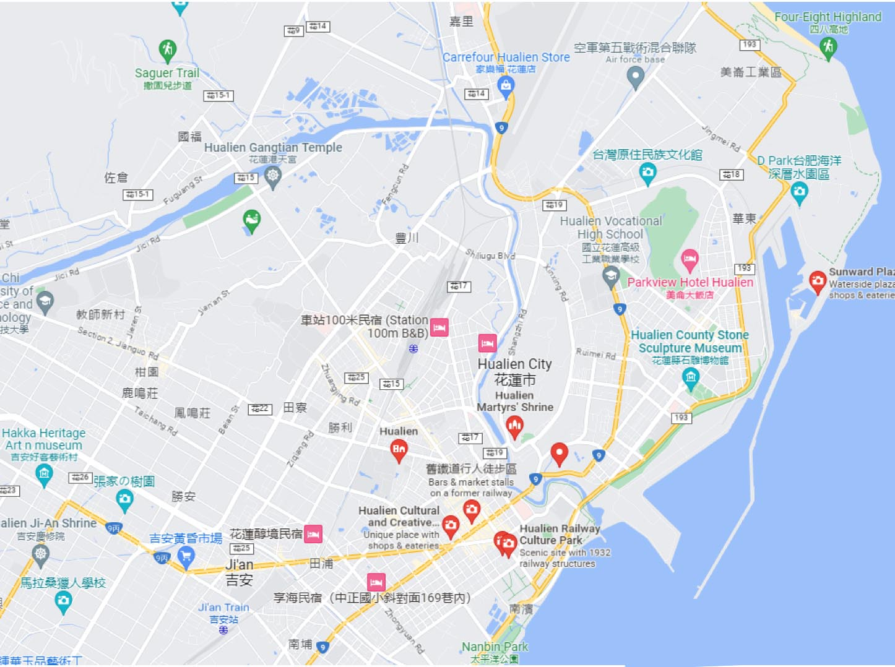
Area Map
Dongdamen Night Market
Hualien Cultural & Creative Industries Park
Hualien Railway Culture Park
Hualien Stone Sculptural Museum
Old Railroad Cultural Shopping Street
Pine Garden
Beibin & Nanbin Beaches
Meilun Mountain Park
Gangtiangong Temple
Jing Si Hall of the Tzu Chi Foundation

Slide 9
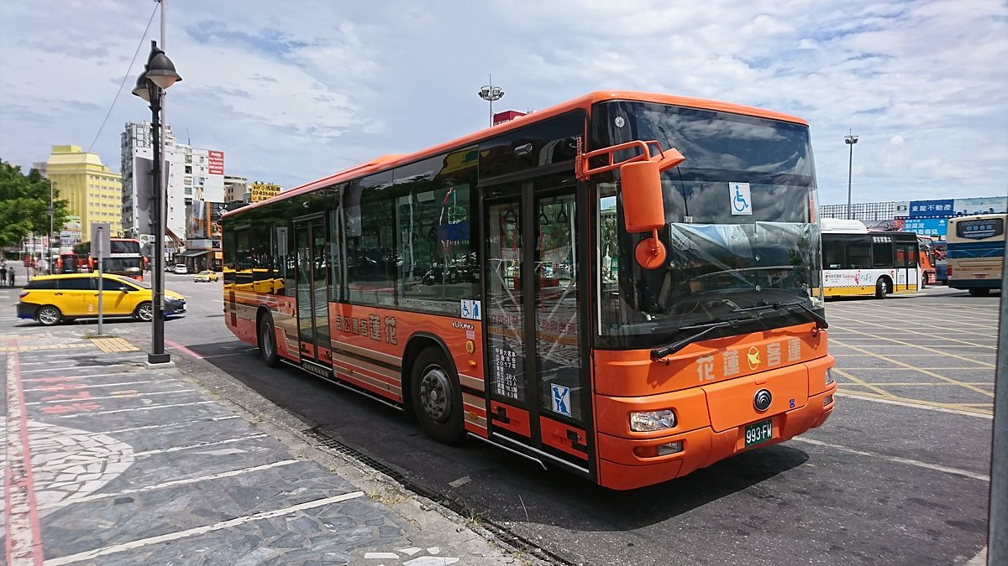
Getting Around
Hualien is a small city without an extensive public transport system, They do have city buses, but I wasn’t able to find routes or prices. so, it is worth considering taking taxis to areas outside the city center.

Slide 10
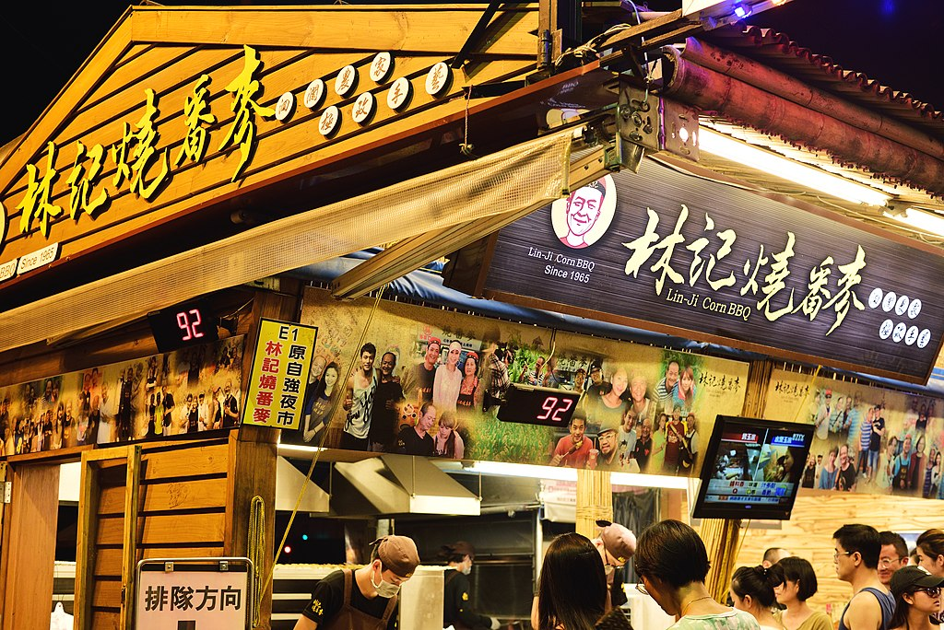
Dongdamen Night Market
Dongdamen means big east gate in English due to its location at the eastern edge of Hualien City. Hualien‘s Dongdamen Night Market is the largest night market in Eastern Taiwan. It is actually four-night markets in one. The night market lies on the spot of a former train station and is also connected to the beach via a pedestrian bridge. Popular delicacies here include fried chicken, shish kabab, coffin bread, and braised duck head. The area where the night market stands today used to be the area of the old train station.
Hours: 5:30 PM to 11:30 PM

Slide 11
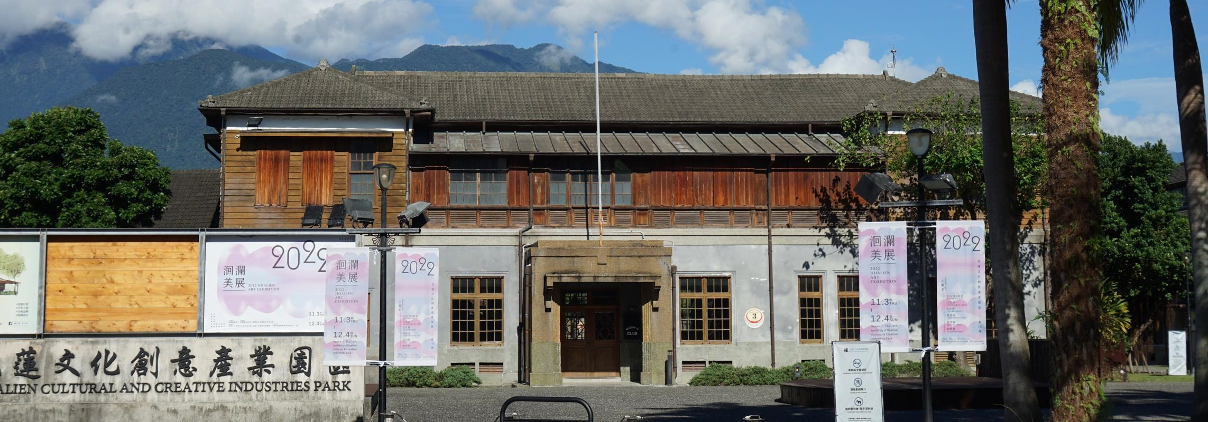
Hualien Cultural & Creative Industries Park
The outdoor admission of the whole park is free. The buildings in the area used to be constructed during the Japanese rule of Taiwan as the brewing site for red wine and rice wine for Yilan Distillery. The land to construct the park was obtained on 2 April 2011. In May 2011, the operation plan was reviewed, and the first phase of the park was opened in September 2011. On 2 October 2011, the park was 30% opened and trial operation began. The park was fully opened in 2015.
Included in the park are:
Hualien Performing Arts Center
Hualien County Cultural Affairs Bureau
Hualien Railway Museum

Slide 12
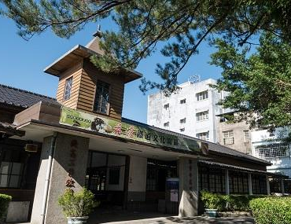
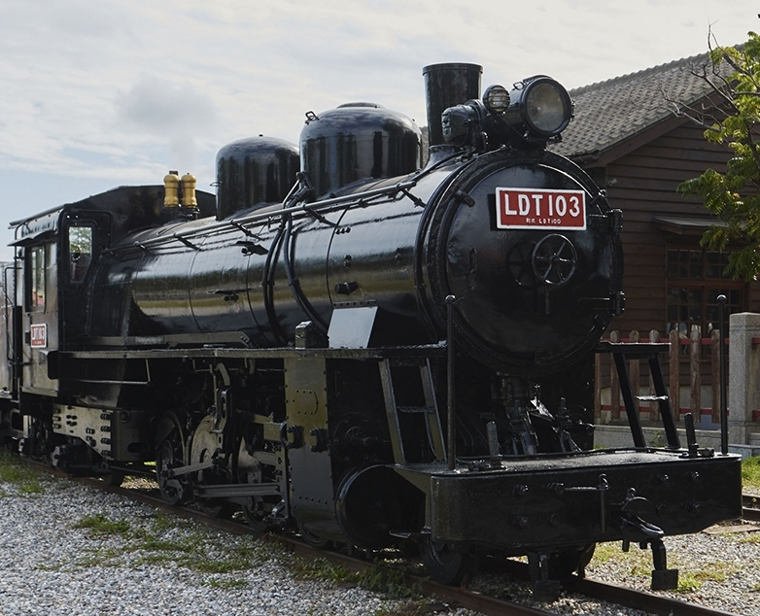
Hualien Railway Culture Park
Several distinct historical attractions were combined to make this cultural park. These include the Old Hualien Construction Section, the Police Section Martial Arts Hall (Budokan) of the Railway Department, and the Railway Tourist Shopping District. Famous for the preserved relics of the old Taiwanese narrow-gauge railway base. Established during the Japanese occupation of the island, this is the only light railway station that remains from those times. It actually used to be the headquarters of the Hualien–Taitung Line management. A popular hangout during the day, the attraction is also close to the night market. Vendors set up shop in the evening and the whole place comes alive.

Slide 13
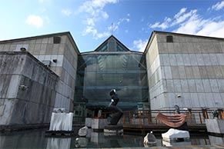
Hualien Stone Sculptural Museum
Hualien County Stone Sculptural Museum about 2 km Southwest from the cruise terminal is located inside Hualien Cultural Park, near mountains and beside the ocean, and with expansive views. The park has a spacious recreational grassy area, a library, a performance hall, a cultural relic hall as well as various green parks, bicycle trails, tourist hotels, and restaurants serving fine food on its periphery. It is a great place to enjoy Hualien’s leisurely pace of life.
After years of official and non-governmental efforts, Hualien stone carving art has become quite well-known. In 2001 "Hualien County Stone Carving Museum" was officially established, becoming Taiwan's first stone carving thematic museum, promoting stone carving culture.
Admission: Standard – NT$20

Slide 14
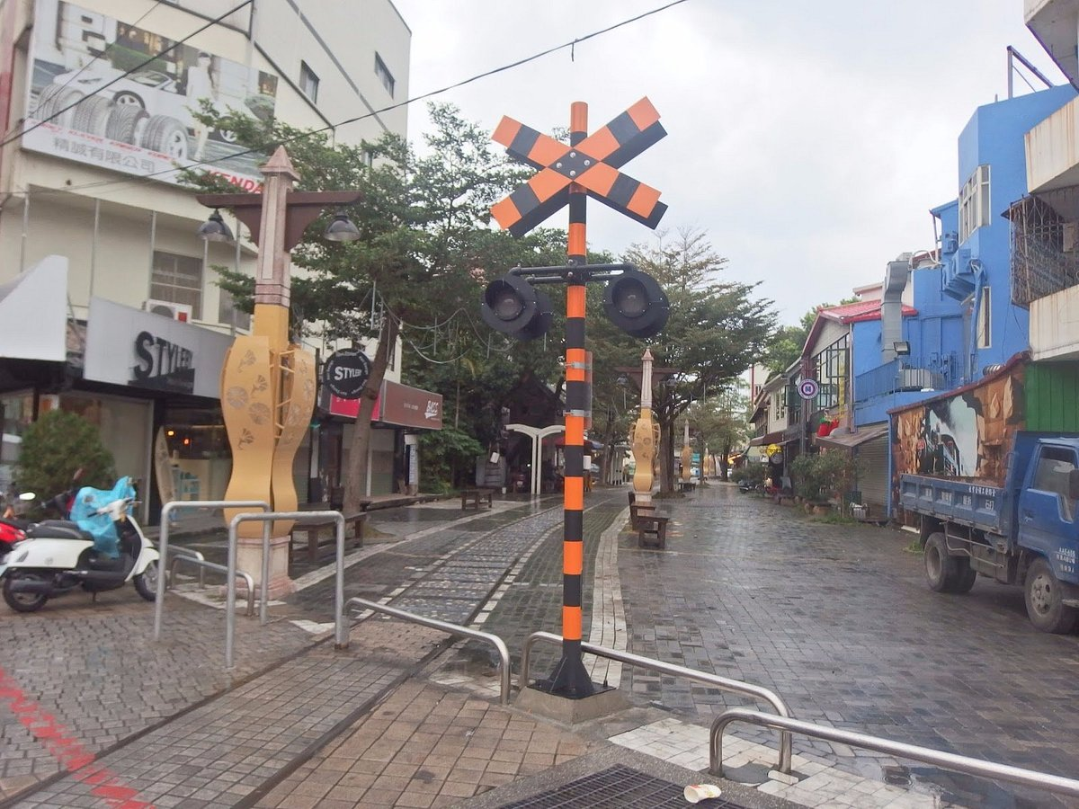
Old Railroad Cultural Shopping Street
Hualien’s old railway pedestrian area in the middle of the city has taken a 1.8 km old railway line and transformed it into a pedestrian shopping district, much like an old street or night market. It is a worthwhile stroll while you visit Hualien. It becomes an Intimate night market filled with shops for handicrafts, clothing and snacks.

Slide 15
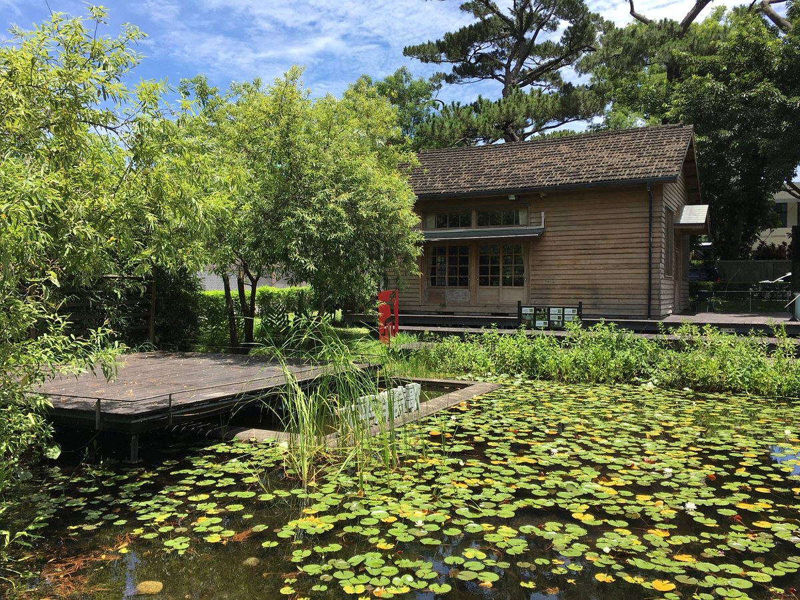
Pine Garden
Hualien Pine Garden used to be the Hualien Harbor Military Command which was built in 1942 by the Japanese who chose the site for its height advantage. From the command, you can see both the mouth of the Meilun River to the north and Hualien Harbor and have a clear, unobstructed view out over the Pacific, making it both a strategic place of a military command center and, later on, a pleasant place for high-ranking officers to relax. It is said that the Kamikaze Special Attack Unit would gather here to partake in "Gentleman's Sake" before departing on missions.

Slide 16
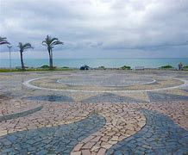
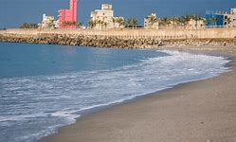
Beibin & Nanbin Beaches
These two recreation areas are directly across the road from the Hualien Nightmarket in downtown Hualien City. Pressed for time? Rent a bike and explore these lovely parks and stone beach areas with views of the Hualien port and beautiful views. Swimming is not permitted as there is a steep drop-off just a few feet into the water.

Slide 17
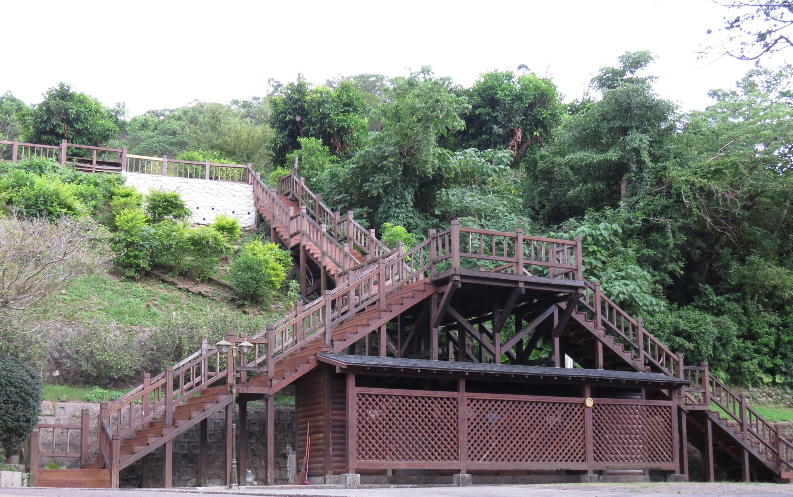
Meilun Mountain Park
Meilun Mountain Park is a sports and recreation complex. It is a site for residents and tourists enjoy natural landscapes and greenish mountains; also, it’s a public space for sports.

Slide 18
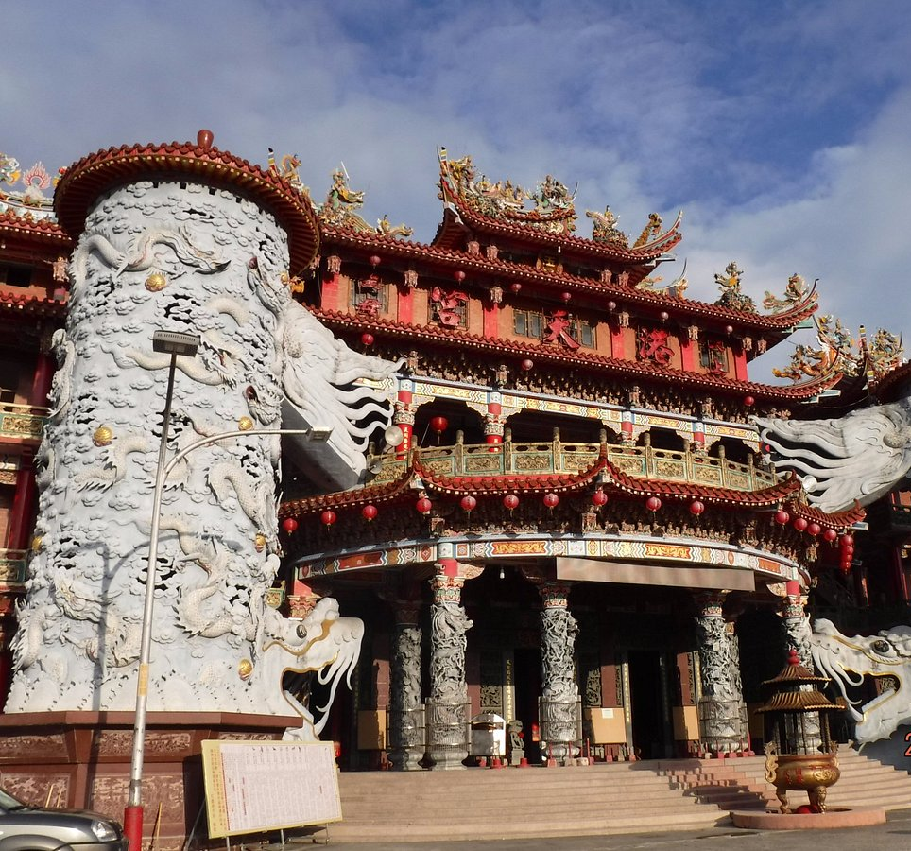
GangtiangongTemple
Climb through a dragon's mouth into one of two spiral staircases that front this gigantic Matsu temple – the biggest in Hualien. There is particularly lavish ornamentation in the central shrine rooms.
It's nearly 3km north of the train station via Zhongshan Road, eventually turning east through a gateway opposite the Hualien Baseball Stadium.

Slide 19
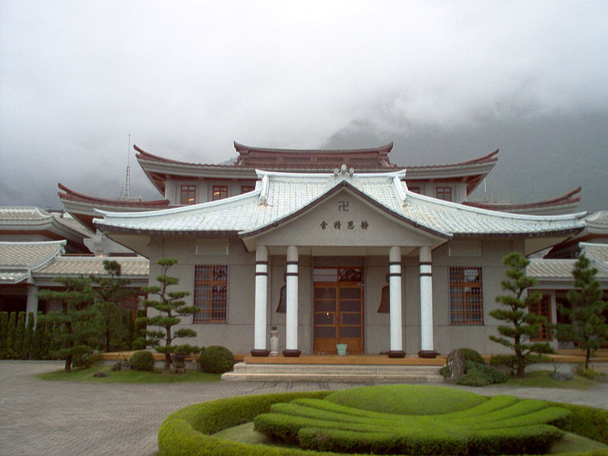
Jing Si Hall of the Tzu Chi Foundation
The Jing Si Exhibition Hall
in the KL Tzu-Chi Jing Si Hall
features through artistic displays
and multimedia presentations,
stories of Tzu Chi and human kindness, global affairs, and more. Whether reading a book quietly or listening to a heart-warming story, one will surely find inner peace and rediscover one's life purpose in this haven of serenity.

Slide 20
Conclusion
Hualien is a beautiful City with a rich history and numerous attractions. Whether you're looking for stunning beaches, historic sites, or unique attractions, Hualien has something for everyone.
I hope this presentation will help when we visit Hualien!

Slide 21
Thanks For Coming
If you have any more questions, please ask.
I will do my best to answer them for you.
Have a great visit in Hualien!

