Slide 1

Homer Alaska Presented by Marc Silver

Slide 2
What I Will Cover
My Port Philosophy
Don’t Miss the Ship
Welcom to Homer
History of Homer
Getting Around Homer
Points of Interest
Food and Dining
Practical Tips
Conclusion

Slide 3
My Port Philosophy
I have been cruising for over 45 years and have taken over 100 cruises. So, I consider myself an experienced cruiser.
The information I will present is based on those many years of
experience.
When I am on a cruise where the city, I want to visit is not the port city,
I always recommend taking a ship’s tour.
But when I am in a port with multiple attractions nearby and easy to see
on my own - I will do it on my own.
This presentation is for that type of port.

Slide 4
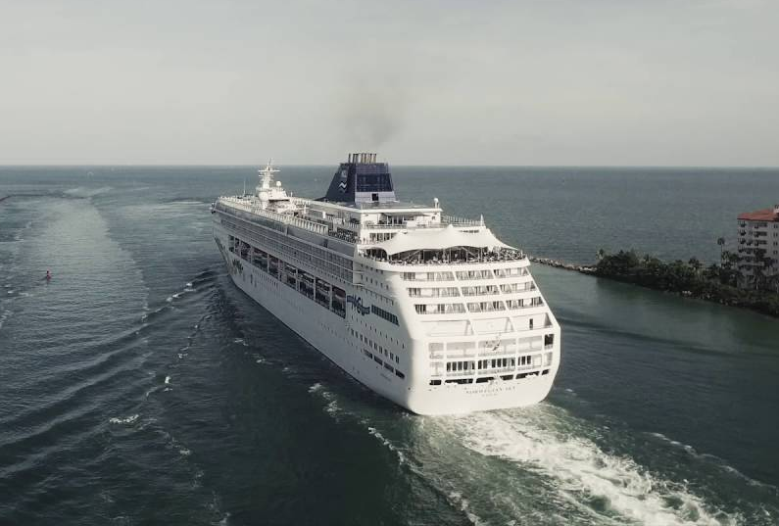
Don’t Miss the Ship
How to Avoid Missing Your Ship
Pay attention to the time. - Ship time and local time are often different.
Put a return-to-ship reminder on your phone.
Choose excursions wisely.
If a ship-sponsored excursion is late returning to port for, the ship will wait for you. If you are on your own???
Be Prepared
Have your Passport, Credit Card and phone numbers for your ship port agent.
What to Do If You Miss the Ship Most cruise lines have port agents stationed in the port area to assist if your ship has left without you. If you’re lucky, when cruisers are late returning to the vessel, the ship's crew will often remove the passengers' essential items -- passports, cell phones, and medication -- from the ship to leave with the port agents.
The Port Officials can help you with contacting your ship and making necessary travel arrangements.

Slide 5
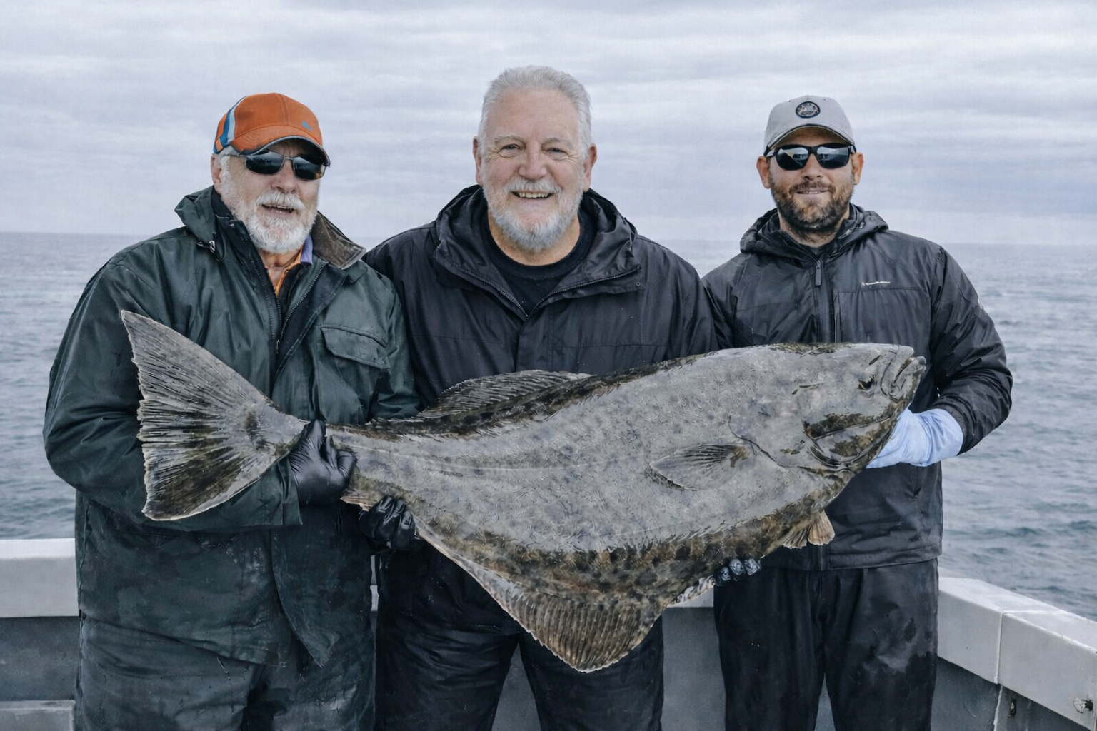
Welcome to Homer
Homer sits at the end of the Sterling Highway, overlooking Kachemak Bay, with views that seem almost exaggerated. Mountains rise straight out of the water. Glaciers hang in the distance. Bald eagles are part of the background.
This town proudly calls itself the “Halibut Fishing Capital of the World,” and it wears that title comfortably.

Slide 6
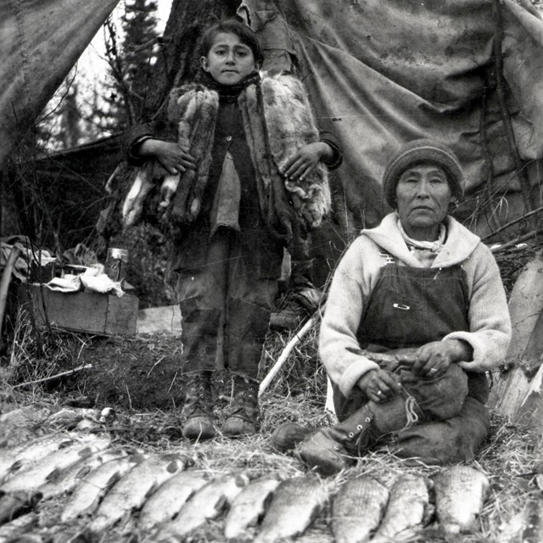
History of Homer
A Brief History of Homer
Long before Homer became a fishing and arts town, the area was used seasonally by the Dena’ina Athabascan people, who understood these waters intimately.
Homer developed in the early 1900s as a supply and fishing center. Over time, commercial fishing, tourism, and a strong arts community shaped its identity.
Homer never tried to become a city. It became a community instead.

Slide 7
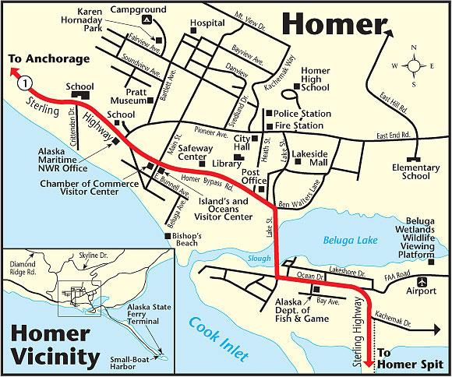
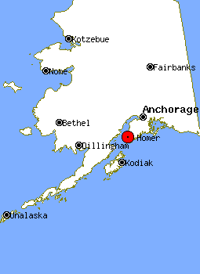

Slide 8
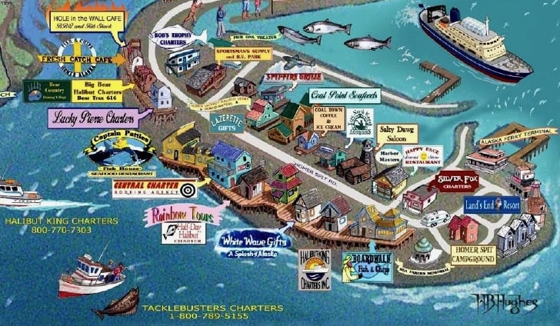

Slide 9
Getting Around Homer
Homer is compact and easy to navigate. The majority of activities and attractions are found within one mile of the boat harbor, so walking and biking, especially along the waterfront path, are feasible.
The cruise landing area connects you to the Homer Spit, the narrow strip of land extending into Kachemak Bay.
Shuttles, taxis, and ride services are usually available and easy to use. Walking works well on the Spit itself, but distances add up if you head into town.
If you plan to explore beyond the harbor, transportation is worth arranging early.

Slide 10
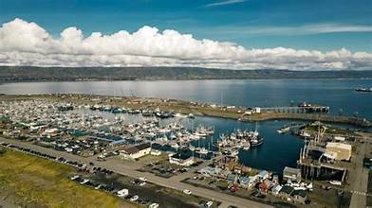
Top Attractions & Points of Interest

Slide 11
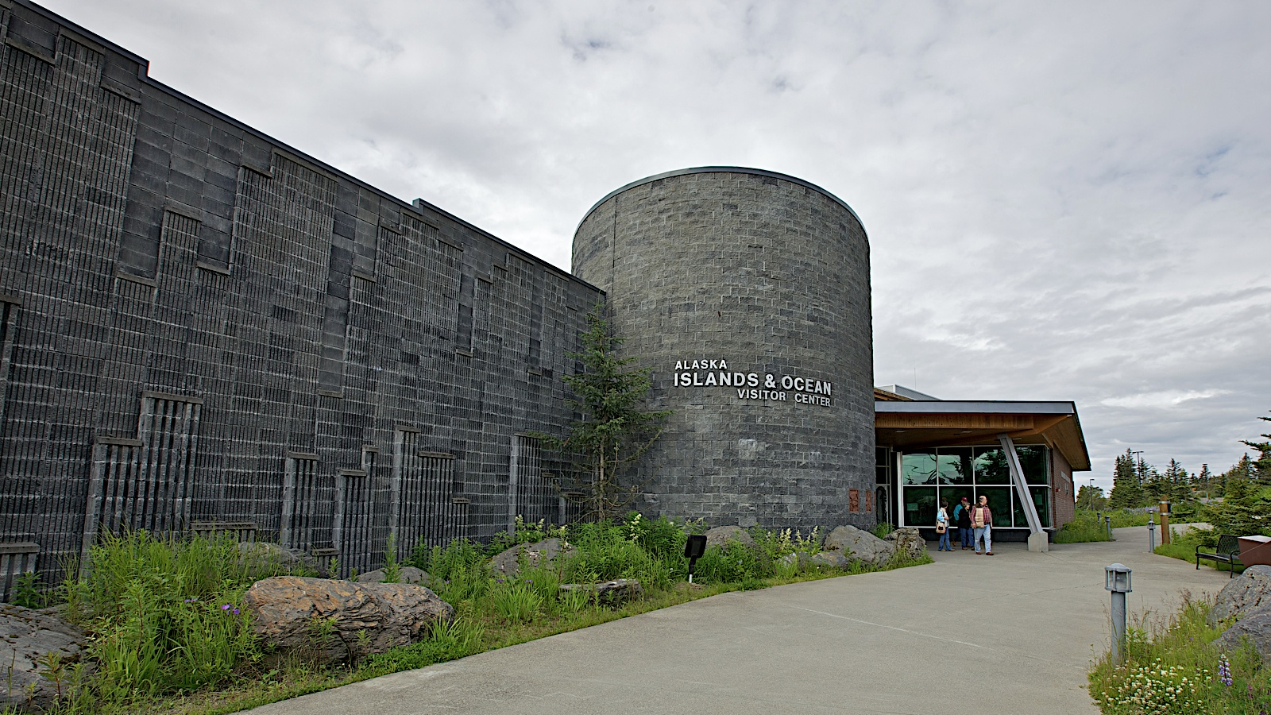
Art, Culture, and Local Character

Slide 12
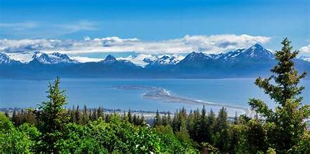
Art, Culture, and Local Character

Slide 13
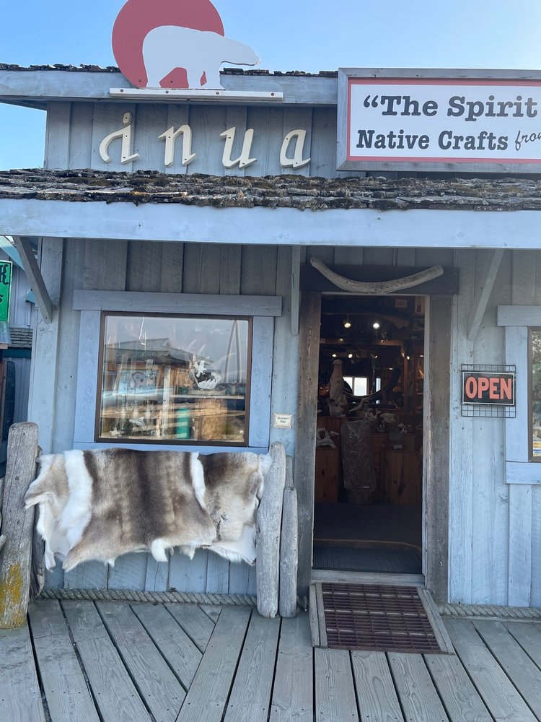
Art, Culture, and Local Character

Slide 14
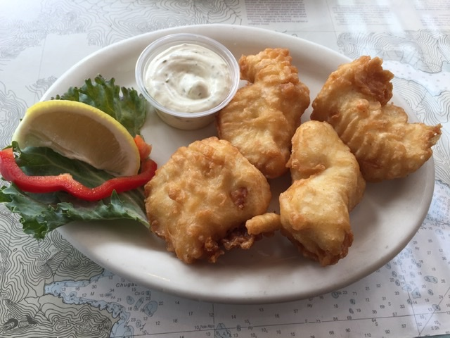
Food & Dining
Seafood is the obvious choice. Halibut, salmon, crab, and chowder show up everywhere, and usually for good reason.
Dining here is casual. Waterfront cafés, food trucks, and small restaurants dominate the scene.
This is not a white-tablecloth town.
Eat well, but don’t rush.
Homer meals tend to come with views.

Slide 15
Practical Tips
Dress in layers. Wind off the bay can change temperatures quickly.
Comfortable shoes matter. Boardwalks, gravel paths, and docks are common.
Weather changes are part of the experience. Clouds and mist are not a disappointment here, they’re normal.
And remember, Homer runs on its own clock. Let it.

Slide 16
Final Thoughts
Homer isn’t about doing everything. It’s about noticing what’s right in front of you.
Fishing boats unloading their catch. Artists opening studio doors. Mountains appearing and disappearing behind clouds.
If you slow down enough to see those things, you’ll understand why people come here for a season and stay for a lifetime.

Slide 17
Thanks For Coming
If you have any more questions, please ask.
I will do my best to answer them for you.
Have a great visit in Homer!

