Slide 1

Hobart
Tasmania
Presented by
Marc Silver

Slide 2
What I Will Cover
My Port Philosophy
Don’t Miss the Ship
Money
About Hobart
Area Map of Hobart
Map of Hobart
Hobart Transportation
Places to see or at least consider
A few restaurant recommendations
Conclusion

Slide 3
My Port Philosophy
I have been cruising for over 45 years and have taken over 200 cruises.
So, I consider myself an experienced cruiser.
The information I will present is based on those many years of
experience.
When I am on a cruise where the city, I want to visit is not the port city,
I always recommend taking a ship’s tour.
But when I am in a port with multiple attractions nearby and easy to see
on my own - I will do it on my own.
This presentation is for that type of port.

Slide 4

Don’t Miss the Ship
How to Avoid Missing Your Ship
Pay attention to the time. - Ship time and local time are often
different.
Put a return-to-ship reminder on your phone.
Choose excursions wisely.
If a ship-sponsored excursion is late returning to port, the ship will
wait for you. If you are on your own???
Be Prepared
Have your Passport, Credit Card, and phone numbers for your ship
port agent.
What to Do If You Miss the Ship
Most cruise lines have port agents stationed in the port area to assist if your ship has left without you. If your are lucky, when cruisers are late returning to the vessel, the ship’s crew will often remove the passengers’ essential items – passports, cell phones, and medication -- from the ship to leave with the port agents.
The Port Officials can help you with contacting your ship
and making necessary travel arrangements.

Slide 5

Money
The currency for Hobart is the Australian Dollar.
The conversion at the rate is $1.48 AUD to $1.00 U.S.
Or $1 AUD $.67 U.S.

Slide 6
About Hobart
The Tasmanian capital of Hobart is a dynamic city that surpasses expectations at every turn. Australia’s southernmost capital is brimming with history and bursting with creativity.
It boasts an incredible food and wine scene with local produce making the short journey from farm to table, and is fringed by scenic wilderness.
In Hobart, you can see world-renowned art, eat freshly caught seafood and climb a mountain all in one day.
Hobart is where the bulk of Tassie locals live. That’s good reason to make it your first port of call. It sits at the southern end of the island, on the edge of the River Derwent.
It is a port town that dates back to early explorers and convicts sent here for stealing rams. Water runs deep – it’s the second deepest port in the world but also offers a myriad of waterways that please the sailor who has navigated a globe of oceans.

Slide 7
Historical Hobart
Hobart’s history that goes back to the beginning of Australia. The stories of indigenous Tasmanians, explorers, mining, agriculture, and much more.
Indigenous stories date back thousands of years and are evident in middens and the way early Tasmanians touched the landscape lightly.
The history of European exploration and settlement is young in many respects. It’s a tiny patch of time. About 40 minutes from Hobart is the country’s first golf course set up by a Scottish fellow who wanted a taste of home. It happens to be very close to a whisky distillery.
Then there’s Port Arthur Historic Site. It’s the type of history that captivates crowds. Once looked upon as a dark blemish few spoke of, these days people are rather proud when they head to Port Arthur and come to find they have convict blood.

Slide 8
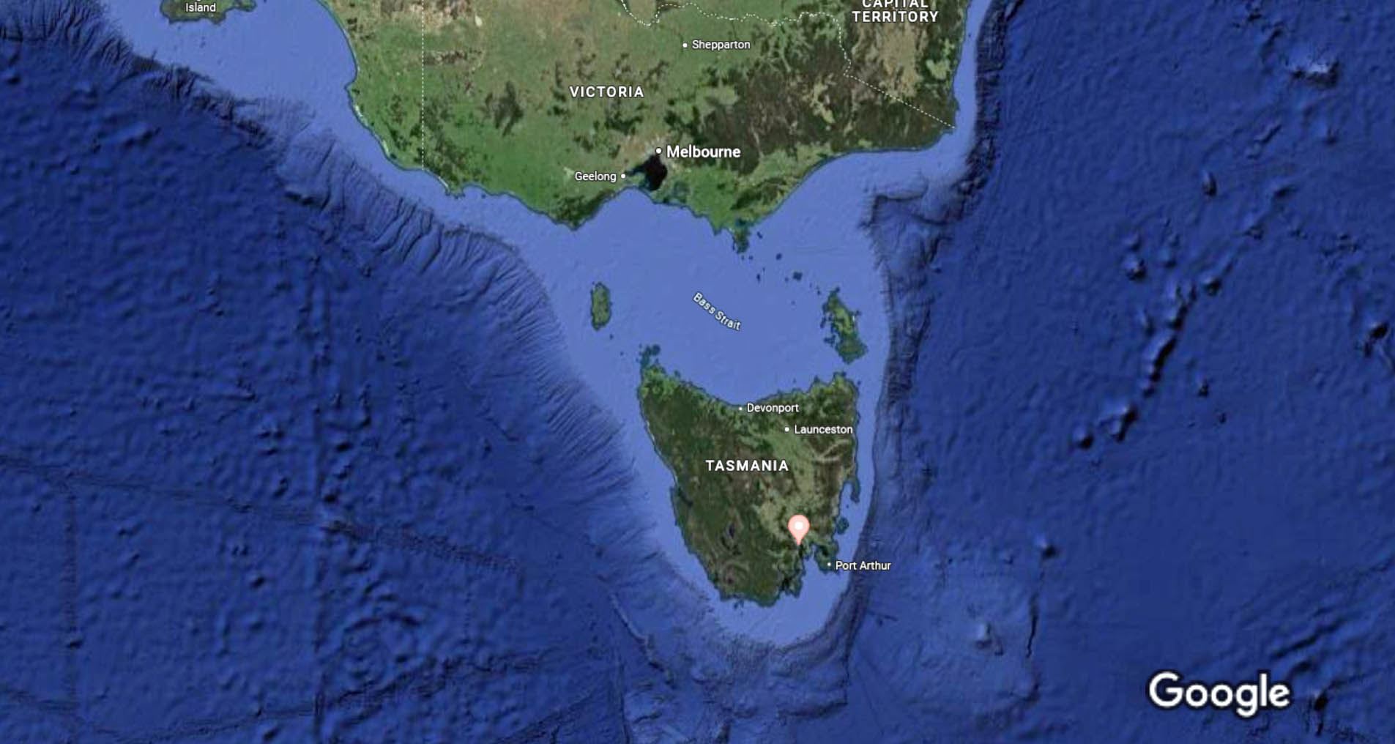
Hobart-

Slide 9
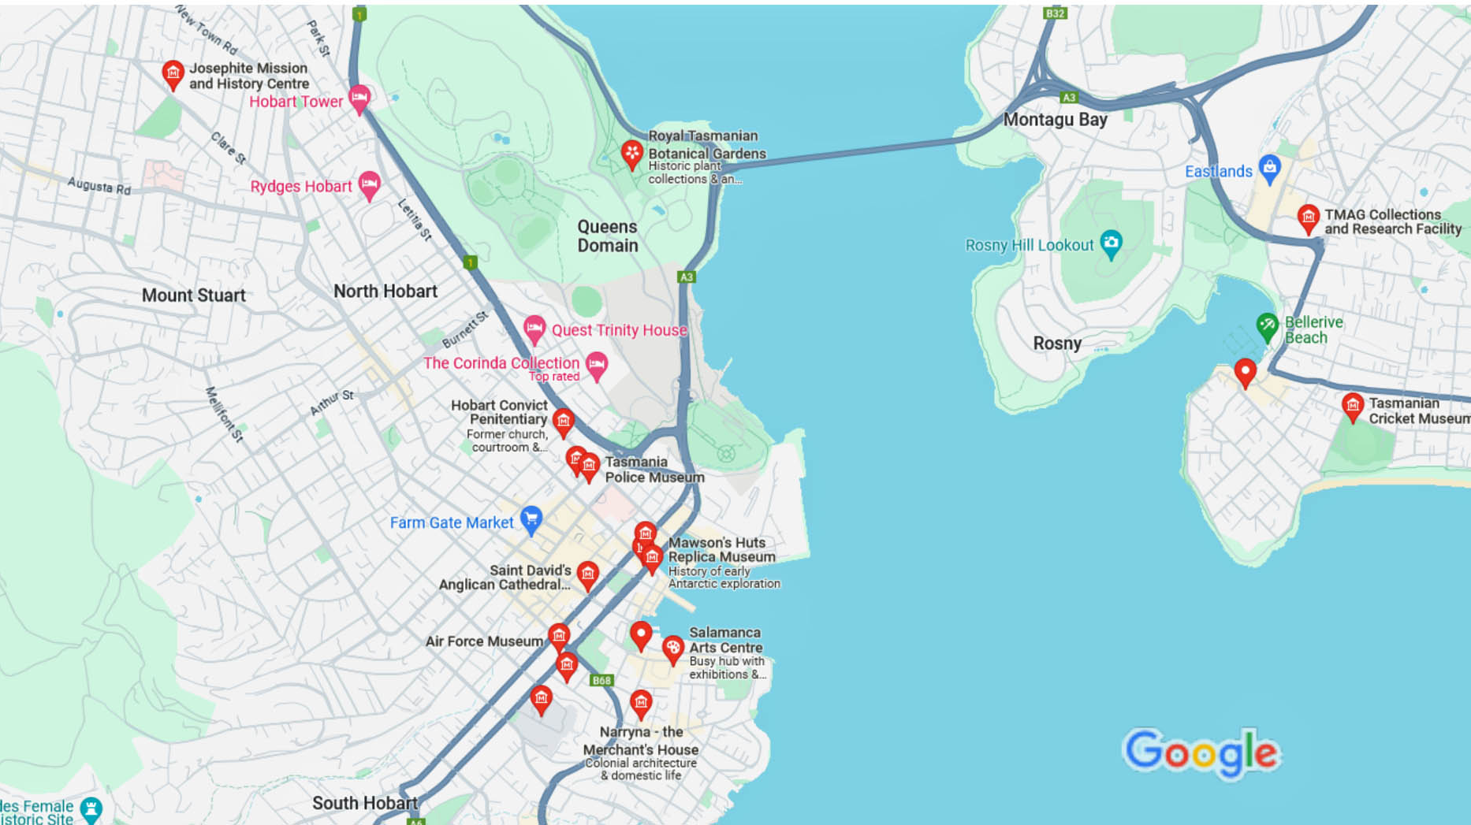
Map of Hobart

Slide 10
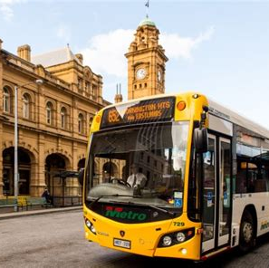
Hobart Buses
Hobart has one of the most comprehensive and user-friendly public transit systems and fare rates are very reasonable.
Urban Hobart bus fares
Adult fares: 1 Zone $1.70,
2 Zones $2.40 All Zones $3.60
Senior & Children under 18
fares: All Zones $1.20
Student fares: All Zones $1.00
Children aged under five
90 Minute Transfers

Slide 11

Hobart Taxis
Standard taxis provide a safe and reliable way to explore the city or for transport between the cruise port and various attractions.
Like taxis in most locations the cost is significantly more expensive than other modes of transport.
Rideshare services are a convenient option for short trips in Hobart.
Uber, Lyft, Didi, Ola, and other rideshares in Hobart!

Slide 12
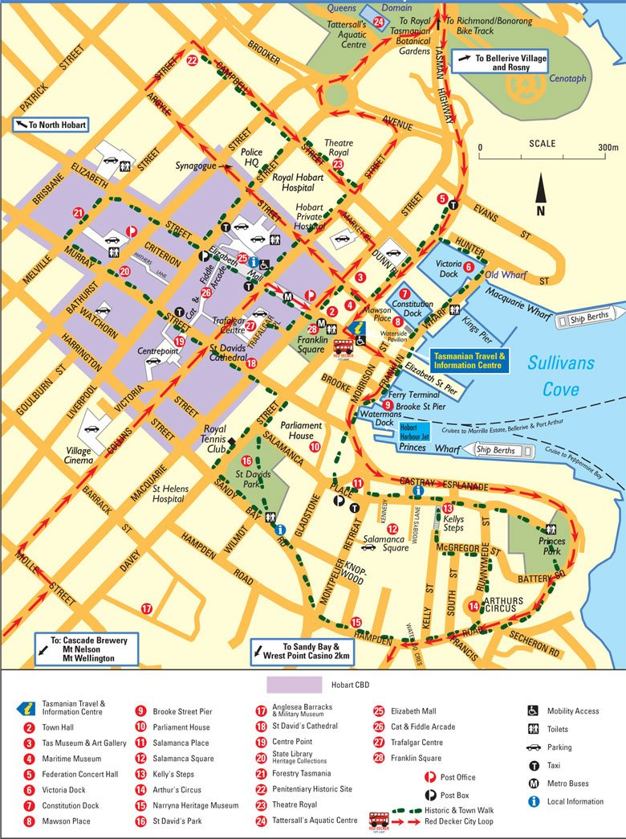
Hobart Walking Tour
Take a Hobart walking tour of the interesting points and historic buildings in the capital city of Hobart.
Depending upon how fast you walk and how much time you spend site-seeing, you need to allow at least 2 hours to walk the loop, and it is easy to spend the entire day exploring Hobart’s downtown sites.

Slide 13
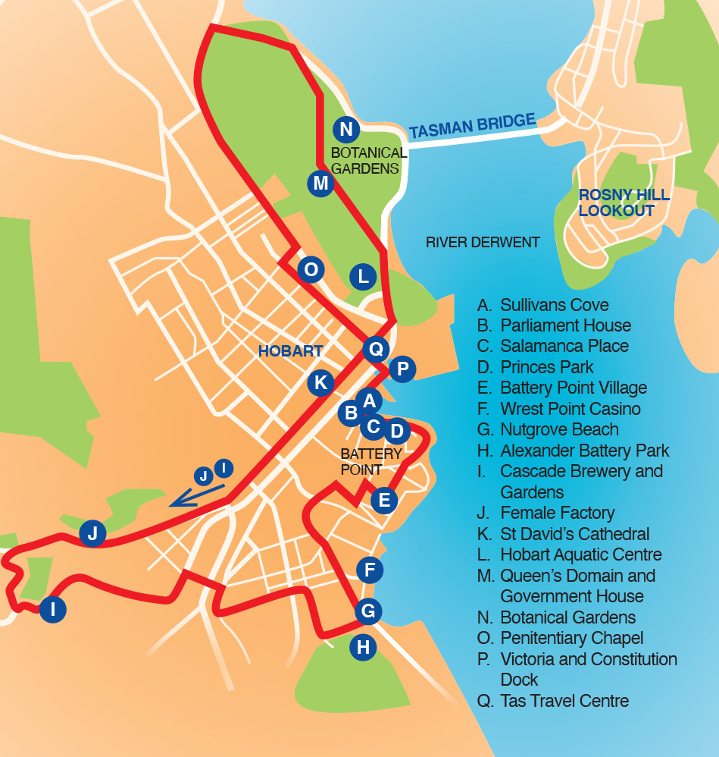
Hop on Hop Off Bus
In Hobart the hop on Bus is Red Decker.
Explore Hobart at your own pace as you hop on and off unlimited times with your HOHO pass or stay on board and do the 90-minute city loop tour – the choice is yours!
Visit 20 different stops featuring the best sights and attractions in and around Hobart with your 24 bus pass.
There is pre-recorded commentary in 8 languages available, also, Free Wi-Fi.
The closest Pick-up location by the pier is Stop P on the map at the foot of the dock.
Fare is $40/person

Slide 14
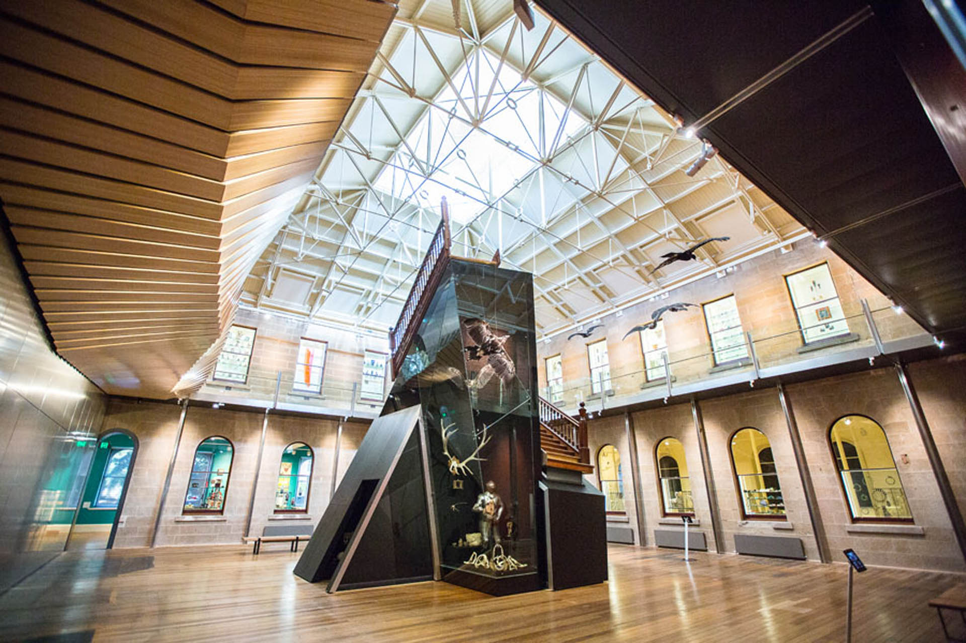
Tasmanian Museum and Art Gallery
Tasmanian Museum and Art Gallery (TMAG) is Tasmania's leading natural and cultural heritage organization. It is a combined museum, art gallery and herbarium which safeguards the physical evidence of Tasmania's natural and cultural heritage, and the cultural identity of Tasmanians.
TMAG is Australia's second-oldest museum and has its origins in the collections of Australia's oldest scientific society, the Royal Society of Tasmania, established in 1843.
The first permanent home of the museum opened on
the corner of Argyle and Macquarie streets in 1863
and the museum has gradually expanded from this
corner to occupy the entire city block.
The TMAG precinct is one of Australia's most
historically significant sites. Included in the pre
Cottage, built prior to 1815 and originally adjacent to
old Government House; and Tasmania's first federal
building, the 1902 Custom House.
Admission to TMAG is FREE!

Slide 15

Bonorong Wildlife Park
Bonorong is a Sanctuary for wildlife oven 364 days a year from 9am to 5pm
The funds generated through the Sanctuary allow them to proactively address problems in their surrounding environment and communities.
A visit to Bonorong is a chance to come closer than ever to something wild and fragile. You’ll come face to face with animals that became extinct long ago in other parts of Australia — the same animals we’re working hard to protect now.
By walking through our old wooden gate you’ll become part of something special – everything we do, we do with your help.
Admission Fee: Adults $34.50, Children 3-15 $19.50

Slide 16
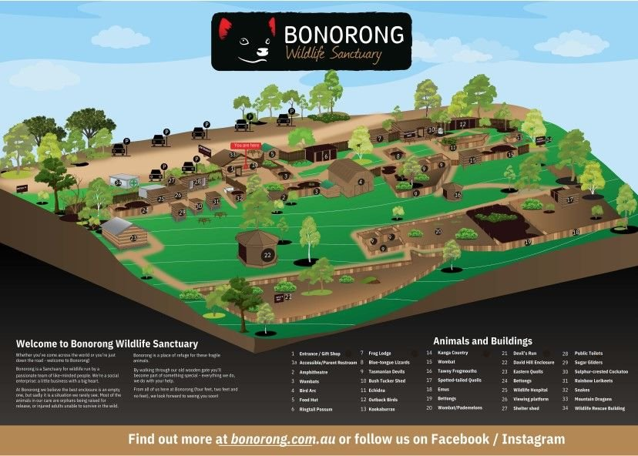
Bonorong Wildlife Park

Slide 17
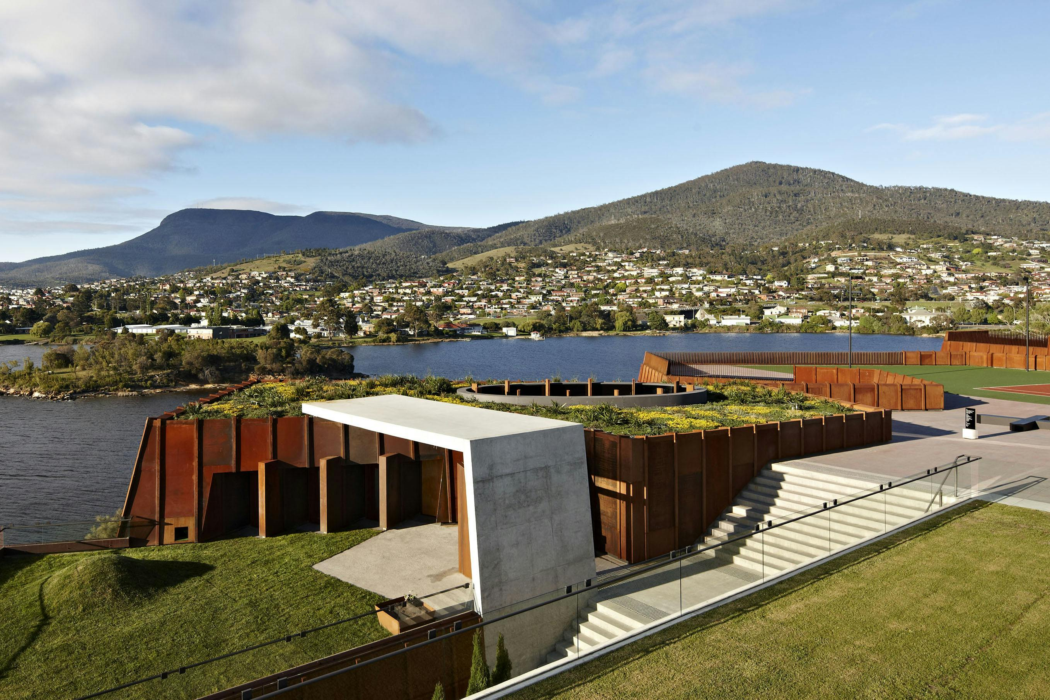
MONA
Described by its owner David Walsh as a “subversive adult Disneyland”, MONA is Australia's largest private museum and one of the most controversial private collections of modern art and antiquities in the world.
This unique and provocative art
collection will leave a lasting
impression with visitors as they
explore 3 floors of subterranean
architecture, art pieces, and
cultural exhibits.
They have old art. New art. Wine.
Dark corners. Nice views & Music.
Admission Fee: Adults $39, Children $17

Slide 18
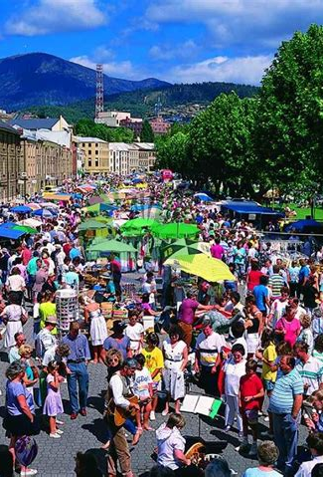
Salamanca Market
Salamanca Market is Tasmania's most visited tourism attraction and runs each Saturday from 8.30 am to 3 pm, rain, hail or shine.
The market extends the full length of Hobart's historic Salamanca Place, from the silos end to the top of Davey Street.
You will find a huge selection of locally made products and you can meet the makers, the artisans, the designers and producers.
With over 300 stallholders, the market includes fresh produce from local growers, hot coffee, delicious breakfast and lunch options, lots of gift ideas and plenty of handmade products.

Slide 19
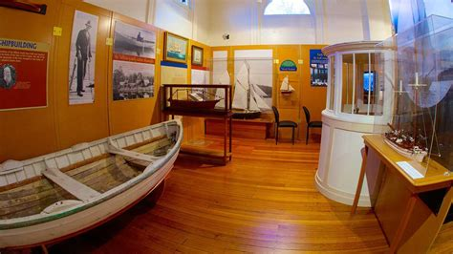
Maritime Museum
The Maritime Museum’s mission is to promote an understanding of the maritime heritage of Tasmania and its importance to people's lives.
As an island state, the sea is significant to all Tasmanians. The Museum explores the influence of the sea on the lives of Tasmanians and the strong maritime heritage of the island.
The exhibitions are informative displays about aboriginal watercraft, early European explorers and whalers, sailing and steam ships were for developing Tasmanian industries.
Discover these stories and more today on a voyage of discovery through Tasmania's maritime past.
Admission: Adults: $15 – Seniors $12
Children 12-17: $6.00 - Children <12 - FREE

Slide 20
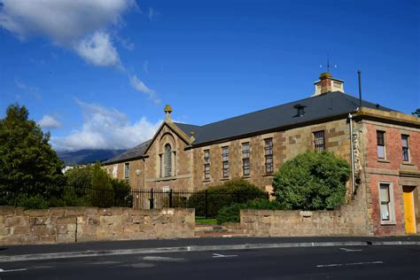
Hobart Convict Penitentiary
The Hobart Penitentiary began in 1821 as the Hobart Prison Barracks, built as accommodation for convicts employed in Government public works.
75,000 convicts were transported to Van Diemen’s Land between 1803 and 1853. Of these 62,500 were male convicts. After 1821 all male convicts were processed here before being given labor assignments across the island.
In 1857, 1860 convicts still under sentence were employed in converting two wings of the former Penitentiary Chapel as courtrooms.
One wing remained as the prison chapel for the Penitentiary, then known as the Hobart Gaol. The Hobart Town gallows were relocated to the site with thirty-two people executed at the site 1857-1946.
Guided Tours: Adults $35 | Seniors $30 | Children aged 7-16 $20 | Children 6 and under FREE

Slide 21
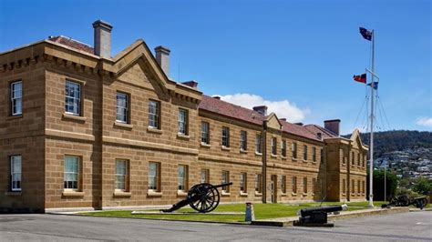
Anglesea Barracks & Military Museum
The Army Museum of Tasmania is located at Anglesea Barracks, in Davey Street.
The barracks is recognized as one of Australia’s most significant historical military precincts and its appearance today is much as it was when the first buildings were constructed in 1814.
It is located 10 minutes walk from the Visitor Information Centre in Davey Street.
Displays interpret the colonial period when the British Army occupied the site and the various conflicts Tasmanian service men and women have been involved in from 1899 to the present day.
Admission is Free

Slide 22
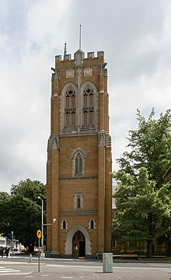
St. David Cathedral
In 1842 Hobart was declared a city and the existing St David's Church became St David's Cathedral.
The Reverend Francis Russell Nixon was appointed first Bishop of Tasmania and Frederick Holdship Cox the first Dean of St David's.
The foundation stone of a new cathedral was laid in January 1868 by Prince Alfred, Duke of Edinburgh, a son of Queen Victoria, and it was built between then and 1936, in the Gothic Revival style, to a design by the English architect George Frederick Bodley.
There are flags dating from the time when Tasmania stopped being a convict settlement. The stained-glass windows depict saints, knights, kings and biblical characters. Small memorial plaques along the walls are dedicated to deceased residents of Tasmania.

Slide 23
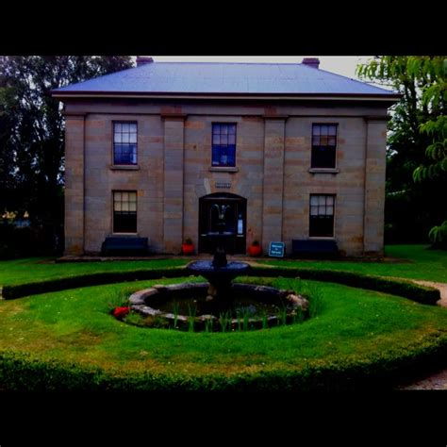
Narryna Heritage Museum
It is set in a lovely old-world garden shaded by huge elm trees is the Narryna Heritage Museum. The building was designed by Edward Winch and built for a merchant, a retired sea captain, Captain Andrew Haig, in 1836.
Approx. 5,000 items plus 124 photos (electronic) Narryna has a significant collection of 19th Century furniture, China, glass, silver paintings, children's toys and domestic equipment.
Of special interest is it's large costume and embroidery collection, possibly one of the best in Australia. The museum was established in November 1957.
The Museum is decorated in the manner of a merchant's house of the early 19th Century and much of the museum's collection is displayed in a "house museum" context.
Admission: Adult $6.00, Seniors $4.00, Child $3.00.

Slide 24

Take a Wine Tour
For the wine enthusiast taking a wine tour is always at the top of your to do list. There are multiple options available leaving from Hobart, offer wine tours, each offering one or more wine tour options across the various regions.
Tour prices ranging in price from about $150 to over $275.
There are five wine regions within easy reach of Hobart, and one that lies further afield.
Coal River Valley – 20 minutes north of Hobart (and where I call home!). Sunny and dry. Pinots, Chardonnays, Rieslings. One of the best foodie destinations in Tasmania and lots of colonial history.
Huon Valley – 30 minutes south of Hobart. Cool and wet. Pinots and chardonnays. Gorgeous valley, and a mecca for cider lovers.

Slide 25
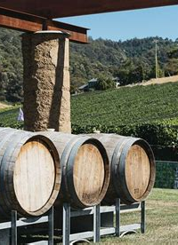
Take a Wine Tour
Derwent Valley – 20 minutes north of Hobart. Warm and sunny. Pinots, chardonnays and excellent sparkling whites. Beautiful views, especially in autumn. Emerging foodie hotspot.
D’Entrecasteaux Channel – 30 minutes south of Hobart. Cool and temperate maritime environment. Pinots. Beautiful coastal scenery. Delicious artisanal food.
Moorilla Estate – Northern suburbs of Hobart. Pinots and syrahs. One of Tasmania’s earliest vineyards. Home of the MONA museum and MOO Brew beers.
Freycinet – 2 hours north east of Hobart. Pinots, sauvignon blancs, chardonnays. Breathtaking scenery. Excellent winery lunch options.

Slide 26
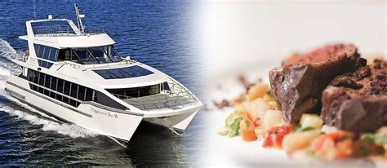
Peppermint Bay Lunch Cruise
Running out of lunch ideas in Hobart?
Here’s something that ticks all the boxes for a
memorable day and lunch on the water!
Try the Peppermint Bay lunch cruise from
Hobart and enjoy a sightseeing tour of Derwent
River, capped off with a delicious waterfront lunch.
Cruise down Derwent River, before entering the crystal-clear waters of Peppermint Bay. Take in all the delightful sights – from Sullivan’s Cove, along the channel, the jagged coastline, and everything else that adds to the charm of this cruise!
You just might spot a seal, turtle, dolphin or even a whale if it’s the right season!
At the Peppermint Bay Hotel, the chefs will have your lunch hot and ready! Lunch features a set menu inspired by seasonal produce from the in-house garden and local producers.
After enjoying your lunch, you can head back to the cruise for a return journey back to Sullivan’s Cove. Cruise and lunch $195/ person

Slide 27
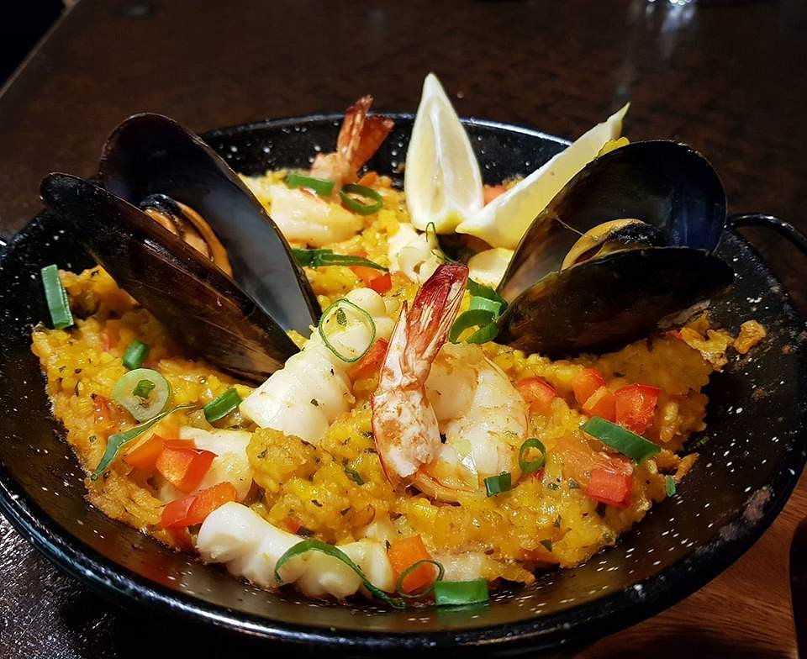
Restaurants in Hobart
There are a lot of excellent restaurants in Hobart. Here are some recommendations:
Asian Gourmet on the Pier $$ - $$$, Chinese, Asian, Cantonese
The Signal Station $$ - $$$, Cafe, Australian, Vegetarian
Da Angelo Ristorante $$ - $$$, Italian, Pizza, Neapolitan
Solo Pasta and Pizza $$ - $$$, Italian, Pizza, Vegetarian
Urban Greek $$ - $$$, Mediterranean, Greek, Healthy
Sawak Café $, Malaysian, Vegetarian Friendly, Vegan
Bar Wa Izakaya $$ - $$$, Japanese, Asian, Vegetarian
Tasty Korea Chicken And Bbq $$ - $$$, Barbecue, Asian, Korean
Syra Restaurant $$ - $$$, Lebanese, Mediterranean, Middle Eastern
Landscape Restaurant & Grill $$$$, Steakhouse, Grill, Australian
The Den Bar & Restaurant Salamanca $$ - $$$, Quick Bites, Bar, Wine Bar
The Black Footed Pig $$ - $$$, Mediterranean, European, Spanish

Slide 28
Conclusion
Hobart is a beautiful City with a rich history and numerous attractions. Regardless of what you're looking for, Hobart has something for everyone.
I hope this presentation will help when we visit Hobart!

Slide 29
Thanks For Coming
If you have any more questions, please ask.
I will do my best to answer them for you.
Have a great visit to Hobart!

Slide 30
Acknowledgement
My seminars are the result of many years of travel experience combined with many hours of research over the internet.
I would like to acknowledge the many source I have accessed.
These include: Wikipedia.com, Britannica.com, and the
various Museum, Park and Government websites.

