Slide 1
Technology Seminar
Marc Silver
Founder & President
Soundscape
Audio & Video
www.soundscapeav.com
e-mail:
marc@soundscapeav.com
Marc has over 55 years experience
as an Audio/Video Consultant and Designer.
1
Presenter: Marc Silver - Soundscapeav.com
4/2/2024
Notes:
1

Slide 2
I’m here to answer your questions!
We’ll discuss basics of Audio and Video.
I’m also here to answer any other technology related questions you may have.
If you have a question – ASK IT.
2
Presenter: Marc Silver - Soundscapeav.com
4/2/2024
Notes:
2
`

Slide 3
Topics
History of TV
EDTV, HDTV, 1080p, K4 and now 8K
OLED vs. QLED plus Plasma vs. LCD
Cable vs. Satellite vs. FREE
Blue Ray vs. 4K DVD
Dolby Digital vs. DTS
Coming technology – WHAT’S NEXT!
Q&A
3
Presenter: Marc Silver - Soundscapeav.com
4/2/2024
Notes:
3

Slide 4
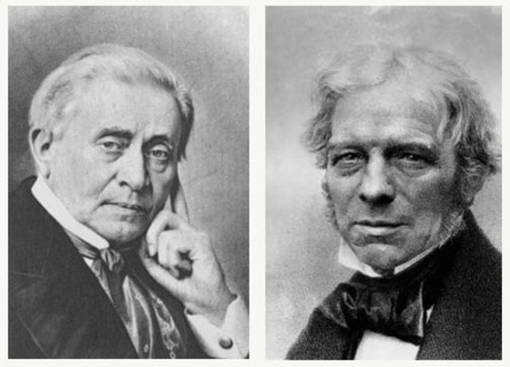
History of TV
1831 Joseph Henry’s and Michael Faraday’s work with electromagnetism jumpstarts the era of electronic communication.
4
Presenter: Marc Silver - Soundscapeav.com
4/2/2024
Notes:
It all started with the Faraday’s work on electromagnitism in 1831
4

Slide 5
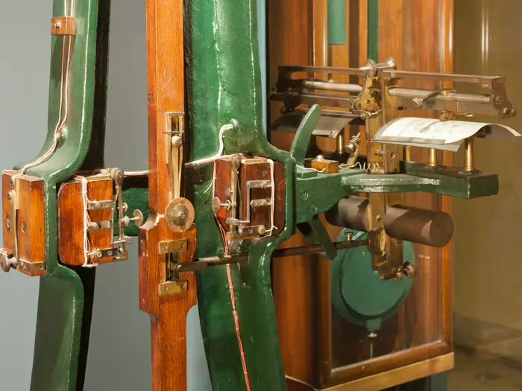
History of TV
1862 Abbe Giovanna Caselli invents his Pantelegraph and becomes the first person to transmit a still image over wires.
5
Presenter: Marc Silver - Soundscapeav.com
4/2/2024
Notes:
It all started with the Faraday’s work on electromagnitism in 1831
5

Slide 6
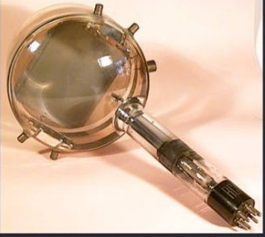
History of TV continued
1924 Vladimir Zworkin patents his iconscope a TV camera tube.
6
Presenter: Marc Silver - Soundscapeav.com
4/2/2024
Notes:
6

Slide 7
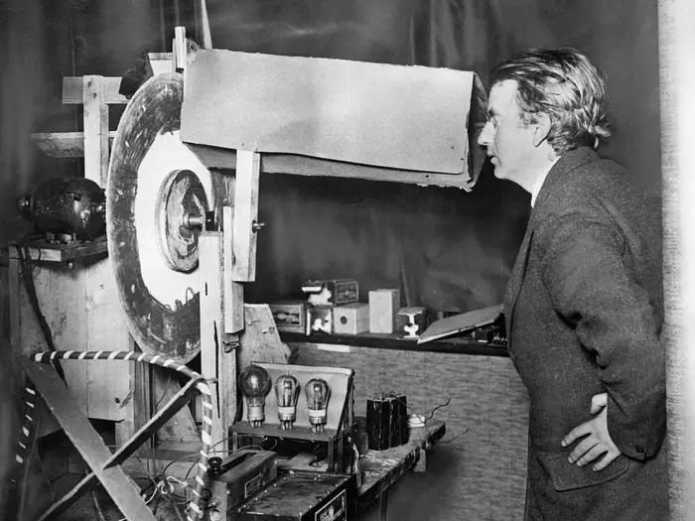
History of TV continued
1924 Scottish engineer John Baird invented the first working TV, using any material he could find, such as cardboard, a bicycle lamp, and wax.
7
Presenter: Marc Silver - Soundscapeav.com
4/2/2024
Notes:
7

Slide 8
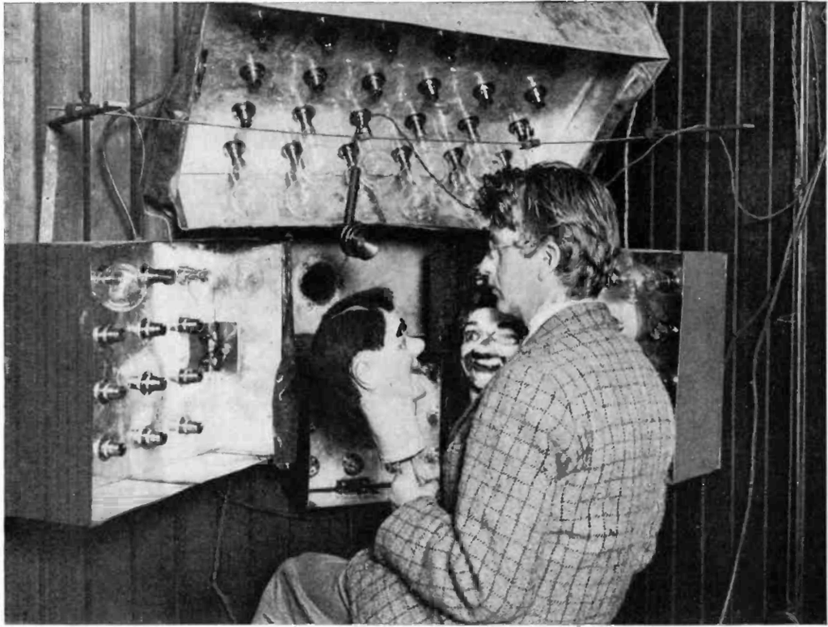
History of TV continued
In 1925, he demonstrated his invention to the public by successfully transmitting an image of a ventriloquist's dummy.
Baird's first television could transmit the outline of an image only a few feet.
8
Presenter: Marc Silver - Soundscapeav.com
4/2/2024
Notes:
In 1926 the first television image is produced. Crude and black and white, but it was television.
8

Slide 9
History of TV continued
1927 Bell Telephone and the U.S. Department of Commerce conducted the first long-distance use of television that took place between Washington D.C. and New York City on April 9th.
Secretary of Commerce Herbert Hoover commented, “Today we have, in a sense, the transmission of sight for the first time in the world’s history. Human genius has now destroyed the impediment of distance in a new respect, and in a manner hitherto unknown.”
9
Presenter: Marc Silver - Soundscapeav.com
4/2/2024
Notes:
9
A year later the syse was put to the test.
That same year Philo Fransworth, files for a patent on the first complete electronic television system, which he called the Image Dissector.

Slide 10
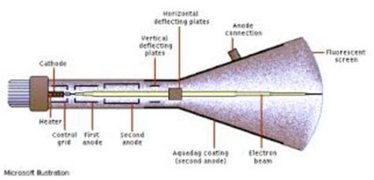
History of TV continued
1928 The Federal Radio Commission issues the first television station license (W3XK) to Charles Jenkins.
1929 Vladimir Zworkin demonstrates the first practical electronic system for both the transmission and reception of images using his new kinescope tube.
Notes:
10

Slide 11
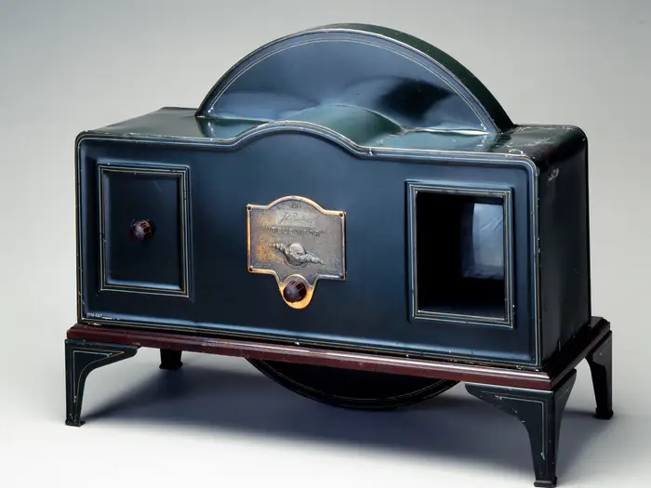
History of TV continued
1929 The Baird Televisor became the first television sold commercially.
Notes:
11

Slide 12
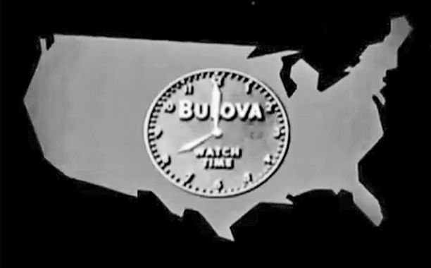
History of TV continued
1930 Charles Jenkins broadcasts the first TV commercial.
12
Presenter: Marc Silver - Soundscapeav.com
4/2/2024
Notes:
12

Slide 13
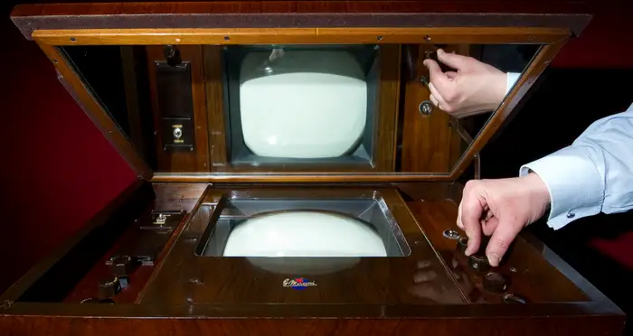
History of TV continued
1930 the Marconi 702 was a luxury item only the rich could afford.
The TV set sold in the UK for £100 ($130), which was half of an average annual salary in the 1930s.
Notes:
13

Slide 14

History of TV continued
1933 Iowa State University (W9XK) starts broadcasting twice weekly television programs in cooperation with radio station WSUI.
14
Presenter: Marc Silver - Soundscapeav.com
4/2/2024
Notes:
14

Slide 15
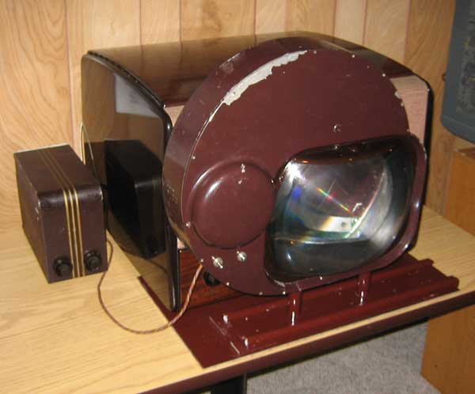
History of TV continued
1936 About 200 television sets are in use world-wide.
1937 Work begins on CBS’s Mechanical Color Television
15
Presenter: Marc Silver - Soundscapeav.com
4/2/2024
Notes:
15

Slide 16
History of TV continued
1939 Vladimir Zworkin and RCA conduct experimentally broadcasts from the Empire State Building.
Television was demonstrated at the New York World's Fair with 1st Presidential speech (Roosevelt) on television.
16
Presenter: Marc Silver - Soundscapeav.com
4/2/2024
Notes:
16

Slide 17
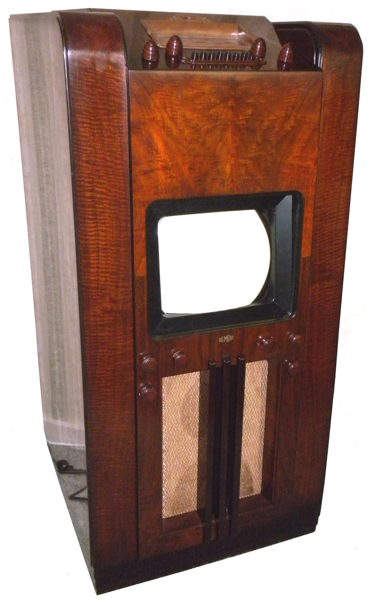
History of TV continued
RCA's David Sarnoff used his company's exhibit at the 1939 World's Fair to introduce RCA's new line of television receivers.
The Dumont company starts making TV sets.
Presenter: Marc Silver - Soundscapeav.com
17
4/2/2024
Notes:
17

Slide 18
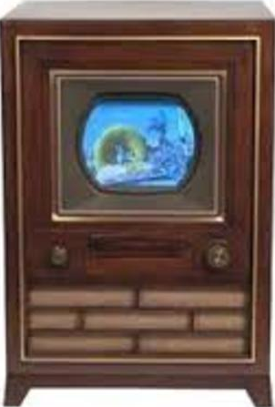
History of TV continued
1940 Peter Goldmark invents a 343 lines of resolution color television system.
1941 The FCC releases the NTSC standard for black and white TV.
1943 Vladimir Zworkin developed a better camera tube called the Orthicon. The Orthicon had enough light sensitivity to record outdoor events at night.
18
4/2/2024
Notes:
18

Slide 19
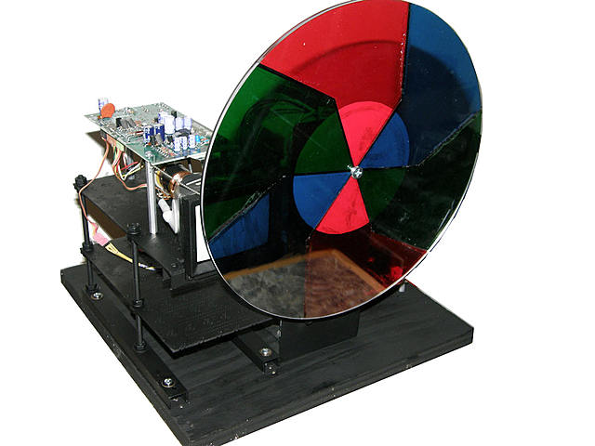
History of TV continued
1946 Peter Goldmark, working for CBS, demonstrated his color television system to the FCC. His system produced color pictures by having a red-blue-green wheel spin in front of a cathode ray tube.
19
Presenter: Marc Silver - Soundscapeav.com
4/2/2024
Notes:
19
1946 In Atlantic City, viewers could come to the convention center to see broadcasts of operations. Reports from the time noted that the realism of seeing surgery in color caused more than a few viewers to faint.
Although Goldmark's mechanical system was eventually replaced by an electronic system he is recognized as the first to introduce a broadcasting color television system.

Slide 20

History of TV continued
1947 marks the debut of two milestone television programs, both broadcast by NBC. Howdy Doody was the 1st TV show for young viewers.
Meet the Press begins its
reign as television’s longest-
running program, of over
77 years.
Notes:
20

Slide 21
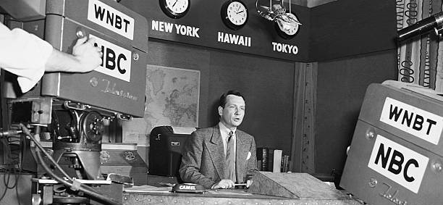
History of TV continued
Both NBC and CBS unveil fifteen-minute national newscasts during the 1947-48 season. John Cameron Swayze is the host of NBC's Camel News Caravan. CBS produces Television News with Douglas Edwards.
Notes:
21

Slide 22
History of TV continued
1948 Cable television is introduced in Pennsylvania as a means of bringing television to rural areas.
A patent was granted to Louis W. Parker for a low-cost television receiver.
One million homes in the United States have television sets.
22
Presenter: Marc Silver - Soundscapeav.com
4/2/2024
Notes:
Cable television, formerly known as Community Antenna Television or CATV, was born in the mountains of Pennsylvania in the late 1940's.
22

Slide 23
History of TV continued
1950 The FCC approved the first color television standard which was replaced by a second in 1953.
23
Presenter: Marc Silver - Soundscapeav.com
4/2/2024
Notes:
23
1956 Ampex introduces the first practical videotape system of broadcast quality.
1956 Robert Adler invents the first practical remote control called the Zenith Space Commander. It was proceeded by wired remotes and units that failed in sunlight. (then known as Zenith Radio Corporation).

Slide 24
History of TV continued
Due to price drops, Americans were buying 100,000 TVs a week in 1949. The mania swept from the cities into rural areas where farmers got their first glimpse.
24
Presenter: Marc Silver - Soundscapeav.com
4/2/2024
Notes:
24
1956 Ampex introduces the first practical videotape system of broadcast quality.
1956 Robert Adler invents the first practical remote control called the Zenith Space Commander. It was proceeded by wired remotes and units that failed in sunlight. (then known as Zenith Radio Corporation).

Slide 25
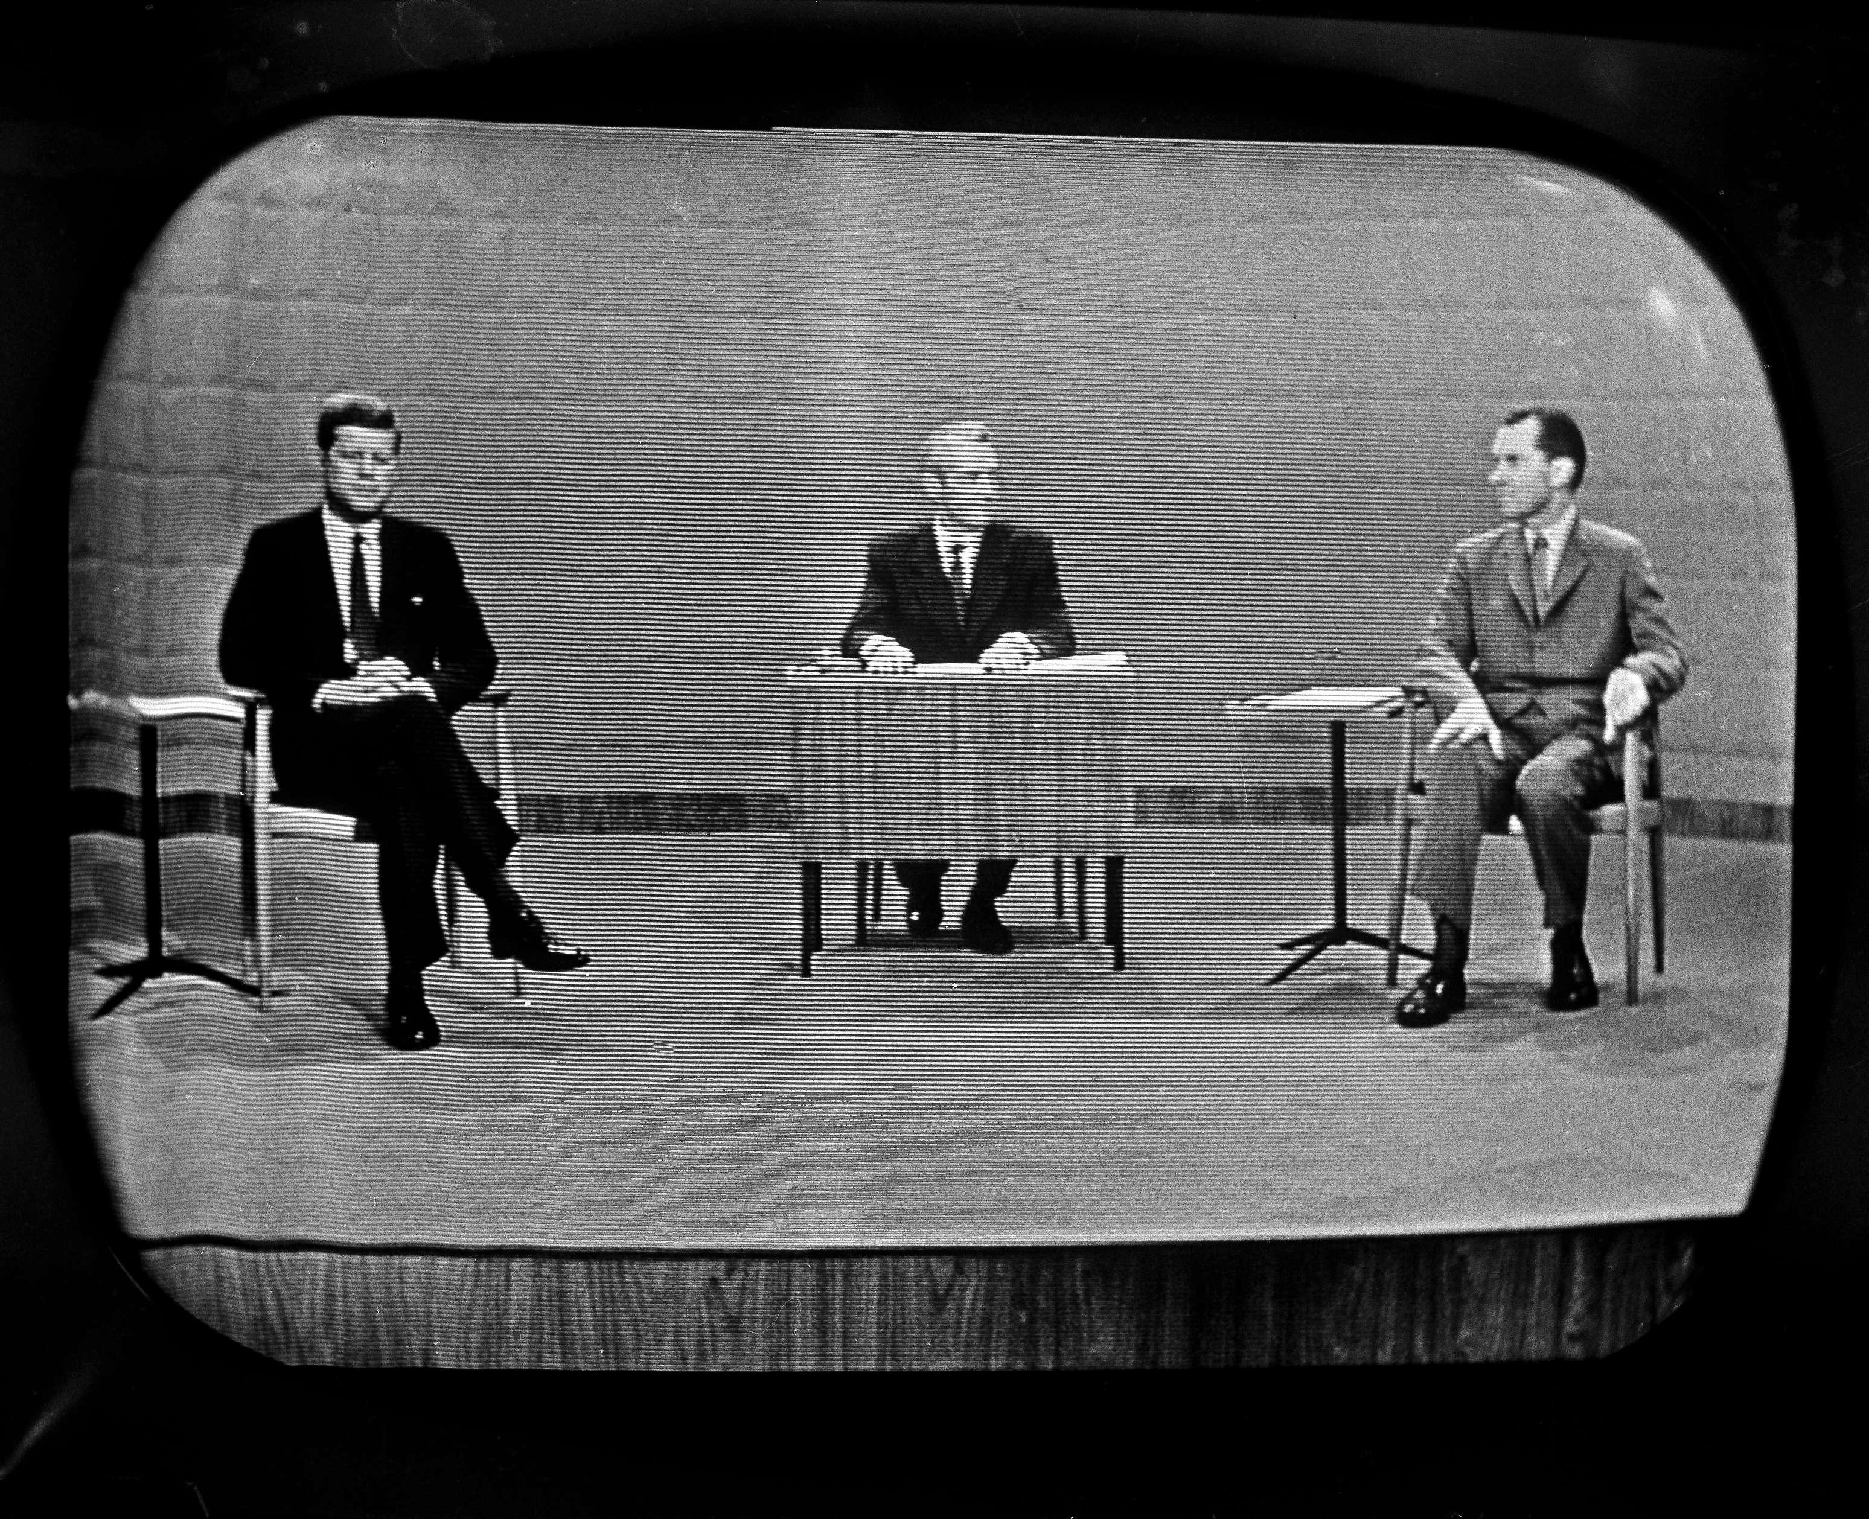
History of TV continued
1960 The first split screen broadcast occurs on the Kennedy - Nixon debates.
1962 The All-Channel Receiver Act requires that UHF tuners (channels 14 to 83) be included in all sets.
25
Presenter: Marc Silver - Soundscapeav.com
4/2/2024
Notes:
25

Slide 26
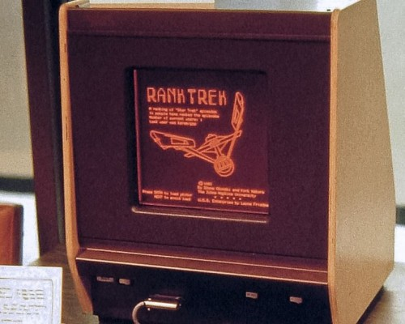
History of TV continued
The very first prototype for a plasma display monitor was invented in 1964 by Donald Bitzer, Gene Slottow, and Robert Willson.
26
Presenter: Marc Silver - Soundscapeav.com
4/2/2024
Notes:
26

Slide 27
History of TV continued
1967 Most TV broadcasts are in color.
1969 July 20, first TV transmission from the moon and 600 million people watch.
1972 Half the TVs in homes are color sets.
1973 Giant screen projection TV is first marketed.
1976 Sony introduces betamax, the first home video cassette recorder.
27
Presenter: Marc Silver - Soundscapeav.com
4/2/2024
Notes:
27

Slide 28
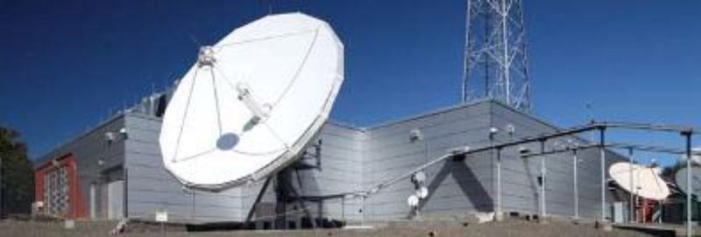
History of TV continued
1978 PBS becomes the first station to switch to all satellite delivery of programs.
28
Presenter: Marc Silver - Soundscapeav.com
4/2/2024
Notes:
28

Slide 29
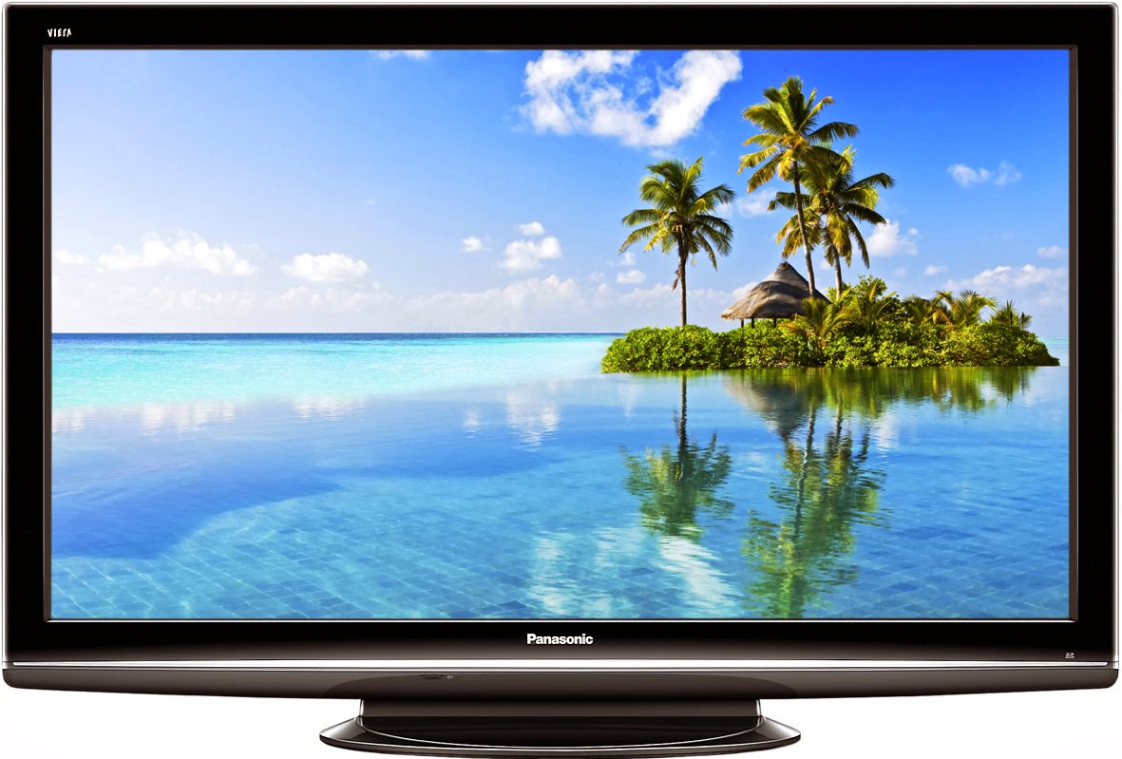
History of TV continued
1981 1,125 Lines of Resolution
NHK (Nippon Hoso Kyokai)
29
Presenter: Marc Silver - Soundscapeav.com
4/2/2024
Notes:
29

Slide 30
History of TV continued
1982 Dolby surround sound for home sets is introduced.
1983 Direct Broadcast Satellite begins service in Indianapolis, In.
30
Presenter: Marc Silver - Soundscapeav.com
4/2/2024
Notes:
30

Slide 31
History of TV continued
1986 Super VHS introduced.
1993 Closed captioning required on all sets.
1996 The FCC approves ATSC's HDTV standard.
1996 A billion TV sets worldwide
31
Presenter: Marc Silver - Soundscapeav.com
4/2/2024
Notes:
31

Slide 32
History of TV continued
1996 The FCC approves ATSC's HDTV standard.
32
Presenter: Marc Silver - Soundscapeav.com
4/2/2024
Notes:
32

Slide 33
HDTV continued
May 30, 2007 NHK's (Nippon Hoso Kyokai) Science and Technical Research Laboratories demonstrates Ultra HD signal; 16 times better then HDTV referred to as 4K.
Super Hi-Vision technology capable of a 7680x4320 resolution.
33
Presenter: Marc Silver - Soundscapeav.com
4/2/2024

Slide 34
History of TV continued
Midnight on February 17, 2009, all U.S. TV broadcasts are now in all-digital format.
This meant that if you had an analog TV and receive TV signals via an antenna, you either needed to switch to a digital TV or get a TV converter.
You couldn’t watch any more television after February 17, 2009.
34
Presenter: Marc Silver - Soundscapeav.com
4/2/2024
Notes:
34

Slide 35
EDTV, HDTV, 1080p, 4K and 8K
The consumer electronics industry has done a spectacular job spreading mass confusion about video.
35
Presenter: Marc Silver - Soundscapeav.com
4/2/2024
Notes:
35

Slide 36
HDTV continued
January 2013 Sharp showed off the first actual 8K TV at CES 2013. 8K would provide a whopping 16 times the pixels of HD and four times the pixels of 4K.
8K resolution equates to 7,680 × 4,320, or 33 million pixels (33,117,600, to be exact).
36
Presenter: Marc Silver - Soundscapeav.com
4/2/2024

Slide 37

HDTV continued
2016 Japanese broadcaster NHK kicking off the first 8K satellite broadcasts.
Later that year, part of the 2016 Rio Olympics were shot and broadcast in 8K by NHK, though
viewers could
only watch
them in that
resolution at
special theaters.
37
4/2/2024

Slide 38
HDTV continued
And if you think you are confused now, just go talk to any sales rep on the floor of your local A/V dealer and you will get some insight into what true confusion is all about.
38
Presenter: Marc Silver - Soundscapeav.com
4/2/2024
Notes:
38

Slide 39
HDTV continued
Most of those salespeople have little or no training and can't tell you anything meaningful about good video.
Invariably however they are pushing the deal of the week and selling equipment that may be exactly wrong for your needs.
39
Presenter: Marc Silver - Soundscapeav.com
4/2/2024
Notes:
39

Slide 40
HDTV continued
Let’s clear up some of that confusion
40
Presenter: Marc Silver - Soundscapeav.com
4/2/2024
Notes:
40

Slide 41
HDTV continued
What do the actual numbers mean?
41
Presenter: Marc Silver - Soundscapeav.com
4/2/2024
Notes:
41

Slide 42
HDTV continued
Progressive scan is basically the same thing with each line scanned one after the other in a progressive manner. Still 1080 lines of resolution.
The Big Mistake happened when people were told progressive scan was twice as good because it had twice the resolution.
42
Presenter: Marc Silver - Soundscapeav.com
4/2/2024
Notes:
42

Slide 43
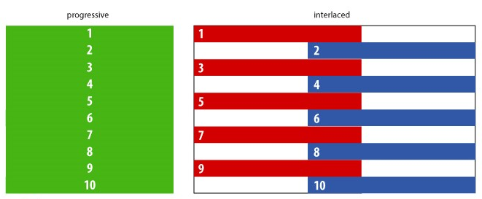
HDTV continued
What is Interlacing?
Each frame is painted on the screen line-by-line in two passes.
43
Presenter: Marc Silver - Soundscapeav.com
4/2/2024
Notes:
43

Slide 44
HDTV continued
What is Progressive scan
Progressive scan is basically the same thing with each line scanned one after the other in a progressive manner.
Now 8K is 7,680 horizontal resolution and 4,320 vertical lines of resolution.
44
Presenter: Marc Silver - Soundscapeav.com
4/2/2024
Notes:
44

Slide 45
HDTV continued
What’s HDTV?
The most popular HDTV format is 1080i, or 1080 lines interlaced.
But most people watch 720p, the minimum standard for HDTV. Though it has fewer lines, the native progressive scan format eliminates motion artifacts.
45
Presenter: Marc Silver - Soundscapeav.com
4/2/2024
Notes:
45

Slide 46
HDTV continued
1080p is the shorthand name for a category of display resolutions.
The number "1080" represents 1,080 lines of vertical resolution, while the letter p stands for progressive scan (meaning the image is not interlaced).
This creates a frame resolution of 1920×1080, or 2,073,600 pixels in total.
46
Presenter: Marc Silver - Soundscapeav.com
4/2/2024
Notes:
46

Slide 47
HDTV continued
1080p is sometimes referred to in marketing materials as "Full High-Definition".
In addition to the meaning of 1080p as a display resolution, 1080p is also used to describe video equipment capabilities.
47
Presenter: Marc Silver - Soundscapeav.com
4/2/2024
Notes:
47

Slide 48
HDTV continued
In the United States, the ATSC is considering amending its standard to allow the incorporation of the newer 1080p codecs.
Of course 4K (2160p) is on the horizon for broadcast and available now streaming.
Streaming 8K real time will soon happen with the help of 5G technology.
48
Presenter: Marc Silver - Soundscapeav.com
4/2/2024
Notes:
48

Slide 49
Plasma vs. LCD
What is an LCD TV?
LCD TV’s use a florescent backlight to send light through its liquid crystal molecules and a polarizing substrate.
LCD TVs work passively, with red, green and blue pixels. By applying voltage to the pixels using a matrix of wires, the pixels can be darkened to prevent the backlight from showing through.
49
Presenter: Marc Silver - Soundscapeav.com
4/2/2024
Notes:
49

Slide 50
What is 4K and 8K?
8K is not double the resolution of 4K, it’s actually a whopping 16 times the pixels of HD and four times the pixels of 4K.
8K resolution equates to 7,680 × 4,320, or 33 million pixels (33,117,600, to be exact), instead of 4K’s 3,840 × 2,160 (8,294,400 pixels).
50
Presenter: Marc Silver - Soundscapeav.com
4/2/2024

Slide 51
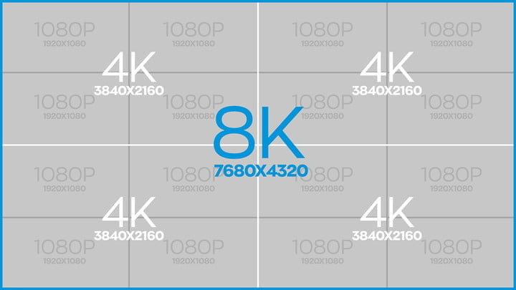
What is 8K?
To more easily visualize it, imagine four 4K TVs placed in a four-by-four grid. That is a lot of pixels.
51
Presenter: Marc Silver - Soundscapeav.com
4/2/2024

Slide 52
Plasma vs. LCD continued
LCD Display Advantages
    Good color reproduction and improving contrast (high contrast tied to peak brightness capability however)
    Very thin
    Relatively lightweight with flexible mounting options
    Perfect sharpness at native resolution
    Excellent longevity
    Among the brightest direct view displays
Highest resolutions possible (1080p models shipping)
    No practical screen burn-in effect
52
Presenter: Marc Silver - Soundscapeav.com
4/2/2024
Notes:
52

Slide 53
Plasma vs. LCD continued
LCD Display Disadvantages
    Fixed resolution
    Notorious "screen door" effect on lesser models (mostly smaller mobile displays)
    Very difficult to produce deep blacks (LED backlighting improving this)
53
Presenter: Marc Silver - Soundscapeav.com
4/2/2024
Notes:
53

Slide 54
Plasma vs. LCD continued
What is a Plasma Screen ?
Today Plasma TVs are considered obsolete.
Plasma screens are a matrix of red, green and blue phosphors that make up each individual pixel captured between two thin layers of glass.
These pixels made up of rare natural gases of argon, neon and xenon used to produce the color information and light. When excited electronically the phosphors create plasma thus emitting UV light.
54
Presenter: Marc Silver - Soundscapeav.com
4/2/2024
Notes:
54

Slide 55
Plasma vs. LCD continued
Plasma Advantages
Excellent (real) contrast ratios and black levels
Excellent color reproduction
Excellent life expectancy
55
Presenter: Marc Silver - Soundscapeav.com
4/2/2024
Notes:
55

Slide 56
Plasma vs. LCD continued
Plasma Disadvantages
Fixed resolution
Although thin, plasma TVs are fairly heavy
Susceptible to screen burn-in (new models compensate with various screen-saving methods)
Lower real peak brightness
56
Presenter: Marc Silver - Soundscapeav.com
4/2/2024
Notes:
56

Slide 57
What’s next in Flat screen Technology?
OLED – Organic Light Emitting Device
OLEDs can provide desirable advantages over today’s liquid crystal displays (LCDs), as well as benefits to product designers and end users. OLEDs feature:
Vibrant colors High contrast
Excellent grayscale Full-motion video
Wide viewing angles A wide range of pixel sizes
Low power consumption Low operating voltages
Long operating lifetime A thin and lightweight form factor
Cost-effective manufacturability
57
Presenter: Marc Silver - Soundscapeav.com
4/2/2024
Notes:
57

Slide 58
OLED vs QLED
LG developed OLED and Samsung confused the market with the introduction of QLED or Quantum LED.
Do not be confused QLED is simply an improvement on LED back lite TV technology.
58
Presenter: Marc Silver - Soundscapeav.com
4/2/2024

Slide 59
OLED vs QLED continued
Two rival TV brands use very similar acronyms to describe their BestTVs
But QLED and OLED are as different as Apples and Oranges.
QLED is a variation of LED LCD, adding a quantum dot film to the LCD "sandwich."
59
Presenter: Marc Silver - Soundscapeav.com
4/2/2024

Slide 60
OLED vs QLED continued
OLED is "emissive," meaning the pixels emit their own light.
QLED, like LCD, is, in its current form, "transmissive" and relies on an LED backlight.
60
Presenter: Marc Silver - Soundscapeav.com
4/2/2024

Slide 61
What’s next in Flat screen Technology?
SED Next-Generation Flat-Screen Display
Like CRT systems, SEDs are self-emitting displays, based on a principle that utilizes the collision of electrons with a phosphor-coated screen.
While offering the same fast video response and high contrast as CRTs, because they do not require electron beam deflection, SEDs combine a slim body design with high-definition, low-distortion imaging performance.
61
Presenter: Marc Silver - Soundscapeav.com
4/2/2024
Notes:
61

Slide 62
Cable vs. Satellite vs. FREE
Cable TV
Advantages:
It works during very bad climate conditions.
No contracts.
Disadvantages:
Higher cost for service.
Lower picture quality.
62
Presenter: Marc Silver - Soundscapeav.com
4/2/2024
Notes:
62

Slide 63
Cable vs. Satellite vs. FREE continued
Satellite TV
Advantages:
Superior picture quality.
More HD channels.
Lower cost for service.
Disadvantages:
It works during very bad climate conditions.
No contracts.
63
Presenter: Marc Silver - Soundscapeav.com
4/2/2024
Notes:
63

Slide 64
Cable vs. Satellite vs. FREE continued
What’s Better?
The truth is regardless of who you get your service from, DISH, Direct TV or Comcast Cable – They all treat you like #%&^!
64
Presenter: Marc Silver - Soundscapeav.com
4/2/2024
Notes:
64

Slide 65
Cable vs. Satellite vs. FREE continued
What’s Better?
FREE is BETTER!
What’s the catch?
You need to be in a Major metropolitan area.
If you live in New York, LA, Chicago, Seattle, Miami, or any other major city you can use a standard antenna and get.
65
Presenter: Marc Silver - Soundscapeav.com
4/2/2024
Notes:
65

Slide 66
Cable vs. Satellite vs. FREE continued
So what's the catch?
You can only receive broadcast channels. So many networks like Discovery, History, Comedy Central, A&E, National Geographic and many many others are not available.
66
Presenter: Marc Silver - Soundscapeav.com
4/2/2024

Slide 67
Dolby Digital vs. DTS
Dolby® Digital
In thousands of cinemas and millions of homes worldwide, Dolby Digital is the reigning standard for surround sound technology in general and 5.1-channel surround sound in particular.
Dolby Digital is a highly sophisticated and versatile audio encoding/decoding technology. Dolby Digital technology can transmit mono, stereo (two-channel), or up to 7.1-channel surround sound in discrete multi-channel audio.
67
Presenter: Marc Silver - Soundscapeav.com
4/2/2024
Notes:
67

Slide 68
Dolby Digital vs. DTS continued
First used in movie theaters in 1992, Dolby Digital technology is the result of decades spent by Dolby Laboratories developing signal-processing systems that exploit the characteristics of human hearing.
68
Presenter: Marc Silver - Soundscapeav.com
4/2/2024
Notes:
68

Slide 69
Coming Technology – WHAT’S NEXT!
Today’s latest and greatest format is called 4K and is soon to be replaced by 8K.
May 30, 2007 NHK's (Nippon Hoso Kyokai) Science and Technical Research Laboratories demonstrates Ultra HD signal; 16 times better then HDTV.
NHK's Science and Technical Research Laboratories demonstrated Super Hi-Vision technology capable of a 7680x4320 resolution.
69
Presenter: Marc Silver - Soundscapeav.com
4/2/2024
Notes:
69
BUT WAIT! There’s more.

Slide 70
Coming Technology – WHAT’S NEXT!
SED, or Surface-conduction Electron-emitter Displays are a new, emerging technology co-developed by Canon and Toshiba Corporation.
The hope for this technology is a display which reproduces vivid color, deep blacks, fast response times and almost limitless contrast.
70
Presenter: Marc Silver - Soundscapeav.com
4/2/2024
Notes:
70

Slide 71
Coming Technology – WHAT’S NEXT!
An SED display is very similar to a CRT (and now we come full circle) in that it utilizes an electron emitter which activates phosphors on a screen.
71
Presenter: Marc Silver - Soundscapeav.com
4/2/2024
Notes:
71

Slide 72
Coming Technology – WHAT’S NEXT!
Canon debuted an SED display prototype at the la Defense in Paris in October 2005. The specs referenced a < 1ms response time, 100,000:1 contrast ratio, brightness of 400 cd/m^2, and 180 degree viewing angle in all directions.
We are still waiting to see if it comes to market.
72
Presenter: Marc Silver - Soundscapeav.com
4/2/2024
Notes:
72

Slide 73
Q&A
WHAT ELSE DO YOU WANT TO KNOW!
73
Presenter: Marc Silver - Soundscapeav.com
4/2/2024
Notes:
73

Slide 74
Summary
I hope I’ve educated and entertained you today.
I can be contacted by e-mail at:
marc@soundscapeav.com
74
Presenter: Marc Silver - Soundscapeav.com
4/2/2024
Notes:
74

