Slide 1
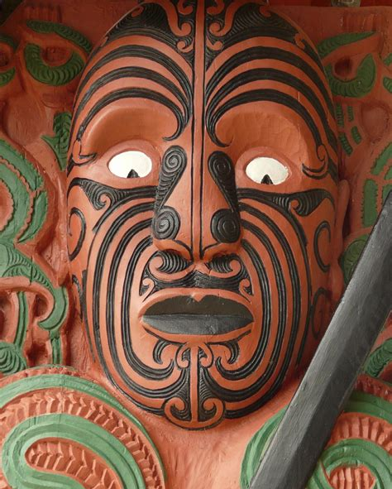
History of
New Zealand
Presented by
Marc Silver

Slide 2
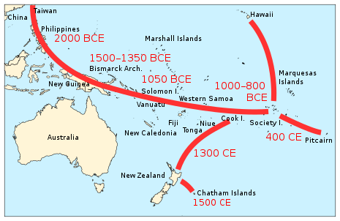
First Arrival
New Zealand has a shorter human history than almost any other country.
The date of first settlement is a matter of debate, but current understanding is that the first arrivals came from East Polynesia between 1250 and 1300 CE. It was not until 1642 that Europeans became aware the country even existed.
The navigator credited in some traditions with discovering New Zealand is Kupe. Some time later the first small groups arrived from Polynesia.
Now known as Māori, these tribes did not identify themselves by a collective name until the arrival of Europeans when, to mark their distinctiveness the name Māori, meaning ‘ordinary’, came into use.

Slide 3
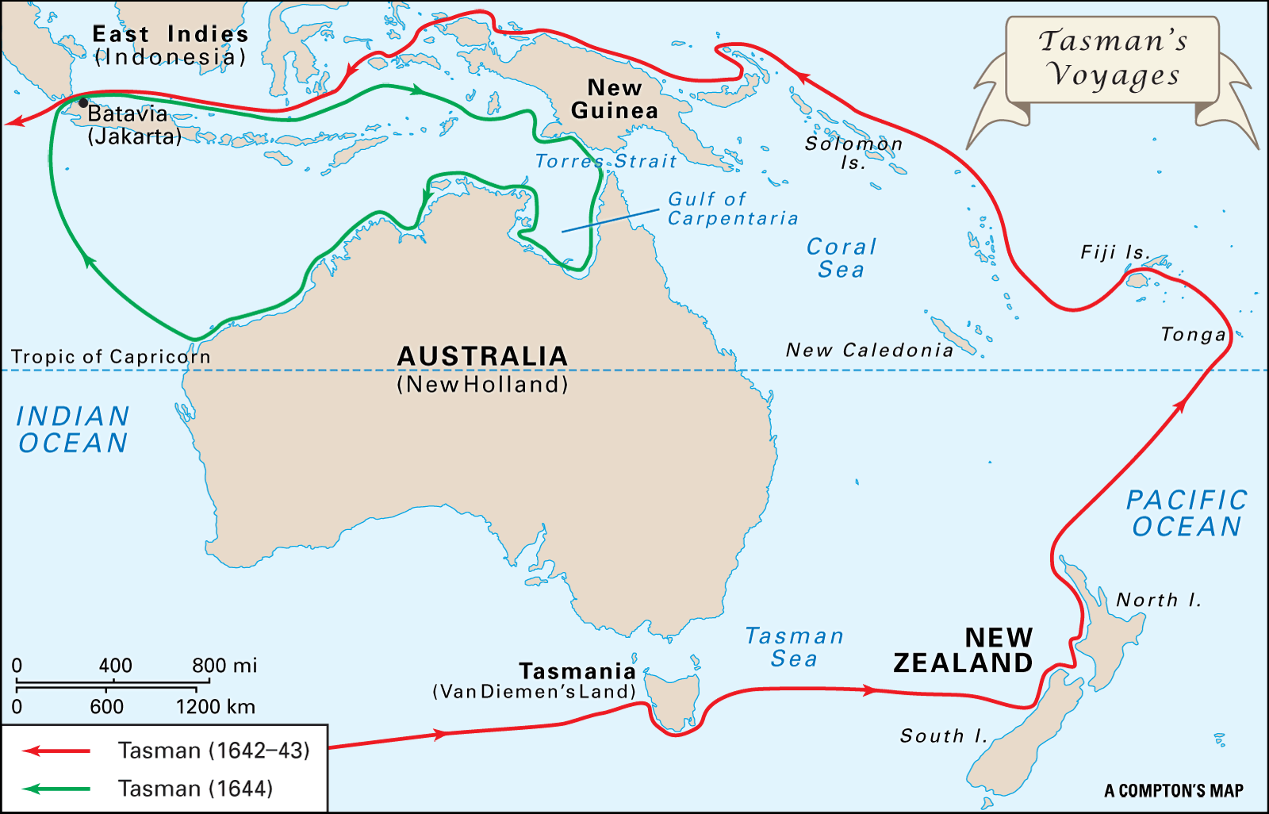
Western Discovery
Abel Tasman, Dutch explorer, is officially recognized as the first European to ‘discover’ New Zealand in 1642.
He names his discovery "Staten Landt.
His men were the first Europeans to have a confirmed encounter with Māori.

Slide 4
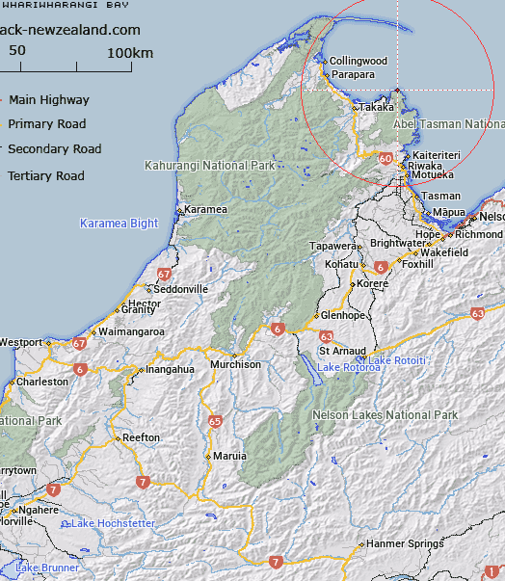
Western Discovery Cont.
Abel Tasman’s expedition departed from the company's base at Batavia Jakarta in August 1642. After sailing west to Mauritius, they turned south before being forced back by the cold to the 45th parallel.
Continuing eastwards, they sighted the mountains of a land that Tasman named Van Diemen's Land (now Tasmania) after the governor general of Batavia.
They continued east on 4 December and sighted the west coast of the South Island on the 13th. They anchored at Wharewharangi Bay, near Wainui Inlet to the north of what is now Abel Tasman National Park, on 18 December.

Slide 5
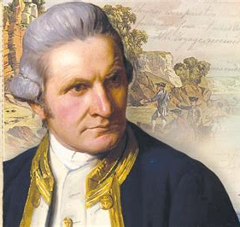
Western Discovery Cont.
It would be 127 years before the next recorded encounter between European and Māori. It wasn’t until 1770 when Captain James Cook arrived in Australia, and not until 1769 when he makes his first visit to New Zealand. He claims parts of the country in the name of King George III.
By 1790 Deep sea whaling, sealing, flax and timber trades commence.
Due to European intervention in New Zealand, the Māori people suffer the first serious introduced epidemic.
The Māori population also declined steeply. It is estimated to have been about 100,000 in 1769. By 1840 it was probably between 70,000 and 90,000. At its lowest point in 1896 it was around 42,000.

Slide 6
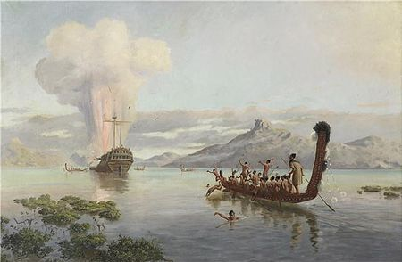
Cannibal Isles
Over the next 60 years contact grew. The overwhelming majority of encounters between European and Māori passed without incident, but when things turned violent.
The Boyd massacre occurred in December 1807 when Māori of Ngāti Pou from Whangaroa Harbor in northern New Zealand killed and ate between 66 and 70 crew and set fire to the ship.
After that attract, sailors referred to New Zealand as the ‘Cannibal Isles’, and people were warned to steer clear of the island.

Slide 7
Māori Utu
The ship carried several passengers, including ex-convicts who had completed their transportation sentences and four or five New Zealanders who were returning to their homeland. Among the latter was Te Ara, known to the crew as George, the son of a Māori chief from Whangaroa.
On the Boyd Te Ara was expected to work for his passage on the ship. He was accused of stealing and the captain deprived him of food and had him tied to a capstan and whipped with a cat-o'-nine-tails.
This treatment of Te Ara prompted him to seek utu, or revenge. Te Ara regained the confidence of the captain and persuaded him to put into Whangaroa Bay, His home village, assuring him that it was the best place to secure the timber he desired.
Upon reaching Whangaroa, Te Ara reported his indignities to his tribe and displayed the whip marks on his back. In accordance with Māori customs, they formed a plan for utu. In Māori culture, however, the son of a chief was a privileged figure who did not bow to an outsider's authority. Physical punishment of his son caused the chief to suffer a loss of face (or "mana"), and to Māori this warranted a violent retribution.

Slide 8
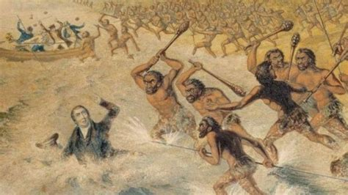
Māori Utu
Three days after Boyd's arrival, the Māori invited Captain Thompson to follow their canoes to find suitable kauri trees. Thompson, his chief officer and three others followed the canoes to the entrance of the Kaeo River.
The Māori stripped the clothes from the victims and a group donned them to disguise themselves as Europeans. Another group carried the bodies to their pā (village) to be eaten.
At dusk the disguised group manned the longboat, and at nightfall they slipped alongside the Boyd and were greeted by the crew. Other Māori canoes awaited the signal to attack. The first to die was a ship's officer: the attackers then crept around the deck, stealthily killing all the crew. The passengers were called to the deck and then killed and dismembered.

Slide 9
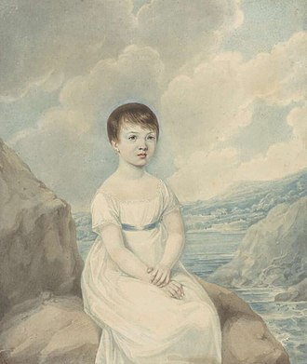
Boyd Massacre Survivors
Five people were spared in the massacre
Ann Morley and her baby, who were hiding in a cabin.
Apprentice Thomas Davis (or Davison), who was hidden in the hold.
Two-year-old Elizabeth "Betsey" Broughton, who was taken by a local chief who put a feather in her hair and kept her for three weeks before she was rescued.
The second mate who was initially forced to make fish-hooks, but his captors found his skill unsatisfactory, so they killed and ate him, too.
Portrait of Elizabeth "Betsey" Broughton

Slide 10
Revenge of the Boyd Massacre
Three months after the massacre, once the European community had time to process and get a clearer picture of the enormity of the atrocity that had occurred, planned to take revenge.
The crews of five whaling ships being confident of their combined numbers set off with the intent of investigating the coastline and rescue any possible survivors. But it is believed their intent was to seek retribution against the Māori responsible.
They landed 60 miles south of Whangaroa at Te Pahi’s ‘Pa’ which was the wrong Māori fort. There, they ran amok, cutting down at least 60 of its defenders before returning to their boats leaving the village a shouldering tangle of death and destructions. They also badly wounded the innocent Chief Te Pahi. A small boat of the Boyd’s and some booty were discovered to vindicate the misdirected raid.
By 1891 the estimated life expectancy of Māori men was 25 and that of women was just 23.

Slide 11
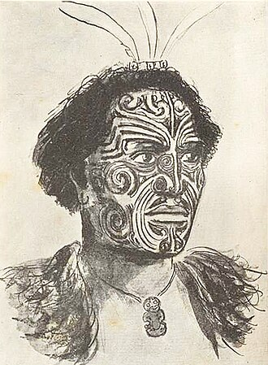
Chief Hongi Hika
The Ngāpuhi tribe controlled the Bay of Islands, the first point of contact for most Europeans visiting New Zealand in the early 19th century. Chief Hongi Hika protected early missionaries and European seamen and settlers, arguing the benefits of trade.
In 1814 Hongi and his nephew Ruatara, himself a Ngāpuhi chief, visited Sydney with Kendall and met the local head of the Church Missionary Society Samuel Marsden. Marsden was later to describe Hongi as "a very fine character ... uncommonly mild in his manners and very polite“.
1820 Ngapuhi chief Hongi Hika visits England and meets with King George IV. He spent 5 months in London and Cambridge where his facial moko tattoos made him something of a sensation. During the trip King George IV presented him with a suit of armor.

Slide 12
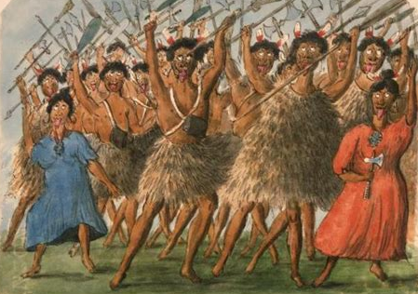
Ngāti Maru pā War
In 1820 while in Australia Hongi Hika studied European military and agricultural techniques and purchased additional muskets and ammunition.
Within months of his return Hongi led a force of around 2,000 warriors (of whom over 1,000 were armed with muskets) against the Ngāti Pāoa chief, Te Hinaki, at Māori forts on the Tamaki River (now Panmure). This battle resulted in the death of Chief Hinaki and hundreds, if not thousands, of Ngāti Paoa men, women and children.
Chief Hika wore the suit of armor that had been gifted by
King George IV during this battle; it saved his life, leading
to rumors of his invincibility

Slide 13
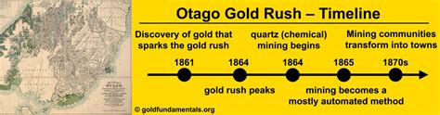
Otago Gold Rush
The gold rush wasn’t just a US thing. the Central Otago Gold Rush was a gold rush that occurred during the 1860s in Central Otago, New Zealand.
This was the country's biggest gold strike and led to a rapid influx of foreign miners to the area, many of them veterans of other hunts for the precious metal in California and Victoria, Australia. The number of miners reached its maximum of 18,000 in February 1864.

Slide 14
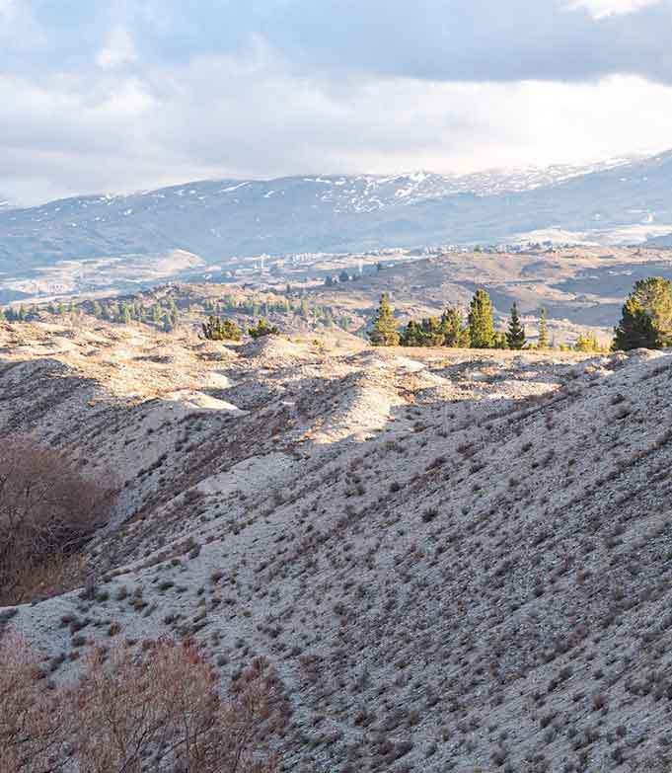
Gold Rush Cont.
The newcomers faced a tough life in the goldfields. Even those who’d come via California or Victoria found the Otago hinterland much wilder and more rugged than any place they’d ever been.
It was desolate and treeless, with brutal mountain ranges and unforgiving rivers. The winters were Arctic, the summers scorching with little shade to provide relief.
Arriving hungry, many of the men converged on Earnscleugh Station, named Mutton Town for the meat sold at a shilling per pound. The station’s boat was also used for crossing the Molyneux, saving the diggers a dangerous swim.

Slide 15
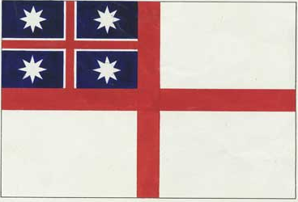
United Tribes Flag
In 1834 the Māori chiefs adopt the United Tribes flag, on Busby's initiative.
This flag was adopted by 25 northern chiefs and their followers in March 1834, in response to the fact that ships from New Zealand were liable to be seized unless they had a flag or certificate representing their country of origin.
The adoption of the flag was the first act of Māori in claiming a collective nationhood. Until that time they had been a community of separate tribes.
The current version of the Flag of the United Tribes of New Zealand
Following the adoption of the flag, many of the same chiefs met again the following year (1835) and issued a Declaration of Independence which represented a claim of sovereignty over the country.

Slide 16
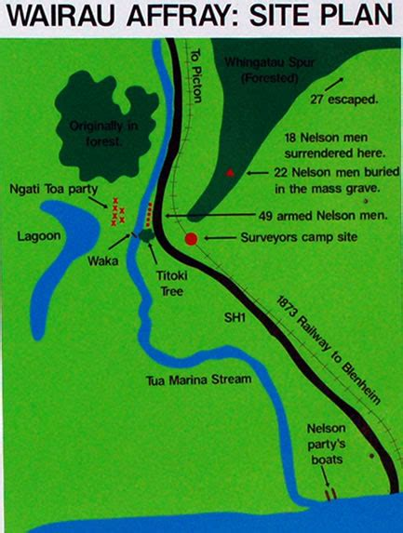
The "Wairau Affair"
The "Wairau Affair". Violent confrontation between Europeans and the Māori. On June 17th, 1843, the "Wairau Affair". Also called the Wairau Massacre or the Wairau Incident, was the first serious clash of arms between British settlers and Māori in New Zealand after the signing of the Treaty of Waitangi and the only one to take place in the South Island.
The incident was sparked when a magistrate and a representative of the New Zealand Company, who held a duplicitous deed to land in the Wairau Valley in Marlborough in the north of the South Island, led a group of European settlers to attempt to arrest Ngāti Toa chiefs Te Rauparaha and Te Rangihaeata.
Fighting broke out and 22 British settlers were killed, nine after their surrender. Four Māori were killed, including Te Rongo, who was Te Rangihaeata's wife.

Slide 17
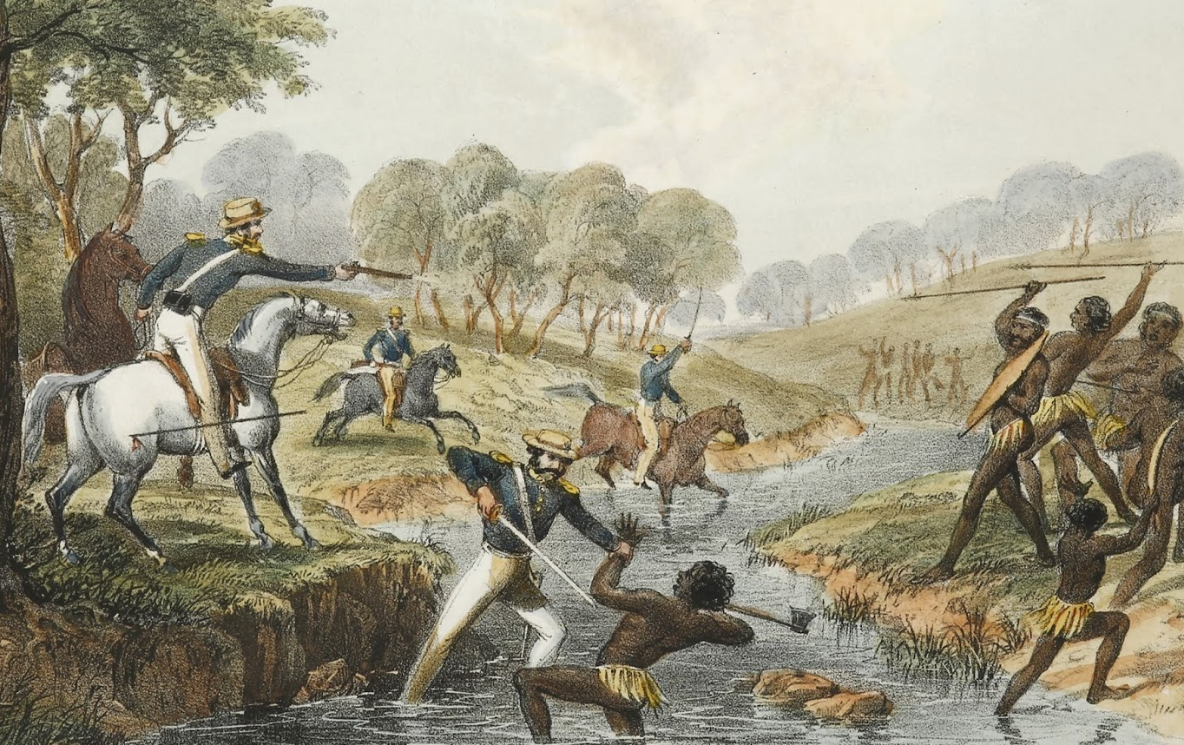
The New Zealand Wars
The New Zealand Wars also referred to as the Land Wars or the Māori Wars, took place from 1845 to 1872 between the New Zealand colonial government and allied Māori on one side, and Māori and Māori-allied settlers on the other. Though the wars were initially localized conflicts triggered by tensions over disputed land purchases by European settlers from Māori, it escalated dramatically in 1860 as the government became convinced it was facing united Māori resistance to further land sales and a refusal to acknowledge Crown sovereignty.
The Māori were ill-adapted to support a sustained campaign. A long campaign would disrupt food supplies and epidemics resulted in significant numbers of deaths among the Māori.
At the peak of hostilities 18,000 British Army troops, supported by artillery, cavalry and local militia, battled about 4,000 Māori warriors in what became a gross imbalance of power.

Slide 18
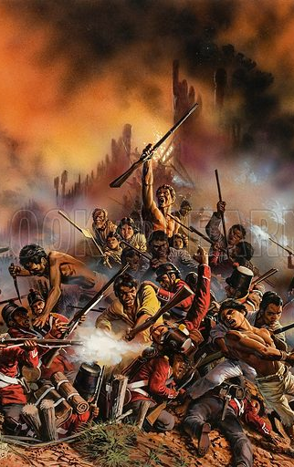
The New Zealand Wars
Although outnumbered, the Māori were able to withstand their enemy with techniques that included anti-artillery bunkers and the use of carefully placed pā (fortified villages) that allowed them to block their enemy's advance and often inflict heavy losses, yet quickly abandon their positions without significant loss.
Guerrilla-style tactics were used by both sides in later campaigns, often fought in dense bush.
Ultimately, large areas of land were confiscated from the Māori by the government under the New Zealand Settlements Act in 1863, purportedly as punishment for rebellion.
The National Day of Commemoration for the New Zealand Wars was inaugurated in 2017.

Slide 19
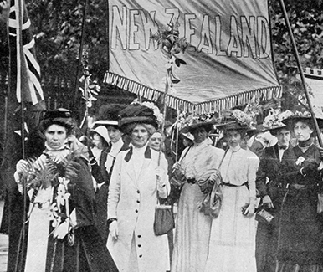
Women Suffrage
New Zealand was progressive in terms of women’s voting rights. In 1893 the country became the first self-governing country to grant women the right to vote in parliamentary elections. Lord Glasgow who was the governor during that time signed the Electoral Act. The act was enacted after years of petitions and suffrage movements.
The Electoral Bill granting women the franchise was given Royal Assent by Governor Lord Glasgow on 19 September 1893.
Women voted for the first time in the election held on 28 November 1893 (elections for the Māori electorates were held on 20 December).
In 1893, Elizabeth Yates became Mayor of Onehunga, the first time such a post had been held by a woman anywhere in the British Empire.
Historically in Polynesian society and European aristocracy, women could achieve significant formal political rank through ancestry. However, Polynesian and by extension Māori society differed in letting charismatic women have significant direct influence.

Slide 20
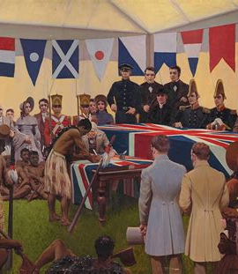
New Zealand’s Independence
New Zealand was officially recognized as a British Empire Dominion in 1907 and it stooped being a colony. However, the change did not have a big impact on the country when the legal and political standing is looked at. Therefore, the people of New Zealand wanted full independence from Britain.
Even though the Statute of Westminster of 1931 revoked London’s right to legislate for The British Dominions without proper permission, this change did not take effect in New Zealand until 1947.

Slide 21
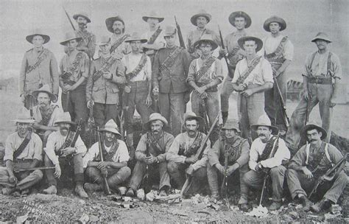
Boer War (1899–1902)
The Second Boer War was a conflict between the British Empire and the Boer republics in South Africa, a culmination of longstanding tensions between the two sides. On 28 September 1899, two weeks before the start of the conflict, the New Zealand House of Representatives approved the formation of a 200-man mounted rifle contingent for service in South Africa, in
a show of colonial solidarity aimed at deterring the Boers from fighting.
New Zealand sent 10 contingents, a total of approximately 6,500 men and 8,000 horses. The first five contingents embarked for South Africa in the first six months of the war. The last three contingents arrived in South Africa near the end of the conflict and saw limited action.

Slide 22
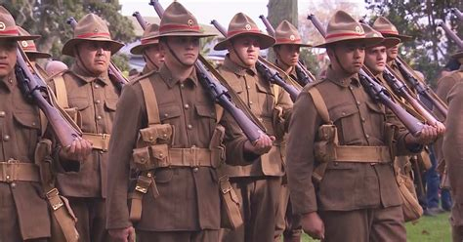
World War I
1914 marked the Outbreak of World War I. New Zealand commits 100,471 troops to the British war effort.
New Zealand Expeditionary Force, fighting alongside Australian troops, in the Gallipoli campaign and on the Western Front. 16,697 New Zealanders were killed and 41,317 were wounded during the war, a 58 percent casualty rate.
The First World War saw Māori soldiers serve for the first time in a major conflict with the New Zealand Army (although a number had fought in the Second Boer War when New Zealand recruiters chose to ignore British military policy of the time of disallowing 'native' soldiers).
A contingent took part in the Gallipoli campaign, and later served with distinction on the Western Front as part of the New Zealand Māori Pioneer Battalion.

Slide 23
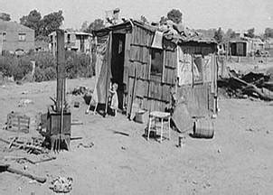
Economic Woes
The Great Depression of the early 1930s was the deepest global economic crisis of the twentieth century. It affected the whole western world, notably the British Empire, Europe and the US.
New Zealand, which had been through several downturns in the 1920s, experienced the economic effects of the Great Depression most severely during 1931-33. It has been estimated that at its peak in 1933, up to 30 percent of the potential workforce were unemployed.
Several mechanisms were at work, all external including the collapse in export prices. More fundamentally, the local economy was drawn into Australia’s deeper problems via cross-contamination with Australia’s balance-of-payments and sovereign debt crisis.
Recovery from the depression was aided by wool and meat prices. Wool prices, in particular, effectively doubled.

Slide 24
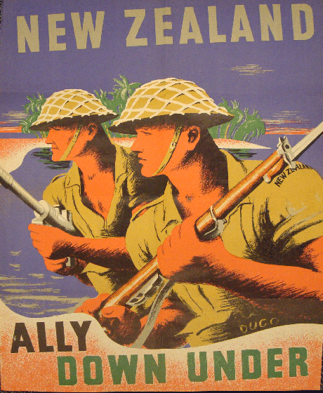
New Zealand and WWII
New Zealand joined WWII in 1939 following Britain's lead and declares war on Nazi Germany and expanded to the Pacific War when New Zealand declared war on Imperial Japan following the attack on Pearl Harbor in 1941.
New Zealand's forces were soon serving across Europe and beyond, where their reputation was generally very good. In particular, the force of the New Zealanders who were stationed in Northern Africa and Southern Europe was known for its strength and determination, and uniquely so on both sides.
New Zealand provided personnel for service in the Royal Air Force (RAF) and in the Royal Navy and was prepared to have New Zealanders serving under British command.

Slide 25
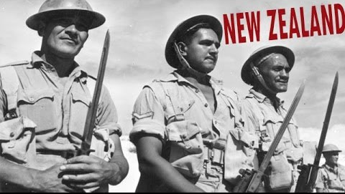
War on Japan
In total, around 140,000 New Zealand personnel served overseas for the Allied war effort, and an additional 100,000 men were armed for Home Guard duty. At its peak in July 1942, New Zealand had 154,549 men and women under arms (excluding the Home Guard) and by the war's end, a total of 194,000 men and 10,000 women had served in the armed forces at home and overseas.
Conscription was introduced in June 1940, and volunteering for Army service ceased from 22 July 1940, although entry to the Air Force and Navy remained voluntary. The Japanese moved on into the Dutch East Indies (modern Indonesia) where they captured some New Zealand soldiers who had escaped from Singapore.
Some spent the next three years in prisoner of war camps in Japan; others stayed in Java.
New Zealand sent more troops to Fiji to help bolster defenses. At home, anti-invasion defenses were thrown up and forces mobilized to man them. The war was suddenly very close to home, and for a time, there were fears that New Zealand itself would become a battlefield.

Slide 26
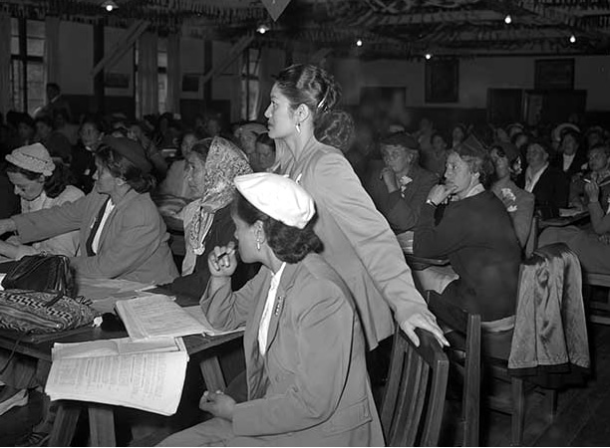
Māori Women's Welfare League
September 25,1951 was the first day of the inaugural conference of the Māori Women’s Welfare League. Eighty-seven delegates – representing 187 branches and a membership of 2503 women gathered at Ngāti Poneke Young Māori Club in Wellington.
The League worked with Māori people and the government. Through the 1950s and 1960s, health issues such as immunization, family planning, obesity and tuberculosis were prominent, as was domestic violence from the 1970s.
In the 1980s, the League set up the Healthy Lifestyles
programmed and released a report, Rapuora: health and
Māori women. In 1993 the League, with the National
Maori Congress and the New Zealand Māori Council, set
up Te Waka Hauora, a national Māori health authority.
The League became involved in the provision of health
and well-being services for families at a regional level in
the 1990s and 2000s.

Slide 27
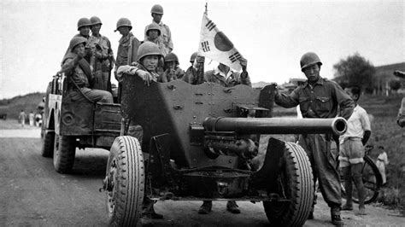
Korean War
New Zealand’s 1056-man Kayforce arrived at Pusan, South Korea, on New Year’s Eve 1950. It was part of the United Nations’ ‘police action’ to repel North Korea’s invasion of its southern neighbor.
The New Zealanders joined the 27th British Commonwealth Infantry Brigade and saw action for the first time in late January 1951. Thereafter they took part in the operations in which the UN forces fought their way back to and across the 38th Parallel, recapturing Seoul in the process.
In all, about 4700 men served in Kayforce and 1300 in Royal New Zealand Navy frigates during the seven years of New Zealand’s involvement in Korea. Forty-five men lost their lives in this period, 33 of them during the war (of whom two were RNZN personnel).

Slide 28
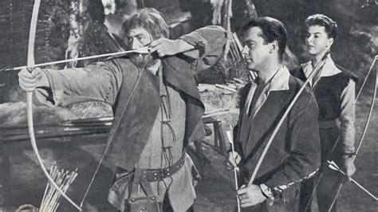
June 1, 1960
New Zealand’s First TV Broadcast
The television age was slow to arrive in New Zealand. Britain’s BBC led the way when it started the world’s first public service in 1936. The NBC began broadcasting in the United States in 1939. Australia had stations operating by 1956.
Broadcast from Shortland St in central Auckland, New Zealand’s first official television transmission began at 7.30 p.m.
The first night’s broadcast lasted just three hours and could only be seen in Auckland. It included an episode of The adventures of Robin Hood, a live interview with a visiting British ballerina and a performance by the Howard Morrison Quartet.
The Adventures of Robin Hood (TV Series 1955-1960)

Slide 29
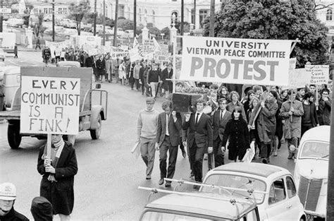
War Protests
On May 12, 1971, Anti-war protesters disrupted a civic reception in Auckland for New Zealand soldiers returning from the Vietnam War.
The civic parade was led by the Band of the Royal New Zealand Artillery, which was followed by Land Rovers carrying the gunners of 161 Battery and troopers from New Zealand’s Special Air Service. The march was relatively uneventful until the column reached the reviewing platform outside Auckland Town Hall.
New Zealand’s involvement in the Vietnam War aroused considerable public debate.
By 1971 up to 35,000 people were protesting on the streets around the country. Many argued that the conflict was a civil war in which New Zealand should play no part. They wanted this country to follow an independent path in foreign policy, not take its cue from the United States.

Slide 30
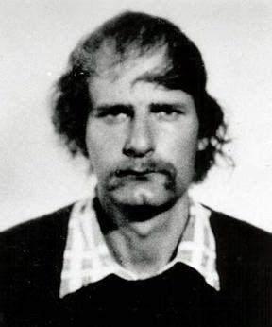
Mass Murder
The United states is not the only country that has suffered due to
mass murder events.
The small seaside township of Aramoana, near Dunedin, was the
scene of what was then the deadliest mass murder in New Zealand
history.
David Gray, a 33-year-old unemployed Aramoana resident, went on a
rampage following a verbal dispute with a neighbor. After shooting the
man and his daughter, he began firing at anything that moved. Armed
with a scoped semi-automatic rifle, Gray killed 13 people, including
Port Chalmers Sergeant Stewart Guthrie, the first policeman to arrive on the scene.
Police located Gray the next day during a careful house-by-house search. When he burst out of a house firing his weapon, members of the Anti-Terrorist Squad (now the Special Tactics Group) shot and mortally wounded him.

Slide 31
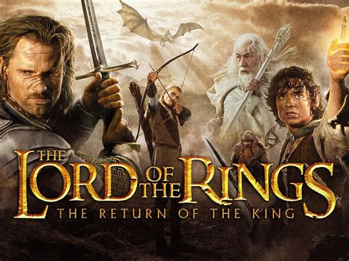
Lord of the Rings
  Unless you have been living under a rock you have to have seen the Lord of the Rings. New Zealand provided the perfect setting for the series which was filmed in mountain ranges, wild rivers and grassy fields
  One of the most popular film locations in New Zealand is found in Matamata where you can still see The Shire and Hobbiton Movie Set.
  Peter Jackson’s The return of the king, won all 11 Oscars it was nominated for at the 76th Annual Academy Awards® in 2004 in Los Angeles.
  This set a record for the largest clean sweep and equaled the highest number of Oscars, achieved by Ben Hur (1959) and Titanic (1997).

Slide 32
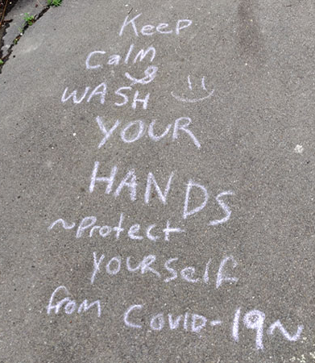
COVID-19 Lockdown
At 11.59 p.m. on Wednesday 25 March 2020, New Zealand entered a nationwide lockdown designed to prevent the spread of the deadly COVID-19 virus around the country.
COVID-19 affects the respiratory system, had begun spreading around the world in January and February, quickly overwhelming health systems and causing widespread loss of life.
On 19 March, for the first time in the country’s history, the government closed the borders to anyone who wasn’t a citizen, permanent resident, or their partner or child (who could enter New Zealand only if travelling with them). Those arriving were required to self-isolate for 14 days.

Slide 33
New Zealand’s History
I hope you found these facts about New Zealand’s History interesting and informative.
Hopefully, you all get the opportunity to visit the beautiful and historic country for yourselves.
Thank you for coming!

Slide 34
Acknowledgement
My seminars are the result of many years of travel experience
combined with many hours of research over the internet.
I would like to acknowledge the many sources I have accessed.
These include: Wikipedia.com, Britannica.com, and the
various Museum, Park and Government websites.

