Slide 1


Hiroshima, Japan Presented by Marc Silver

Slide 2
What I Will Cover
My Port Philosophy
Don’t Miss the Ship
Money
IC Cards
About Hiroshima, Japan
Hiroshima’s History
Points of Interest
Places to see or at least consider
A few restaurant recommendations
Conclusion

Slide 3
My Port Philosophy
I have been cruising for over 45 years and have taken over 100 cruises. So, I consider myself an experienced cruiser.
The information I will present is based on those many years of
experience.
When I am on a cruise where the city, I want to visit is not the port city,
I always recommend taking a ship’s tour.
But when I am in a port with multiple attractions nearby and easy to see
on my own - I will do it on my own.
This presentation is for that type of port.

Slide 4

Don’t Miss the Ship
How to Avoid Missing Your Ship
Pay attention to the time. - Ship time and local time are often different.
Put a return-to-ship reminder on your phone.
Choose excursions wisely.
If a ship-sponsored excursion is late returning to port, the ship will wait for you. If you are on your own???
Be Prepared
Have your Passport, Credit Card, and phone numbers for your ship port agent.
What to Do If You Miss the Ship Most cruise lines have port agents stationed in the port area to assist if your ship has left without you. If your are lucky, when cruisers are late returning to the vessel, the ship’s crew will often remove the passengers’ essential items – passports, cell phones, and medication -- from the ship to leave with the port agents.
The Port Officials can help you with contacting your ship and making necessary travel arrangements.

Slide 5
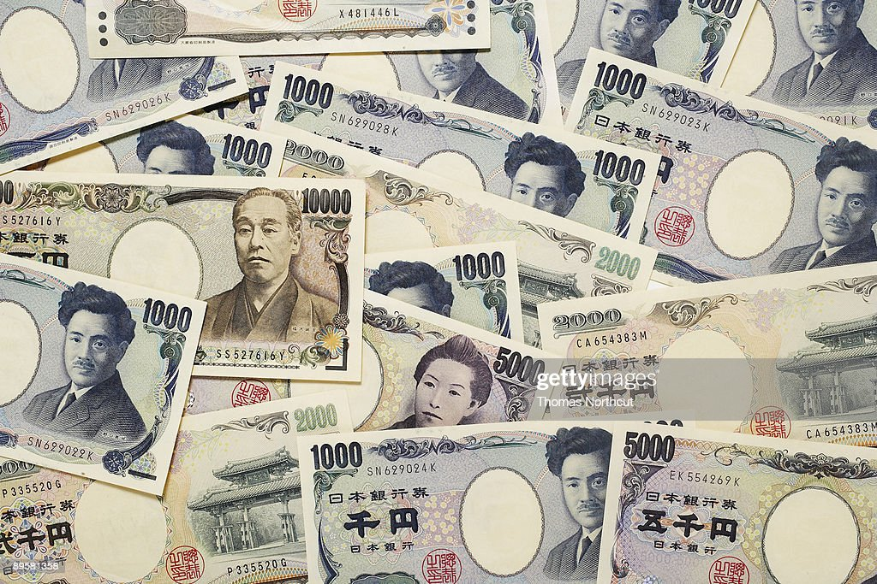
Money
The Yen is the official currency of Japan
Official Exchange is $1.00 US to 142.15 Yen
Or 100 Yen equals 70 cents

Slide 6
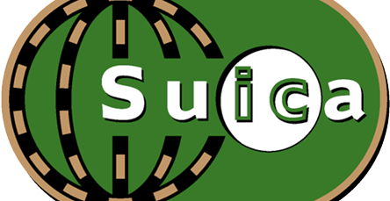

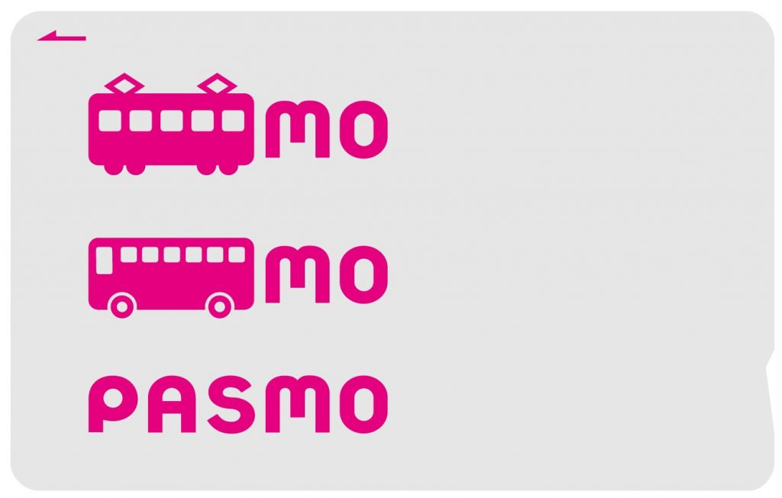
PASMO, Suica, & ICOCA Cards
The PASMO, Suica, and ICOCA Cards are e-money IC cards that can be used for travel and shopping across Japan.
Cashless fare payment
Use it for shopping
No waiting for change
Get special privileges
Apple phone users can also link with all three cards.
PASMO refunds - If you no longer need your PASMO, it can be refunded. Suica and ICOA cards do not offer refunds.

Slide 7
About Hiroshima
Hiroshima Prefecture is a prefecture of Japan located in the Chūgoku region of Honshu. Hiroshima Prefecture’s population is 2,811,410 with an area of 3,274 sq mi. It borders Okayama to the east, Tottori to the northeast, Shimane to the north, and Yamaguchi to the southwest.
It is the capital and largest city of Hiroshima Prefecture and the largest city in the Chūgoku region. Hiroshima Prefecture is located on the Seto Inland Sea across from the island of Shikoku and is bounded to the north by the Chūgoku Mountains. Hiroshima Prefecture is one of the three prefectures of Japan with more than one UNESCO World Heritage Site.

Slide 8
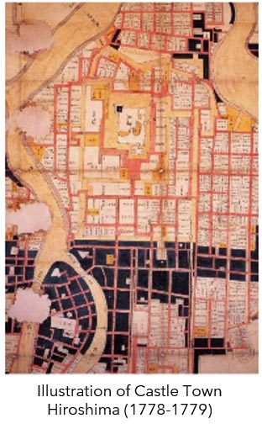
Hiroshima’s History
Hiroshima was founded in 1589 as a castle town on the Ōta River delta. Following the Meiji Restoration in 1868, Hiroshima rapidly transformed into a major urban center and industrial hub. At the end of the 16th century, Hiroshima was a small village with some small islands that floated on the mouth of the Ota River. In 1589, warlord Terumoto Mori built his castle there. He ruled the area and named it “Hiroshima.” Nagaakira Asano became the next feudal lord. Afterward, Hiroshima had been a castle town of Hiroshima domain, yielding 430,000 koku of rice, governed by the Asano Family throughout the Edo period. Hiroshima developed as a big city which was surrounded by inner and outer moats and canals, and with residential areas and temple districts established along with the Saigoku Kaido Road, which passed through the southern area of the castle. The outbreak of the First Sino-Japanese War (1894) brought improvements to transportation facilities in Hiroshima City, such as the rapid two-week completion in August of that same year of the Hiroshima-Ujina railroad line for military use.

Slide 9
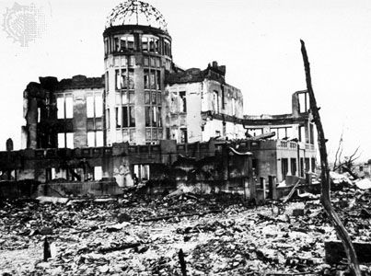
Hiroshima’s History
On August 6, 1945, the United States dropped an atomic bomb on the city of Hiroshima. The bomb was known as “Little Boy”, a uranium gun-type bomb that exploded with about thirteen kilotons of force. At the time of the bombing, Hiroshima was home to 280,000-290,000 civilians as well as 43,000 soldiers. Between 90,000 and 166,000 people are believed to have died from the bomb in the four-month period following the explosion. Soon after the Japanese surrendered bring an end to the war in the Pacific.

Slide 10
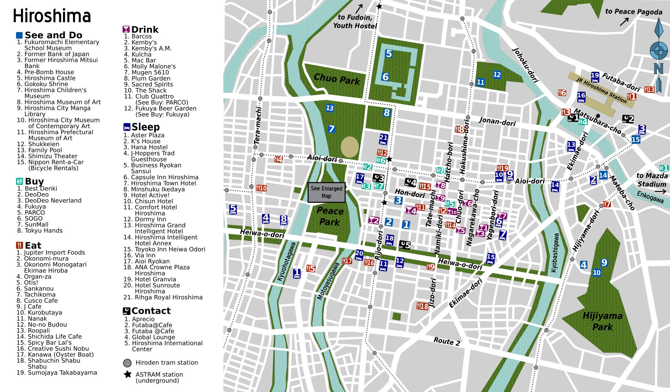
Points of Interest

Slide 11
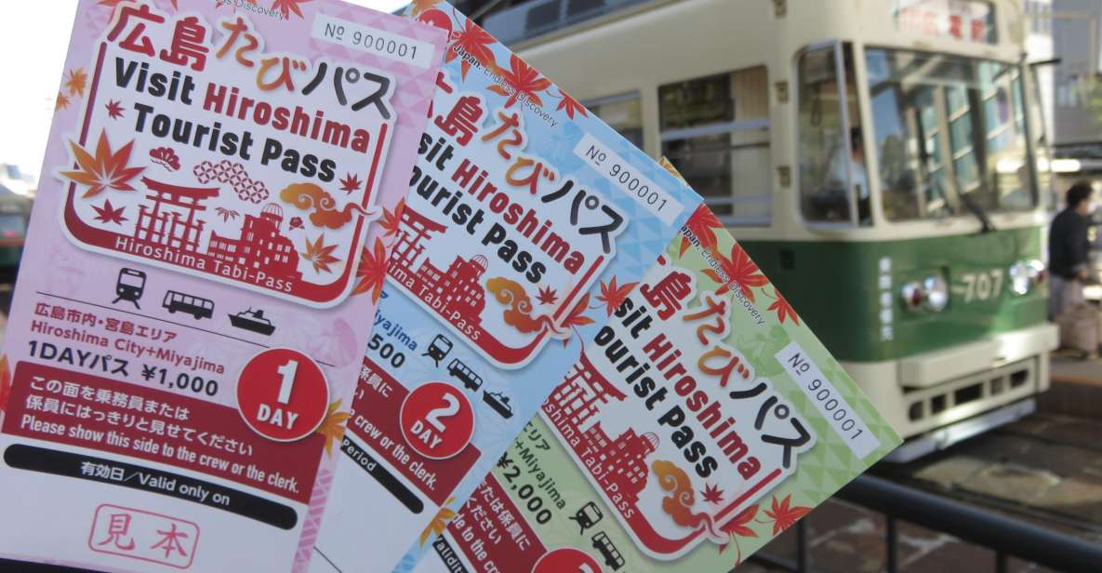
Visit Hiroshima Tourist Pass
There’s an extensive bus network which you can ride for a flat fee of 200-yen, a 400-yen day pass. The best options for visitors to Hiroshima are the green and orange sightseeing lines which travel via Hiroshima Station and take you to most major tourist destinations, including downtown and the Peace Park. You can also use your Japan Rail Pass on these specific lines, and they have free Wi-Fi.
The Hiroshima Tourist Pass is your most economical way to get around the city.
INCLUDES: Unlimited use of all Hiroden streetcar lines, ferries (Miyajima route), and bus routes operated by 6 bus companies in the central area of Hiroshima City.
24-hour Pass - Adults and Children: 1,000-yen

Slide 12
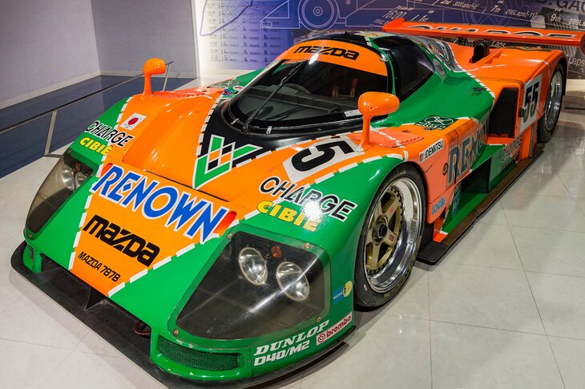
Mazda Museum
An observation deck where you can watch vehicles
become assembled right in front of you Car enthusiasts
won't want to miss the Mazda Museum, which pays
homage to one of Japan's oldest car manufacturers
(the company switched from machine tools to automobiles
in 1930). While enjoying an up-close look at some fine-
looking cars is reason enough to visit,
the real excitement takes place with the tour of the
adjoining manufacturing plant.
From the comfort of the observation deck situated directly
above the production line in Plant 1, you'll watch in
amazement as these great-looking vehicles are put together before your eyes. Afterward, you have the chance to learn about Mazda's future vehicle plans.
Reservations for the one-hour-long plant tour need to be made in advance and can be done via the company's website.

Slide 13
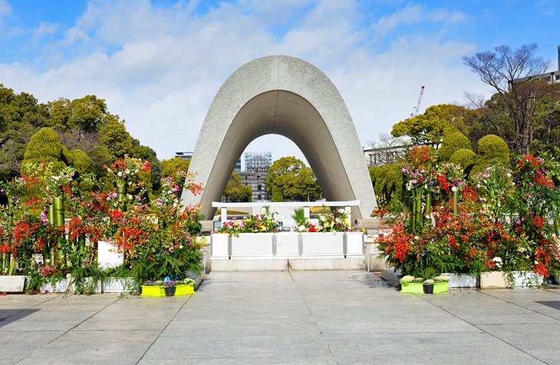
Hiroshima Peace Memorial Park
Created to symbolize the need for everlasting peace, Hiroshima Peace Memorial Park commemorates the many victims of the world's first nuclear attack in August 1945. Located at the epicenter of the blast in what was once a bustling part of the city, the park includes a variety of important monuments, memorials, and museums relating to the events of that fateful day and its aftermath and attracts more than a million visitors each year.
.

Slide 14
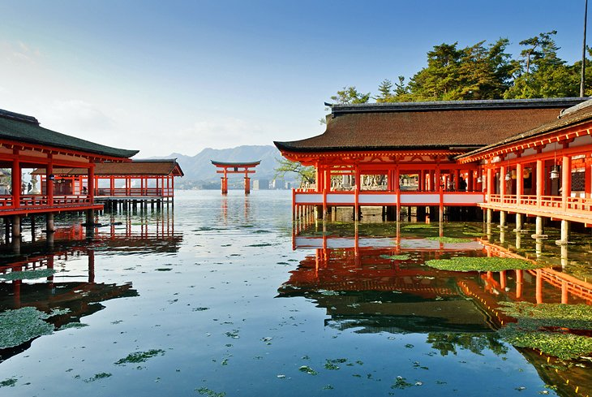
The Island Shrine of Itsukushima
Miyajima, aka "Shrine Island," is one of Japan's most important (and most visited) coastal sites. Covering some 30 square kilometers of Hiroshima Bay, the island is famous for the spectacular Itsukushima shrine, dedicated to the Princesses Ichikishimahime, Tagorihime and Tagitsu-hime, daughters of the Shinto wind god Susanoo.
First mentioned in 811 CE, the shrine's buildings rise out of the waters of a small bay supported on piles and, at high tide, appear to float on water, presenting a picturesque and colorful spectacle with their red timber framing and white walls (the buildings are linked by covered gangways).
Tours available for about $101.41

Slide 15
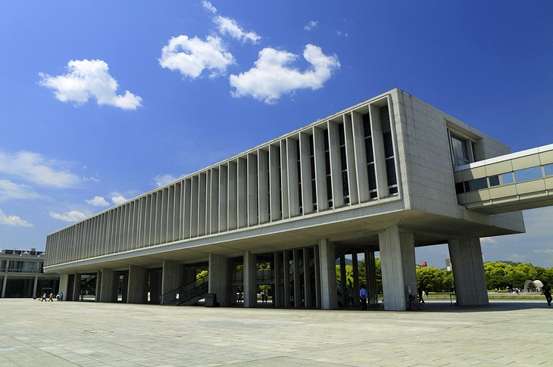
Hiroshima Peace Memorial Museum
A must-see when visiting Hiroshima Peace Memorial Park is the Peace Memorial Museum with its many chilling displays focusing on the atomic bombing of the city, as well as numerous exhibits dealing with the issue of world peace. Comprised of two rather starkly designed modern buildings, the museum contains numerous graphic exhibits conveying the terrible reality of the atomic bombing and takes about two hours to see in its entirety.
The east building tells of Hiroshima before and after the bombing, while the west building concentrates on the events of that fateful August day. One of the most popular of Hiroshima's tourist attractions, the Peace Memorial Museum draws more than a million visits a year from those wishing to learn about the city's destruction, the causes of the war, and its results.

Slide 16
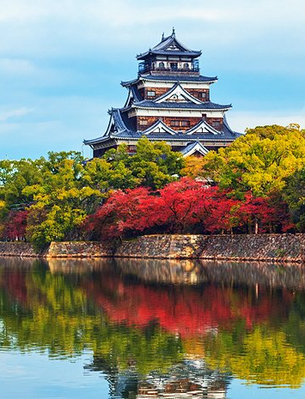
Hiroshima Castle
A 16th-century castle-turned-museum dedicated to the history of Hiroshima and the castle itself. Also known as the "Castle of Carp," Hiroshima Castle (Rijō) was built in 1593 as the residence of local nobleman Fukushima Masanori before passing into the possession of famous samurai Asano Nagaakira in 1619.
The castle's lovely five-story main tower, fully reconstructed in 1958, contains an informative museum dealing with both the history of the city as well as the castle itself. From here, you'll also enjoy fine views over Hiroshima, the harbor, and the island of Miyakojima on the top floor.
Of interest within the castle grounds are three trees that famously survived the atomic blast - a willow, holly, and eucalyptus - as well as a concrete bunker used for radio broadcasts after the bombing. Be sure to also view the castle at night, when it is lit up in colorful displays that change with the season.

Slide 17
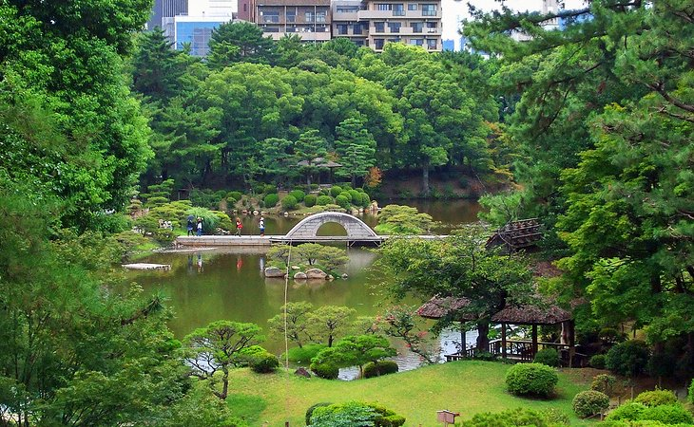
Shukkei-en Garden
Beautifully landscaped gardens and trails that were once on the grounds of the home of Emperor Meiji
Located on the banks of the Ōta River sits the beautiful Shukkei-en Garden. This oasis of peace and tranquility was splendidly laid out by Asano Nagaakira of Kyoto in 1620 in imitation of the famous landscaped garden on the Western Lake of the old South Chinese Sung Dynasty
all their former glory in 1951. capital of Hangzhou. Once the home of Emperor Meiji, the gardens opened to the public after being donated to the city in 1940. A highlight of a visit is simply walking its many garden trails and traversing its bridges while enjoying the abundance of pools and streams, which draw their water from the Ōta. Join in one of the authentic tea ceremonies offered at the on-site teahouses.

Slide 18
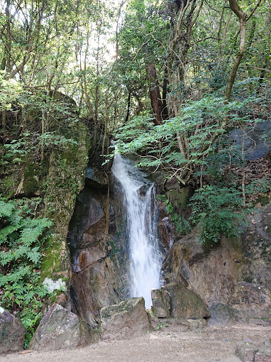
Mitaki-dera Temple
One of the oldest temples in Hiroshima, with gorgeous grounds and views of Mount Mitaki
Of Hiroshima's many fine historic temples, one of the most attractive is Mitaki-dera. Originally built in 809 CE and reconstructed after the war, the site is as famous for its splendid temple as it is for its beautiful grounds. Come autumn, the trees here burst into an array of vibrant reds and golds as the maples change color. Also known as the "Three Falls Temple" for its location at the foot of Mount Mitaki, the temple is notable for its red-lacquered pagoda, Tahoto, and nearby waterfalls.

Slide 19
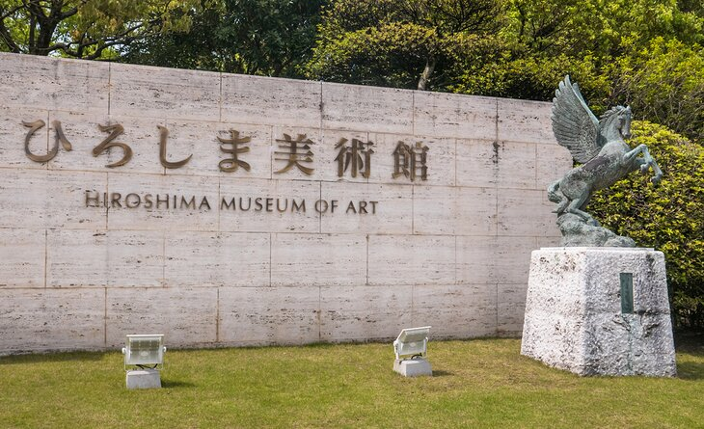
Hiroshima Museum of Art
A spectacular collection of world-class art, including European masters and Japanese artists Consisting of eight galleries, the Hiroshima Museum of Art (Hiroshima Bijutsukan) is just one of a number of world-class art galleries worth visiting.
Highlights include a collection of paintings
by European Masters such as Monet,
Renoir, Degas, Maillol, and Picasso,
representing key movements such as
Romanticism and Impressionism. There
are also numerous works by leading
Japanese artists such as Ryohei Koiso
and Yuzo Saeki.
Adults¥1,300 - Children ¥500

Slide 20
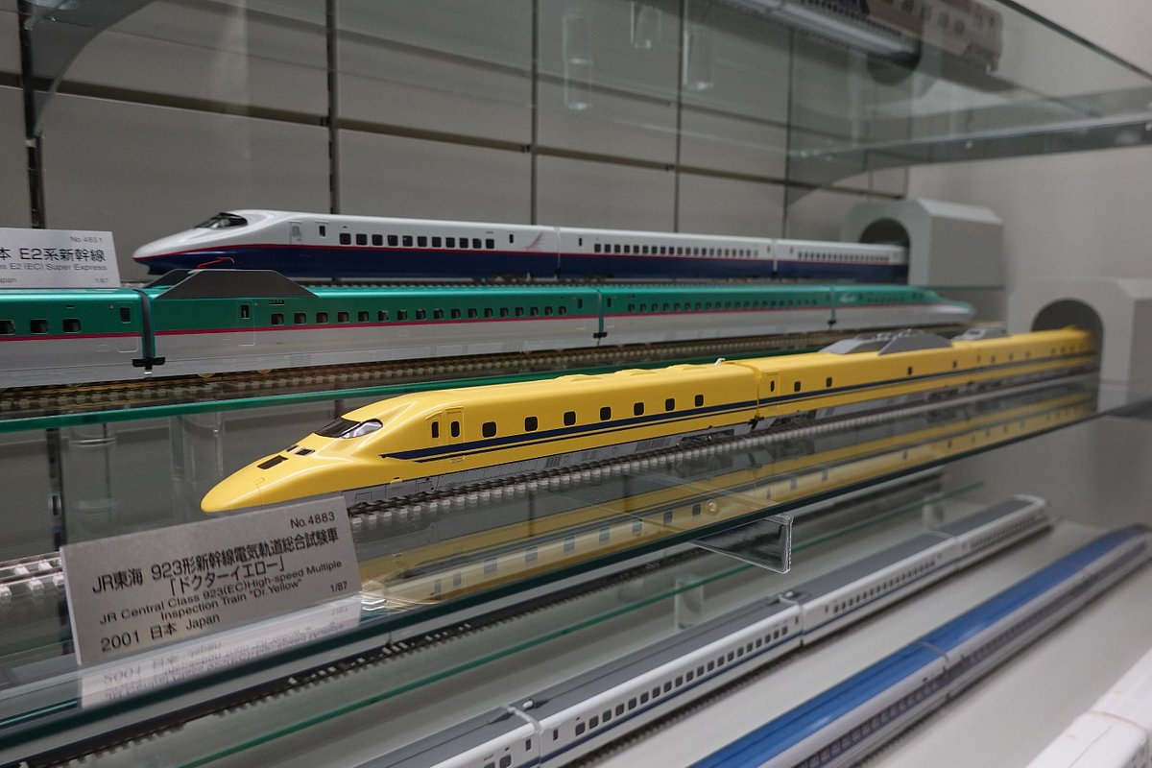
Hiroshima City Transportation Museum
Hiroshima has a slew of fascinating museums, including a transportation museum; a children's museum; and museums on meteorology, history, and crafts.
In addition to its many fine museums dealing with war and peace, Hiroshima boasts numerous other such attractions. One of the most popular is the Hiroshima City Transportation Museum (Hiroshima-shi Kōtsū Kagakukan) with its collection of old trams and streetcars, including the famous "A-Bomb Tram" that survived the devastation of 1945.
Also, check out the Hiroshima City Ebayama Museum of Meteorology and the Hiroshima City Museum of History and Traditional Crafts, with its displays related to local industry and agriculture.

Slide 21
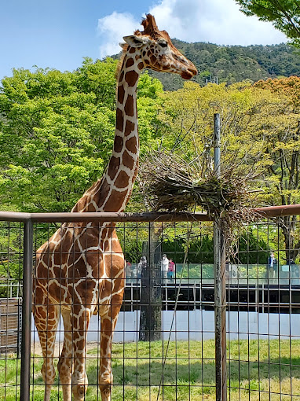
Hiroshima City Asa Zoological Park
A sprawling 124 acres of 170 different animal species from around the world. Owned and operated by the city since it opened in 1971, the Hiroshima City Asa Zoological Park (Hiroshima-shi Asa Dōbutsukōen) is a fun (and certainly less intense) diversion from the many sometimes somber, yet vitally important, museums and monuments in the area.
Covering an area of close to 124 acres, the zoo is home to 170 species of animals, including native species such as lesser pandas and Japanese giant salamanders, along with African animals including lions, giraffes, and rhinos.
A fun children's petting zoo is also on site.
Adults | ¥510

Slide 22
Conclusion
Hiroshima is a beautiful City with a rich history and numerous attractions. Whether you're looking for stunning beaches, historic sites, or unique attractions, Hiroshima has something for everyone.
I hope this presentation will help you when we visit Hiroshima!

Slide 23
Thanks For Coming
If you have any more questions, please ask.
I will do my best to answer them for you.
Have a great visit in Hiroshima!

